Slide 1



Status of the Latvian WLCG Tier 2 site
Igors Makarkins (RTU IPPAT)
LV CMS Tier-2 project leader
5th CERN Baltic Conference (CBC 2025)

Slide 2

CERN CMS TIER2 project goals
Cooperation between partners and CERN in high energy physics and HPC
Project member education about CMS and HPC technologies at CERN
Involvement of CERN PhD students in TIER2 activities
Joint participation among partners in EU cross-border HPC projects
Development of Latvia's HPC infrastructure and its promotion for scientific applications
5th CERN Baltic Conference (CBC 2025)

Slide 3
Project funding and partners
Funded by Latvia’s government via Ministry of Education and Science
Led by Riga Technical University
Academics partners in Latvia
Private partners in Latvia
5th CERN Baltic Conference (CBC 2025)

Slide 4
Summary of activities (2022-2025)
CERN Baltic Group meetings held in Latvia, Lithuania and Estonia
CERN PhD student assigned to the TIER-2 project
9 TIER-2 HPC computing nodes procured and deployed for TIER-2 site in RTU managed datacentre and OpenStack cloud infrastructure with CephFS storage subsystem
Configuration of Arc-CE, SLURM workload management VMs and TIER2 supporting services
OSG and WLCG registrations and configurations completed
WLCG agreement signed on June 5th, 2024
Site onboarded to production and first HammerCloud jobs completed successfully
Agreement with private partner signed for additional compute resources
5th CERN Baltic Conference (CBC 2025)

Slide 5
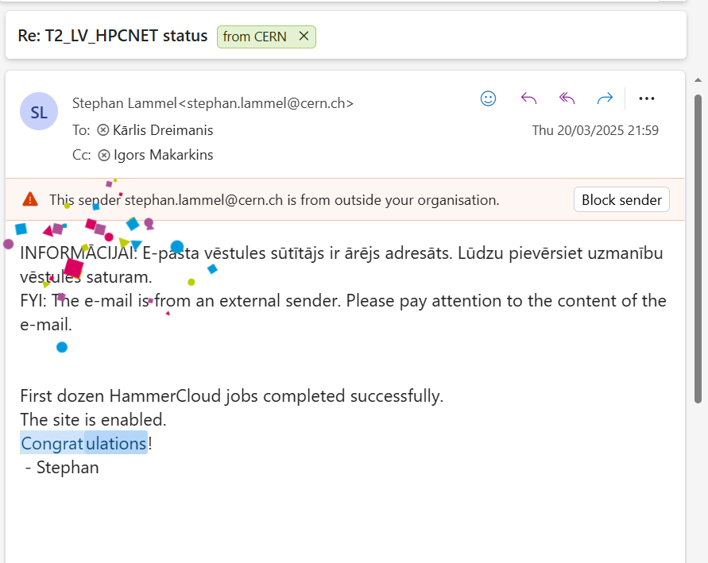
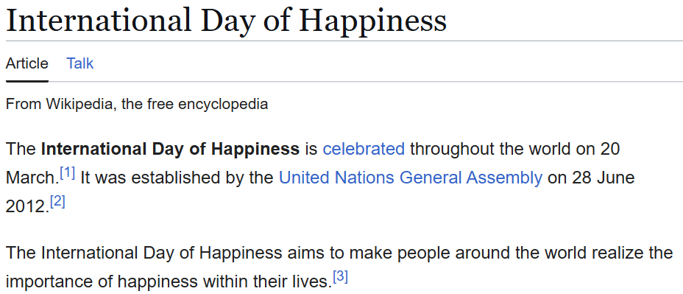
20th March,
2025
5th CERN Baltic Conference (CBC 2025)

Slide 6
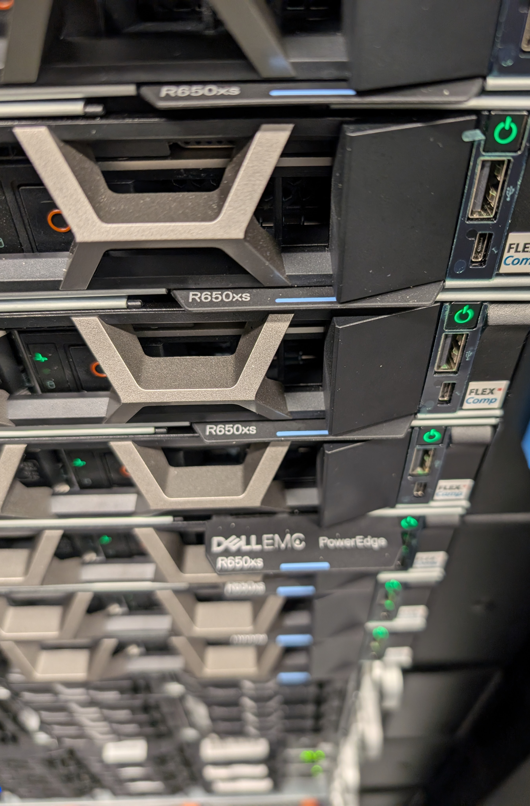
Deployed TIER2 resources in the Main site @RTU
9 worker nodes with:
  Total of 550+ CPU cores, 4+TB total RAM
  nVME pool + HDDs pool on CEPH Software Defined Storage platform
  4x25Gb/s LAN connections
  100Gb/s gateway to GEANT network
  One node has NVidia Ampere A40 high-performance GPU for hybrid CPU/GPU processing

Slide 7
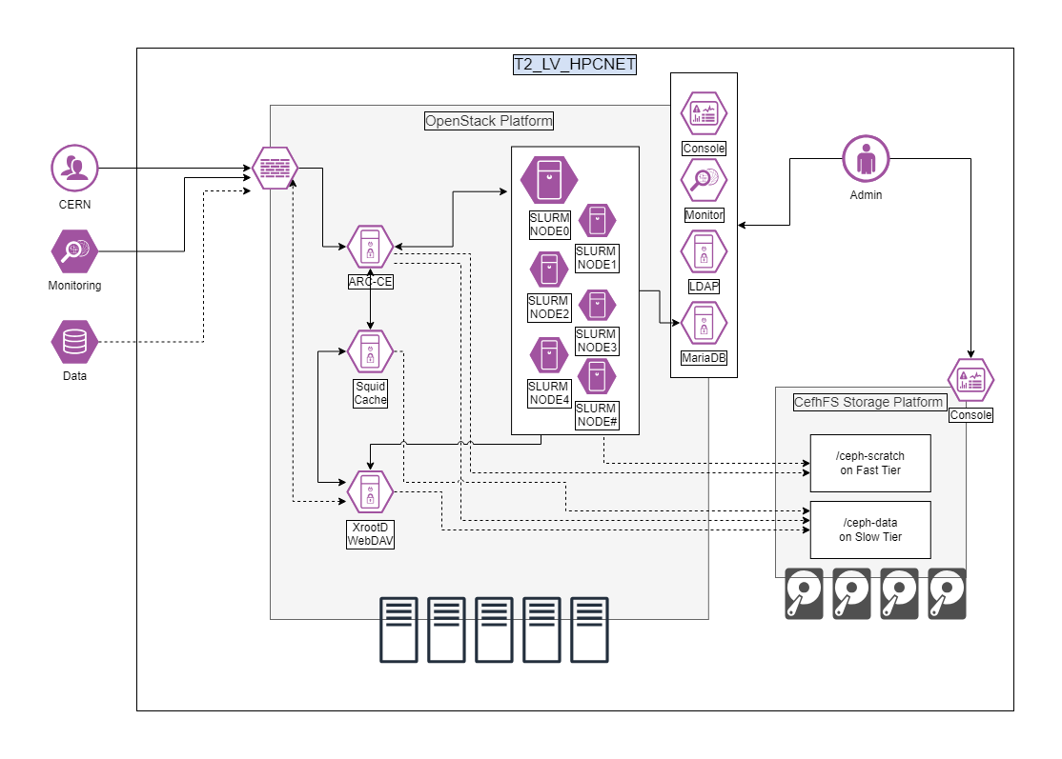
Deployed TIER2 resources in the Main site @RTU
5th CERN Baltic Conference (CBC 2025)

Slide 8
Current T2-LV-HPCNET site configuration @RTU
OSG configuration and binaries
WebDAV and XRootD storage endpoint
ARC-CE compute element interface
SLURM control node
SLURM worker nodes (16 CPU/32 GB RAM per worker)
SQUID proxy
CEPH software-defined storage on local disks
OpenStack cloud-server platform for VM management
Basic monitoring

Slide 9
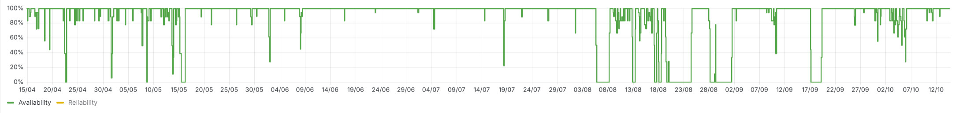
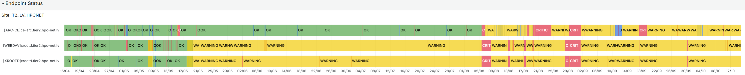
Last 6 months

Slide 10
Planned site activities for 2025/2026
Site-wide OS and software version upgrade to ALMA9 and newest OSG 24 versions
Dual-stack with IPv6 configuration for endpoints
Automated worker node deployment system
Deployment and tests of federated partner resources
Onboarding Nvidia Ampere A40 for GPU workload-processing tests
Storage pool expansion with fast nVME drives
Evaluate Compute Element interface replacement (ARC-CE to HTCondor)
Creation of Solution Architecture Design documentation for stabilized platform
Focus on partner onboarding – National Library of Latvia (LNB) & Ventspils International Radio Astronomy Centre(VIRAC)
5th CERN Baltic Conference (CBC 2025)

Slide 11
… a few key takeaways
Plan way ahead - it takes significantly longer than anticipated
Pick newest OS/SW versions, the upgrade paths are problematic
Plan automated deployment, it will save time
Introduce good monitoring – do not rely only on external helpdesk tickets, be proactive
Carefully choose underlying infrastructure
Stability is the key, focus on important parts
KISS principle; do not let it distract you
The most problematic element – XrootD endpoint
Network dependency – high bandwidth requirement, difficult troubleshooting
OS and SW version introduced instabilities
Documentation could be better
Write down the issues and contribute back to the source!
Dual-stack IPv4 and IPv6 is now mandatory
Site is always in “WARNING” state due to connectivity check failure
5th CERN Baltic Conference (CBC 2025)

Slide 12
Thank you!
5th CERN Baltic Conference (CBC 2025)

