Slide 1



Estonia: state of play
October 2025
Fjodor Sergejev
Tallinn University of Technology (TalTech)

Slide 2

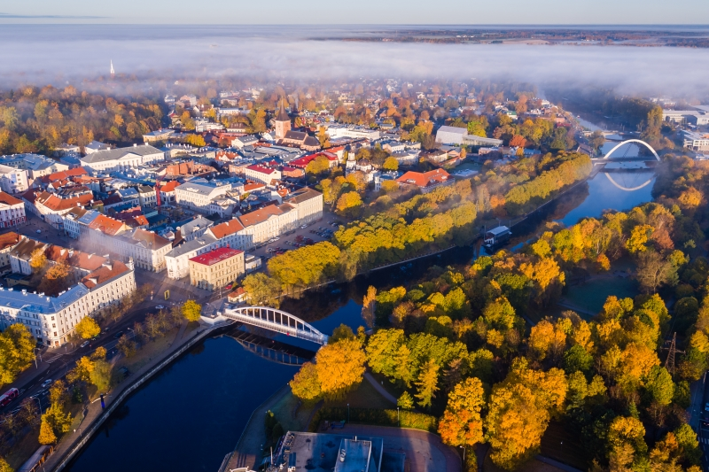
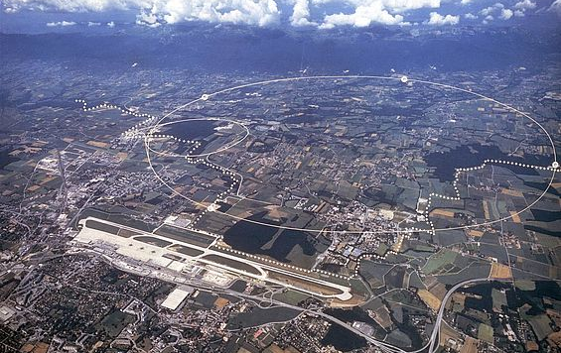
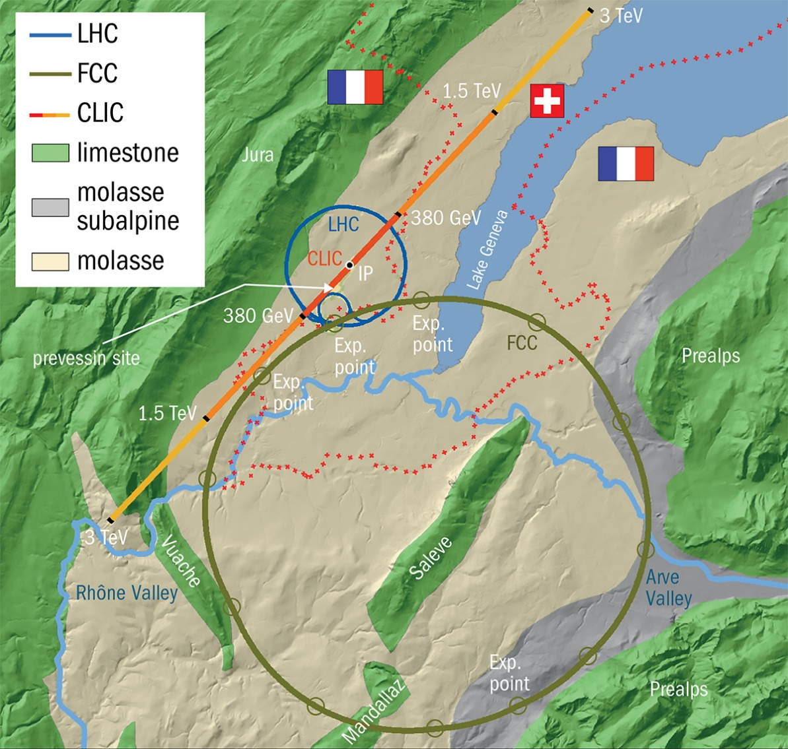
CERN – opportunities and challenges
Computing
Social and cultural aspects
Preparation and manufacturing of exotic materials
Advanced multi scale and multi physics materials modeling
Education
Climate Research
Leadership, management, organization & economical aspects
Sensor/detector Technologies
Accelerator technologies
Medicine, radiotherapy etc.
Theory
Microscopy and characterization of materials, surfaces and structures
Robotics
Author: V. Zadin (University of Tartu)

Slide 3
Estonian CERN consortium
The aim of Consortium is to ensure:
Ensure continuation of Estonian CERN research,
improve CERN research capacity in R&D institutions
Ensure participation in active CERN experiments
Consortium communicates with state agencies, policy makers and companies
Consortium forms Estonian CERN Scientific advisory board to advise Estonian CERN council in Ministry of Econimic Affairs and to advise the policy makers
Consortium coordinates current participation in CERN experiments
Consortium has state funding and capacity to increase the funding for Estonian research infrastructure
2026 year action plan development (deadline 17.12.2025)
Estonia CERN strategy development for 2026-2031 in progress. Text to be finalized in December.

Slide 4
Funding and organization
New financing instrument from behalf of Ministry of Education and Science.
Competitive financing, 175€/year (2023), for participation in CERN actions.
Funding increased ~30% for 2024
CERN Consortium formed, active and working
members: NICPB, Tartu University, Tallinn University of Technology.
Lead partner for the first period – NICPB.
Estonian CERN consortium first tasks
Estonian CERN strategy revision ongoing in Ministry of Industrial Affairs and Communication
Application to the financing instruments: upcoming Estonian Research Infrastructures Roadmap.
Consortium Funding actions since October 2024:
Success at funding Estonian CERN Science Roadmap object - 2 765 000,00 EUR
2 National Estonian Research Agency Grants 2x1.35 MEUR (UT)
EU Twinning Grant EXANST 1.3 MEUR (UT)
FinEstBeAMS Roadmap Object 1 180 000,00 EUR (UT, TalTech, NICPB)
*utApplication for Estonian PRG Grant “Effective Approaches in the Theory of Heavy Hadrons”​
Run for EU Teaming Grant TERA-Science: Estonian CERN Research Centre (UT, TalTech, NICPB)

Slide 5
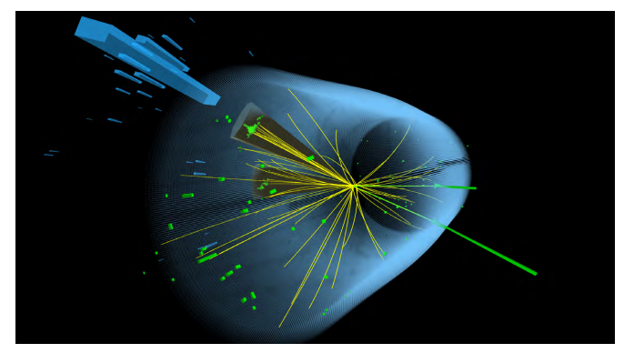
Funding, Infrastructure, Strategy
CERN continues on Estonian Research Infrastructures Roadmap
Tera-Science Teaming - Estonian CERN Research center got into final round. We have support from the ministries of Economic affairs and commuication, Ministry of Research and Education

Slide 6
UT research
CLOUDi measurements session, September- December 2025.
Aerosol particles in higher layers of toposphere
More strict regulations for participating in measurements, we need long-term planning and commitments.​
New PhD student starts in Tartu for CLOUD project on 1st of May 2025​
New MCSA ITN proposal in preparation for 15PhD within CLOUD​
COST Action “International Network on Hadron Physics“ in preparation, 46 participants​
AMBER/COMPASS Intensity Drell-Yan Test, 1 PhD student participating.​
Succesful defense of 1PhD student ​
Participation of CERN School of Computing Advisory board (Veronika Zadin)​
MEVARC 2025 conference in Uppsala presenting latest developments in CERN vacuum arcs studies ​
5 presentations from UT​
Research results​
1 Nature article by CLOUD experiment public

Slide 7
PhD and other students
Since 2022 PhD students are hired as junior researchers
State granted salary for 4 years
State average salary (currently 1981 €/month, growth 8,1%, in 2025 growth is ca 6%)
Work contract for the duration of PhD studies – minimum load 0.5, max 1.0.
Smaller work load extends studies
Very strong pressure to finish in time
Study plans are flexible, but 1 article per year (incl. 1st year is assumed)
3 articles needed for finishing (1 first authorship)
Tartu will ogranize CERN Spring Campus 2026 in the beginning of November 2026

Slide 8
Research and education: NICPB(KBFI)
CERN CMS MoU from 1996
Work is ongoing with three analyses at the CMS experiment.
This year, two students defended their PhDs based on CMS analyses, and two students defended in theory.
KBFI is currently renovating the CMS Tier 2 computing center and will purchase new computers next year.
KBFI signed a "Memorandum of Understanding for the Terrestrial Very Long Baseline Atom Interferometer Study," which is a gravitational wave experiment likely to be built at CERN.
The theorists are working on theory as usual (on daily bases).
The KBFI server room has been renovated, and the procurement process for new computing nodes is currently in progress

Slide 9
Research: TalTech
FCC MoU-s and addendums signed with CERN by University of Tartu and Tallinn University of Technology
CMS Associated Member from August 2022, Integration of energy storage in conventers feeding particle accelerator magnets, incl. thesis co-supervision (CERN EPC Group)
Ongoing collaboration with BRIL (FBCM ASIC system)
TECH contributions:
develops printed circuit boards (PCBs) for ASIC validation and deployment,
develops FPGA firmware
participates in the FBCM system validation tests in the radiation environments
Journal and conference publications
DRD7 MoU signed in Q1 2025
Ongoing collaboration in DRD7.2b „Intelligence on the detector: Radiation Tolerant RISC-V System-On-Chip“
Participation in the DRD7 annual workshop, 23–26 Sept 2025 at CERN
Strong synergy with research in our new EU projects:
Horizon Europe MSCA DN “TIRAMISU” (2024-2028, M. Jenihhin)
Horizon Europe Twinning “TAICHIP” (2024-2027, M. Jenihhin)

Slide 10
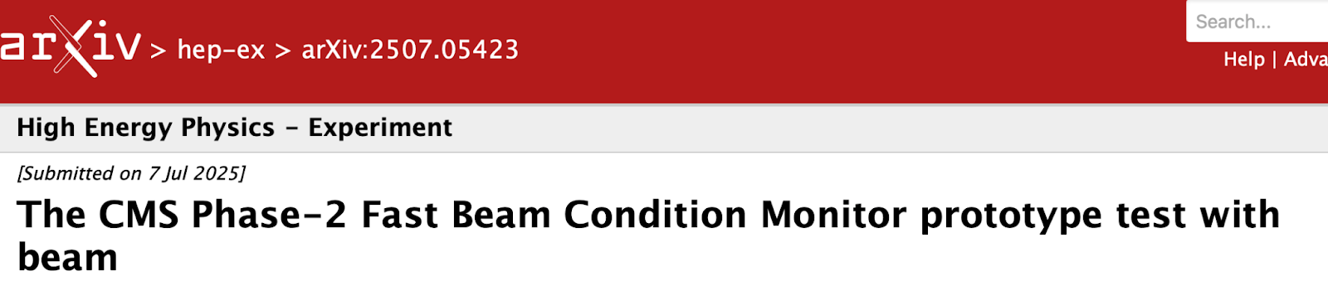
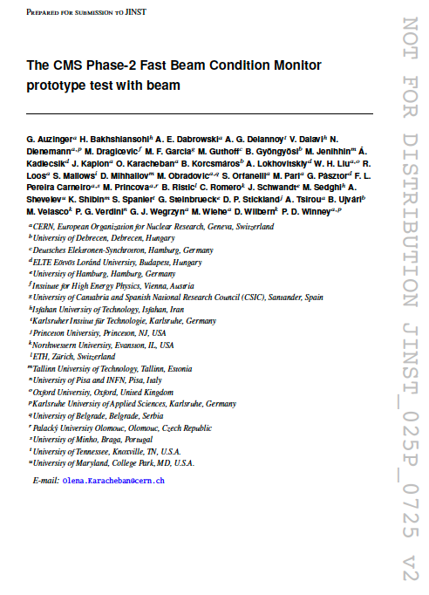
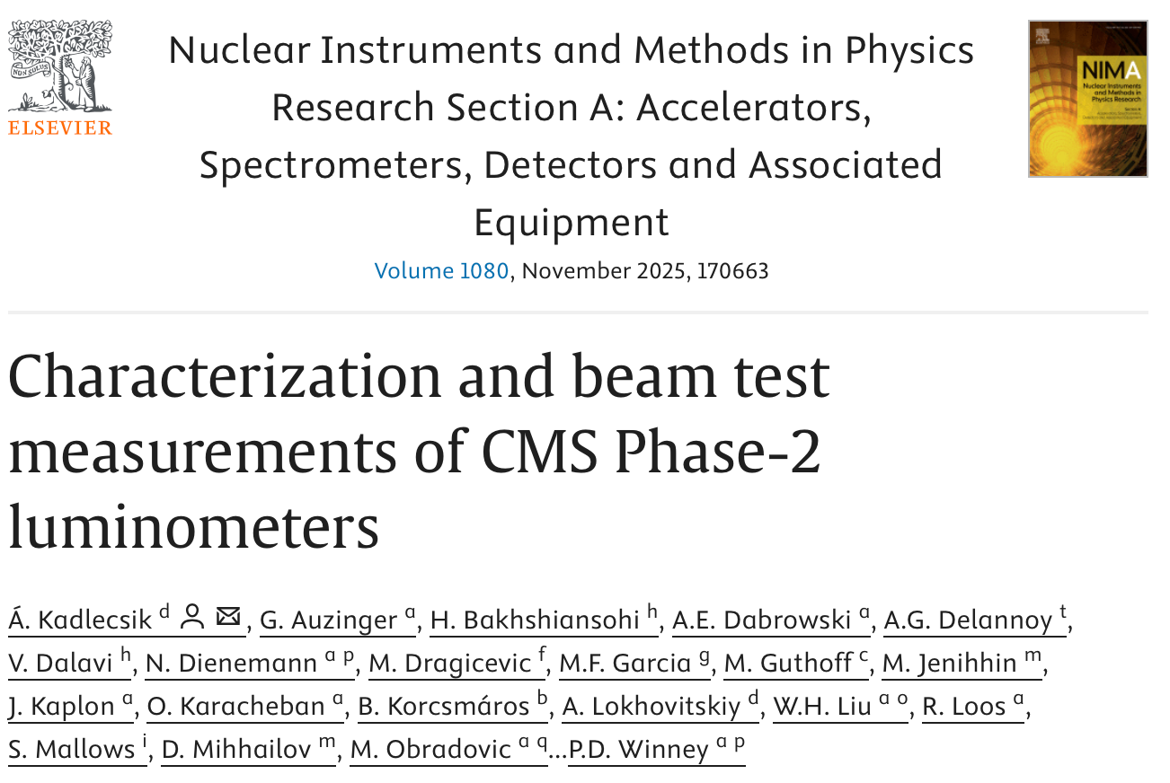
Publications
Preprint of JINST paper
NIMA Published proceedings

Slide 11
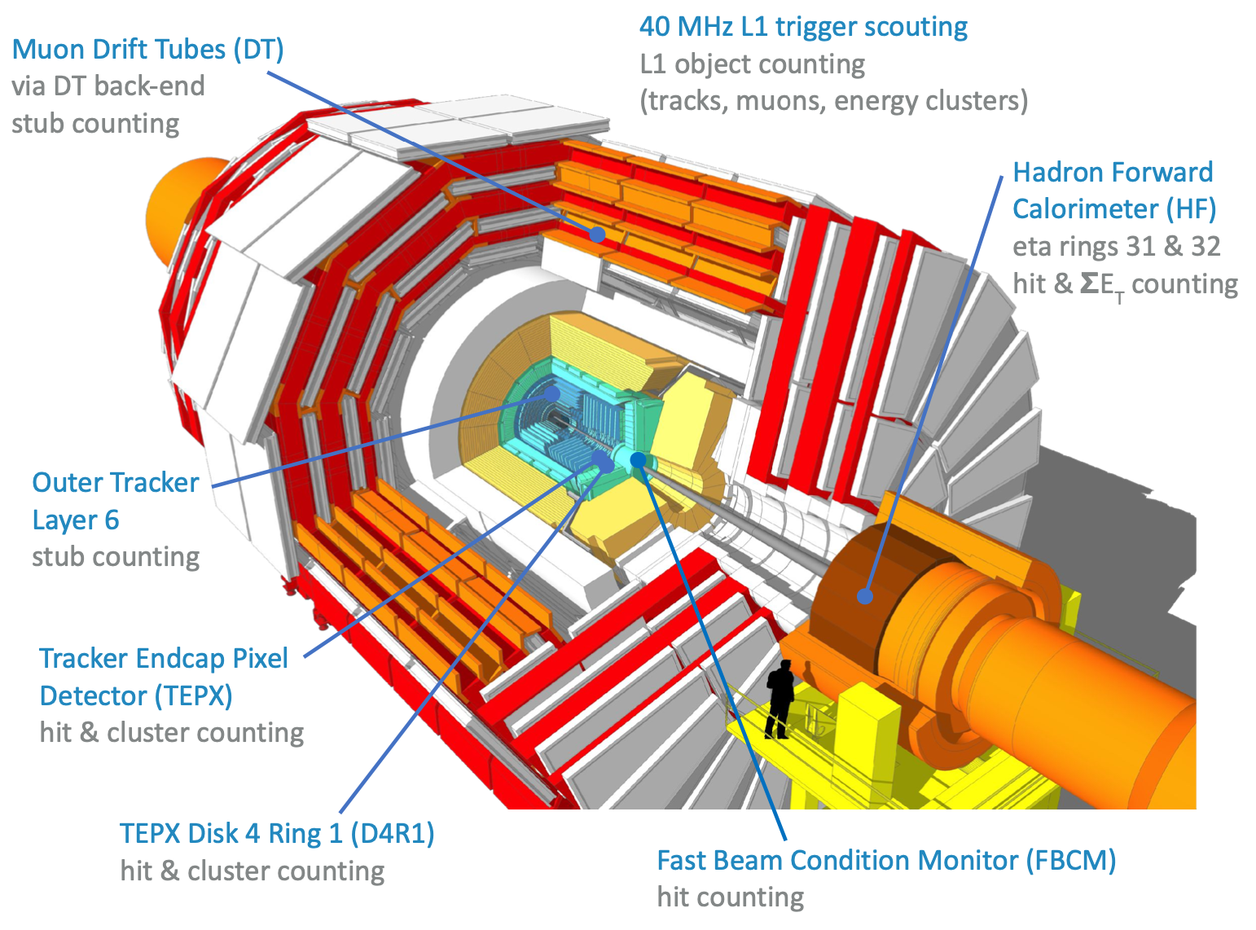
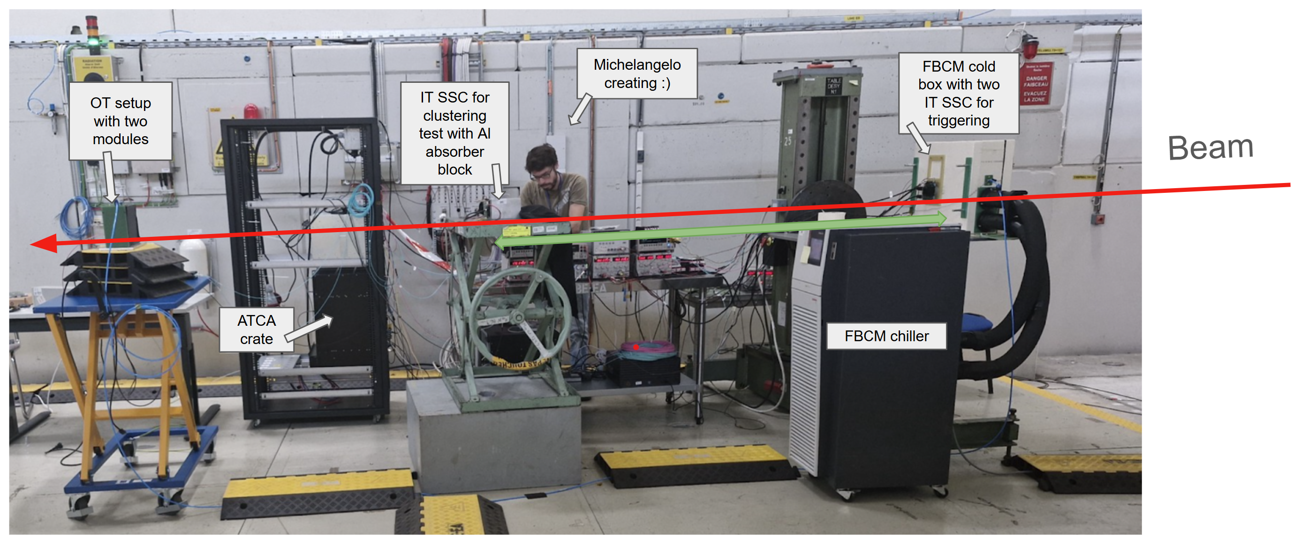
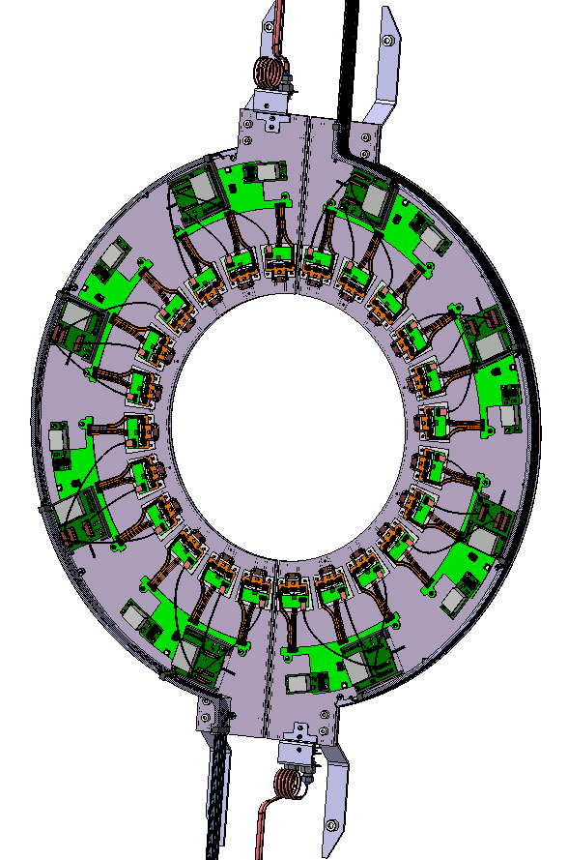
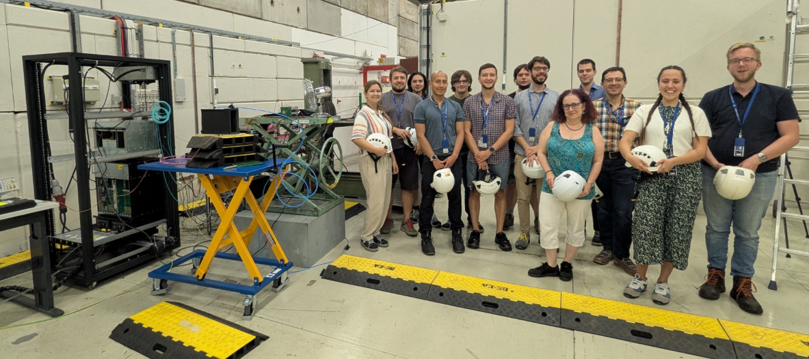

Slide 12
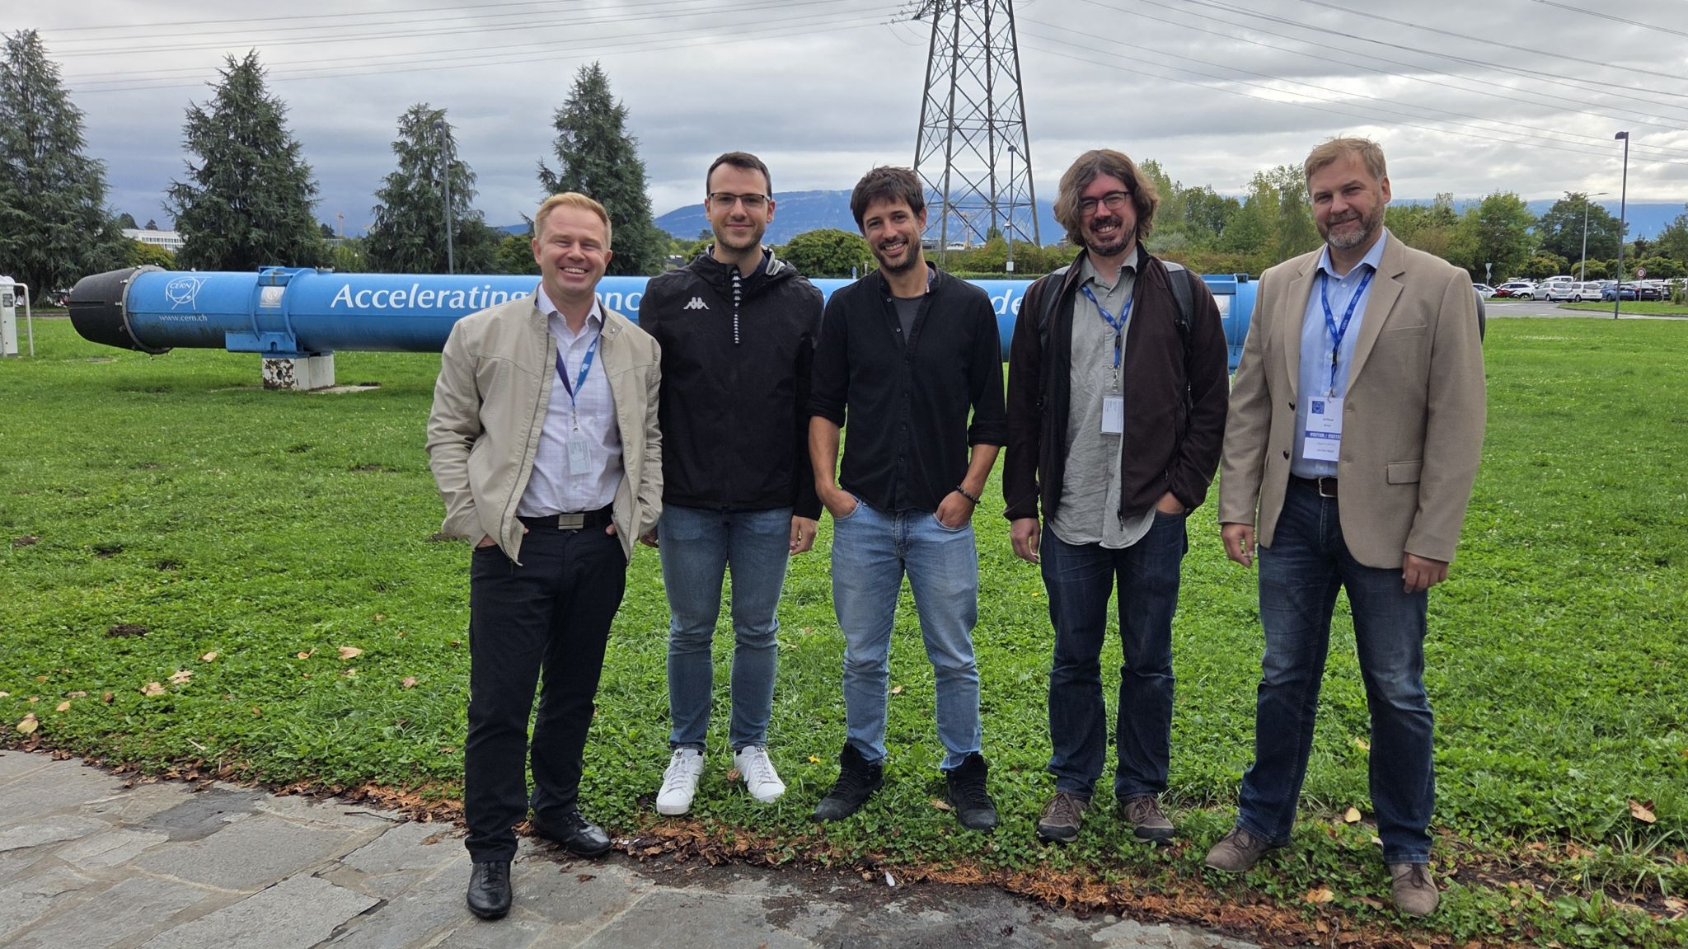
Participation in the DRD7 annual workshop, 23–26 Sept 2025 at CERN

Slide 13
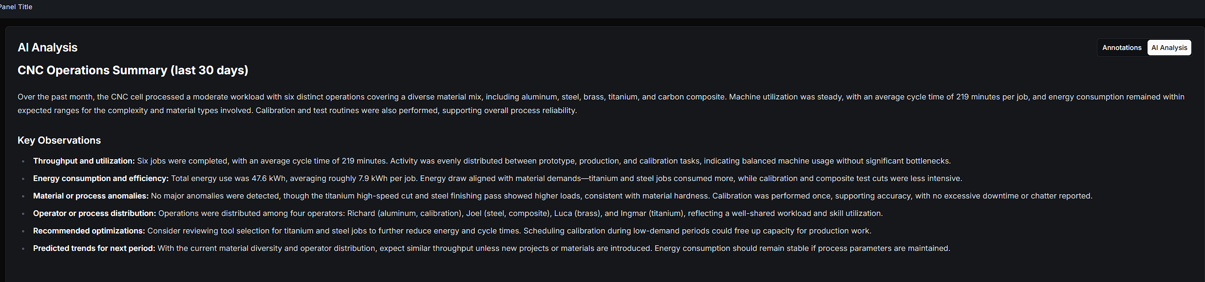
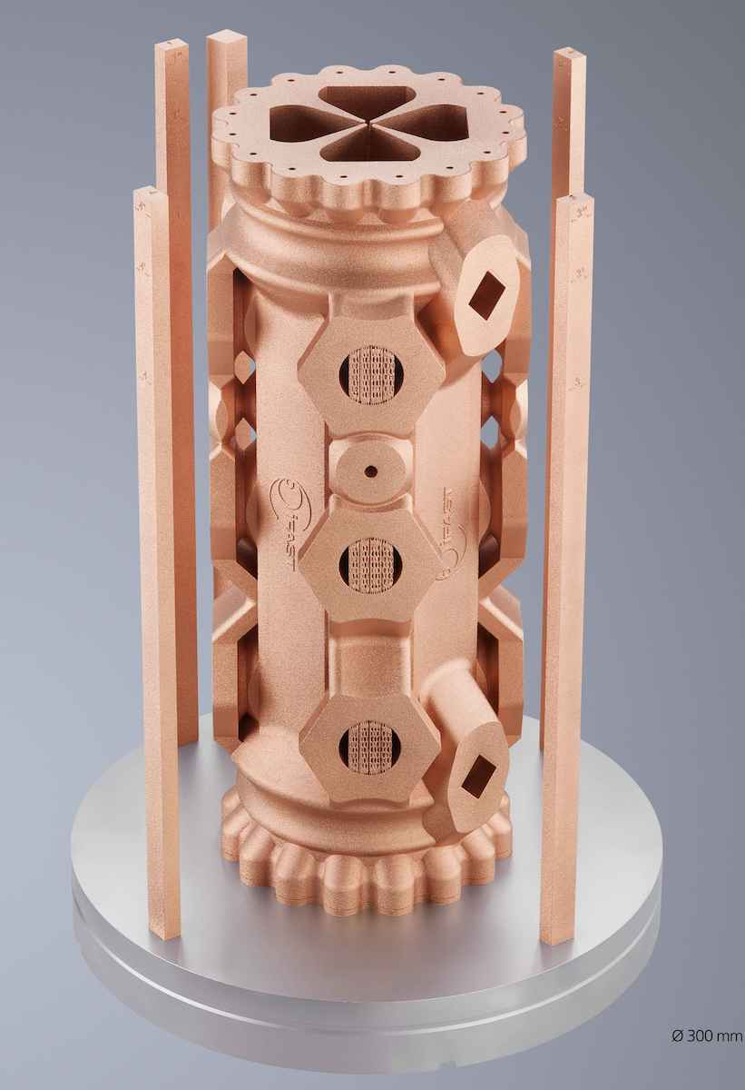

AI analysis: operations summary and key observations
Using AI for precise monitoring of CNC machine tool vs metal 3d printer for comparative energy consumption/CO2 footprint analysis
5th and Final Project Meeting of I.FAST will be held at the Globe of Innovation at CERN, Geneva, Switzerland on Tuesday 21 October and Wednesday 22 October 2025
Through its partnership with Trumpf, I.FAST maintains an innovation ecosystem around accelerator-based research infrastructure by enhancing industry (image: TRUMPF).

Slide 14

Implementing the Research Infrastructure Technology Roadmap for Particle Accelerators: proposal for Emerging Technologies pillar of the 2025 INFRA-01-TECH-02 accelerator proposal
Title of proposed action: Safety verification and validation toolkit for AI components
Proposal was submitted 2025 (in cooperation TalTech, POLIMI, ITT Group, RoboXpert)
CERN uses artificial intelligence (AI) algorithms across multiple areas to support its mission of exploring fundamental physics. AI components are notoriously difficult to validate, and this factor is most acute within the context of safety critical systems such as autonomous vehicles (AV). Using the extensive experience from safety-critical AV Validation and Verification (V&V), this team proposes to build an AI V&V software toolkit which can be used by CERN to validate important AI components. The result would accelerate the development and deployment of AI within CERN.
It appears we did not win, but we were close. CERN took 8 (score of 38.5) and TalTech was 12th (Score of 37) ... out of 45 proposals...

Slide 15
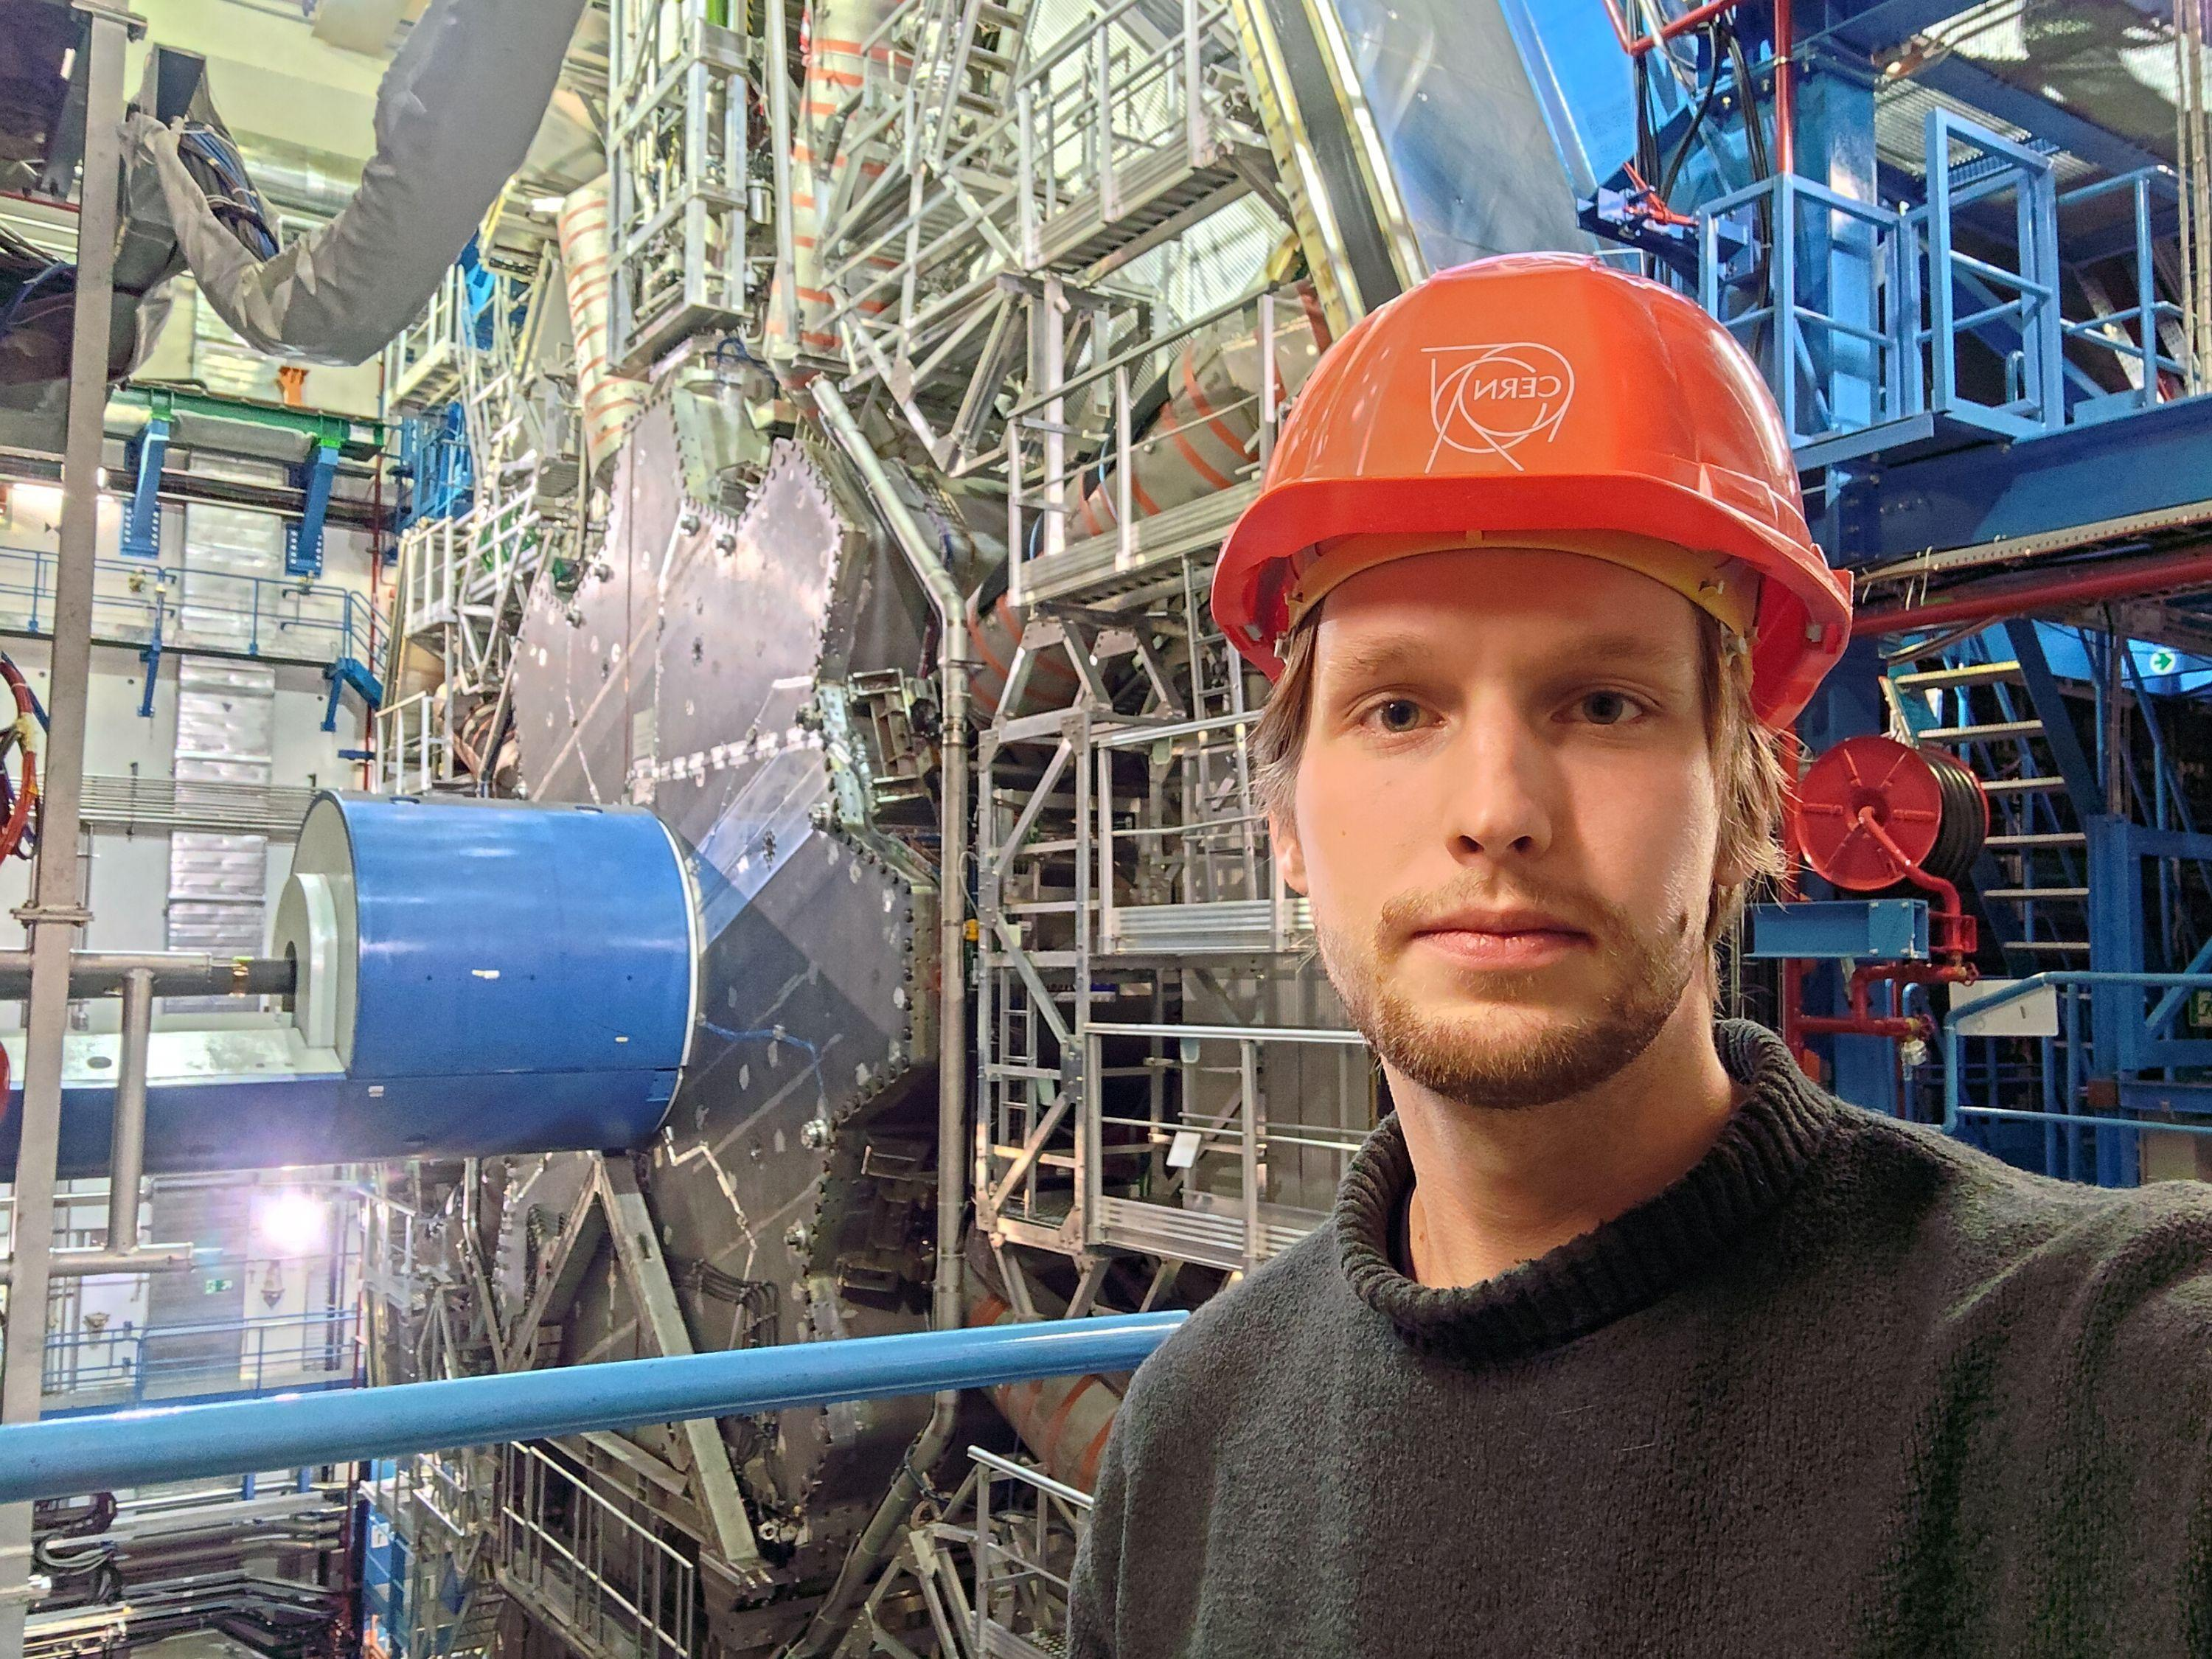
Education: TalTech
Second master student finished thesis at CERN Cryolab (Ott Salla, co-supervised by Patricia Borges de Sousa –Technical Student from TalTech in cryogenics and mechanical engineering) – defended in January 2025
Ott Salla has applied for PhD position in CERN (unfortunatelly not selected, will try again next year)
2 Ph.D student starts in 2025
Partially funded from RVTT3 project
Source: https://taltech.ee/uudised/ott-salla-varvikas-aasta-teadlas-ja-soprussuhete-kiirendis-cernis

Slide 16
Challenges
Fighting with national bureaucaritc systems.
Excessive bureauracy is disabling all new developments.

