Slide 1
Report of FSSG Working Group
"Advanced Particle Therapy Center for the Baltic States“
Feasibility Study Proposal preparation
On behalf of CERN Baltic Group’s APTCB FSSG working group
Convener dr. Erika Korobeinikova (LSMU)
Deputy Convener Kristaps Paļskis (RTU)

Slide 2
Re-introduction: Overall concept
Integration of helium synchrotron technology and all the capabilities into a modern clinical treatment center and large scale scientific research infrastructure
Clinical cancer treatment facility
Particle therapy and nuclear medicine
Industry involvement infrastructure
Research institution

Slide 3
Re-introduction: Overall concept
A scientific research facility WITH a clinical functionality
NOT
A clinical hospital WITH a research opportunities
Clinical cancer treatment facility
Particle therapy and nuclear medicine
Research institution

Slide 4
Timeline up to now
Activities during 2024
End of 2021
Idea and
first discussions
Aug 2022
Baltic Assembly support – letter to 3 prime ministers
May 2023
Baltic implementation – part of IPAC paper by NIMMS
Oct 2023
Report on the workshop findings approved by CERN Baltic Group
Oct 2022
Resolution of Baltic Assembly
Presentations and discussions with relevant professional societies,
scientific universities and political stakeholders
Apr 2022
Conceptual design paper and working group establishment
Oct-Nov 2022
Bi-lateral discussions with stakeholders in all 3 Baltic States
25th of May 2023
Workshop at CERN
Particle therapy - future for the Baltic States? State-of-play, synergies and challenges

Slide 5
Timeline up to now
Key events during 2024
Throughout 2024
Development of the Feasibility Study proposal document
Spring 2024 Workshop results published in Health and Technology special issue
January and October CERN Medical Applications Steering Committee meeting – highest CERN engagement level
April Presentation and discussions with Heidelberg Ion-Beam Therapy center – potential collaborator
September Workshop with Lithuanian stakeholders
October 11th Short overview within PMNET forum held in Riga
During 2024 Working towards radiotherapy statistics publication for December 2024/January 2025
( M.Dosanjh, E.Korobeinikova, E.Gershkevitsh, K.Palskis )
November Participation in The Nordic-Baltics as a European pilot region for cross-country cooperation in health data conference

Slide 6
Working groups of APTCB initiative
"Advanced Particle Therapy Center for the Baltic States“ working group
Convener: prof. Toms Torims (RTU)
Deputy Convener: prof. Diana Adliene (KTU)
12/04/2022 – 18/10/2024
Main activities:
Initial concept development
Initial stakeholder engagement activities and strengthening collaboration with CERN
Development of Feasibility Study proposal first iteration
"Advanced Particle Therapy Center for the Baltic States“
Feasibility Study Strategy working group
Convener: dr. Erika Korobeinikova (LSMU)
Deputy Convener: Kristaps Palskis (RTU)
06/12/2024 – now and on-going
Main activities:
Continuation of stakeholder engagement
Development and finalization of Feasibility Study proposal

Slide 7
Outline
Re-introduction of the Feasibility Study: necessity and overall idea
Establishment of APTCB FSSG
Overview of the updates for Feasibility Study Proposal document
Stakeholder engagement and possible pathways to approach funding
Future outlooks
Main focus today – report on updates of Feasibility Study Proposal
Discussion on future steps within context CERN Baltic Group

Slide 8
Beginning of the Feasibility Study idea: “Particle therapy - future for the Baltic States?”
A joint, dedicated workshop
“Particle therapy - future for the Baltic States? State-of-play, synergies and challenges”
Set-up of the event
5 sessions dedicated to each of the core discussion areas identified with reporters on subject matter and moderators of the session
Cancer statistics and indication profile in the Baltic States. Status of radiotherapy technologies in the Baltic States. | Cancer statistics in the Baltic States – number of patients diagnosed and treated with RT yearly Most common malignancies, with a correspondence to eligibility for particle therapy Technological level of currently used radiation therapy techniques, statistics of RT equipment
Clinical indications for proton and particle therapy. Existing clinical evidence and on-going clinical trials. | Main cancer types and oncological indications eligible On-going clinical trials for evidence-based medicine are to be discussed Existing consensus statements and alternative approaches for patient selection
The technology of helium synchrotron: technology readiness level and research needed. | Current status of the technology and technology readiness level Potential challenges in the development and construction stages Scientific research inputs necessary
Current status of nuclear medicine in the Baltic States. Trends and research pathways going into the future. | Current status of the nuclear medicine field within the Baltic States Insights gained from PRISMAP project - focus on novel radioisotopes Technical aspects and scientific research needed to develop production of such isotopes
Educational necessities and possible solution pathways for clinical and technical personnel training. | Key educational necessity areas International educational opportunities and collaborations Educational aspect implementation paths early-on within the project initiative

Slide 9
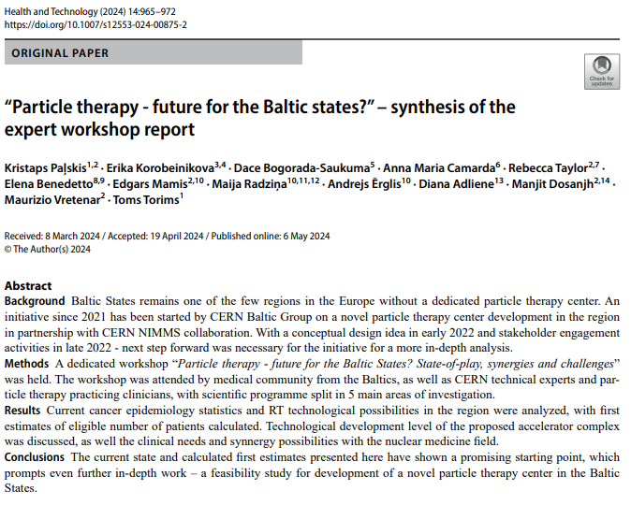
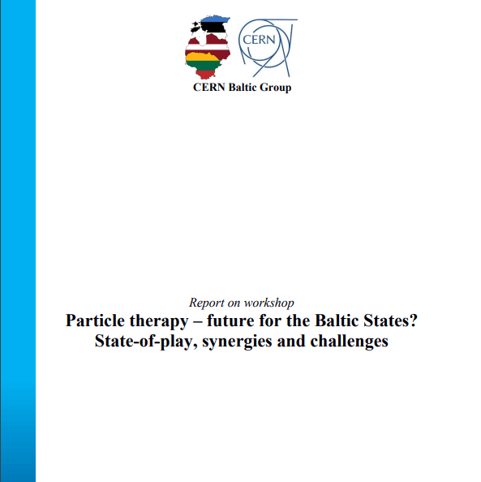
Beginning of the Feasibility Study idea: “Particle therapy - future for the Baltic States?”
Workshop report
Approved in 12th CERN Baltic Group General meeting (October 11-12th, 2023)
https://link.springer.com/article/10.1007/s12553-024-00875-2
Publication «Health and Technology» «Hadrontherapy and BNCT: Current Status and Future Trends»
https://indico.cern.ch/category/16259/attachments/2838075/4960020/REPORT_25_05_2023.pdf

Slide 10
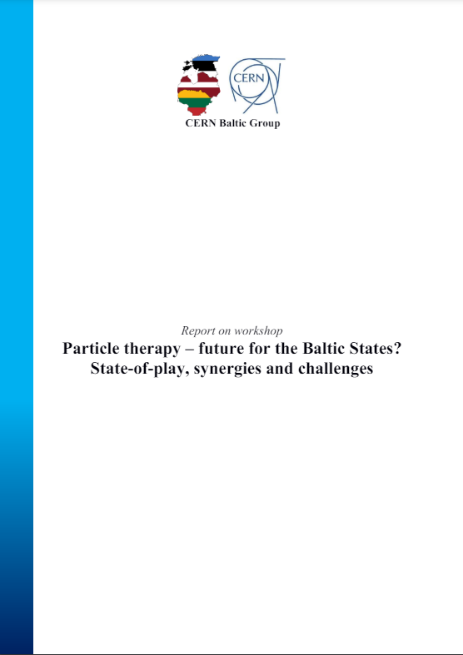
Beginning of the Feasibility Study idea: “Particle therapy - future for the Baltic States?”
Workshop
«Particle therapy - future for the Baltic States? State-of-play, synergies and challenges»
« . . . In order to proceed with this promising idea, a full-scale feasibility study of the project is needed. It shall assess feasibility of the facility of this research infrastructure from financial (business case), clinical (medical case), technological (technical outline, availability and R&D required) and multi-disciplinary scientific research perspective. In each of these segments, feasibility study would need to have involvement of experts from every Baltic State and CERN researchers, as well as representatives of European particle therapy centers. The best existing platform for such feasibility study is CERN based NIMMS collaboration . . . »

Slide 11
Overall idea of the Feasibility Study
Main aims of the Feasibility Study
  to investigate the feasibility of the implementation of the APTCB facility to a certain level ( see point 3 ) in main domains of proposed functionality:
      clinical aspects and regional epidemiology;
      technology itself and integration into a facility
      aspects on economics, innovations and business
  to provide a factual based Feasibility Study Report to be used as tool for the decision making in the APTCB project continuation;
  through the Feasibility Study Report and associated documents – to provide multiple possible scenarios for implementation at various levels: full, partial or no implementation, with possible alternatives.

Slide 12
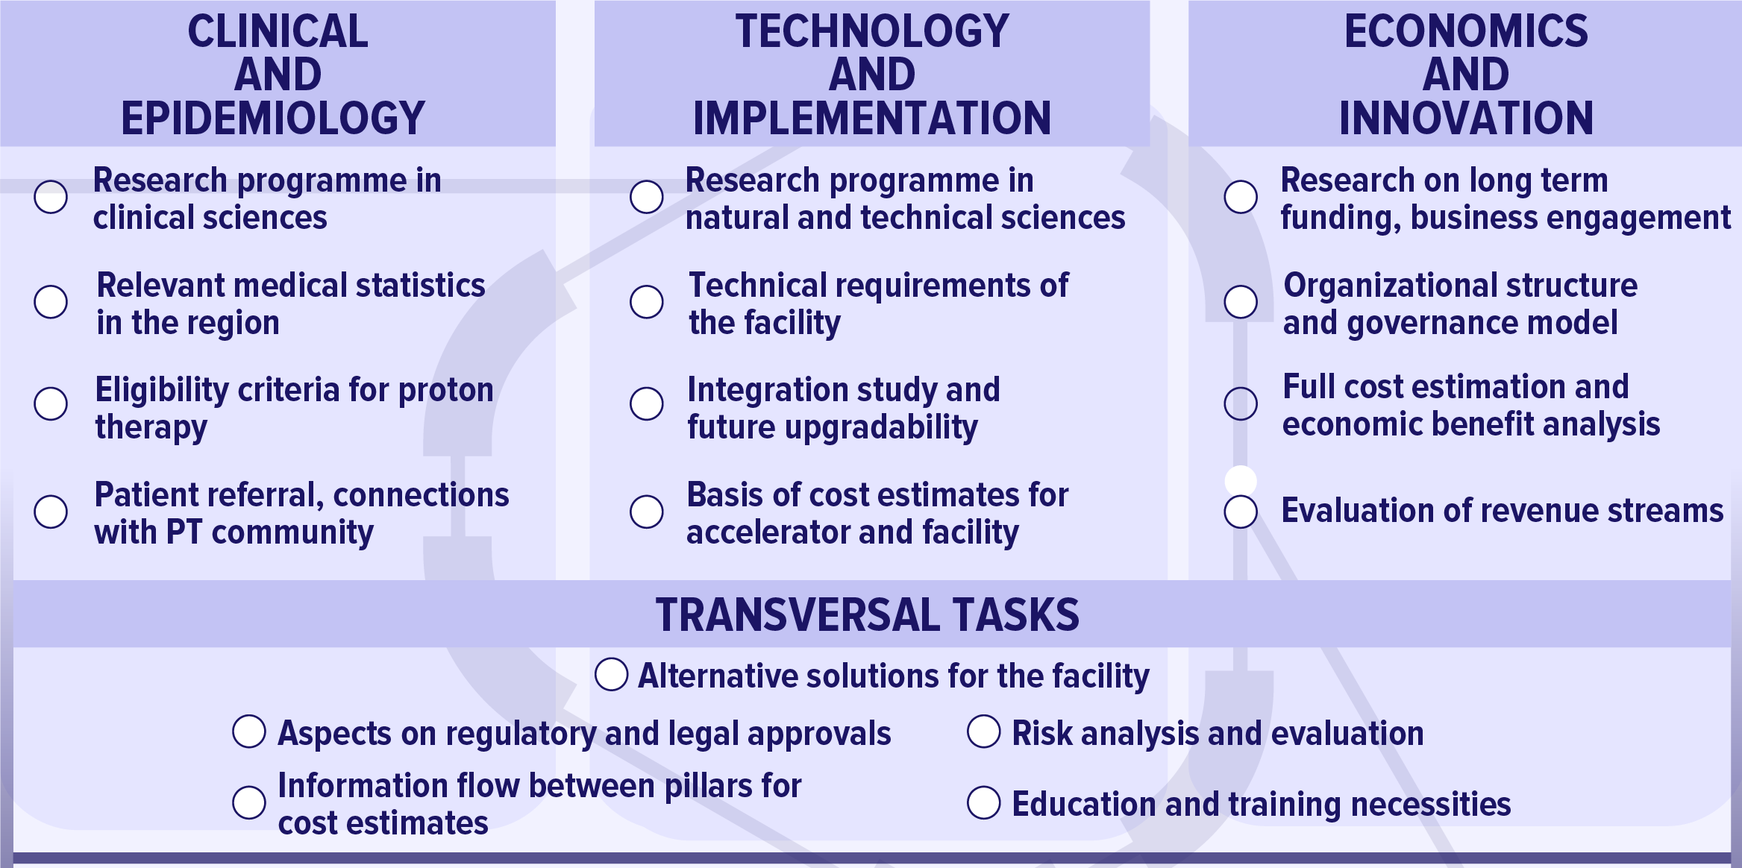
Overall idea of the Feasibility Study

Slide 13
What is the Feasibility Study Proposal document?
What IS the Feasibility Study Proposal ?
Above all: definition of core questions to be answered and areas of investigation necessary
Definition for the motivation of the APTCB facility and long-term vision
Outline of organizational structure, working plan, stakeholder involvement necessary
Identification of possibly participating research groups
Raising institutional interest and awareness among stakeholders
Aim of the proposal – a document to approach political stakeholders, funding agencies etc.
A proposal NOT a definitive plan – changes can be expected upon start
What the Feasibility Study Proposal IS NOT ?
NOT the final version of the plan of whole Feasibility Study - a proposal to discuss for further actions to be taken and updated after discussions with funding agencies, political stakeholders etc.
NOT the expected outcome of the Feasibility Study: answering key areas of investigation is part of the Feasibility Study itself. Factual basis for the facility is to be provided after the Feasibility Study, though a brief initial overview is provided in the “Motivation” section

Slide 14
Timeline of the Feasibility Study Proposal preparation
End of 2023
First ideas on the structure of the Feasibility Study proposal
June 2024
Finalization of first draft of the Feasibility Study proposal
October 2024
Finalization of first version of the proposal. Adaptation to comments from CBG member institutions
During Spring 2024
Preparation of the first draft in collaboration with CERN NIMMS
Summer to September 2024
Additions to the proposal writing group and further adaptations of the document
From December 2024
to now
Work of APTCB FSSG

Slide 15
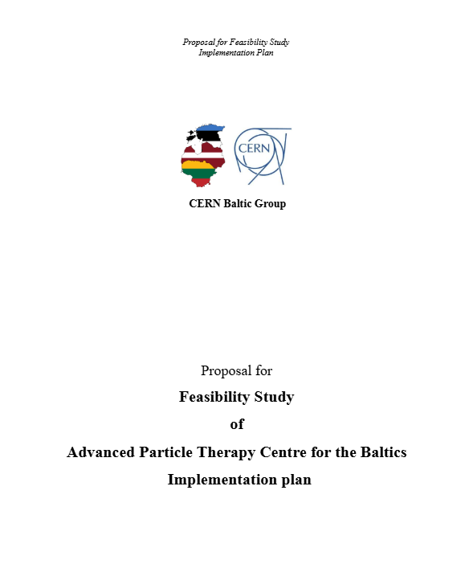
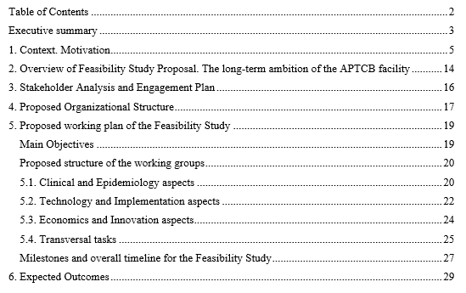
1st and 2nd iteration of the Feasibility Study proposal: Overview
  Draft preparation:
    Convener of the WG: Prof. Toms Torims (Riga Technical University, LV)
    Deputy Convener of the WG: Prof. Diana Adlienė (Kaunas University of Technology, LT)
    Kristaps Palskis (Riga Technical University, LV)
    Dr. Erika Korobeinikova (Lithuanian University of Health Sciences, LT)
    Dr. Alberto Degiovanni (Riga Technical University, LV)
    Dr. Maurizio Vretenar (CERN, CH)
    Dr. Andris Ratkus (Riga Technical University, LV)
    Prof. Saulė Mačiukaitė-Žvinienė (Vilnius University, LT)
    Dr. Eduard Gershkevitsh (North Estonia Medical Centre, EE)
  Draft edits:
    Prof. Maija Radziņa (University of Latvia and Riga Stradins University, LV)
    Dr. Jevgenijs Proskurins (Riga Stradins University, LV)
    Dr. Gediminas Stankūnas (Lithuanian Energy Institute, LT)

Slide 16
1st and 2nd iteration of the Feasibility Study proposal: Feedback
Presented and discussed during 14th CERN Baltic Group General meeting
October 17th, 2024
Key areas necessitating improvement . . .
  more detailed milestone definition
  clearer definitions in stakeholder identification and engagement plan
  additional considerations for tasks (addition of certain scientific directions etc.)
  identification of possible contributions by CBG institutions
  rationale of the facility, especially as “centre of excellence” and “innovation hub”
. . . and above all
  expansion of the working group for second iteration of the document to have broader expertise and CBG institutional representation
Decision on the next steps from CERN Baltic Group

Slide 17
Establishment of APTCB FSSG Working Group
Advanced Particle Therapy Center for the Baltic States
APTCB FSSG
Feasibility Study Strategy Group
Main goal of the Working group
  direct heir of the CBG Working Group: "Advanced Particle Therapy center for the Baltic States“
  continue the work of the CBG towards the implementation of a Feasibility Study for the establishment of a novel scientific research and particle therapy centre in the Baltic states, based on the advancements made by the CERN-led Next Ion Medical Machine Study (NIMMS) project
Composition of the Working group
  during November 2024: CBG institutions with interest and willingness to contribute to the activity were providing official nominations of two institutional representatives to the Feasibility Study Strategy Group

Slide 18
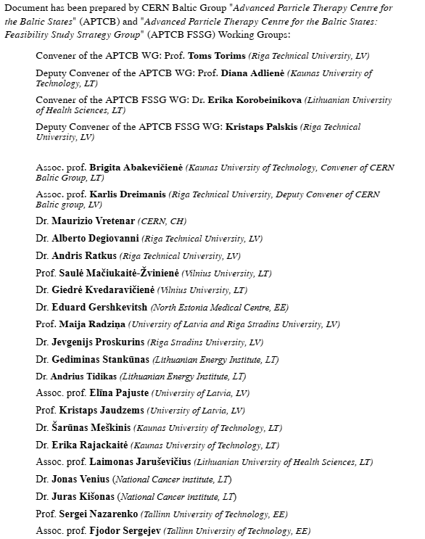
Establishment of APTCB FSSG Working Group

Slide 19
APTCB FSSG work on Proposal document preparation
06/12/2024 Inaugural meeting
January 10 APTCB FSSG #1, Meeting minutes: HERE
January 24 APTCB FSSG #2 , Meeting minutes: HERE
February 07 APTCB FSSG #3 , Meeting minutes: HERE
March 07 APTCB FSSG #4 , Meeting minutes: HERE
March 28 APTCB FSSG #5 , Meeting minutes: HERE
To continue the work after CBG General meeting

Slide 20
Brief overview of the main changes in the Proposal
/ not an exhaustive review, rather focus on the main aspects /

Slide 21
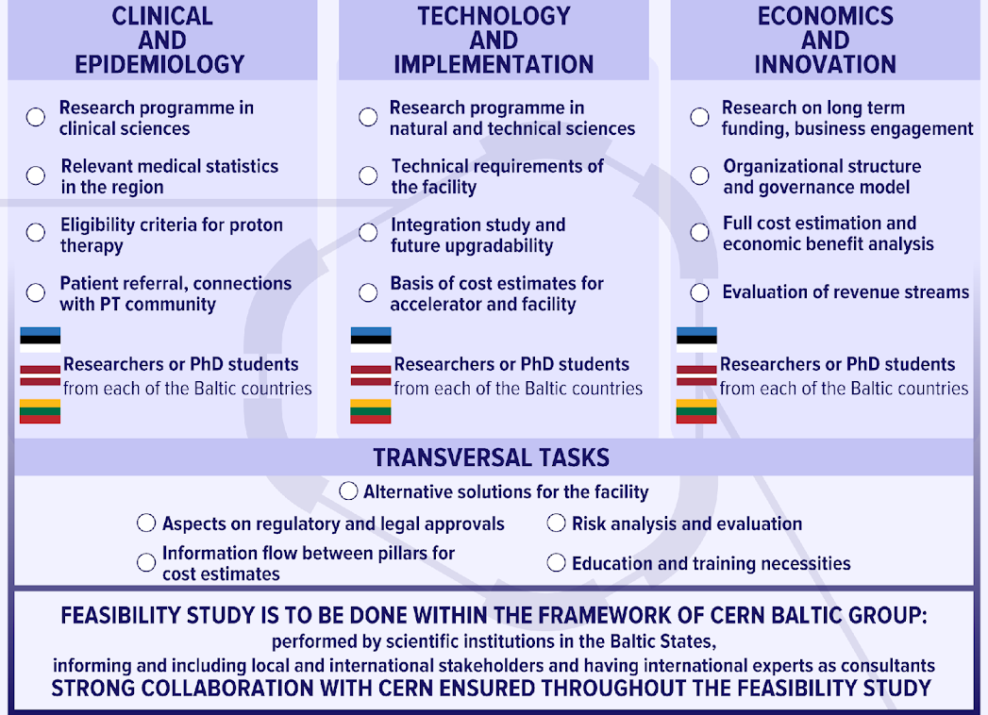
Main updates of the document: Proposed organizational structure of Feasibility Study
No “national leadership” for the different Working Groups
  institutions from each country contributing to all investigation areas, no single country leadership for investigation area (compared to as proposed before)
  leadership – Task level
  from discussions, also helps to apply for funding form different sources and ministries
Feasibility Study in the Baltic States, collaborating with CERN Technical experts
  considering the costs necessary and necessary relocation, especially – clinical specialists – Feasibility Study is to be done in the Baltic States, (not CERN as possible host as proposed before)
  tasks assigned to scientific institutions in the Baltic States with overall coordination by CERN Baltic Group
  strong collaboration with CERN is crucial as CERN NIMMS HeLICS technology is the core of the idea – most significantly applies to technology work group

Slide 22
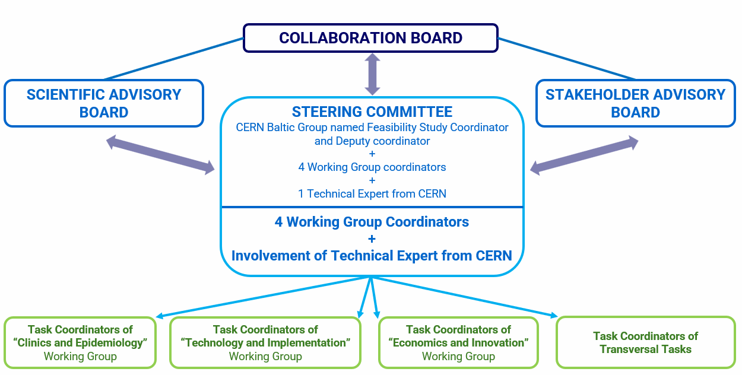
Main updates of the document: Proposed organizational structure of Feasibility Study
Task Level leadership
  as mentioned, institutions from each country contributing to all investigation areas, no single country leadership for investigation area
  instead of scientific leadership – coordinator within of the Working Groups to ensure organizational aspects
  furthermore – coordinators also at the Task level from participating institutions
  as proposed before: Scientific Advisory Board and Stakeholder Advisory Board
  CERN Baltic Group named Feasibility Study Coordinator and Deputy Coordinator
  1 Technical expert from CERN, to ensure communication with NIMMS on technology aspects

Slide 23
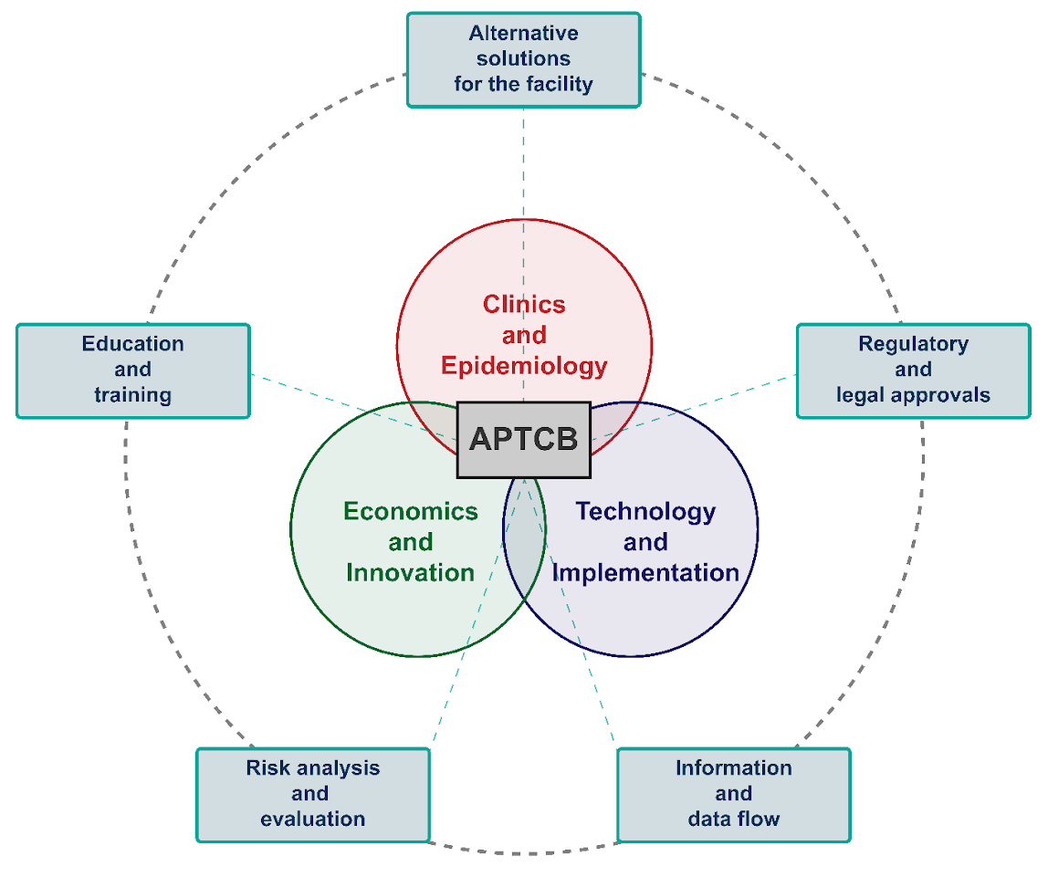
Main updates of the document: Proposed organizational structure of Feasibility Study
Additional note on
the “integral approach”
  Collaboration between all the participating institutions, working groups for the different areas of investigation, involved stakeholders and consulting international experts
  IS CRUCIAL TO ENSURE THE SUCCESS OF THE MULTIDISCIPLINARY INVESTIGATIONS OF THE FEASIBILITY STUDY!

Slide 24
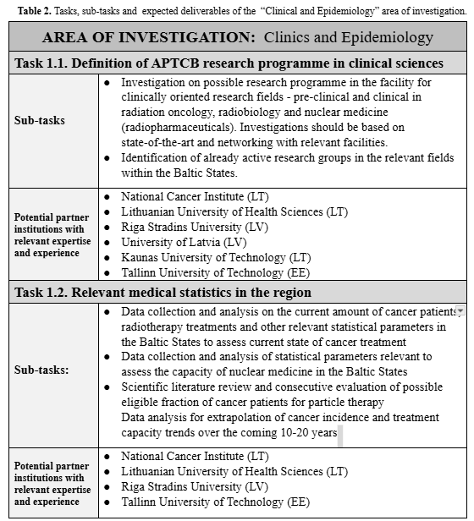
Main updates of the document: Updated working plan and deliverables
Redefinition of “Tasks-Subtasks-Deliverables”
  to limit the reporting necessary – previously named “Deliverables” → Sub-Tasks
  the amount of work and investigations necessary is kept the same as all previously identified aspects are essential to have sufficient factual basis for the future of the initiative
  in the end – all the work essentially contributes to the Feasibility Study Report as main deliverable
First identification of possible contributors
  survey of the participating institutional representatives – identification of the possible institutions as contributors to each Task
  no official engagement yet, identification of possible interest
  discussions to create a Memorandum of Understanding at the start of the Feasibility Study – assigning the Tasks, coordination of the different Tasks and other relevant aspects

Slide 25
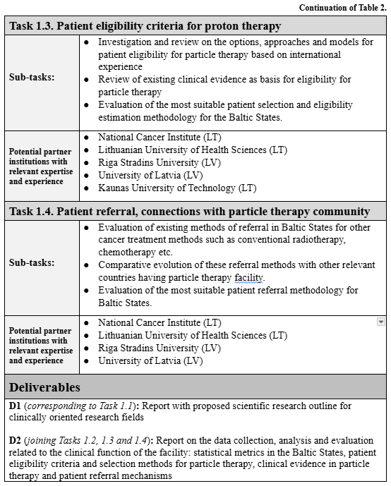
Main updates of the document: Updated working plan and deliverables
Redefinition of “Deliverables”
  as mentioned, number of Deliverables reduced (maintaining the amount of investigation) to limit the necessary reporting
  2 deliverables per 3 core investigational areas
  3 deliverables for the Transversal tasks
  at the end – all deliverables contribute to the main deliverable of the Feasibility Study – the Feasibility Study report

Slide 26
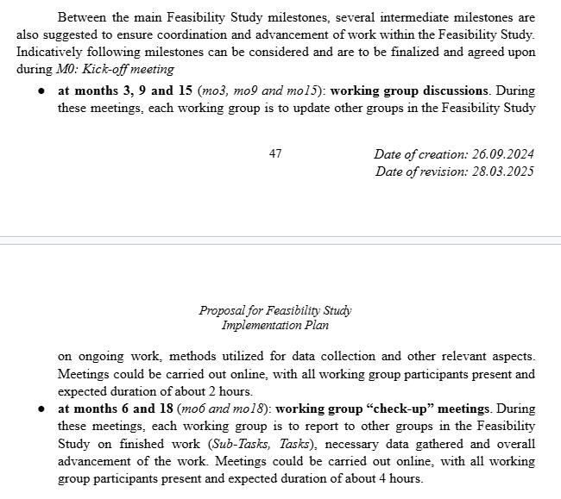
Main updates of the document: Updated timetable and milestone definiton
Addition of intermediate milestones
  at months 3, 9 and 15 working group discussions. During these meetings, each working group is to update other groups in the Feasibility Study on ongoing work, methods utilized for data collection and other relevant aspects.
  at months 6 and 18 (mo6 and mo18): working group “check-up” meetings. During these meetings, each working group is to report to other groups in the Feasibility Study on finished work (Sub-Tasks, Tasks), necessary data gathered and overall advancement of the work.
Additional regular meetings/milestones
  within each Working Group – regular coordination meetings are expected. Periodicity (weekly, bi-weekly and monthly), organization is to be agreed upon within the Working Group
  a regular Feasibility Study “newsletter” could be organized to ensure informing all the Working Groups about on-going work within each Working Group or other relevant news of the Feasibility Study
  the deliverables and information collected within each Working Group will be the basis for the Feasibility Study Report. Feasibility Study Report will be built upon this information and will be finalized and released at month 24

Slide 27
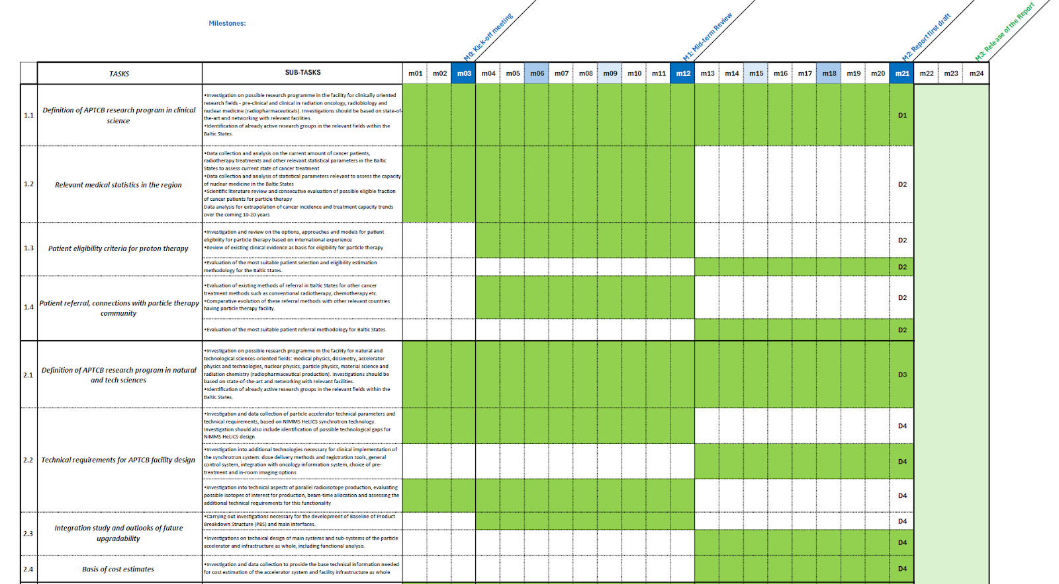
Main updates of the document: Updated timetable and milestone definiton
Adaptation of Gannt chart template for the timeline of the Feasibility Study

Slide 28
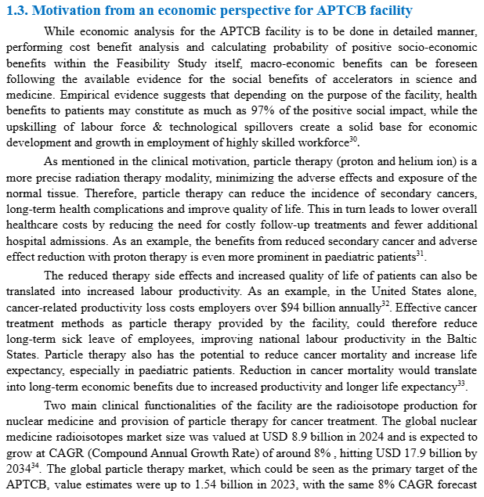
Main updates of the document: Motivation from economics and innovation perspective
Additions for economic perspective
  potential to deliver long-term socio-economic returns, identification of the key areas of such returns
  inclusion of market value of nuclear medicine radioisotope production as addition for particle therapy
Addition for innovation aspects
  Motivation for the facility:
  boost innovation ecosystems and enhance the capacity of national economies to generate, adopt, and commercialize advanced technologies;
  provide environment for high-skilled workforce development, including upskilling and improved career prospects for early-stage researchers, engineers, and professionals in various fields

Slide 29
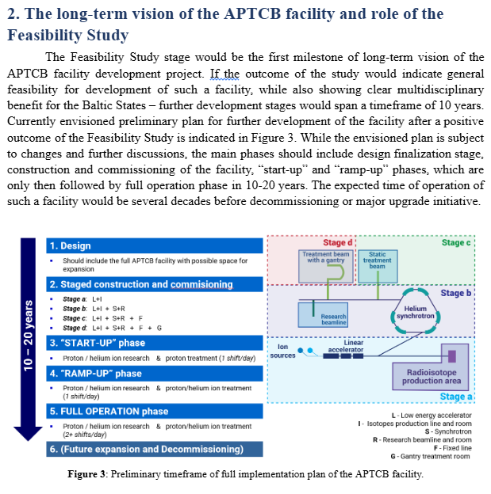
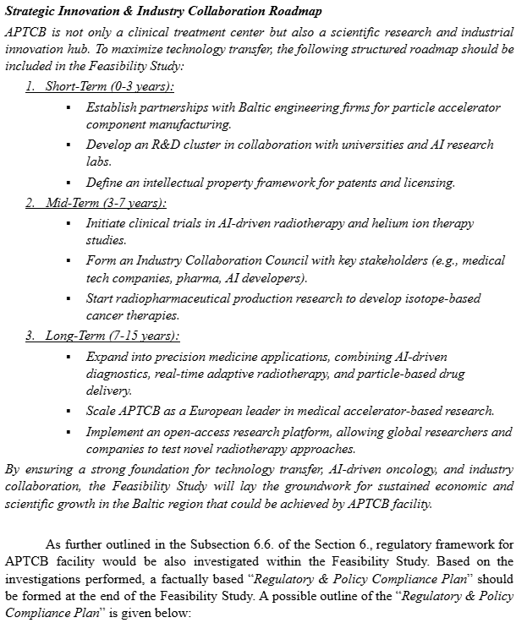
Main updates of the document: Long-term vision of APTCB and post-FS activities
Addition of long-term vision
  previously – possible staging of the project
  now – addition of necessity for “Strategic Innovation & Industry Collaboration Roadmap” for the future of the APTCB facility and “Regulatory & Policy Compliance Plan” as crucial aspects for long-term vision of the project
Addition of post-FS activities
  Based on collected information during the Feasibility Study: “Strategic Innovation & Industry Collaboration Roadmap” and “Regulatory & Policy Compliance Plan” should be created along with all the other envisioned aspects

Slide 30
What to expect at the end of the Feasibility Study?

Slide 31
Main updates of the document: Long-term vision of APTCB and post-FS activities
Tool for decision making process for the future of this initiative
The main tangible outcome: the Feasibility Study Report. The information collected to be used as decision making tool made by CBG the future of the APTCB project
Other documents will be created along with the Feasibility Study report by CBG:
  risk analysis associated with APTCB proposal and overall risk management strategy;
  finalized and factual-based proposal for layout of the APTCB facility;
  finalized and factual-based beam-time usage proposal for the APTCB facility;
  finalized and factual-based list of selection criteria for the choice of most suitable APTCB facility construction site;
  initial proposal for the expected staging for full-scale development of APTCB facility;
  initial basis for a business plan for the APTCB facility.
Multiple possible scenarios
Feasibility Study report and other accompanying documents: to provide the basis for multiple possible scenarios, not a definitive solution, for the decision making stakeholders. Providing factual basis for comparison of the different alternative options.
  full-scale implementation scenario, with varying weights of scientific research and clinical treatment functions;
  partial implementation scenario, limiting certain technical functionalities of the proposed facility;
  scenario of not implementing the facility, while identifying possible alternatives.

Slide 32
Current state of the Document

Slide 33
Main updates of the document: Current state of the document
Current iteration of the document: HERE
All comments, corrections and suggestions from APTCB FSSG member institutions are implemented
We could be looking at the finalization of the document
Main discussion point for today after ~ 4 slides:
What are the next steps of the initiative and possibly launching the Feasibility Study?

Slide 34
Initial discussion on ideas of possible funding pathways

Slide 35
Initial discussions on possible funding pathways
From APTCB FSSG #5 meeting on March 28
Lithuania
“ significant political and governmental interest in the project. Multiple stakeholders, including the Ministry of Foreign Affairs and the Lithuanian Presidency, are requesting updates and details regarding the finalized Proposal ”
Latvia
“ Two potential funding pathways have been identified:
a) Applying for a national research project grant, where the Feasibility Study would be included as a key deliverable;
b) Exploring joint institutional support from leading Latvian universities (Riga Technical University, University of Latvia and Riga Stradiņš University) for approaching relevant ministries as a
united front. ”
Estonia
“ a positive shift in government attitudes towards the project. Non-binding discussions have been held, and several funding possibilities are being explored. Estonian public funding would likely require a formal procurement process ”

Slide 36
Short note on other activities

Slide 37
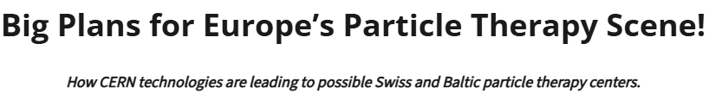
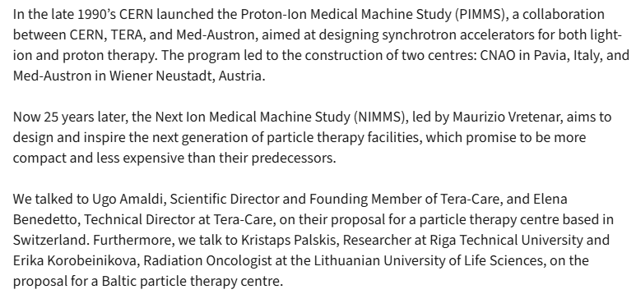
Other activities
Article in CERN ATS MedTech Newsletter
Big plans for Europe’s particle therapy scene! – ATS-News

Slide 38
For discussion:
Do you consider the currently proposed document as sufficient for approaching relevant stakeholders for possible launch?
What are your suggestions for stakeholders to approach for this initiative?

