Slide 1
ESTONIA: State of play
Research groups, existing actions, interests and collaborations
Veronika Zadin
Professor of materials technology

Slide 2

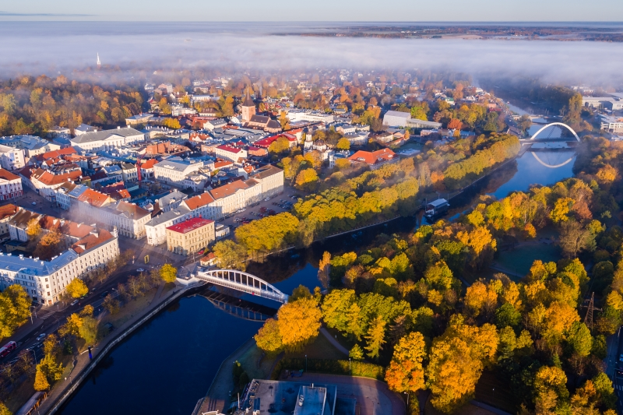
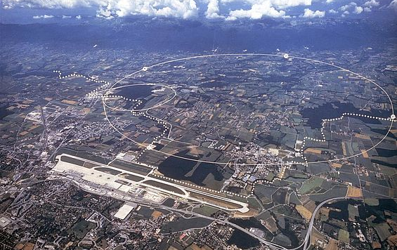
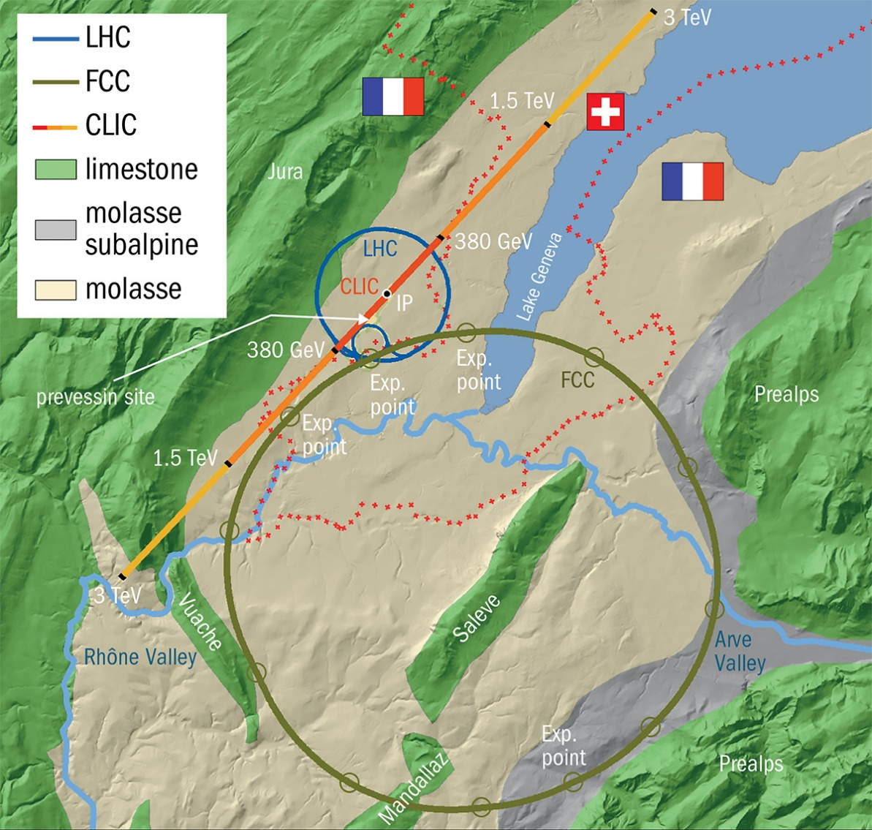
CERN – opportunities and challenges
Computing
Preparation and manufacturing of exotic materials
Social and cultural aspects
Advanced multi scale and multi physics materials modeling
Education
Climate Research
Leadership, management, organization & economical aspects
Sensor/detector Technologies
Accelerator technologies
Medicine, radiotherapy etc.
Theory
Microscopy and characterization of materials, surfaces and structures
Robotics

Slide 3
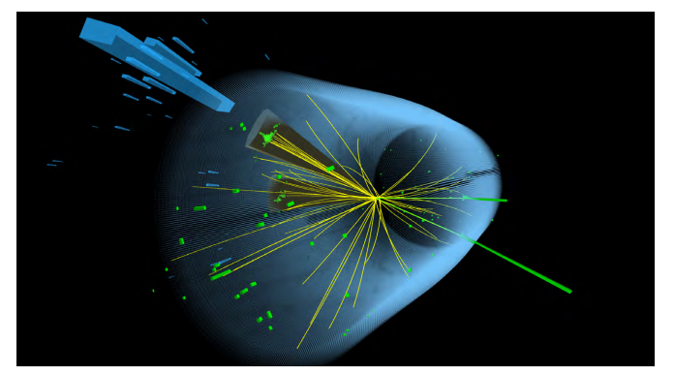
Funding, Infrastructure, Strategy
CERN continues on Estonian Research Infrastructures Roadmap
NEW funding opportunities in coming years!

Slide 4
Estonian CERN consortium
The aim of Consortium is to ensure:
  Ensure continuation of Estonian CERN research,
  improve CERN research capacity in R&D institutions
  Ensure participation in active CERN experiments
Consortium communicates with state agencies, policy makers and companies
Consortium forms Estonian CERN Scientific advisory board to advise Estonian CERN council in Ministry of Econimic Affairs and to advise the policy makers
Consortium coordinates current participation in CERN experiments
Consortium has state funding and capacity to increase the funding for Estonian research infrastructure
2026 year action plan development (deadline 17.12.2025)
Estonia CERN strategy/vision development for 2026-2036 (2040?).

Slide 5
Funding and organization
New financing instrument from behalf of Ministry of Education and Science.
  Competitive financing, 175€/year (2023), for participation in CERN actions.
  Funding increased ~30% for 2024
CERN Consortium formed, active and working
  members: NICPB, Tartu University, Tallinn University of Technology.
  Lead partner for the first period – NICPB.
Estonian CERN consortium first tasks
  Estonian CERN strategy revision ongoing in Ministry of Industrial Affairs and Communication
  Application to the financing instruments: upcoming Estonian Research Infrastructures Roadmap.
Consortium Funding actions since October 2024:
  Success at funding Estonian CERN Science Roadmap object - 2 765 000,00 EUR
  2 National Estonian Research Agency Grants 2x1.35 MEUR (UT)
  EU Twinning Grant EXANST 1.3 MEUR (UT)
  FinEstBeAMS Roadmap Object 1 180 000,00 EUR (UT, TalTech, NICPB)
*utApplication for Estonian PRG Grant “Effective Approaches in the Theory of Heavy Hadrons”​
Run for EU Teaming Grant TERA-Science: Estonian CERN Research Centre (UT, TalTech, NICPB)

Slide 6
UT research
CLOUDi measurements session, September- December 2025.
    Aerosol particles in higher layers of toposphere
More strict regulations for participating in measurements, we need long-term planning and commitments.​
New PhD student starts in Tartu for CLOUD project on 1st of May 2025​
New MCSA ITN proposal in preparation for 15PhD within CLOUD​
COST Action “International Network on Hadron Physics“ in preparation, 46 participants​
AMBER/COMPASS Intensity Drell-Yan Test, 1 PhD student participating.​
Succesful defense of 1PhD student ​
Participation of CERN School of Computing Advisory board (Veronika Zadin)​
MEVARC 2025 conference in Uppsala presenting latest developments in CERN vacuum arcs studies ​
  5 presentations from UT​
Research results​
  1 Nature article by CLOUD experiment public

Slide 7
PhD students
Since 2022 PhD students are hired as junior researchers
  State granted salary for 4 years
  State average salary (currently 1981 €/month, growth 8,1%)
  Work contract for the duration of PhD studies – minimum load 0.5, max 1.0.
    Smaller work load extends studies
Very strong pressure to finish in time
Study plans are flexible, but 1 article per year (incl. 1st year is assumed)
  3 articles needed for finishing (1 first authorship)

Slide 8
Research and education: NICPB(KBFI)
CERN CMS MoU from 1996
Work is ongoing with three analyses at the CMS experiment.
  This year, two students defended their PhDs based on CMS analyses, and two students defended in theory.
KBFI is currently renovating the CMS Tier 2 computing center and will purchase new computers next year.
KBFI signed a "Memorandum of Understanding for the Terrestrial Very Long Baseline Atom Interferometer Study," which is a gravitational wave experiment likely to be built at CERN.
The theorists are working on theory as usual (on daily bases);

Slide 9
Research and education: TalTech
FCC MoU-s and addendums signed with CERN by University of Tartu and Tallinn University of Technology
CMS Associated Member from August 2022, Integration of energy storage in conventers feeding particle accelerator magnets, incl. thesis co-supervision (CERN EPC Group)
DRD7 MoU will be signed in Q1 2025
Second master student finished thesis at CERN Cryolab (Ott Salla, co-supervised by Patricia Borges de Sousa –Technical Student from TalTech in cryogenics and mechanical engineering) – defended in January 2025
Ott Salla has applied for PhD position in CERN
2 Ph.D student starts in 2025
Partially funded from RVTT3 project
Strong synergy with research in our new EU projects:
  Horizon Europe MSCA DN “TIRAMISU”
  (2024-2028, M. Jenihhin)
  Horizon Europe Twinning “TAICHIP”
  (2024-2027, M. Jenihhin)

Slide 10
Thank you for your attention!

