Slide 1
dBLM Overview

Slide 2
Statistics 2024: UFO Signals and Autotrigger
39 UFO events visible at dBLM:
  3 UFO events (6 signals) only found by dump (no autotrigger)
  33 UFO events found only by Autotrigger (no dump)
  3 UFO events (Autotrigger + Dump)
39 UFO events sum up to approx 49 UFO signals (different devices at same event)
Devices with UFO signal:
  .3: 3x Autotrigger, 1x Dumptrigger
  .5: 7x Autotrigger, 1x Dumptrigger
  2.3: 3x Autotrigger
  2.5: 2x Autotrigger, 1x Dumptrigger
  3.3: 15x Autotrigger, 1x Dumptrigger
  3.5: 15x Autotrigger, 1x Dumptrigger
26 (reconstructable) events in 2024:
  19 during ramp, 2 during squeeze, 1 in adjust, 4 in stable beams
  6 lead to beam dump
1108 False Autotrigger

Slide 3
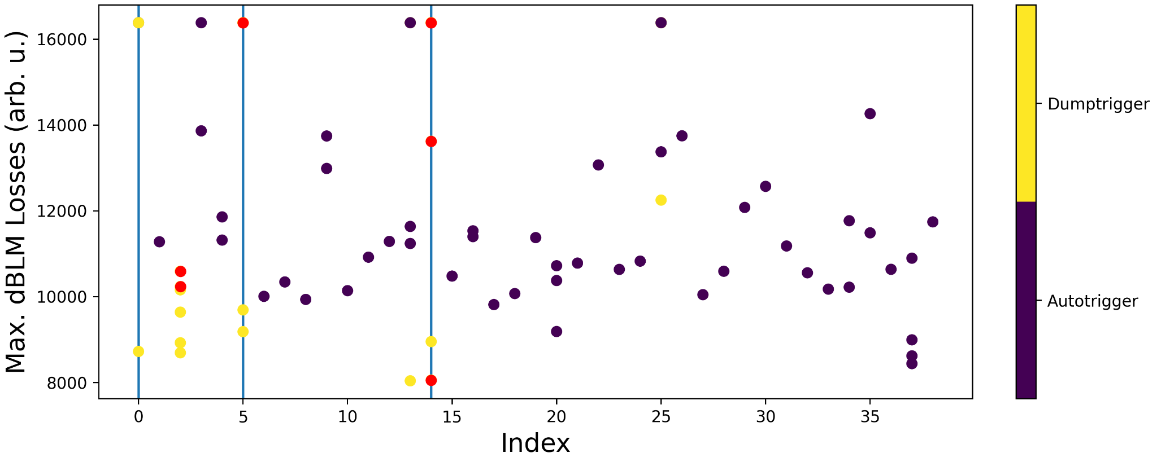
Comparison between max. losses within PM buffer of dump- and autotrigger
Each index shows one UFO event (meaning one index could have up to 6 points for the different devices)
Purple refers to correct Autotriggering
Yellow refers to signals obainded by dump trigger
Red indicate the max. losses of different devices at UFO dumps, where the Autotrigger did not trigger
Y-axis shows the max. of the dBLM losses per device
During the UFO events with beam dumps, some max. losses are caused by dump itself as UFO signal lead to slightly smaller losses than the dump itself

Slide 4
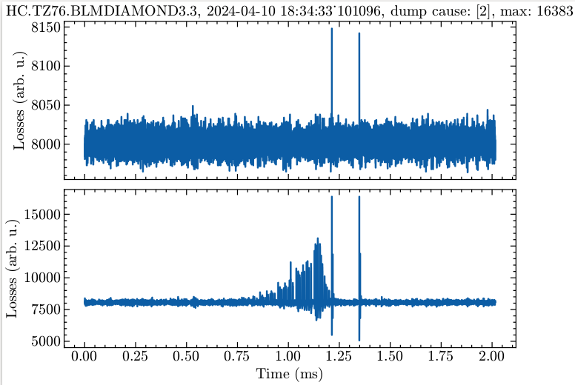
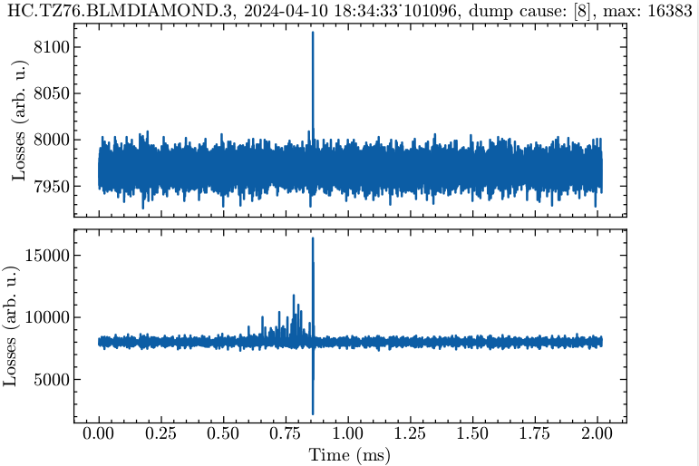
Example: successful vs non-successful Autotrigger (UFO dump 2024-04-10)
Autotrigger successful before beam dump
Signal only obtained by dump trigger

Slide 5
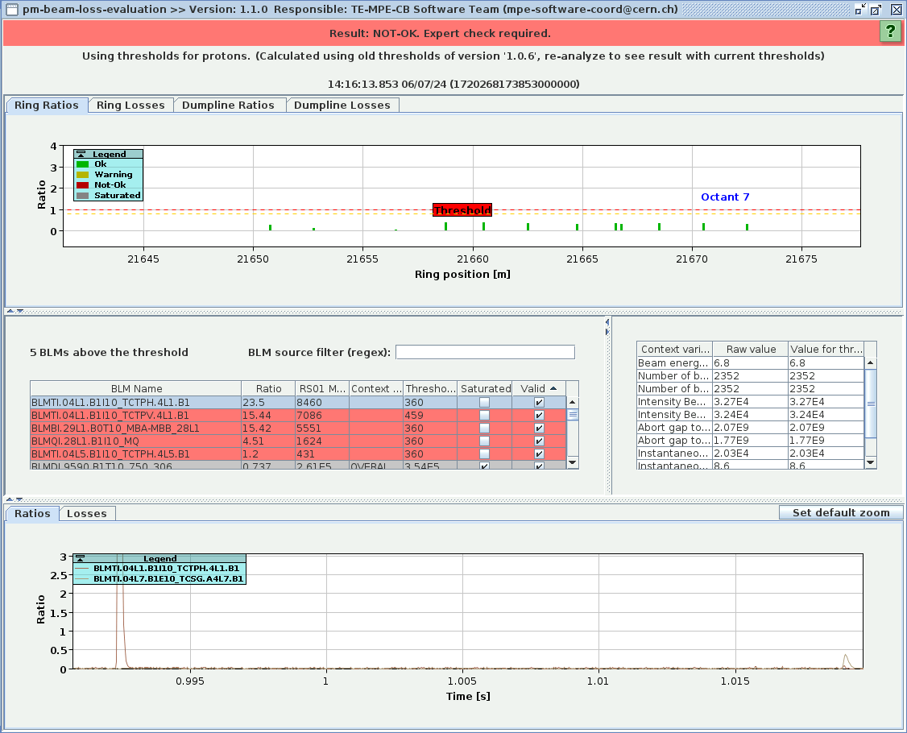
Quench 06/07: Dump losses compared to UFO losses
UFO losses 30 ms before dump losses
No autotrigger, dBLMs show at dump time no UFO losses

Slide 6
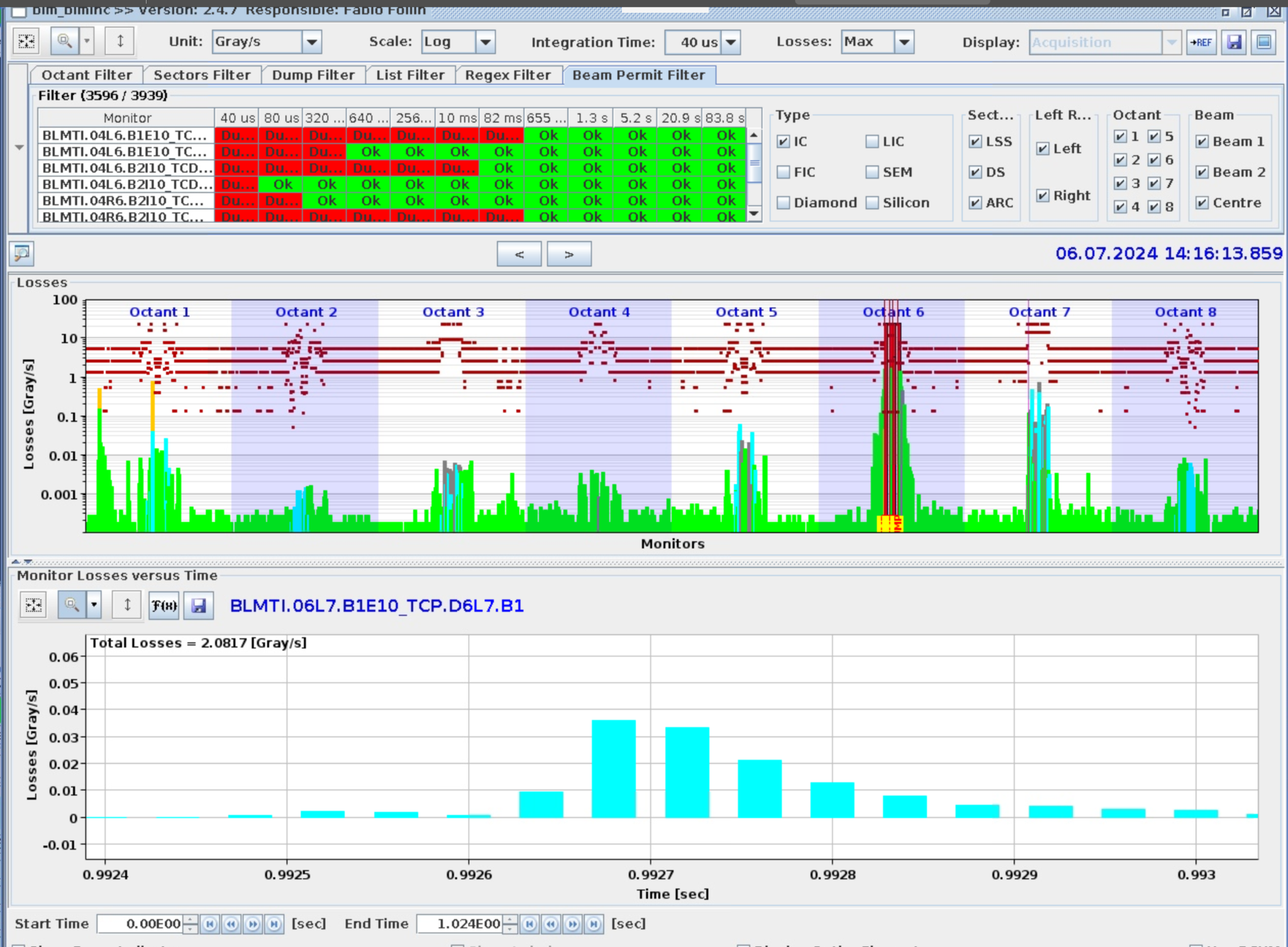
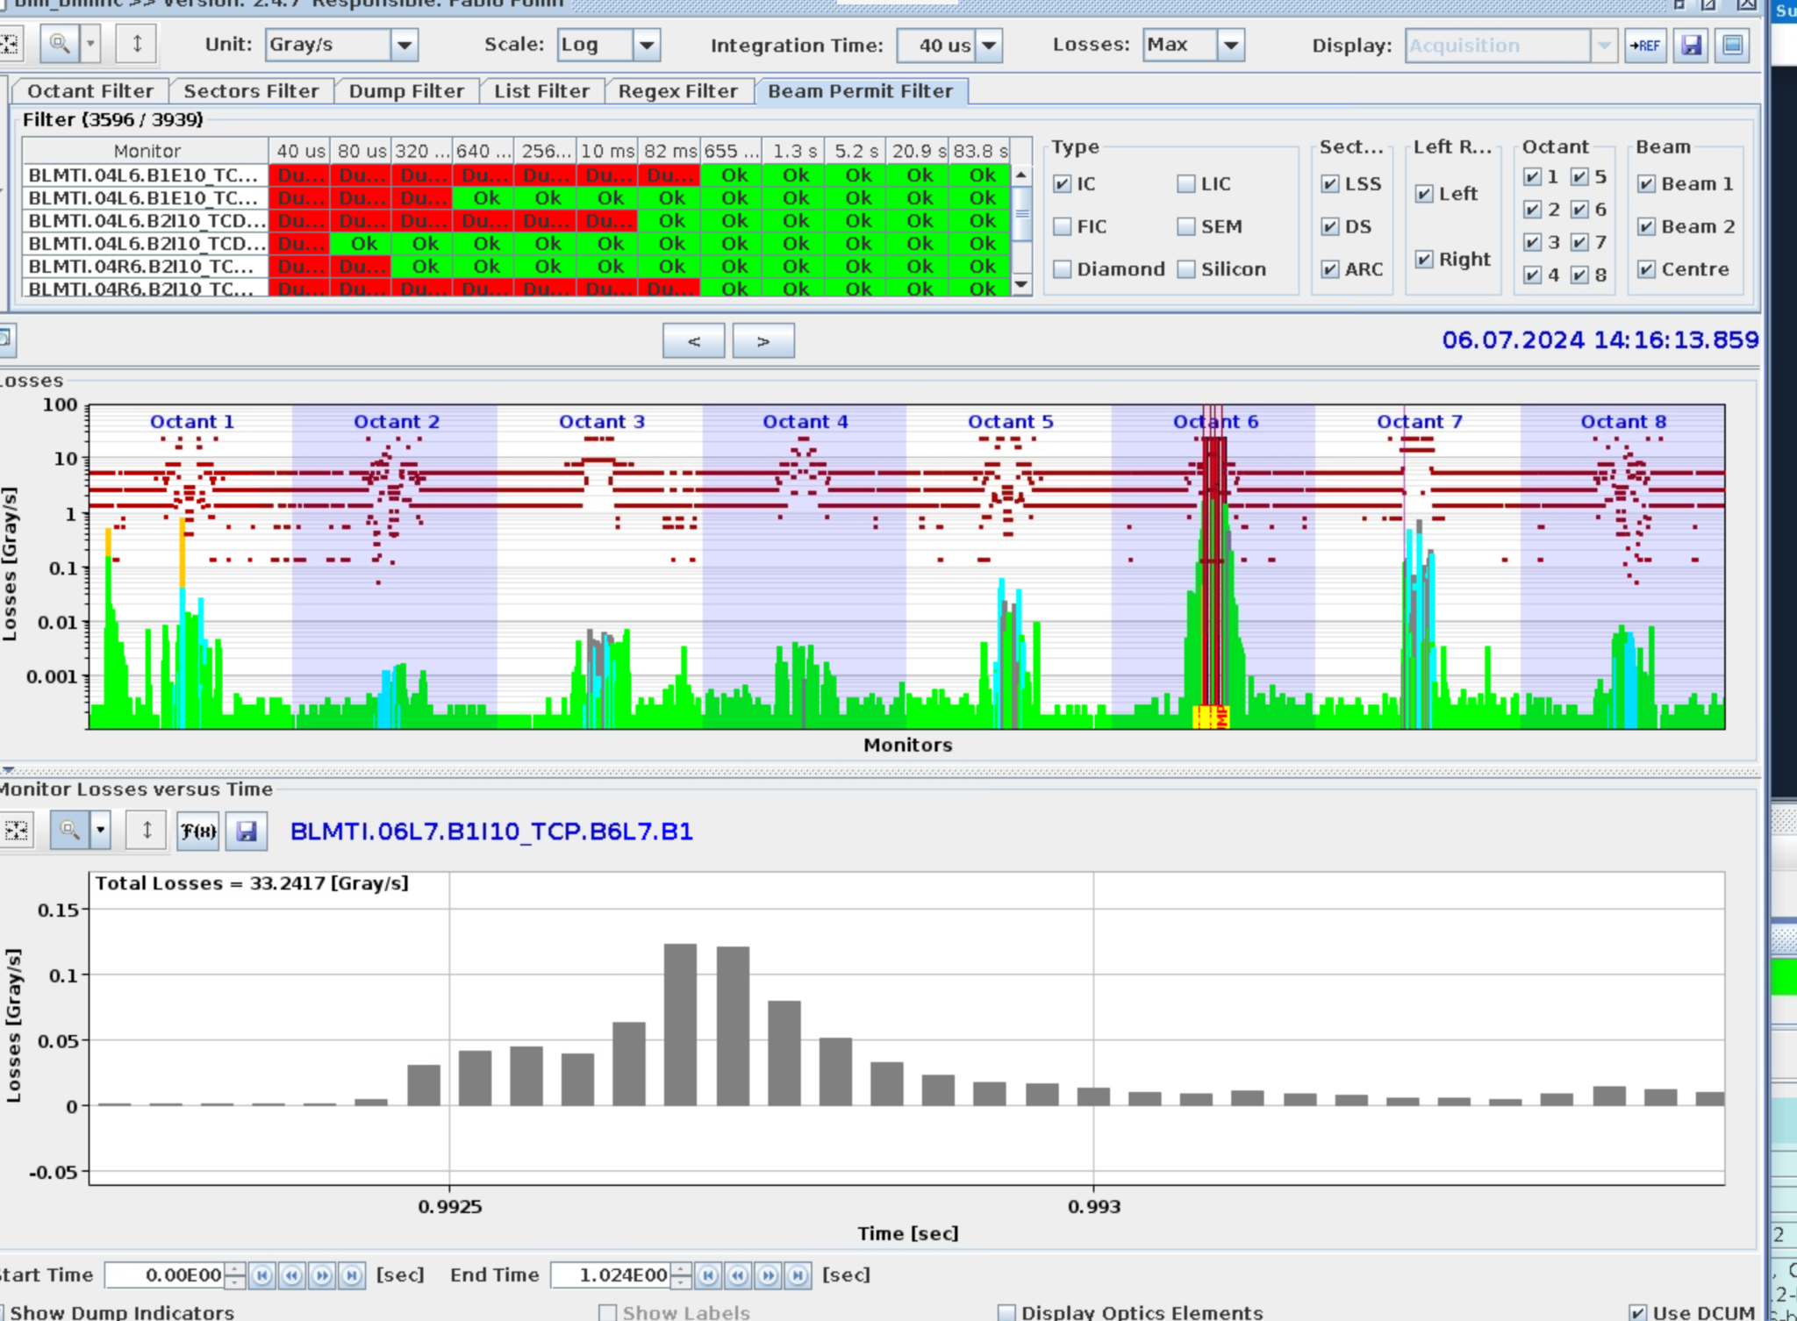
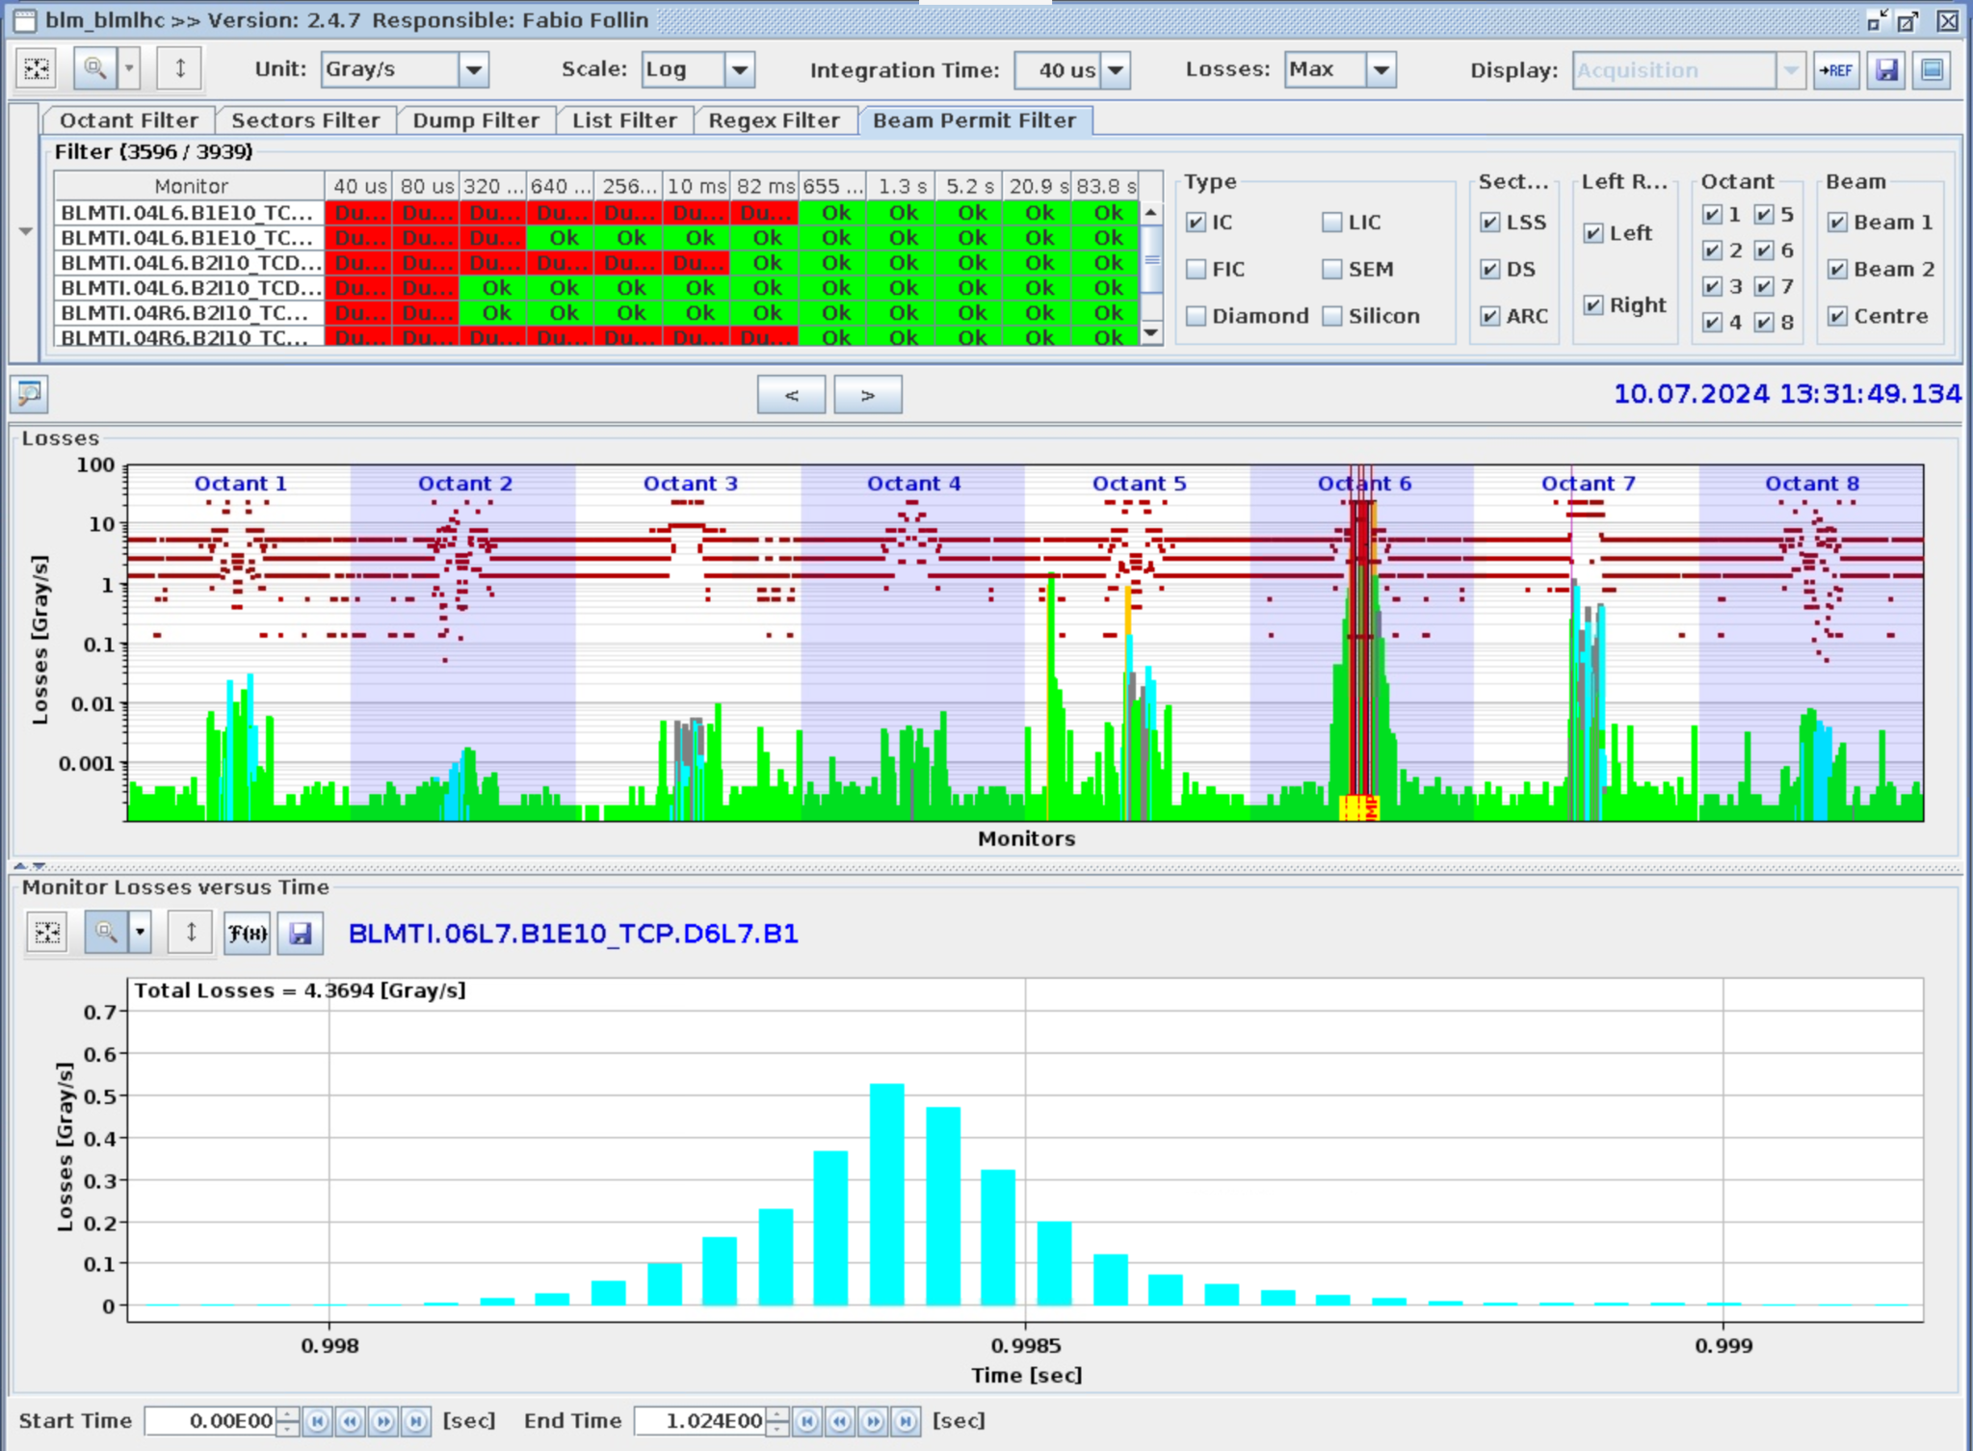
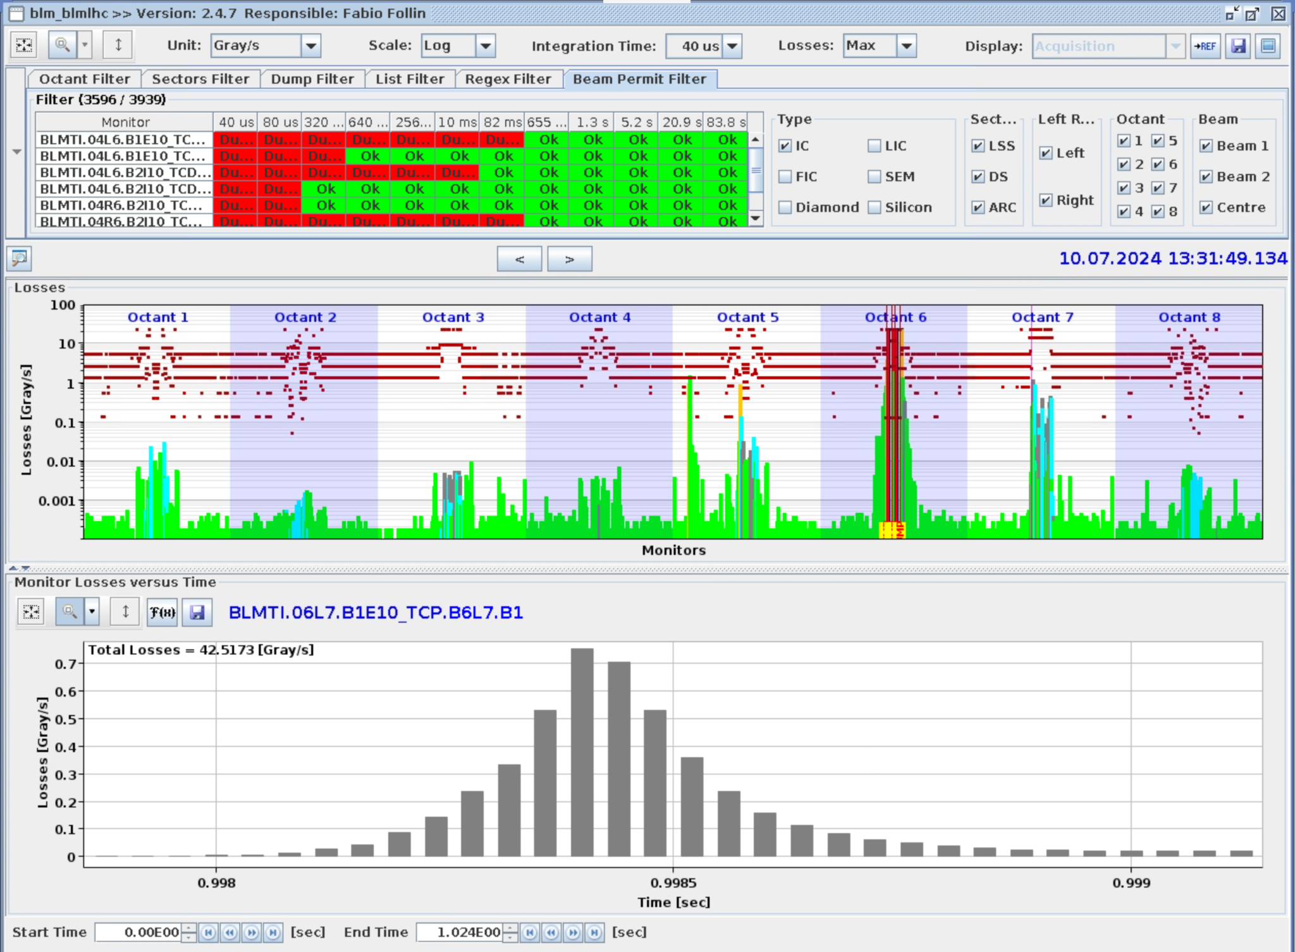
Quench, 06.07 No autotrigger
Quench, 10.07 With autotrigger

Slide 7
Losses at TCP
During quench at 06/07/2024 autotrigger did not trigger
BLM at TCP.D6 has for first quench at 06/07/2024 0.035 Gray/s and for quench at 10/07/2024 0.5 Gray/s
Further downstream at .B6: quench (06/07/2024) losses are ~7 times smaller than during the one from 10/07/2024
Could threshold for minimum losses be reduced?

Slide 8
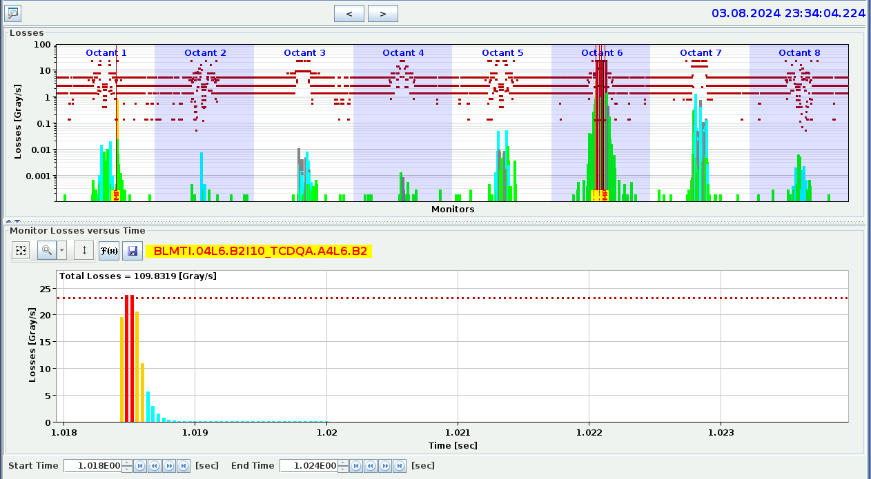
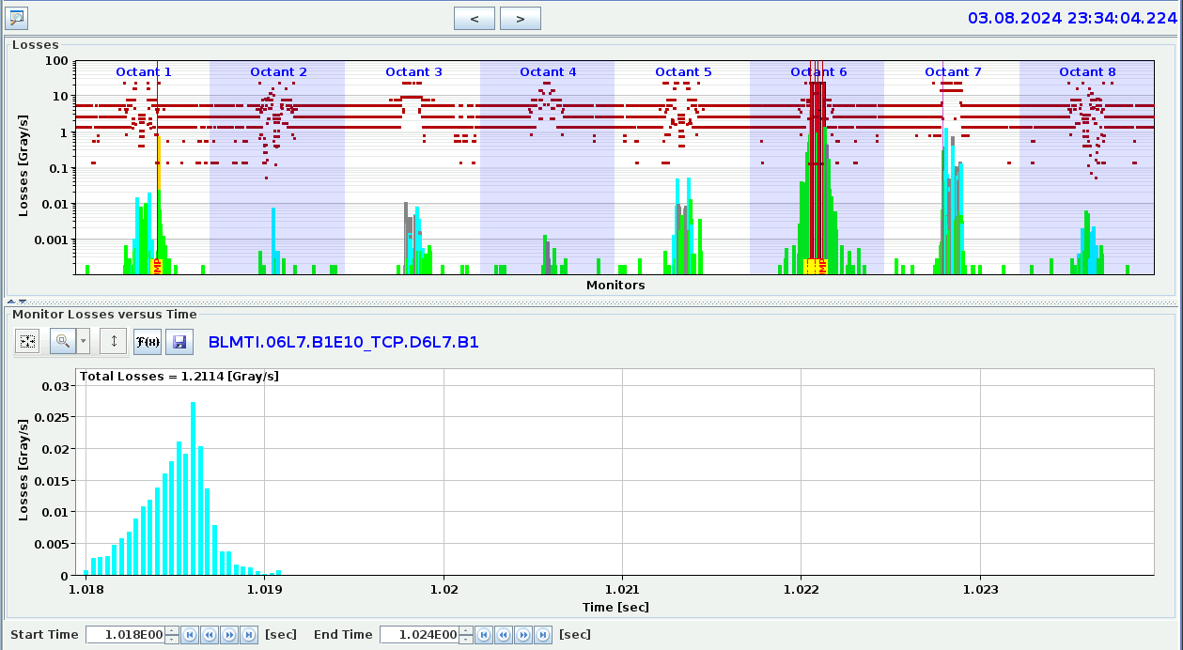
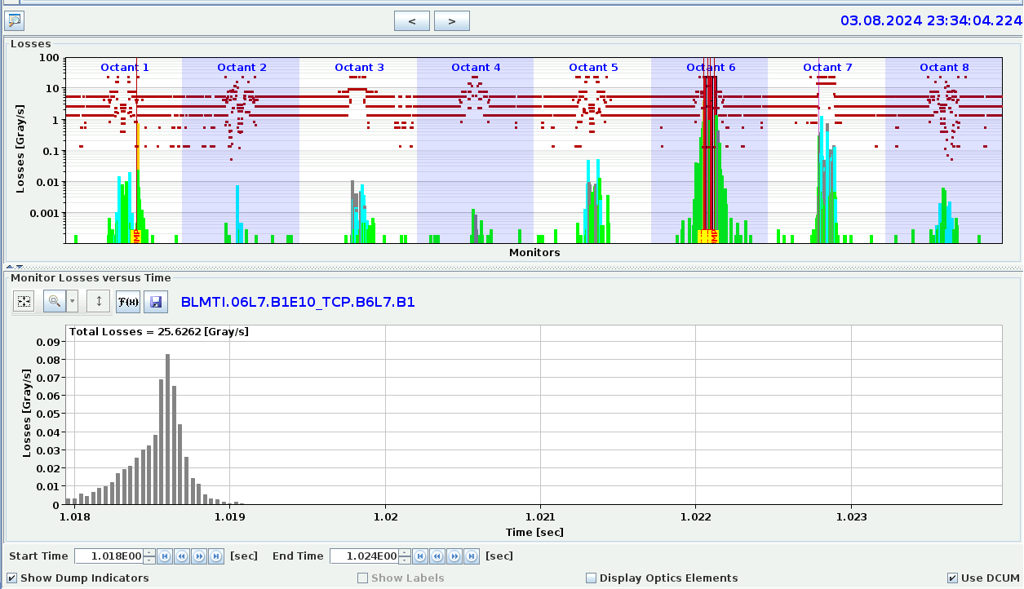
UFO without autotrigger
Losses at TCP.D6 0.025 Gray/s and at B6: 0.08 Gray/s
Beam losses are visible, but factor 10 smaller compared to quench event at 10/07/2024

