Slide 1
Technical Meeting on MQXFB09 Coils:
Introduction
Susana Izquierdo Bermudez, Nicholas Lusa, Penelope Quassolo
06/01/2025

Slide 2
Objective
Summarize manufacturing data and non-conformities for the coils to be assembled in MQXFB09, built using the same procedures as MQXFB03/04/05/06/07/08 coils
Agenda
  Conductor and cable: J. Fleiter, S. Hopkins
  Coil fabrication: N. Lusa
  Coil ordering: E. Ravaioli and S. Izquierdo Bermudez

Slide 3
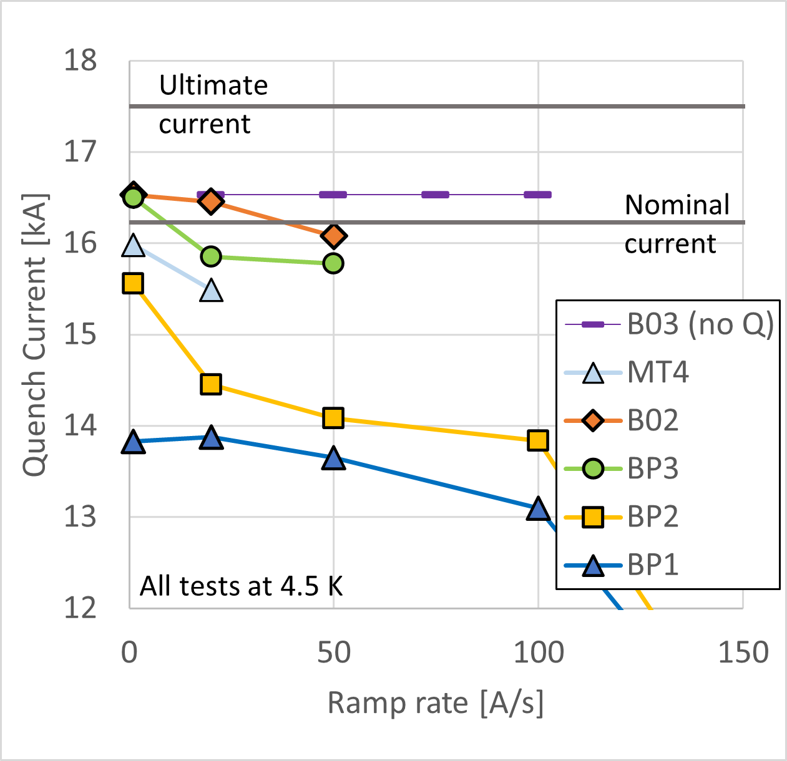
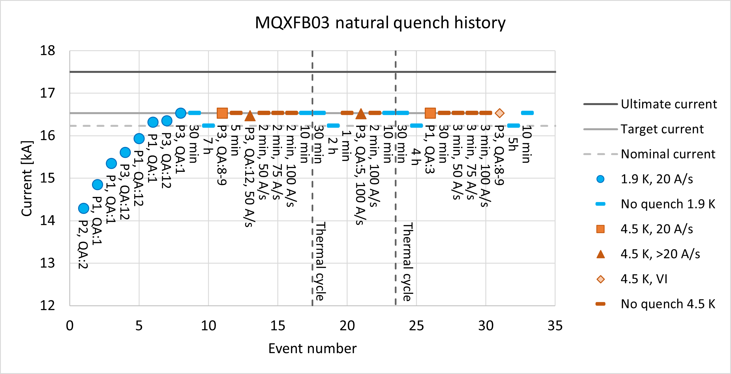
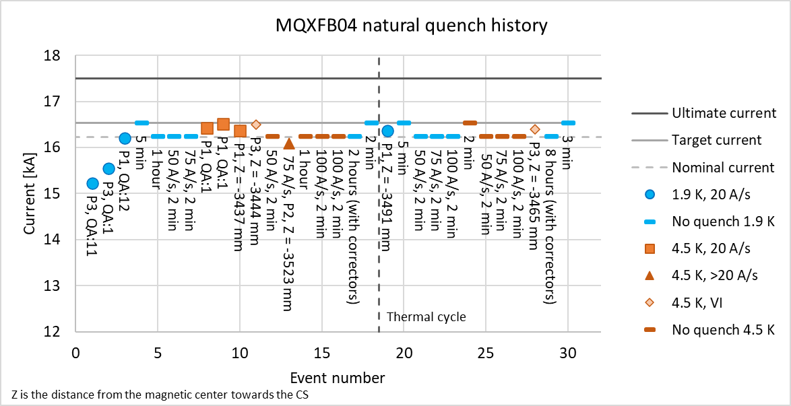
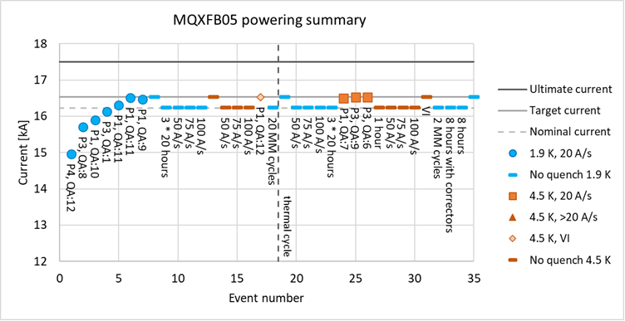
Introduction – MQXFB magnet performance
  MQXFB03 implement a series of features to improve the coils→ no signs of conductor limitation
  MQXFB04 and MQXFB05 confirms the results
  Status of next magnets:
    MQXFB06: test February 2025
    MQXFB07: cold mass assembly done

Slide 4
Main documents –
Acceptance criteria
Acceptance Criteria
Conductor performance | EDMS 2268225
Heat treatment | EDMS 2333499
Impregnation | EDMS 2428078
Coil geometry | EDMS 2496377
Electrical tests | EDMS 2447487
Also see:
  MIP: EDMS 1996152
  Flow Chart: EDMS 1736688

Slide 5
Main fabrication reports
MTF link (FUFs, NCR and all info) | CR152 | CR153 | CR154 | CR155
Conductor performance | 3230327 | 3230332 | 3230333 | 3230334
Cabling | 3093914 | 3123166 | 3230333 | 3230334
Heat treatment | 3177139 | 3180925 | 3203144 | 3212506
Coil geometry | 3194787 | 3203534 | 3224515 | 3231594
Final electrical tests | 3190921 | 3203532 | 3224564 | 3230561

