Slide 1
Status of the use of resources, based on information until M36 (P2)
3rd I.FAST Governing Board meeting
11 April 2025
Cloé Levointurier-Vajda (CERN, I.FAST Coordination Office)

Slide 2
Contents
Current contractual situation
P2 reporting overview
Status of the use of resources in P1+P2 (full costs)
Timeline of EC payments in I.FAST
P2 interim payment calculation – reminder on methodology
P3 reporting and final payment distribution modalities
Concluding messages

Slide 3
Current contractual situation
2 amendments to the Grant Agreement so far: all GB voted decisions are now included in the GA latest legal data.
Project extension granted:
  End date: 31.10.2025 ➔ P3 is extended by 6 months, and the final reporting will take place in Nov-Dec. 2025
See GA Annex 2 for the EU contribution per Beneficiary

Slide 4
P2 reporting overview
End of P2 = end of Y3 = M36 = April 2024
Consortium: Consolidating preparation of P1 report
  Technical part (WP Leaders, I.FAST Management)
  Financial part (Beneficiaries & Partners, I.FAST Management)
P2 report due on 30 June was submitted on 2 July !
EU review meeting mid-July
The EU accepted the revised report Mid-October
CERN proceeded to interim payments to Beneficiaries in Dec. 2024 and to CERN Partners in Jan. 2025

Slide 5
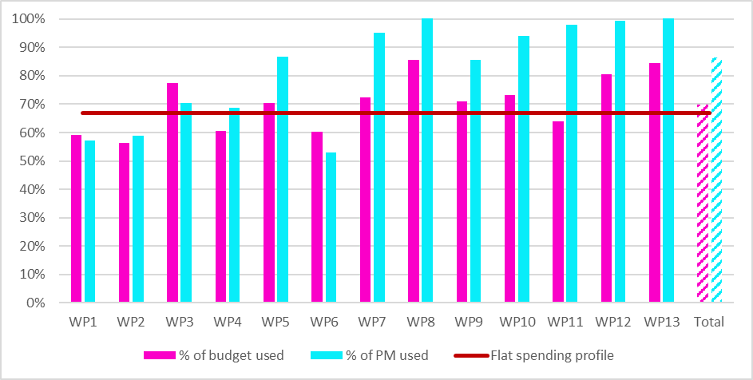
Use of resources in P1+P2
Full costs reporting per Work Package
At the end of Period 2, the participants have used resources for 12,82 M€, which is 70% of the total estimated budget for the 4.5 years of the project.
The reported man-power utilisation amounts to 1,563 PMs, which is 86% of the total estimated person-months.
Flat-spending profile: 36/54 = 67%
WP6: underuse of resources due to
(i) Covid pandemic that has forced to hold
mostly online the 2021 European Advanced
Accelerator Concepts workshop,
and (ii) the change of employer of a key collaborator.
WP8: The activities under WP8 suffered from delay and
difficulties due to withdrawal of two partners.
This requested more resources (+ matching funds from
the partners and + staff effort) than initially planned.
WP13: The WP13 activities have been completed.

Slide 6
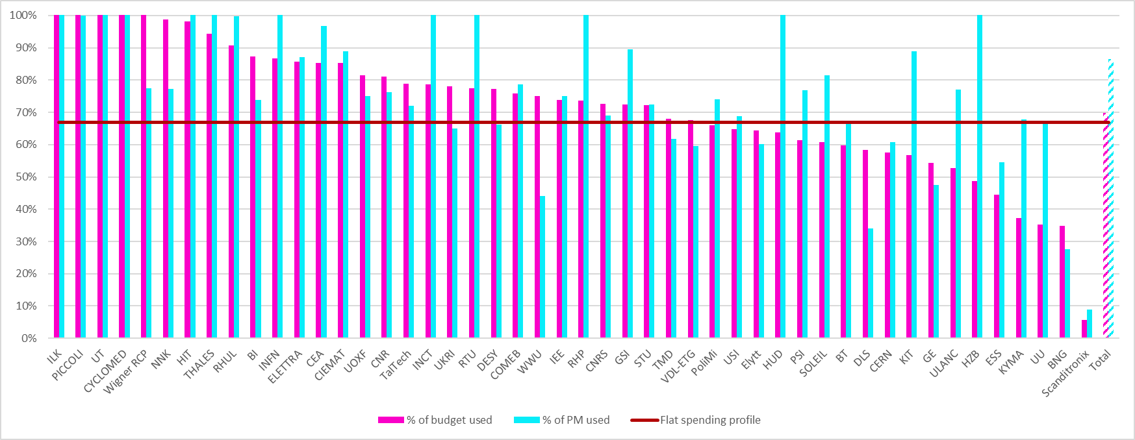
Use of resources in P1+P2
Full costs reporting per Beneficiary

Slide 7
P2 interim payment calculation
Overview: possible scenarios
EXAMPLES | HIT | UU | RTU
Maximum Grant Amont (MGA) | 60,000 € | 372,000 € | 225,500 €
Requested EC contribution in P2 Financial Statement (EC₂) | 0 € | 126,904 € | 92,724 €
Effective payment for P2 | 0 € = EC₂ | 78,730 € = FC₂ x R x 1.25 | 34,373 € = L - PF
Not capped:
The requested EC contribution for P2 will be fully paid, since the 85% ceiling is not reached yet, and sufficient full costs have been declared in the IRUS.
→ 2 beneficiaries (i.e. 4% of our consortium)
Capped due to Funding rate:
The requested EC contribution for P2 will be capped, since the 85% ceiling is not reached yet, but no sufficient matching funds have been used in P2, according to the Funding rate principle.
The amount is not lost, as it is possible to be paid at the balance payment if sufficient matching funds are used during P3.
→ 3 beneficiaries (i.e. 6% of our consortium), but would have been 38 without the 85% ceiling option
Capped due to 85% ceiling:
The requested EC contribution for P2 will be capped, since the 85% ceiling is reached.
The amount is not lost, it will be paid in the balance payment after the end of the project.
→ 43 beneficiaries (i.e. 90% of our consortium)
In all cases, reporting the full costs (EU funds and matching funds) in the IRUS is important to receive the appropriate payment.

Slide 8
Timeline of EC payments in I.FAST
5%
48,3%
30.1%
6.6%
5%
10%
M0
M18
M24
M36
M42
M54
1st Reporting Period
2nd Reporting Period
3rd Reporting Period
Reminder
Full costs budget I.FAST = ~ 19 M€
→ Full costs reporting in IRUS
EC contribution = 10 M€
→ EC costs reporting in FS (EC Portal)
→ all partners contribute with a certain amount of matching funds and the funding rate for the beneficiaries varies between 25% and 75%
Articles 7.1 & 7.3 of the Consortium Agreement:
The financial contribution of the Funding Authority to the Project shall be distributed by the Coordinator according to the Consortium Plan, as set out in Attachment 1A (full costs), Attachment 1B (full costs of Partner Organisations) and Attachment 1C (reduced costs).
Funding of costs included in the Consortium Plan will be paid to Parties after receipt from the Funding Authority in separate instalments as agreed below:
Interim payments after the submission of each financial report in accordance with the reporting procedures as set out in Attachment 5
The sum of pre-financing and interim payments received by any Party shall not exceed 85% of its share of the maximum Funding Authority contribution.

Slide 9
P3 reporting and final payment distribution modalities
P3: 01.05.2024 – 31.10.2025 (18 months)
P3 report (technical and financial) is to be submitted to the EU by the end of December 2025
The approval of the final report from the EC may take a few months, before to lead to the balance payment
The Governing Board will be asked, in 2026, to vote on the modality to distribute the final payment. Three options prepared by I.FAST Management Team are presented in the next slides
May you think any further option should be considered, please contact the Management Team to present this possible additional option (IFAST-PMT@cern.ch)

Slide 10
P3 reporting and final payment distribution modalities
As a first step, the final payment calculation will be capped to the Maximum Grant Amount of each Beneficiary, or to the beneficiary’s total Requested EU funding, whichever amount is the lowest.
This may lead to an «undistributed» amount, and I.FAST Management Team suggests to consider the following three options for the distribution of this amount:
Option 1: pro-rata increase based on the full costs reported through the IRUS files
Option 2: pro-rata increase based on the requested EU contribution reported through the Financial Statements
Option 3: no redistribution, but a common pot for next project (if the proposal is accepted for funding) to increase the next Innovation Fund
NB: for options 1 & 2, a lower limit would be fixed in order to avoid payments of unsignificant amounts, and a upper limit would be fixed in order to avoid too high discrepancies

Slide 11
Concluding messages
Many thanks to all scientific & financial contacts for their support in the P2 report preparation & answers to reviewers & PO’s questions
The very last GB financial decisions (taken today, if any, and in the last GB meetings to come) will not be implemented in the Grant Agreement annexes, but will apply for the calculation of the final payment
For the final financial reporting, in order to receive the due final payment, we strongly encourage all beneficiaries to include the full costs in the IRUS file, and to avoid underclaiming eligible costs in the Financial Statement

Slide 12
Many thanks for your attention
Any questions?

