Slide 1
Report from the Coordinator
M. Vretenar, 2025 I.FAST Governing Board Meeting
Krakow, 11 April 2023

Slide 2
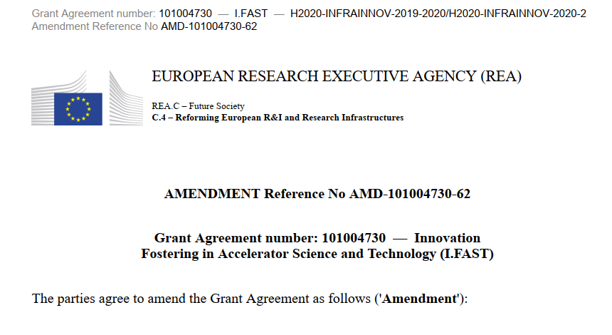
Report on the last 12 months
Periodic Report 2 (October 2022 – April 2024) submitted on 30 June 2024, 162 pages.
Project review by the EC on 15 July. Periodic report approved; interim payment received on 15 October.
Letter asking for an extension of the project by 6 months for “force majeure” events (Covid, increase of material costs and delays, loss of key personnel) sent on 25 October, with rescheduling of major deliverables. Formal Amendment request started soon afterwards, with many updates.
Long and exhausting negotiations with the Project Officer from REA for corrections and additional details requested. Exceptional work by Cloé and positive attitude by the PO, Sotirios Kakarantzas.
Amendment (with extension) approved on 12 December.

Slide 3
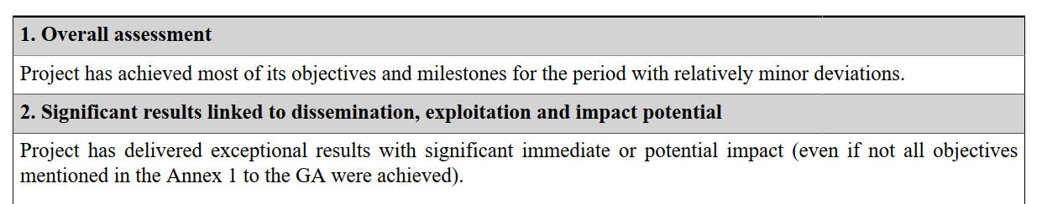
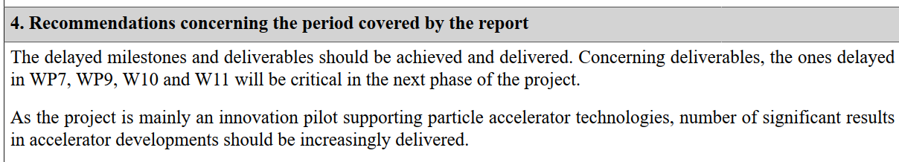
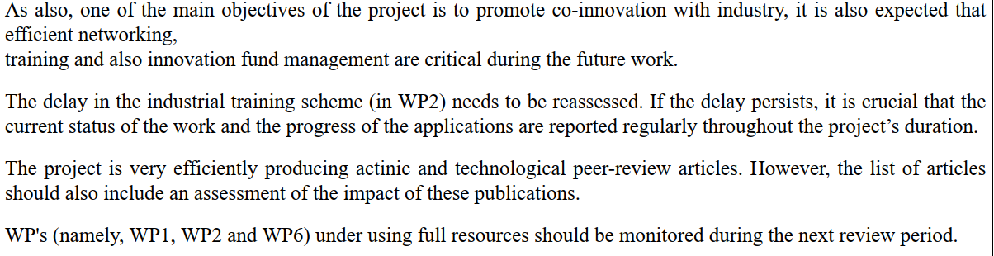
2nd Periodic Review – project assessment

Slide 4
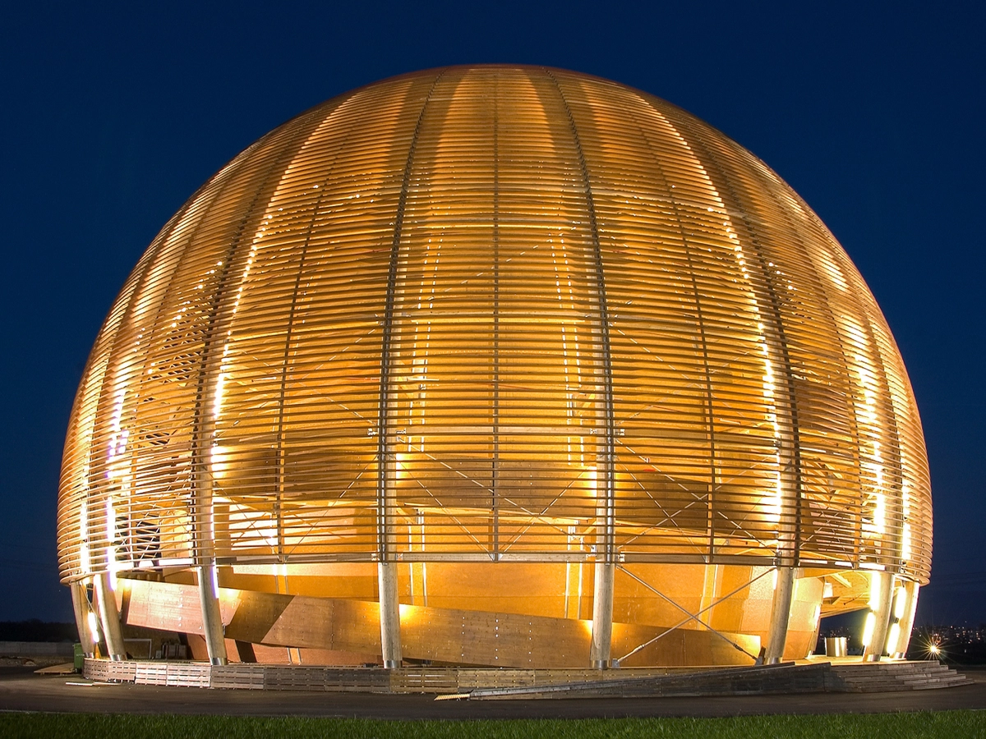

Last steps to go before the end
End of Project 31 October 2025.
Final Report to be delivered by 31 December 2025.
Final I.FAST meeting Tuesday 21 – Wednesday 22 October at the CERN Globe.
Final Governing Board Meeting in March 2026.
Last payment (final instalment, 15%) around June 2026.
Procedure for Final Report (period 01.05.2024 – 31.10.2025)
September 2025: Task Leaders receive a template to be filled in.
End of October 2025: deadline for sending the Task contributions.
15 November 2025: deadline for WP Coordinators to send WP chapters.
End of November: complete document sent to WP Coordinators for approval.
15 December: Report ready for submission.

Slide 5
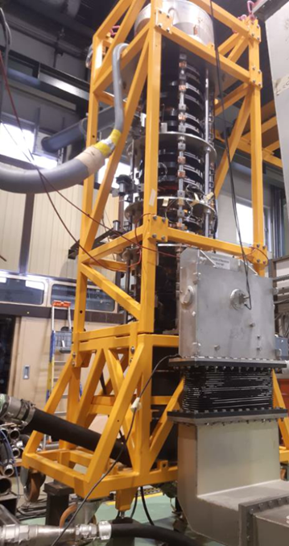
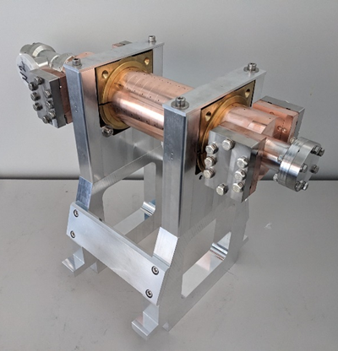
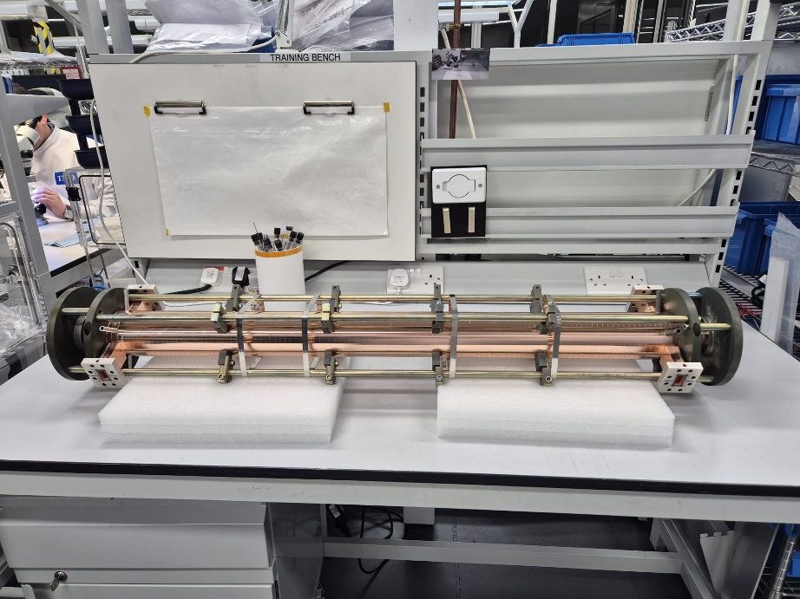
Scientific highlights 2024/25
A selection of key deliverables in 2025/24:
Beam windows prototypes (4.3)
Machine learning at ESS (10.5)
Thin films roadmap (9.1)
Klystron prototype (11.2)
Test of 2 RF guns (7.4)
Roadmap for future accelerators (5.2)
Sustainable accelerators report (11.1)
Ripple mitigation for slow extraction (5.3)
+ brazing of the first X-band structure

Slide 6
12 Deliverables to the end…
 |  |  | Resp. | M old | M new | Due | Status
1 | D7.5 | Construction of the XLS accelerating structure pre-prototype | ELETTRA | 24 | 44 | 31/12/24 | End March
2 | D5.1 | International collaboration plans towards a multi-TeV muon collider | INFN | 46 | 46 | 28/02/25 | in work
3 | D9.3 | First 6 GHz cavity coated and characterised | UKRI | 36 | 50 | 30/06/25 | Delayed M50
4 | D9.5 | 1.3 GHz Nb-coated cavity irradiated by laser in argon atmosphere and RF tested | RTU | 45 | 46 | 28/02/25 | waiting for cavity
5 | D11.3 | Prototype adjustable PM quadrupole and combined function magnets | UKRI | 28 | 46 | 28/02/25 | waiting for magnet
6 | D7.1 | Final report on the development of high brightness electron beams for light sources | DESY | 48 | 48 | 30/04/25
7 | D9.2 | RF test on coated resonant cavity | INFN | 46 | 50 | 30/06/25
8 | D7.6 | Construction of the XLS accelerating structure full prototype | ELETTRA | 36 | 50 | 30/06/25
9 | D8.4 | Construction of combined CCT demonstrator | INFN | 42 | 50 | 30/06/25
10 | D7.3 | Longitudinally variable bend prototype fabrication | CERN | 40 | 51 | 31/07/25
11 | D2.3 | Industrial training scheme | UU | 24 | 52 | 31/08/25
12 | D8.5 | Construction of HTS CCT demonstrator | INFN | 38 | 54 | 31/10/25
Please report during the presentations on the status of these deliverables,
In particular the 4 that are late (Elettra, INFN, RTU, UKRI)

Slide 7
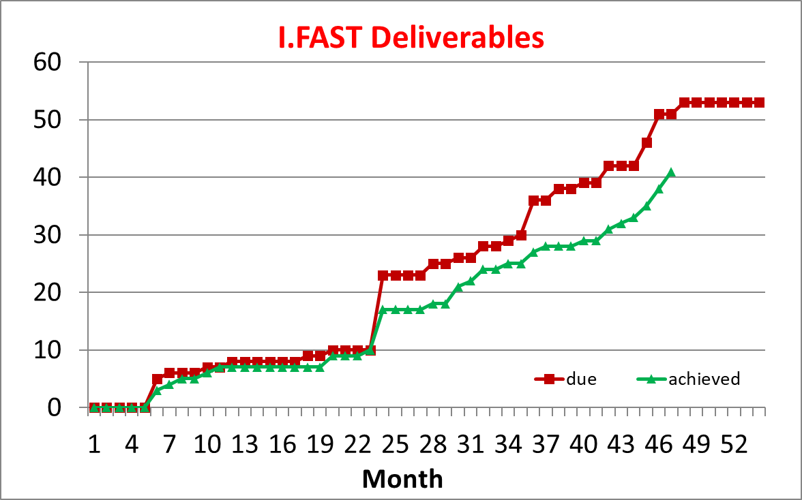
Status of Deliverables
On the positive side: good progress in the last months.
On the negative side: quality of some deliverables is going down (people have less time to write…)

Slide 8
Status of critical prototypes
XLS accelerating structures: brazing in December successful, still some leaks to repair.
Coating and laser treatment of cavities delayed because of copper procurement.
Magnet for prototype PM system being delivered.
Longitudinally variable dipole prototype in construction.
Two magnet demonstrators in construction.

Slide 9
Changes in management
T. Torims (deputy coordinator, WP10 coordinator) joined CERN from 1 April 2025.
Coordination of WP10: A. Ratkus (RTU), deputy M. Vedani (POLIMI).
Previous changes (2024): F. Carra (CERN) replaced M. Losasso (CERN) as coordinator of WP4, M. Ferrario (INFN) replaced R. Assmann as Coordinator of WP6.

Slide 10
Financial issues
Please refer to Cloé’s talk.
I did not receive requests for modification in the budget distribution for this meeting (I vaguely remember of an old minor pending issue – costs for a workshop – but I could not find track of it).
However, even if a modification is voted today, it will have effect only in June 2026 at the time of the final redistribution → the vote can be done at the next and last Board meeting in March 2026.
Instead, it is important to profit of this Board meeting to start the discussion on the criteria for unused budget redistribution, an important decision that we will have to vote in March 2026 – see Cloé’s presentation.

Slide 11

Thank you for your attention
This project has received funding from the European Union’s Horizon 2020 Research and Innovation programme under GA No 101004730.

