Slide 2
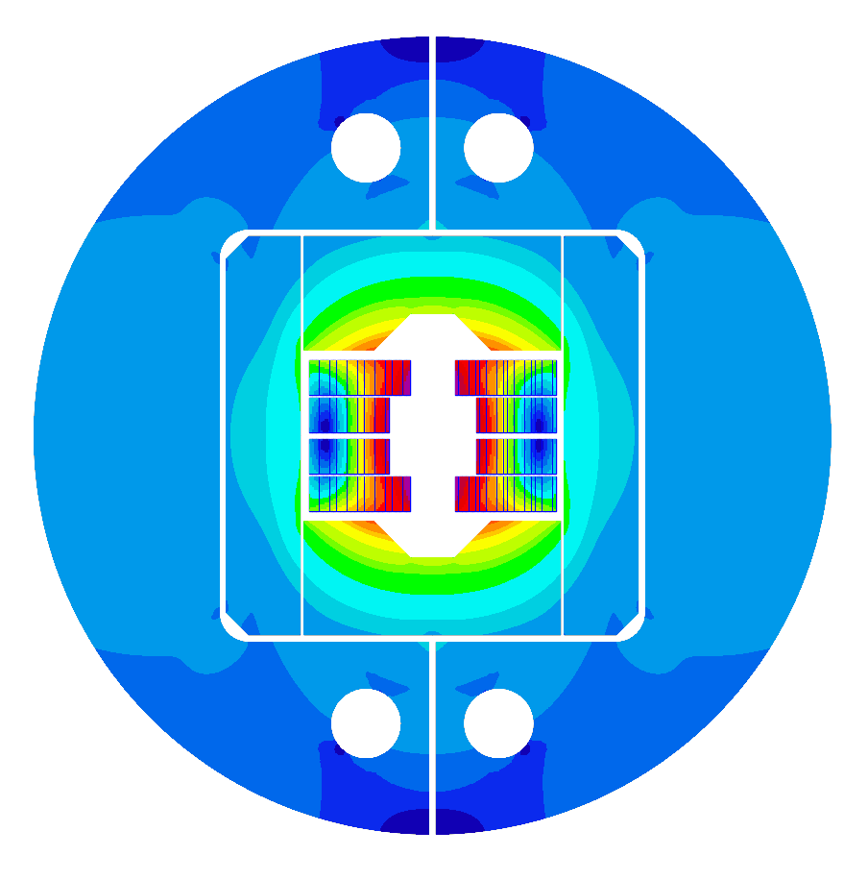
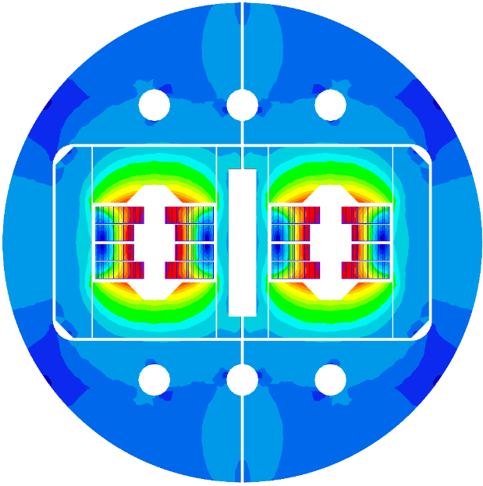
WP3.5
Nb₃Sn 14 T Block dipole BOND
HFM Annual Meeting 2025
J. C. Pérez, N. Bourcey, E. Fernandez, J. Ferradas, A. Haziot, N. Lusa, S. Izquierdo, N. Peray and E. Todesco
https://indico.cern.ch/event/1471305/

Slide 3
Table of contents
Scope of the Work Package 3.5
14 T BOND design
Overview on manufacturing tooling
Overview on manufacturing mock-ups
Cooling strategies
eRMC & RMM activities update
14 T BOND development plan & schedule
Summary

Slide 4
Table of contents
Scope of the Work Package 3.5
14 T BOND design
Overview on manufacturing tooling
Overview on manufacturing mock-ups
Cooling strategies
eRMC & RMM activities update
14 T BOND development plan & schedule
Summary

Slide 5
Scope of the Work Package
WP3.5: Nb₃Sn 14 T Block dipole BOND
Demonstrate Nb₃Sn performance in a 14 T block-type dipole at 1.9 K.
Design and construction of a 14 T accelerator quality dipole model magnet.
  The short model magnet should reach 15-15.5 T field.
Explore alternatives and develop design and technology for Nb₃Sn accelerator dipoles.
REVIEW

Slide 6
Table of contents
Scope of the Work Package 3.5
14 T BOND design
Overview on manufacturing tooling
Overview on manufacturing mock-ups
Cooling strategies
eRMC & RMM activities update
14 T BOND development plan & schedule
Summary

Slide 7
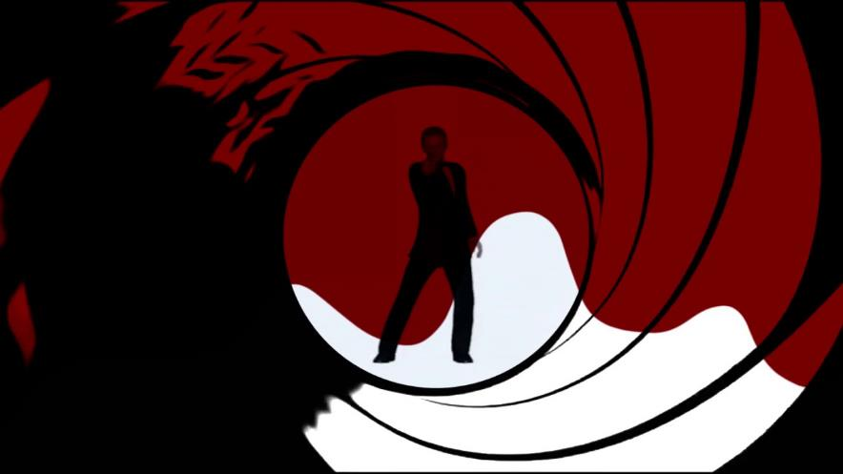
14 T Block dipole BOND
BOND
BlOck-type Nb₃Sn Dipole

Slide 8
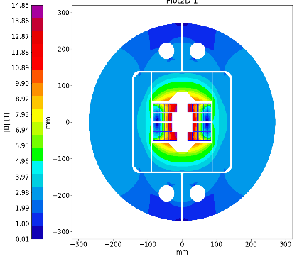
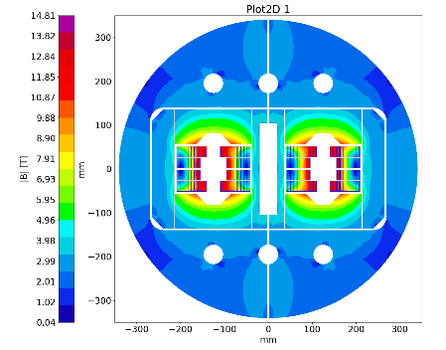
14 T Block dipole BOND
Slide 7 & 8 will be merged
BOND stands for BlOck coil Nb₃Sn Dipole

Slide 9
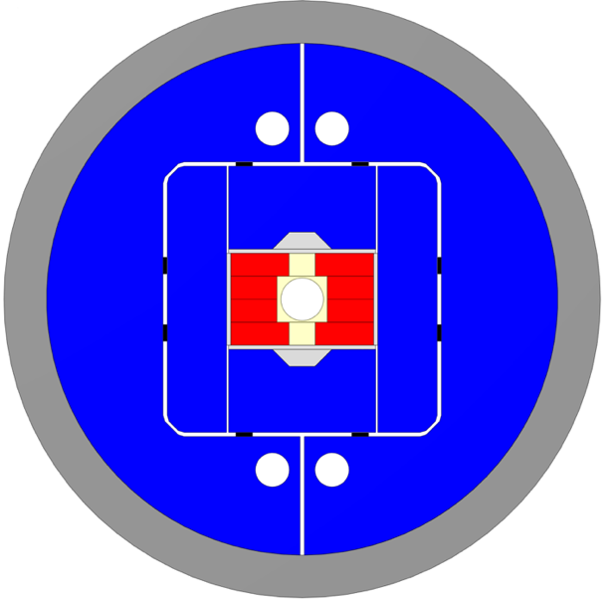
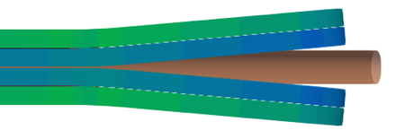
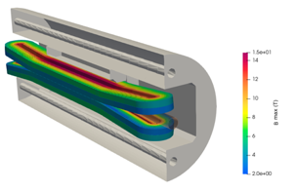
14 T Block dipole BOND
Design requirements:
14 T bore field with ≈ 20 % load line margin
(1.9 K using HFM specs).
Protection time margin*¹ > 40 ms.
Aperture = 50 mm.
Eq. coil width*² < 60 mm → “accelerator coil size”.
Field quality within 10 units at all current levels (excluding PC effects).
Magnet OD:
  Double aperture, inter-beam distance: 250 mm.
  Cold mass OD: 800 mm and Magnet OD: 760 mm.
  For the 1 in 1, we will scale down.
Coil
Vertical pad
Al shell
Horizontal pad
Key
Ti post
Iron yoke
Courtesy of A. Haziot, J. Ferradas & E. Fernandez

Slide 10

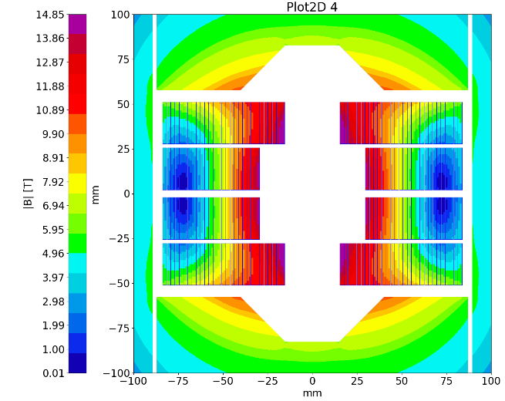
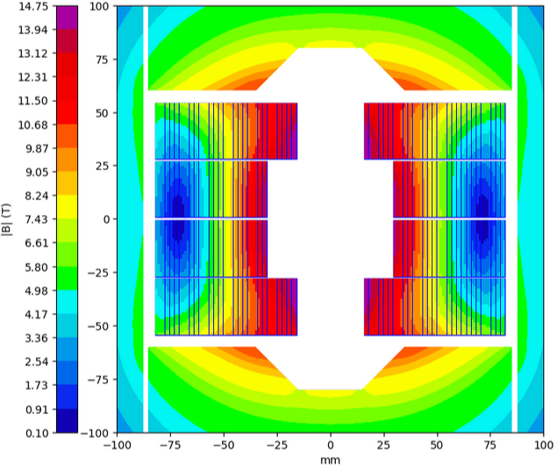
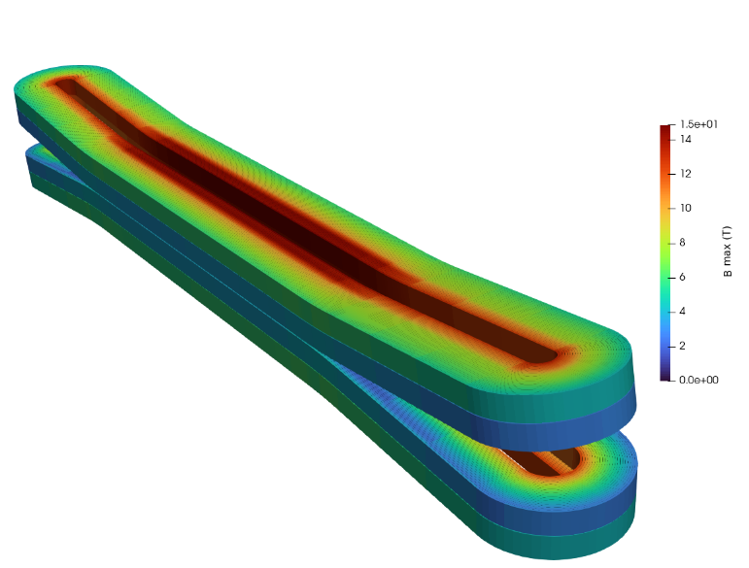
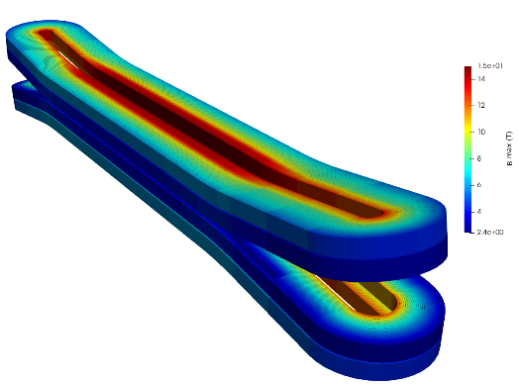
14 T Block dipole BOND
A first BOND conceptual design (2024) was investigated accounting for the use of a large cable made of 44 strands of 1.1 mm diameter. The cable would be the same as the Test Facility Dipole (TFD), manufactured at LBNL since the strand number exceeds the current capability of CERN’s Rutherford cabling machine.
Check / comment on baseline change
In parallel, a second design based on a 40 strands cable (which can be manufactured at CERN) was also considered and initially kept as an alternative.
BOND – 40 strands cable
BOND – 44 strands cable
In December 2024, a decision was made to change the baseline for BOND design and proceed with the 40 strands (1.1 mm diam.) option, allowing for the internalization of the cable production.

Slide 11
40 strands cable design

Slide 12
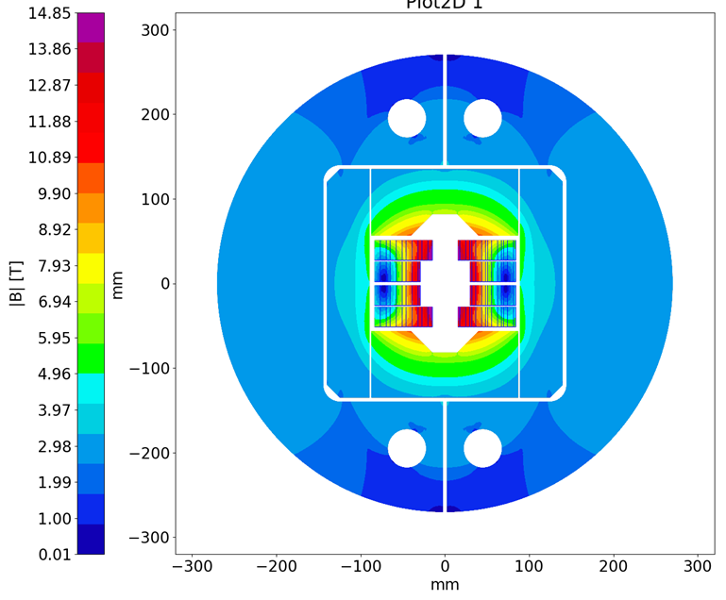

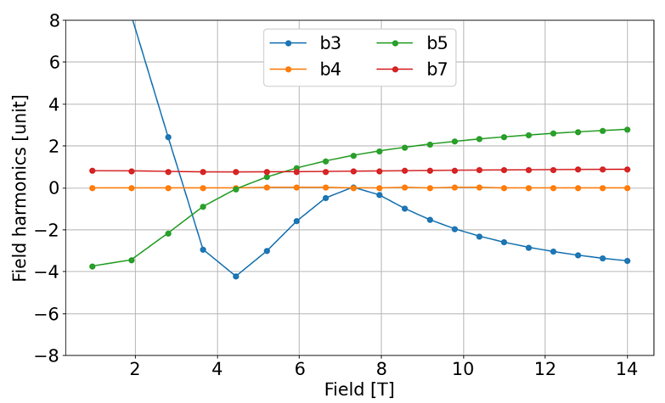
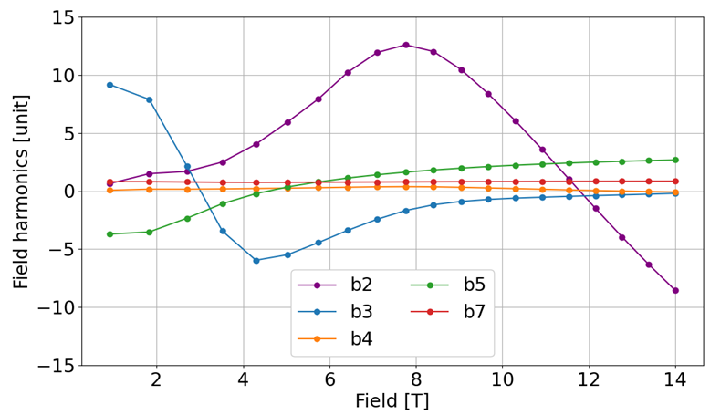
14 T Block dipole BOND – 40 strands cable
The 2D & 3D electromagnetic design for the single aperture configuration was completed in January 2025.
Magnet |  | Single | Double
Aperture | [mm] | 50 | 50
Intra-beam distance | [mm] | - | 250
Yoke diameter | [mm] | 540 | 680
Shell diameter | [mm] | 640 | 780
Nominal current | [kA] | 20.005 | 19.340
J overall | [A/mm2] | 360 | 348
J strand (eng.) | [A/mm2] | 526 | 509
Nominal field | [T] | 14.00 | 14.00
Peak field | [T] | 14.85 | 14.81
Ap. to peak field ratio | [%] | 6.0 | 5.7
Load line fraction @1.9 K | [%] | 82.7 | 81.7
Load line fraction @4.2 K | [%] | 92.6 | 91.2
Temperature margin | [K] | 3.99 | 4.11
Inductance | [mH/m] | 4.72 | 10.24
Stored energy | [MJ/m] | 1.031 | 2.064
Coil |  | Single | Double
No. of turns per pole |  | 52
Insulated cable surface | [mm²] | 11572
Equivalent coil width | [mm] | 53.4
Coil efficiency *¹ | [T.mm/A] | 0.00073 | 0.00075

Slide 13
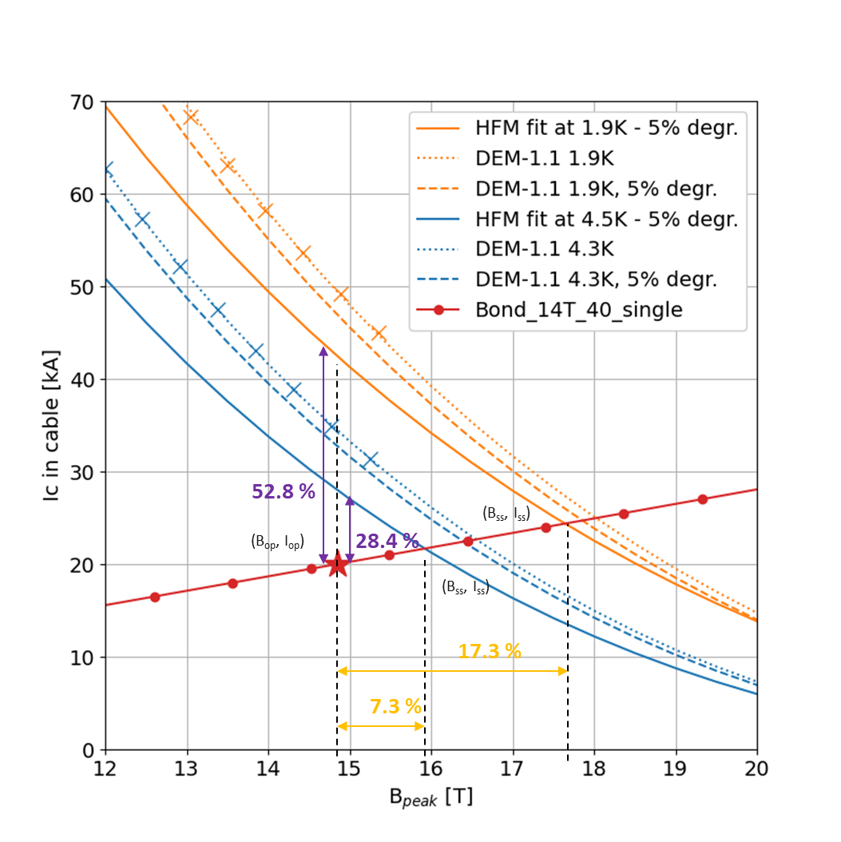
14 T Block dipole BOND – 40 strands cable
Loadline and critical surface margins for single and double aperture designs

Slide 14
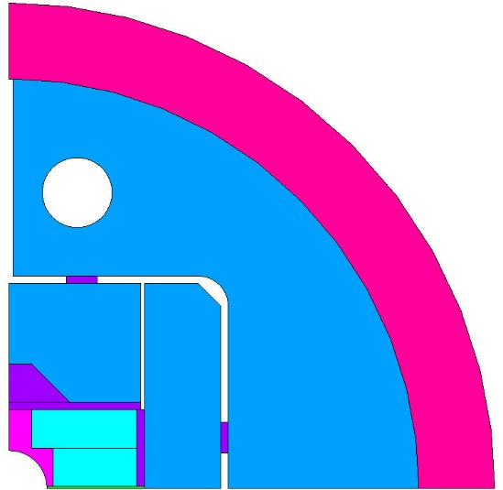
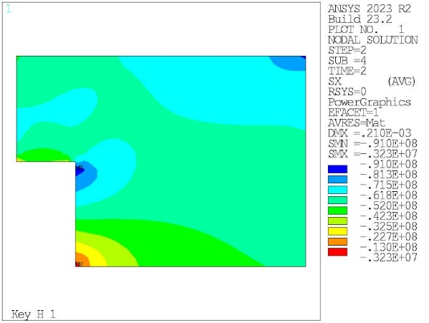
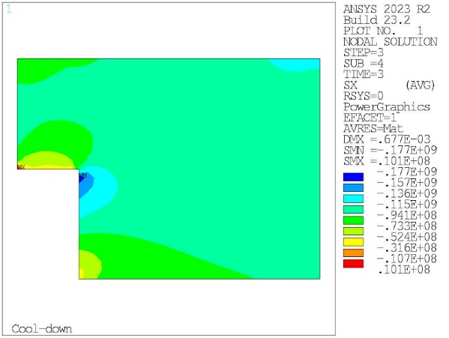
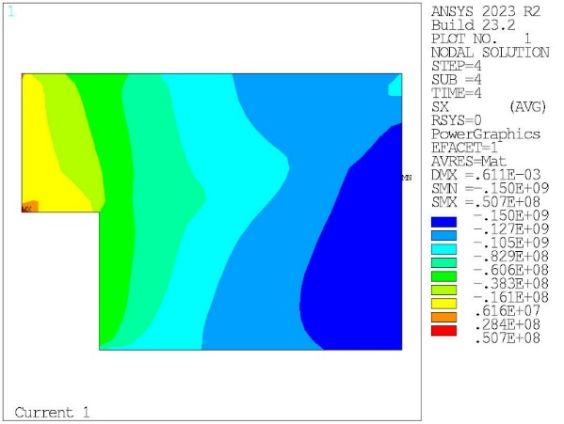
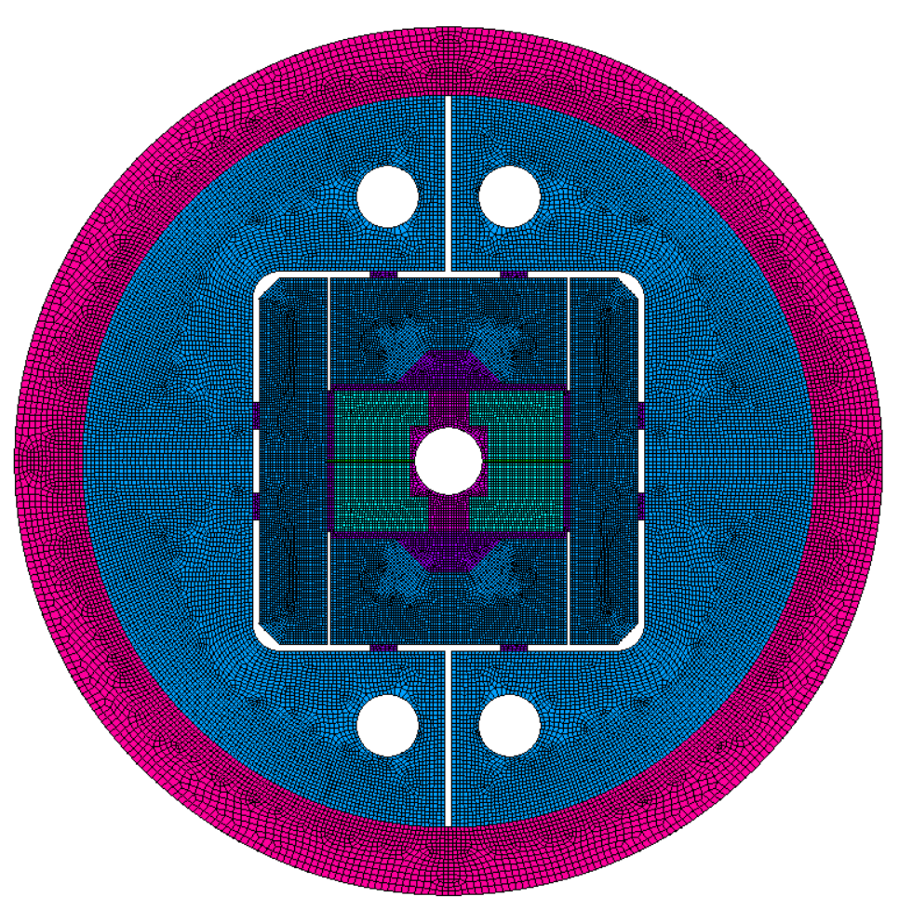
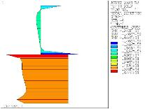
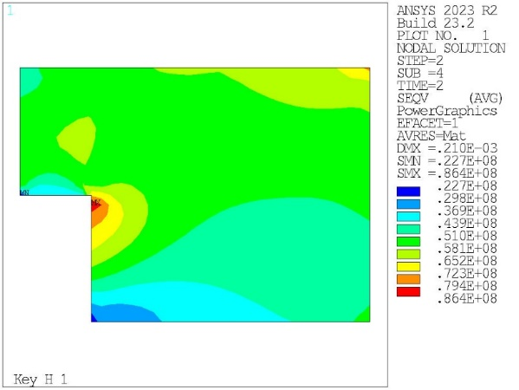
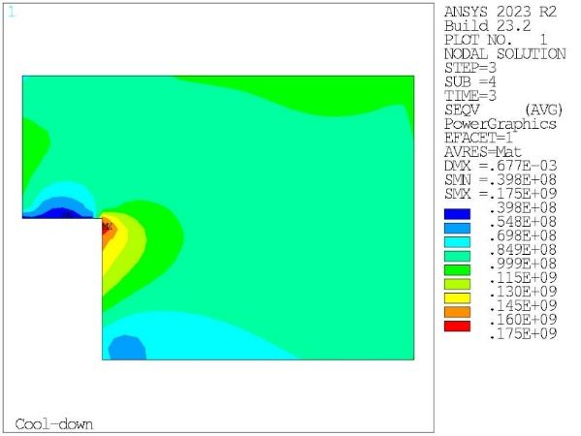
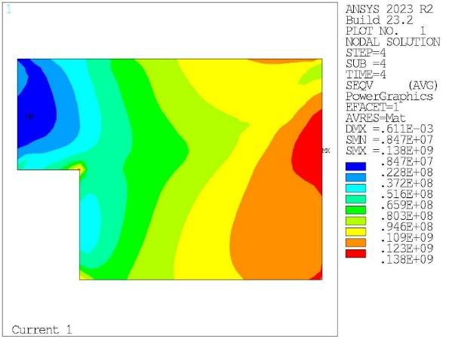
14 T Block dipole BOND – 40 strands cable
Peak at RT = 91 MPa
Peak at CD = 177 MPa
Peak at 14 T = 150 MPa
X-component of stress (MPa) during assembly (left), cool down (centre), and at 14 T (right).
Coil to pole contact pressure at 14 T
Peak at RT = 86 MPa
Peak at CD = 175 MPa
Peak at 14 T = 140 MPa
Von Mises stresses (MPa) during assembly (left), cool down (centre), and at 14 T (right).
Magnet structure designed with enough margin to operate at 15.5 T.

Slide 15
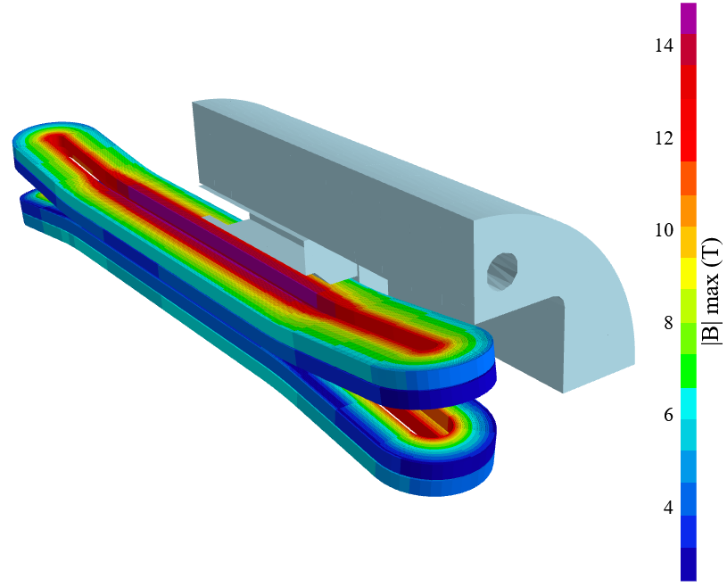
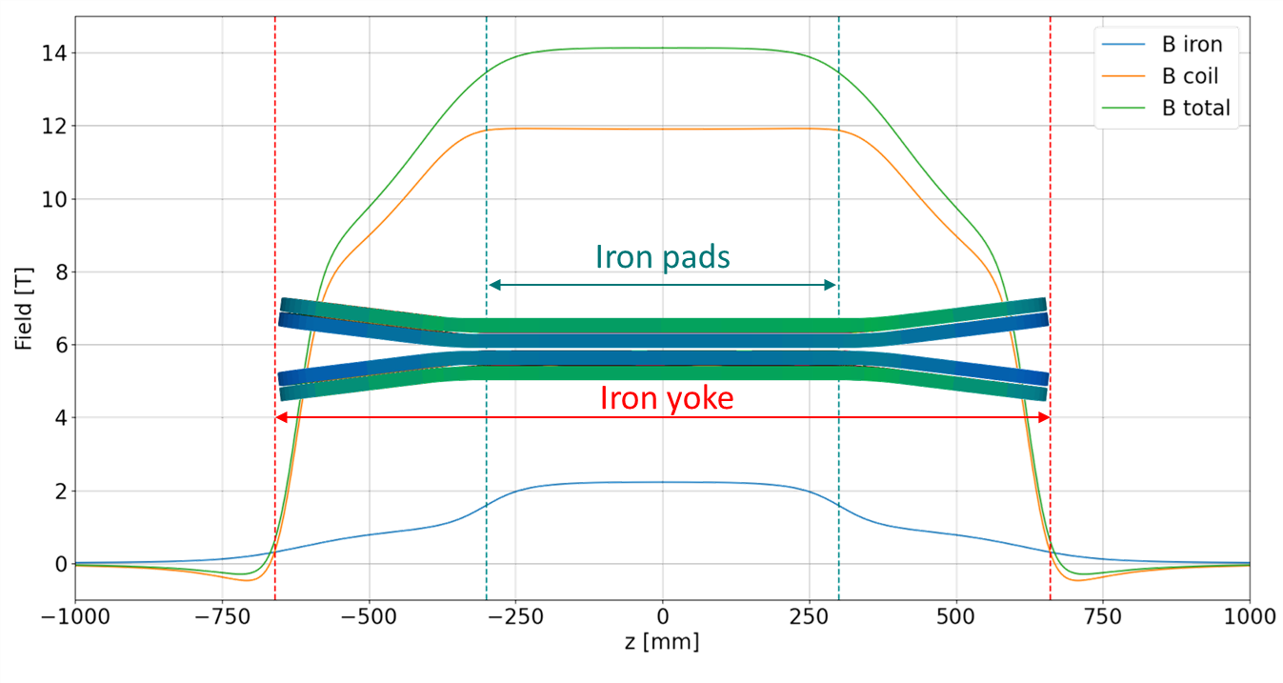
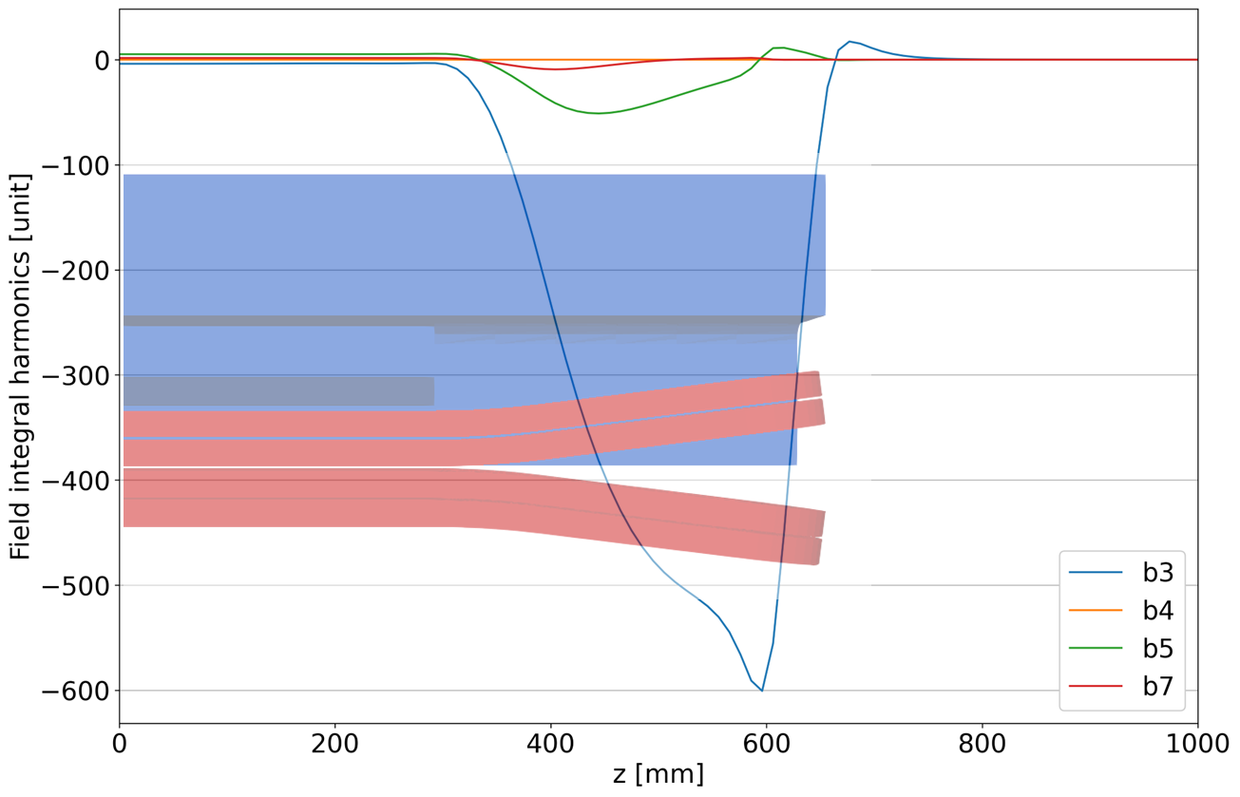
14 T Block dipole BOND – 40 strands cable
Flared end curvature radius | mm | 750
Flared end angle | º | 7
Flared end straight section | mm | 178.4

Slide 16
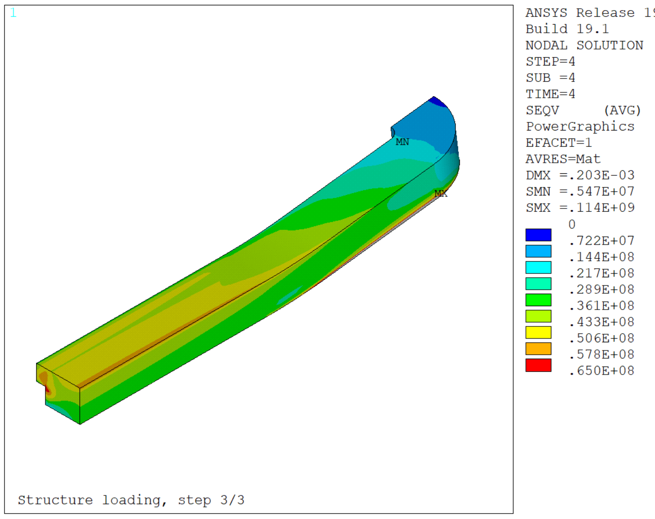
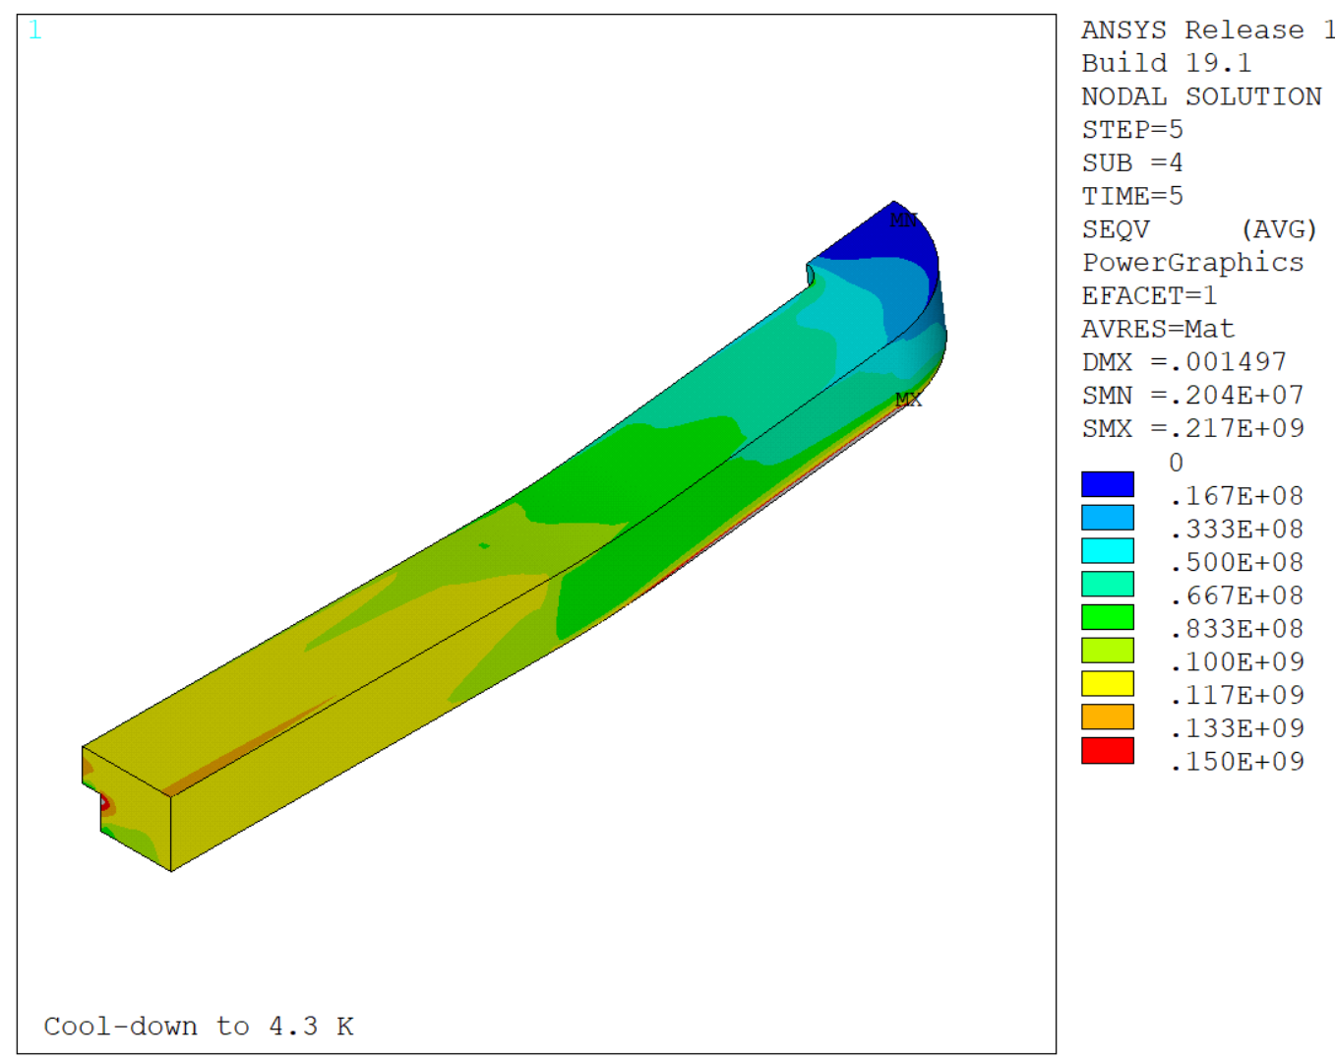
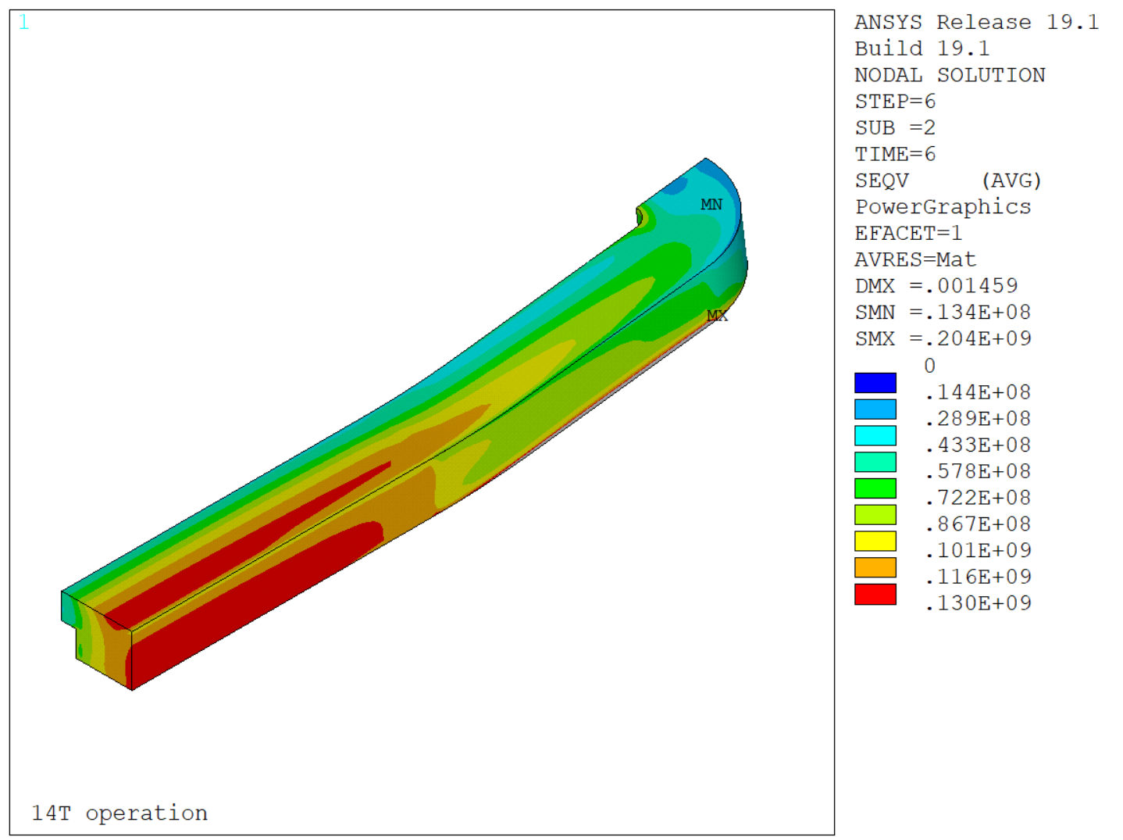
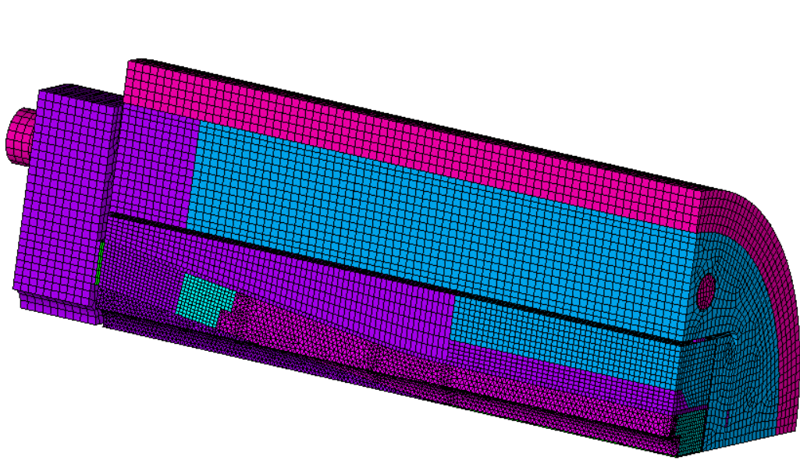
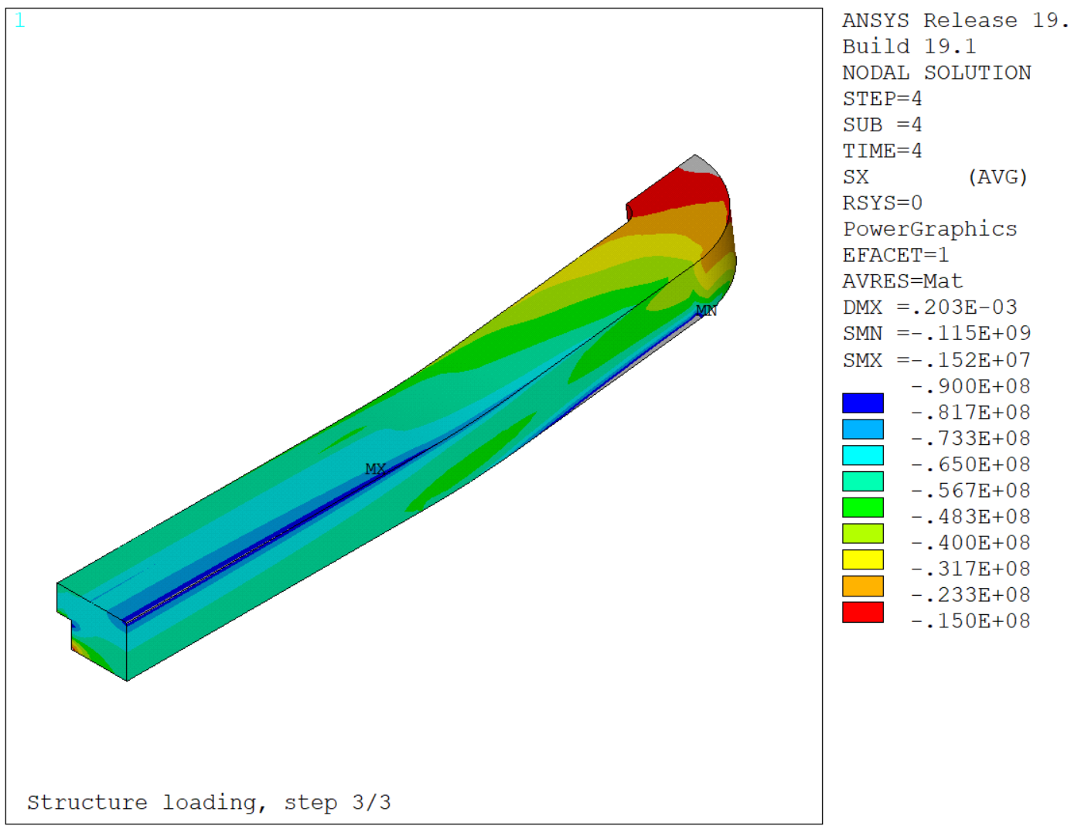
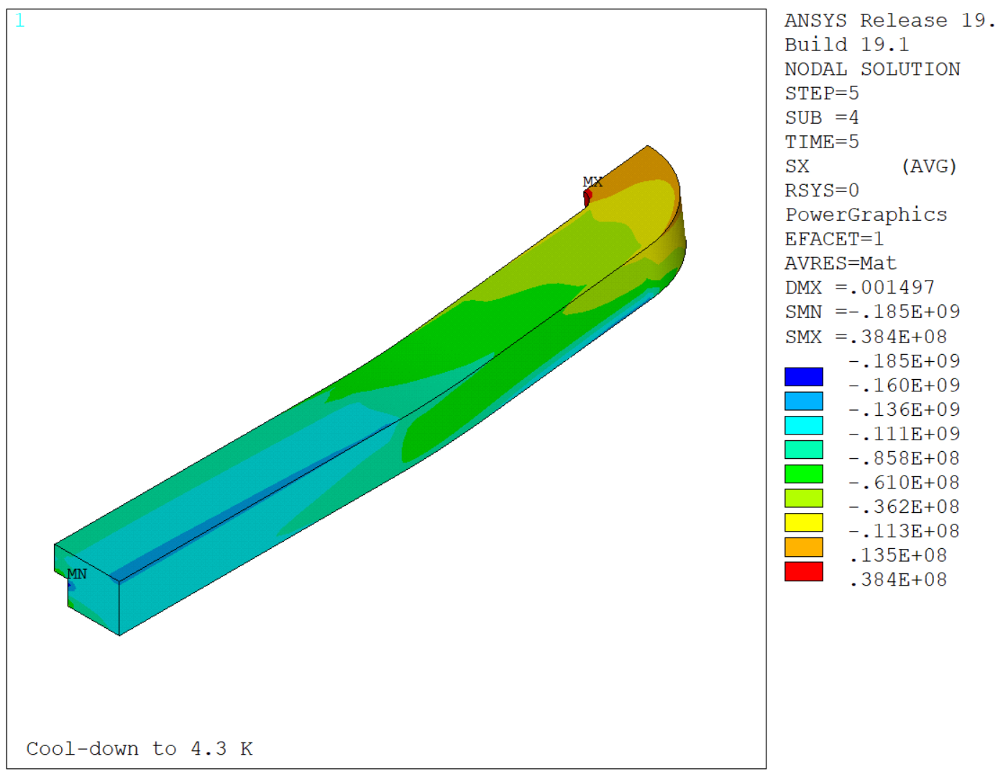
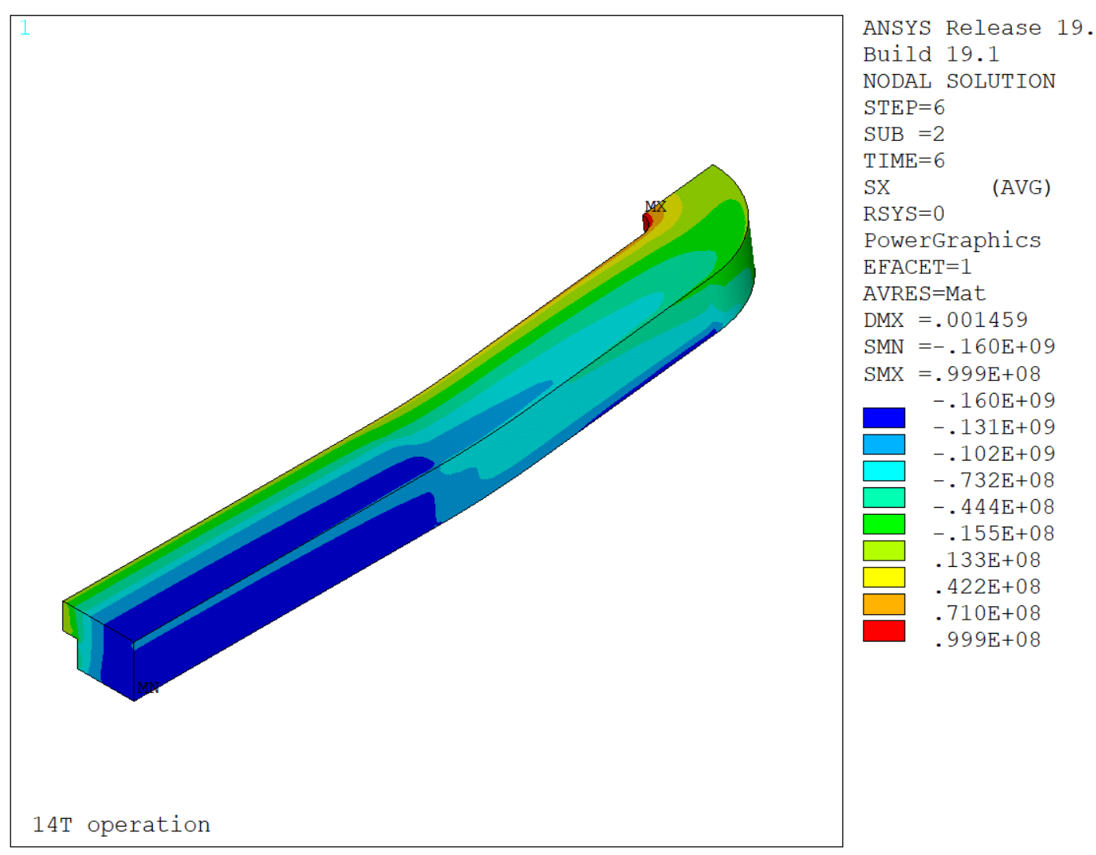
14 T Block dipole BOND – 40 strands cable
*Final design of the endplate missing, simulations account for a very thick endplate for the moment.

Slide 17
Table of contents
Scope of the Work Package 3.5
14 T BOND design
Overview on manufacturing tooling
Overview on manufacturing mock-ups
Cooling strategies
eRMC & RMM activities update
14 T BOND development plan & schedule
Summary

Slide 18
Tooling design
From Nicolas
2 or 2.5 months for finishing 3D tooling Winding/Splicing/Reaction – End April
Then we need to add some time for drawing preparation:
  1 month per tooling

Slide 19
Table of contents
Scope of the Work Package 3.5
14 T BOND design
Overview on manufacturing tooling
Overview on manufacturing mock-ups
Cooling strategies
eRMC & RMM activities update
14 T BOND development plan & schedule
Summary

Slide 20
Mock-ups
From Nicholas
General delays for pieces:
  2 weeks for offers
  8 weeks after contract signed
Ti-bar mock-up:
  April ready for test (best scenario)
  May ready for test (in case we need to heat treat everything)
Coil mock-up:
  End of February for the model and drawings
  Beginning March + 10 weeks = End May / beginning of June for tests on coil mock-ups

Slide 21
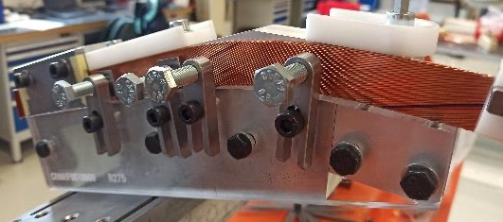
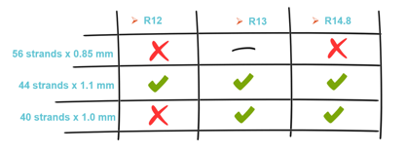
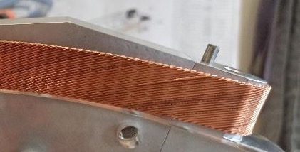
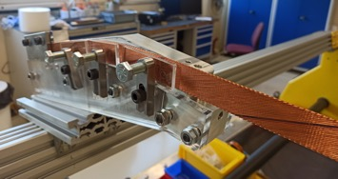
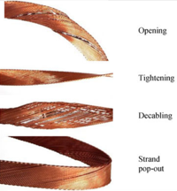
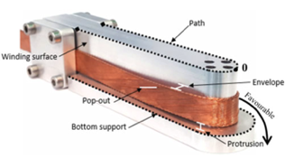
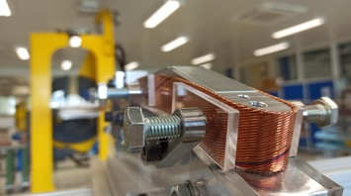
Winding tests at CERN
44 strands x 1.1 mm
Initial tests performed
Final tests
  Easy-way bending tests
  Experimental validation and consolidation of the new baseline
  Additional winding test to explore the impact of the winding tension.
    R_{easy-way} = 12 mm
    R_{easy-way} = 13 mm
    R_{easy-way} = 14.8 mm
    For our baseline cable architecture (44 strands x 1.1 mm), all tests were successfully completed.
  Combined easy-way and hard-way bending tests → Focus on 44 strands x 1.1 mm
    R_{easy-way} = 13 mm & R_{hard-way} from 275 to 450 mm
      Strand instabilities and pop-outs identified.
    R_{easy-way} = 15 mm & R_{hard-way} 350 and 450 mm
      For 450 mm → feasible. In general, cable stable.
      No pop-outs identified.
    Decision made to take a safety margin and to align with previous experience (FRESCA2) → increase the R_{hard-way} to 750 mm (small impact in coil length, ~52 mm)
Courtesy of D. Pulikowski, PhD. Thesis
[https://cds.cern.ch/record/2641140/files/CERN-THESIS-2018-181.pdf]
    New design baseline: R_{easy-way} = 15 mm & R_{hard-way} = 750 mm
Courtesy of E. Fernandez Mora

Slide 22
Table of contents
Scope of the Work Package 3.5
14 T BOND design
Overview on manufacturing tooling
Overview on manufacturing mock-ups
Cooling strategies
eRMC & RMM activities update
14 T BOND development plan & schedule
Summary

Slide 23
Cooling strategies
From Patricia

Slide 24
Table of contents
Scope of the Work Package 3.5
14 T BOND design
Overview on manufacturing tooling
Overview on manufacturing mock-ups
Cooling strategies
eRMC & RMM activities update
14 T BOND development plan & schedule
Summary

Slide 25
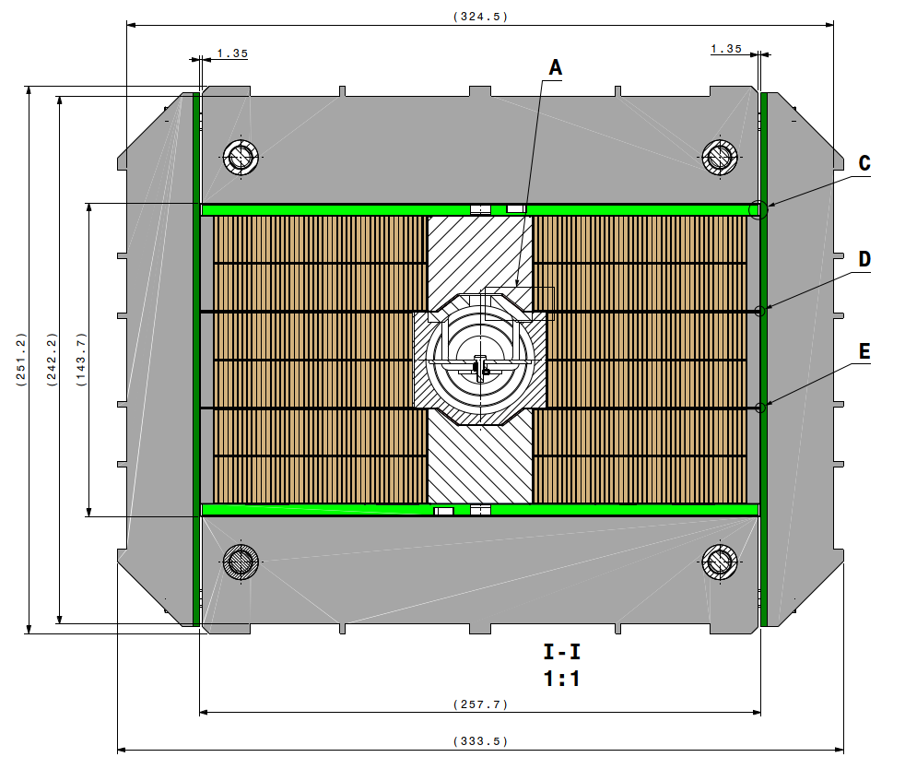
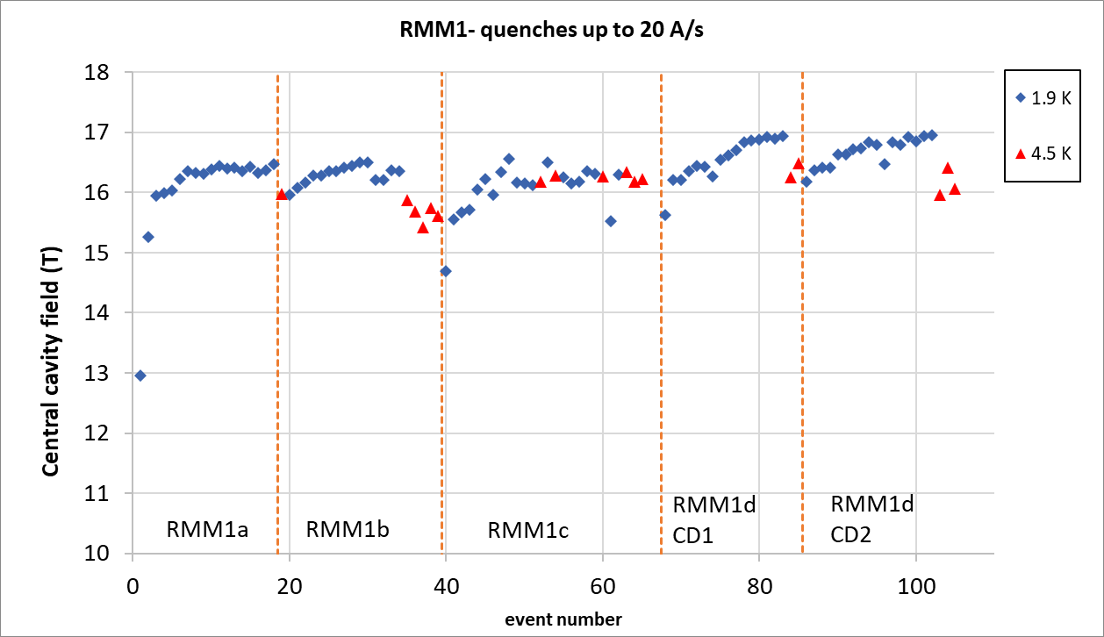
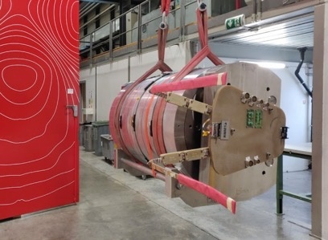
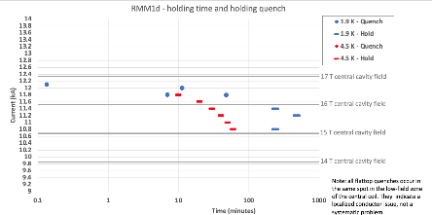
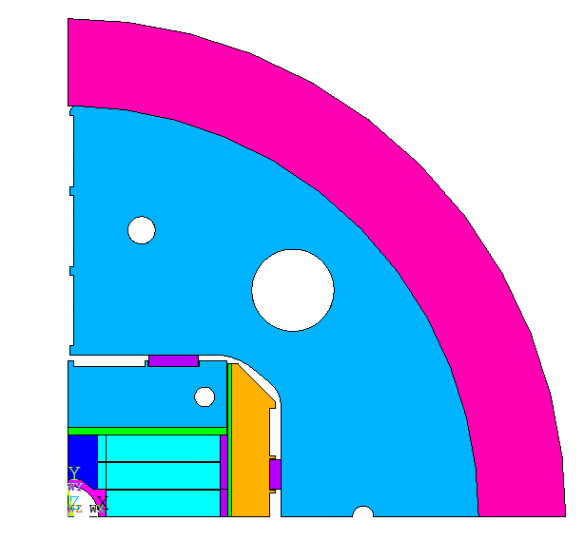
RMM activities
RMM is a Racetrack Model Magnet, with a 50 mm closed cavity made of 2 eRMC coils & 1 RMM coil in the middle.
The objective is to explore high field straight section region of a 16+ T dipole, focusing on mechanical aspects.
3 RMM assemblies have already successfully been tested and the magnet reached 16.5 T in the 50 mm diameter and 431 mm long closed cavity.
eRMC coil
Update
RMM coil
eRMC coil
(HFMMHRMM0080)
RMM1a | I (kA) | Bp (T) | Bo (T)
Short Sample @4.3 K | 12.26 | 17.07 | 16.85
Short Sample @1.9 K | 13.64 | 18.77 | 18.51
RMM1d has been assembled with increased preload w.r.t. RMM1c and tested in September 2024.

Slide 26
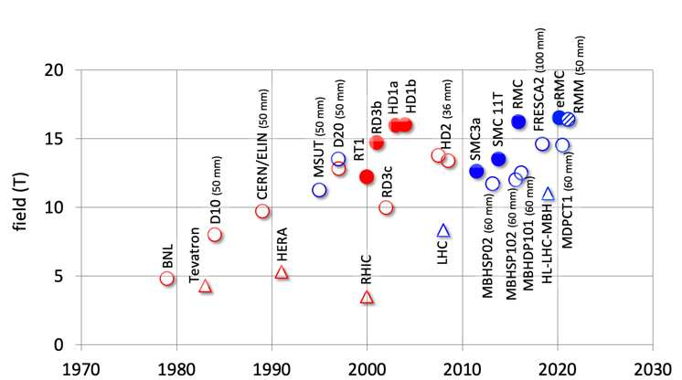
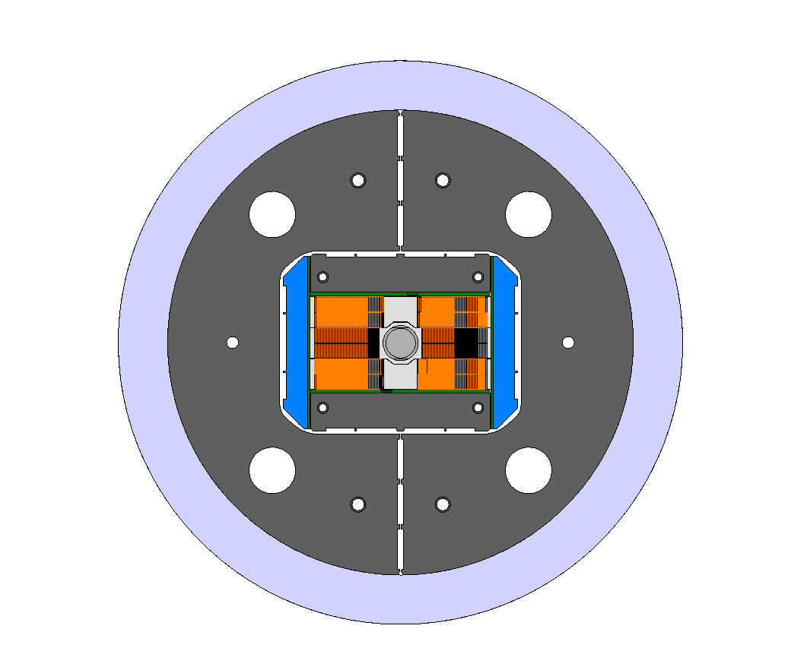
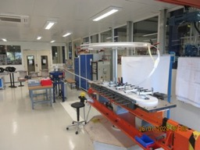




eRMC/RMM
The production of 3 eRMC coils has been completed to prove the repeatability of the results obtained with the first set of coils
  eRMC coil #104
  eRMC coil #105
  eRMC coil #106
eRMC2 magnet will be assembled in the following months (Q2-2025).
The assembly of RMM2 is scheduled Q4-2025.
eRMC
(enhanced Racetrack Model Coil)
RMM
(Racetrack Model Magnet)

Slide 27
Table of contents
Scope of the Work Package 3.5
14 T BOND design
Overview on manufacturing tooling
Overview on manufacturing mock-ups
Cooling strategies
eRMC & RMM activities update
14 T BOND development plan & schedule
Summary

Slide 28
14 T Magnet development plan
First Single Aperture Magnet assembly
CAD Mechanical Structures
Insulated Nb₃Sn Cable delivery
1st Nb₃Sn Coil
To be completed
Cold Powering Tests Magnet #1
Analysis
Iterative engineering design
Trial Copper Coil
3D CAD Impregnation Tooling
Q1_2025
Q2_2025
Q3_2025
Q4_2025
Q1_2026
Q2_2026
Q3_2026
Q4_2026
Today
Magnet #2 assembly
First dummy copper cable at CERN
Coil 3D CAD Design
3D CAD Winding, reaction & splicing tooling
Structures Characterisation
Winding & Reaction Tooling
at CERN
Impregnation tooling
at CERN
Single & Double aperture
Mech. structure at Cern

Slide 29
Table of contents
Scope of the Work Package 3.5
14 T BOND design
Overview on manufacturing tooling
Overview on manufacturing mock-ups
Cooling strategies
eRMC & RMM activities update
14 T BOND development plan & schedule
Summary

Slide 30
Summary
X

Slide 31
Thank you for your attention

Slide 32
Glossary
*1 Defined as the time available to react and to quench all the coil before the magnet reaches Tmax
E. Todesco, “Quench limits in the next generation of magnets,” in Proc.Workshop Accel. Magn. Supercond. Des. Optim.
*2 Width of a 60° sector coil whose area is the same of the area of the layout that we are considering.
E.Todesco, ”Masterclass - Design of superconducting magnets for parti-cle accelerators. Chapter 4,” Available at https://indico.cern.ch/category/12408/.
*3 Coil efficiency: Ratio between the field and the current times the coil width, given in [T.mm/A].
E.Todesco, ”Masterclass - Design of superconducting magnets for parti-cle accelerators. Chapter 4,” Available at https://indico.cern.ch/category/12408/.

Slide 33
Backup slides

Slide 34
44 strands cable design

Slide 35




14 T Block dipole BOND – 44 strands cable
The 2D & 3D electromagnetic design for the single aperture configuration was completed in 2024.
Magnet |  | Single | Double
Aperture | [mm] | 50 | 50
Intra-beam distance | [mm] | - | 250
Yoke diameter | [mm] | 540 | 680
Shell diameter | [mm] | 640 | 780
Nominal current | [kA] | 20.255 | 19.590
J overall | [A/mm2] | 331 | 320
J strand (eng.) | [A/mm2] | 484 | 468
Nominal field | [T] | 14.00 | 14.00
Peak field | [T] | 14.75 | 14.53
Ap. to peak field ratio | [%] | 5.4 | 3.8
Load line fraction @1.9 K | [%] | 80.1 | 79.7
Load line fraction @4.2 K | [%] | 89.8 | 89.4
Temperature margin | [K] | 4.13 | 4.25
Inductance | [mH/m] | 4.60 | 10.00
Stored energy | [MJ/m] | 1.030 | 2.064
Coil |  | Single | Double
No. of turns per pole |  | 52
Insulated cable surface | [mm²] | 12746
Equivalent coil width | [mm] | 56.9
Coil efficiency *¹ | [T.mm/A] | 0.00074 | 0.00077

Slide 36







14 T Block dipole BOND – 44 strands cable
X-component of stress (MPa) during assembly (left), cool down (centre), and at 14 T (right).
Coil to pole contact pressure at 14 T
The shell provides all azimuthal force pre-loading the coils. This force is almost doubled when the magnet is cooled down to cryogenic temperature (differential thermal contraction).
Von Mises stresses (MPa) during assembly (left), cool down (centre), and at 14 T (right).

Slide 37


14 T Block dipole BOND – 44 strands cable
Flared end curvature radius | mm | 750
Flared end angle | º | 5
Flared end straight section | mm | 250

Slide 38
44 vs 40 strands cable designs

Slide 39

14 T Block dipole BOND
BOND – 44 strands cable
The new 40 strand baseline allows for:
  Save in coil area of 9.2 %.
  Save in conductor volume of 20 % (shorter coil with the new flared end design).
  Increased midplane distance between coils (4 mm between insulated conductors) - potentially opening the possibility for improved cooling, see next slides.
  Internalization of the cable production at CERN.
At the expense of :
  9 % larger J_{overall}
  Decrease of loadline margin by 2.6 % in the single aperture and 2 % in the double aperture.
  Increased peak stresses in the homogenized coil block by 15 MPa
BOND – 40 strands cable

