Slide 1
Bond
Mock-up design of sliding reaction tooling
N. Lusa and J. Ferradas Troitino
Acknowledgements to B. Pellet and N. Peray
04/02/2025

Slide 2
Test set-up
Updates based on last meeting comments (13/12/24)
  Linear ceramic bearings test set-up
    Drawings sent for approval
  Circular ceramic bearings set-up
    3rd central bearing implemented on a manually adjustable eccentric axis
    Drawings sent for approval
  Meeting with S. Sgobba to avoid deformation/distortion of the metallic parts due to heat load
    Suggestion to heat treat all the metallic parts under vacuum at EN-MME facility at about 700°C for 70h and slow cool-down inside the oven prior to perform the finishing pass
    Parts to be properly cleaned prior to heat treating (cleaning service)
    About 600 CHF/day of cycle
  Displacement measurement based on high temperature capacitive sensors or other measurement device
    Meeting with EN-MME on 03/12/2024 to activate a collaboration aiming at finding the appropriate measuring device for our case
    We expect to have soon (within end of February) a tentative timeline for
      Feasibility study
      Purchasing of one or more measurement systems
      Calibration
      Implementation and integration of the measurement system in a dedicated mock-up
    In parallel mechanical system will be implemented to measure the maximum displacement during RHT, once the cycle is finished

Slide 3
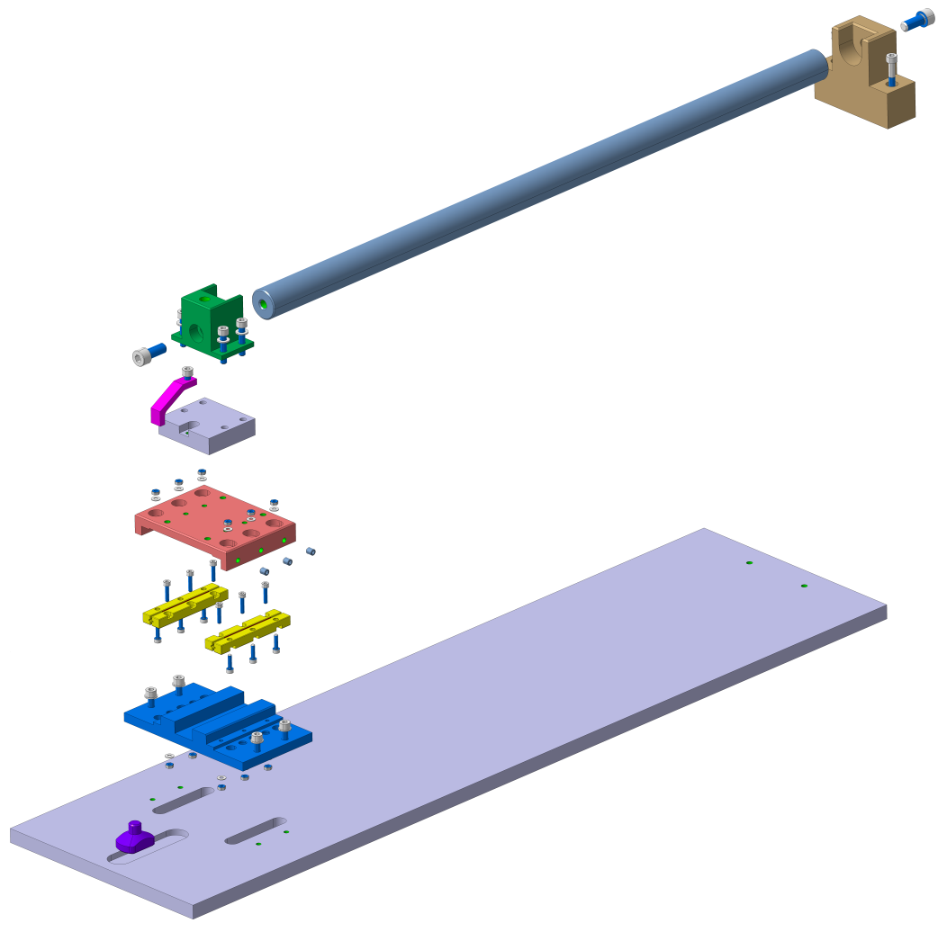
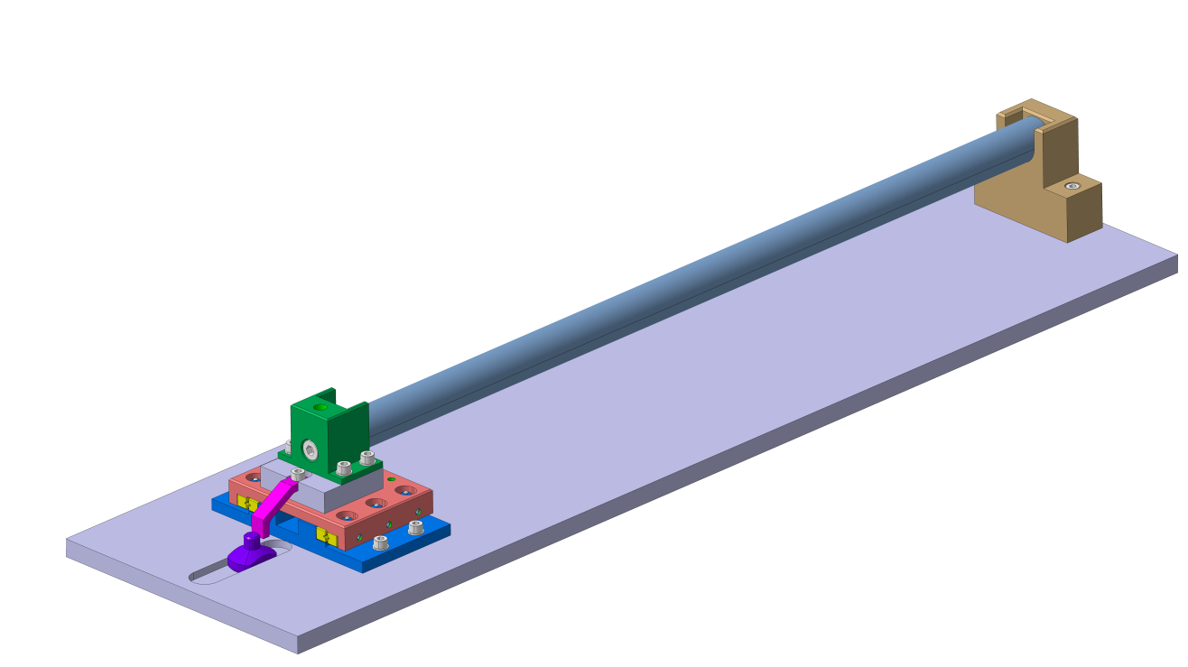
Test set-up:
Linear ceramic bearing
Courtesy of B. Pellet

Slide 4
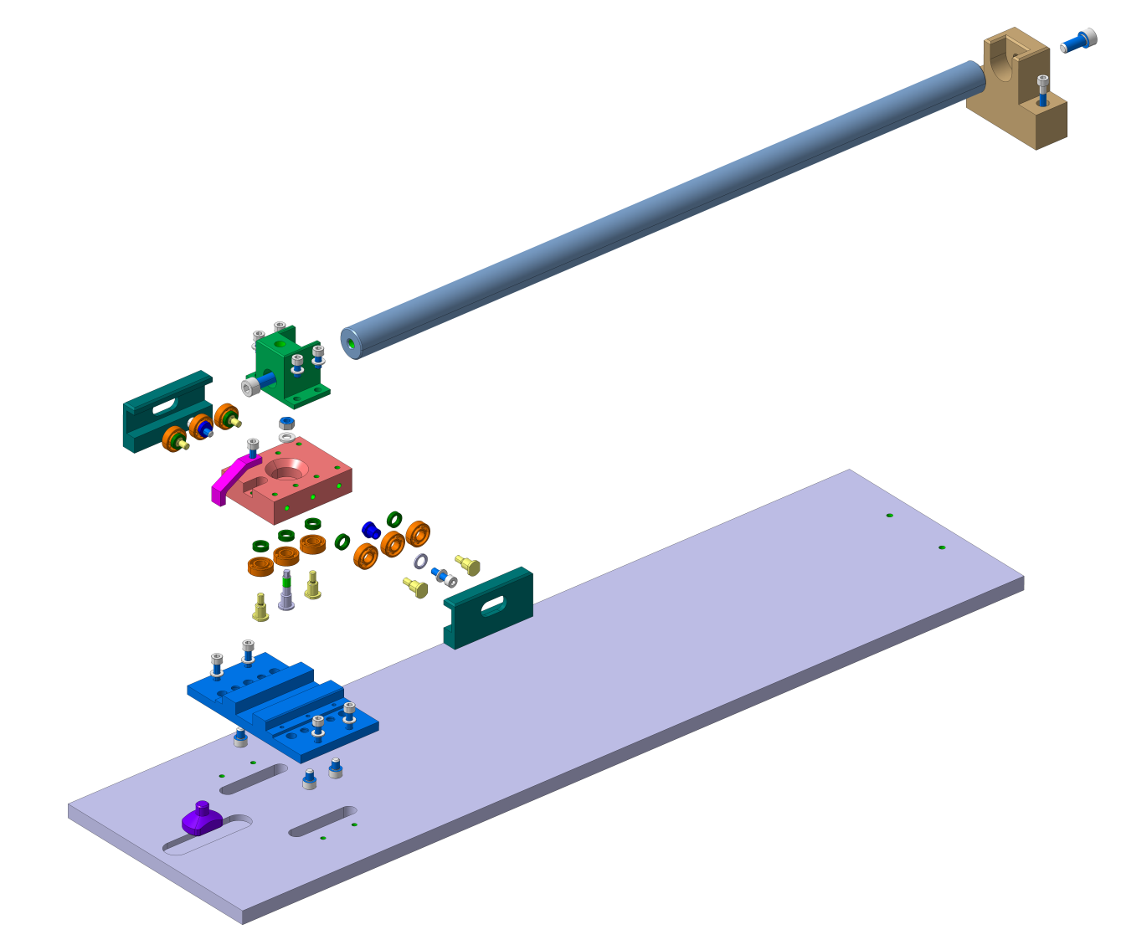
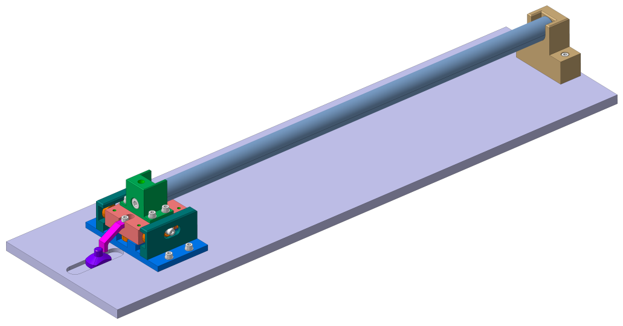
Test set-up:
Circular ceramic bearing
Courtesy of B. Pellet

Slide 5
Manufacturing schedule
Totality of the titanium raw material expected for week 6
Sliding systems purchased
  Circular ceramic bearings already received
  Linear ceramic bearings already received
Bolts, nuts and washers purchased
  Silver coating to be done
  Expected to be back for week 10
The machining of the components for the 2 mock-ups will be done mostly in the mechanical workshop of building 180 with the main workshop as support
What impact the schedule the most?

Slide 6
Manufacturing schedule
Will the HT cycle have an impact on the final shape of the components (deformations)?
  Based on titanium material certificate, the raw material was already subjected to 650°C for 120 min air cooling (AC)
    Our cycle will be at around 660°C and will last longer → additional stress relieving may occur
Strategy
  Rough machining of few components
  Heat treat them at 700°C for 70h and slow cool-down inside the oven
  Check any deformation that may have occurred prior to perform the finishing pass
If NO DEFORMATIONS
  Final manufacturing of all components without intermediate HT cycle
  Manufacturing process is less time consuming
If DEFORMATIONS
  Rough manufacturing with intermediate HT cycle is needed
  Manufacturing becomes trickier and very long in terms of time required

Slide 7
Manufacturing schedule
Scenario A (no deformations after HT cycle)
Scenario B (deformations after HT cycle)

Slide 8

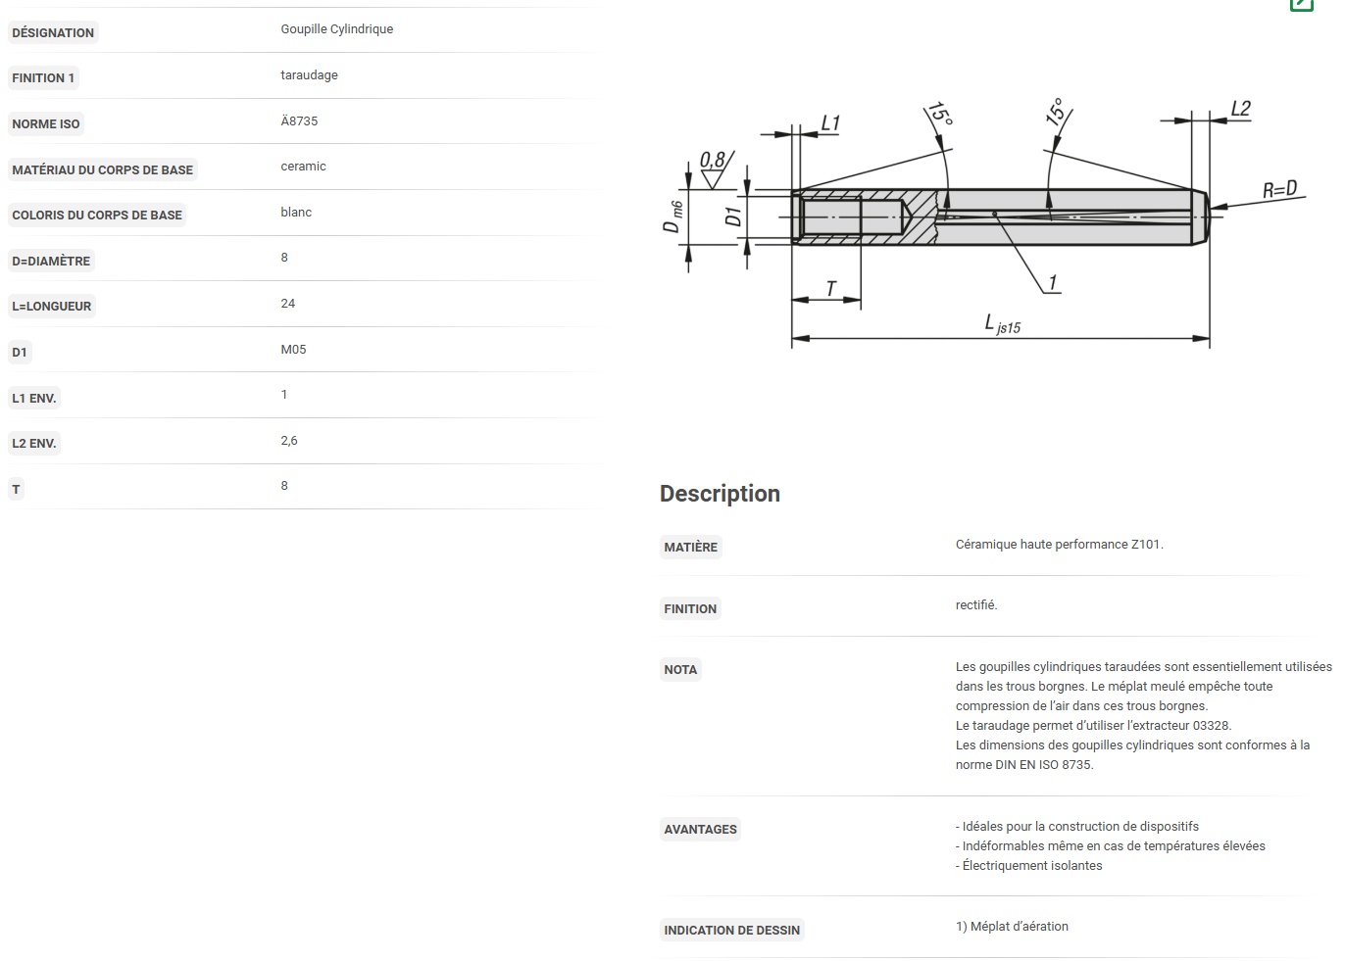
Test set-up
Updates based on last meeting comments (13/12/24)
  Design of a test set-up with a racetrack coil mock-up
    Additional titanium raw material has been purchased to have a second dedicated set-up (delivery expected for week 6)
    ZrO₂ alignment pins have been purchased to ensure the alignment of the poles without the risk of material sticking due to the temperature
    2 modified MQXFB outer layer poles (non-conform parts)
    MQXFB insulated cable leftovers for the winding, about 15m for the test
    Cable expansion assumption for the reaction mold cavity: 4.5% azimuthal and 1.2% radial (same as for MQXFB coils)
    Sectorized reaction mold (like for BOND concept mold)
    Implementation of a mechanical system to measure longitudinal displacement of the floating pole
    3D model completed → detail drawings ongoing
    The manufacturing of the components will be probably subcontracted
  Design of a test set-up with one flared end coil mock-up
    Coming soon, using N. Peray coil design as input for the coil end
    Take advantage as much as possible of the components manufactured for the racetrack coil mock-up

Slide 9
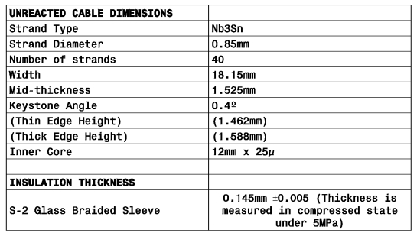
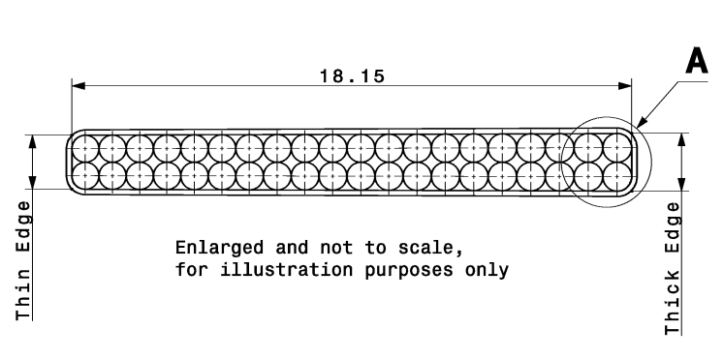
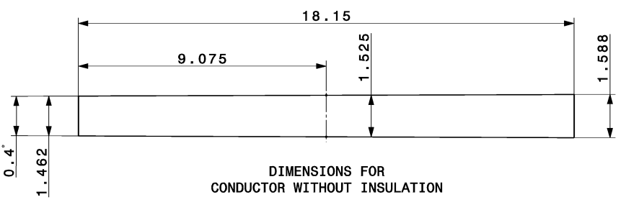
Racetrack coil mock-up
Insulated cable reference parameters in the table below from drawing LHCMQXFBC0057
Based on expansion coefficient assumptions:
  4.5% azimuthal
  1.2% radial
18.36mm (reacted bare cable)
18.65mm (insulated reacted cable)
1.594mm (reacted bare cable)
1.884mm (insulated reacted cable)

Slide 10
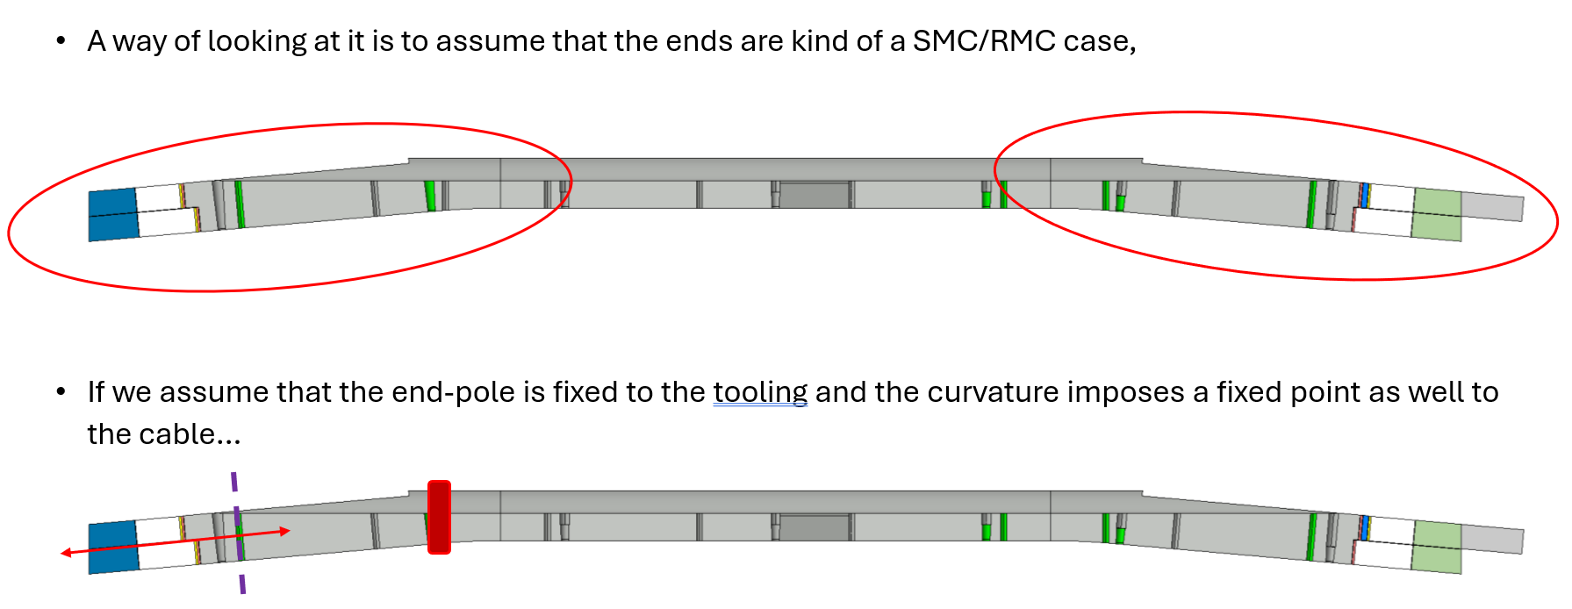
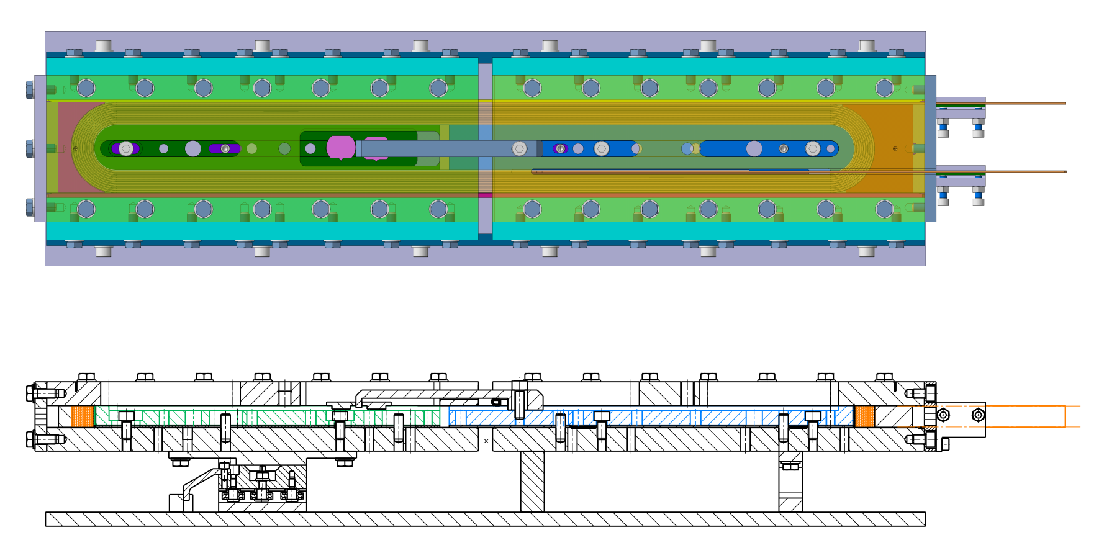
Racetrack coil mock-up
Tests can be done to validate/explore different scenarios
  1 pole fixed and 1 pole completely free (just pinned to the base plate to ensure alignment) with gap between poles and 2-parts mold
    Assuming free sliding of the coil inside the mold, the sliding system should not move
  Both poles fixed to the base plates (and pinned for alignment) with gap between poles and 2-parts mold
    Simulation of the fix point caused by the flared end, the sliding system should move accordingly to the cable expansion/contraction
Sez. A-A
A
A
Courtesy of B. Pellet

Slide 11
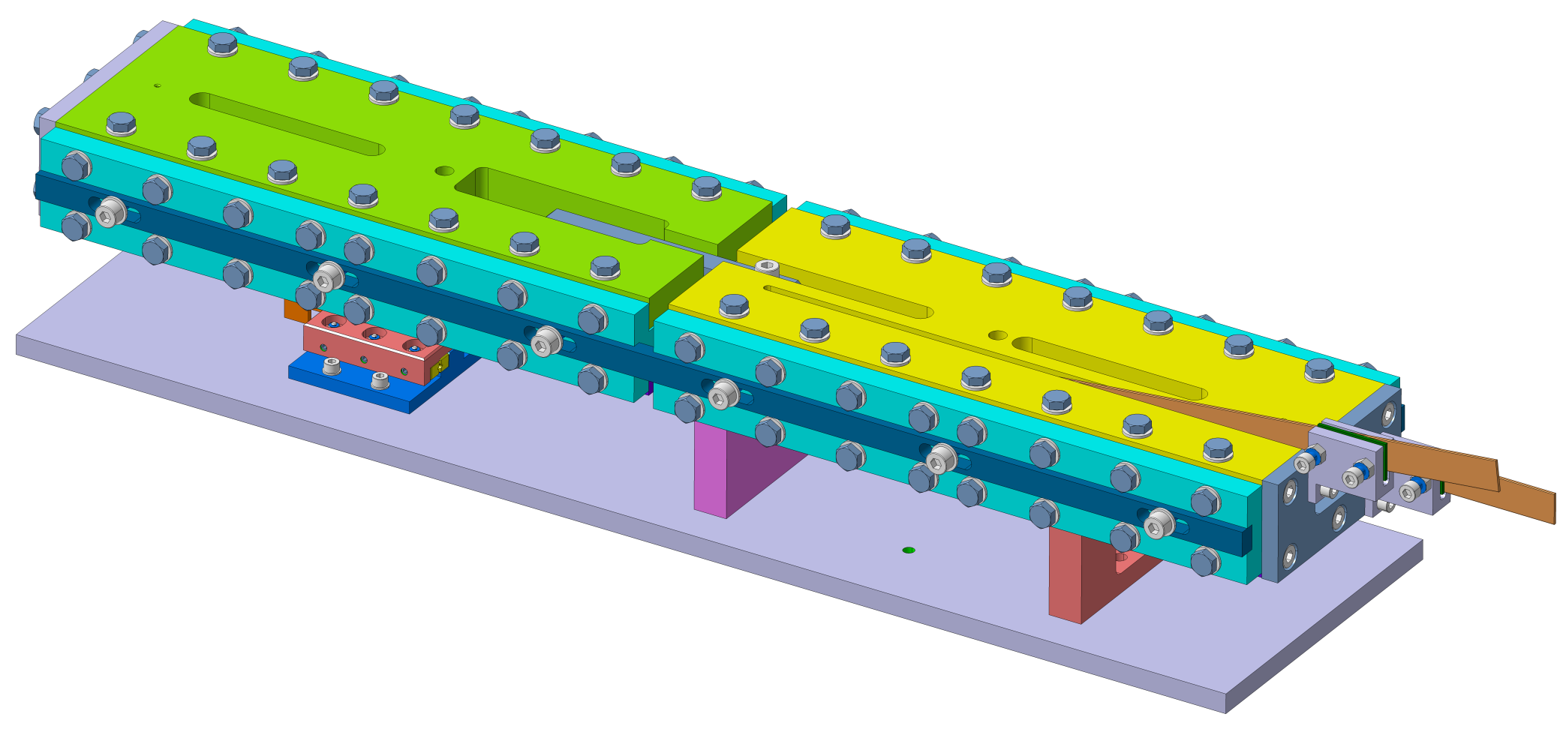
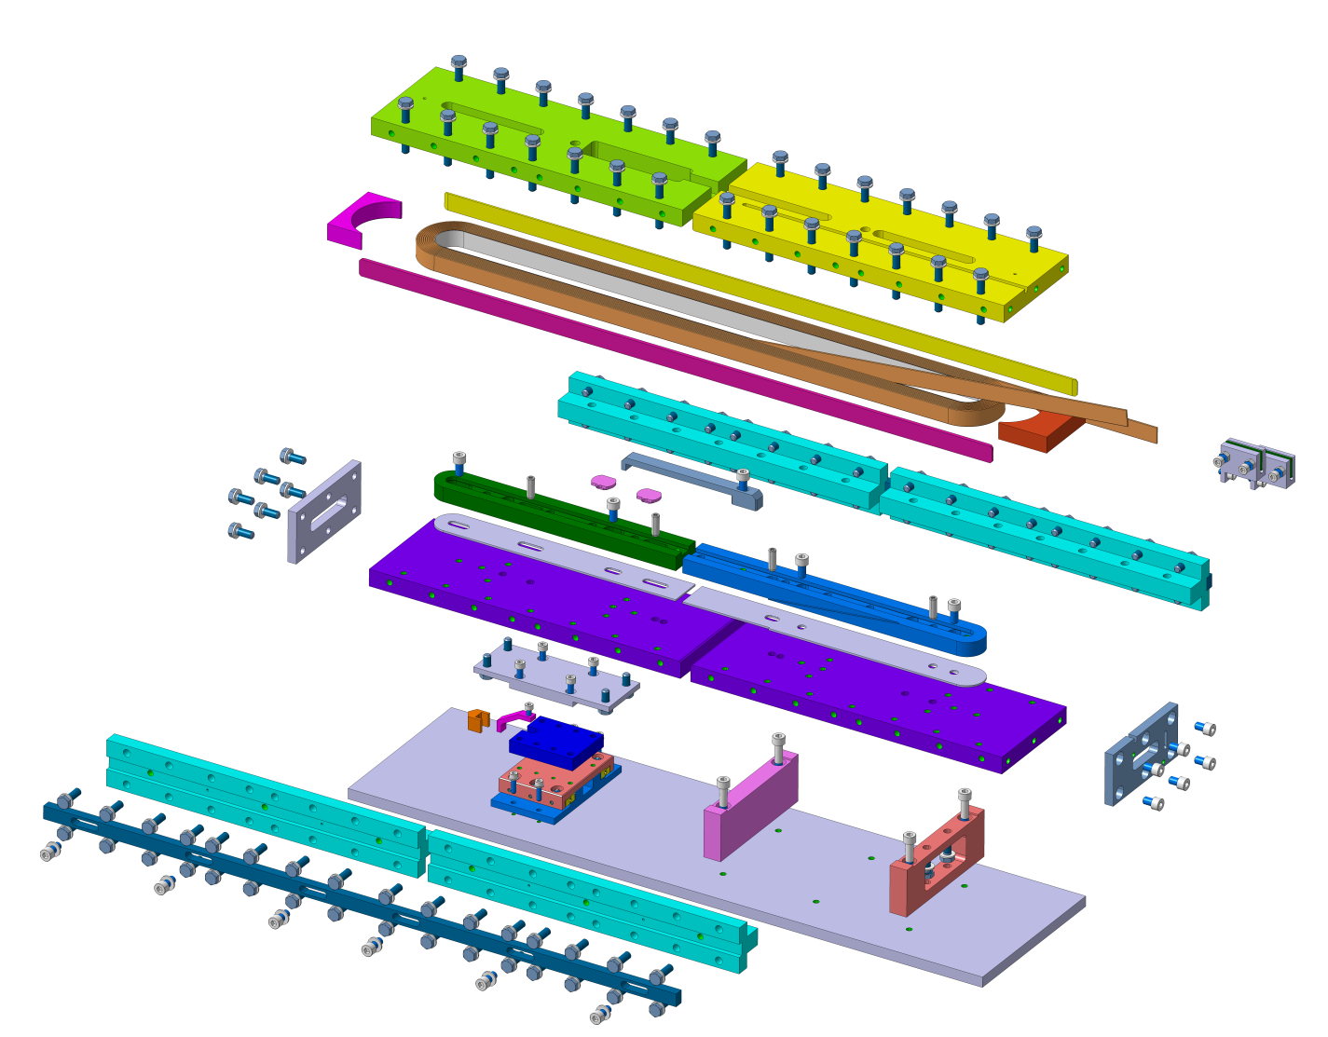
Racetrack coil mock-up
Set-up suitable for both sliding systems (linear and circular ceramic bearings)
Courtesy of B. Pellet

Slide 12
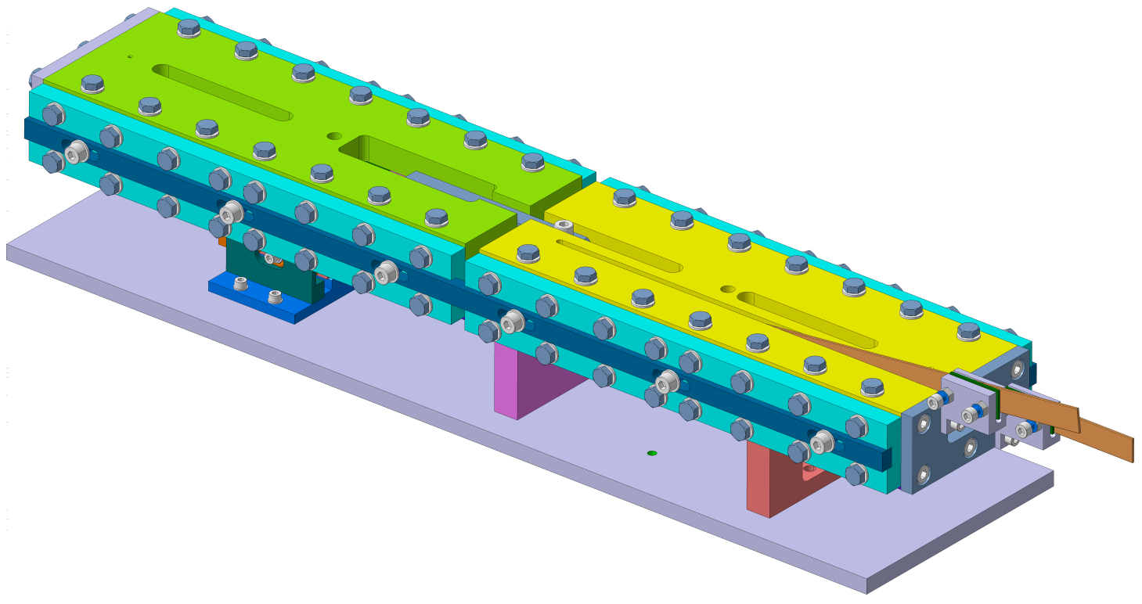
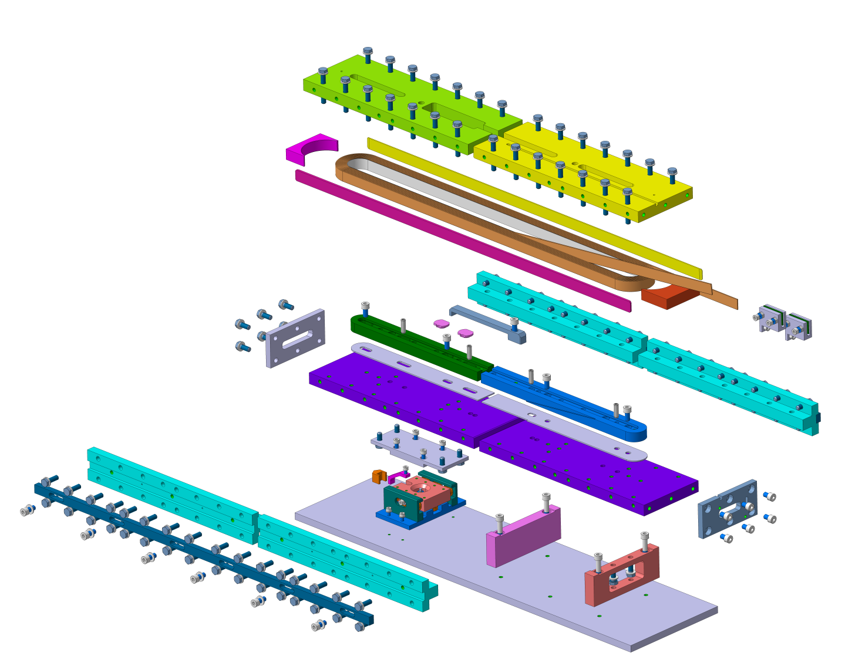
Racetrack coil mock-up
Set-up suitable for both sliding systems (linear and circular ceramic bearings)
Courtesy of B. Pellet

Slide 13
Spare slides

Slide 14
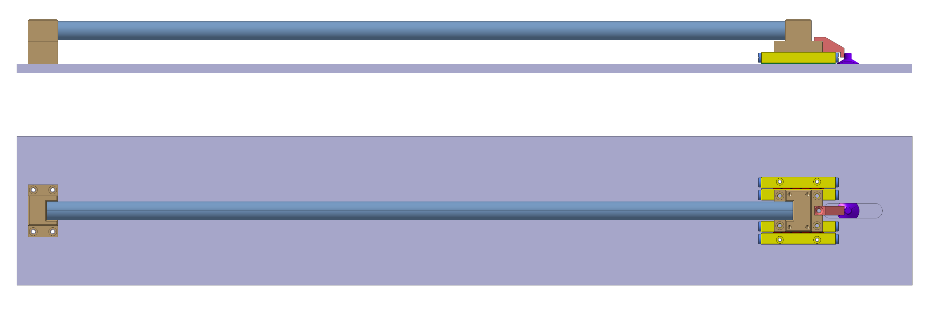
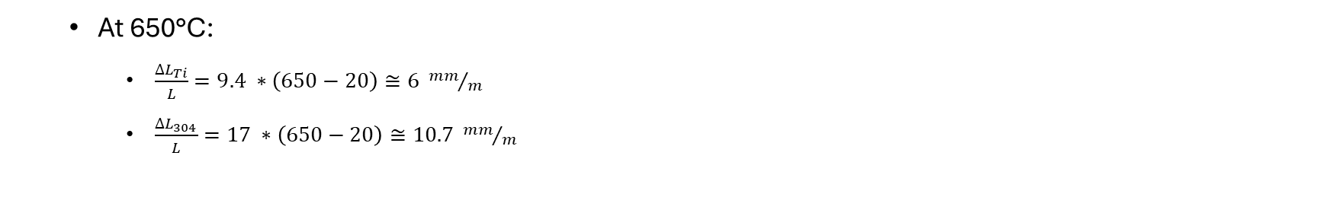
Test set-up
0.6m long bar
(SS 304)
  At 650°C:
    $\frac{{∆L}_{Ti}}{L}=9.4 ∗\left(650−20\right)≅6 {mm}/m$
    $\frac{{∆L}_{304}}{L}=17 ∗\left(650−20\right)≅10.7 {mm}/m$
A 0.6m long bar of SS 304 is enough to have a differential displacement of about 2.8 mm

Slide 15

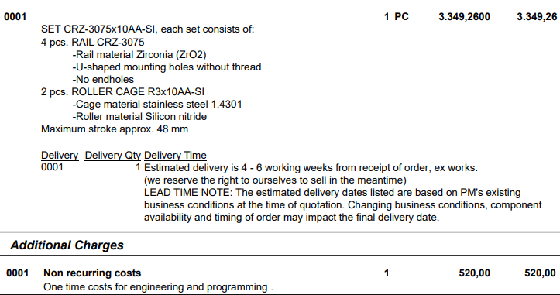
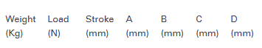
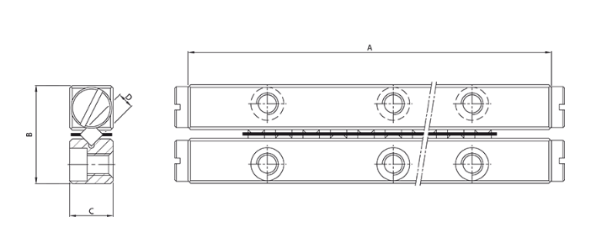
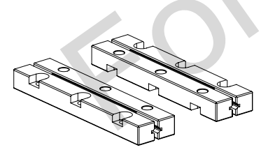
1st option
Linear ceramic bearing
Purchasing of 1 set CRZ-3075x10AA-SI:
  4 pcs ZrO₂ rails (Si₃N₄ rails available upon request and for a MOQ)
  2 pcs stainless steel roller cage and Si₃N₄ rollers

Slide 16
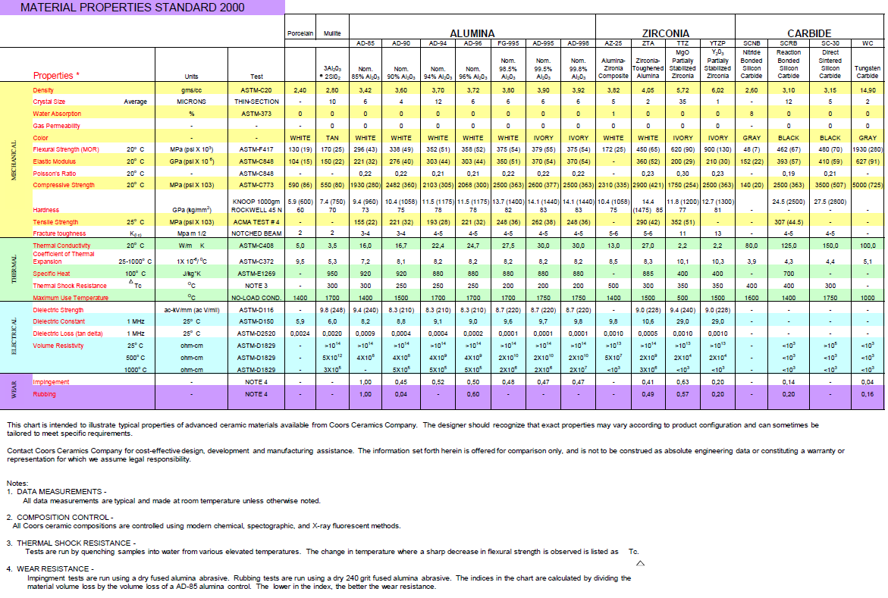
ZrO₂ properties (supplier datasheet)

Slide 17

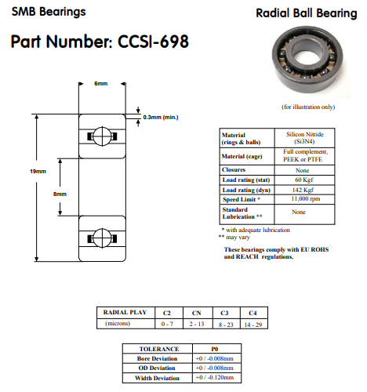
2nd option
Circular ceramic bearing
Based on actual full Si₃N₄ bearing stock, they can propose us only bearings without cage
  In principle for temperatures between 500-900°C a GH4099 nickel-based alloy cage could be used
Price for 6 bearings CCSI-698 (chosen randomly for the mock-up manufacturing)
  26.97 £/piece (30.48 CHF/piece)
  12 bearings in stock
COMMENT: The use of this type of bearing could be more challenging w.r.t. another system
  Fitting shaft/bearing must be careful check both at ambient and high temperatures to
    Ensure the alignment of the mold parts during the whole reaction cycle
    Make sure that interference fits due to differential thermal expansions do not reduce the radial play of the bearing to an unacceptable level (or shaft and housing fits should always accommodate differences in expansion coefficients)

Slide 18
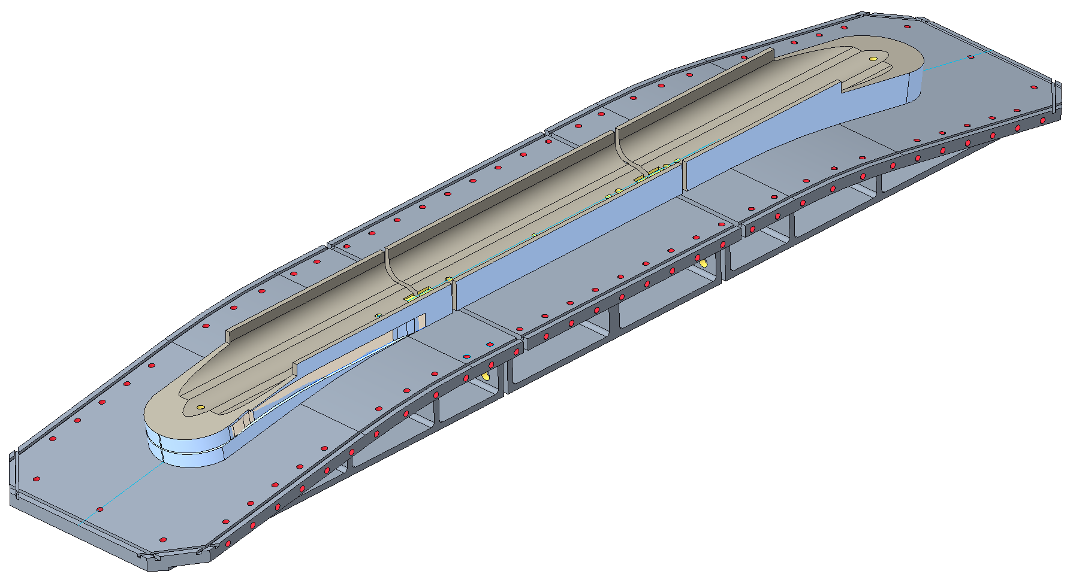




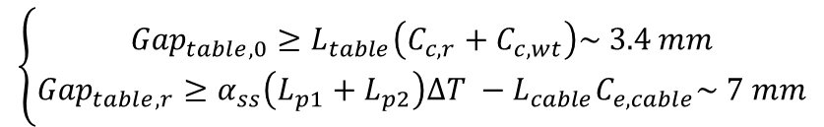
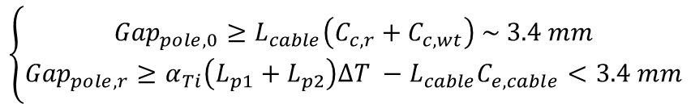

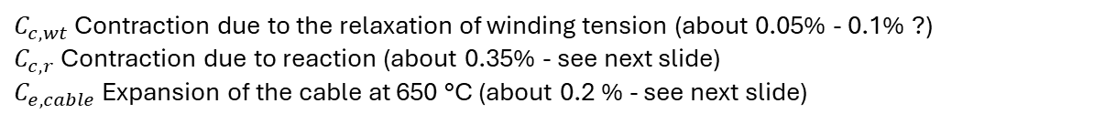


Some comments on gaps
For the first-order assessment of the required gaps, we follow a similar logic than for TFD (see J.L. Rudeiros presentation).
$$L_{p2}$$
$${Gap}_{pole}$$
$$L_{p1}$$
Central plane
Main parameters
Pole extremity
Pole center
$C_{c,wt}$ Contraction due to the relaxation of winding tension (about 0.05% - 0.1% ?)
$C_{c,r}$ Contraction due to reaction (about 0.35% - see next slide)
$C_{e,cable}$ Expansion of the cable at 650 °C (about 0.2 % - see next slide)
Cable
$$L_{cable}$$
Table extremity
Table center
$$L_{t2}$$
$${Gap}_{table}$$
$$L_{t1}$$
$$\left\{\begin{aligned}{Gap}_{pole,0}≥L_{cable}\left(C_{c,r}+C_{c,wt}\right) \sim 3.4 mm \\ {Gap}_{pole,r}≥α_{Ti}\left(L_{p1}+L_{p2}\right)∆T −L_{cable}C_{e,cable}<3.4 mm\end{aligned}\right.$$
Pole
Central plane
$$\left\{\begin{aligned}{Gap}_{table,0}≥L_{table}\left(C_{c,r}+C_{c,wt}\right)\sim 3.4 mm \\ {Gap}_{table,r}≥α_{ss}\left(L_{p1}+L_{p2}\right)∆T −L_{cable}C_{e,cable}\sim 7 mm\end{aligned}\right.$$
Table
Assuming SS 316
** Without considering the change in coil length after releasing winding tension
* Courtesy of Jose Luis Rudeiros

Slide 19
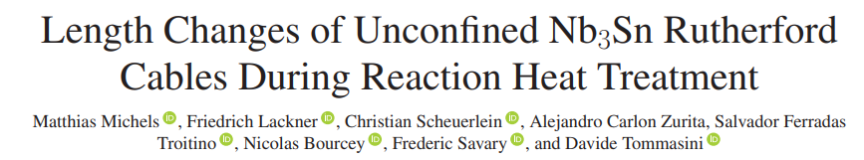
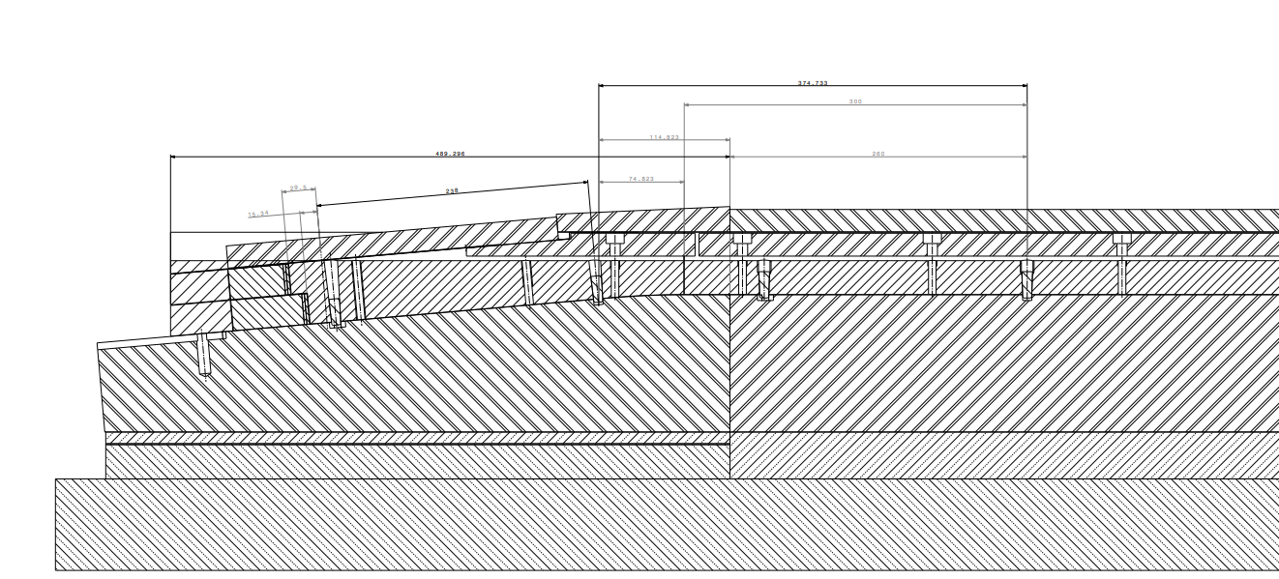
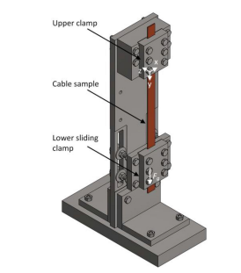
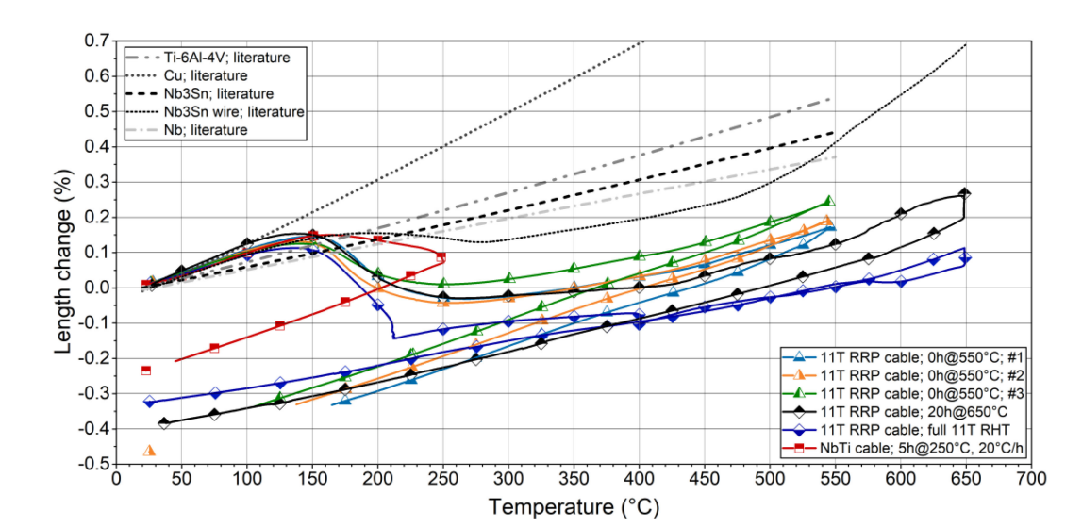
Some comments on gaps

Slide 20
Reaction mold – Motion during reaction cycle
Because of non homogenized material choice in coil/mold component, relative movement will occur during the reaction process.
For transverse dimension change, the mold will expand more than the pole and the conductor. And the cavity is design with the reacted cable dimension to anticipate its growth during reaction.
For the longitudinal direction it is a different story. The “angle” between the straight section and the head creates a kind of fixed point that restrain the straight section to live its life freely.
* Slide from N. Peray

Slide 21
Reaction mold – Central pole fixed point
Pins or part of it might be removed during reaction
Fixed point
Nice, but what happen with the layerjump ?
Screwed cap
Conical section
Pin interface in the mold
Cylindrical section
* Slide from N. Peray

Slide 22
Reaction mold – Motion during reaction cycle
A way of looking at it is to assume that the ends are kind of a SMC/RMC case,
If we assume that the end-pole is fixed to the tooling and the curvature imposes a fixed point as well to the cable…
All displacement is then happening in the head. Would we need to cut the end region to introduce a gap (magenta dashed line) as well?

