Slide 1
Site and Civil Engineering Department
CERN Smart Mobility
Gilles Bollinger, Stéphanie Blanchard - SCE-SSC-CS
CERN, February 17th, 2025

Slide 2
Bike-sharing service :
From a pilot to a service execution

Slide 3
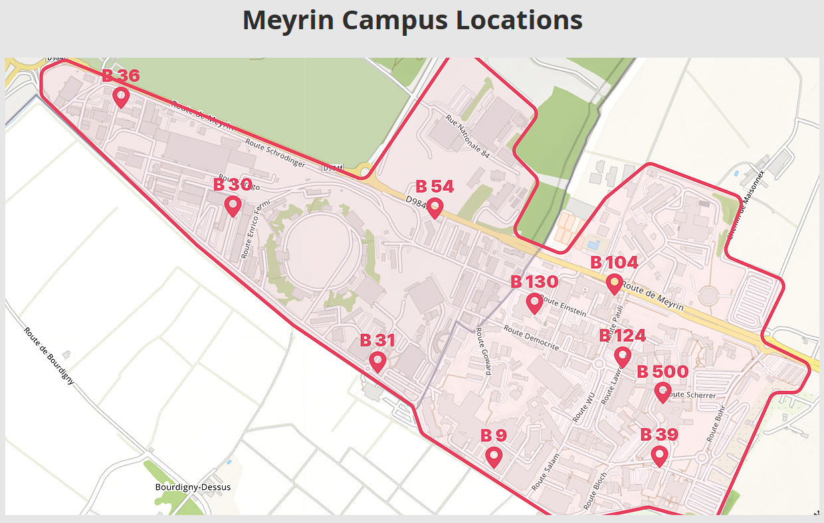
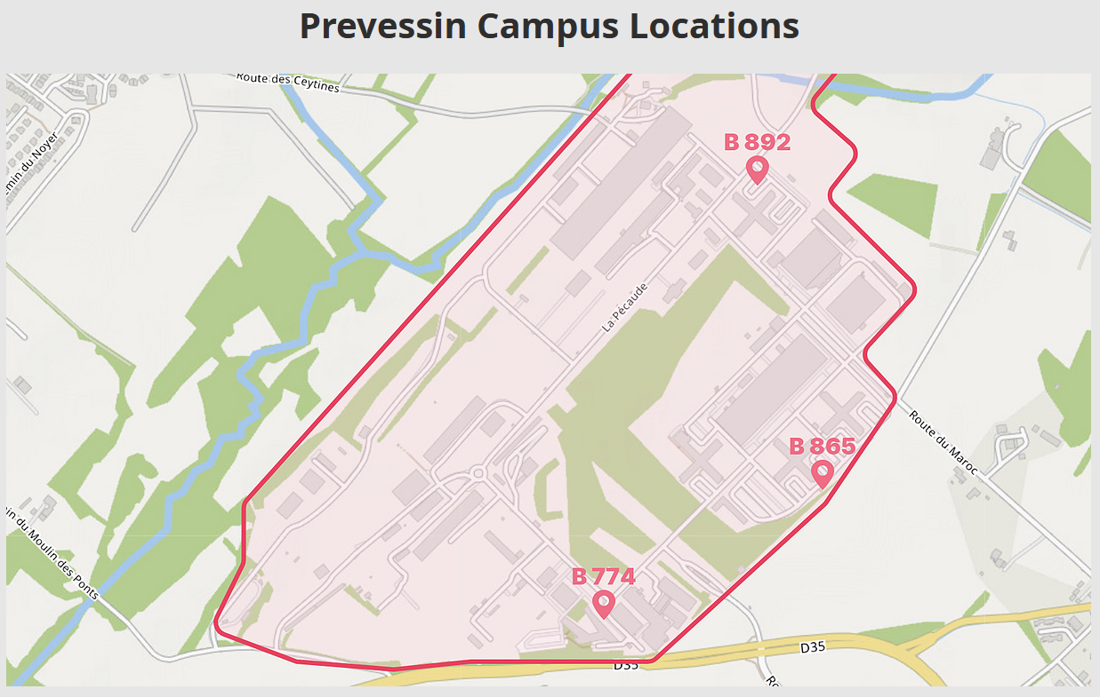
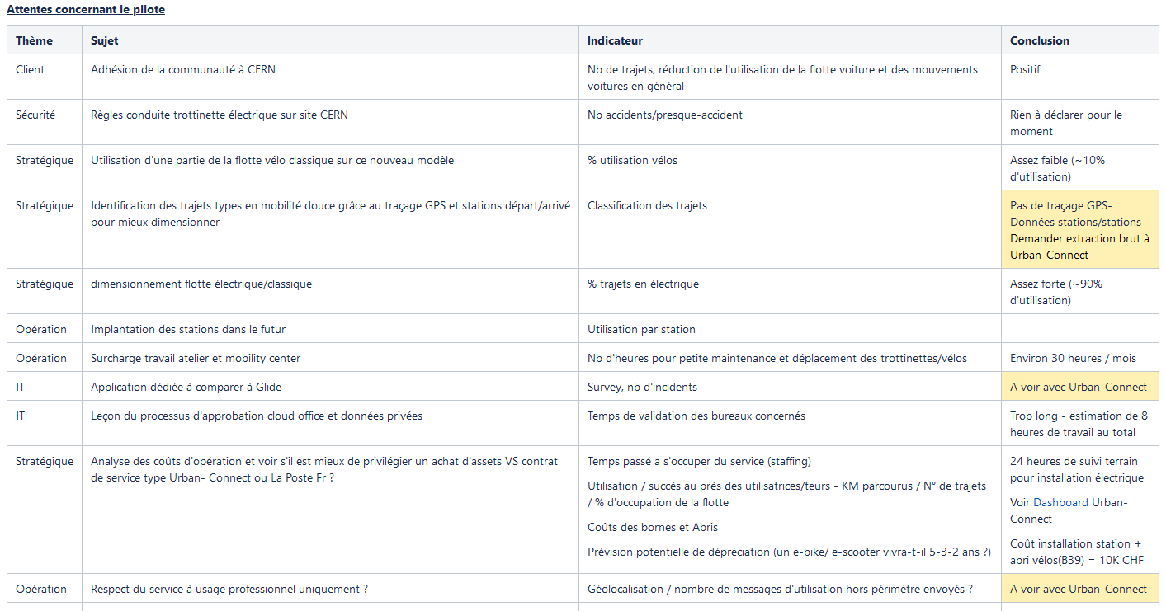
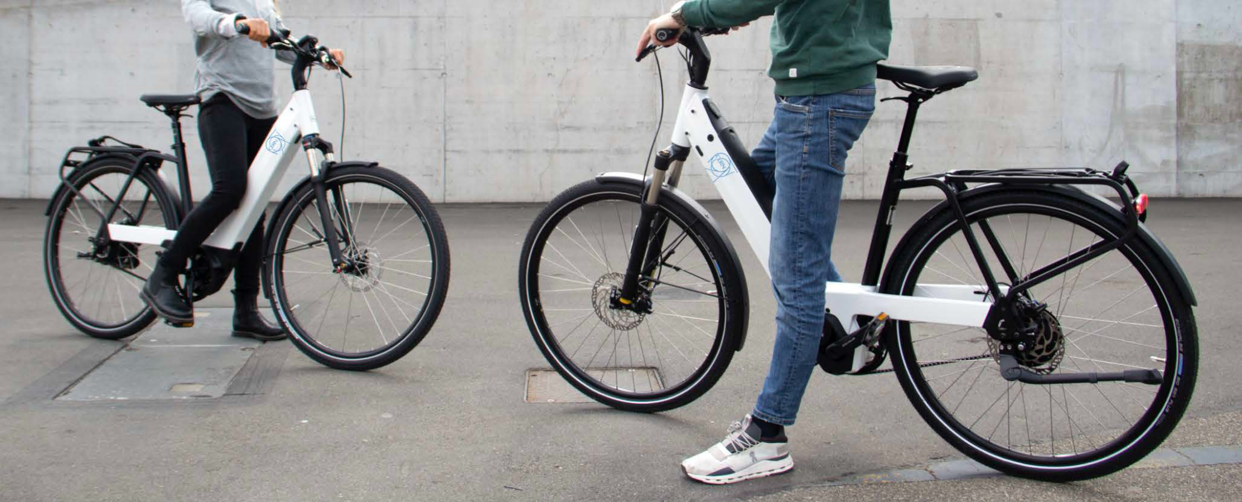
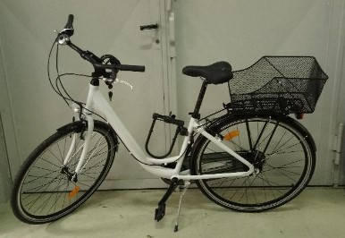
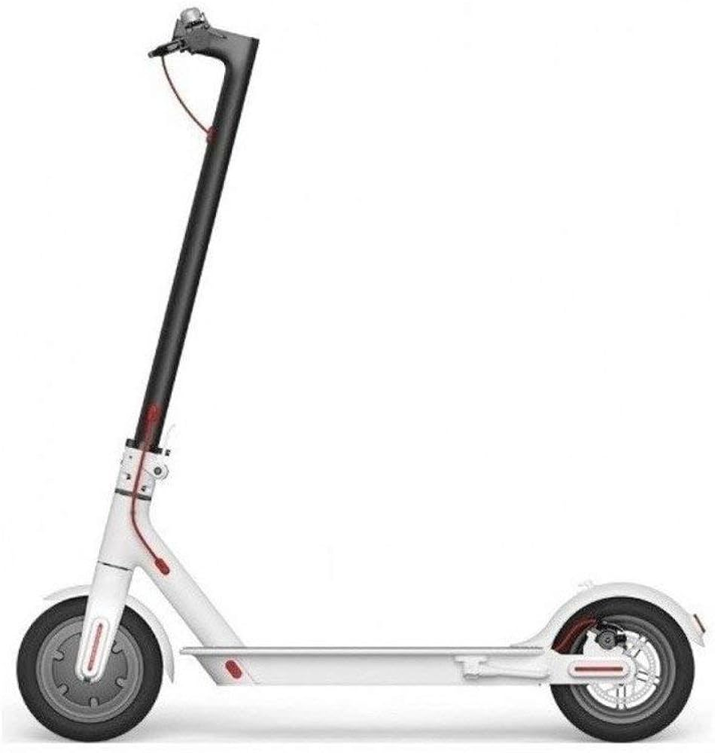
    Bike sharing begins: pilot & objectives
Initiated in 2021, a project with past trial, soft mobility promotion and assess the level of interest of the CERN community
Gather enough data to define the best strategy to offer a sustainable service solution across the CERN sites
Pilot concept
Pilot indicators

Slide 4
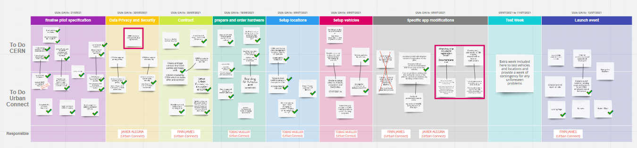
    Bike sharing pilot preparation
Decision taken to launch the pilot for summer 2021
Scope clarification and expectations of the pilot
CERN insurance review
Conditions of use for this pilot
Order confirmation by CERN purchase office
CERN communication and event preparation
HSE review to use electrical assets at CERN
Data agreement and Privacy Policy finalization
CERN Electrical work
CERN legal review for disclaimer
Kick-off mid July
March 2021
April 2021
May 2021
June 2021
July 2021
CERN stakeholders’ coordination :
  Civil engineering (SCE) / Security (HSE) / Insurance (FAP) / Legal (DG) / Data Protection (FAP) / IT Security (IT) / Purchase (IPT)

Slide 5
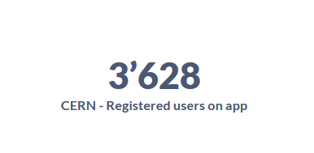
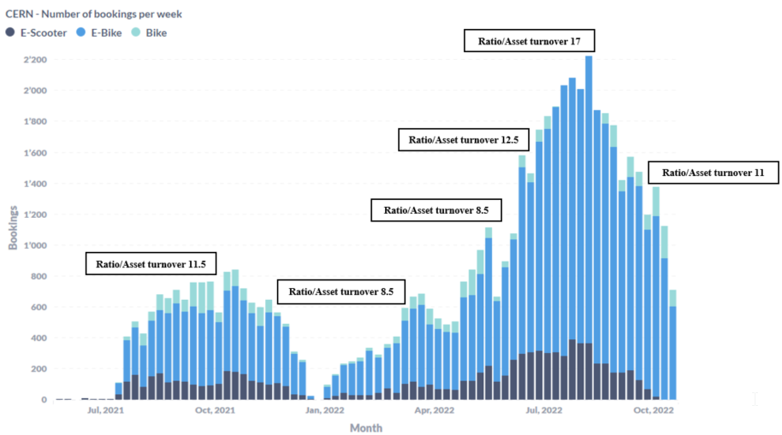
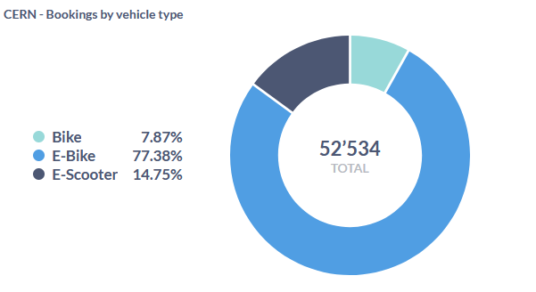
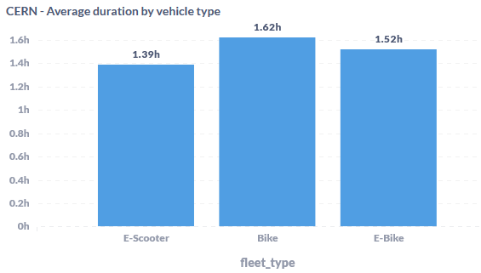
    Bike sharing pilot data analysis
Fleet sizing: increase to 80 e-bikes since May 2022
Ration/ Asset : number of times an asset is used in average per week

Slide 6
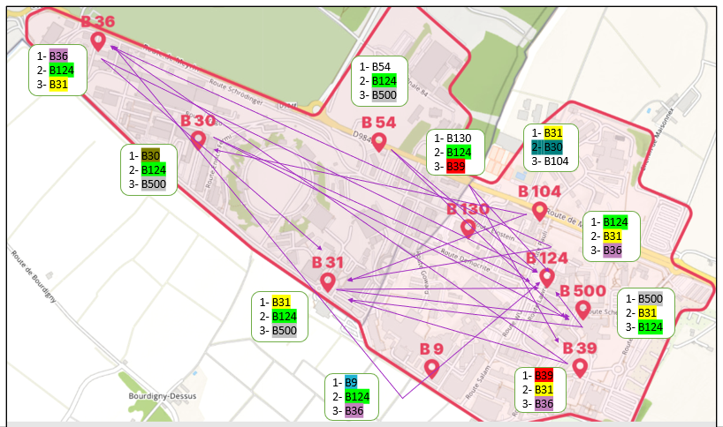
    Bike sharing flows analysis (Meyrin)
Top 3 destinations per station
Main points of interest, are: B.124
B.31
B.36

Slide 7
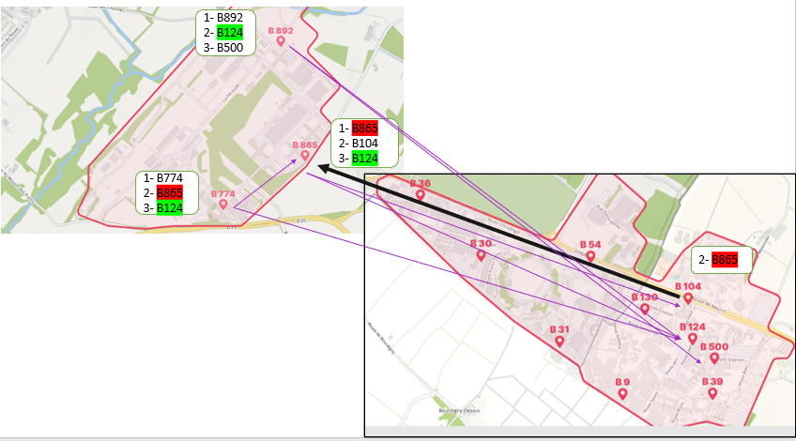
    Bike sharing pilot flows analysis (Prevessin <> Meyrin)
Top 3 destinations per station
E-Bikes mainly used to commute from Prevessin to Meyrin

Slide 8
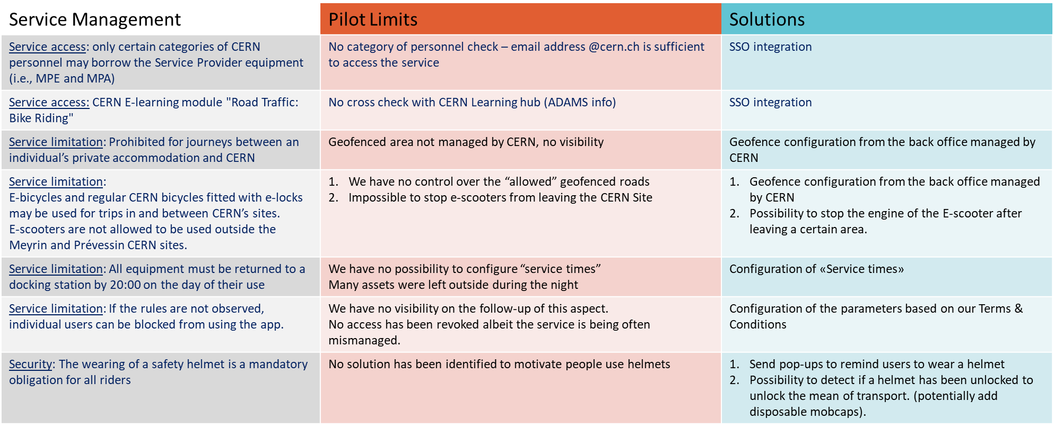
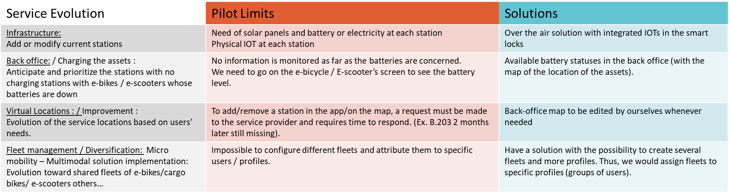
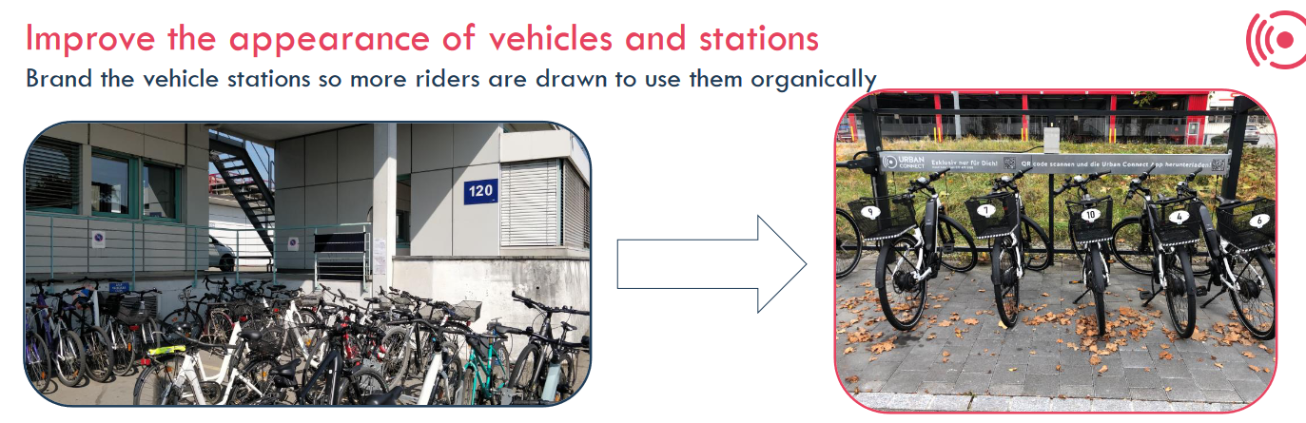
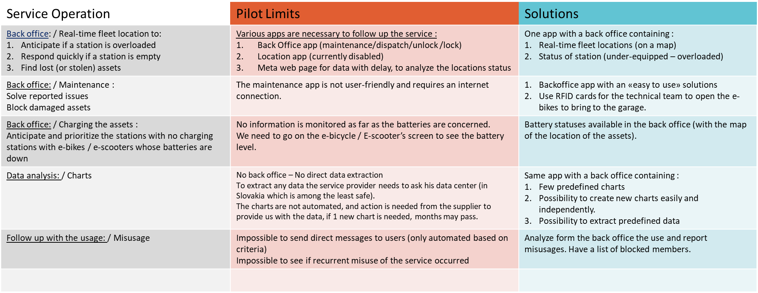



    From a Pilot to a Service execution
Infrastructure CERN

Slide 9


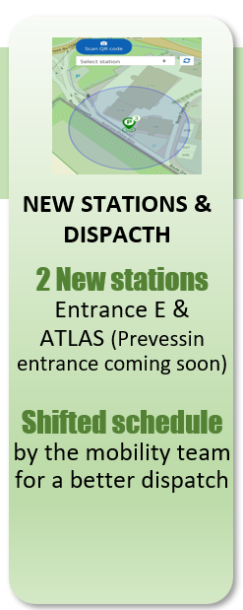


    New contract, new provider and new records !
Finalization of a call of tender incorporating all lessons learned from the pilot (seasonality approach, fleet expansion, addition of stations, etc.)
Since January 2023 : Contract enforced with Bike Sold
  Local service provider
  Acquisition of e-bikes
  Integration with existing mobility services
New service execution
  Service free of charge
  Conditions of use and related information on SCE mobility webpage
  Safety first : Helmet and jacket available at Mobility Centre
  Mobility services in charge to dispatch bikes to the attractive stations
E-bike sharing
Users: 2’864
(+104%)
Bookings: 60’829
(+40%)
Distance : 105’627 KM
+6%

Slide 10
Car-sharing service:
Key role for mobility evolution

Slide 11

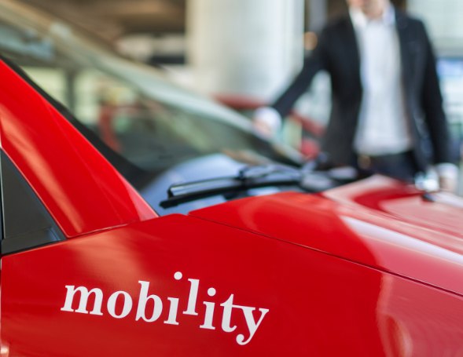

Car sharing – History via
2019 Pre-COVID period: Service provided by
Cars were often overbooked and kept by few users even if not used
End of technology “2G” Swisscom by end of 2020
Business modal not built for CERN usage, and no tool adjustment done after several requests
2020 The service stopped during the COVID crisis
2021 Pilot project to select the right supplier with the right tool

Slide 12






Test phase with various solutions (2020/2021)
Hardware (fleet management)
Software (car sharing solution)
System is running @ CERN
Some issues fixed
Continuous improvement
Solution not “out of the-box”
Basic order not mastered
Wasting time with deadlines not respected
Was really Promising
Big issue for integration since to SoFleet upgrade its box
Not interested to invest time/money only for 35 cars
System is running fine @ CERN
Better responsiveness for doors opening
INVERS cannot provide the car fleet tool CERN needs (trips, analysis, geofencing, etc.…)
Starting the pilot within SCE and some Users :
  Selection of 10 cars
  Parking location between Meyrin, Prevessin and CMS
Notes:
-> LATVIAN COMPANY : Several emails exchanged

Slide 13
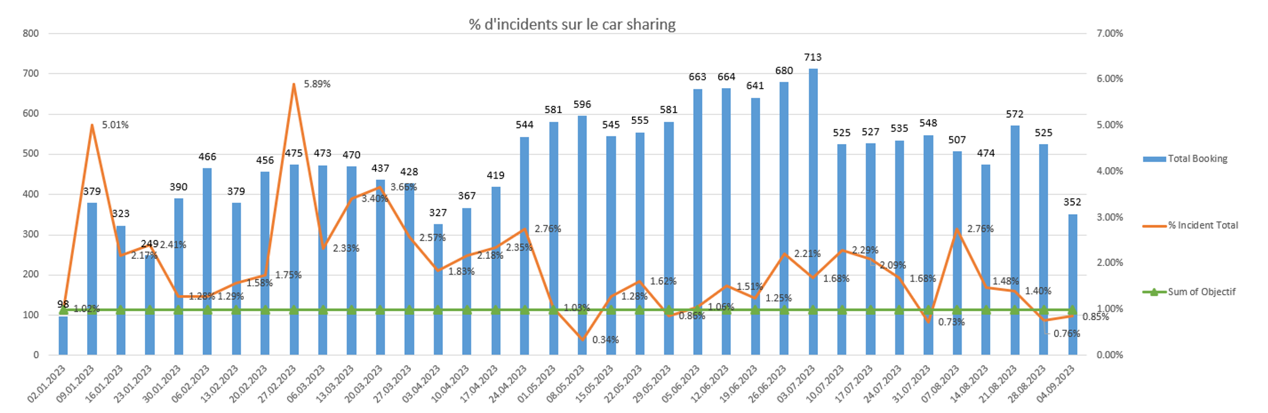
Car Sharing pilot: Objectives & Follow up
Objectives :
  Reactivation of the car-sharing service (successor to operator)
  Covering all use cases for car-sharing (no shows, booking delay, etc.…)
  Change management (key into the car)
KPIs and follow up of GLIDE pilot :
  Less than 1% of incident
  Recurrent issues to be highlighted and to be fixed
  Regular follow-up with Glide via an actions list

Slide 14
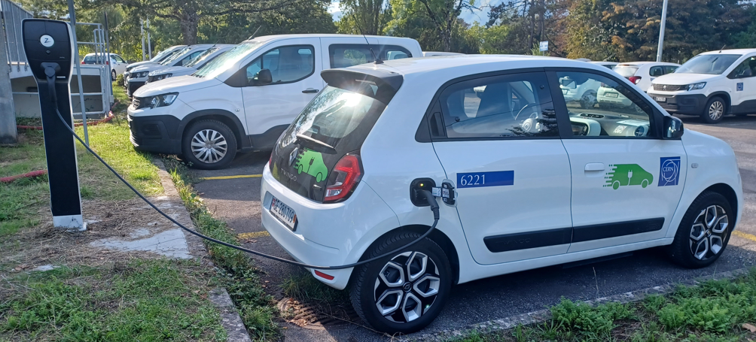
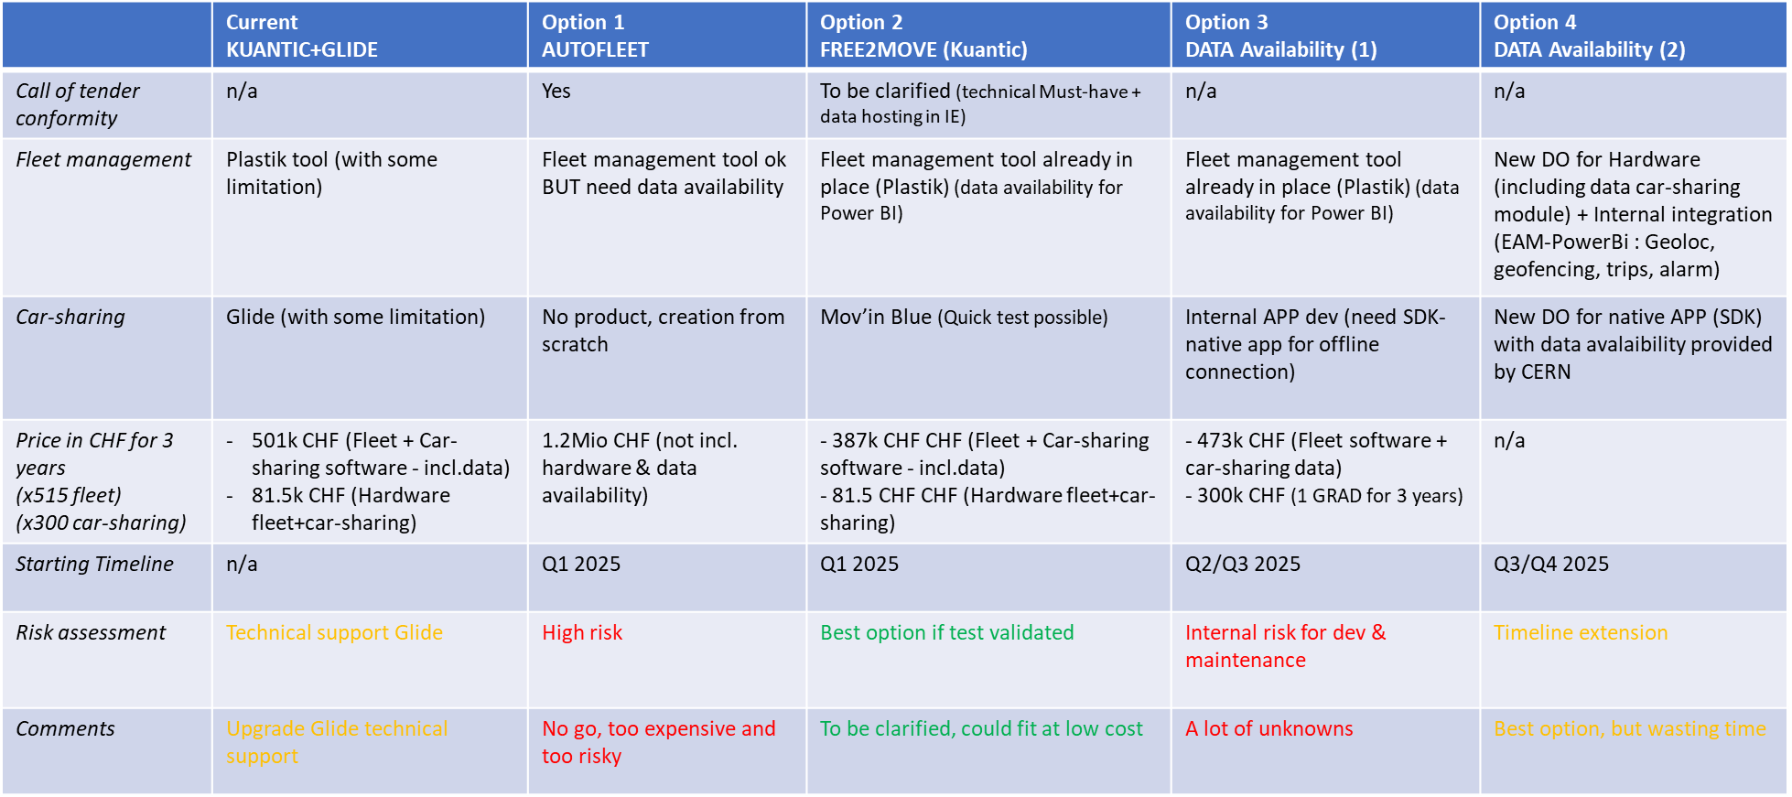
Time to change (2024)
Issues not fixed, no reactive responsiveness
Users' complaints
No real levers ( only order, no contract)
Call of tender for market analysis
Various options taken into consideration
Selection of best value for money

Slide 15
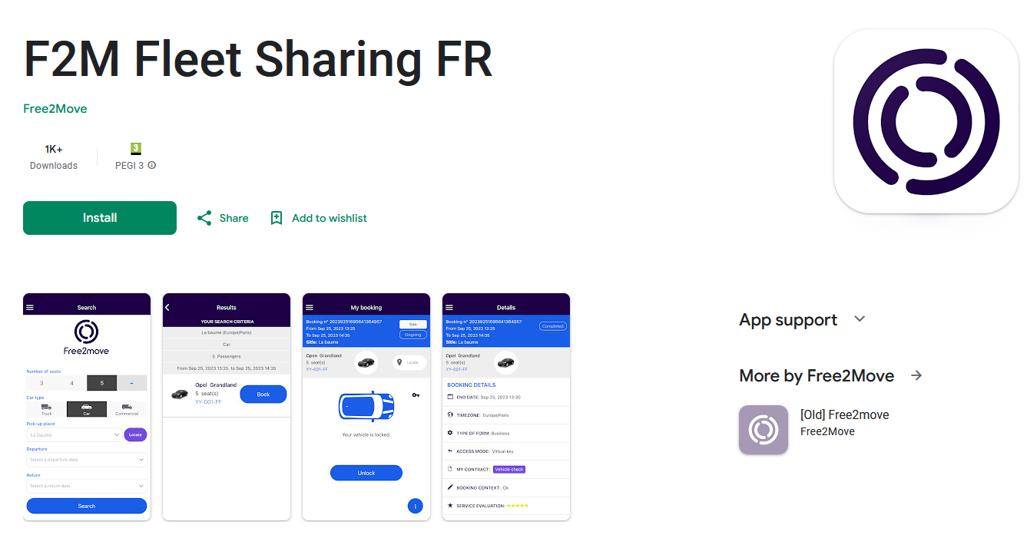

Free2move solution : 2025 and beyond
IT-4767 (Provision and Support of a software solution for CERN’s car sharing service and car fleet management)
Test deployment ongoing with approx. 10 cars (SCE + EN + HSE )
Same Hardware will be used (Kuantic)
Monitoring and decision making by end of March 2025
Progressive Glide solution replacement until end of June 2025
https://play.google.com/store/apps/details?id=com.sogeti.inblue.free2move

Slide 16


Increase of local car-sharing solution in 2025
Replacement of Glide solution for existing cars + extension for new cars
Progressive sharing per parking/building area + inter departments
HSE(Fleet sharing)
Sep-25
IT (Fleet sharing)
Oct-25
June-25
EN (Fleet sharing)
July-25
+17 cars
EP (Fleet sharing)
BE/SY (fleet Sharing)
Aug-25
+10 cars
+10 cars
+ 10 cars
+3 cars
End 2025 ~150 cars shared (including local car sharings)
Car sharing
Users: 1739
(+24%)
Bookings: 32’429
(+19.5%)

Slide 17

