Slide 1
Transforming mobility
CERN’s journey towards sustainability and cost efficiency
Frédéric Magnin – 17.02.2025
Notes:
Facility management network

Slide 2

Long journey
2014 – 2028
Real change mangement project
Data driven
Possibility to combine
  Cost efficiency
  Improved sustainability
  Personnel satisfaction

Slide 3
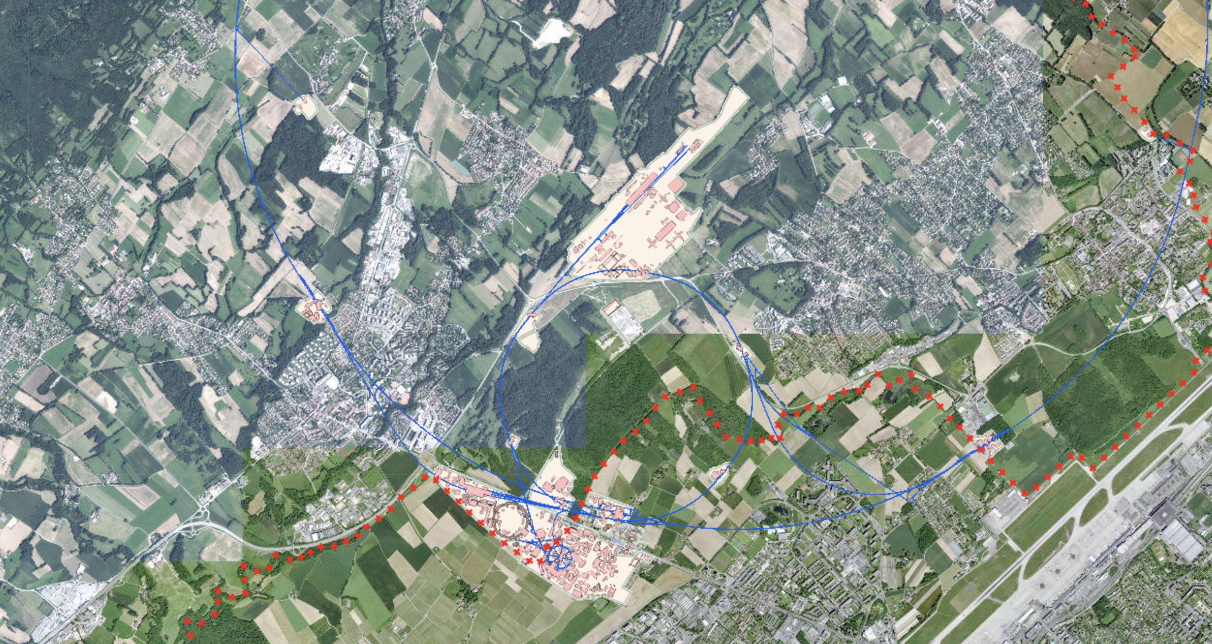
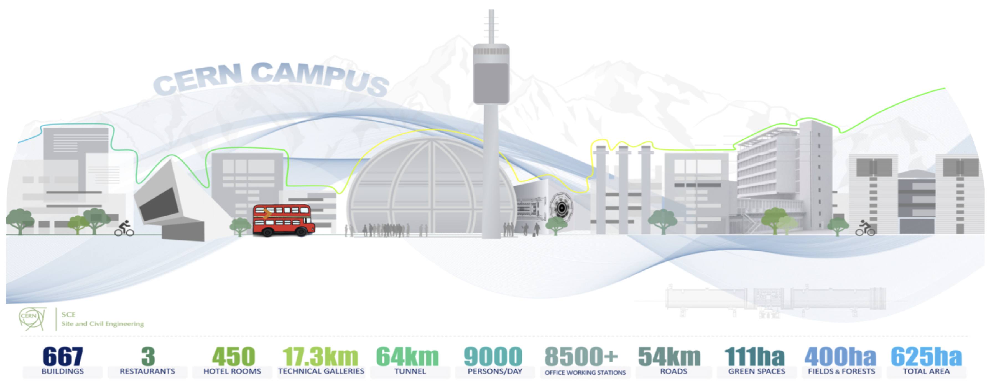
CERN context – Operational organisation

Slide 4
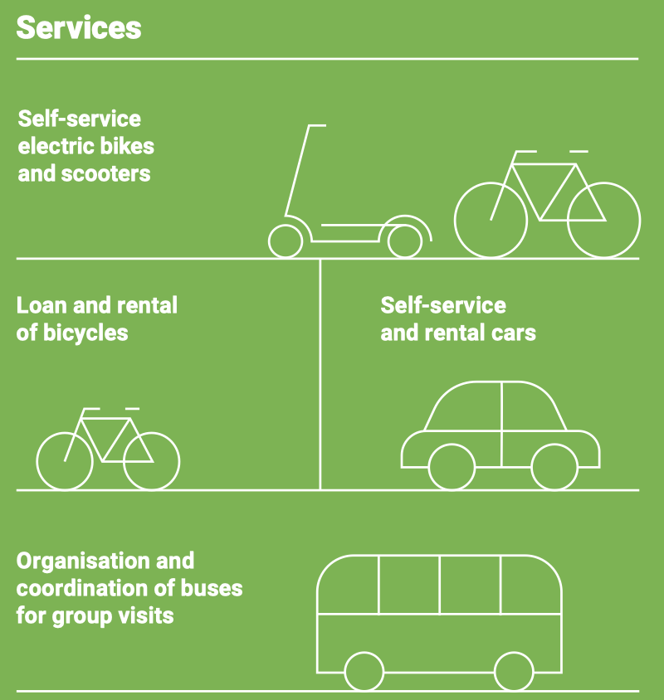


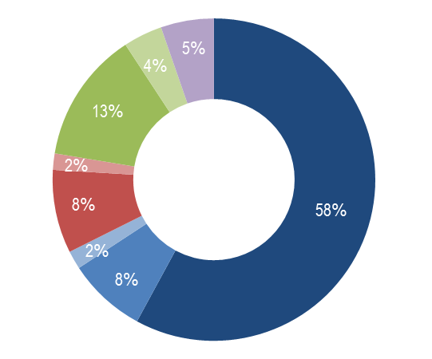







CERN context – Operational organisation
Commuting
+
CERN

Slide 5
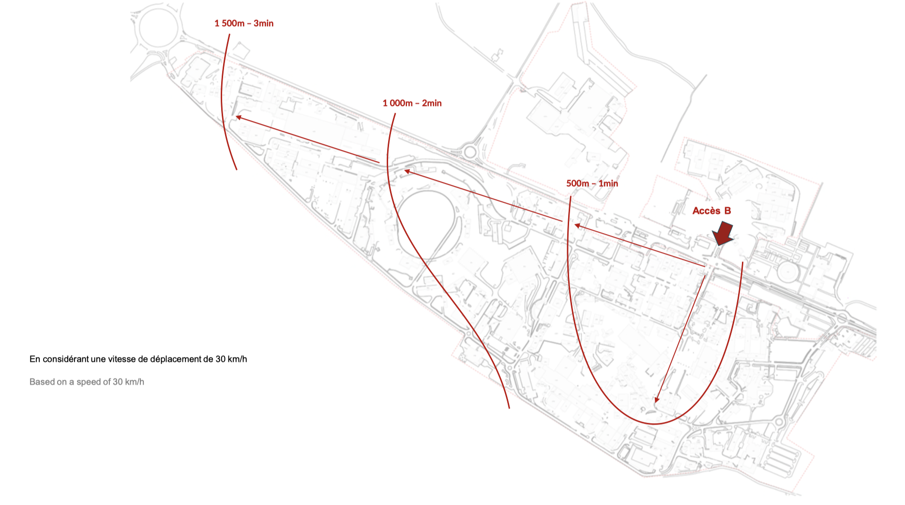
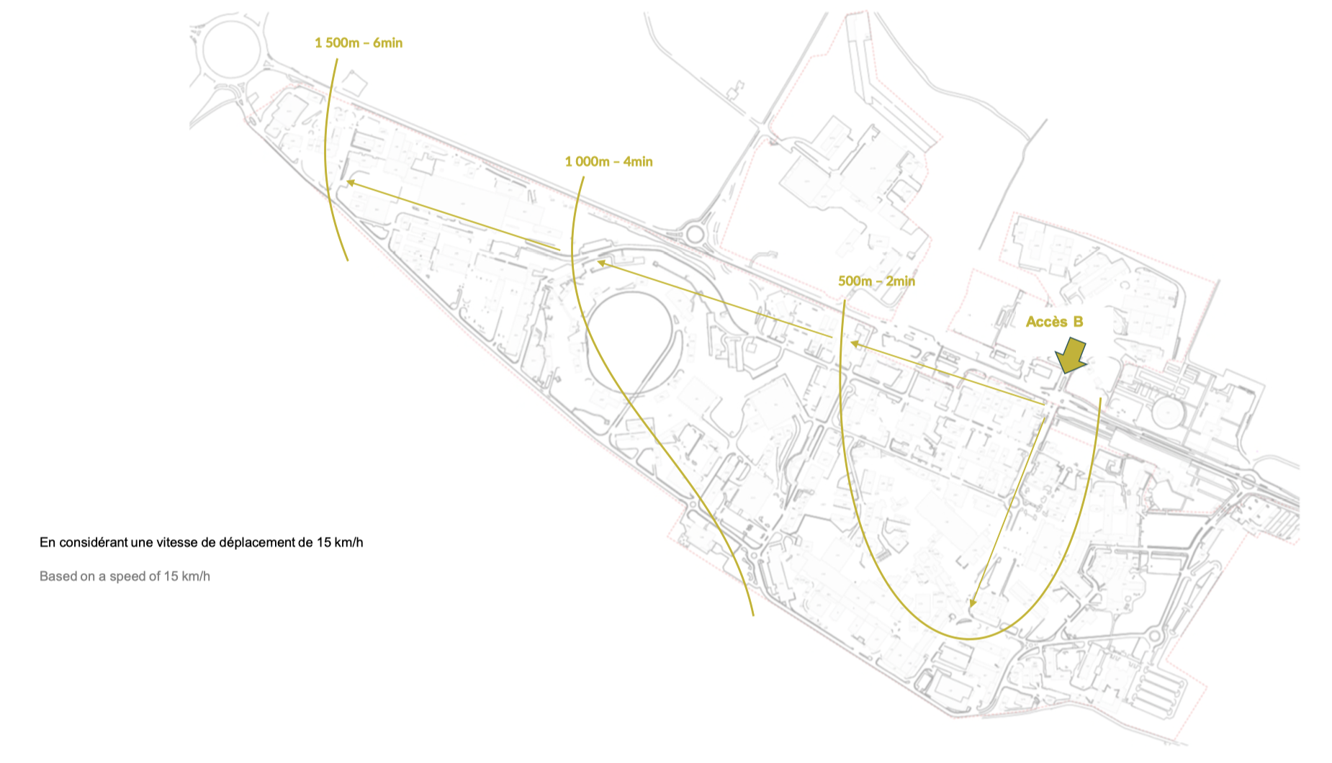
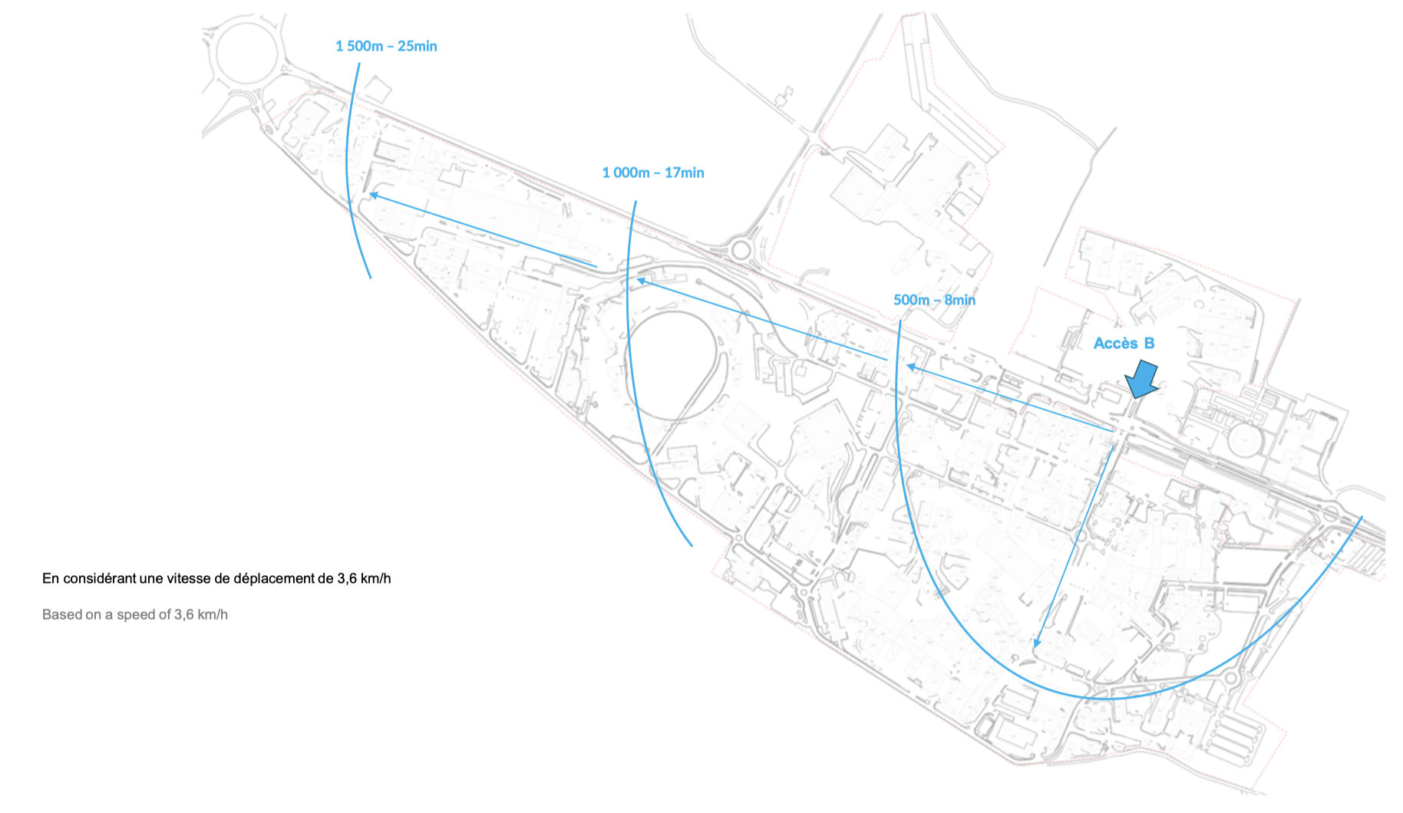
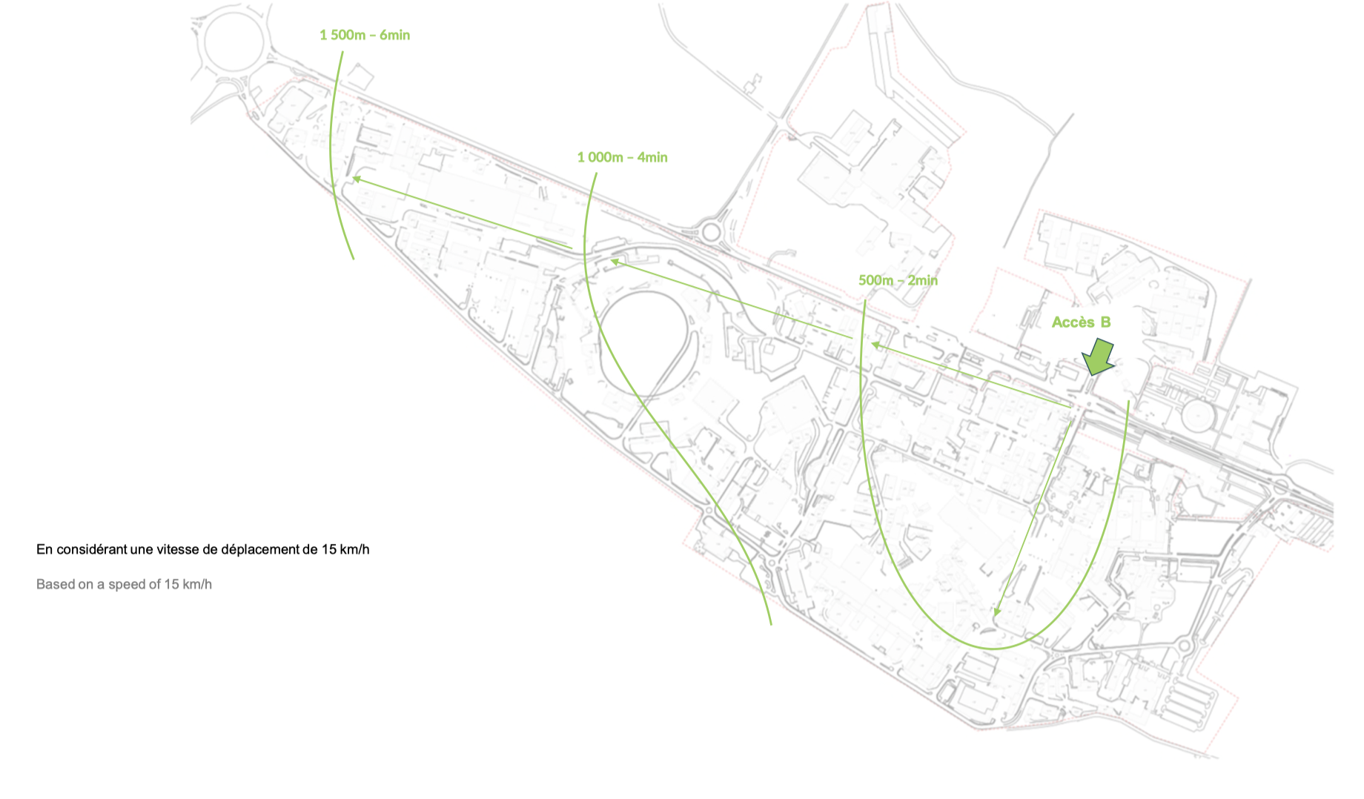

Slide 6
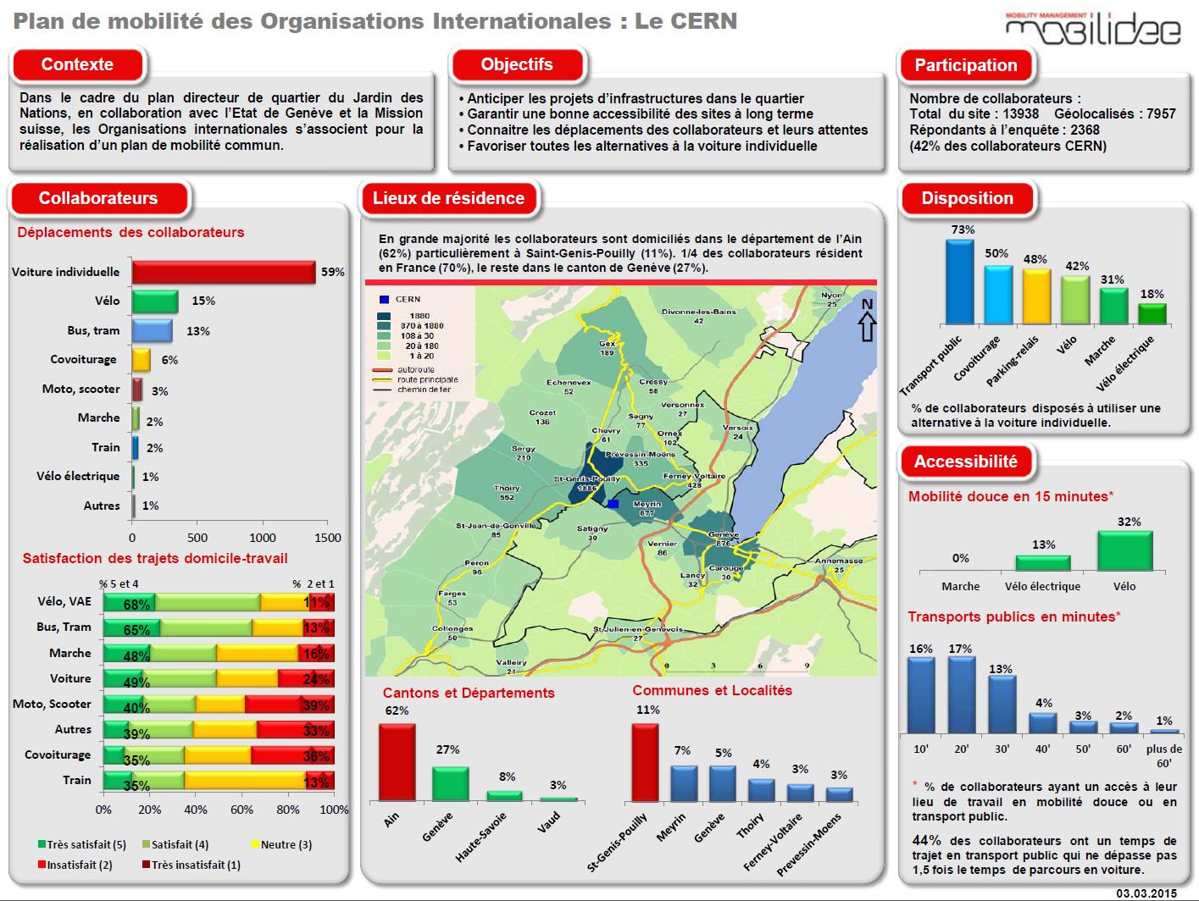
2014 when it all started
Only 30% living in Switzerland with easy access to PT
40% using alternative mode
UNOG - 54% living in Geneva and 48% using alternative mode
Overall satisfaction 50+%
Willingness to switch mode above 40% but under conditions

Slide 7
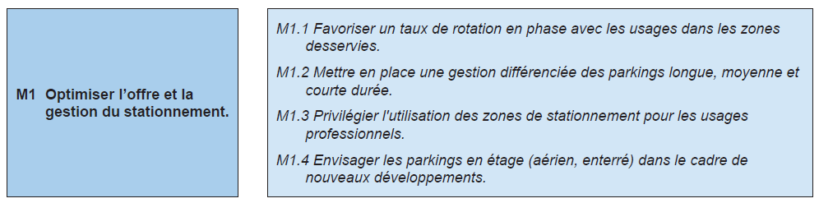
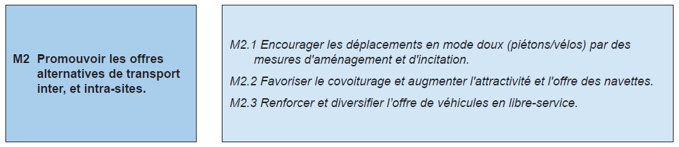
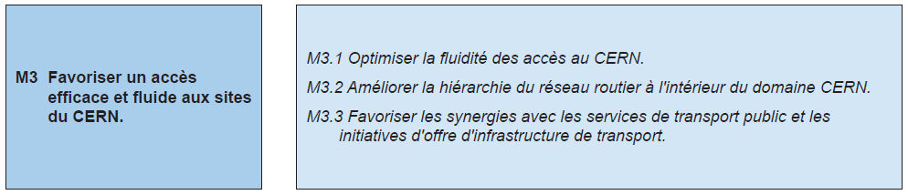
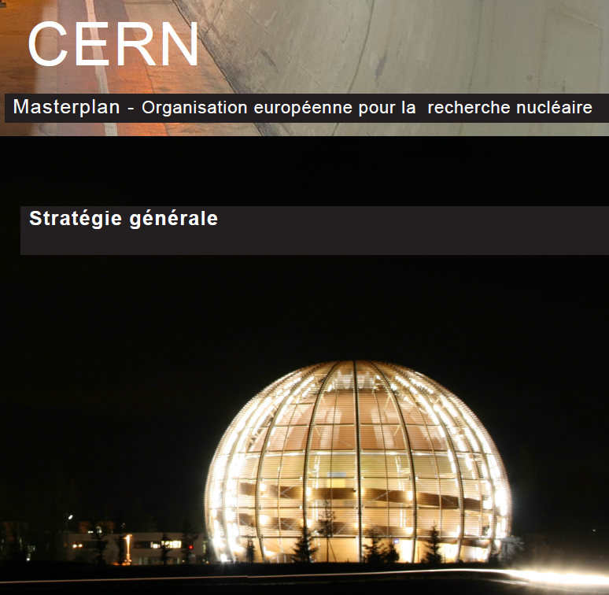
CERN Masterplan 2015-2030 – Mobility
Parking management
Communication
Infrastructure

Slide 8
Turning a vision into strategy - 2017/18
Equal treatment of all modes of transport
Considering the constraints of employees and the organisation
Transparency of measures and criteria
Dynamic and scalable mobility management
Active and continuous communication
Notes:
Basic principle

Slide 9

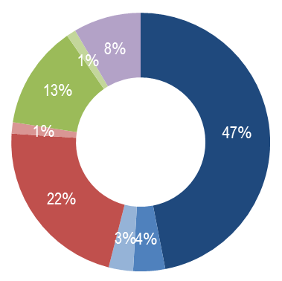
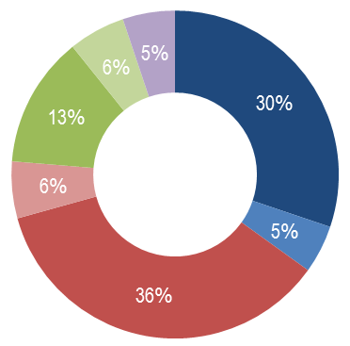

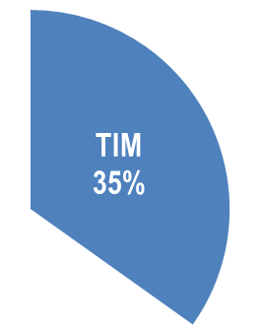
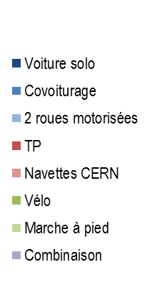
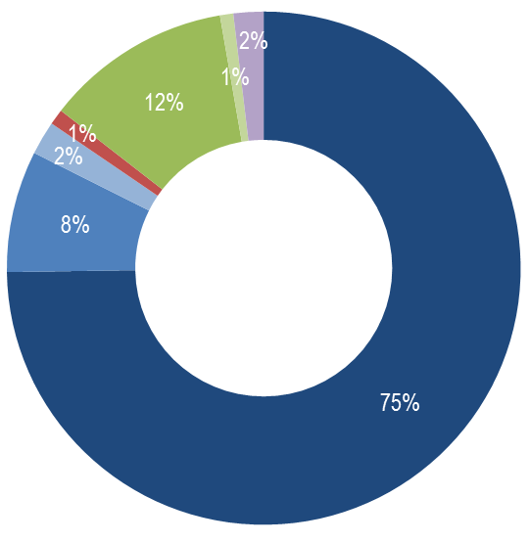
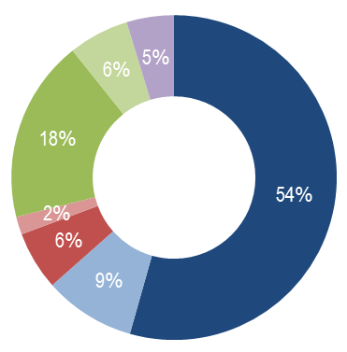
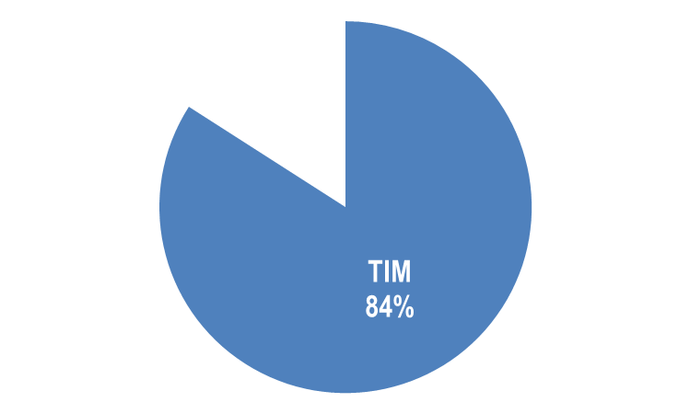
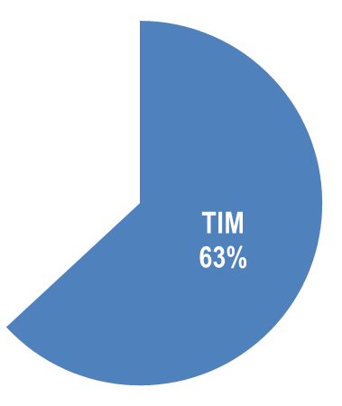
Surveying - diving into the data
CERN Staffs
CERN Users
Living in CH
Living in FR

Slide 10
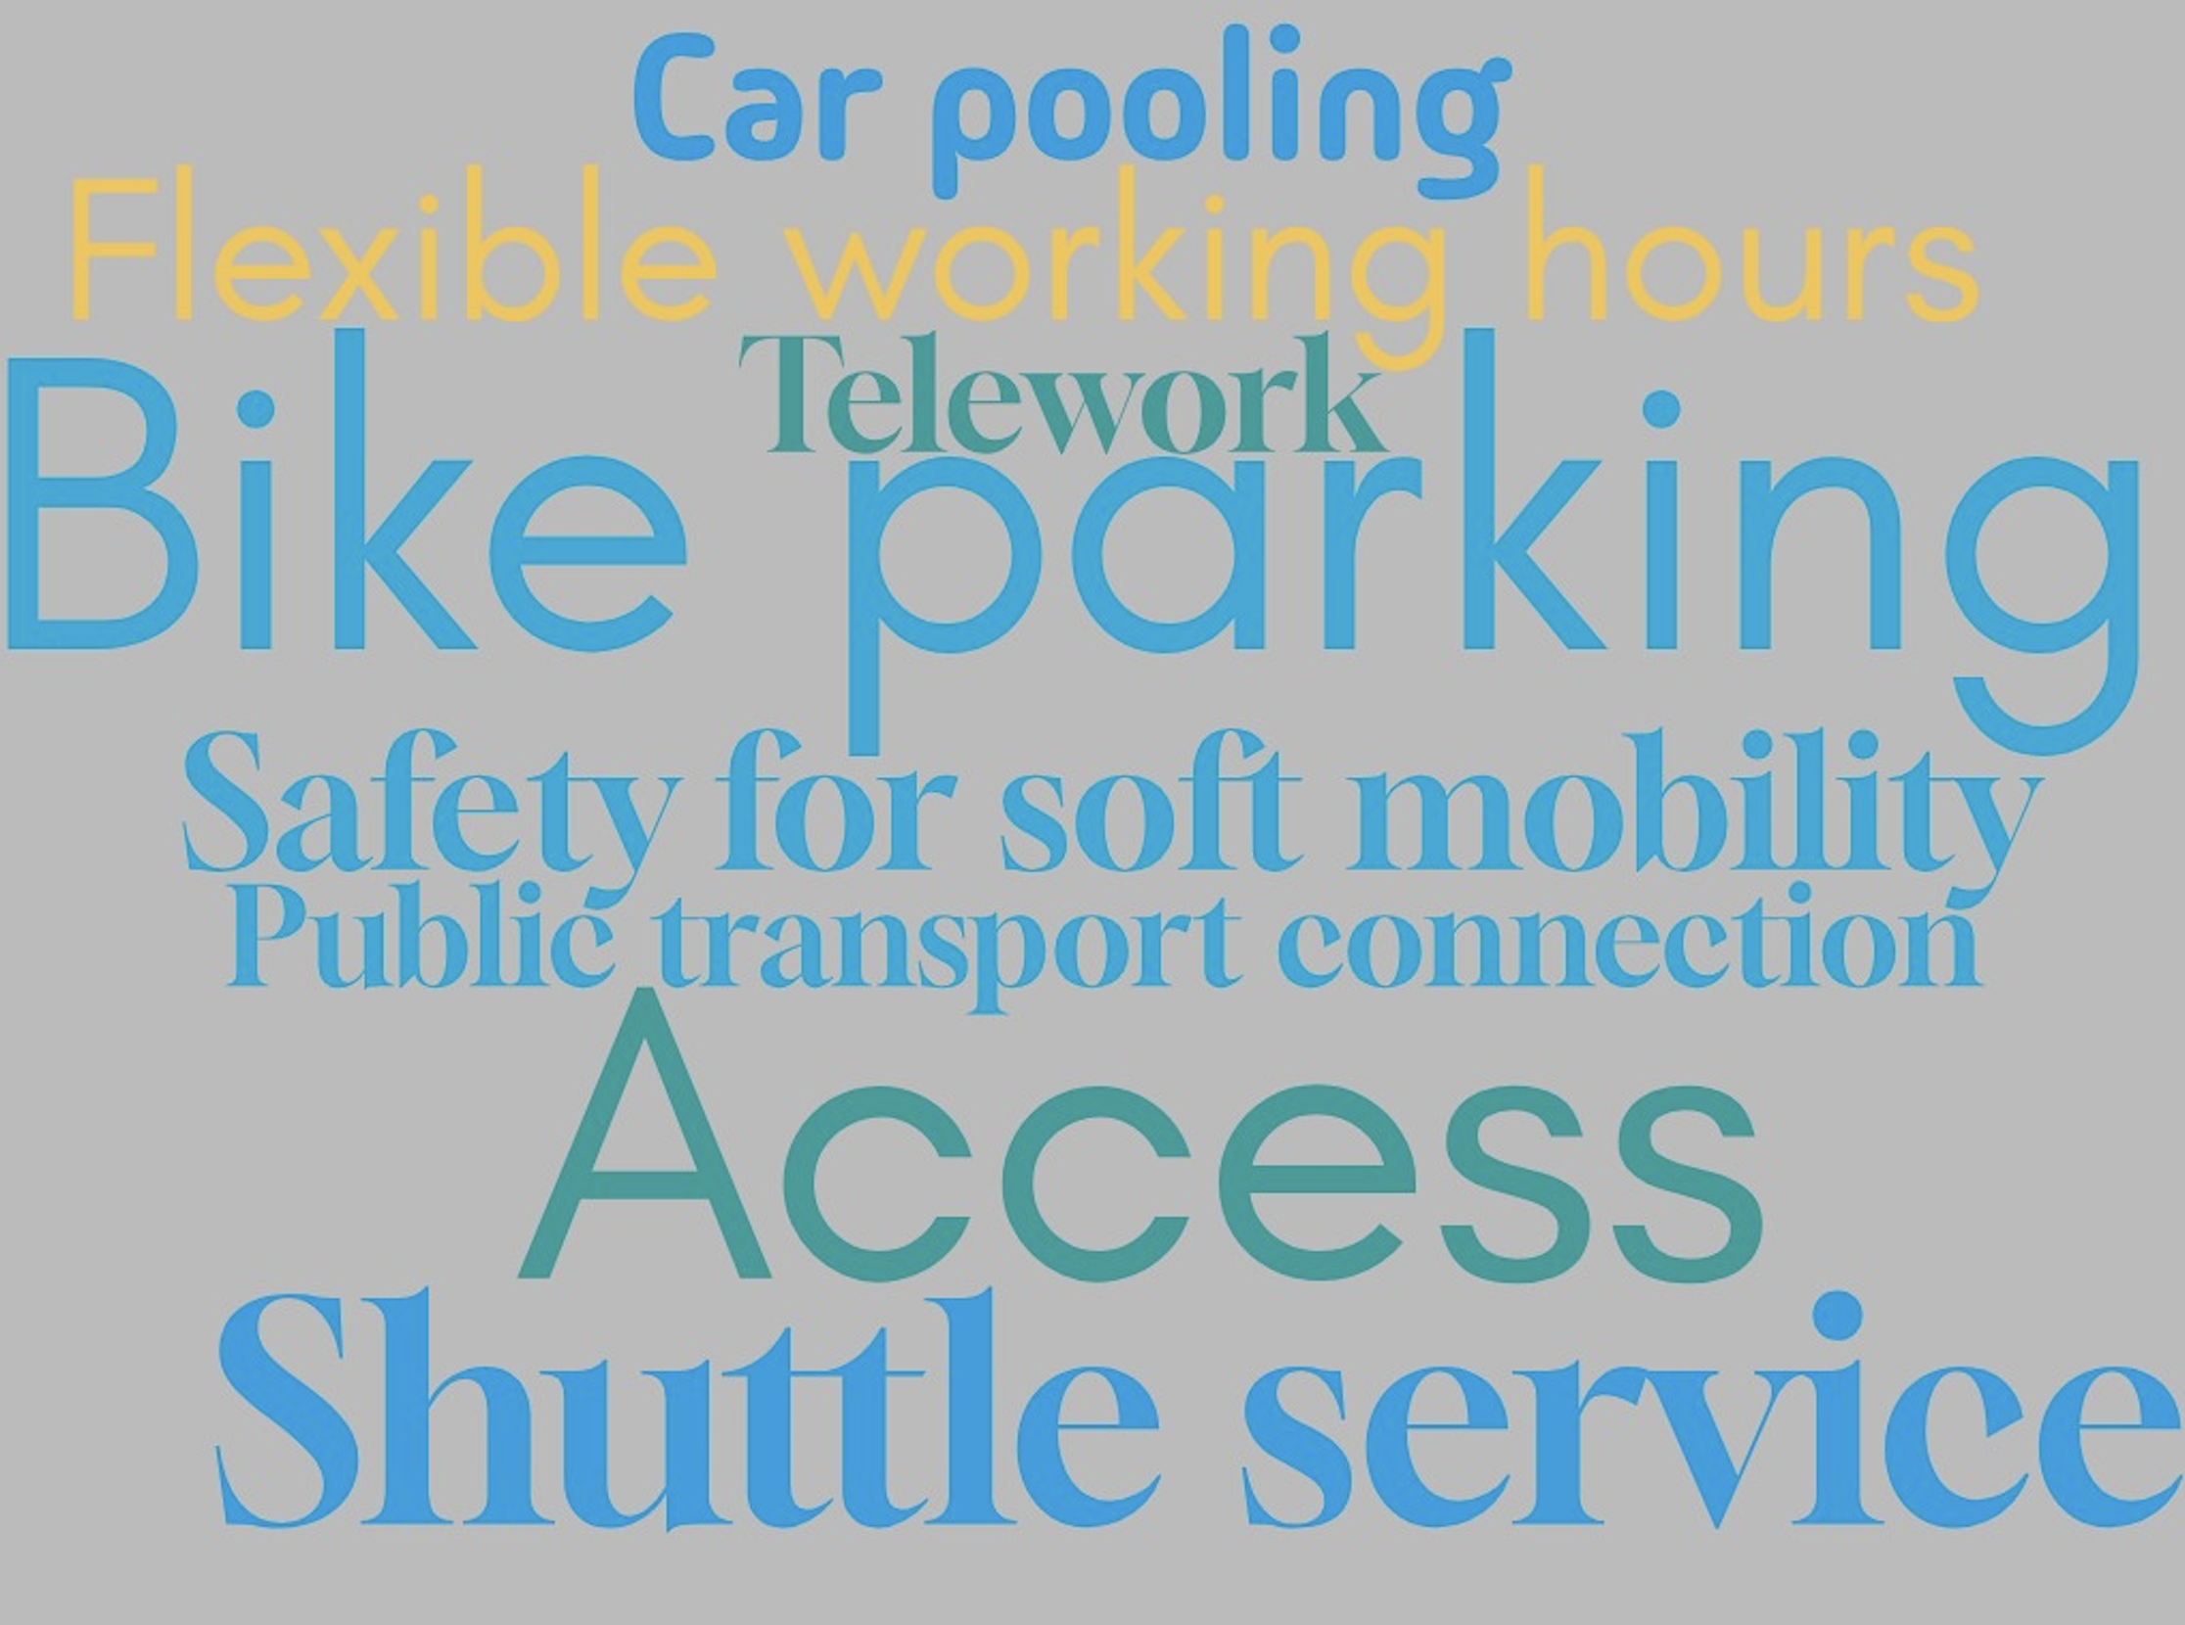

Slide 11
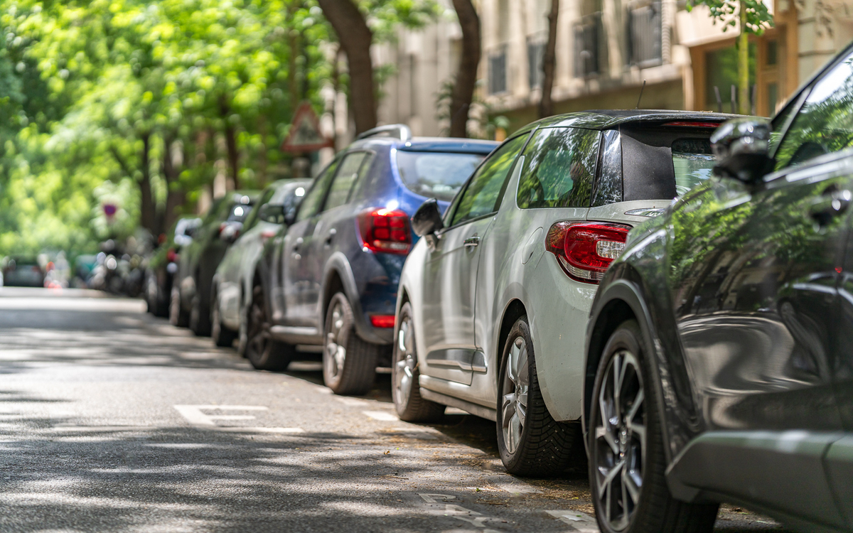

Parking…
About 0.8 parking spot/personnel
50% declare finding a spot near their building
13% declare to have a hard time finding one
No parking management policy in place
Delicate topic…

Slide 12

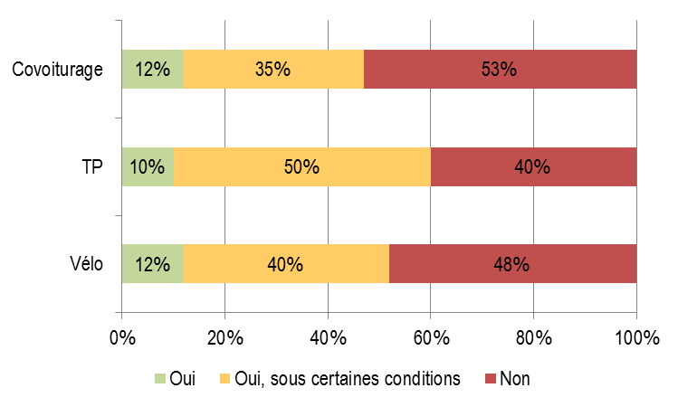



Wilingness to change

Slide 13
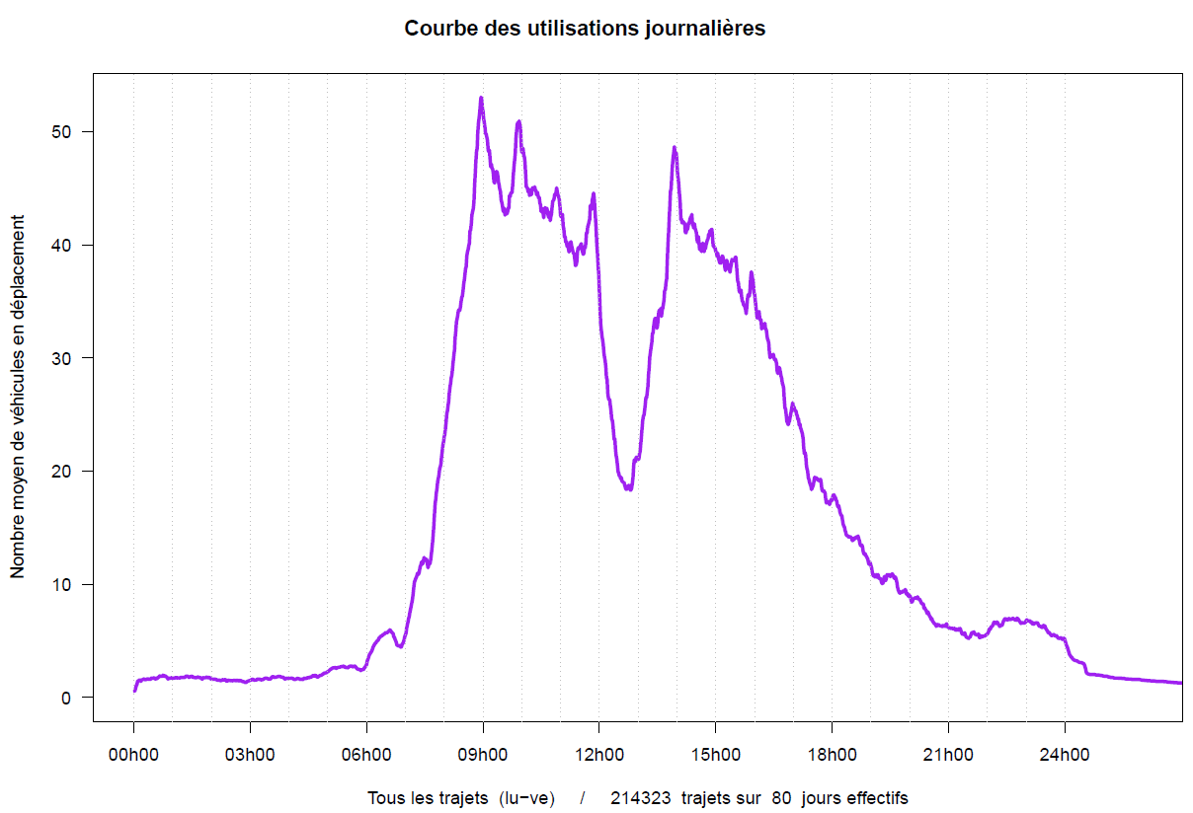
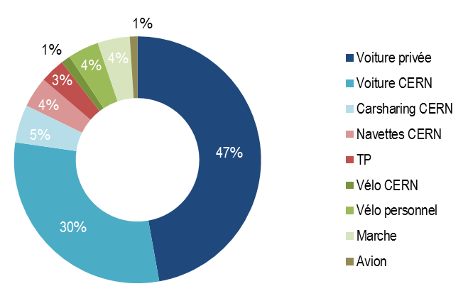
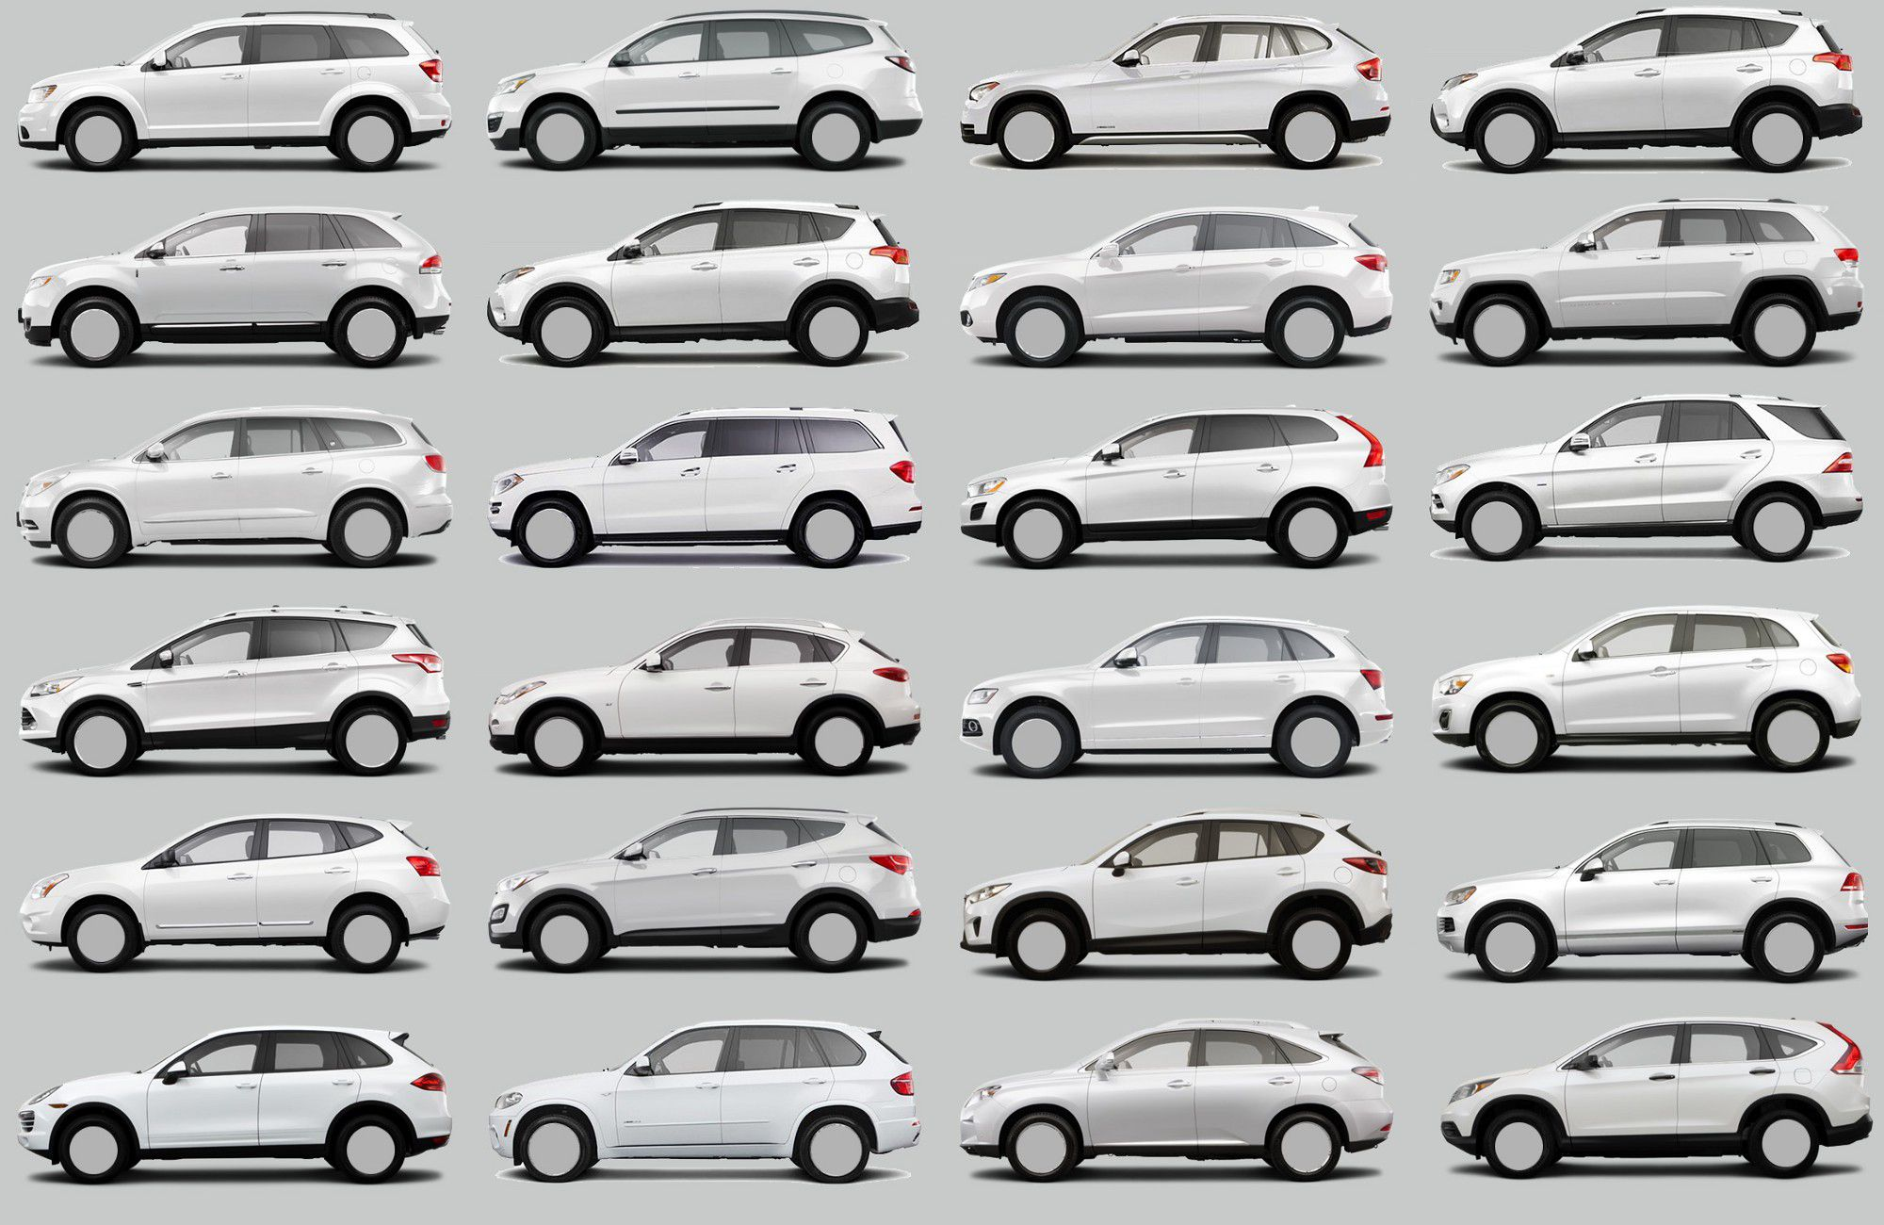
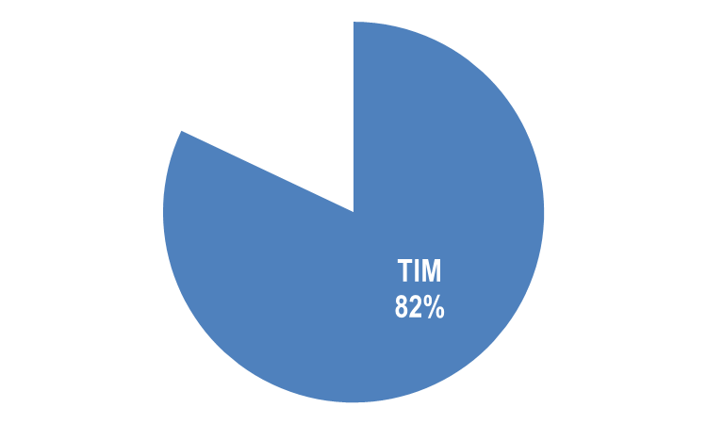

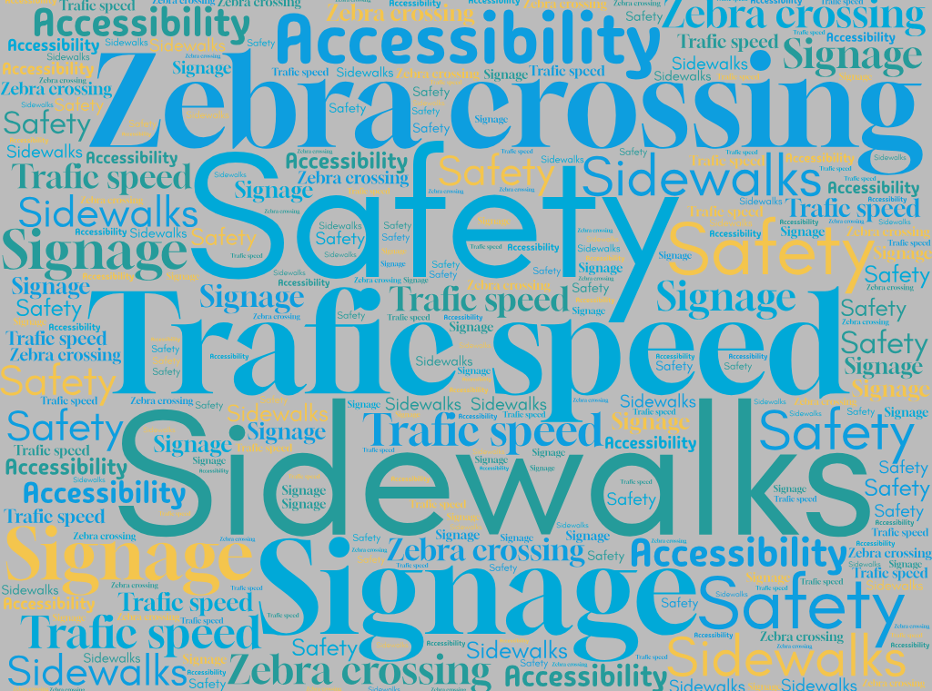

Professional mobility on site
800 cars but only max 50 on the road

Slide 14








Action plan
Action | Cost impact | GHG Emission
CERN car fleet reduction and free floating | -1.6MCHF | -1.3%
CERN bikes | +40 kCHF | -0.12%
Shuttle service | +250 kCHF | -1.3%
Carpooling | +310 kCHF | -0.6%
PT subvention | +300 kCHF | -4%
Soft mobility subvention and infra | +600 kCHF | -6%
Communication & work organisation | +100kCHF | -1%
TOTAL | 0 kCHF | -15%

Slide 15
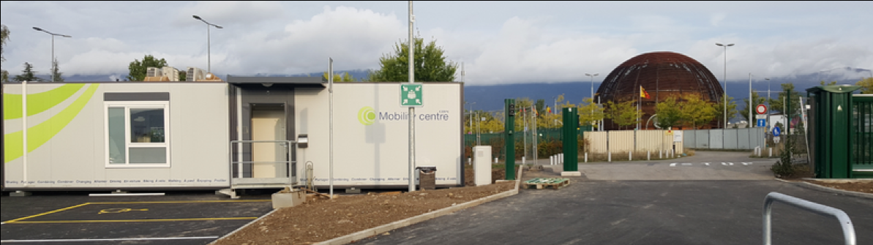
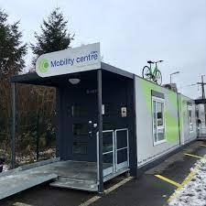
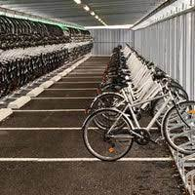
Mobility Center

Slide 16


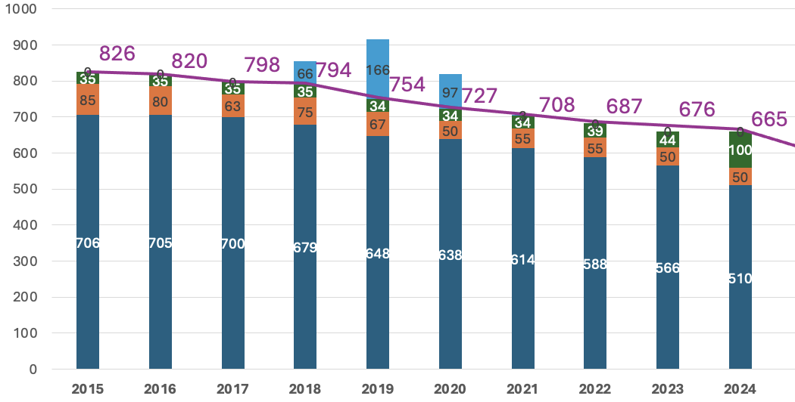
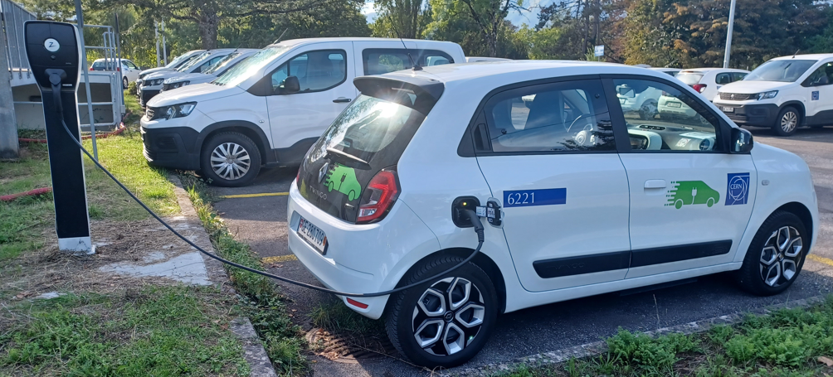
CERN car fleet goes sharing and electric
20 EV in the fleet + 17 charging point

Slide 17
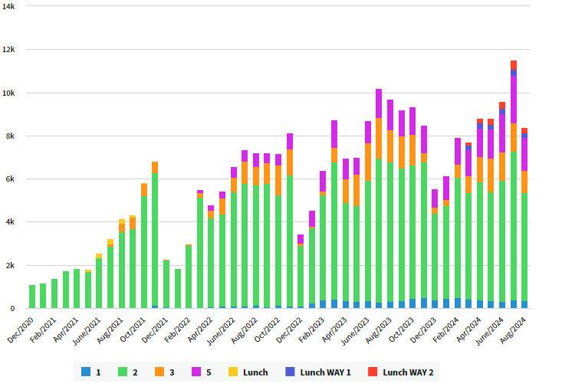
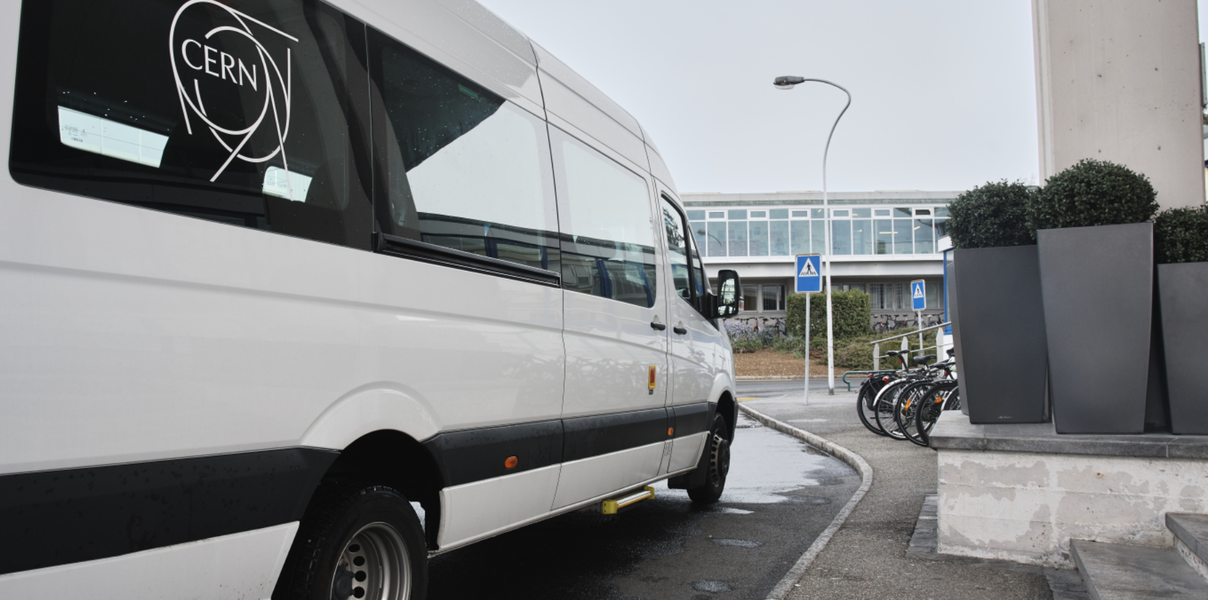
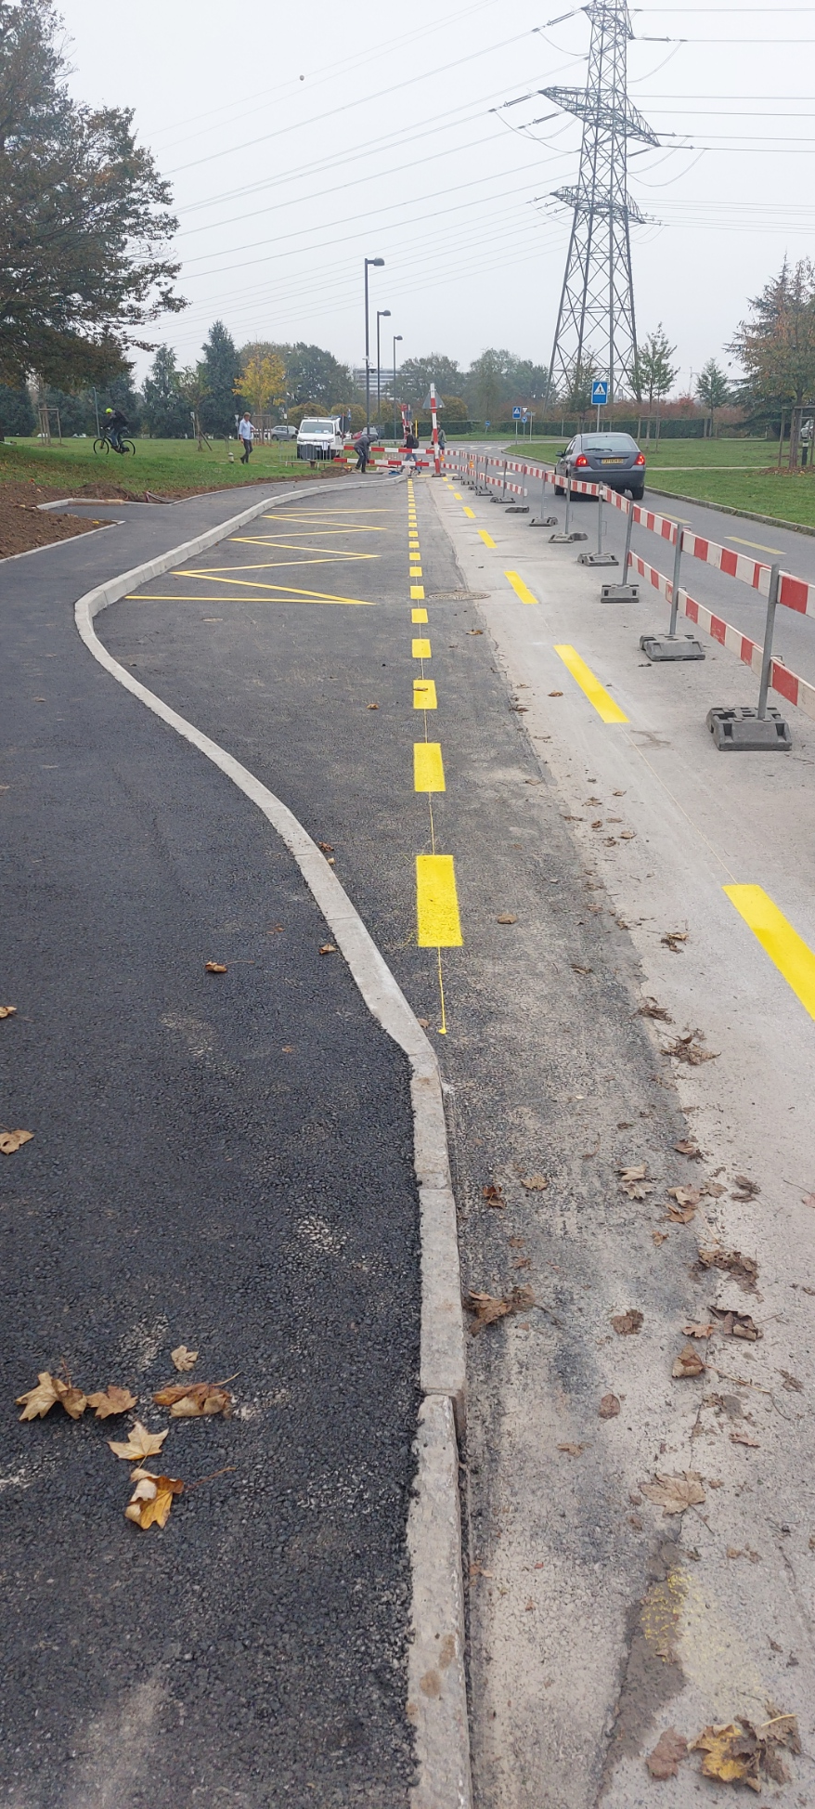
CERN Shuttle optimisation

Slide 18
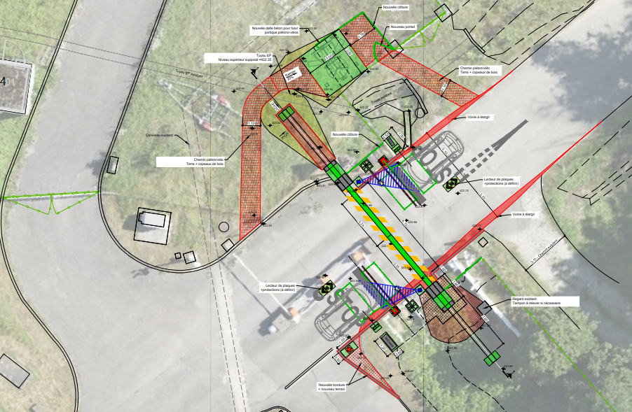
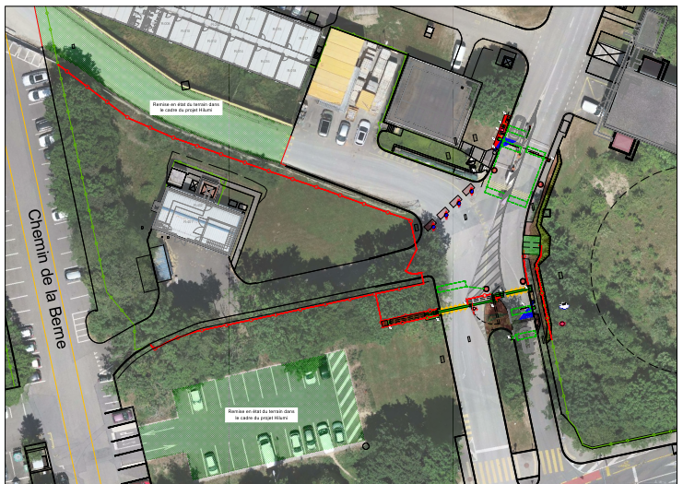
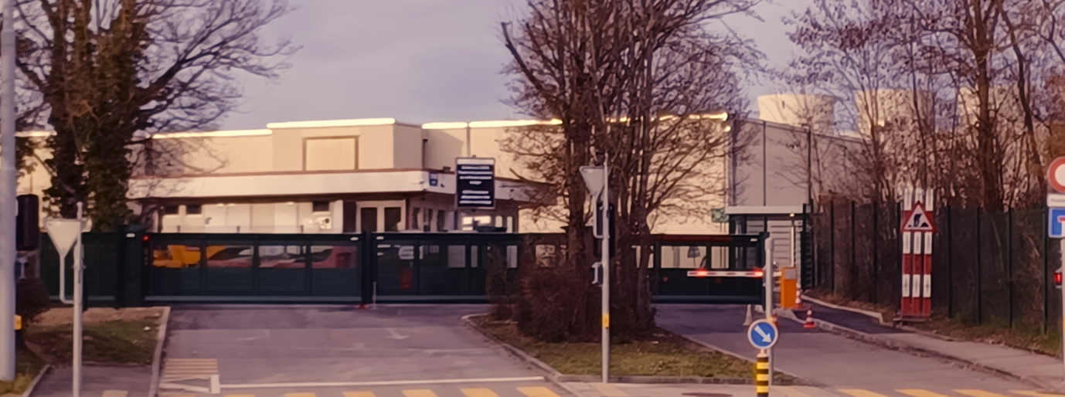
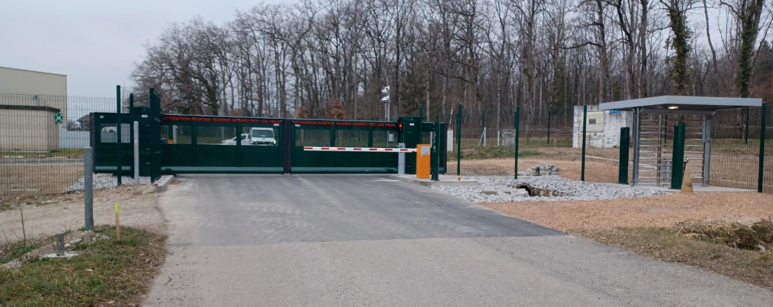
Reorganization of CERN entrances

Slide 19
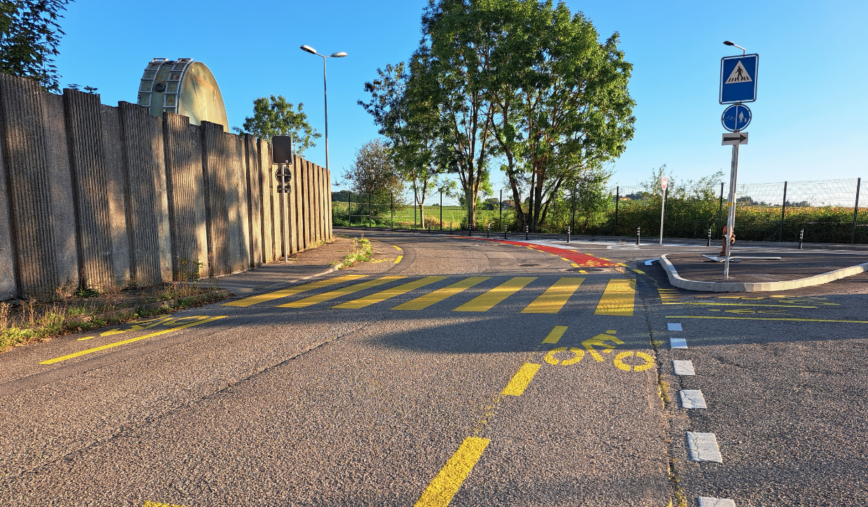
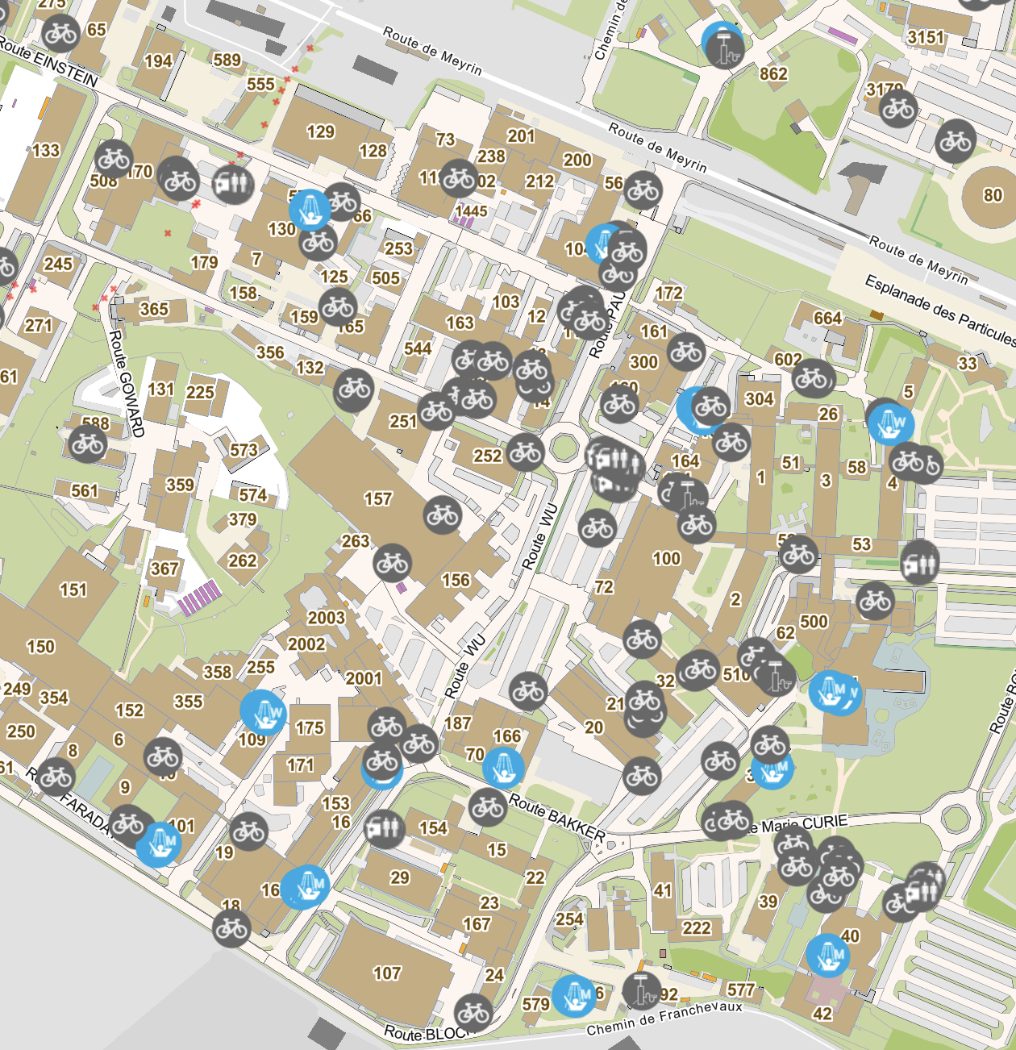
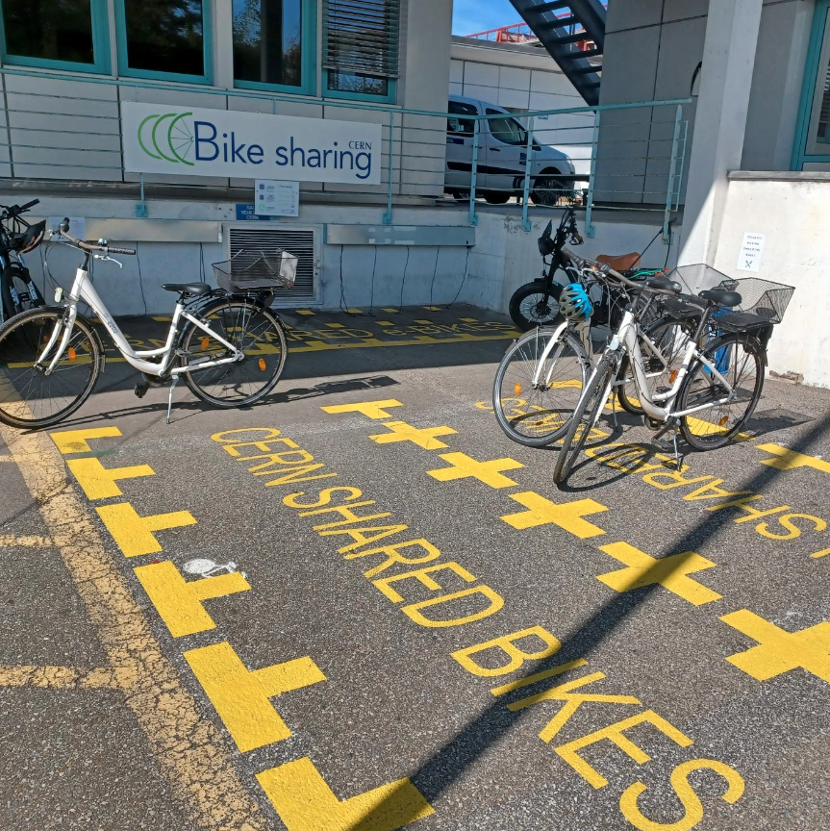
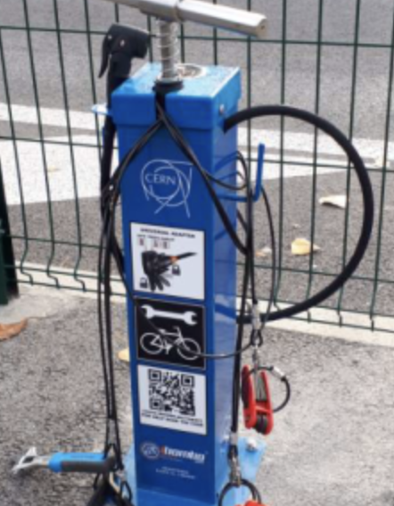
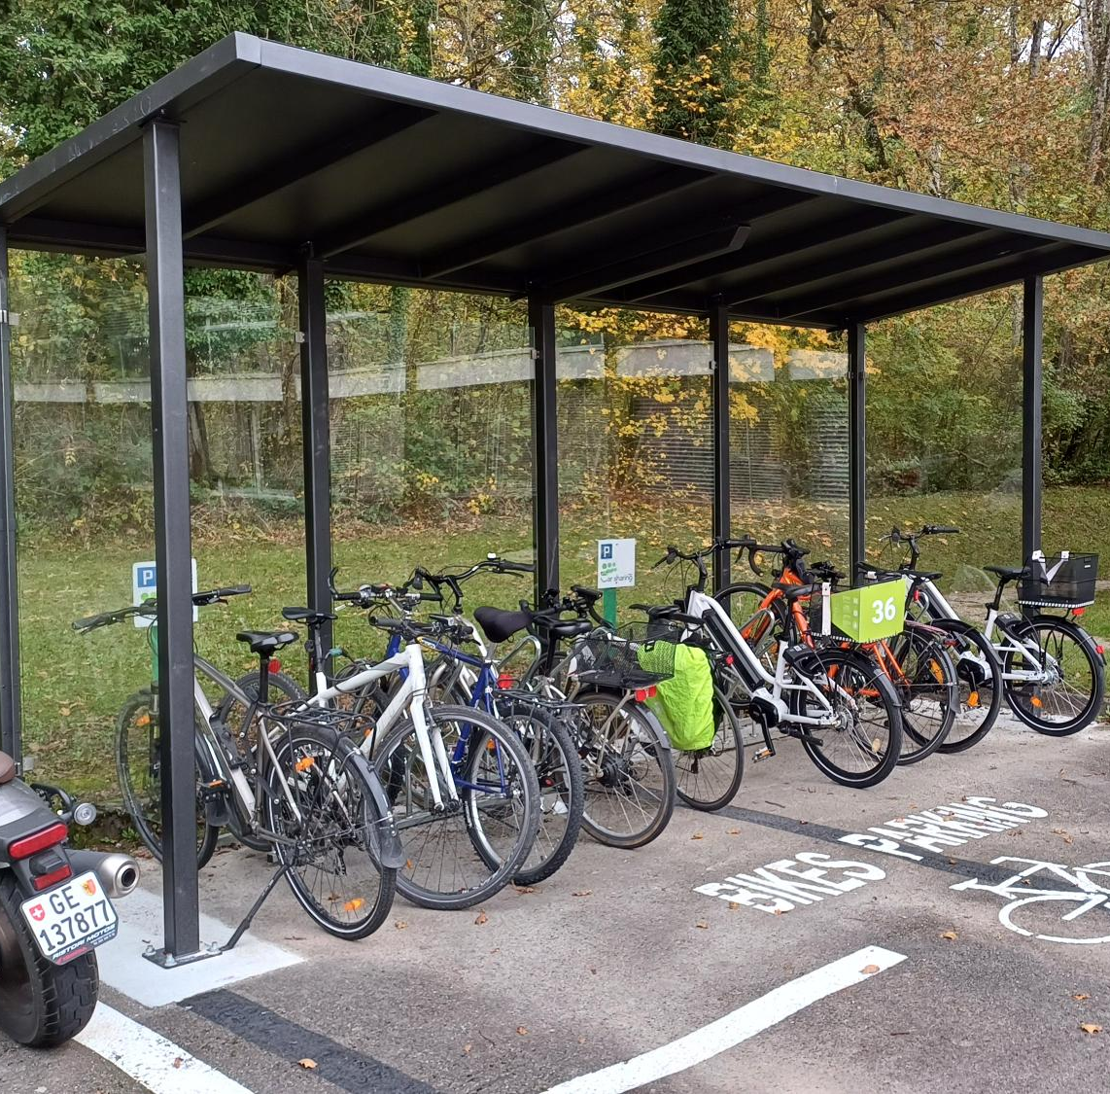
Soft mobility catch-up
3000 bikes park – 30+ public showers – Repair stations – Road marking

Slide 20
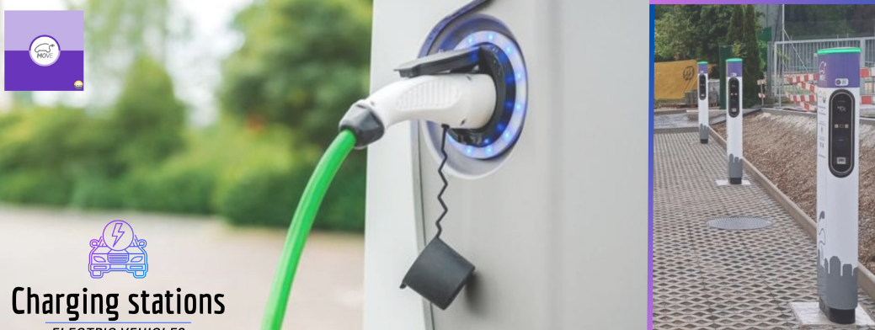
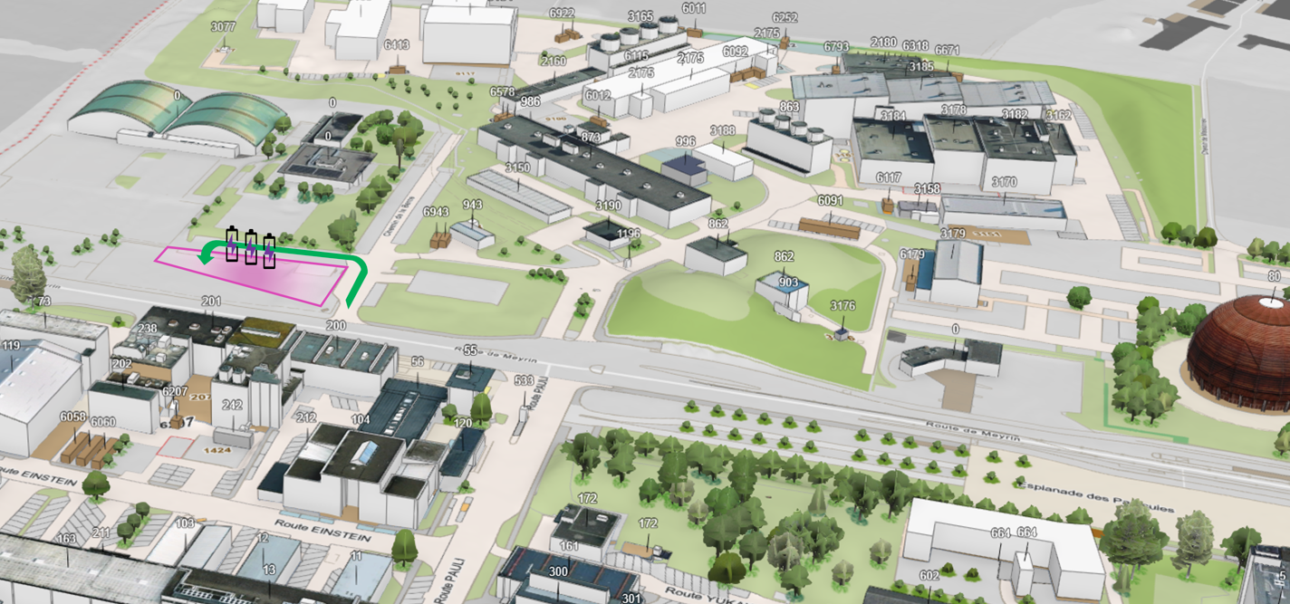
New parking for charging private electrical vehicles

Slide 21

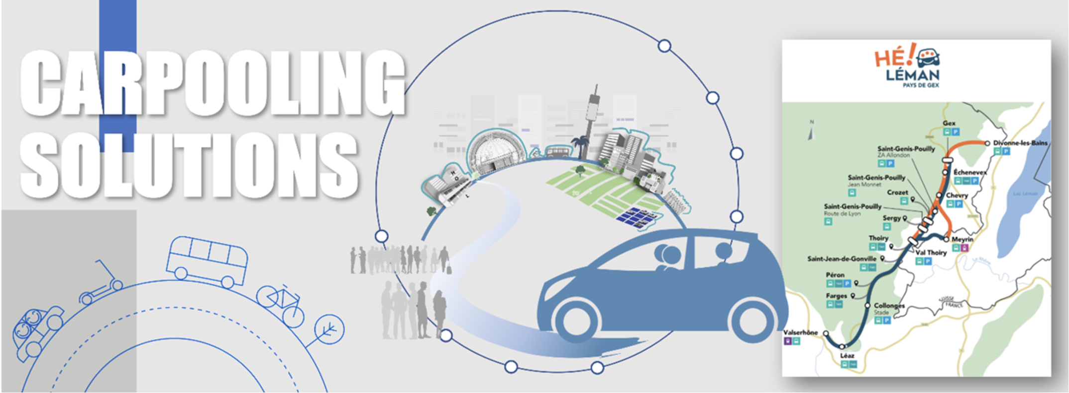

Slide 22
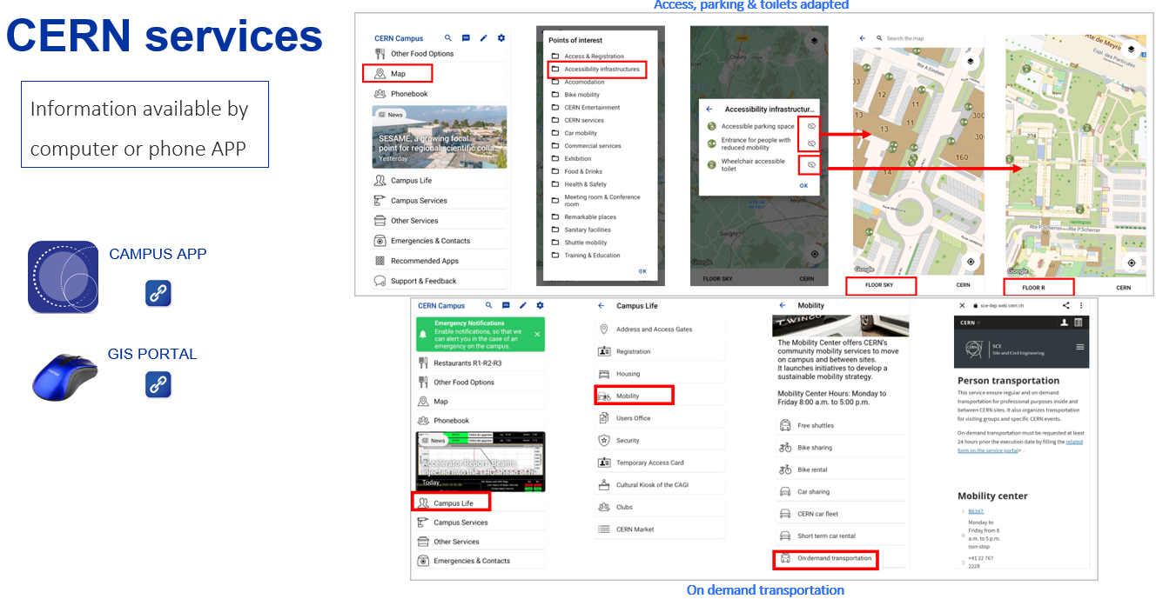


Slide 23


Fostering collaboration with external stakeholders
  New cycling path connections
  New bus stops
  Increased frequency of PT

Slide 24






Indicators evolution
47%
60%
2017
TIM 69%
52%
73%
66%
50%
63%
55%
75%
2023
52%
45%
55%
39%

Slide 25
What’s next
2024-2028

Slide 26
Category | Objective | Target year | Indicator | 2023 | 2024 | 2025 | 2026 | 2027 | 2028 | 2029 | 2030
TIM 1 | Reduce the CERN vehicle fleet by 25% | 2027 | Fleet size | 686 | 676
TIM 1 | Shared fleet of 300 cars | 2027 | Shared fleet size | 44 | 101
TIM 1 | 50% electrification CERN vehicle fleet | 2030 | % e-vehicles | 2.5% | 2.5%
TIM 1 | 65 e-charging stations on FR and CH sites | 2030 | Nb of operational e-chargers | 13 | 35
TIM 1 | Increased electrification of private cars of CERN community | 2028 | Nb of e-charges available for private cars near CERN | 0 | 6
TIM 2 | Increase the percentage of users accessing CERN through carpooling to 15% | 2028 | % users using Carpooling | 7% | 7%
TIM 4 | Operational internal hitchhiking | 2028 | Nb of users using the hitchhiking service | 0 | 0
ALT 1 | Improvement of 20 km of sidewalks, pedestrian paths, and cycling lanes networks | 2028 | Nb of km upgraded | --- | 0.5
ALT 2 | Increase the community accessing the site by bike or by foot up to 30% | 2028 | % of users accessing CERN by bike or foot | 19% | ---
ALT 2 | Increase available bicycle parking spaces by 1600 (from 1530->3130) | 2024 | Nb of bike parking places on site | 1465 | 2600
ALT 2 | Increase covered bicycle parking spaces by 500 (800->1300) | 2026 | Nb of covered bike parking places on site | 800 | 1300
ALT 2 | Install 10 private electric bicycle charging points | 2028 | Nb of bike parking places with e-chargers for private bikes | 2 | 2
ALT 3 | Increase the number of km for internal displacements by bike in 50% (e-bike sharing service) | 2028 | Nb of km of internal displacements by bike | 99855 | 105,627
ALT 3 | Increase the number of electric bicycles to 100 | 2028 | Nb of e-bikes in the fleet | 80 | 95
ALT 4 | Adapt shuttle schedules and frequencies to reduce service cost per traveler by 10%. | 2028 | Average cost per trip per person (CHF) | 7.86 | 8.68
ALT 4 | Install 4 shelters at sensitive or high-traffic shuttle points | 2025 | Nb of bus shelters on site | 0 | 4
ACC 1 | Renovation of entrances at different sites to enable independent access for vehicles, bicycles, and pedestrians in complete safety | 2028 | % of gates with soft-mobility access features | 56% | 70%

Slide 27



Car Fleet evolution
Ambitious targets but low risk thanks to an implementation model based on data analysis, cooperation, flexibility and transparency

Slide 28






EV chargers for CERN vehicles
MEYRIN-LHC1-SM18
PREVESSIN
LHC-5
LHC-2
LHC-8

Slide 29

Shuttle service evolution
New contract signed with all electric shuttles
Increase visibility
Increase frequency

Slide 30

Hitchhiking on site
Accessible to all
Secured environment
Foster community spirit
Highest frequency
Cheap

Slide 31
Commute mobility
Several initiatives to be further explored
Corporate shuttle or self driving shuttle
Incentive to carpool
Contribution for Public transport annual pass
Incentive to walk/cycle to work

Slide 32





Smart mobility flyer

Slide 33

Smart mobility week
2 events of one week for 2 years (September-March)
Incentive to try alternative transport mode for one week
  Try to adopt
  Gamification
  One car-free day
Offering
  Self driving shuttle for commute
  Electric bike for commute
  Bike repair truck
  Financial contribution for public transport ticket
  Rewards for those who try

Slide 34

Conclusion
Sustainable mobility
  Does not need to be costly
  Imposes limited constraints
  Generates overall satisfaction increase
It is about managing change and unlocking resistance
It is positive for the environment, the employees and the organisation

Slide 35











The end…
Contact: frederic.magnin@cern.ch

