Slide 1
Anomaly Detection and Forecasting for the KFA71/79 Extraction Kicker
SY-ABT-BTP
Algelly Malik
Supervisors: Francesco Velotti & Kostas Papastergiou

Slide 2
Content
1. Context
EPA WP8 goals,
KFA71/79 importance.
2. KFA71/79
System Overview
Key components,
challenges.
3. Proposed Approach
Anomaly detection pipeline.
4. Data & Models
Waveform analysis,
VAE/CVAE.
5. Results & Outlook
Insights and future directions.
6. Continual Learning
Requirements and benefits.

Slide 3
Context
PhD at CERN: Continual Learning for anomaly detection and forecasting in accelerator systems.
Part of the Efficient Particle Accelerators (EPA)[1] project:
  Work Package 8 (WP8) : Equipment Automation[2] : reduce downtime through predictive maintenance and automation of critical equipment.
Current focus: Anomaly forecasting for the KFA71/79 extraction kicker magnet in the Proton Synchrotron (PS).

Slide 4
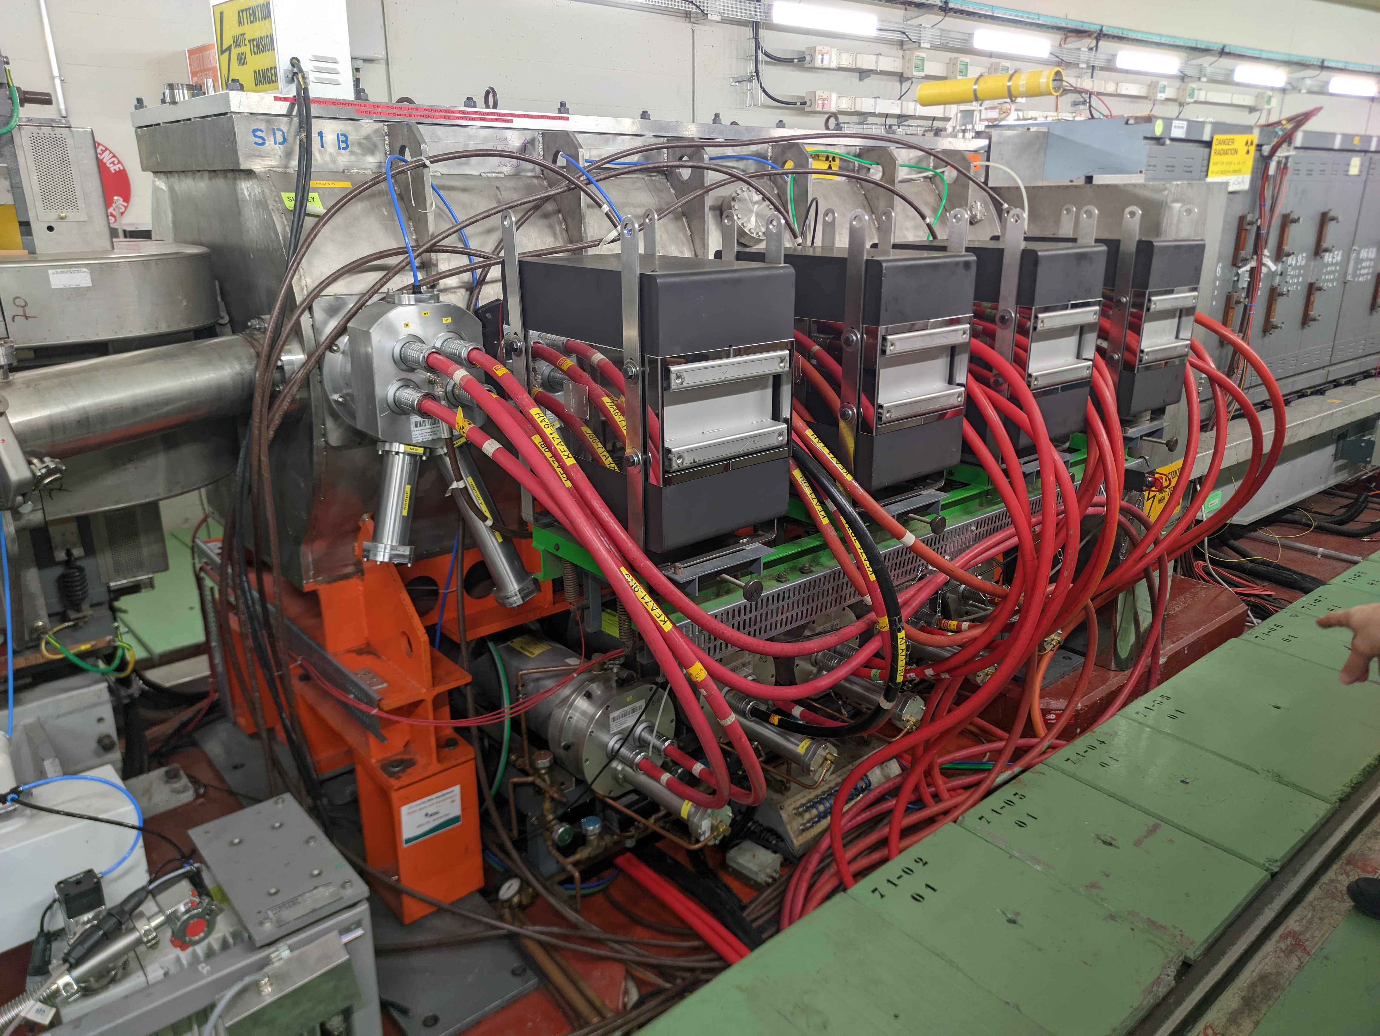
System Overview – The KFA71/79 Extraction Kicker
Purpose: Fast-pulsed magnet system to extract particle beams from the Proton Synchrotron (PS).
Components: 12 generator modules operating simultaneously in vacuum tanks.
  9 modules: Section 71 (KFA71).
  3 modules: Section 79 (KFA79).
Output: High-voltage pulses (~80 kV peak, ~4 μs total duration).
Focus: Main region of interest is ~1 μs within the pulse.
Picture: Modules of KFA71

Slide 5
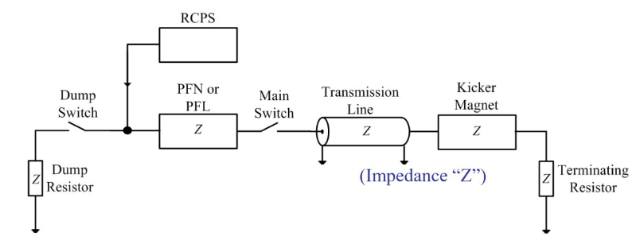
System Overview – The KFA71/79 Extraction Kicker
Charging: RCPS charges the PFL to the required voltage.
Switch Timing: The Main Switch closes at the precise moment for beam extraction.
Pulse Generation: High voltage discharges through the magnet.
Beam Extraction: The beam is deflected onto the transfer line.
Energy Dumping: The Dump Switch redirects remaining energy.
Schema: Simplified schematic of a kicker module [4]
PFL: Pulse Forming Line
RCPS: Resonant Charging Power Supply

Slide 6
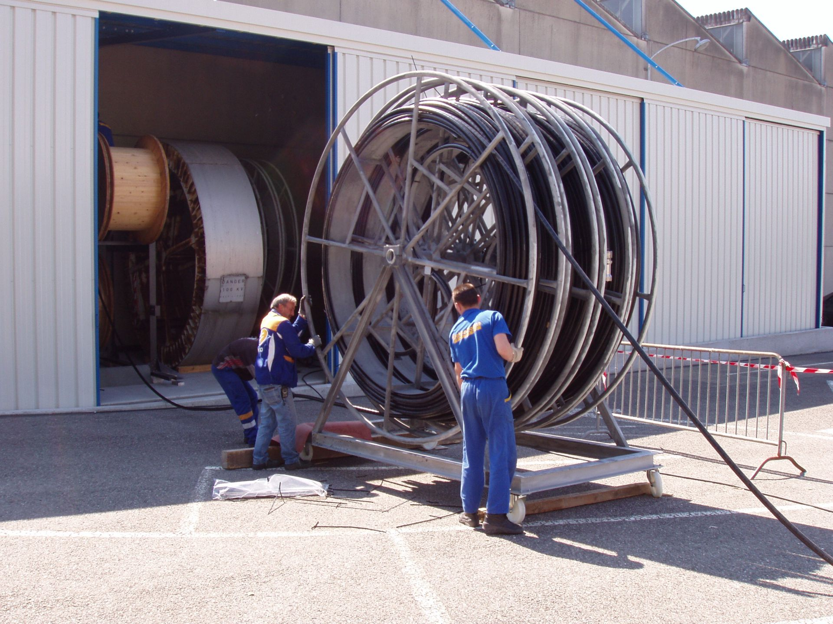
System Overview – The KFA71/79 Extraction Kicker
Picture: CPS PFL DRUM Winding 2005

Slide 7
System Overview – The KFA71/79 Extraction Kicker
Historical and Future Outlook
System installed in the 1970s.
Undergoing a major consolidation project during LS3 [5] to improve:
  Reliability and availability.
  Safety (e.g. replacing mineral oil with ester oil, managing SF6 gas issues).
  Diagnostics and remote monitoring.
  Obsolescence and environmental impact.
Why Focus on KFA71/79
Complex sub-components: HV switches (thyratrons), cables, transmission lines, ferrite magnets.
High risk of beam losses during module failure.
Rich waveform datasets enable machine learning studies.
Aging system = higher anomaly rates.
Current Monitoring Limitations
Threshold-based alarms on selected signals.
Detection occurs after anomalies happen.
Reactive maintenance, not proactive or predictive.
Gaps in addressing long-term reliability.

Slide 8
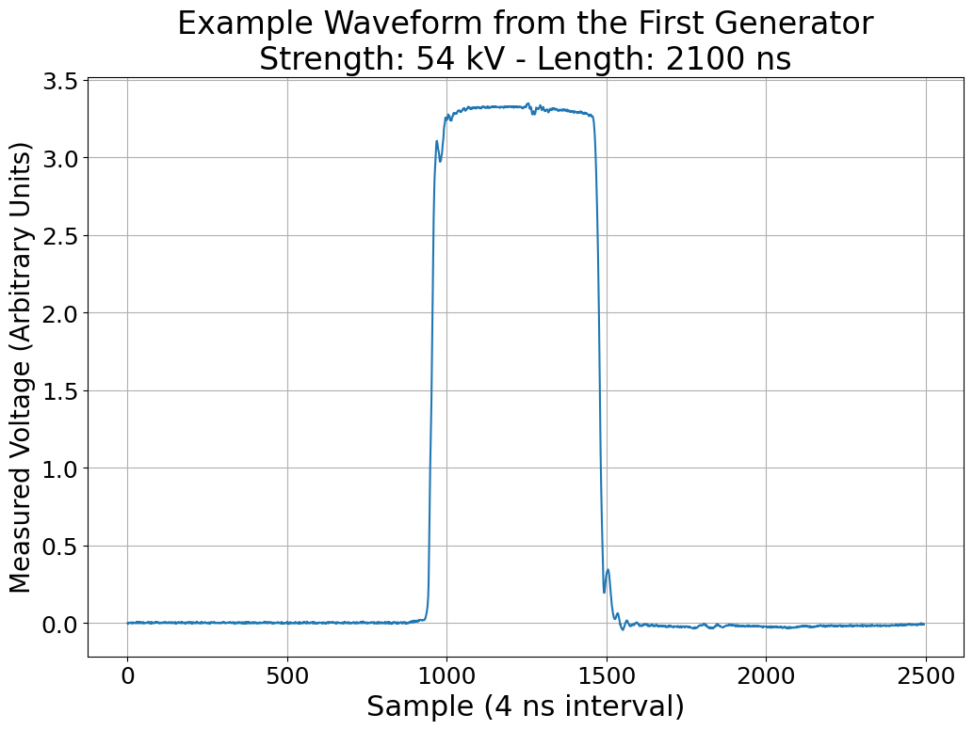
Data Description
Waveform Characteristics:
Sampling Rate: 1 sample every 4 ns for 10 µs → 2500 data points
Signal Content: Short rise and fall times, short plateau region.
12 generators → 12 waveforms per cycle
Pulse Settings: Includes desired pulse strength, pulse length, enabled generators, etc.
Waveforms have been stored in NXCALS since the end of September 2024
→ Current analysis and training focus on October 2024 data.
Length
Strength

Slide 9
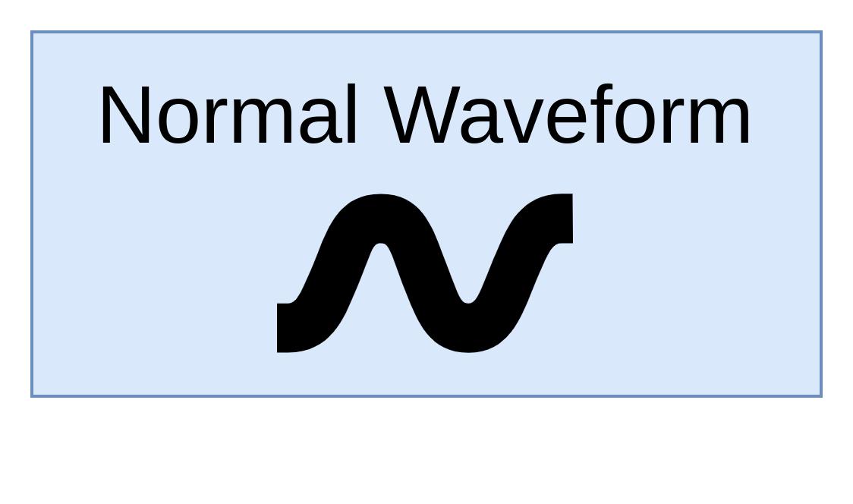
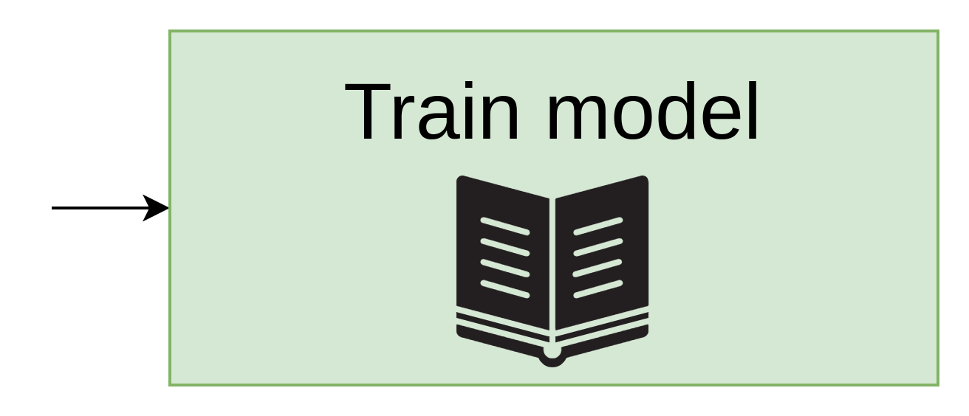
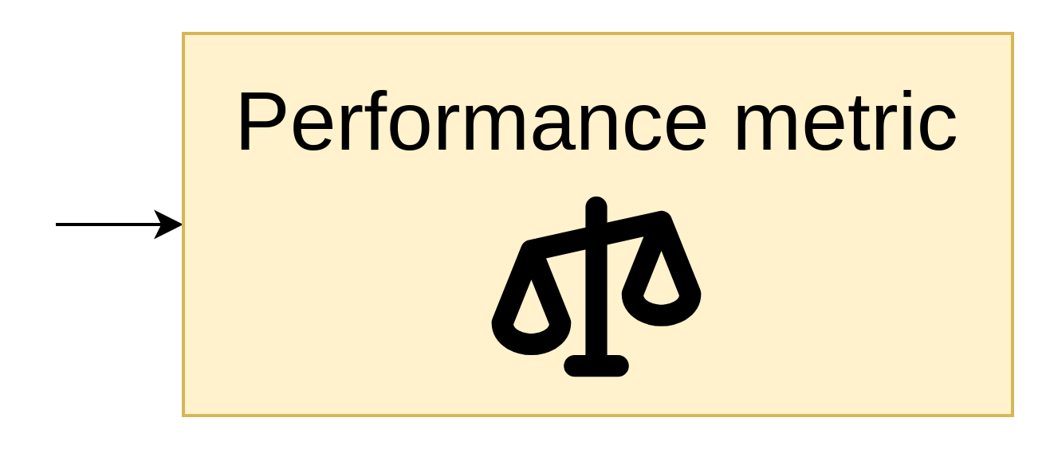
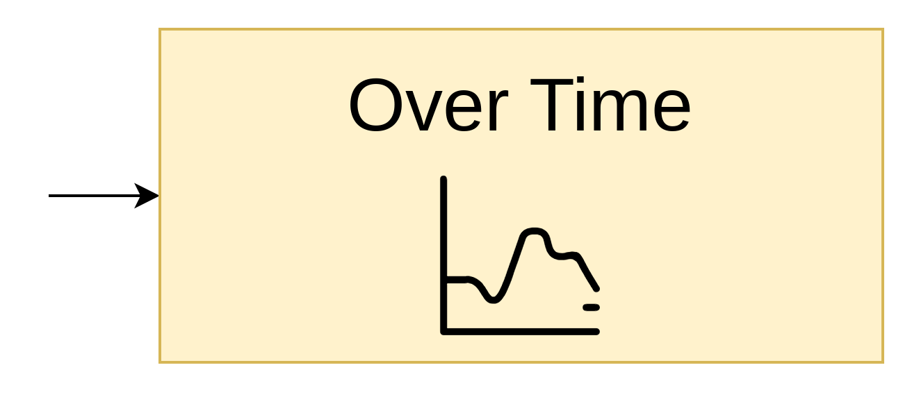
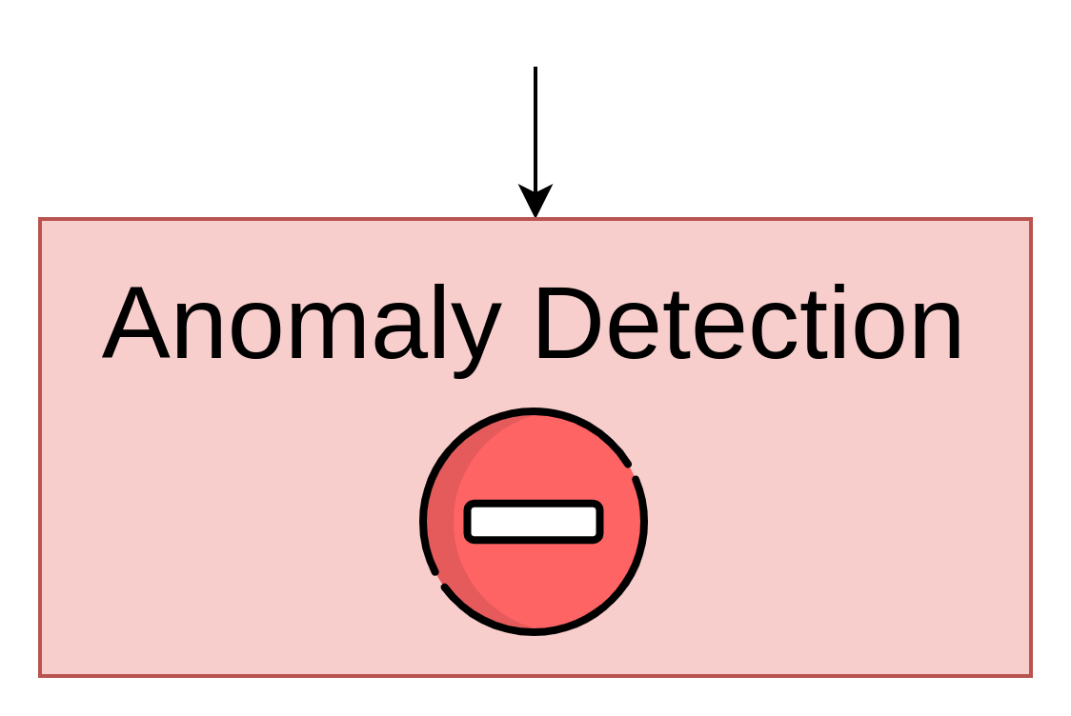
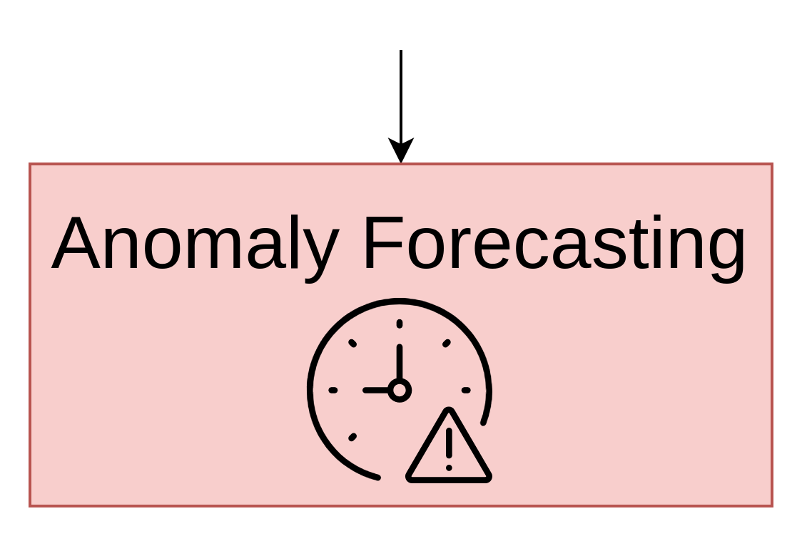
Proposed Approach: Anomaly Detection & Prediction
General Idea:
Train a model on nominal waveforms.
Detect deviations using performance metrics.
Monitor trends to identify drifts or early anomalies.
Goals:
Real-time anomaly detection.
Minimized reliance on labeled failures.
Adaptation to variations via Continual Learning.
Automated recovery support.

Slide 10
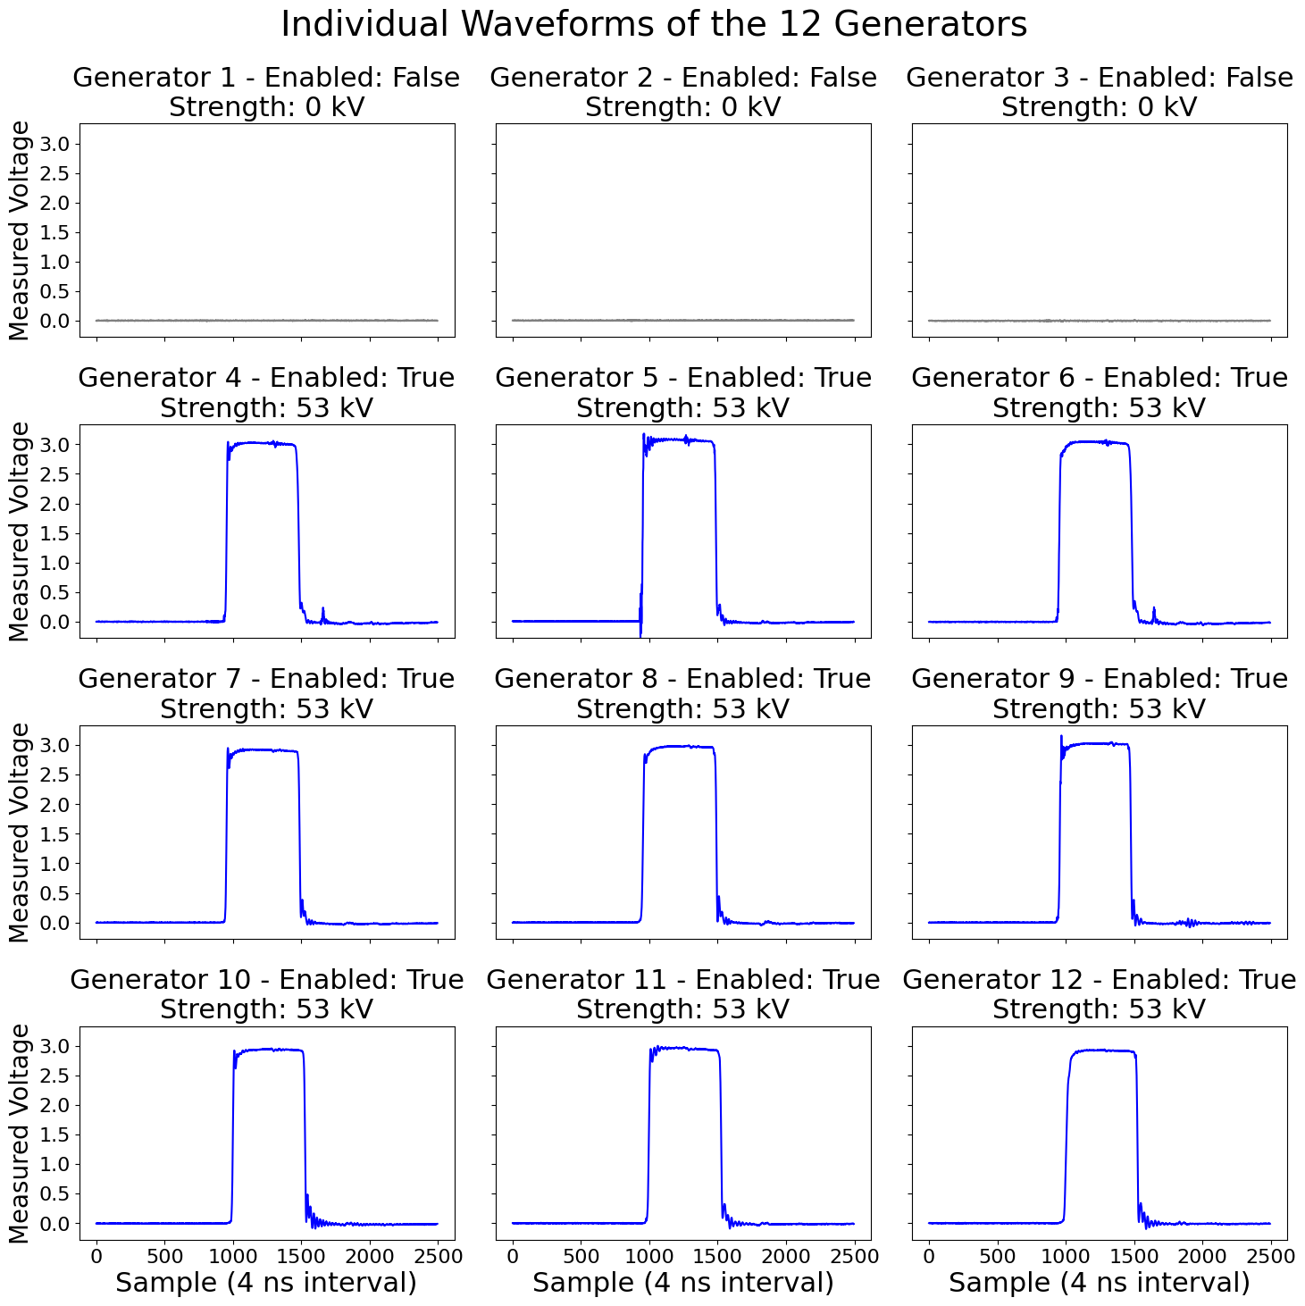
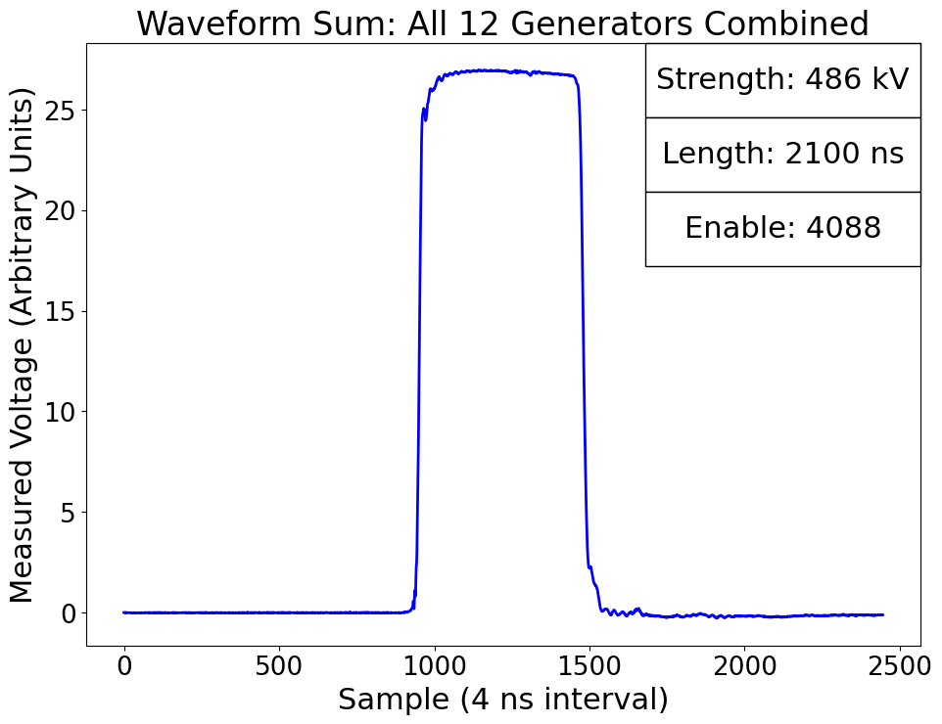
Data Description
Data & Settings Overview:
Enable Setting: 12-bit integer, indicating which generators are switched on or off (e.g., 4095 if 12 generator enabled).
Main Strength Setting: Divided among enabled generators (e.g., if 9 out of 12 are enabled, total strength is split by 9).
Main Length Setting: Applied both globally and per generator to define the pulse duration.

Slide 11
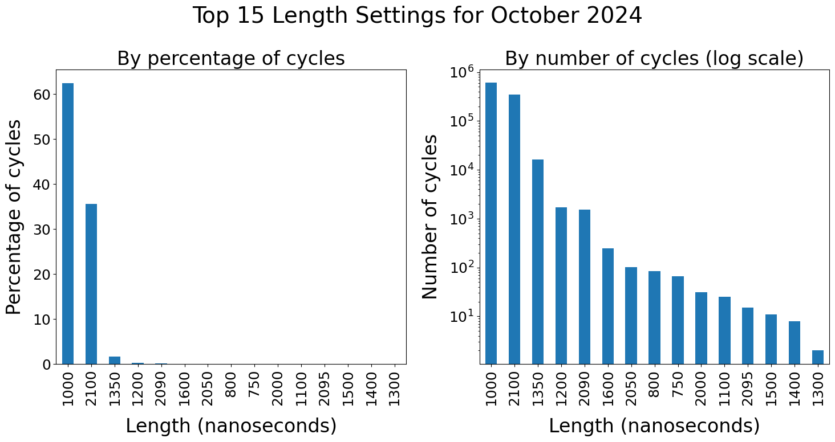
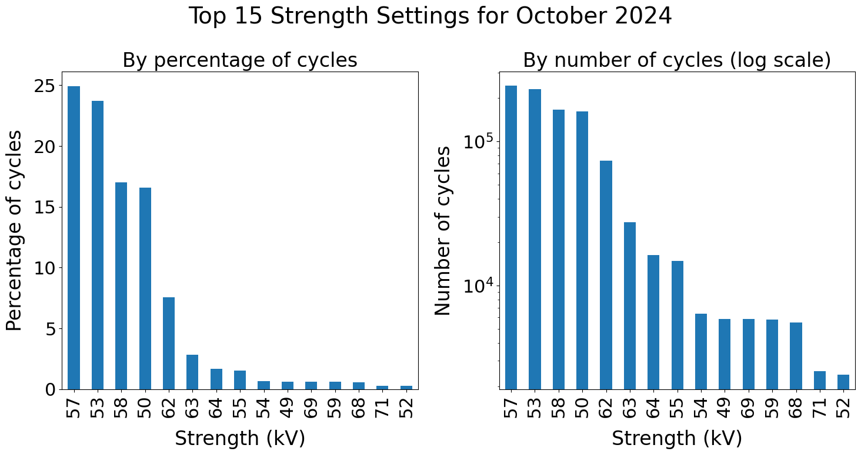
Settings Distribution – Strength and Length
Key Challenges and Implications:
Imbalanced Data:
~98% of waveforms share 2 length values.
~80% of waveform share 6 voltage values.
Risk: Overfitting to dominant settings.
Consequences:
Rare configurations misclassified as anomalies.
Reduces detection accuracy and increased biases.
Recommendations
Dataset Balancing: Sampling, augmentation, reweighting.
Performance Monitoring: Focus on rare settings.
Leverage Diversity: Use rare configurations to improve robustness.

Slide 12
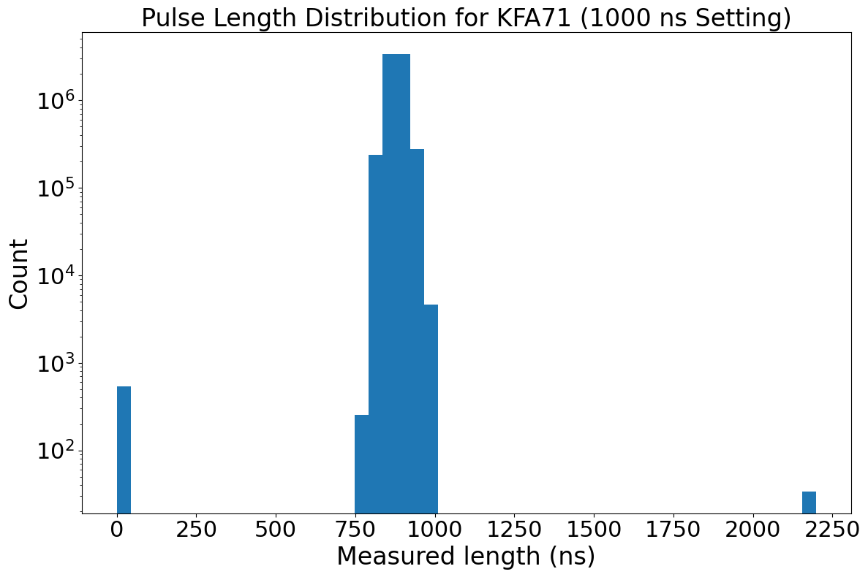
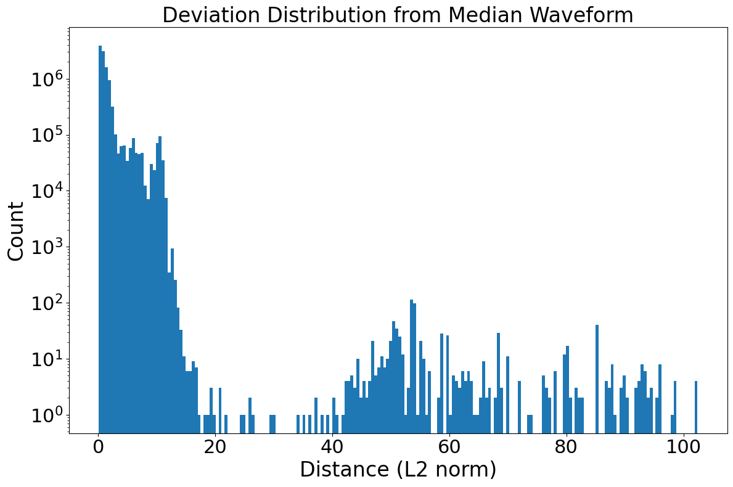
Labeling Process: Challenges and Key Steps
Context:
How to label a subset of waveforms from millions of records ?
Approach:
Comparing IPOC Data:
    Measured pulse properties against expected settings.
    Detect issues like missing pulses or faulty shot.
Median Waveform Computation:
    Group waveforms by strength and length.
    Compute median waveforms.
    Compute deviations (e.g., L2 norm).
Outcome:
Preliminary set of anomalies for evaluation.
Manual verification feasible due to reduced candidate anomalies.
Potential missing pulses
Potential main/dump switch failures
Expected length values
Potential Anomalies

Slide 13
Data Approach
Moving from Multi-Generator
to Per-Generator Analysis
Initial Approach:
Data Format: Treated 12 waveforms as a 1-channel image (12 rows × 2500 columns).
Grouping: Total strength, pulse length, and enable settings combined into a single data point.
Challenges:
Complex relationships between waveforms, strength, and enable settings were hard to learn.
  Increased model complexity reduced interpretability and made training harder.
Per-Generator Approach:
Independent Circuits: Each generator operates with separate, parallel circuits.
Simplified Modeling: Analyze one generator’s waveform at a time.
Benefits:
  Reduced Complexity: Easier to train models.
  Better Interpretability: Anomalies traced to specific generators.
  Faster Data Handling: Fewer variables for each analysis.

Slide 14
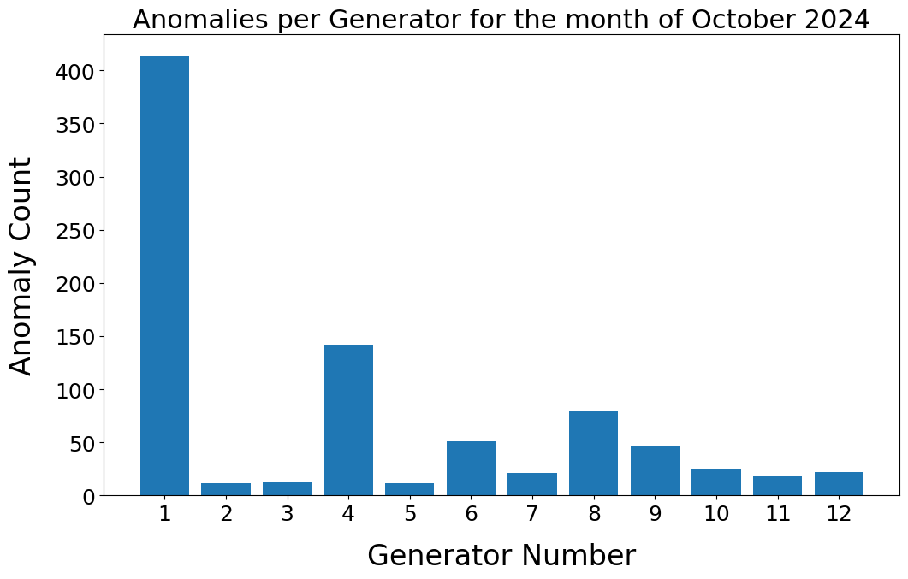
Data Approach
In the following sections, we focus specifically on the first generator of the KFA71
→ more than 600k cycle where this generator should have pulsed.

Slide 15
Preprocessing - Creating Training and Validation Dataset
Creating Training Dataset
Creating Validation Dataset
Time Period Selection:
  October 1st to 17th.
Data Filtering:
  Removed inactive generator cycles and known anomalies.
Setting Combination Processing:
  Kept combinations with ≥100 cycles (from 89 to 32 combinations).
Setting Balance:
  Balanced strength/length settings
Number of Sample
→ ~500k
→ ~350k
→ ~349k
→ ~600
Three subsets:
  Settings present in training.
  Settings absent in training.
  Known anomalies.
  Key Features
Excludes inactive generator cycles.
Removes low-sample combinations (<10).
Limits to max 50 samples per combination for diversity.
October 18th to 24th, including anomalies for evaluation.

Slide 16
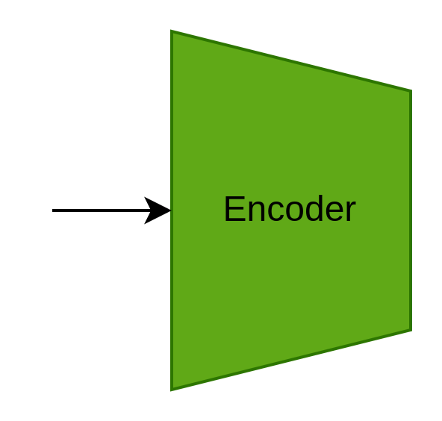
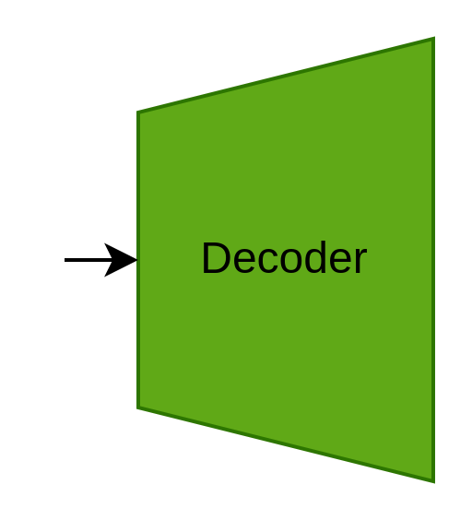
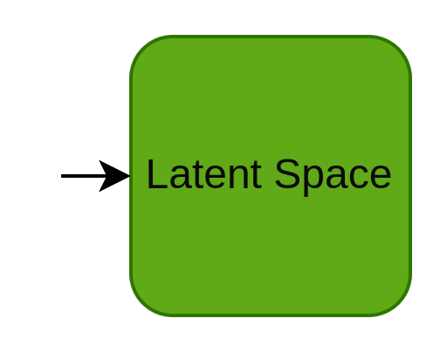
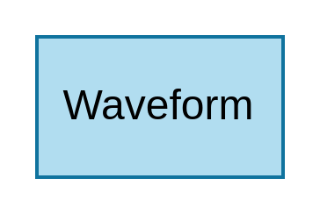
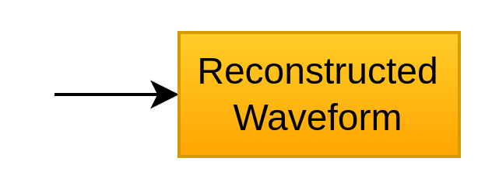
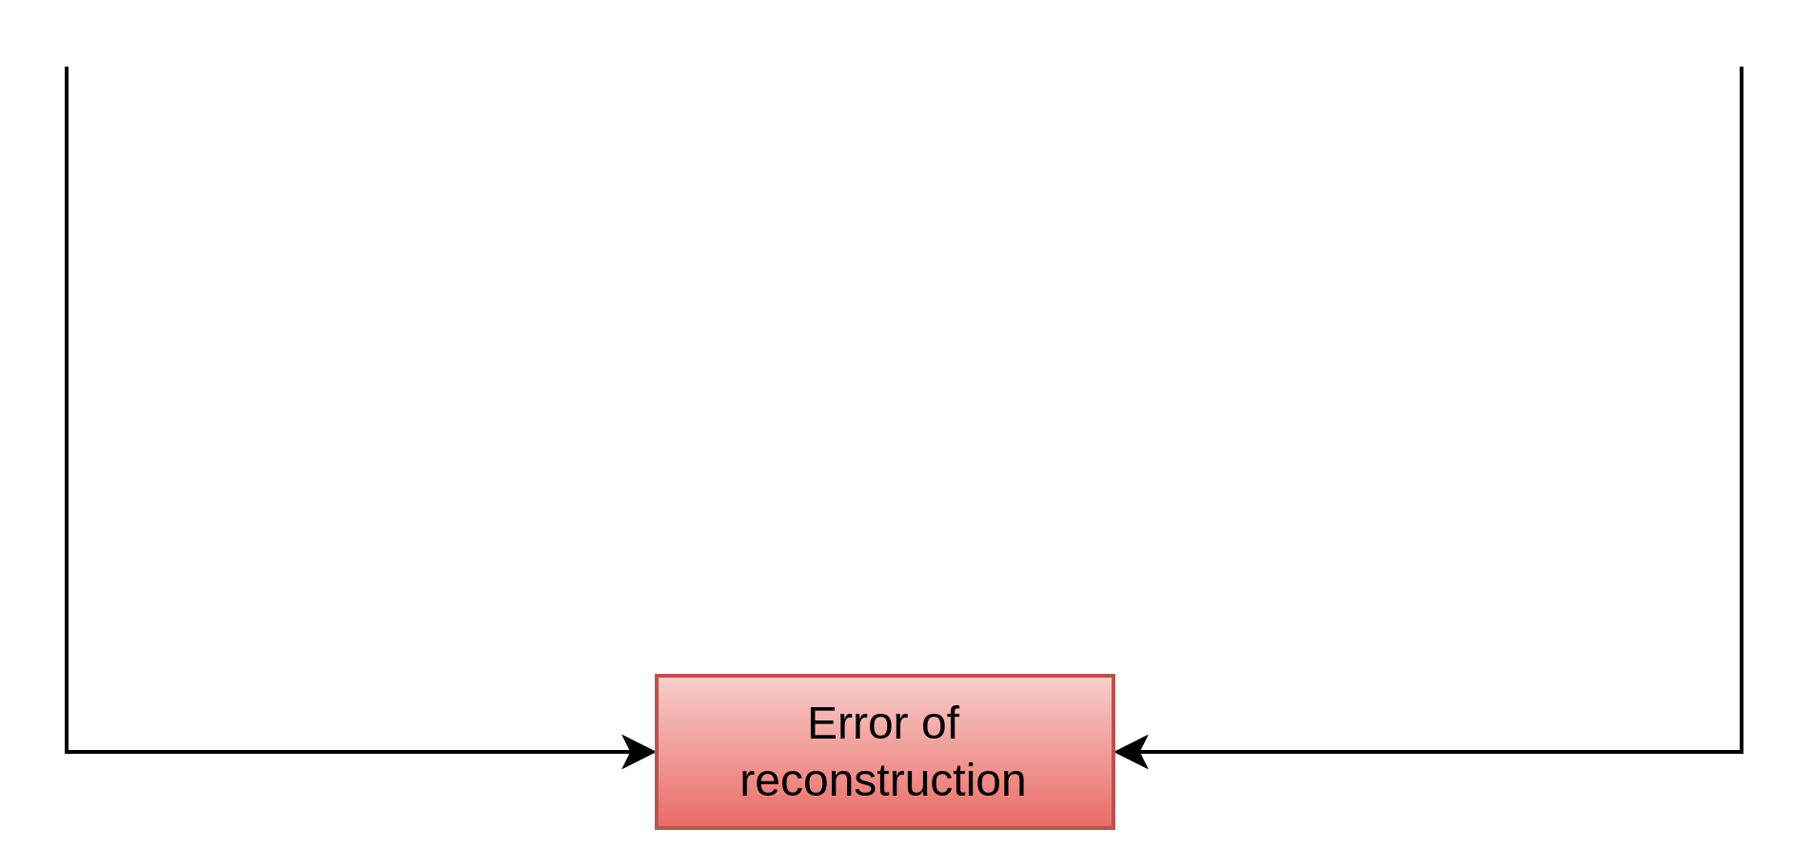
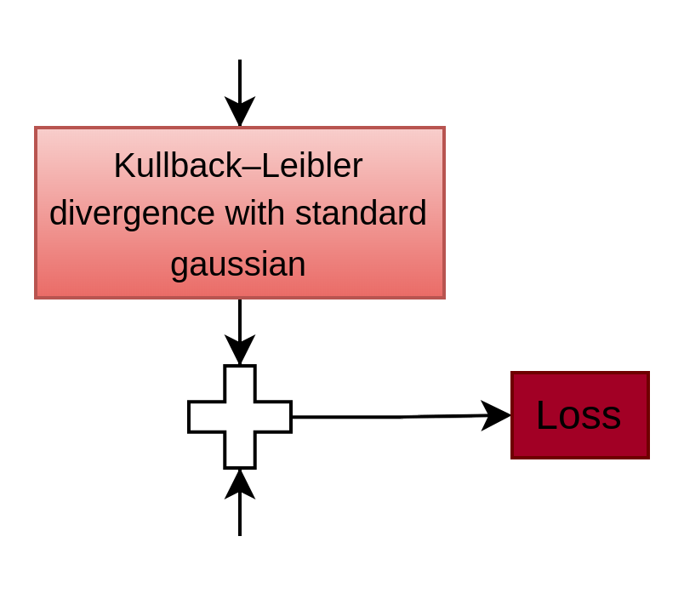
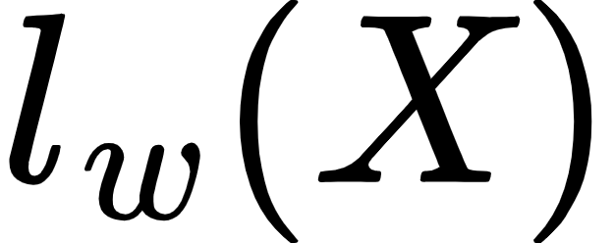



ML Models – Variational Autoencoders (VAE)
Challenge:
Unlabeled Data: Supervised learning not applicable
Goal:
Model normal waveform distribution
Minimize reconstruction error.
VAE Components:
Encoder: Maps waveforms to a compressed representation.
Latent Space: Probabilistic representation.
Decoder: Reconstructs waveforms.
Loss Function:
Reconstruction Loss (MSE): Measures how well the waveform is reconstructed.
KL Divergence: Aligns latent space with a Gaussian distribution.
Mathematical Formulation:
  : Loss for waveform with model's weights .
  : Fraction of anomalies.
Anomaly Detection​
High Error: Indicates data deviates from normal distribution → Anomaly
Low Error: Data aligns with normal waveforms → Normal

Slide 17
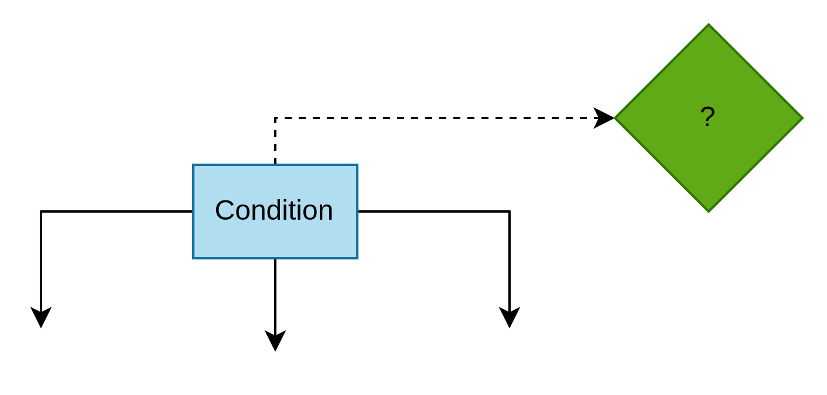
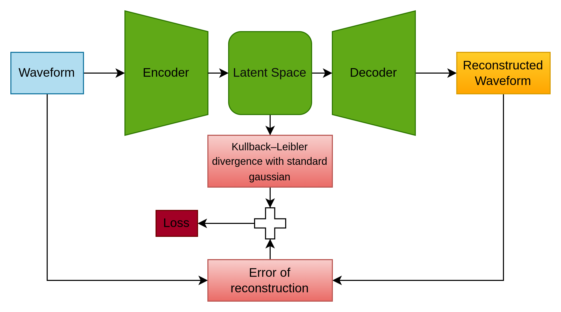
ML Models – Conditional Variational Autoencoders (CVAE)
Problem with VAEs:
VAEs often reconstruct subtle anomalies too well [6].
Assume all data shares one global distribution.
Goal:
Use contextual information (e.g., strength, length)
Conditioning Inputs:
Incorporates external conditions (settings) into the model.
Why CVAEs Solve This:
Learn conditional distributions, not a single global one.
Use conditions to adapt reconstructions
Increasing errors for out-of-context anomalies.
Generalize better with conditional distributions. [14].

Slide 18
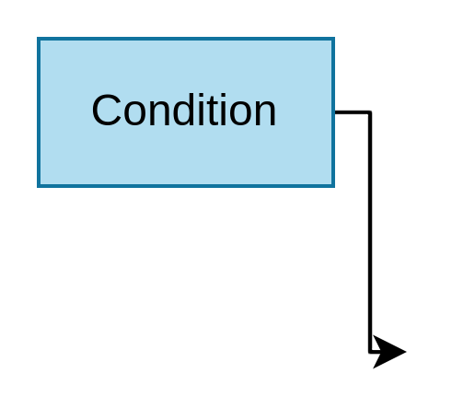
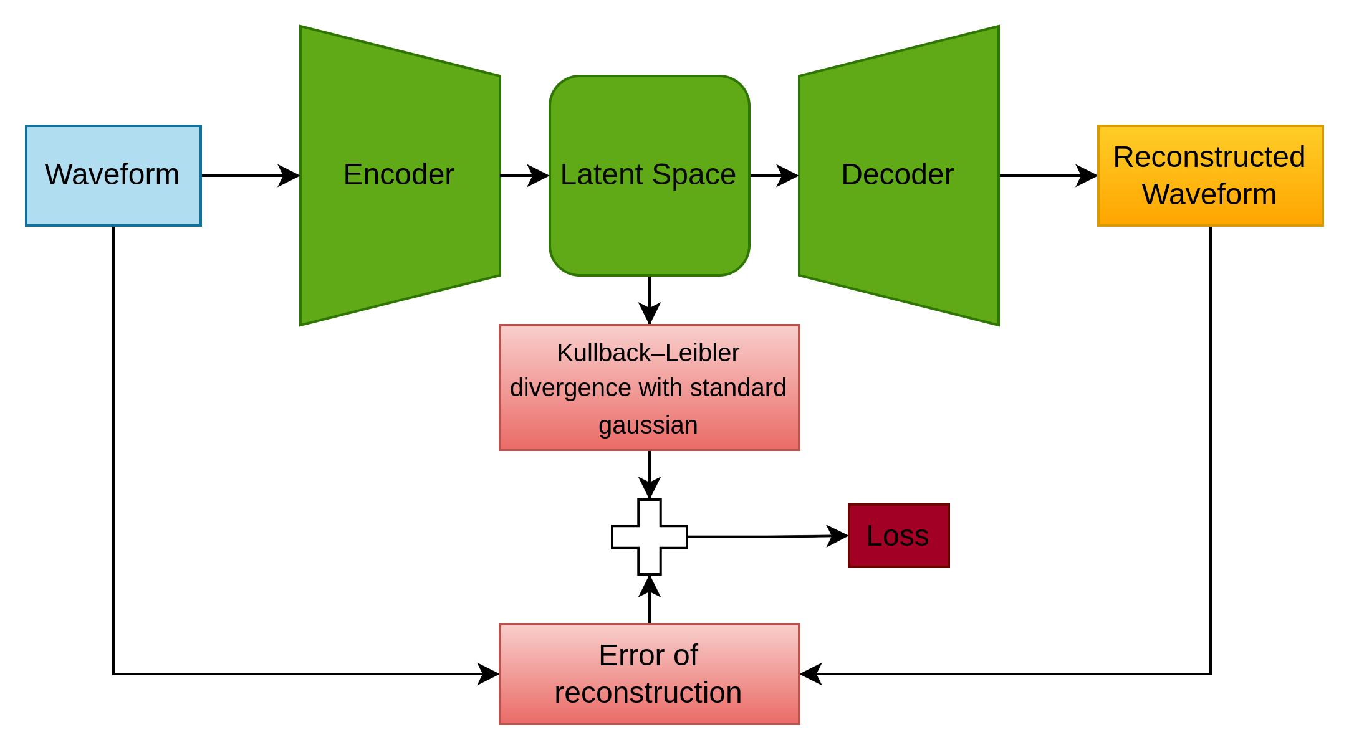
ML Models – CVAE 1
Specificity:
Condition Integration: Conditions are concatenated with the latent space before reconstruction.
Contextual Reconstruction: Adjusts outputs based on waveform settings.

Slide 19
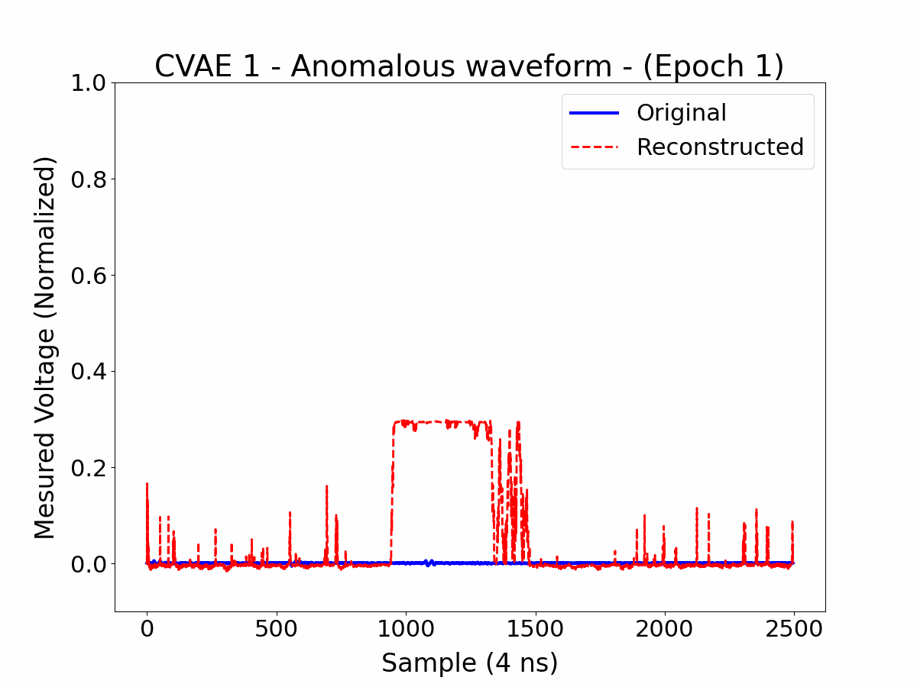
ML Models – CVAE 1
Specificity:
Condition Integration: Conditions are concatenated with the latent space before reconstruction.
Contextual Reconstruction: Adjusts outputs based on waveform settings.
Issues:
Over-reliance on Conditions: Neglects actual waveform data.
Anomalies Dilution: Reconstructs averaged waveforms (e.g., missing pulses ignored).
Still in Progress: Requires tuning to enhance performance.
Plot: Reconstruction matches the waveform based on the conditions, ignoring the input anomaly.

Slide 20
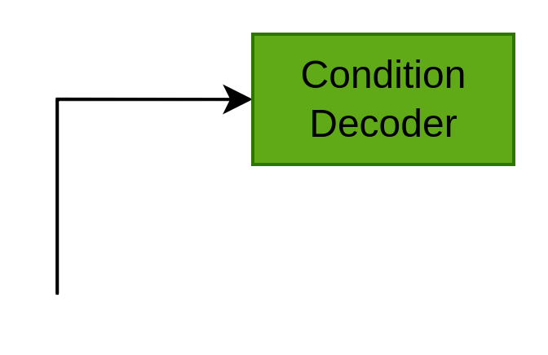
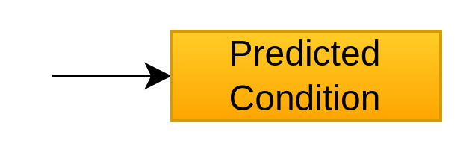
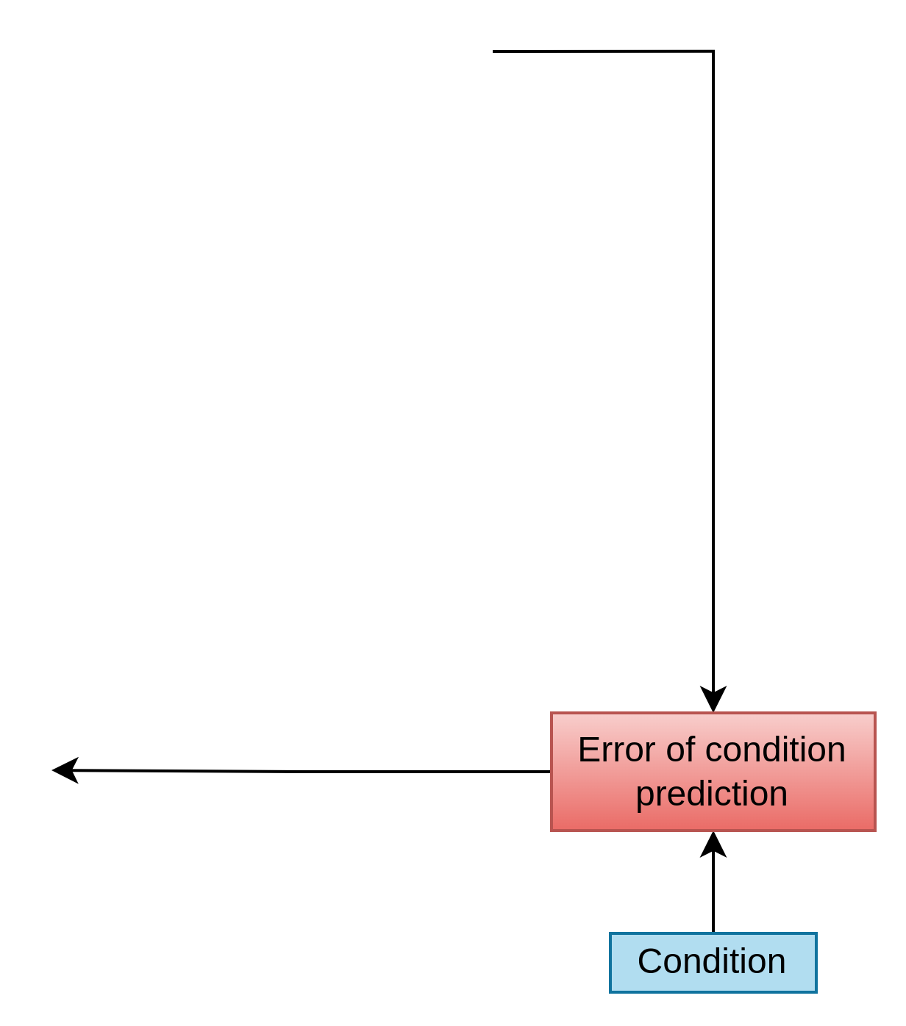

ML Models – CVAE 2
Specificities:
Condition Decoder: Predicts the conditions from the latent space using an additional neural network.
Prediction Loss (MAE): Minimizes error between predicted and true conditions.
Indirect Conditioning: Decoder uses latent space information without direct condition input.
Latent Space: Encodes condition-specific features for better representation.

Slide 21
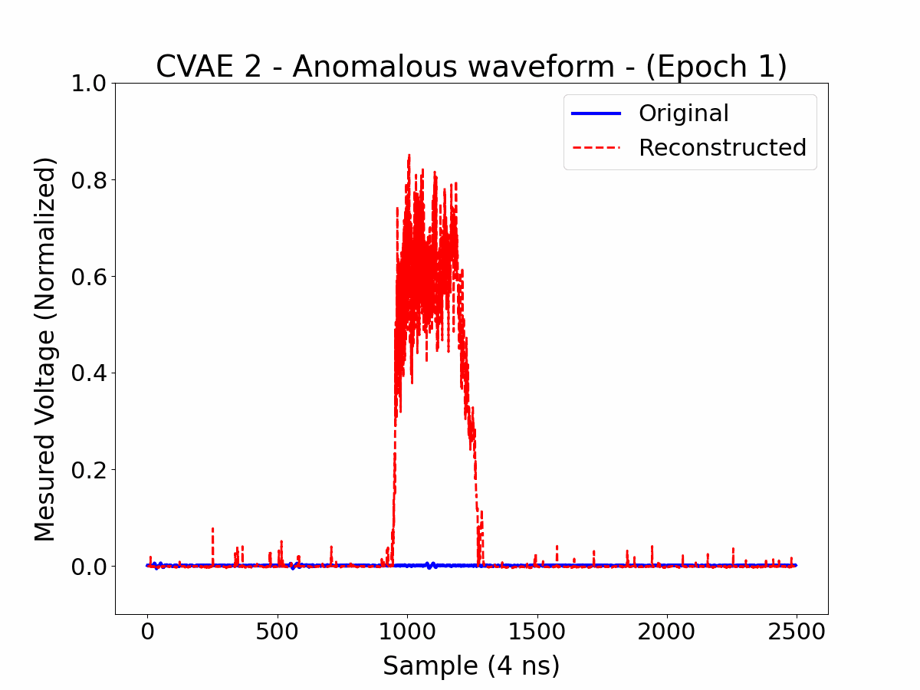
ML Models – CVAE 2
Specificities:
Condition Decoder: Predicts the conditions from the latent space using an additional neural network.
Prediction Loss (MAE): Minimizes error between predicted and true conditions.
Indirect Conditioning: Decoder uses latent space information without direct condition input.
Latent Space: Encodes condition-specific features for better representation.
Advantages:
Reduced Over-reliance: Avoids direct dependence on condition inputs, improving robustness.
Improved Performance: Addresses issues of CVAE 1 by better capturing waveform anomalies.
Plot: No waveform-like reconstruction for large anomalies

Slide 22
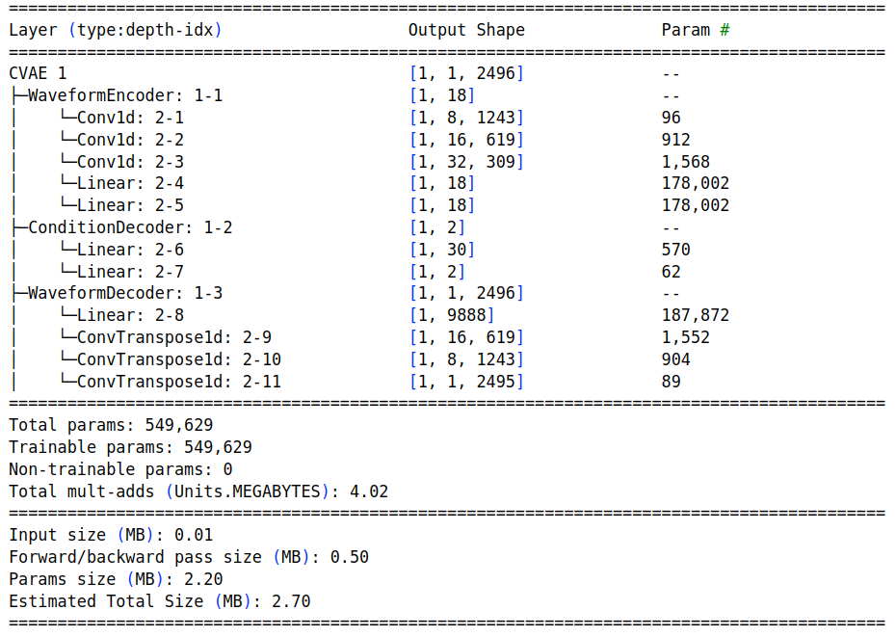
ML Models – CVAE 2: Architecture

Slide 23
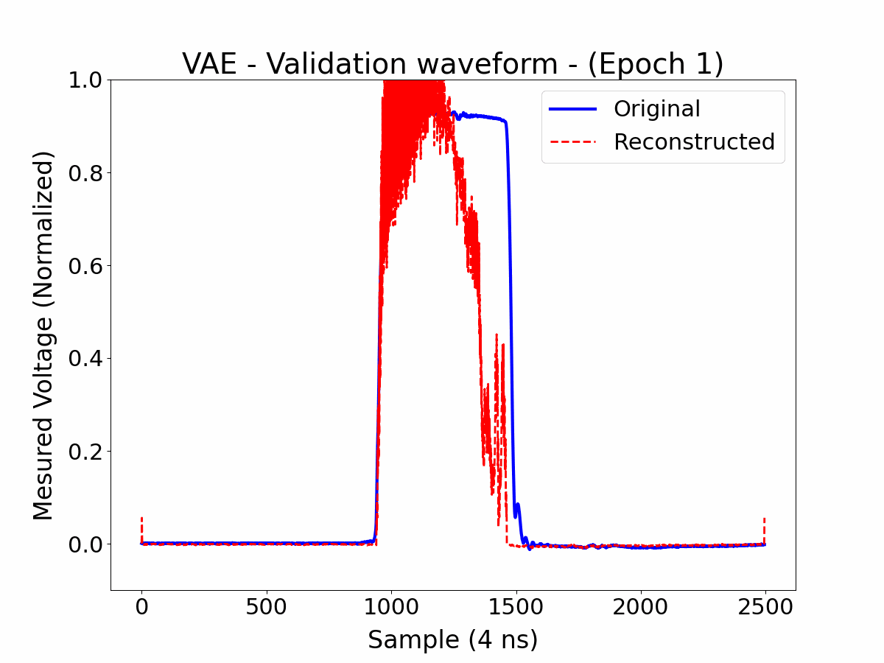
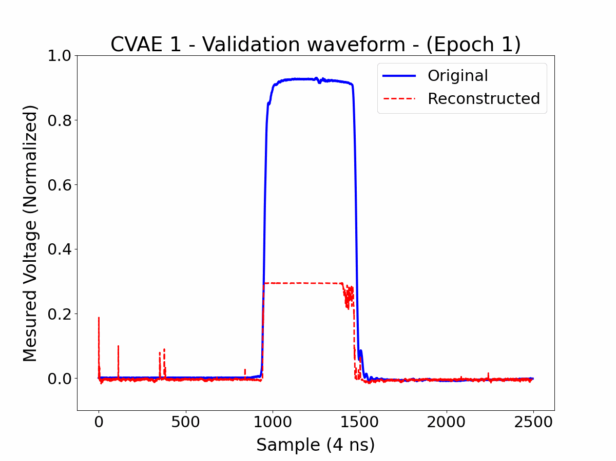
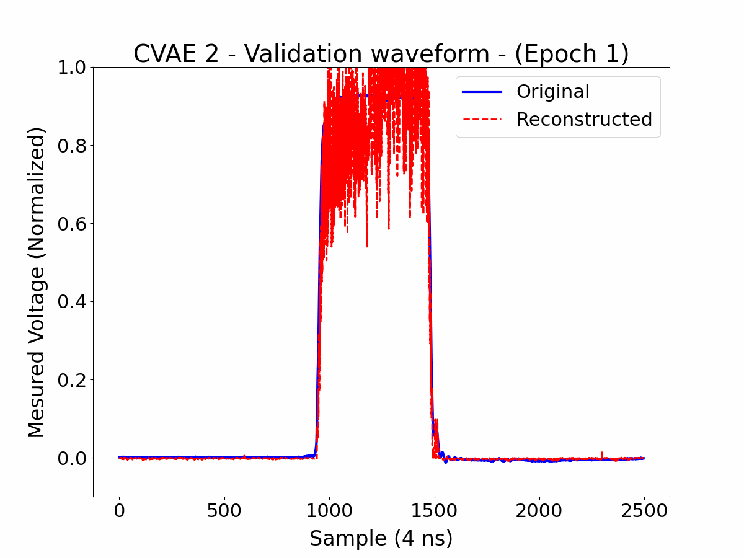
Results – Validation Normal
Best Model:
CVAE 2 provided the best results.

Slide 24
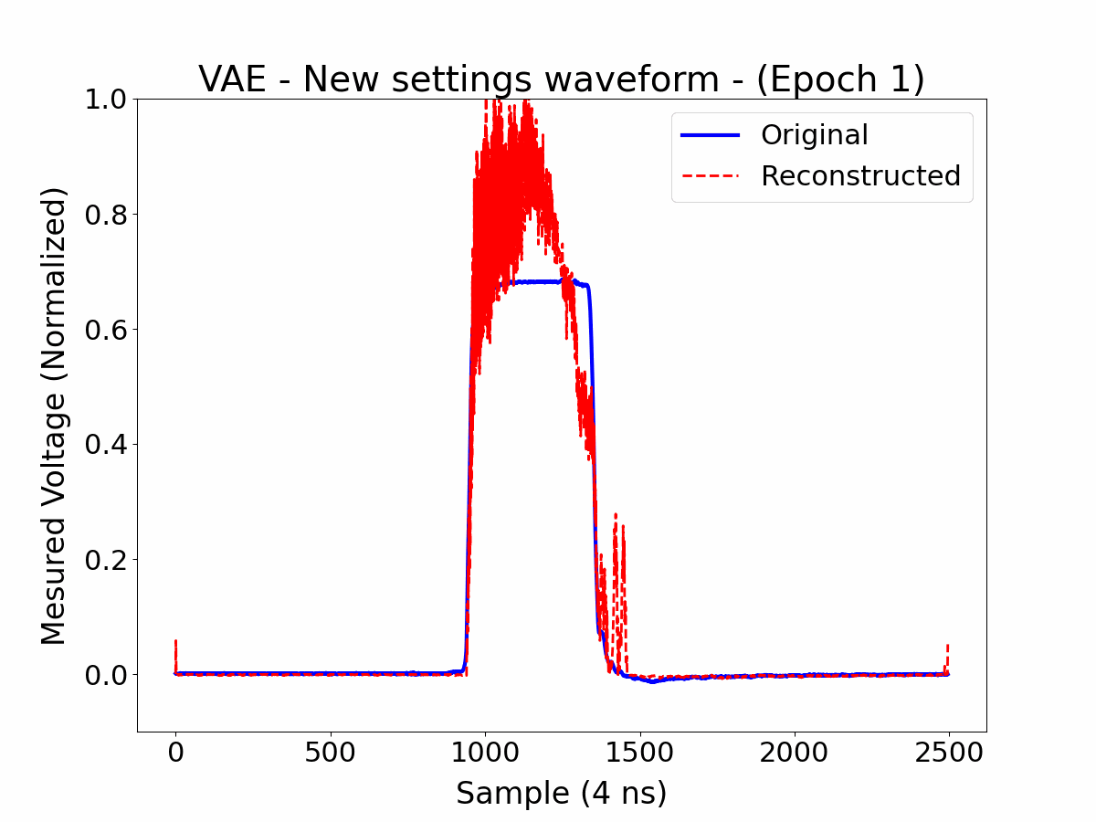
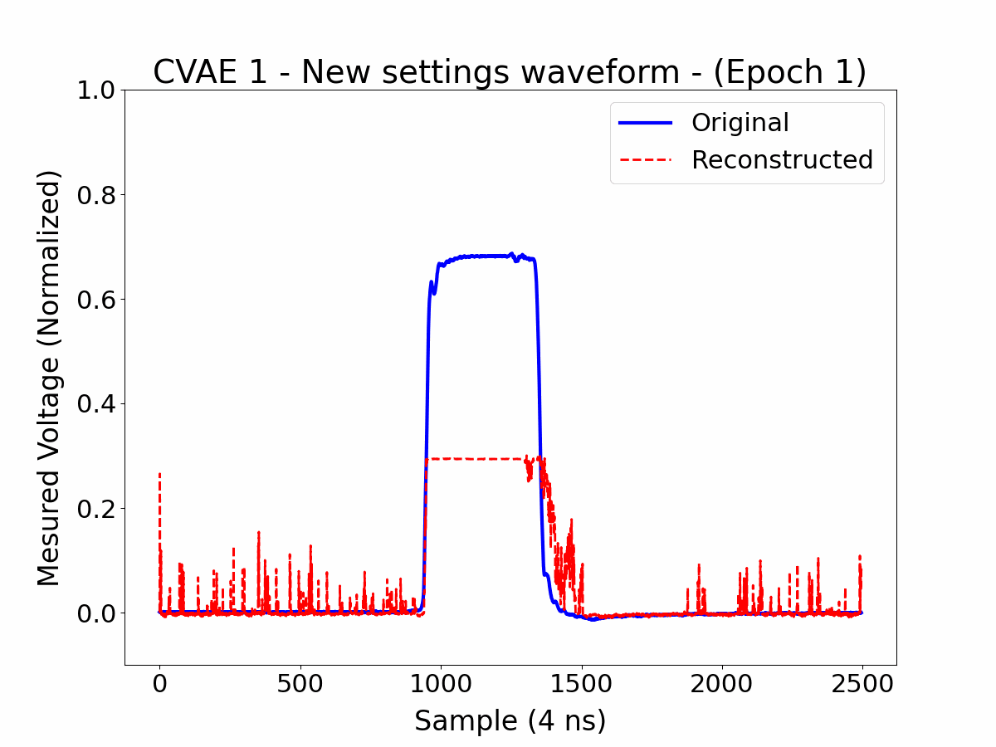
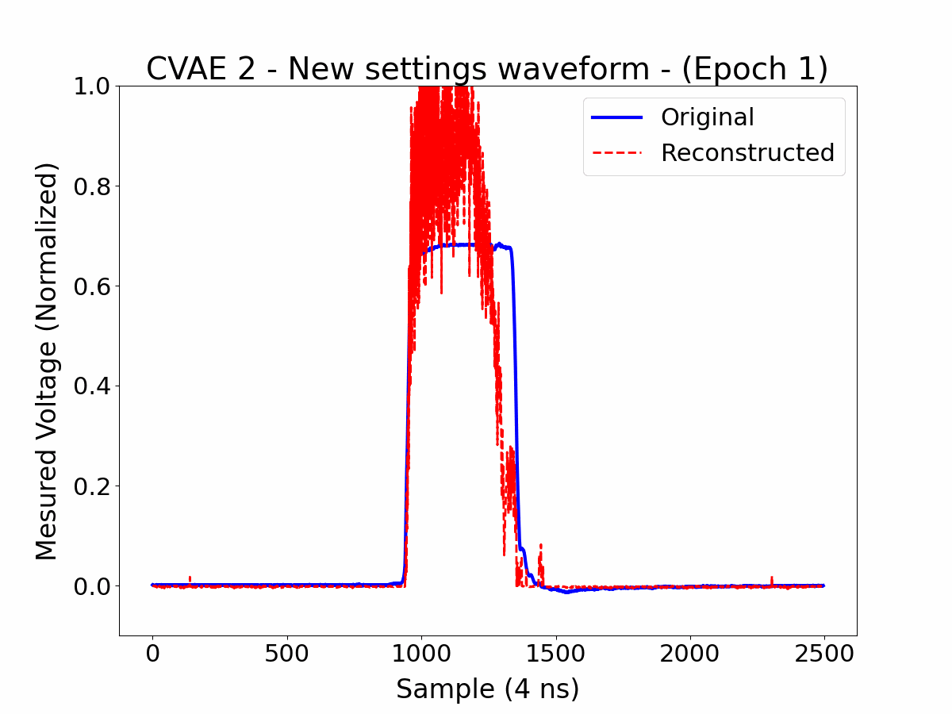
Results – Validation New Settings
Best Model:
CVAE 2 provided the best results.

Slide 25
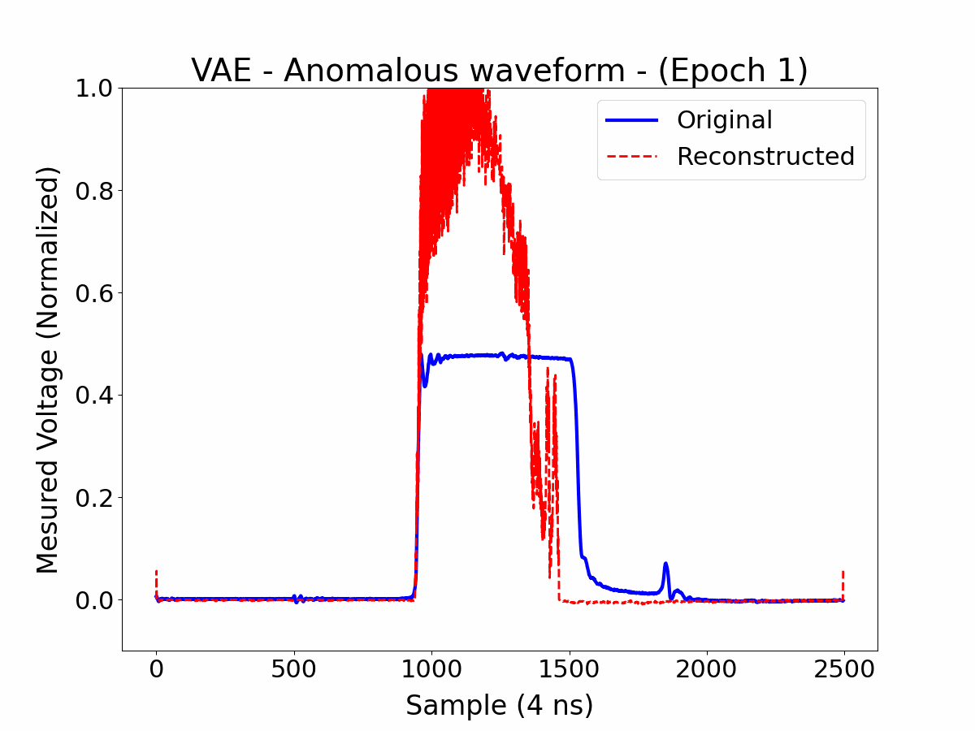
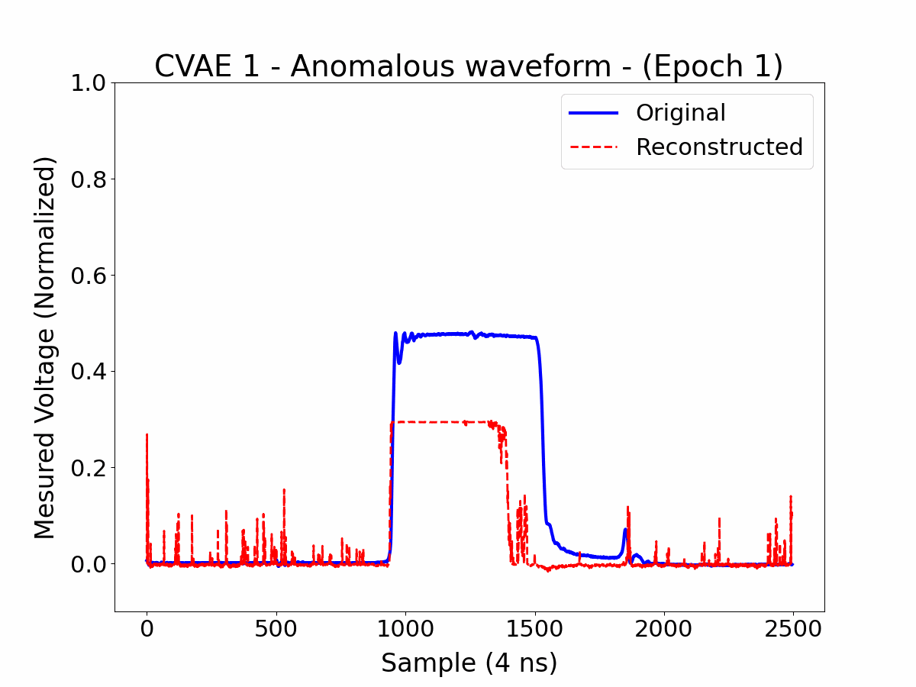
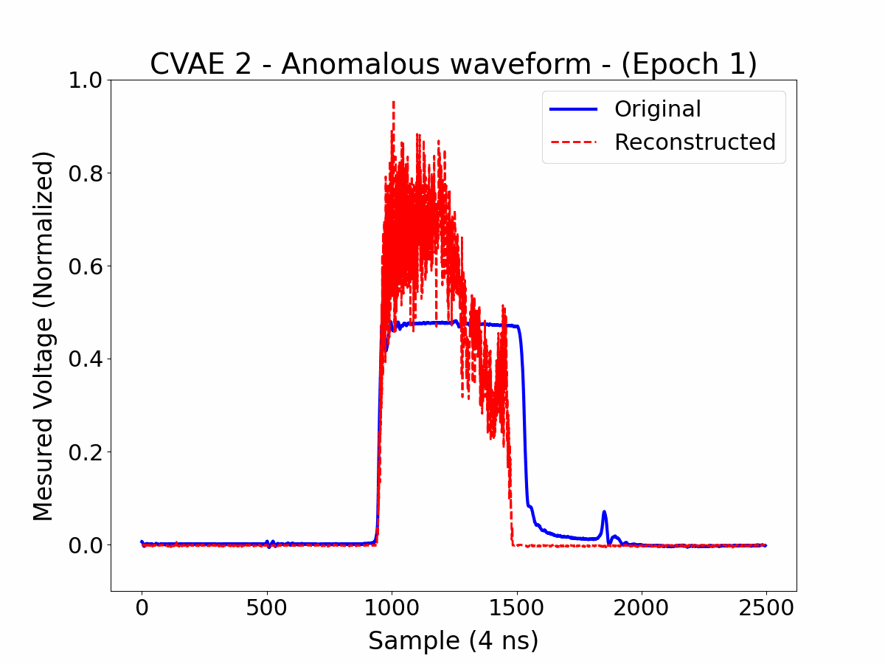
Results – Validation Anomalies
Best Model:
CVAE 2 provided the best results.

Slide 26
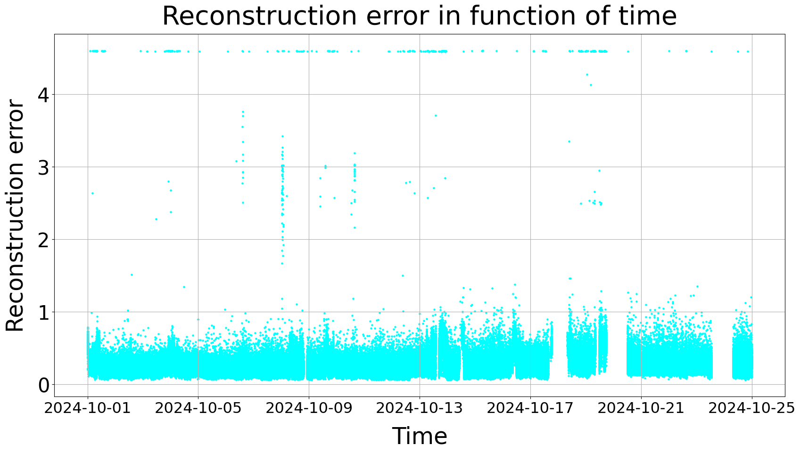
Results – Reconstruction errors
High Reconstruction Errors: Observed in some data.

Slide 27
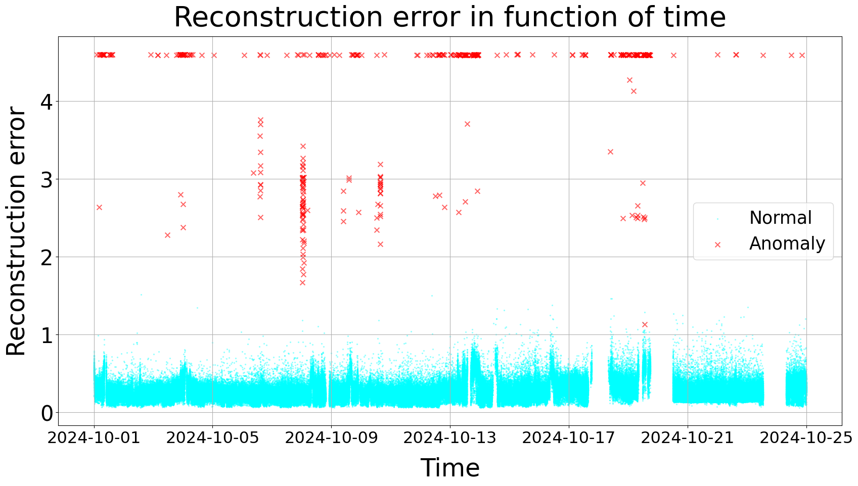
Results – Reconstruction errors
High Reconstruction Errors: Observed in some data.
Known Anomalies: Associated with high errors.

Slide 28

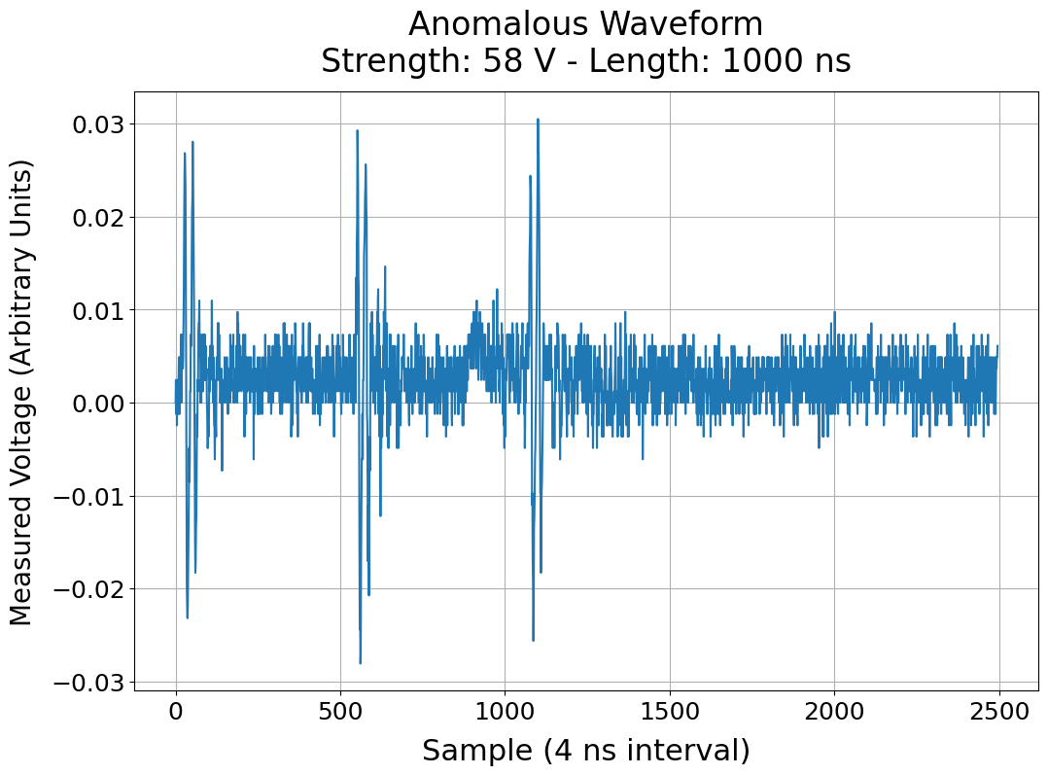
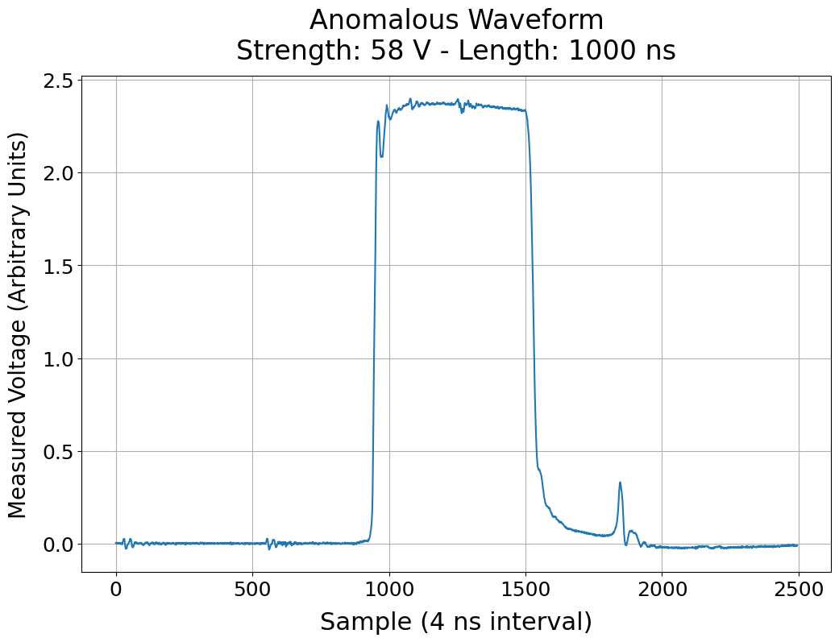
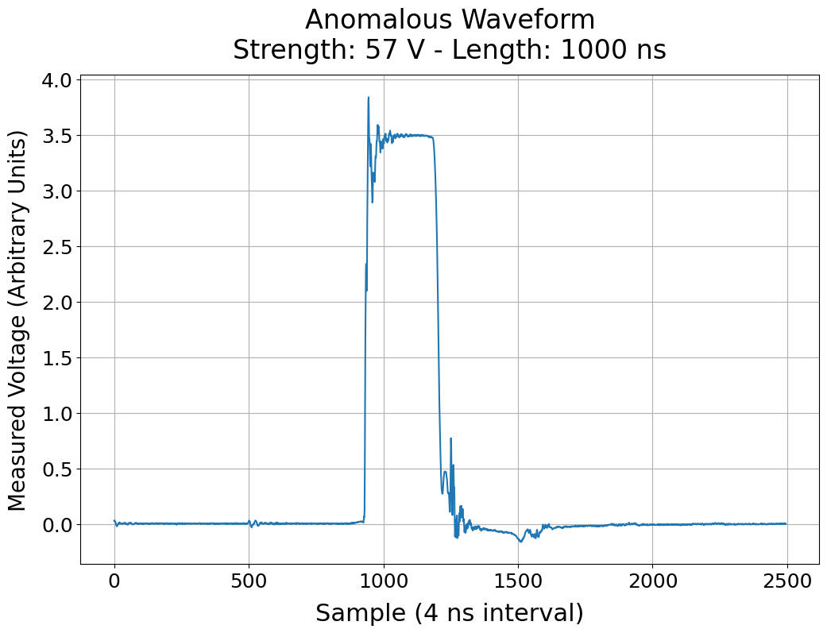
Results – Reconstruction errors
High Reconstruction Errors: Observed in some data.
Known Anomalies: Associated with high errors.

Slide 29
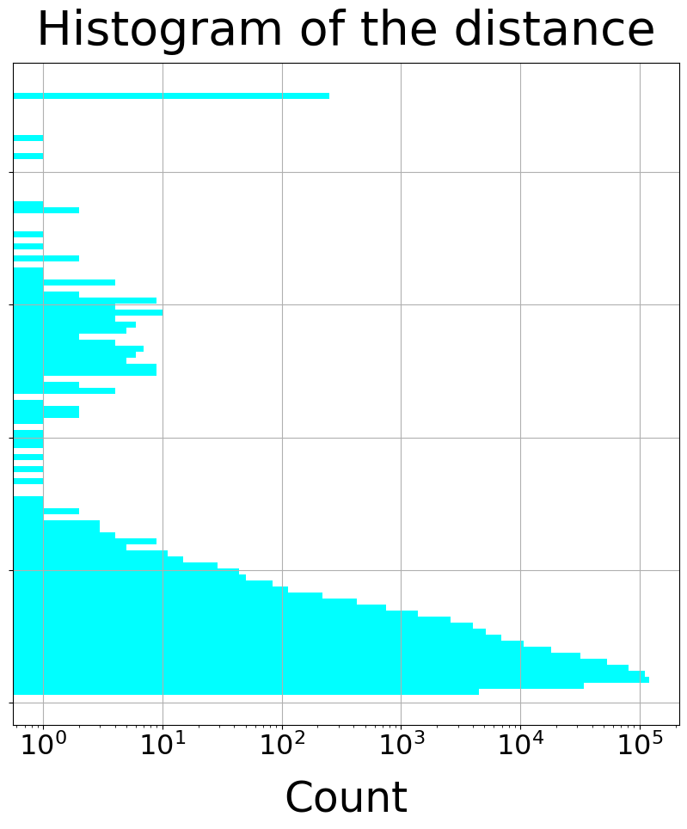
Results – Reconstruction errors
High Reconstruction Errors: Observed in some data.
Known Anomalies: Associated with high errors.
Threshold

Slide 30

Results – Reconstruction errors
High Reconstruction Errors: Observed in some data.
Known Anomalies: Associated with high errors.
Visualization: Logarithmic y-axis for clarity.

Slide 31

Results – Reconstruction errors
High Reconstruction Errors: Observed in some data.
Known Anomalies: Associated with high errors.
Visualization: Logarithmic y-axis for clarity.
Rolling Median: Provides insights into anomaly precursors.

Slide 32

Results – Reconstruction errors
High Reconstruction Errors: Observed in some data.
Known Anomalies: Associated with high errors.
Visualization: Logarithmic y-axis for clarity.
Rolling Median: Provides insights into anomaly precursors.
Rolling Threshold: Dynamically adjusts for trends and variability compute as:
  → Rolling Median + 5 * Rolling Std

Slide 33


Preliminary Results – Anomaly Forecasting
Observation: Gradual rise in reconstruction error before failures.
Technique: Analyze error trends (e.g., rolling medians) for patterns.
Future Potential: Combine threshold-based and advanced models (e.g., LSTM).
Data Quality: Limited labels and root cause information.
Imbalance: Sparse anomalies, limited diversity in settings.

Slide 34


Preliminary Results – Anomaly Forecasting
Threshold-based methods:
Risk: 30 min rolling mean of reconstruction error
  → Mean gives more weight to anomalies compared to median for risk calculation.
Threshold: 12h Rolling median + Rolling median absolute value (MAD).
  → Median and MAD is chosen for a more stable threshold.
Condition: If Risk > Threshold for 5 min continuously → Warning.
Visualization: Vertical dash lines show the time warnings occur.

Slide 35



Preliminary Results – Anomaly Forecasting

Slide 36
Operational Deployment for Model Validation:
UCAP Deployment: Launch before machine restart.
Detection: Flag anomalies and send warnings.
Forecasting: Two warning levels:
  Rising Risk: Signals moderate issues for monitoring.
  Critical Risk: Alerts for significant risks, advising a machine stop.
Feedback: System stops generate reports with reasons, anomalies, and system trends, logged in the logbook.
Improvement: Refine detection using expert insights.

Slide 37
Continual Learning
Why Continual Learning in This Context:
Operational Shifts: Upgrades, different beam types, new hardware components, varying high-voltage settings across years.
Traditional static models may forget old knowledge or misinterpret new normal conditions as anomalies.
Key Requirements:
Adaptation: Ongoing training with new waveforms while preserving knowledge of previously seen modes.
Stability vs. Plasticity: Avoid catastrophic forgetting while still learning new patterns and normal states.
Drift Detection: Distinguish natural drift in data (e.g., new standard operation) from true anomalies.
Implementation Approaches:
Rehearsal-based: Keep a small representative buffer of past pulses to retrain or regularize the model.
Regularization-based: Techniques like EWC (Elastic Weight Consolidation) or MAS to preserve crucial model parameters [10, 11].
Dynamic Architectures: Expandable network components to handle truly novel operational regimes [12, 13].
Generative replay: Generate past data with the model and combine them with new data for training [10].
And More to Explore: ...

Slide 38
Conclusions & Outlook
Conclusions:
CVAE models show potential for anomaly detection.
Forecasting is promising but needs further validation.
Challenges: Data imbalance and limited operational diversity.
Outlook:
Testing: UCAP deployment this year with A/B testing of thresholds and forecasting methods.
Improvement: Refine models based on feedback and validated thresholds.
Future: Scale to other systems and enhance adaptability with continual learning.

Slide 39
References
  EPA core team, Efficient Particle Accelerators What is on the Horizon, Joint Accelerator Performance Workshop 2023 , Montreux, 7 December 2023
  F. Velotti, K. Papastergiou, Alex and V. Kain, WP8 Automate equipments (https://docs.google.com/presentation/d/130UolLf9o8UhCt4jOGE1xjmaZxSLKH2Tx90BCM7fwwc/edit#slide=id.p)
  S. Gilardoni and D. Manglunki, Fifty years of the CERN Proton Synchrotron - Volume I, CERN-2011-004.
  M.J. Barnes, CAS: Beam Injection, Extraction & Transfer 2 Kicker Systems - Part 1 - Introduction and Hardware, CERN TE/ABT
  Luis Miguel Coralejo Feliciano, Matthew Fraser, Thomas Kramer, Christophe Boucly, Functional Specification for PS Extraction Kickers PE.KFA71 and PE.KFA79, CERN SY-ABT
  Bercea et al., What Do We Learn? Debunking the Myth of Unsupervised Outlier Detection (2023).
  Ran et al., Detecting Out-of-Distribution Samples via Variational Auto-Encoder with Reliable Uncertainty Estimation, (2021)
  Bhosale et al., Anomaly Detection using Diffusion-Based Methods, (2024)
  Takuya Akiba, Shotaro Sano, Toshihiko Yanase, Takeru Ohta, and Masanori Koyama. Optuna: A Next-generation Hyperparameter Optimization Framework. In KDD (2019).
  Faber et al., Lifelong Learning for Anomaly Detection: New Challenges, Perspectives, and Insights (2023).
  Dohare et al., Loss of Plasticity in Deep Continual Learning (2024).
  Ross et al., Incremental Learning for Robust Visual Tracking (2008).
  Shenggang Li, Dynamic Time Series Model Updating (2024).
  Adrian Alan Pol and Victor Berger and Gianluca Cerminara and Cécile Germain and Maurizio Pierini, Anomaly Detection With Conditional Variational Autoencoders (2020).

