Slide 1
Networking for low density (nano) materials at CERN
Introduction
Ray Veness / SY-BI

Slide 2
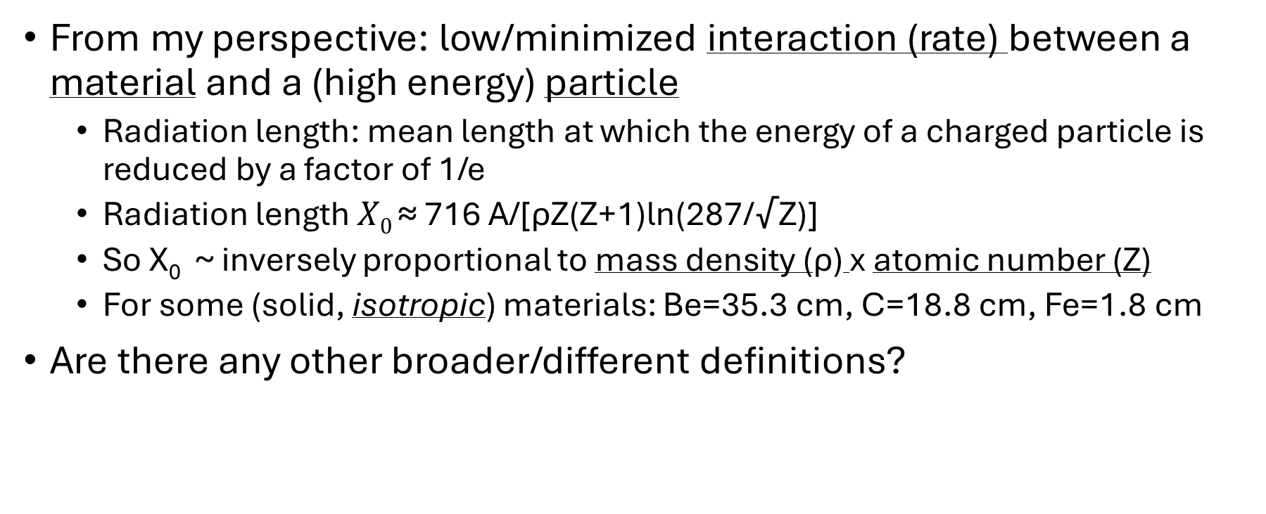
What do we mean by ‘low density materials’
From my perspective: low/minimized interaction (rate) between a material and a (high energy) particle
Radiation length: mean length at which the energy of a charged particle is reduced by a factor of 1/e
Radiation length $X0 \text{≈}$ 716 A/[ρZ(Z+1)ln(287/√Z)]
So X₀ ~ inversely proportional to mass density (ρ) x atomic number (Z)
For some (solid, isotropic) materials: Be=35.3 cm, C=18.8 cm, Fe=1.8 cm
Are there any other broader/different definitions?

Slide 3
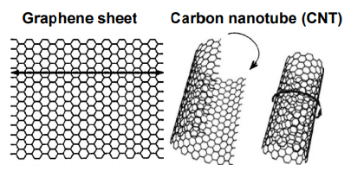
Why is this interesting?
Many areas at CERN where ‘low density’ in the beam/particle interacting sense is important to control or minimize
Beam interacting components (windows, collimators, targets, dumps, beam instrumentation…)
Secondary particle interacting materials (experimental beampipes, detector structures, shielding, moderators…)
There is a bit of a ‘paradigm shift’ in progress in this field
Materials being produced with structures at the atomic level which can give intrinsically lower densities as well as other properties, such as tensile strength, with the potential to exceed existing materials by orders of magnitude
Key examples are Carbon Nano-Tubes (CNTs) and graphene, but other structures and elements (boron…) are used
These are being produced and available in ‘engineering’ dimensions (ie, mm, cm lengths)

Slide 4
Why should we work together?
Finding materials
Interesting publications, encouraging research in areas of common interest, finding and evaluating suppliers (commercial and research)
Using materials at CERN
Safety rules and procedures, handling equipment, best practice, expert analysis and materials expertise
Funding
CERN MTP, KT, Projects, EU funding,… sharing knowledge
Advantages of larger ‘grouped’ proposals around a theme
CERN-wide infrastructure requests

Slide 5
What are the aims of today’s meeting?
Define a ‘scope’ for this definition of low-density materials
Understand what is happening at CERN and who is interested in working together
Just CERN, or external interested parties?
Make some decisions about how we work together and how we will communicate
Mailing list? Regular meetings? Discussion forum? Knowledge base? Periodic Workshops,
Collaborate on funding requests inside/outside CERN?

