Slide 1
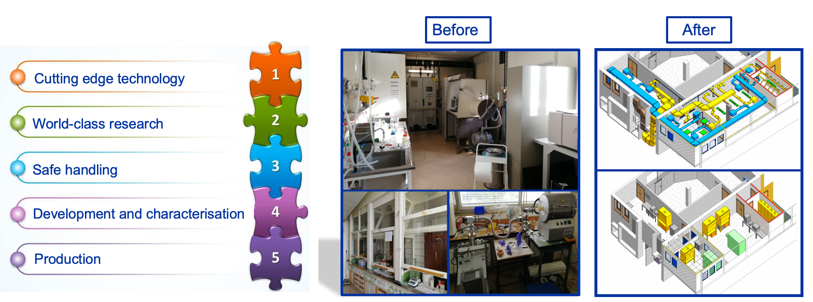
B26 Chemical Lab Extension
Non-actinide Nanolab:
Engineered Nano Material
Chemical & Thermal processes
Commissioning and operation - Q1 2026
Q2 25
Q1 2026
LS3
B26 Chemical Lab Extension
1

Slide 2
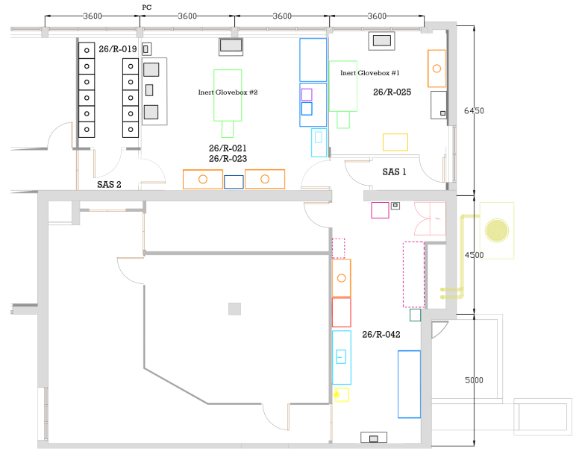
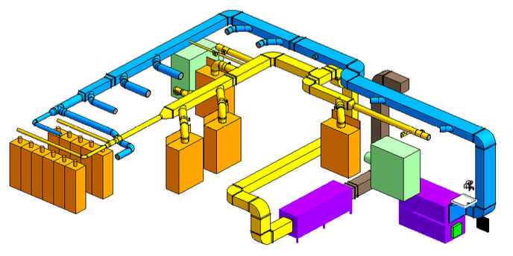
Placeholder - Chemical lab extension – non-actinide nanomaterials
Extension and upgrade of the current chemical and thermal laboratories:
Chemical storage, thermal activities, process area → only one facility, relocated from office area to dedicated Nano-2 and Nano-3 lab
Foreseen construction of:
NANO-3 Production laboratory for non-actinide nanomaterials target production
NANO-2 Characterization & Development laboratory for target materials development
Chemical and Thermal laboratory for bulk materials handling and thermal treatments

