Slide 1
Nanomaterials, safety
Jonathan Gulley
13th February 2025
EDMS reference

Slide 2
Guideline SG C-0-0-5,
Safe handling and disposal of nanomaterials
Definition
Hazard Identification (labelling, warning signs)
Risk assessment methodology
Exposure monitoring
Safe Practices (disposal, etc.)

Slide 3
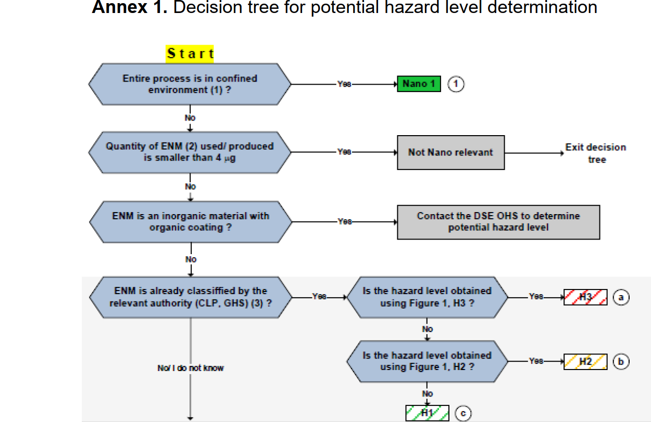
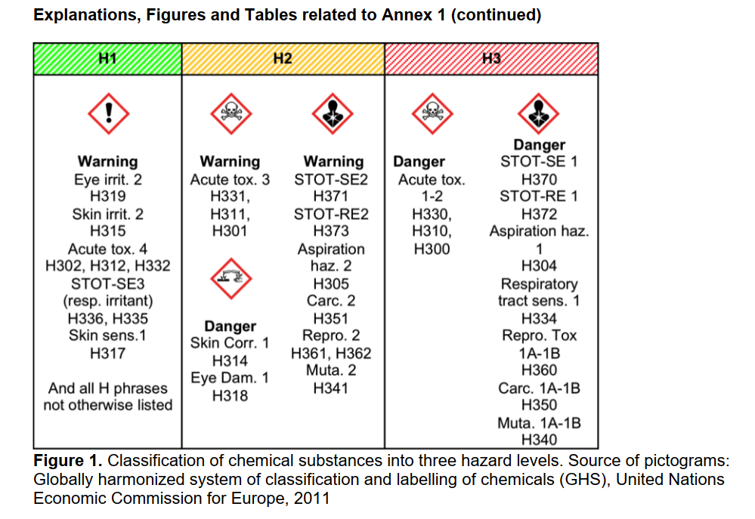
EPFL Methodology

Slide 4
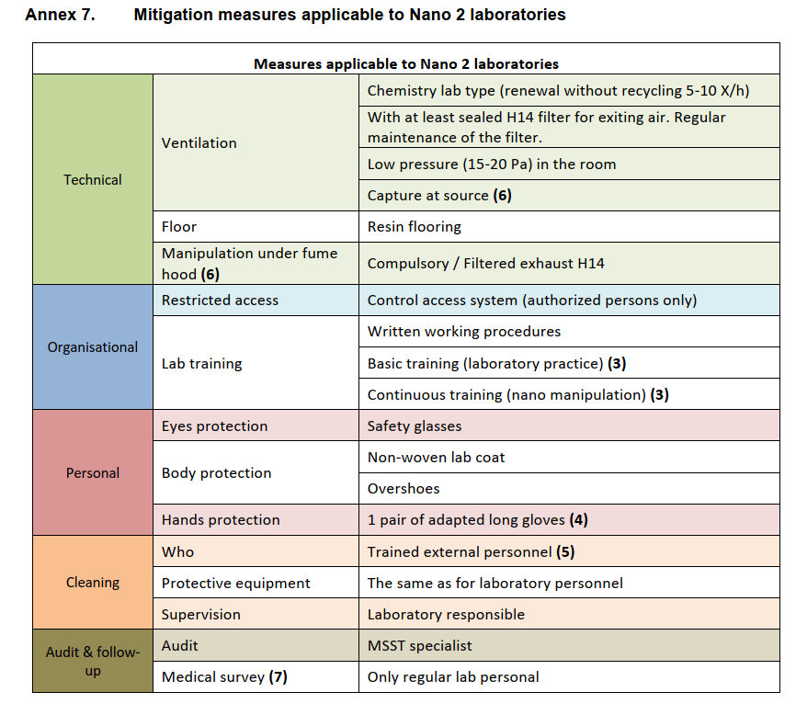
Protection Measures

