Slide 1

Some (past and future ?) EU supported activities related to nano for high power targets for secondary beams*
High power in the GW/cm3 inst. Power (PSB@ISOLDE) or in the 100kW’s cw range (EURISOL, Medical accelarators)
T. Stora , involving or supporting different colleagues along the EU programmes

Slide 2
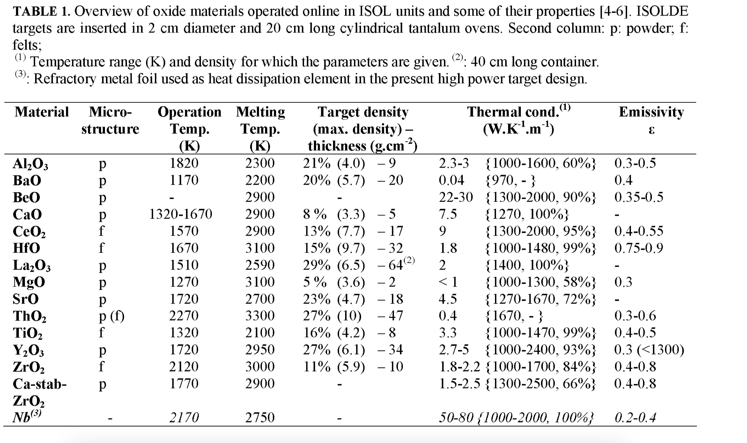
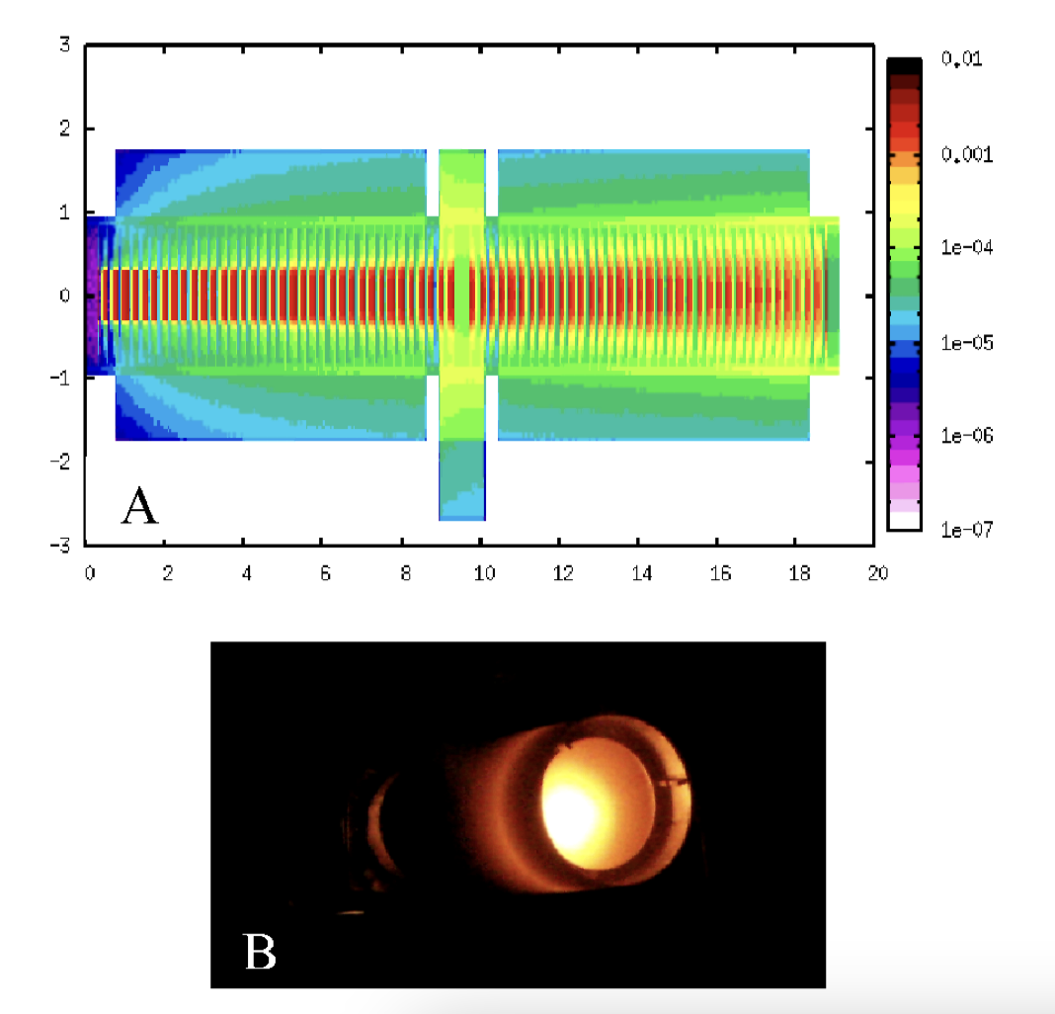
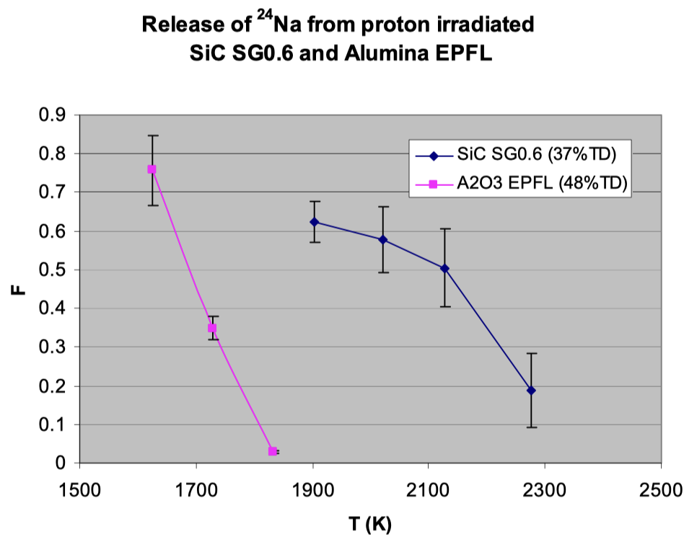
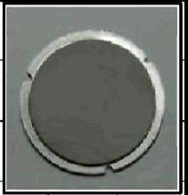
Nb-porous Al2O3 ‘Nano’-composite:
Brazed, Nb as “radiator”, porous/nano Al2O3 for fast release radioisotopes
FP7 – EURISOL DS (Design Study for large insfrastructure of EU Nuclear Physics ) 2009-2013 – total 8 MiEuros 20+ institutes
WP3 : 100kW direct target
~ 500 kEuros, 6 FTE @ CERN
T. Stora

Slide 3
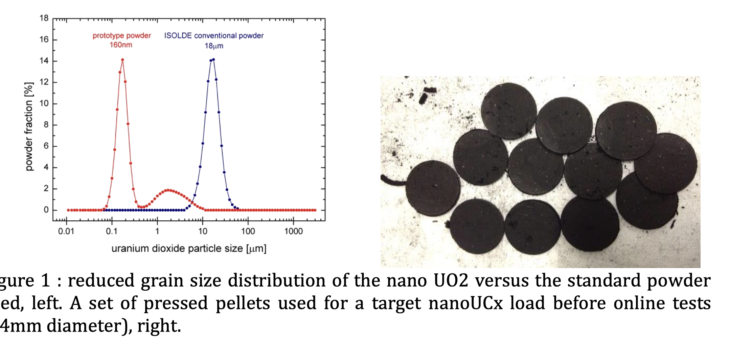
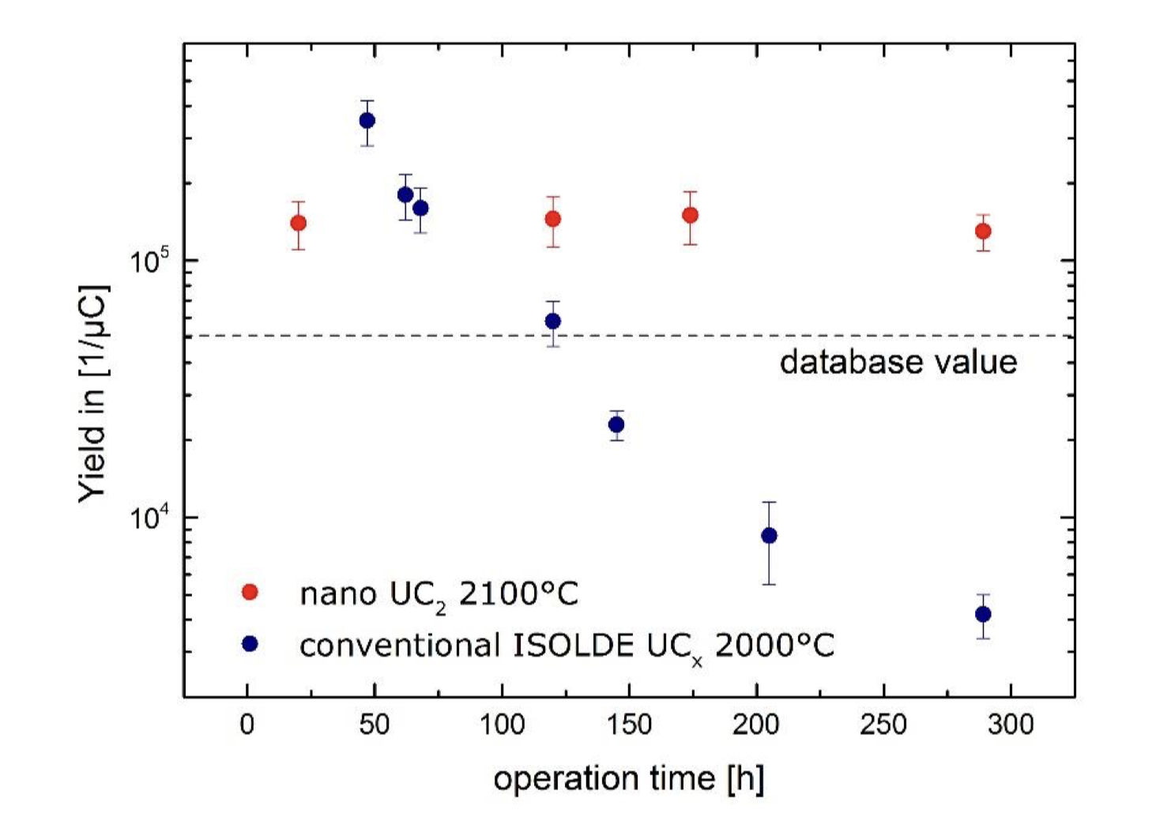
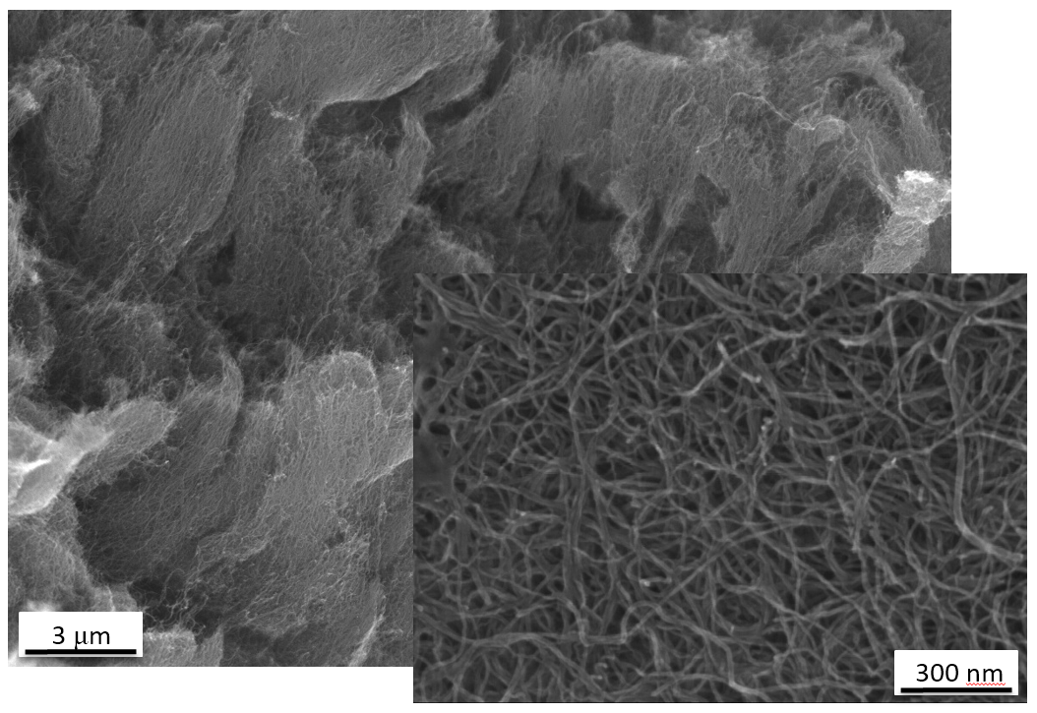
Porous UCx nanocomposite : MWCNT+nano UO2
WP8 Actilab 2010-2014 in ENSAR (INFRA for nuclear physics) – 350kCHF + FTEs – 5 institutes (EURONS-ENSAR-ENSAR2- now EUROLABS)
Synthesis Nanostructures, Characterization, PIE, Online tests
MWCNT
Gottberg,
Ballof, Ramos,
T. Stora

Slide 4
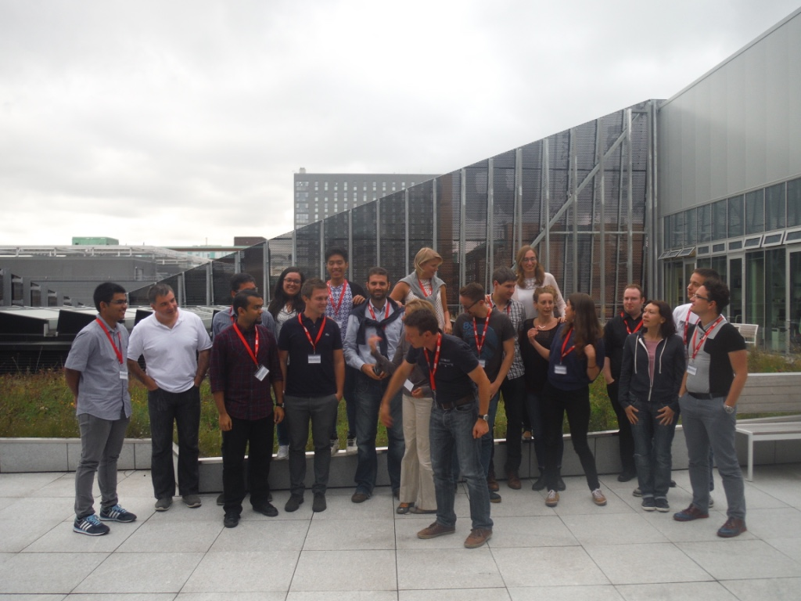
Horizon Europe as “food for thoughts” :
HORIZON-INFRA-2025-01-SERV-03 (sept 2025)
Physical sciences and engineering: nanoscience (5-10 MiEuro),
need to liaise with major EU infrastructures ( eg CEA-Leti Grenoble)
HORIZON-INFRA-2025-01-TECH-02: technology roadmaps (sept 2025)
Coordinated by CERN (follow-up of ARIES) (10-15 MiEuro)
EU & CERN strategy ?
Marie-Curie ITN : typically 15 young researchers / 3yrs 4 MiEuros (Nov 2025) (Graphene on Tantalum with K. Novozelov)
Functional materials Upcoming Call ?
“Dear Thierry
…. (Graphene) Flagship more or less finished now,
but there is a huge program on functional materials starting now in EU.
I think you should definitely try to apply
Kostya”
HiRadMat (or FermiLab, IPAC24 talk last year) keen in joining in the collaboration
T. Stora

