Slide 1
Detector Response
EPICal Meeting
20/02/2025
Nick Sundstrom

Slide 2
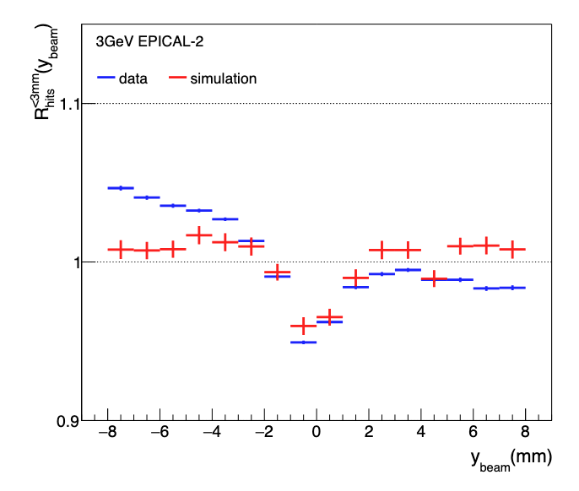

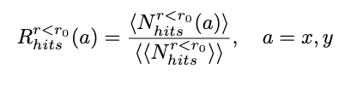
Recap
Sum the number of hits (clusters) within a cylinder about the shower center
  Place into bins based on X or Y position
Normalize to get the relative response compared to all X or Y values

Slide 3
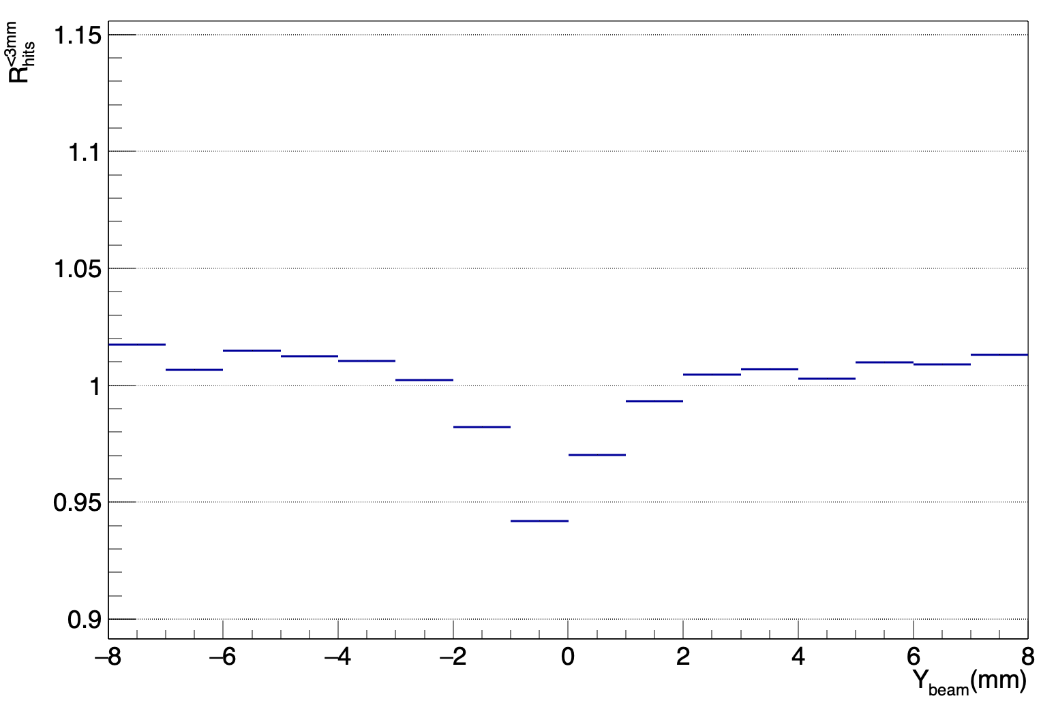
Correction from Previous meetings
SPS Slope was due to error when I did not include the amplitude correction
Since implementing the amplitude correction slope has disappeared
SPS 40 GeV

Slide 4
X and Y Binning
r
Take each detector half and divide into bins
  Ensure cylinder stays within chip bounds
This allows us to view Y dependence at different X values and vice versa
Implemented for two cylinder radii
  3mm, 5mm, (6.5mm)
r

Slide 5
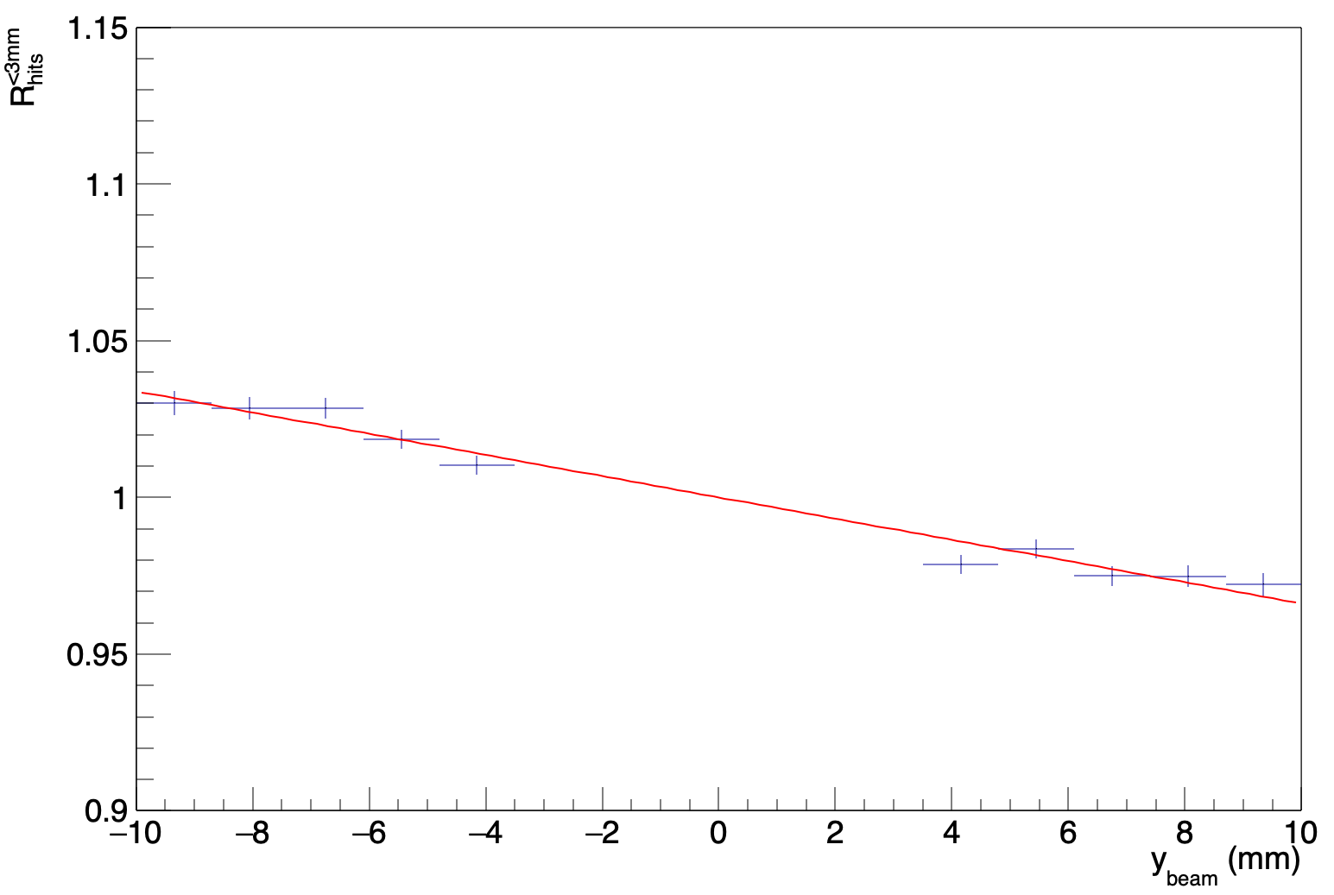
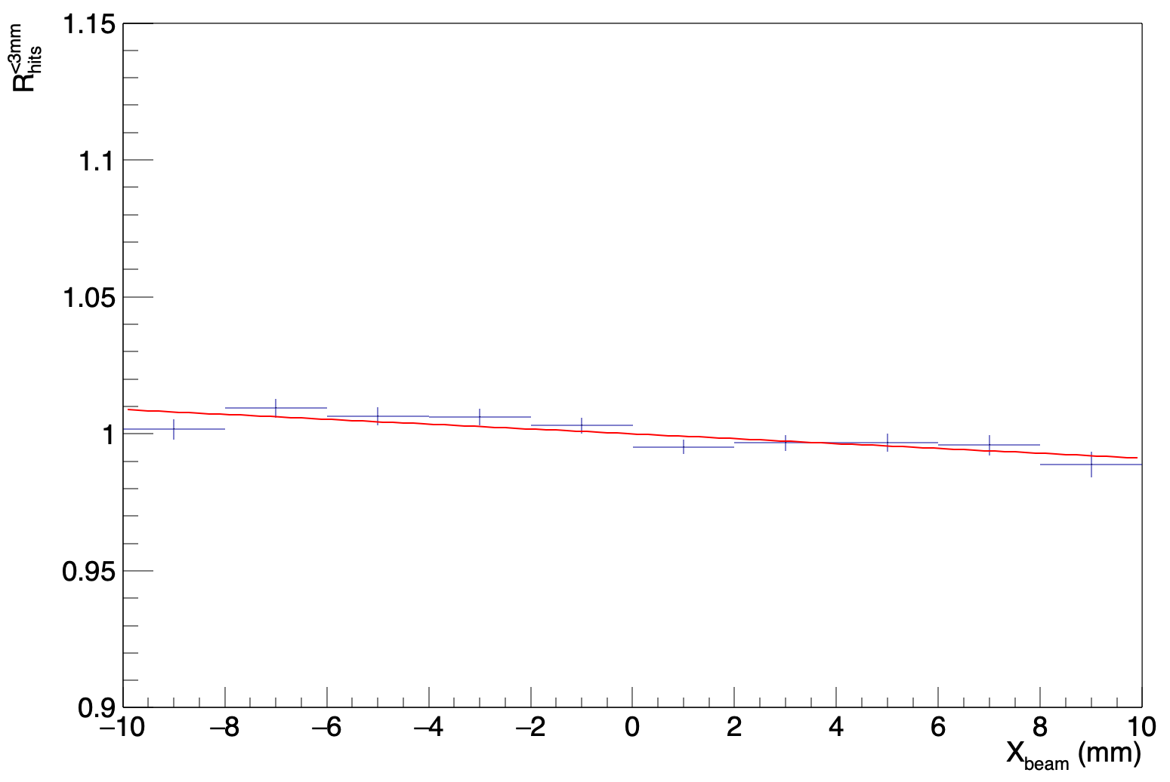
Output
3 GeV 3mm Response
Y
Provides response plots relative to X and Y position
Fits slope to each plot
By plotting the slopes we can identify outliers
X

Slide 6
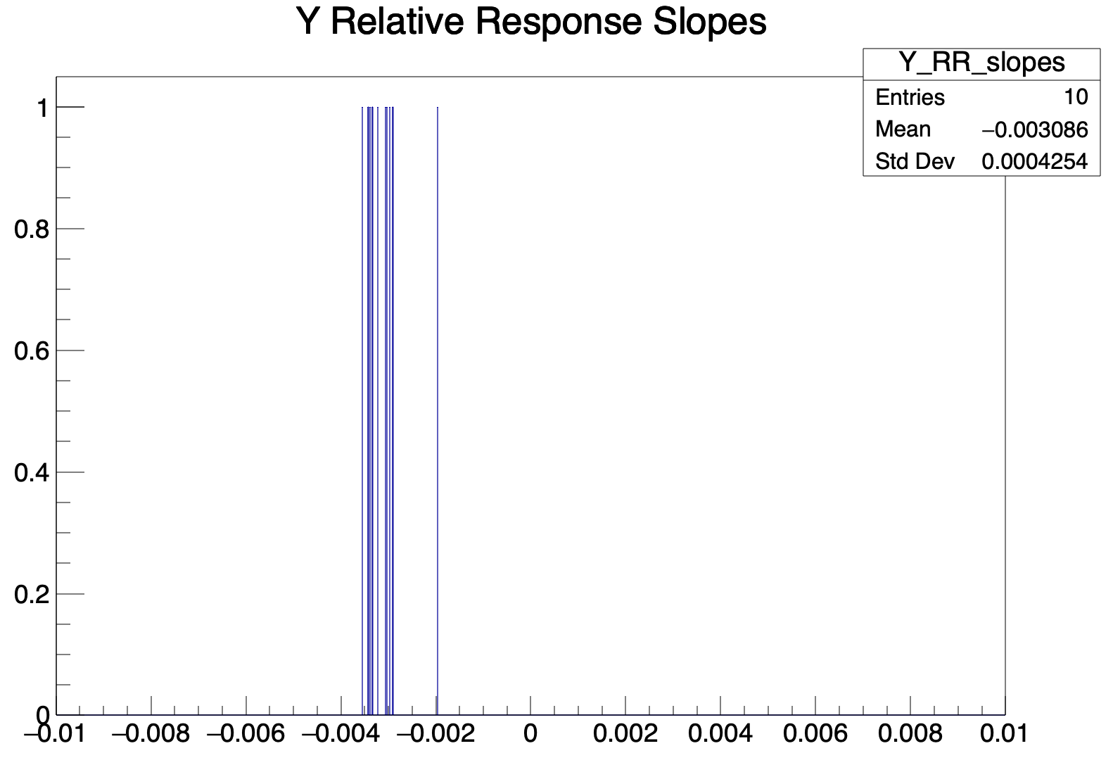
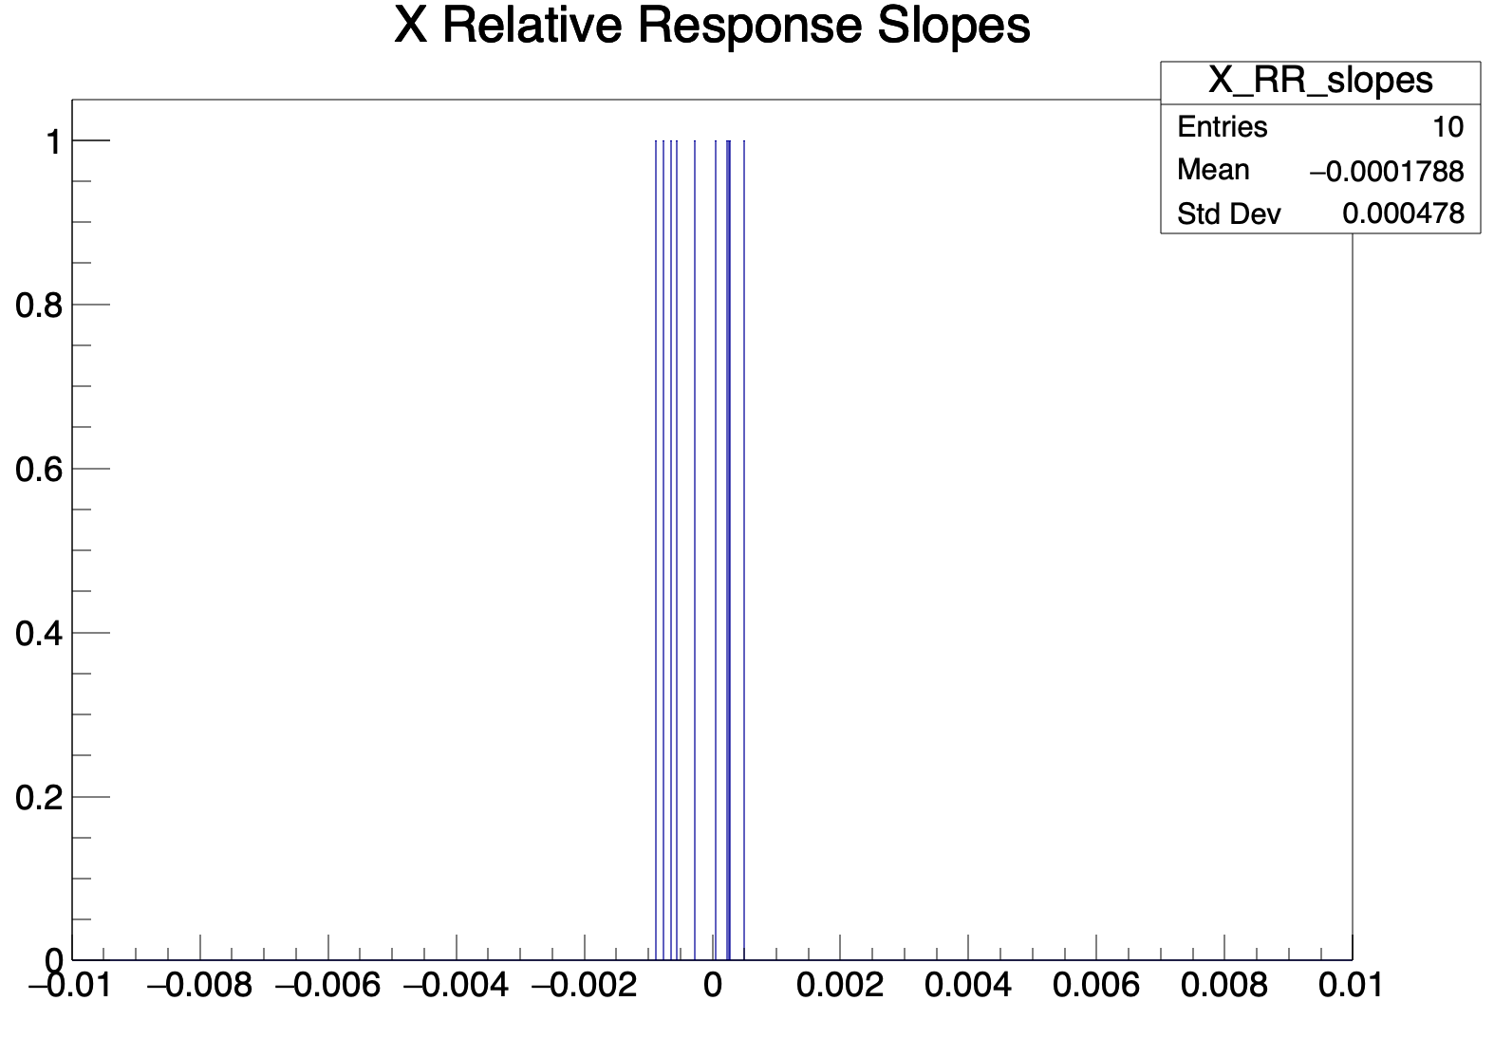
Results (3GeV 3mm)
-6% deviation over Y axis
~.35% deviation over X axis
clearly negative

Slide 7
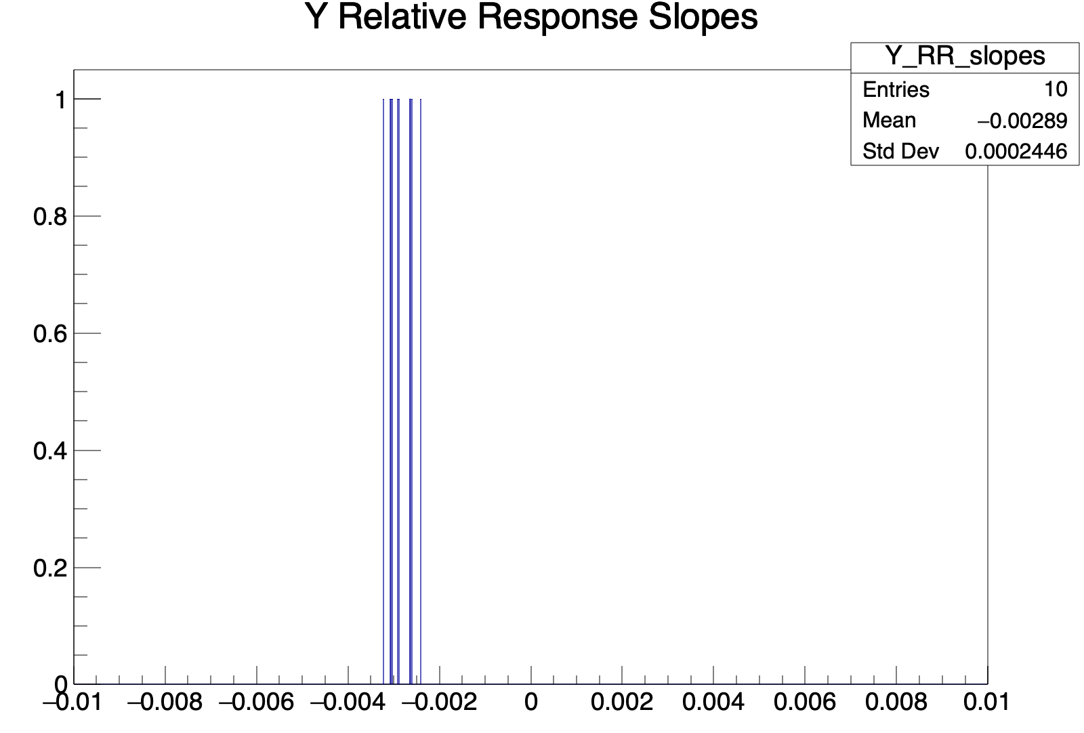
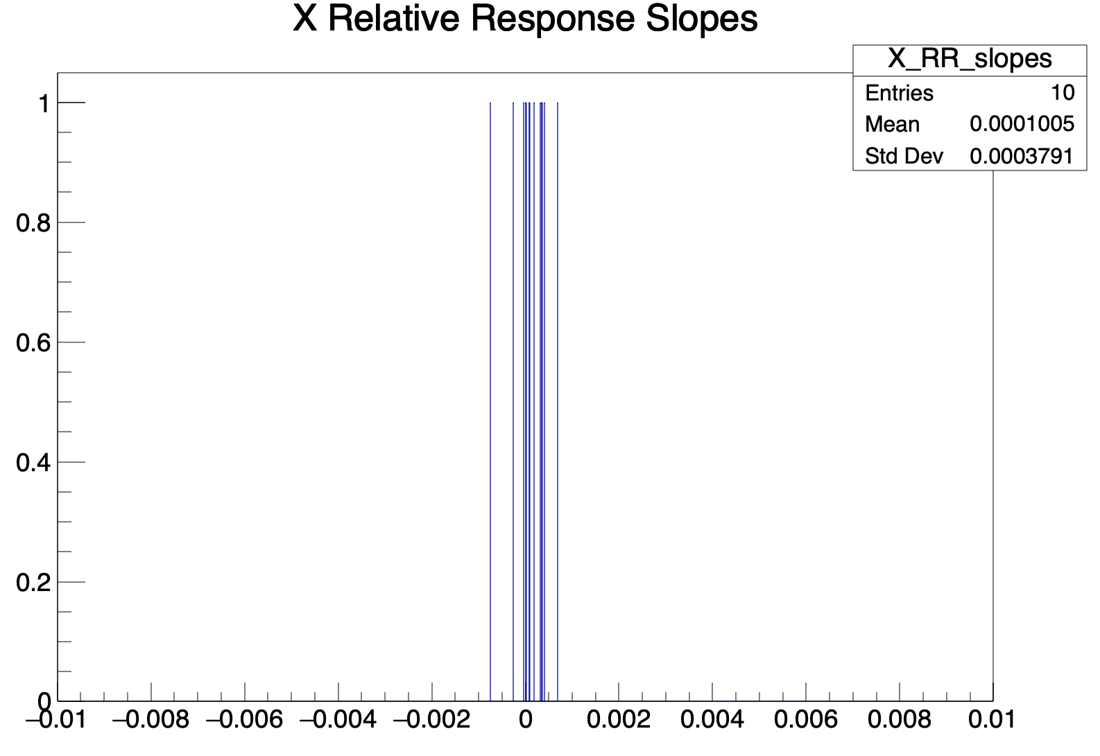
Results (5GeV 5mm)
-5.8% deviation over Y axis
~.2% deviation over X axis
clearly negative

Slide 8
Next Steps
Implement for 6.5mm cylinder radius
Continue to run over 4, 5.8 GeV data
Continue write up

