Slide 1
Loss measurements in superconducting magnets at CERN
Incomplete collection of data to start a discussion and direction of future research
Gerard Willering
19 February 2025
HFM QuaT meeting

Slide 2
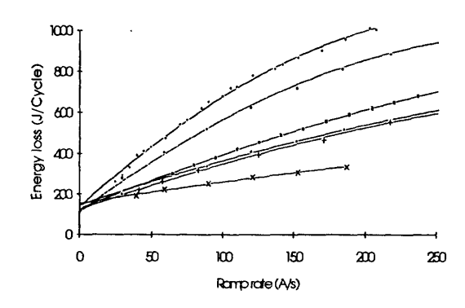
Loss measurement methods for magnets, introduction
Two methods to measure losses:
Calorimetric
  Requires well controlled and measured temperatures and helium liquid/gas flows. Often the cryostats are not designed to have accurate enough measurements.
Electrical
  Rather accurate. Methods exist to distinguish different type of losses, notably the hysteresis loss and coupling loss.
  Method in use at CERN at least since 1994: “A. Verweij et al., Analysis of the AC Loss Measurements on the One-Metre Dipole Model Magnets, IEEE Transactions on Magnetics, Vol 30, No 4, July 1994.

Slide 3
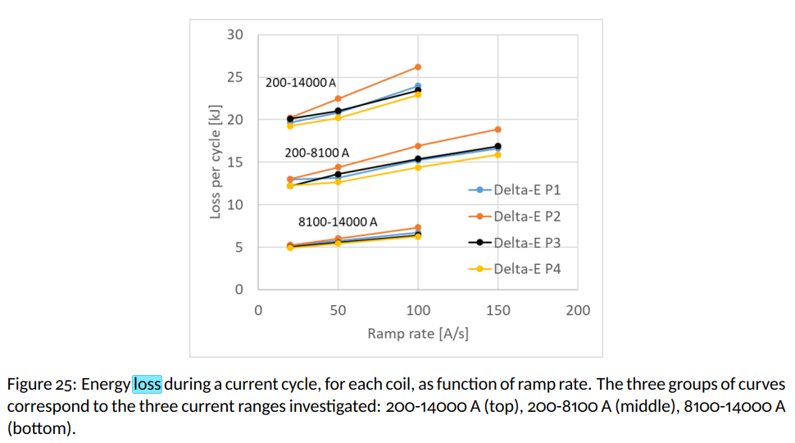
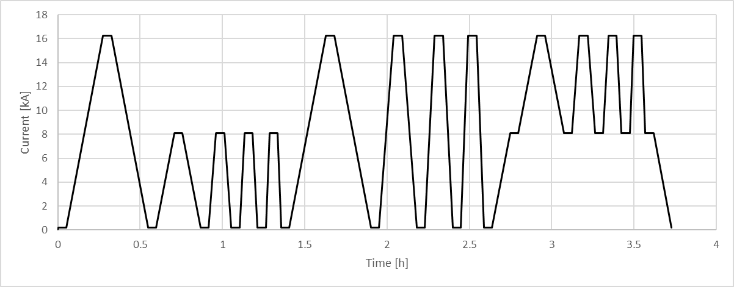
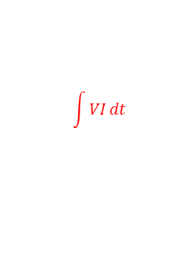
Loss measurement methods - electrical
AC-loss cycle from Q2 MQXF test plan, EDMS 2873724
4 ramp rates
0.2 – 16.2 kA
4 ramp rates
0.8 – 16.2 kA
Pre-cycle
4 ramp rates
0.2 -8 kA
$$\int{VI}dt$$
MQXFBP2 test results: EDMS 2469619
Note: values per 7 meter long coil.
Simple and clean method.
Requires: Full cycle required to remove stored magnetic energy from the integral.
Requires: Good offset compensation, no drift in voltage measurements, no splice resistance. 1 µV gives about 25 J for a 20 A/s cycle.

Slide 4
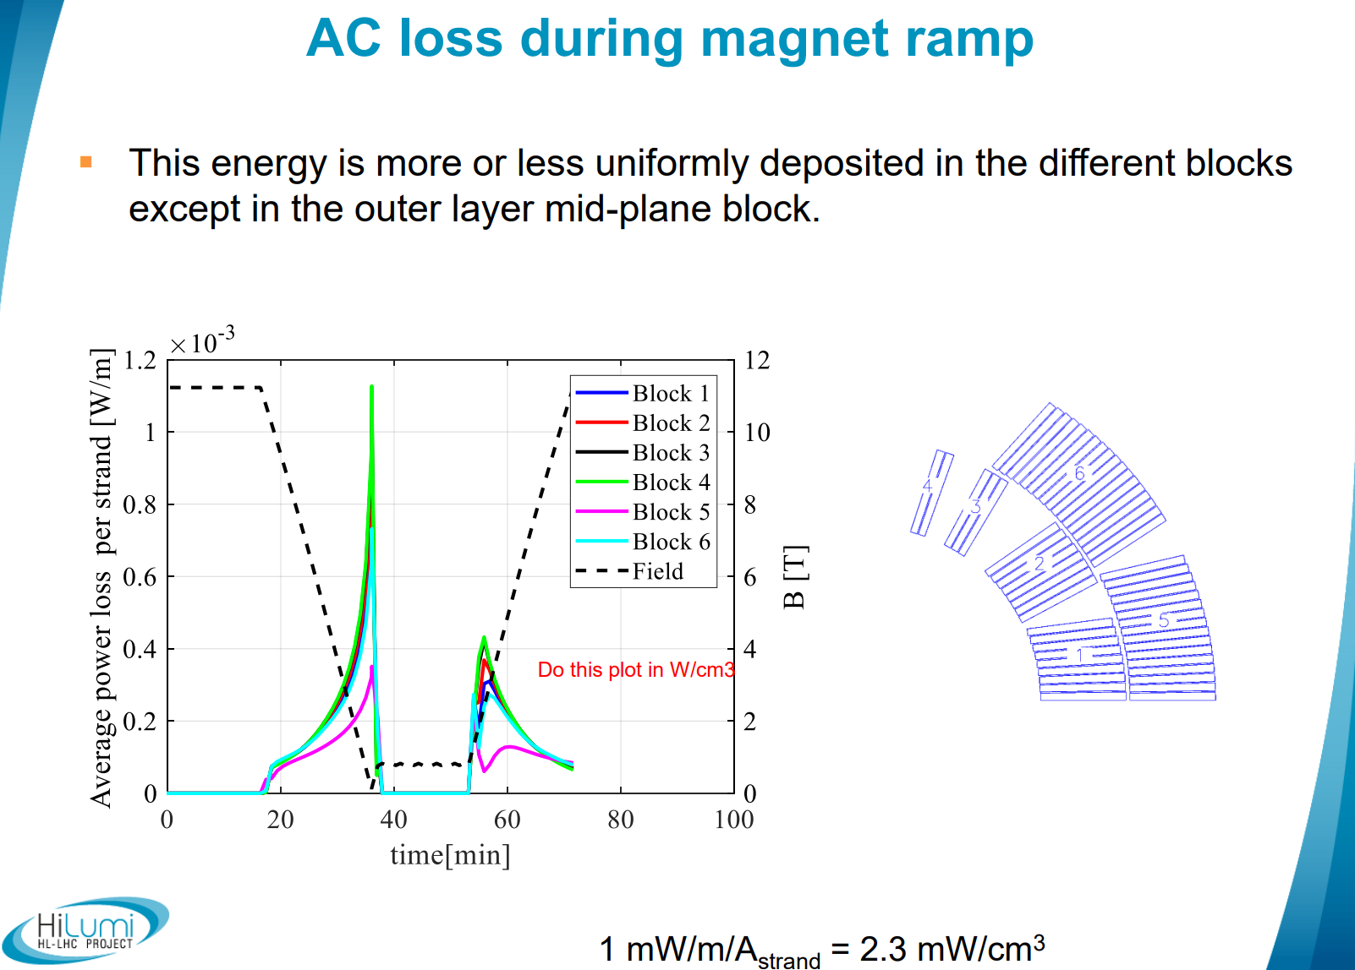
In the11T
It is good to realize that the loss depends on current and moment in the cycle.
Typically low field (higher J_{c} ) gives higher loss.
S. Izquierdo Bermudez – Margin on the 11T dipole https://indico.cern.ch/event/760815/contributions/3156774/

Slide 5
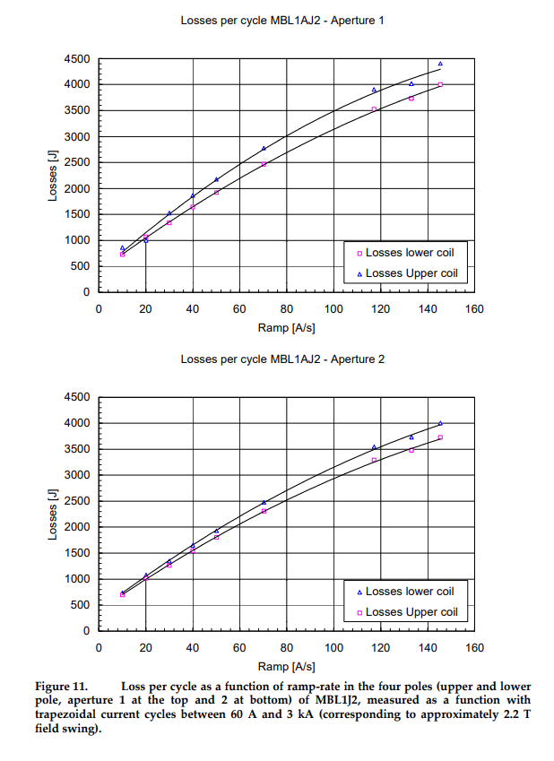
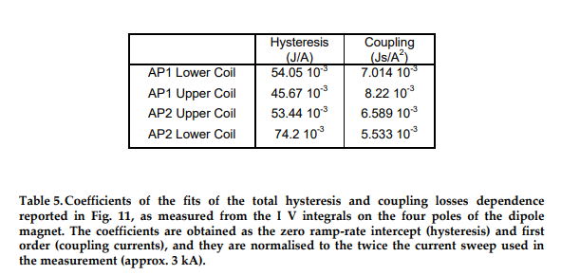
Some historic measurements at CERN
10 meter long dipole magnet MBL1J2 – 1997
Losses were defined as function of ramp rate
Measurements done between 60 A and 3 kA
Hysteresis loss small compared to coupling loss
For LHC main dipole magnets, it seems that it was mainly used for calculating interstrand resistances, with less emphasis on energy deposited in the helium bath.
https://edms.cern.ch/ui/file/356495/1/mta-in-97-012.pdf
https://edms.cern.ch/ui/file/384105/1/ELFA.pdf

Slide 6
MBH 11T full length prototype AC loss measurements - 2018
Calorimetric and electrical loss measurements

Slide 7
MBH 11T full length prototype - AC losses campaign - 2018
Normalize and compare to short models.
Translate to average power loss per cycle at 10 A/s
Very little variation in the loss per cycle between the 4 coils of MBH-prototype.
Ramp rate dependent loss contribution (coupling loss) is very small.
Summary plot of SP102, SP104, SP105, DP101, SP106, SP107, MBH-proto and calculations
Good correlation between all models and prototype all values within ± 10 %
Calculations higher than measurements.
1-3 kA cycles results for MBH prototype seem an anomaly. To be verified.
Average power dissipation per double aperture varies between 2 and 4 W/m, depending on the cycle.
The 3 W/m (as has been confirmed before) during ramping will be used throughout the rest of the presentation.
G. Willering – AC-loss measurements 11T horizontal magnet – calorimetric and electric. https://indico.cern.ch/event/760815/contributions/3156773/

Slide 8
MBH 11T full length prototype - AC losses campaign - 2018
This was the only (recent) measurement campaign using calorimetric loss measurements at CERN and comparing them to the electrical loss measurements.
~18 kJ, 360 s, ~ 50 W
Measurement method:
Current cycles done in MBH-prototype with different ramp rates between 1 and 6 kA
Fixing the pumping valve (45 % open)
Monitoring the temperature rise in TT821 (between shell and yoke in the middle of the magnet)
Results are summarized by :
Calculating the average power dissipation over the cycles (Electrically measured)
Time to reach 2.17 K
Slope from 1.95 K to 2.15 K
With the cryo heater reference power losses are done at 0, 4 and 8 W.
G. Willering – AC-loss measurements 11T horizontal magnet – calorimetric and electric. https://indico.cern.ch/event/760815/contributions/3156773/

Slide 9
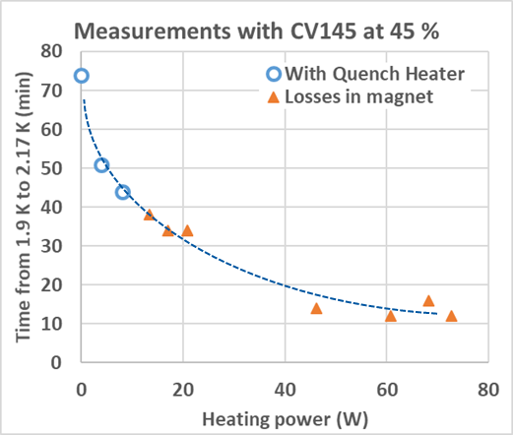
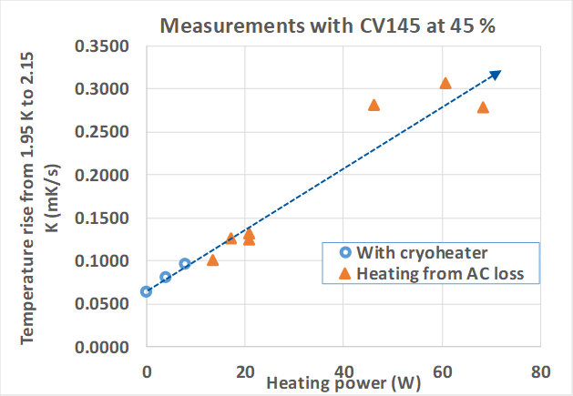
Calorimetric loss measurements MBH-proto
Electrical AC loss measurements are consistent with cryoheater calibration measurements
Calorimetric loss measurement could work for the horizontal benches at 1.9 K, but only when calibrated with electrical measurements.
G. Willering – AC-loss measurements 11T horizontal magnet – calorimetric and electric. https://indico.cern.ch/event/760815/contributions/3156773/

Slide 10
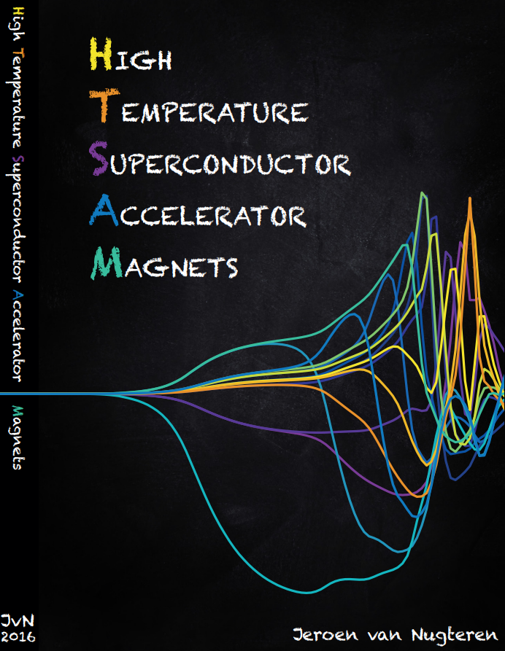
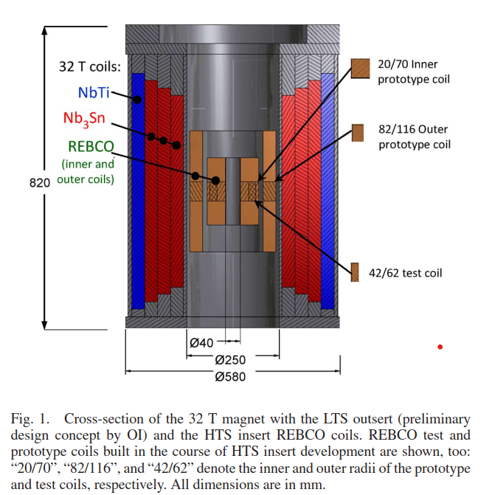
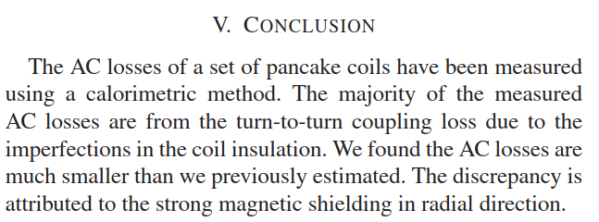
Loss measurements in HTS coils
At CERN some loss measurements were done on Feather coils, maybe some data could be extracted for Eucard coils. This will take some time.
Literature shows more calculations than measurements, to be investigated in more detail.
J.Lu et al., AC losses of REBCO pancake coils measured by a calorimetric method, IEEE Trans. Appl. Supercond. Vol 25, No 3, June 2015
A. Gavrilin et al., Observations from the analysis of magnetic field and AC loss distributions in the NHMFL 32 T all-superconducting magnet HTS insert, IEEE. Trans. Appl. Supercon., Vol 23, No 3, June 2013
E. Berrospe-Juarez et al., Screening currents and hysteresis losses in REBCO insert of the 32 T all-superconducting magnet using T-A homogeneous model, IEEE Trans. Appl. Supercond., Vol 30, No. 4, June 2020
I could not find reports on measurements, to be verified.
Thesis by Jeroen van Nugteren, 2016
It is worth to read chapter 4. https://cds.cern.ch/record/2228249/files/CERN-THESIS-2016-142.pdf

Slide 11
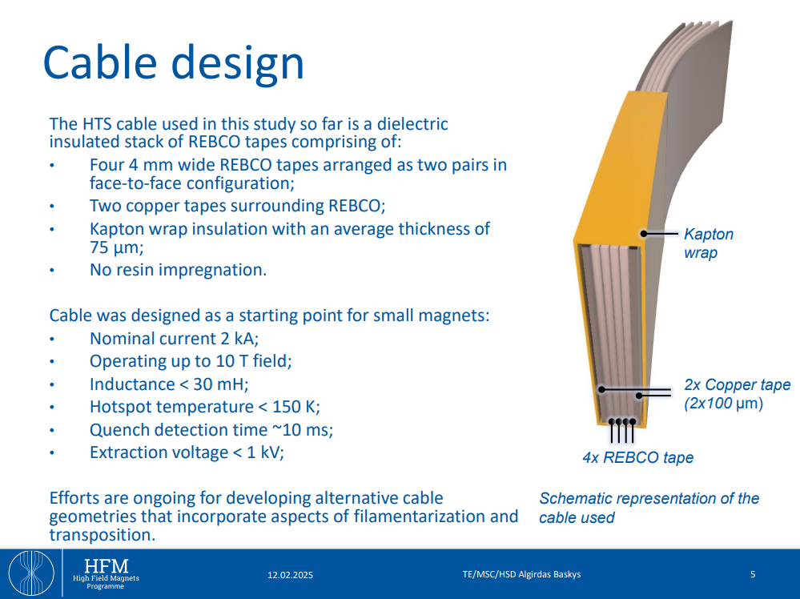
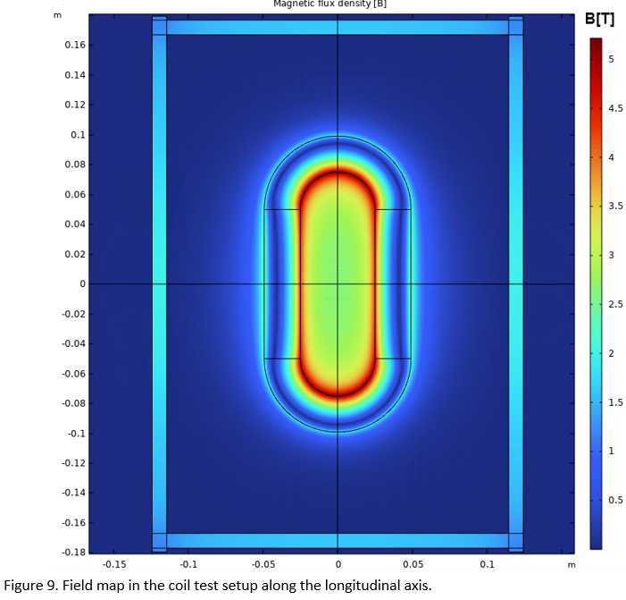
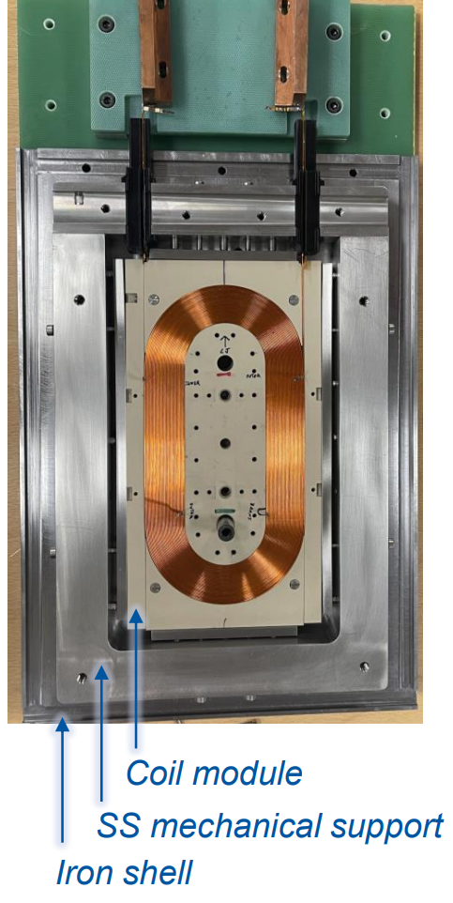
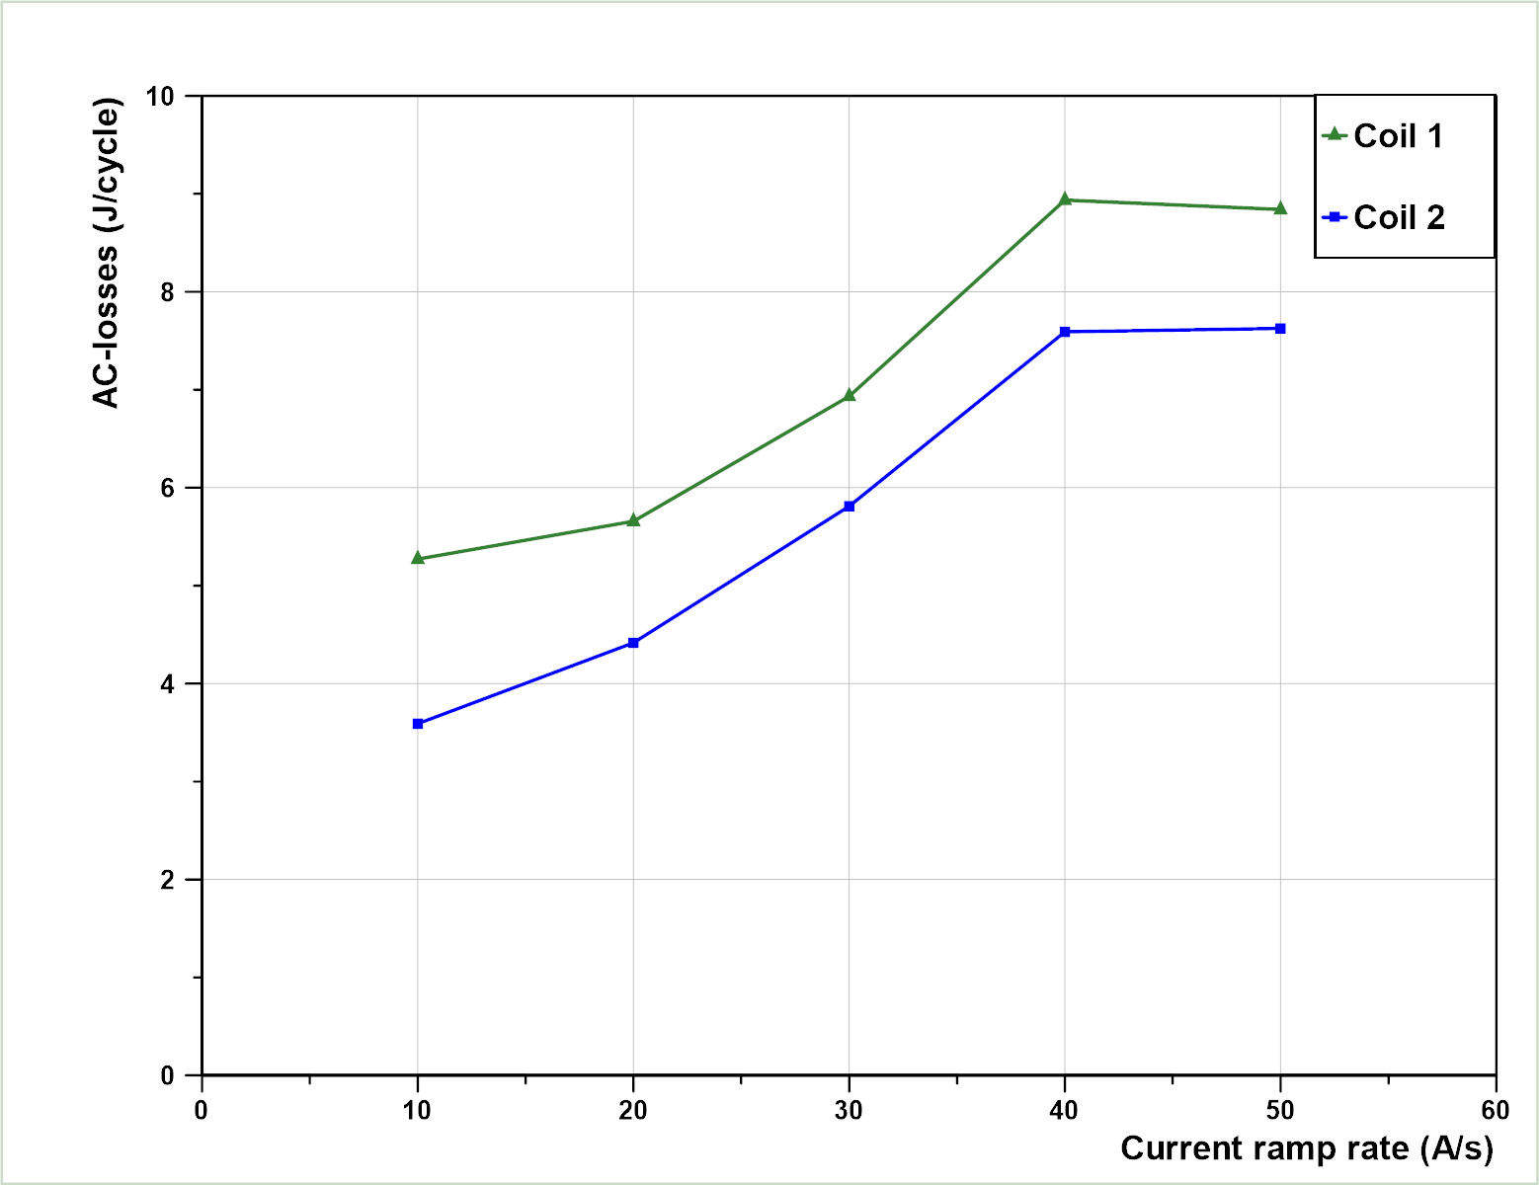
Recent test of HTS in SM18
https://indico.cern.ch/event/1471305/contributions/6260711/attachments/3013697/5314373/A_Baskys_HFM_2025Feb12.pdf
F. Mangiarotti

Slide 12
Conclusion
Measurement method well established
Nb₃Sn magnet loss well established and predictable. It is mostly ramp rate independent.
For HTS the data set seems much smaller.
  What is the impact of cable type (roebel, tape stack, CORC)
  How does loss depend on ramp rate?
  How important is inter-tape contact resistance?

Slide 13
Interesting publications:
Rossi, L.; Senatore, C. HTS Accelerator Magnet and Conductor Development in Europe. Instruments 2021, 5, 8. https://doi.org/10.3390/instruments5010008
Presentations of interest:
G. Willering – AC-loss measurements 11T horizontal magnet – calorimetric and electric. https://indico.cern.ch/event/760815/contributions/3156773/
H. Bajas – AC losses quantification in Nb₃Sn magnets. https://indico.cern.ch/event/704235/contributions/2932038/
S. Izquierdo Bermudez - Hysteresis losses in Eurocircle: model and measurements https://indico.cern.ch/event/1449701/contributions/6112671/
S. Izquierdo Bermudez – Margin on the 11T dipole https://indico.cern.ch/event/760815/contributions/3156774/

Slide 16
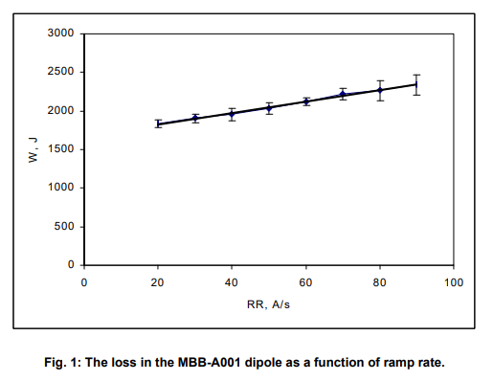
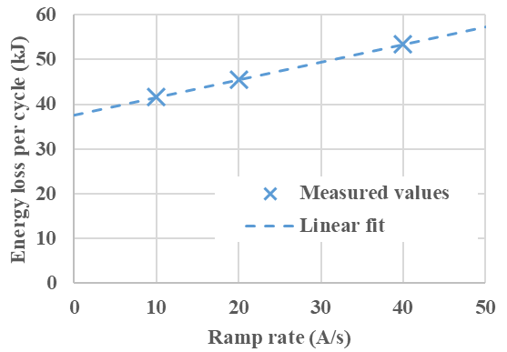
Collection of loss measurements.
The measurement is rather standard and done for most magnet types.
There may be much more data available that has not been reported on, since there was no real focus on it in the last decade.
FRESCA2 magnet from 0.1 to 10.6 kA (13T)
MQXFBP2: EDMS 2469619
Note: values per 7 meter long coil.
MBB-A001 pre-series dipole from 1 to 4 kA: https://edms.cern.ch/document/357352/1

Slide 17
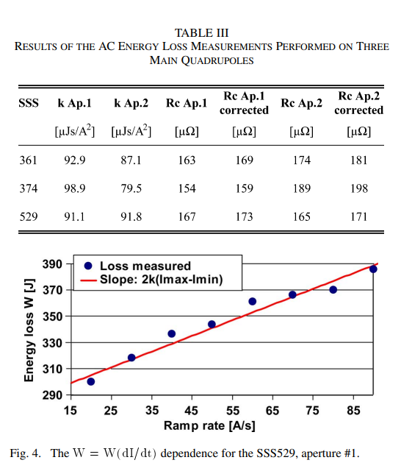
Collection of loss measurements.
AC loss measurements used to calculate Rc in LHC main quadrupoles
https://edms.cern.ch/document/866619/1

