Slide 1
TSO meet-up
Safety at CERN: our shared commitment
Benoît DELILLE – HSE Unit Head
5 June 2025

Slide 2
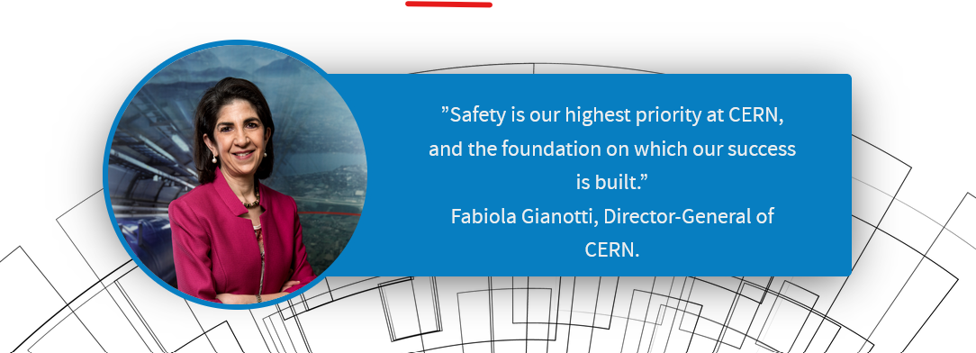
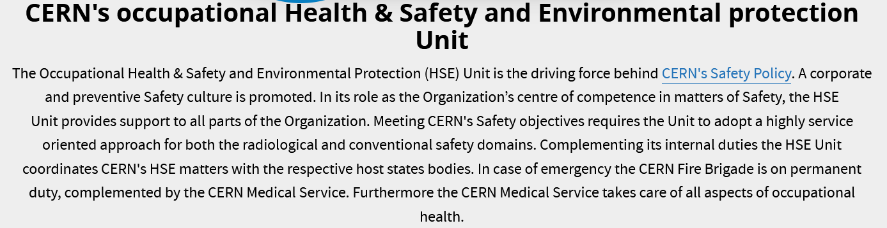
Commitment from the top

Slide 3
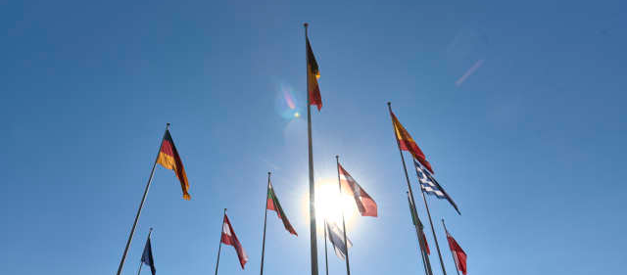
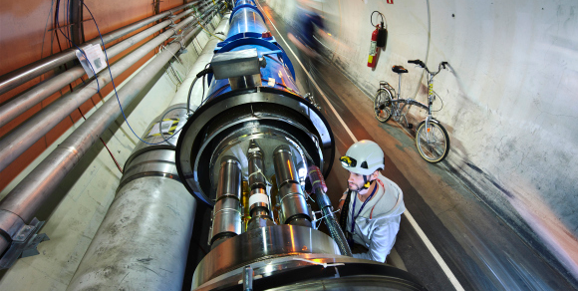
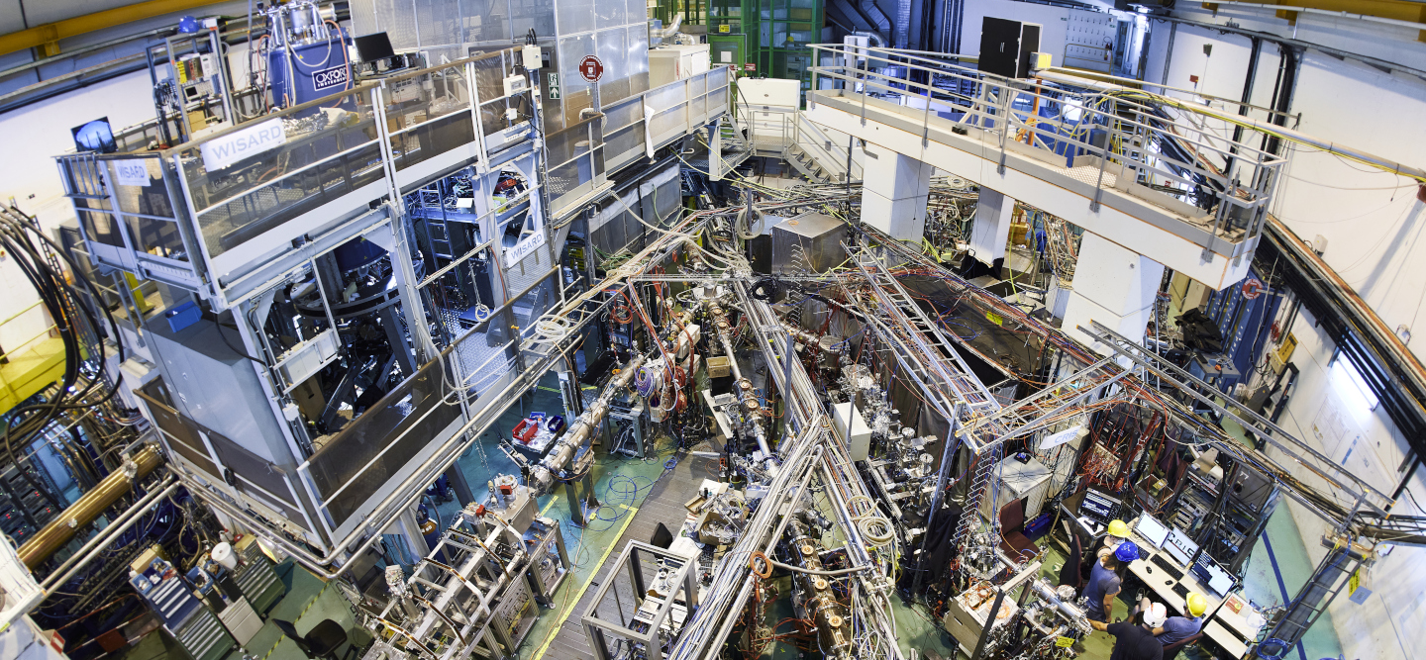
CERN’s mission is ambitious, and so are its Safety challenges
IO Status: own legislator and controlling authority
Cutting-edge technologies: in some cases, no relevant regulations/standards exist
Major “industrial” site: a great variety of risks
Dynamic installations according to research needs: fulfilling safety standards and freedom of research
Bilateral regulation: two different regulatory frameworks on a site that forms a technical and geographical unity (no border marking)
A large variety of populations on site:
CERN staff, scientific users, trainees and students, retirees, family members including small children, visitors including VIPs…

Slide 4
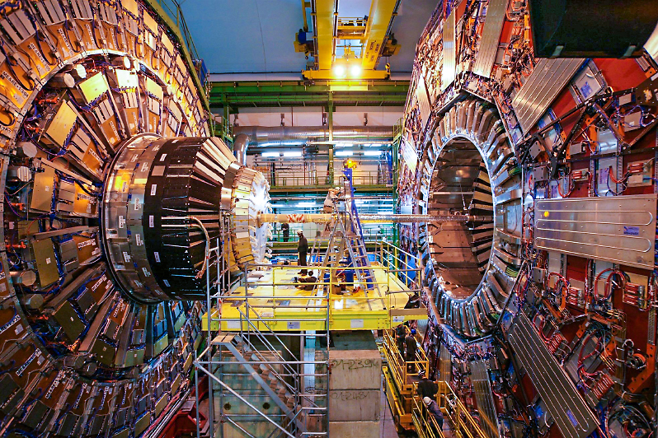
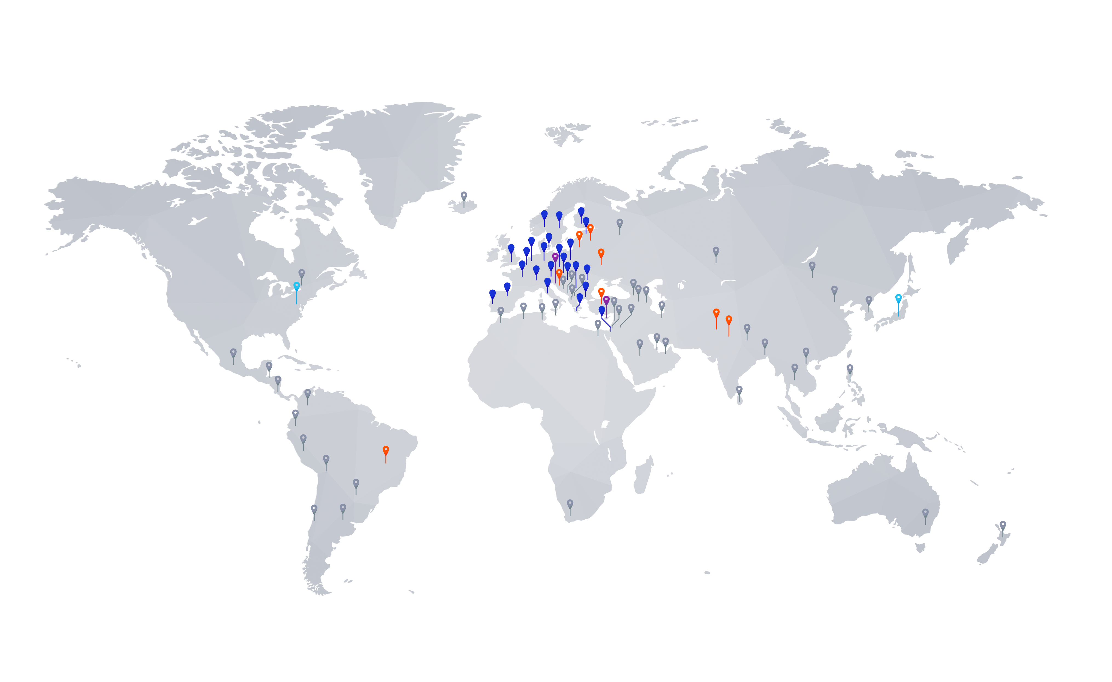
Shared and … specific challenges
Safety management of Experiments
  CERN Experiments are (independent) collaborations with financial and organisational autonomy linked to CERN by MoUs
  There are many Experiments of varying size, running time and complexity
  The Large (LHC) Experiments are complex and very costly installations and have hundreds of collaborators
Need to:
  Ensure safety of collaborators (“users”)
  Ensure that in kind contributions and equipment and materials brought on site are “safe”
Diversity of Safety challenges

Slide 5
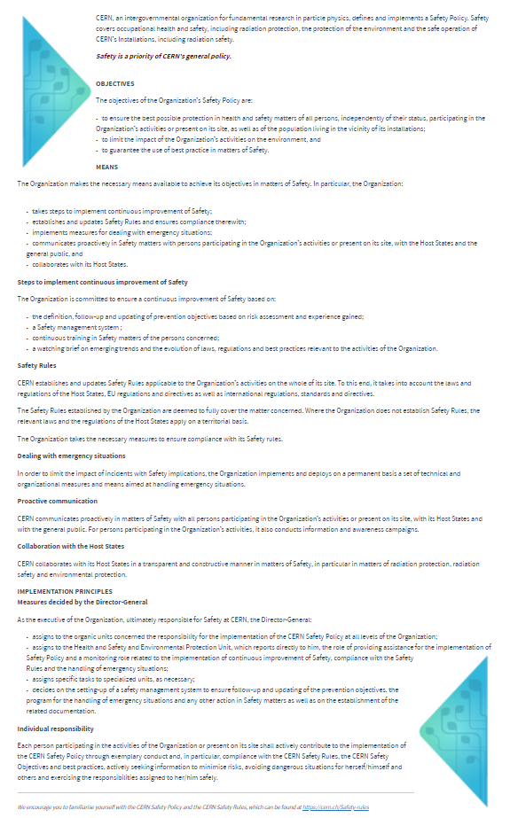
CERN Safety Policy – In short:
CERN commits to protect people, the environment and its assets; the freedom to innovate, safely.
Extract from CERN Safety Policy
Safety is a priority of CERN’s general policy, and includes occupational health and safety, including radiation protection, the protection of the environment and the safe operation of CERN’s Installations, including radiation safety.
The objectives of the Organization’s Safety Policy are:
  to ensure the best possible protection in health and safety matters of all persons, independently of their status, participating in the Organization’s activities or present on its site, as well as of the population living in the vicinity of its installations;
  to limit the impact of the Organization’s activities on the environment, and
  to guarantee the use of best practice in matters of Safety.
The Organization makes the necessary means available to achieve its objectives in matters of Safety.
CERN collaborates with its Host States in a transparent and constructive manner in matters of Safety, in particular in matters of radiation protection, radiation safety and environmental protection.

Slide 6
CERN Safety Policy & responsibilities
Extract from CERN Safety Policy
As the executive of the Organization, ultimately responsible for Safety at CERN, the Director-General:
  assigns to the organic units concerned the responsibility for the implementation of the CERN Safety Policy at all levels of the Organization;
  assigns to the Health and Safety and Environmental Protection Unit, which reports directly to him, the role of providing assistance for the implementation of Safety Policy and a monitoring role related to the implementation of continuous improvement of Safety, Safety Policy compliance with the Safety Rules and the handling of emergency situations;
  assigns specific tasks to specialised units, as necessary;
  decides on the setting-up of a Safety management system to ensure follow-up and updating of the prevention objectives, the program for the handling of emergency situations and any other action in Safety matters as well as on the establishment of the related documentation.
Individual responsibility
  Each person participating in the activities of the Organization or present on its site shall actively contribute to the implementation of the CERN Safety Policy through exemplary conduct and, in particular, compliance with the CERN Safety Rules,
… always a good reminder
Individual Responsibility through Exemplary Conduct

Slide 7
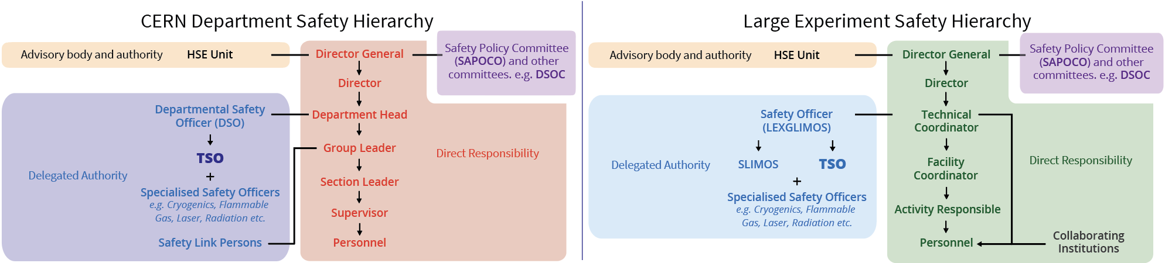
Safety Responsibilities @ CERN
Enablers of a safe working environment
Except in RP, operational responsibility follows the hierarchical line:
Departments are responsible for the Safety of their activities
HSE has an advisory role but also an authority in terms of Safety
Clear line of Safety Responsibilities
Continuous improvement in Safety

Slide 8
Safety Responsibilities @ CERN
Enablers of a safe working environment
Except in RP, operational responsibility follows the hierarchical line:
Departments are responsible for the Safety of their activities
HSE has an advisory role but also an authority in terms of Safety
Clear line of Safety Responsibilities
Continuous improvement in Safety

Slide 9
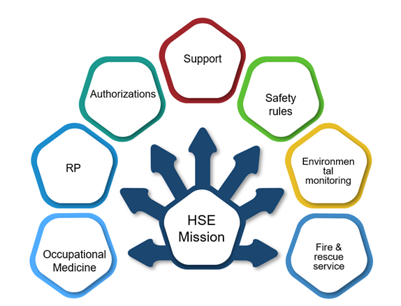

Summer 2020 – Feedback process – Some examples
HSE made huge progress - great job to turn HSE into a guide, while keeping authority
Safety rules edition, much more collaborative than in the past, everyone understands the key role of HSE in this regard
Departments need rules translators, not only staying on the prescriptive side, but also open to a pragmatic approach when reviewing activities/projects
Clear operational documents are needed: SLAs, risks, training level, intervention of external stakeholders
Need to clarify minimum operational activities
This will be a good starting point for the training plan
Operational procedures would profit from benchmarking with the outside
Level of operations not so high, CERN sites/activities globally very safe, but can become very complex
Change of strategy towards risk-based occupational health is the way forward.
Guiding MoP to finding the right doctor is a must.
The definition of occupational health follow-up for MPAs should be communicated better
Lots of good activities within different HSE groups
  Eyes and ears of the DH in the field
  Helping translate policy into daily practice
  Being the Safety conscience of the department
Clarifying the mission
Empowering
From compliance to supporting Safety culture

Slide 10

Clarification and Implementation will be brought by the
Product Owner: B. Delille & HSEMB
Programme Coordination & Integration: P. Bonnal
Six work packages:
WP1 — Stakeholders Cartography
WP2 — Safety Risks and Emergency Identification
WP3 — Medical and Personal Assistance Response
WP4 — Environment and Asset Emergency Response
WP5 — Safety Inspections and Safety Reviews Response
WP6 — Framework Design and Implementation
P. Bonnal
R. Otzenberger
S. Schadegg & J. Audrain
P. Bonnal & al.

Slide 11
WP5 — Safety Inspections and Safety Reviews Response
Revisiting the response over three subjects
General Safety Inspections
  Redefinition of the scope and periodicity
Safety Reviews
  Development of a general activity safety review methodology
  Development of processes and tools for implementing reviews
Revaluation of TSO role
  Analysis of the means and tools needed to monitor tasks and corrective actions
  Enable the TSO to perform their Safety oversight role for the building(s) assigned to them
Safety Officers empowerment

Slide 12

Is this enough?
Commitment from the top
Diversity of Safety challenges
Clear line of Safety Responsibilities
Individual Responsibility through Exemplary Conduct
Safety Officers empowerment
Continuous improvement
And many more…
A Safety system doesn’t work without Safety culture, i.e.
The way we do things … when no one is watching

Slide 13
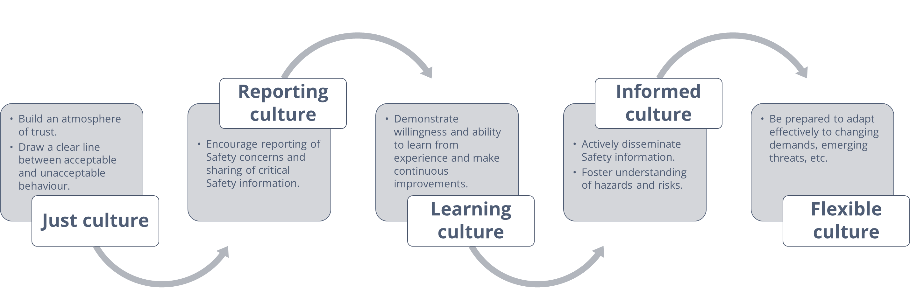

Safety Culture
James Reason - Safety Culture model
Let’s enjoy the TSO Meet-up, the CERN Safety day
And exchange about the 5 building blocks of the Safety Culture
Source: James Reason

Slide 14

World Environment Day – 5 June
Goals for 2030

