Slide 1
TSO meet-up
The evolution of the TSO/DTSO role: a historical perspective and a look ahead
Gunnar Lindell on behalf of the HOR WP5.3
5 June 2025 EDMS 3304806
Notes:
Talk about the TSO role in the past and the future.

Slide 2
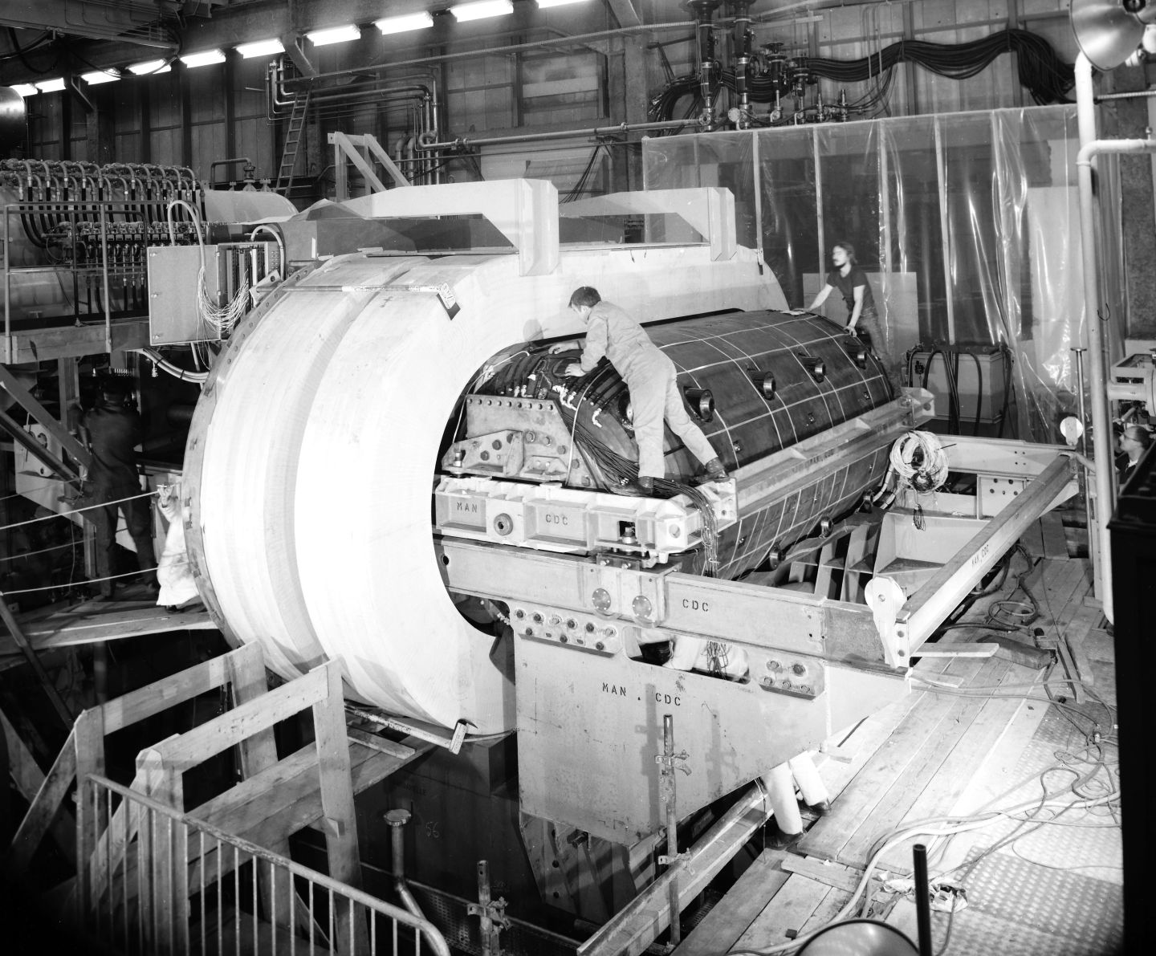

Historical perspective of the TSO role
TSO
Notes:
Photo from 1970 - Safety culture has evolved!
Installation of Gargamelle in the PS 1970
TSO’s did not exist but Safety Monitors in the Divisions.
TSO role introduced 1977
I am sure, you as TSO’s, would react if a similar situation would occur today. TSO’s not responsible for the activities but can intervene and talk to the responsble for the activity or DSO/LEXGLIMOS….
Reminder: Everyone can stop Imminent & serious situations”- doesn’t have to be the TSO.
Historical documents describe the same type of questions as we have today
about safety and responsibility.
TSO mandate (A9 safety code 2003-2016):
“A decision by the TSO may be overruled only by the concerned DH, jointly with
the HSE Leader (TIS Leader)”
HSE’s general safety inspections were addressed directly to the DH’s at one
point in time.
Oh – did you look at the left side of the photo? Zoom! Smoking while working!

Slide 3
The TSO role
TSO
289
Do you know how many TSO’s we are?
195
Do you know how many DTSO’s we are?
1160
Do you know how many “buildings” have a TSO?
960
Do you know how many “buildings” have a DTSO?
Notes:
289 TSO’s
195 DTSO’s
Many TSO’s are also DTSO’s.
1160 “buildings/ouvrage” have a TSO
960 “buildings/ouvrage” have a DTSO
Logicallly 200 bdgs do not have a DTSO.
Data from Roles

Slide 4
The TSO role
TSO
Valuable for CERN
  Local knowledge with eyes in the field & strong engagement are very
  important contributions to Safety at CERN.
Valuable for the person
  There is also a mutual benefit for the TSO’s as it gives a broader
  understanding of CERN and a network of people from CERN’s different services
Sharing experience
Plenty of good examples and initiatives to improve Safety.
Notes:
And you will discover several good examples this morning.

Slide 5
The TSO role
TSO
Sometimes perceived as:
Concierge
Not enough time
Little recognition and visibility
Resources and support lacking
Training?
Notes:
- The TSO’s consider they do not have enough time for the TSO role.
Limited recognition and visibility.
Resources and support lacking – need to insist a lot to get things done. Have no money. Who is paying?
- Occupants of the building consider the TSO as the concierge – asked about non safety related issues as well.
- TSO Training too long/too short (barrack vs big complex buildings). TSO course 3→2 days and updated again earyl 2025. Right training? Enough training? Domains covered?

Slide 6

TSO
Can the TSO role be improved?

Slide 7
Clarification and Implementation will be brought by the
Product Owner: B. Delille & HSEMB
Program Coordination & Integration: P. Bonnal
Project Support: Anastasiia Ovdiienko
Six work packages:
WP1 — Stakeholders Cartography
WP2 — Safety Risks & Emergency Identification
WP3 — Medical & Personal Assistance Response
WP4 — Environment & Asset Emergency Response
WP5 — Safety Inspections & Safety Reviews Response
WP6 — Framework Design & Implementation
P. Bonnal
R. Otzenberger
S. Schadegg & P. Bonnal
P. Bonnal

Slide 8
WP5 — Safety Inspections and Safety Reviews Response
Growing role of highly skilled safety officers within their department or experiment, part of the implemented safety provisions are designed and endorsed at department or experiment level
Revisiting the response over three subjects:
General Safety Inspections
  Redefinition of the scope and periodicity
Safety Reviews
  Development of a general activity safety review methodology
  Development of processes and tools for implementing reviews
Revaluation of TSO role
  Analysis of the means and tools needed to monitor tasks and corrective actions
  Enable the TSO to perform their safety oversight role for the building(s) assigned to them
Notes:
General Safety Inspections: Can they be done in a better way?
Safety review: In-depth review of an activity, a service etc
Revaluation of the TSO role: Subject of this presentation

Slide 9
WG – Revaluation of the TSO role
TSO
Presentation of the WG members
Alexis Vidal TSO & DDSO TE
Evelyne Dho TSO & ADSO EP
Julien Fernandez DSO EN
Manuel Guijarro TSO IT
Christophe Boucly TSO SY
Laure Tranchand TSO & DLEXGLIMOS ATLAS
Marc Vadon DSO SCE
Gunnar Lindell TSO, DSO & Chair WG DG/HSE/IR
Stephane Rey* TSO & DDSO SY
Zakaria Oichikh* TSO & DLEXGLIMOS CMS
Anastasiia Ovdiienko* HOR Project support HSE
* previous members
Notes:
WG members all on voluntary basis.
Good representation of the Organization.
Very interesting to share good and bad experiences in good spirit.
Often common experiences and sometimes specific. Enriching!

Slide 10
WG – Revaluation of the TSO role
Sub-WG - Communication
TSO
Presentation of the members
Anna Cook Communications coordinator HSE
Rob Fowler Communications officer HSE
Christophe Boucly TSO SY
Gunnar Lindell TSO & DSO DG/HSE/IR
Laure Tranchand * TSO & DLEXGLIMOS ATLAS
Zakaria Oichikh* TSO & DLEXGLIMOS CMS
Anastasiia Ovdiienko* HOR Project support HSE
* previous members
Notes:
This WG turn ideas in to concrete actions.
Especially Anna and Rob doing a great job behind the scene.
Examples: TSO Info Hub, TSO meet-up, films, posters, announcements…

Slide 11
TSO
Revaluation of the TSO role: Proposals
Enable the TSO to perform their safety oversight role for the building(s)
assigned to them.
The TSO role needs recognition and visibility:
  MERIT, estimated time allocated..
  TSO meet-up - today 5 June!
Define the responsibilities in buildings.
  Matrix by HOR WP5.1 & 5.3 – ongoing
  Responsibility at the right level, clarify budget policy
TSO Guideline (clarifications on how to apply the TSO mandate) – ongoing
Notes:
MERIT: Mention the TSO role, achievements, objectives, estimated time.
TSO meet-up. Hopefully useful for you and hopefully creating a buzz in the Organization.
Matrix: Who does what? Maintenance, repairs, inspections etc. Collaboration with SCE. Should allow the TSO to be efficient by doing the right thing. Not too much and not too little.
Responibility: TSO should not need to run after budget codes. Responsibility at the right level….
TSO guideline – useful reminder.
Practical advice (evacuation exercise, how to communicate, coordination of works, waste, etc.)
Sometimes difficult to distiguish between the TSO role and doing the activity in the bdg.

Slide 12
TSO
Revaluation of the TSO role: Proposals
Analysis of the means and tools needed to monitor tasks and
corrective action.
TSO Info Hub. (https://www.cern.ch/tso) - available
  Topics: TSO mandate, Key safety documents.Support, Tools & Resources,
  Training, In an Emergency…..
Update of the TSO check lists – ongoing
Notes:
I hope you are using the evolving TSO webpage!
Open the Wepage
Updated checklist
Re-assurance for the TSO to do the right thing. Not too much and not too little.
Pilot cases ongoing in some Departments.

Slide 13
Tentative Timeline
TSO
Responsibilities bldgs
Continuous
improvements
TSO Guideline
TSO Info Hub
Updated check lists
TSO
Meet-up
Planned for
2nd half 2025
Released
June 2024
TSO
Meet-up
Annual event?
2024
2025
2026
Notes:
Responsibilities in blgs – matrix.
TSO guidline – practical advice.
Updated check lists – TSO’s doing the right thing
Continues improvements…
New user friendly tool for updaded checklists? Other….
Annual TSO Meet-up? Different format? More interaction betweenTSO’s/DTSO’s?

Slide 14
TSO
Summary
Our aim and actions are to support the TSO’s & DTSO’s.
We look forward to your ideas and suggestions for improvements!
Please contact us on: tso-proposals@cern.ch
Sign up for the TSO course if you did it before 2021!
Notes:
Lot’s of updtates in the TSO course since 2021.

Slide 15
Thank you for your attention!

