Slide 1
TSO meet-up
Safety incident management: your participation is key!
Carine Pividori
5 June 2025

Slide 2
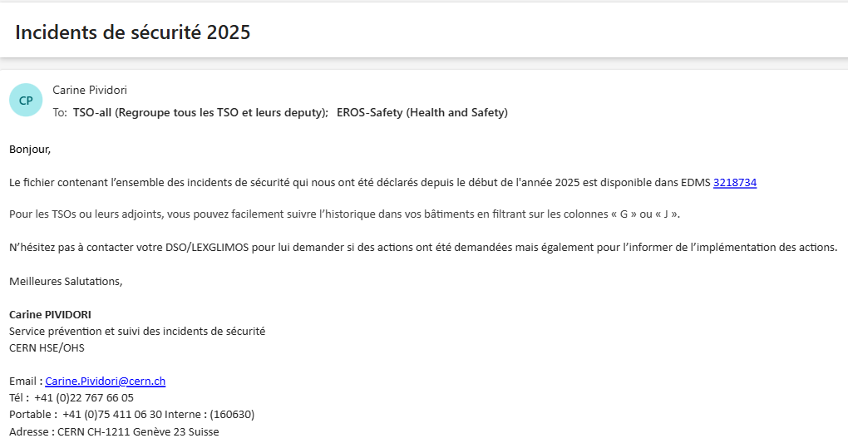

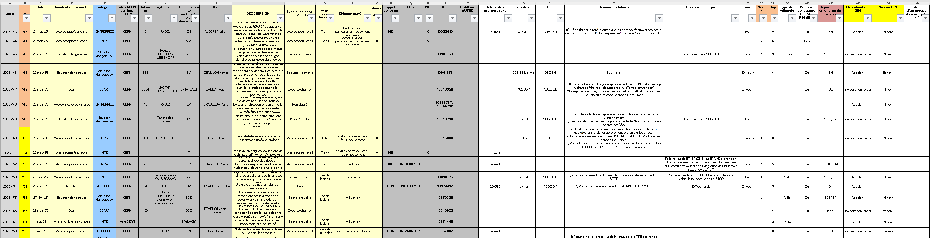
Congratulations!

Slide 3
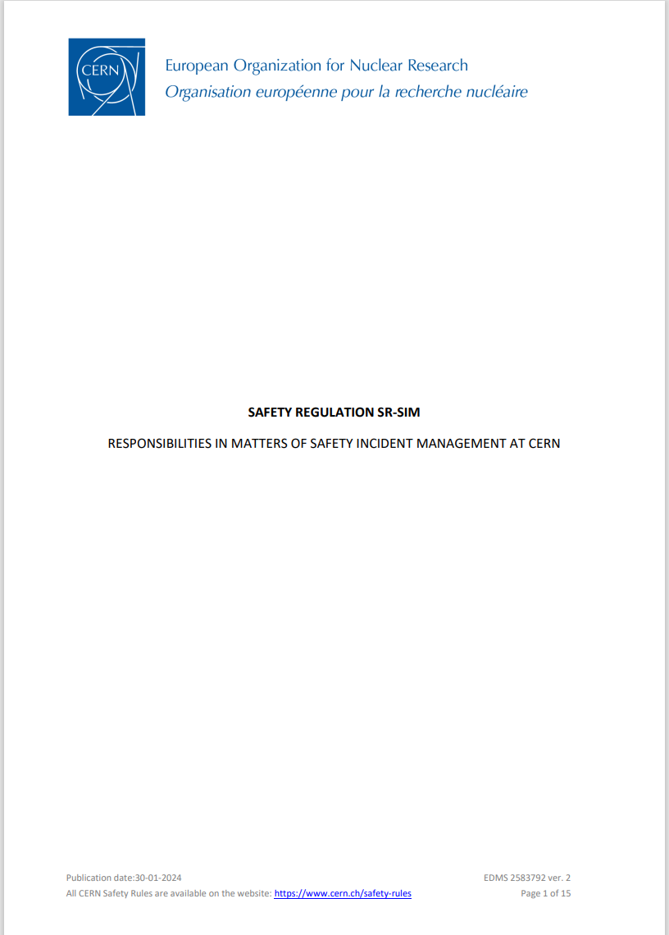
Safety Incident Management Procedure at CERN
Safety Regulation SR-SIM “Responsibilities in matters of safety incident management at CERN”
Safety Incident: an unintended event or situation that has non-negligible, negative consequences or potential consequences from the point of view of Safety.
Safety Incident
Unsafe situation
Radiological events
Near miss
Accident
Deviation
Injuries
Material damage
Environmental impact
Courtesy of J. Fernandez DSO EN

Slide 4
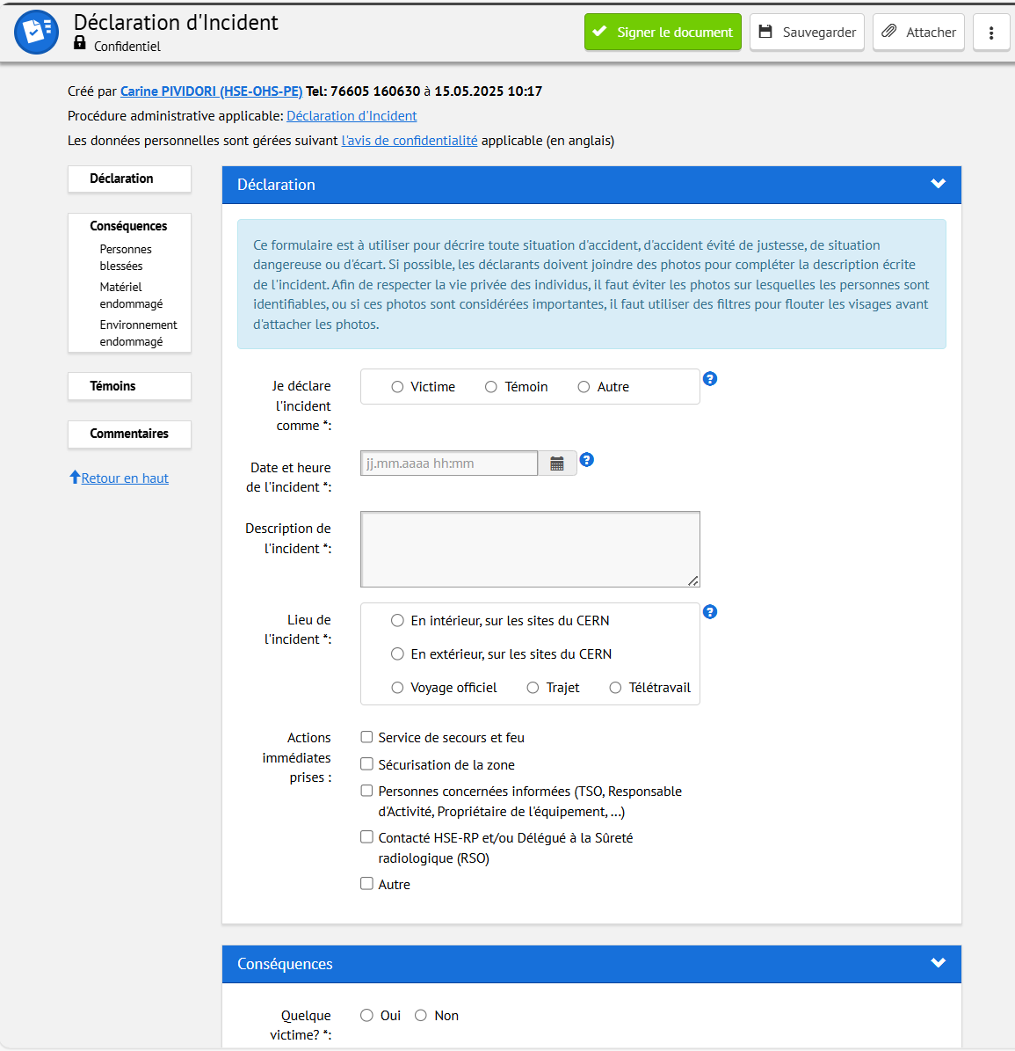
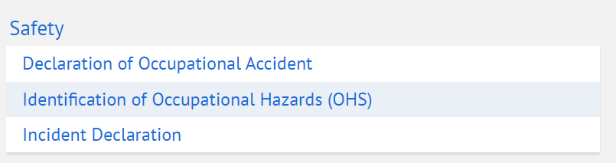
Safety Incident Management Procedure at CERN
Any safety Incident shall:
promptly be notified to the appropriate CERN services if immediate action is required, in particular the CFRS → +41 22 76 74444
be reported
This allows the relevant safety office to start the incident analysis that will lead to define measures to avoid reoccurrence and improve the level of safety at CERN

Slide 5
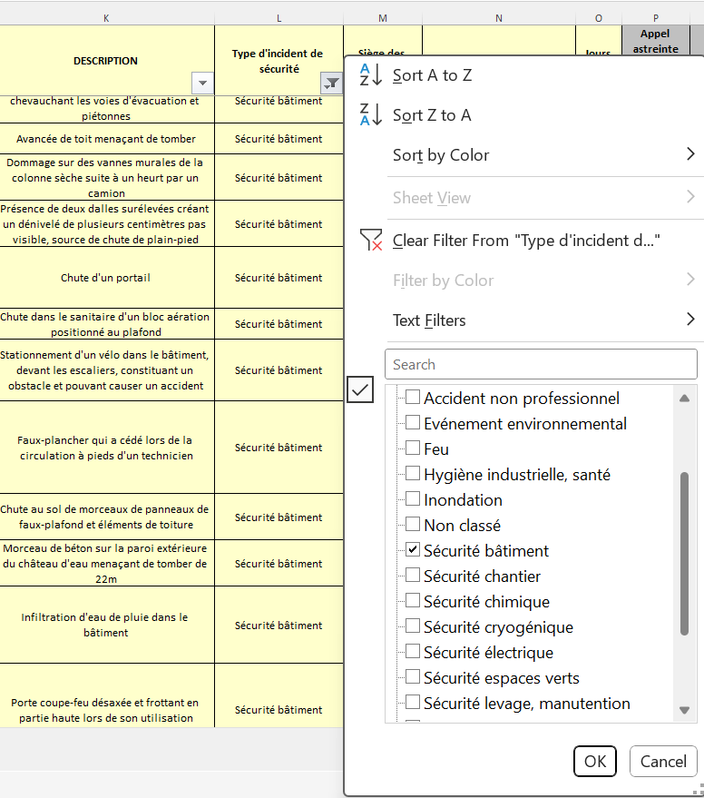
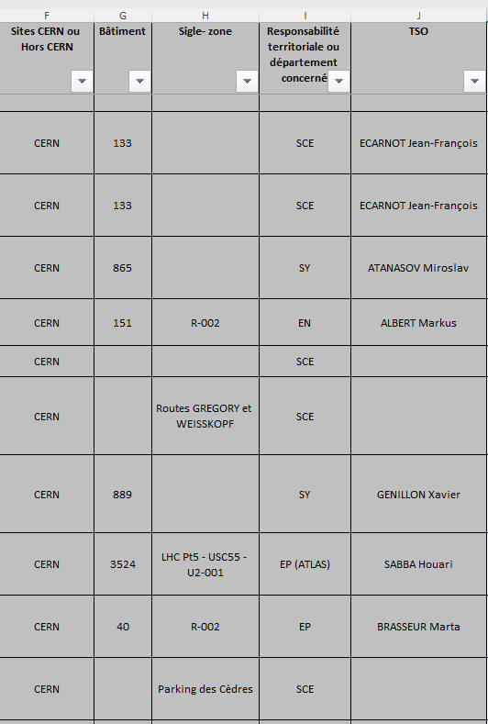
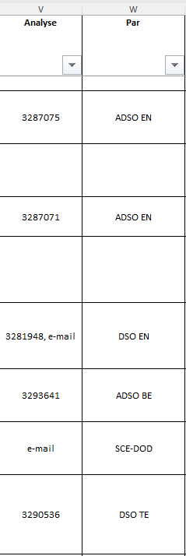
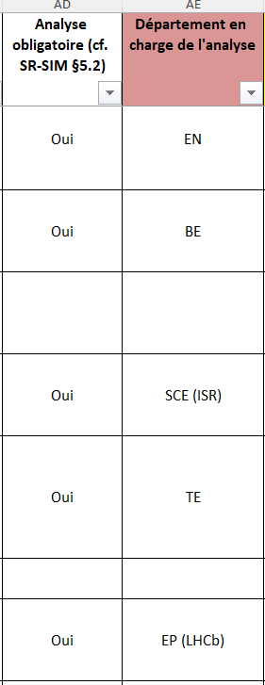
Excel spreadsheet

Slide 6
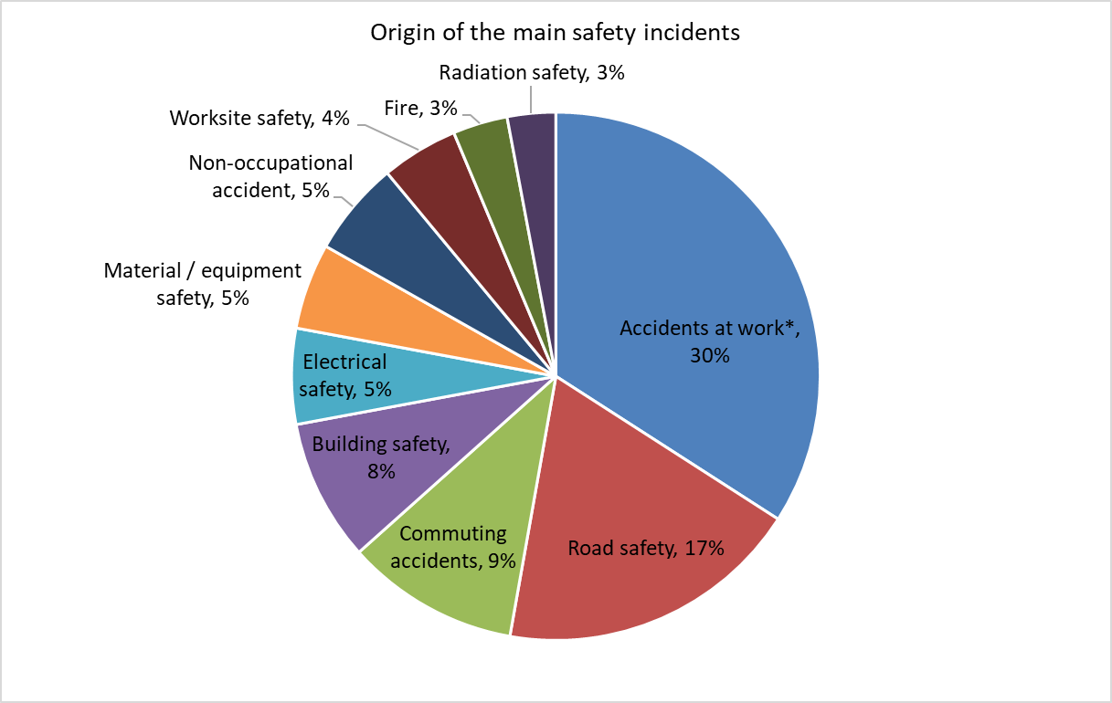
Safety incidents statistics over the last 6 years
3247 safety incidents recorded
* CAT1 Civil-engineering worksites excluded

Slide 7
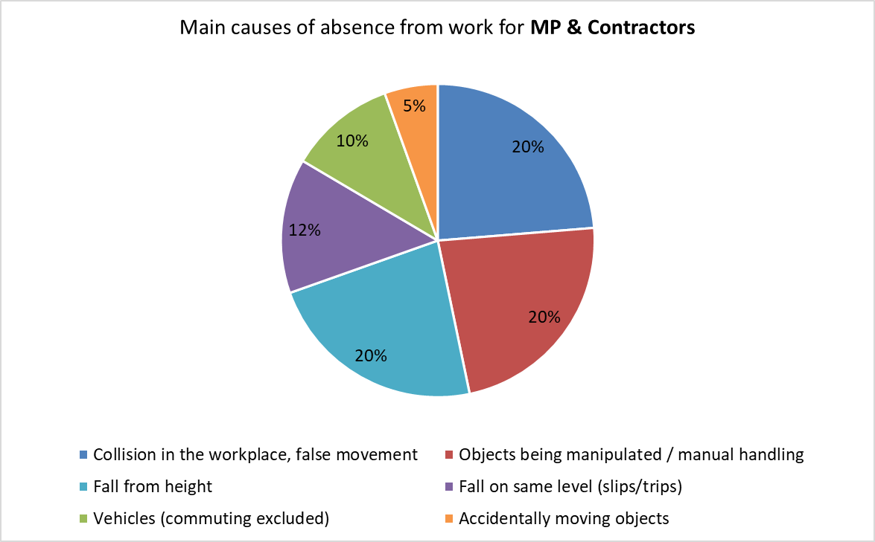
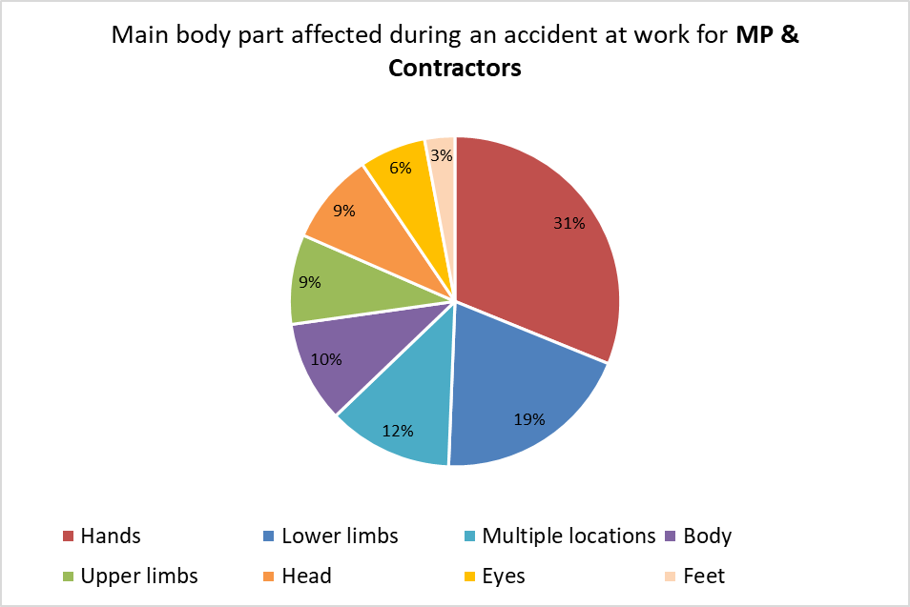
Accident at work statistics over the last 6 years
1282 Accidents at work recorded

Slide 8
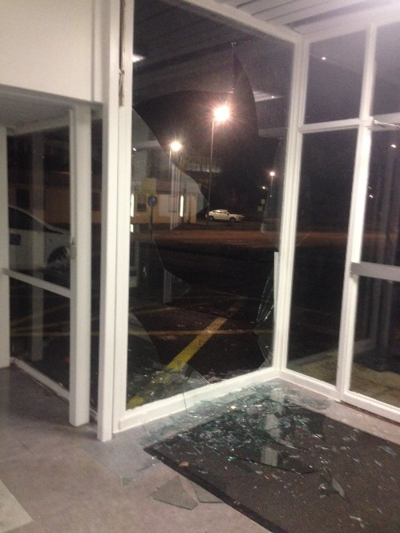
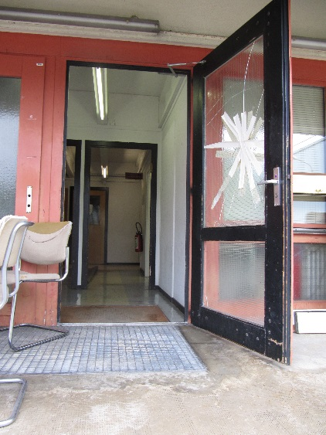
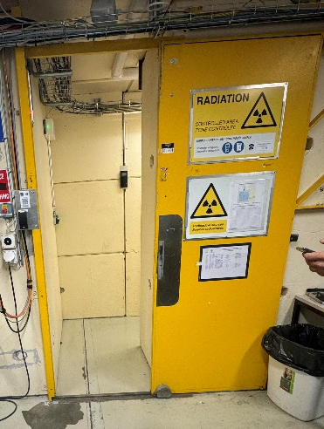
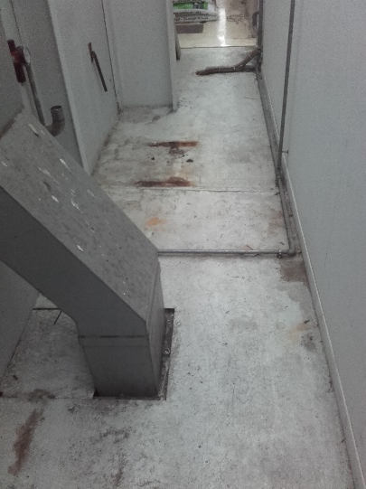
Example of accidents at work over the years
… where one of the causes comes from the design or maintenance of the building
Multiple facial wounds – 16 days of absence + reconstructive facial surgery
Haemorrhagic wound on wrist – 12 days absence
Knee pain after falling on a protruding door threshold - 127 days absence
Cut on the lip after falling by hitting a pipe across the passage – no days of absence

Slide 9
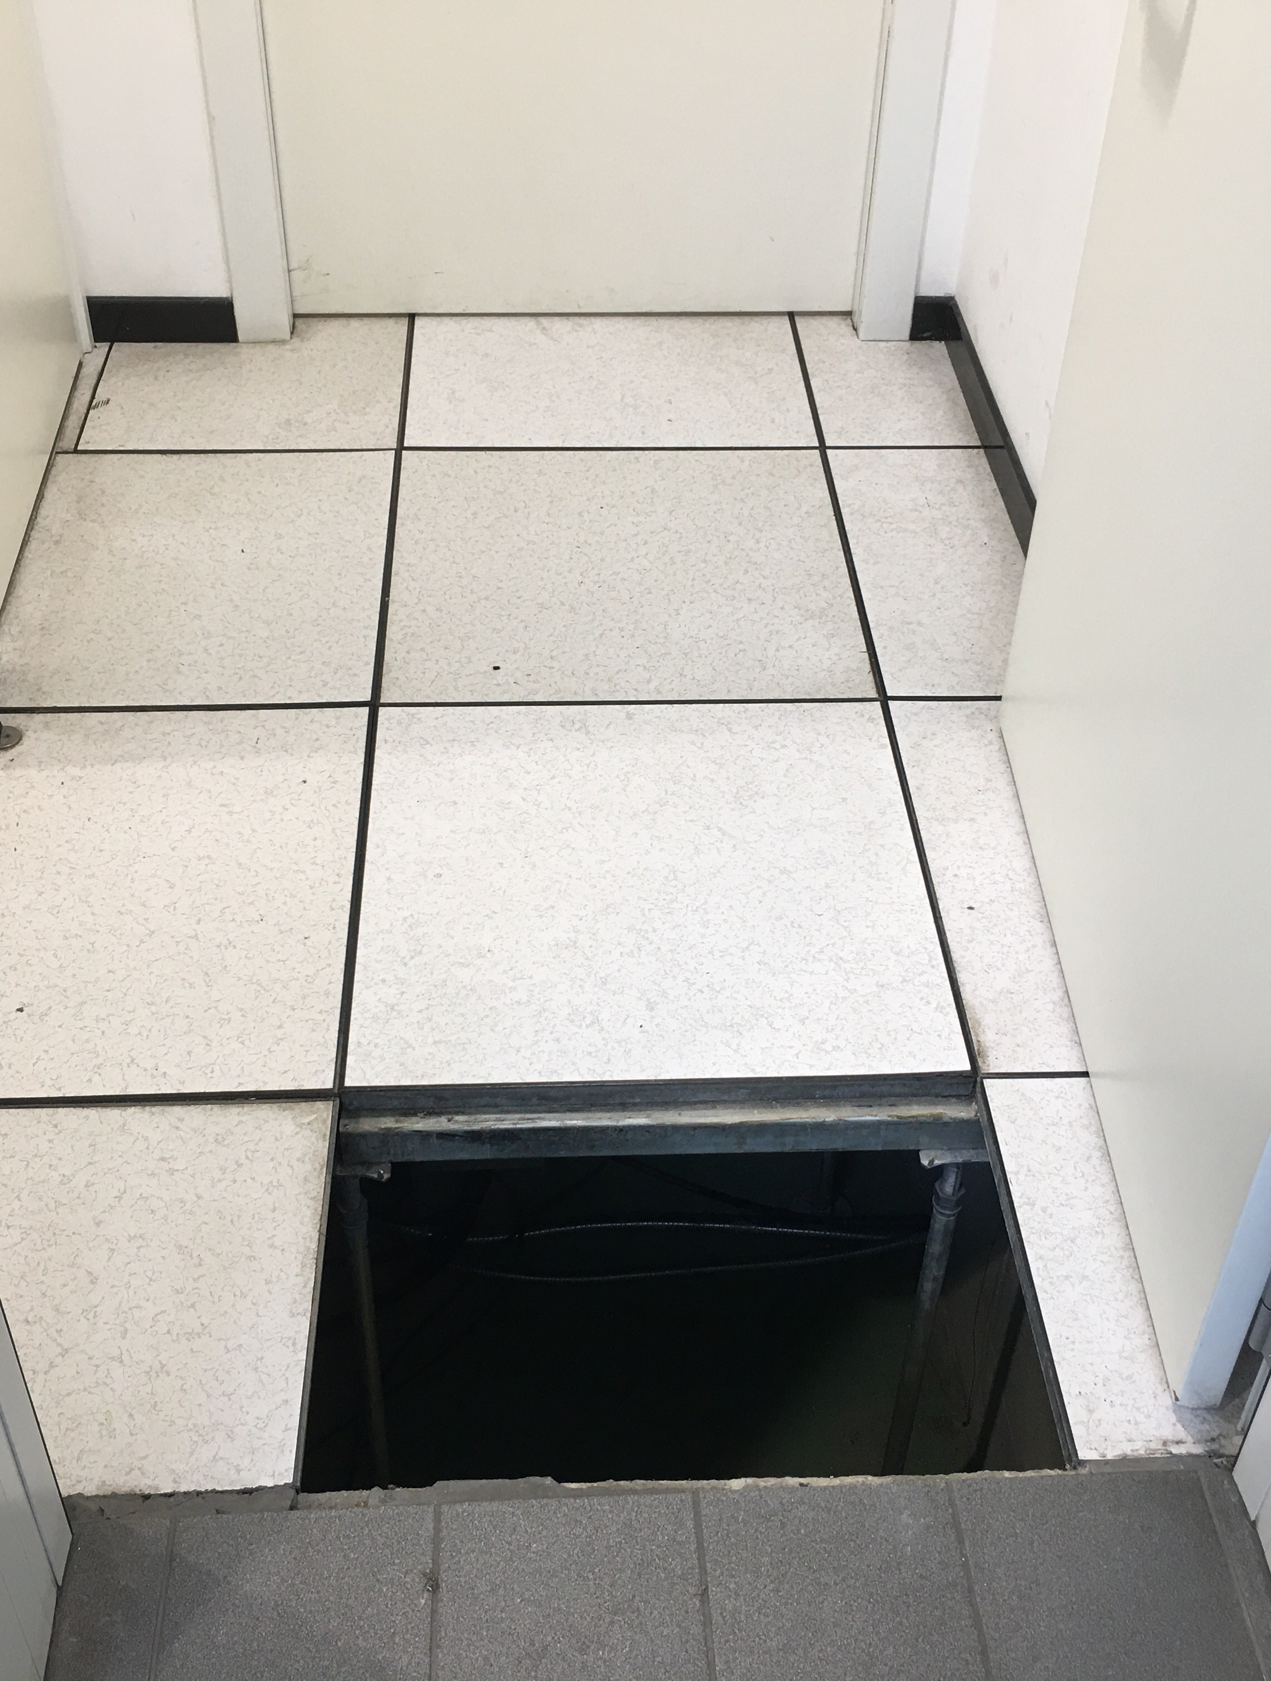
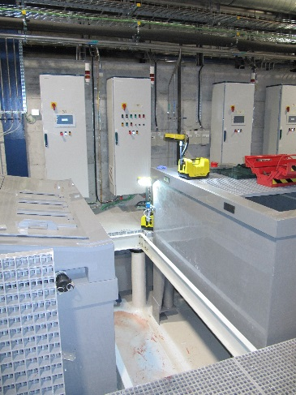
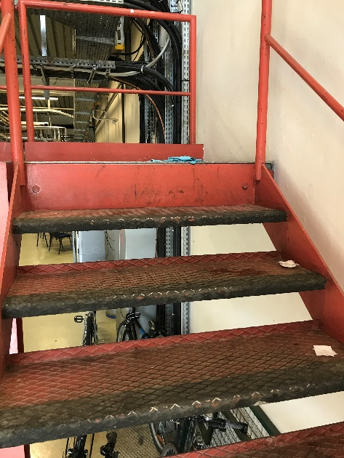
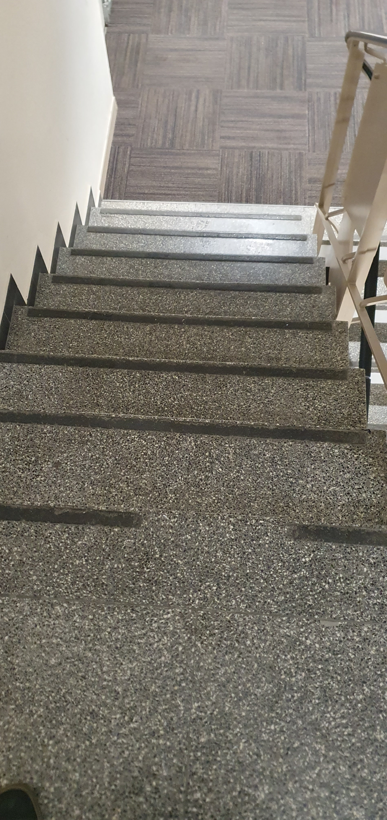
Example of accidents at work over the years
… where one of the causes comes from the design or maintenance of the building
Multiple contusions after falling into a false floor, a plate having slipped away on its way – 47 days of absence
Fracture of tibia after falling into an opened false floor – 180 days of absence
Back pain after falling down the stairs – 19 days of absence
Contusions to elbows and hands while falling slipping on a step edge – no days of absence

Slide 10
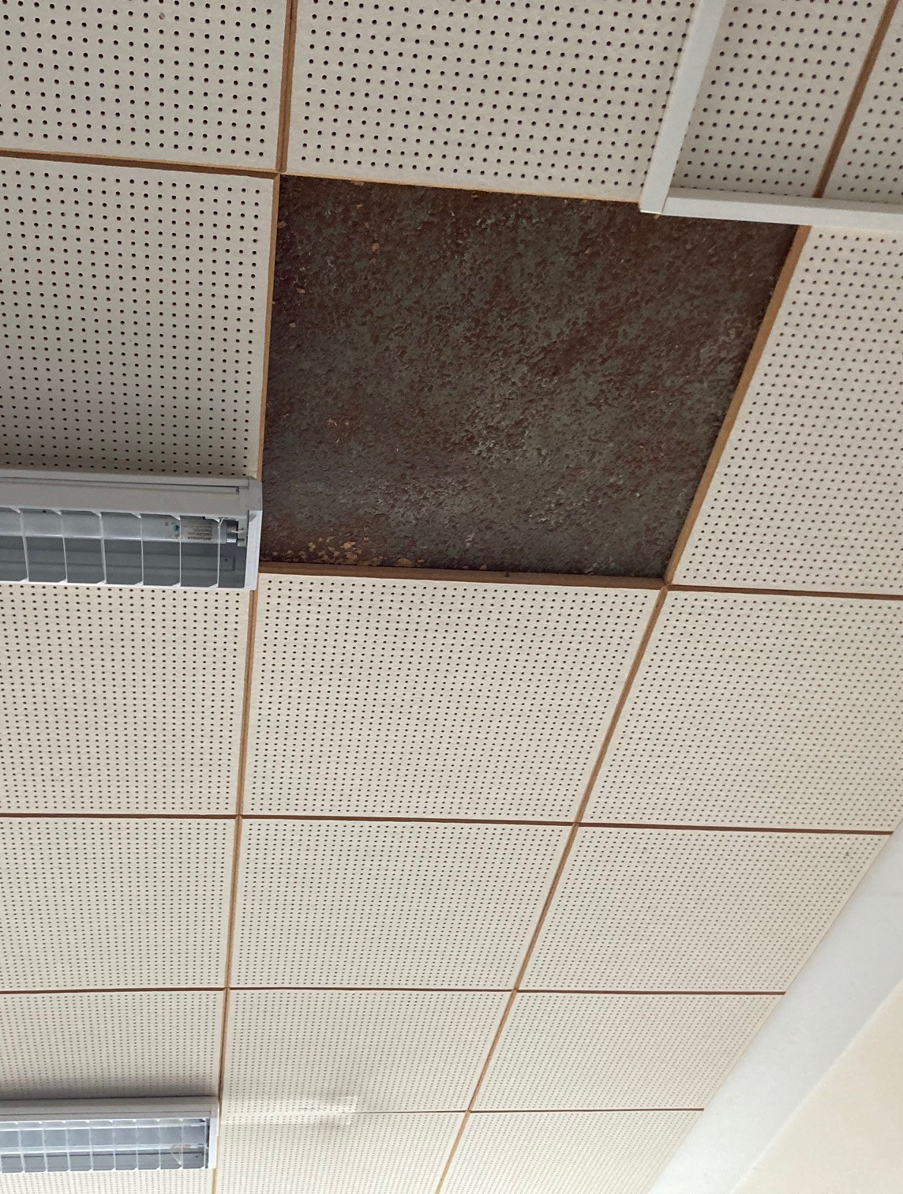
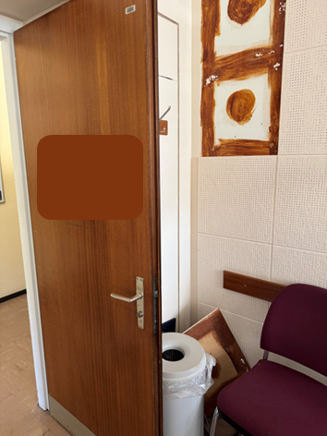
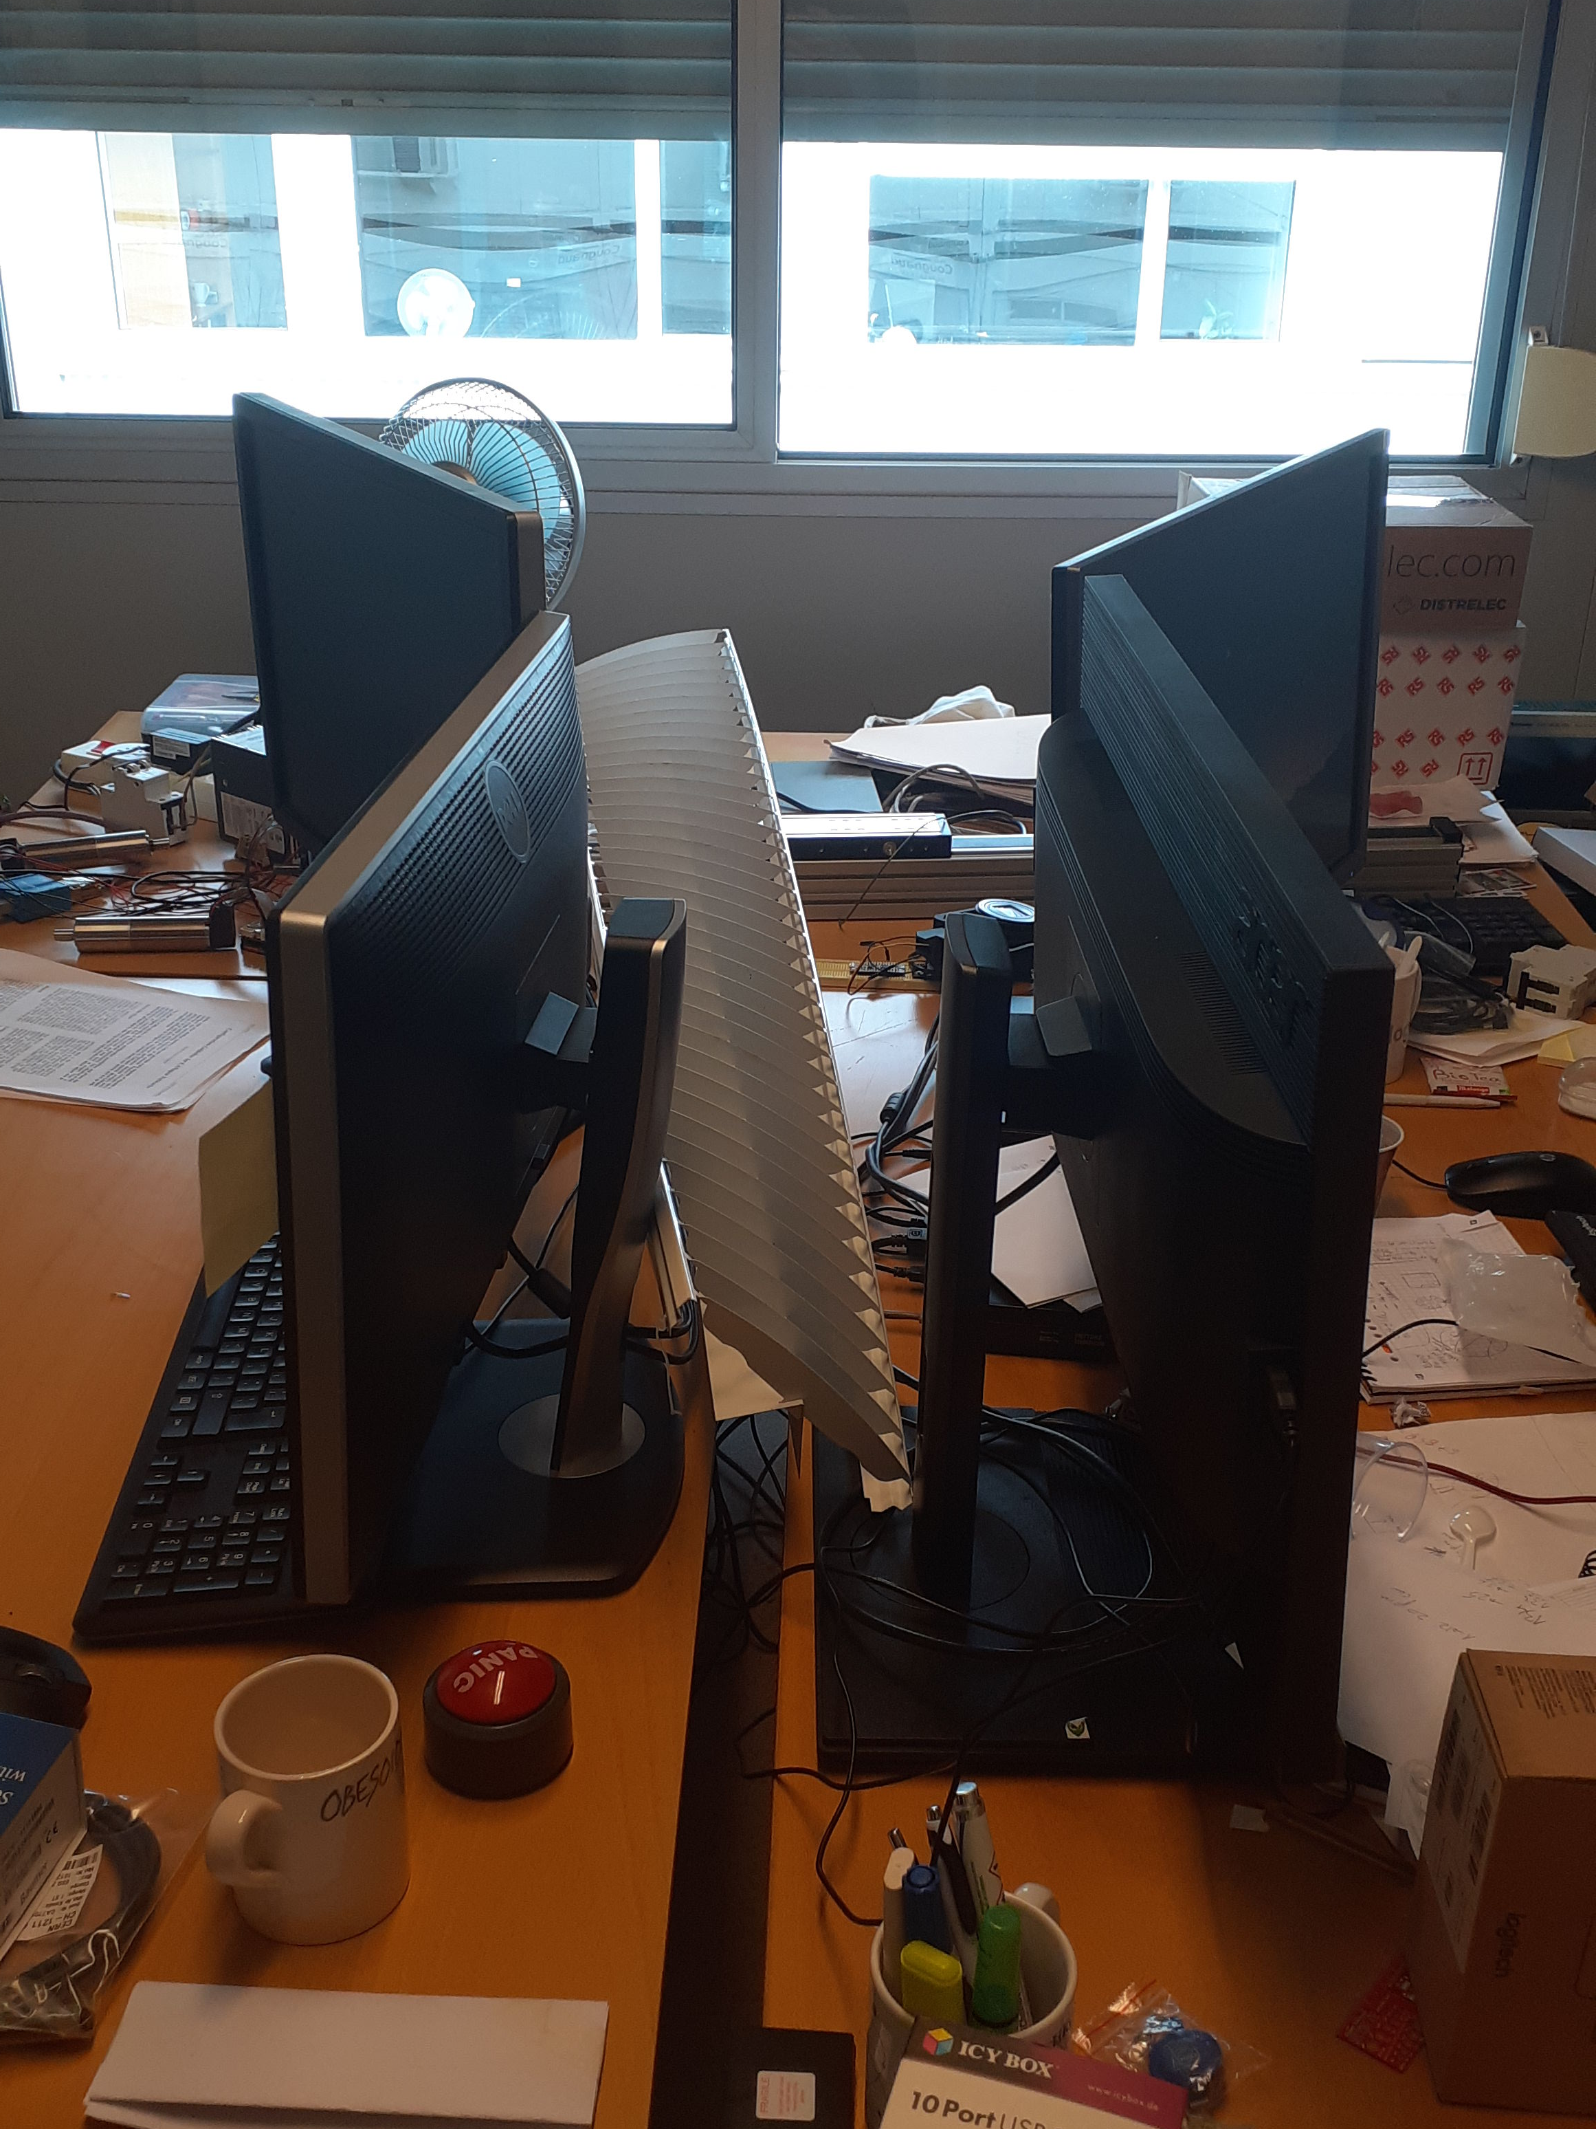
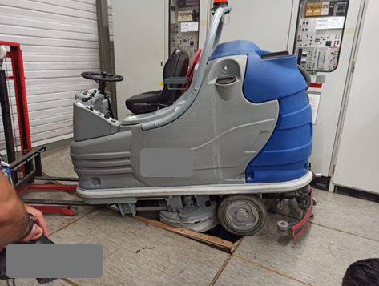
Example of other safety incidents in buildings over the years (material damage only)

Slide 11

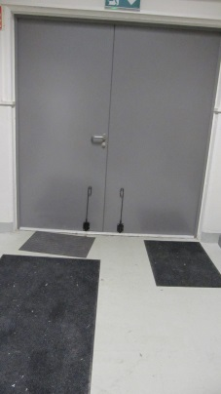
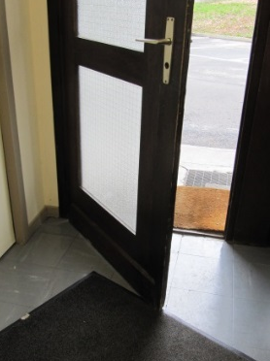
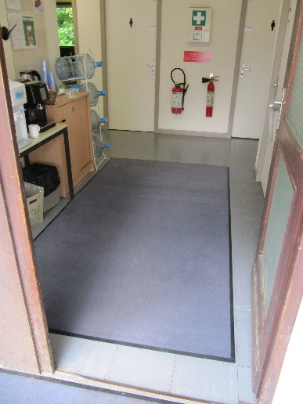
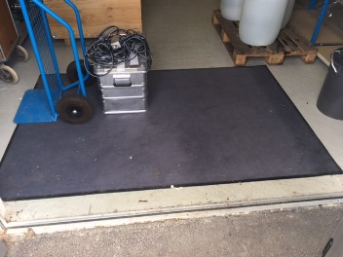
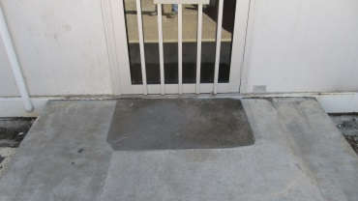
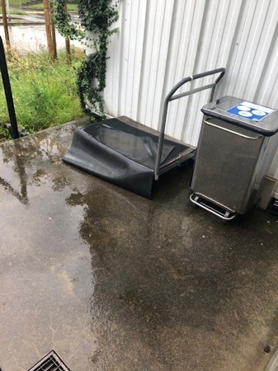
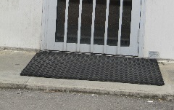
Improve the safety when entering buildings – campaign on carpets
Multiple carpets, undersized compared to the door opening capacity
Old carpet
Carpet too thick that needed to be placed away from the door to allow its opening
Carpet available, in good state but not put back in place

Slide 12

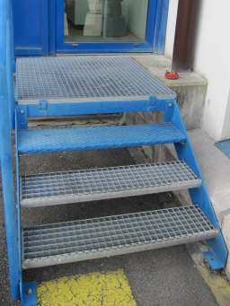
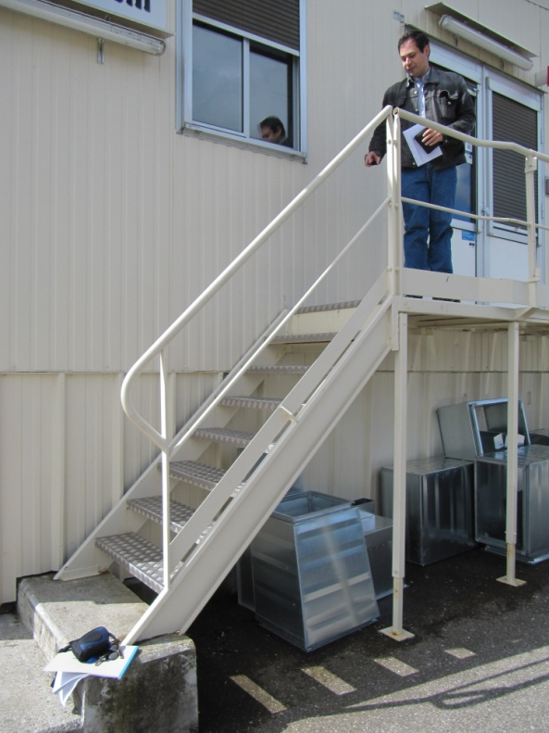
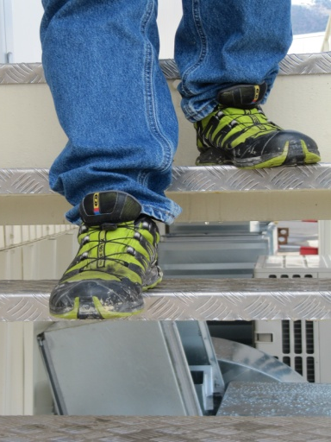
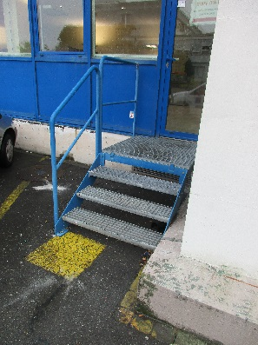
Improve the safety when entering buildings – campaign on outside stairs

Slide 13
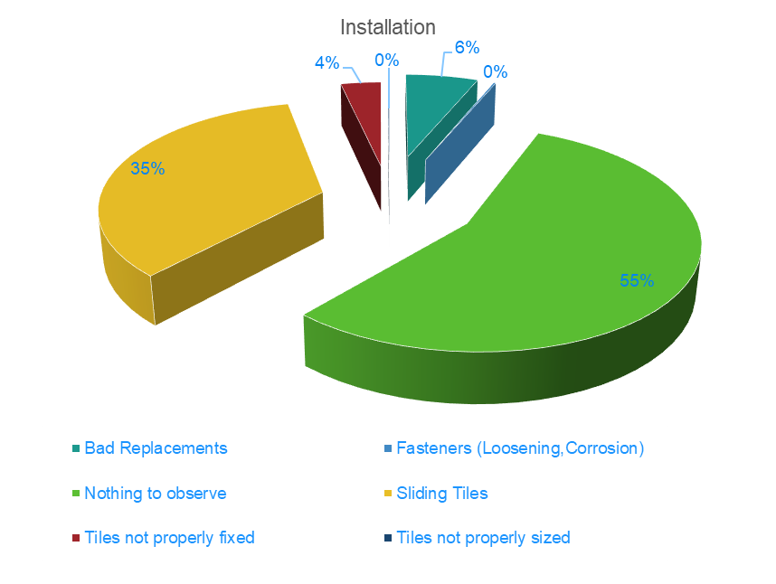
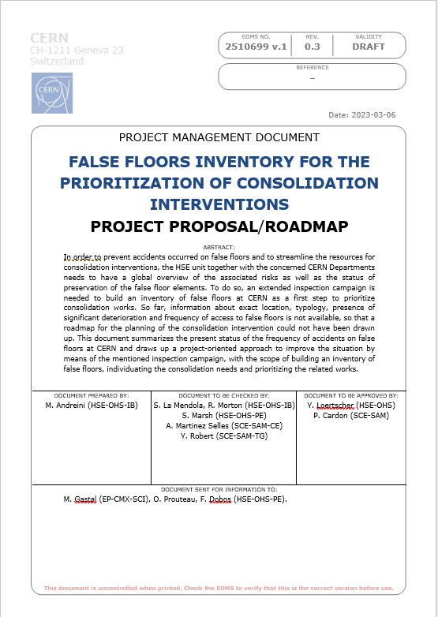
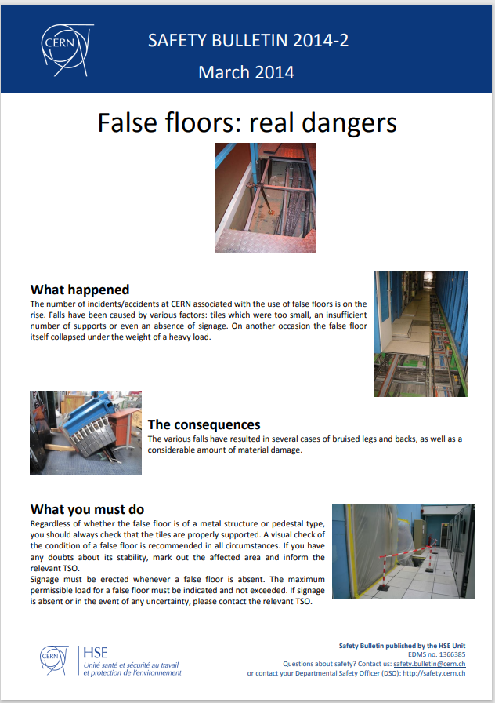
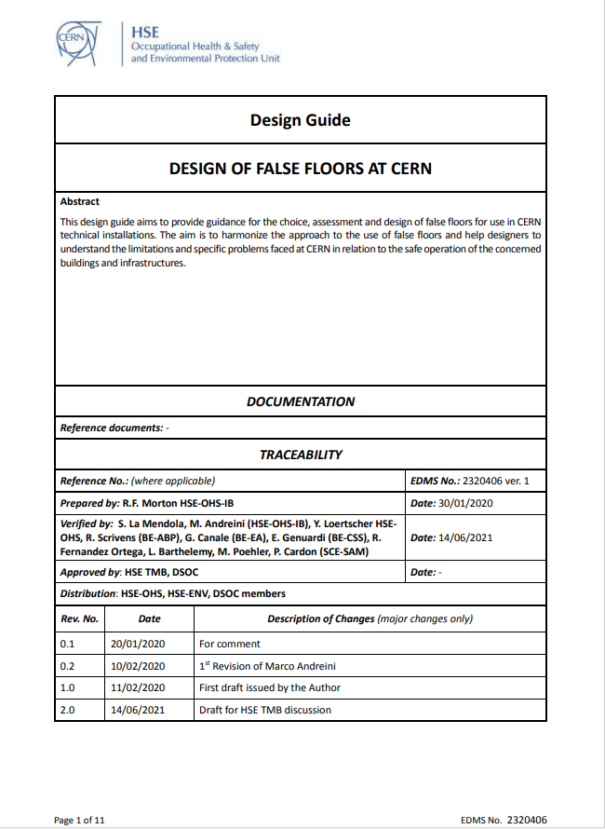
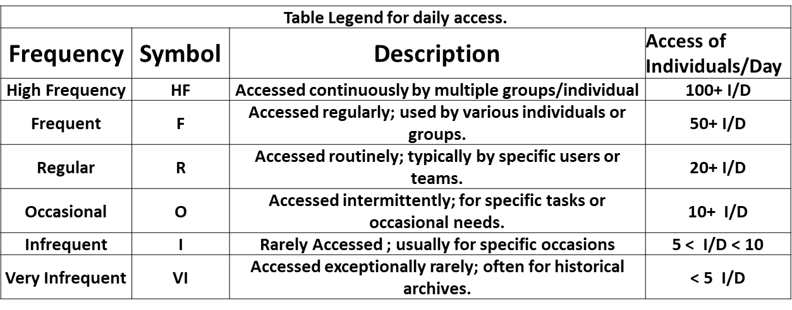
Improve the safety inside buildings – campaign on false-floors
1032 false floors inspected
Sliding tiles
Tripping hazard
Panel wear
Water leakage
Courtesy of Z. Nader, M. Andreini and R. Morton

Slide 14

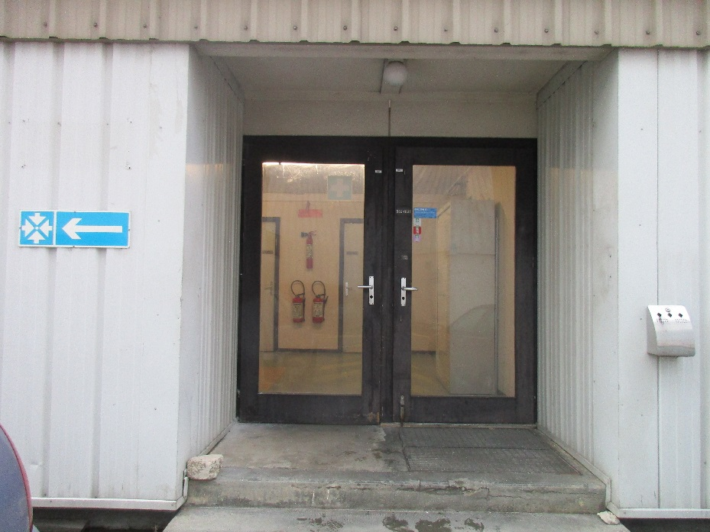
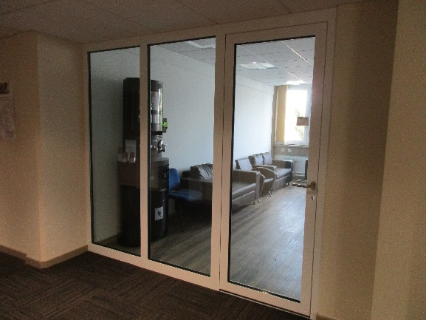
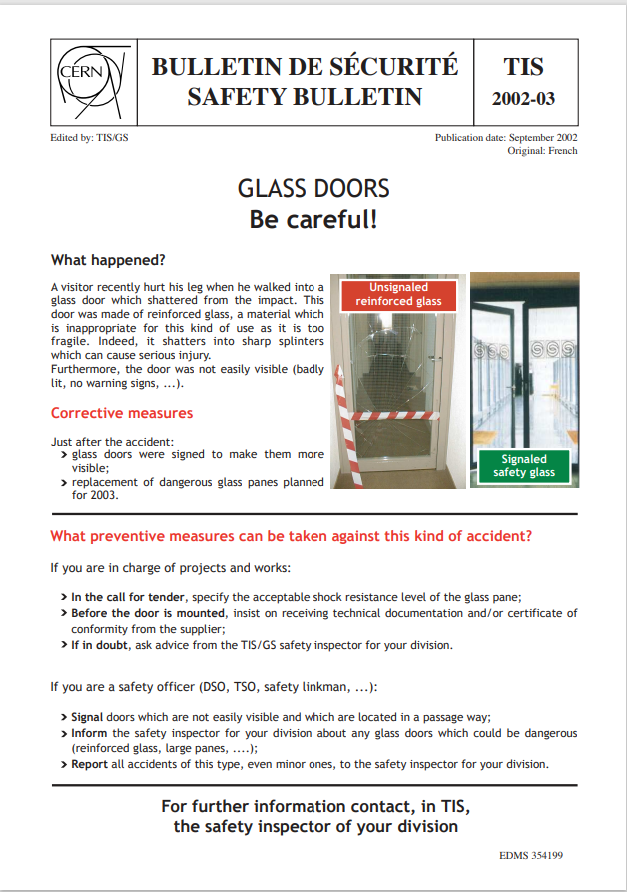
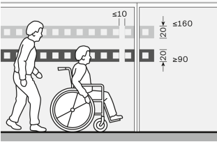
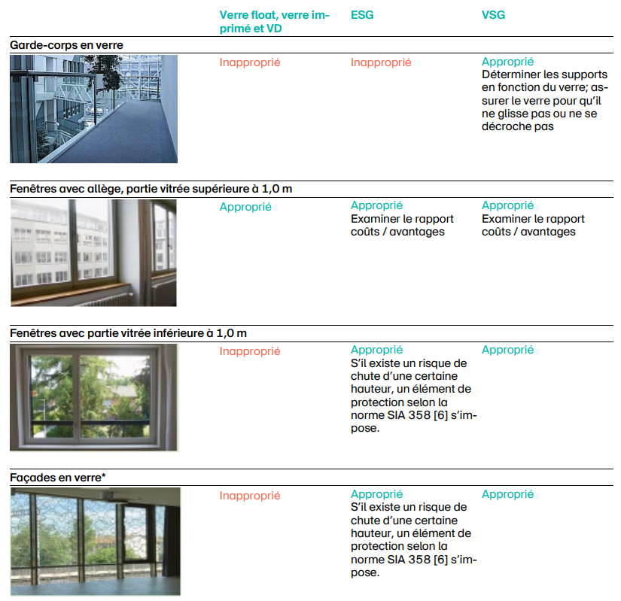
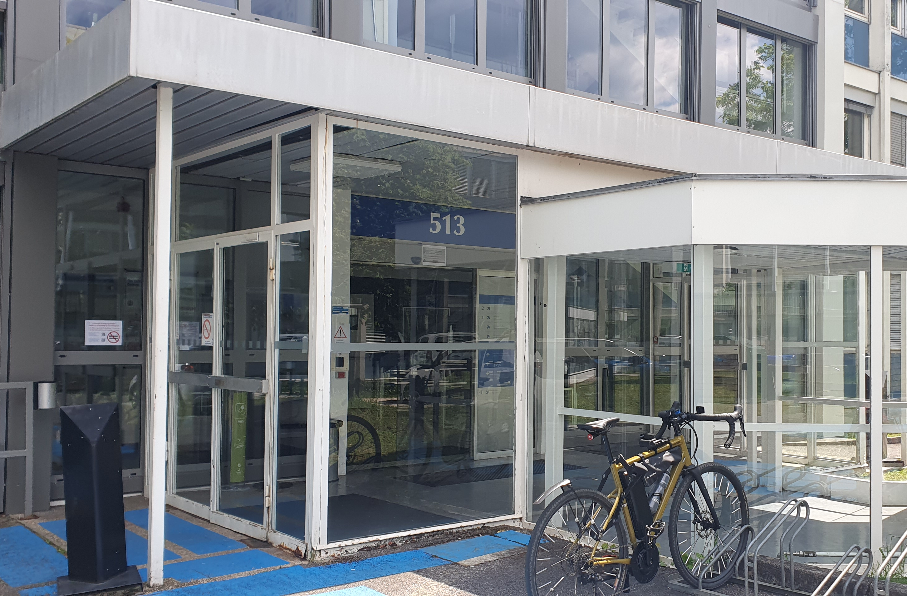
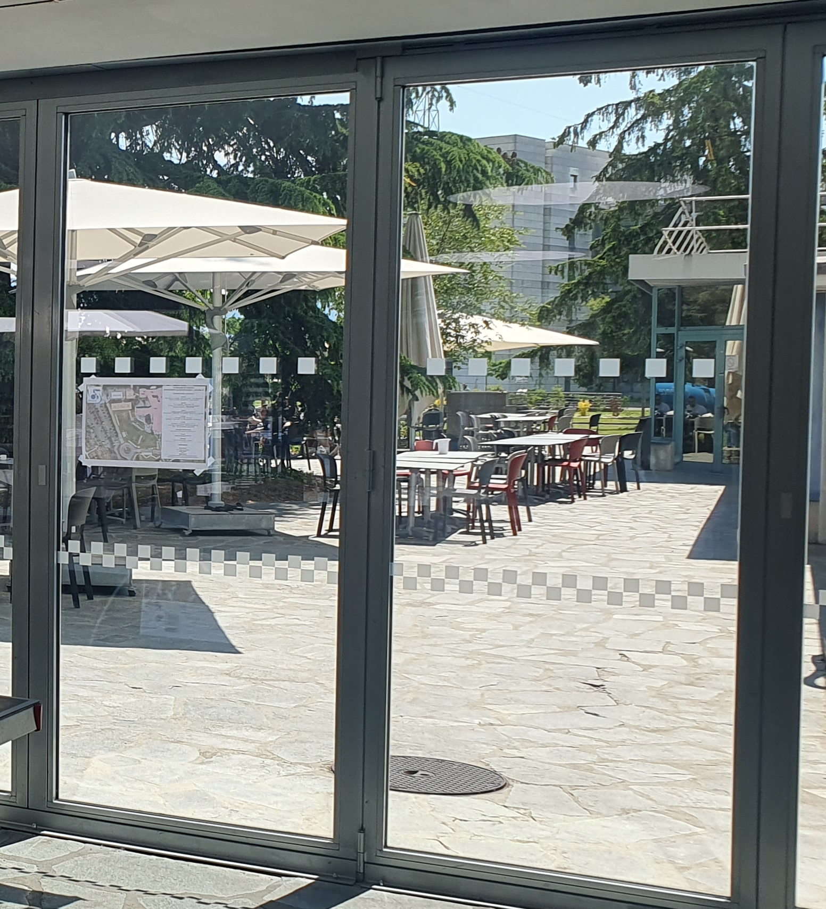
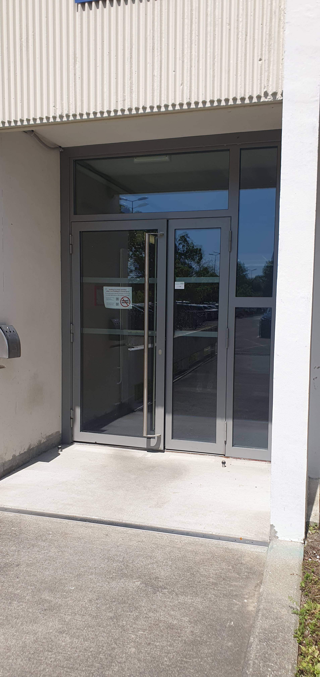
Improve the safety when entering buildings – campaign on identification of glass walls

Slide 15
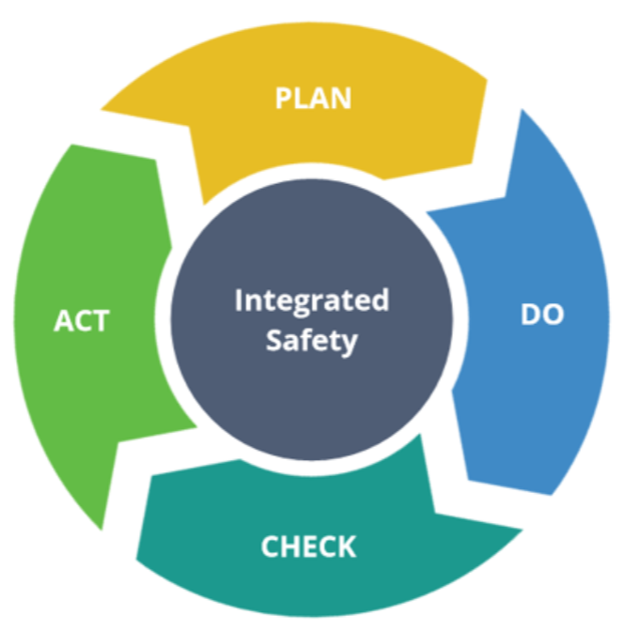

Conclusion
XXX
XXX
XXX
Courtesy of HSE-TS-ST
XXX
You know your premises better than anyone
You play a key role in identifying hazardous situations in your premises
You participate actively in improving the level of safety on CERN premises, years after years – long-term investment
Thank you for your commitment to Safety at CERN.
Please share your good practices together!
Notes:
Exemples présentés donnent une idée que votre rôle de TSO ne se résume pas à l’apposition d’une etiquette – complétée ☺ – sur les portes d’accès.
Mais que vous avez un rôle clef pour le CERN du fait de votre connaissance des bâtiments sous votre responsabilité territoriale.
Et vous avez pu le constater, c’est un travail sur le long terme – le bulletin de sécurité sur les baies vitrées date par exemple de 2002 – mais qui entre dans un processus d’amelioration continue pour le CERN, années après années

