Slide 1
TSO meet-up SCE: Collaboration for a safe and sustainable campus
Pierre Cardon (SCE-SAM), Cédric Garino (SCE-SSC)
5 June 2025

Slide 2
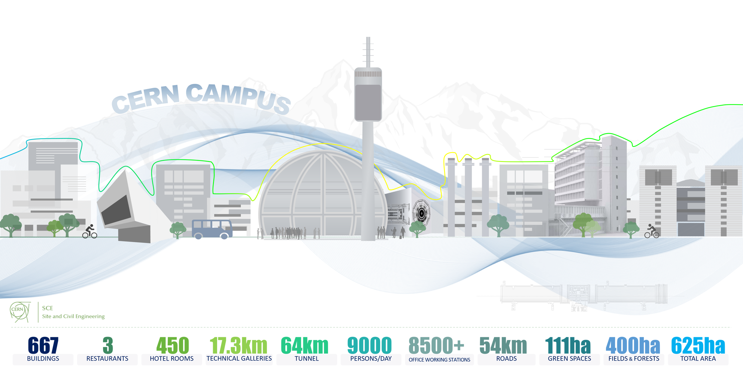
“Where is my ticket? Which budget code? Is it my responsibility? Am I a concierge? Ticket follow-up?”

Slide 3

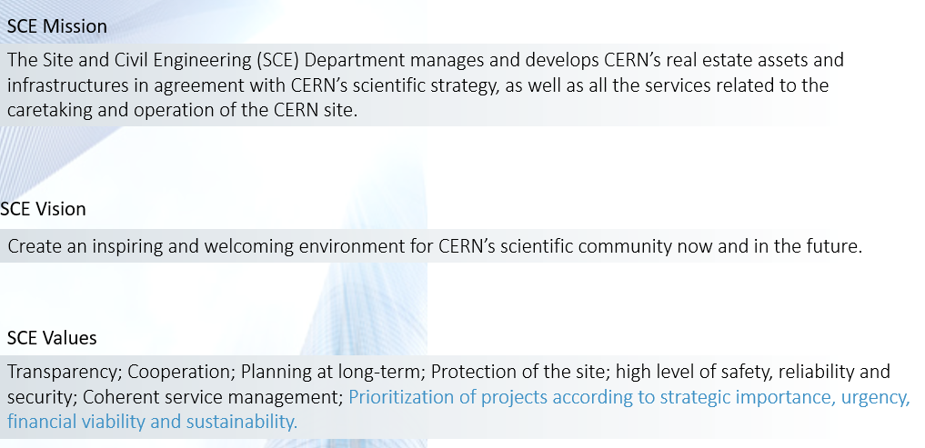
SCE AT A GLANCE

Slide 4

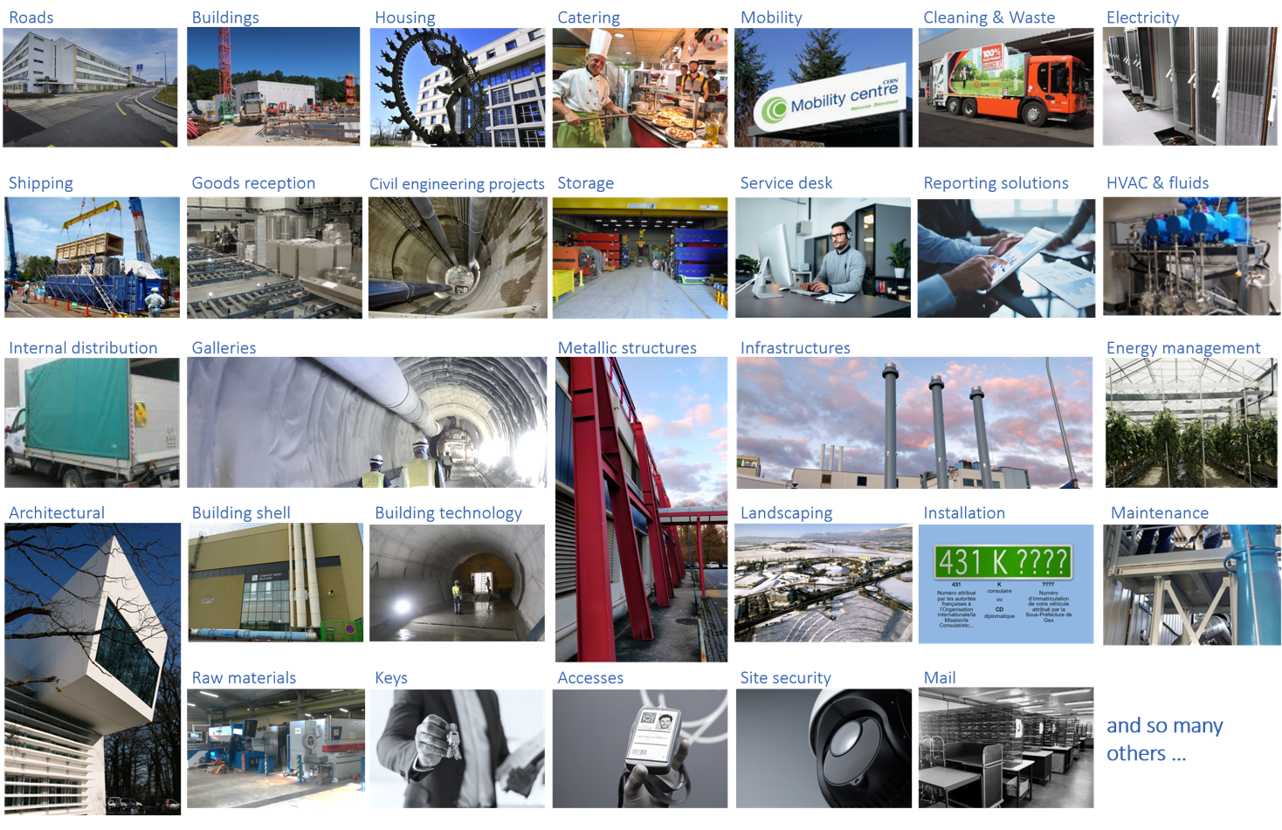
AN EXTENSIVE OFFER DEDICATED TO CERN’S COMMUNITY
SCE 2024 video

Slide 5
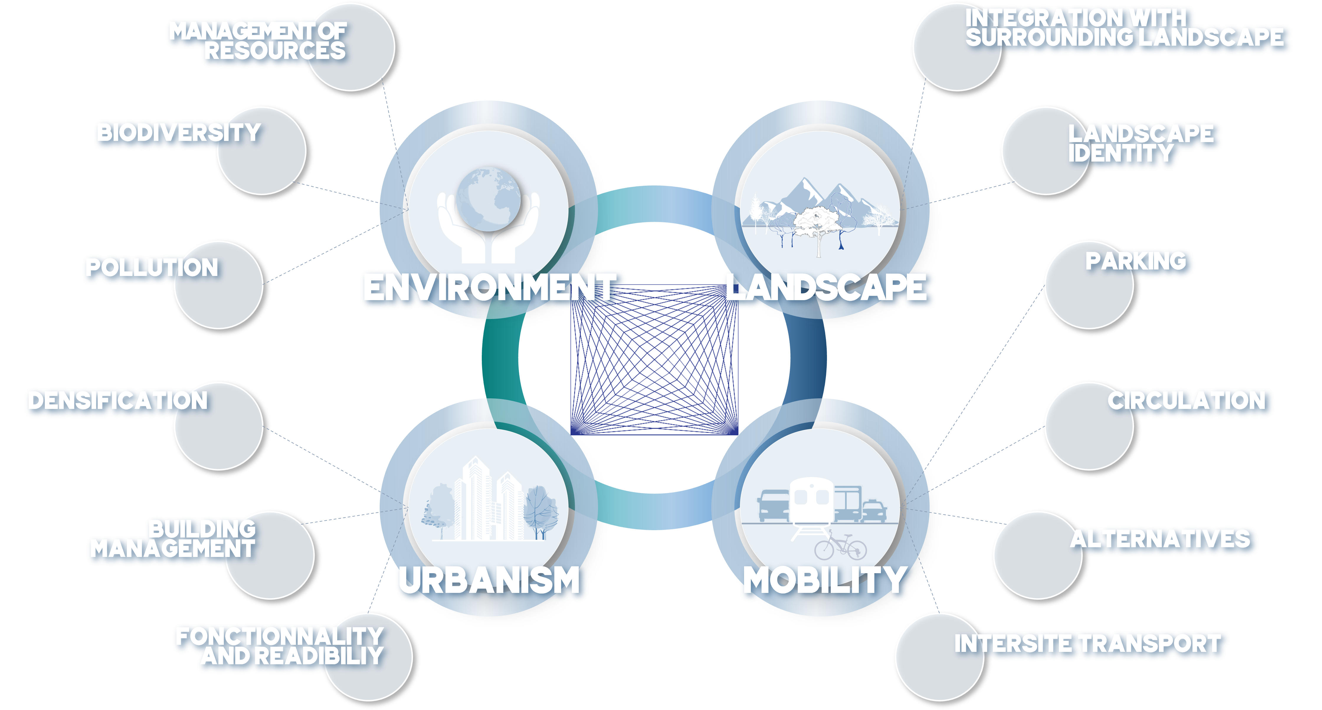
MASTERPLAN 2040 (link) AS SCE FRAMEWORK AND ROADMAP

Slide 6
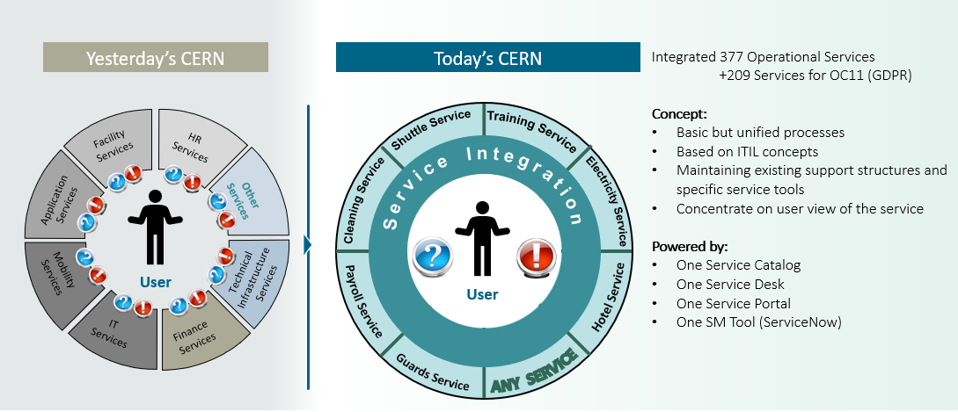

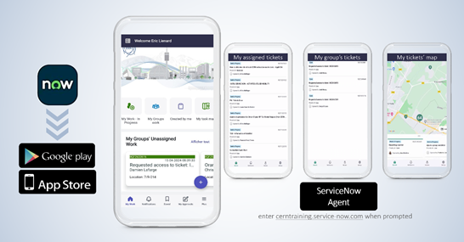
SCE SUPPORT FOR TSOs: SERVICENOW AS FIRST ENTRY POINT
SCE Service Catalogue
800k tickets (2024)
747 Functional Elements
927 forms
New mobile app!
Courtesy of Gyorgy Balazs

Slide 7
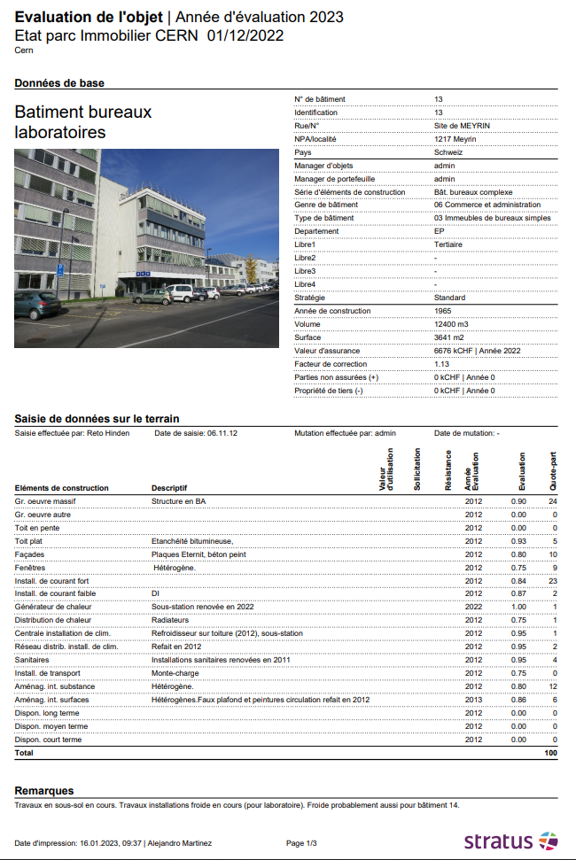
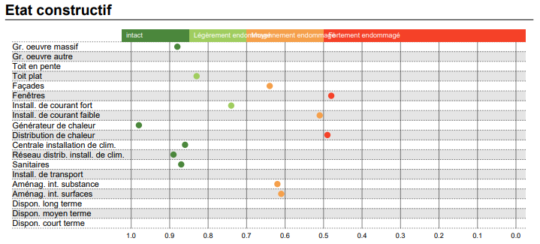
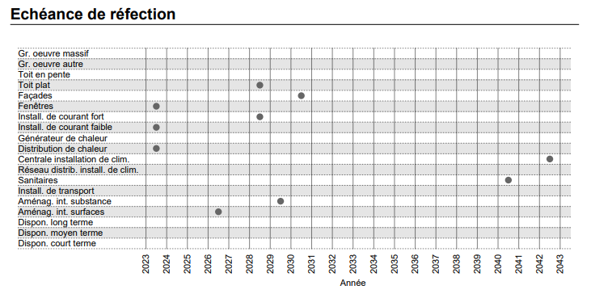
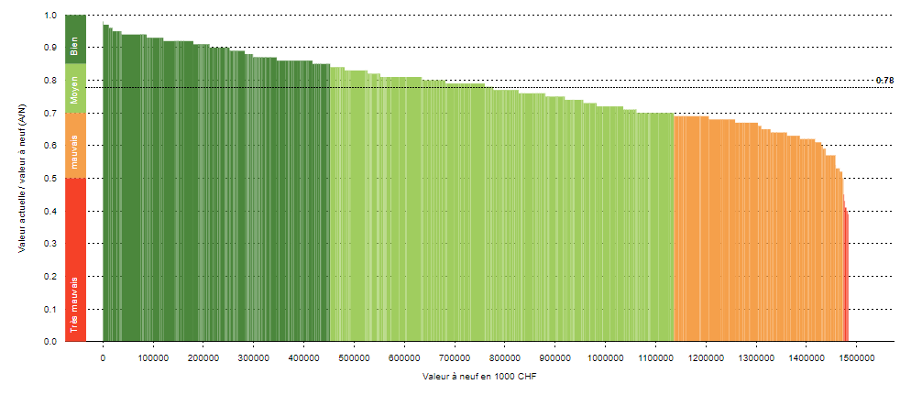
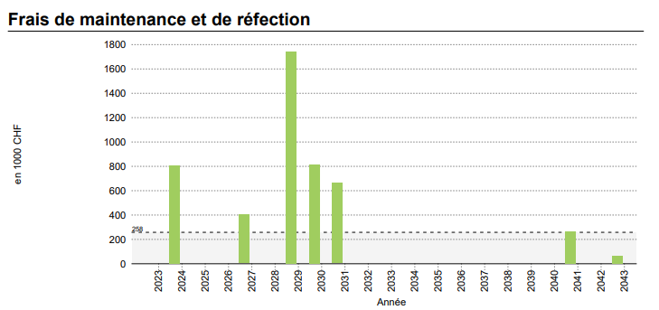
HOW DO WE MONITOR THE BUILDINGS’ CONDITIONS?
STRATUS tool
As a real state assets management tool, STRATUS is used to monitor the buildings’ conditions and keep updated data about the buildings’ construction elements renovation optimal due dates, as well as a very rough preliminary renovation cost estimate.
Example : Building 13
Overall conditions of CERN buildings

Slide 8
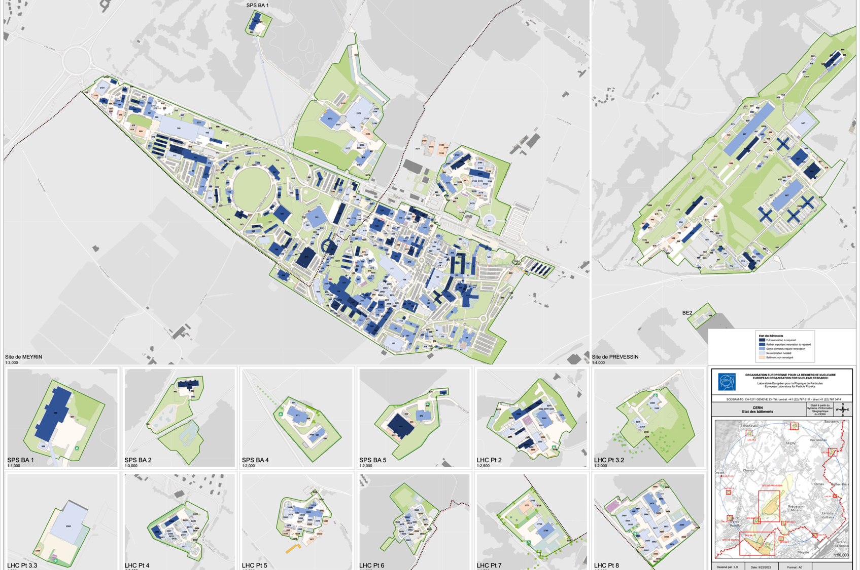
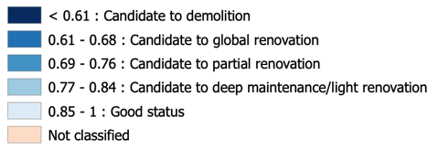
WHAT IS THE EXISTING STATE
Condition of Assets
Stratus Update 2024
451 buildings

Slide 9
HOW DO WE MAINTAIN THE CAMPUS?
Infrastructure lifecycle
Maintenance (OPE budget)
Consolidation (CONS budget)
Corrective maintenance
Preventive regular maintenance
Roofs
Buried networks
Machine building's exterior doors
Smoke extraction systems
Green spaces
Safety verifications to technical installations
Emergency intervention
Funded by SCE Operation budget ~8.5MCHF/Y
Planification cyclical maintenance
Well identified set of works planned to 10-years time (including campaigns)
Group activities in the same area
Aim: full renovation
Emergencies that cannot be covered by Operation budget
Safety works prioritized together with HSE and DSOC chair : asbestos removal, compliance with fire standards, roof access, etc.
Funded by SITE-CONS budget ~10MCHF/Y
Construction
No maintenance
Operation
Retrofits / Projects / Processes / Upgrade
Demolition / Renovation
Regular maintenance
Cyclical maintenance
Retrofits / Projects / Processes related works funded by client’s budget ~8MCHF in 2024

Slide 10
HOW DO WE PRIORITIZE IN CONSOLIDATION PLAN?
Strategy
Capital investment plan
Entry into the SITE CONS programme
Stratus outcome (<0.8) x 3S Factorization:
Strategy
Safety
Sustainability
Quarterly Steering committee – Decision gate
Plan proposal
Steering committee
Plan update
Production follow-up
Prioritization
(Workshops)
Including DSOC chair for safety-related projects
CONTINUOUS INTERVENTIONS
TARGETED INVESTMENTS

Slide 11

FOCUS ON SAFETY ACTIVITIES (COLLABORATION WITH HSE)
Asbestos remediation
All renovations include full asbestos remediation in the concerned facilities (B251, B36, B168/20/21, B108/164)
In addition, 1.91 MCHF have been invested between 2021 and 2024 for other smaller interventions
Septic tank removal and networks consolidation
1.71 MCHF invested between 2021 and 2024 in septic tanks and networks rehabilitation
12 supressed septic tanks (9 in ISR, B73, B108, B181) + > 2 km of networks (mainly foul water) rehabilitated
Fire safety improvements (fire doors + smoke extraction systems)
482 kCHF invested between 2021 and 2024
Improvements on buildings : 4, 5, 30, 31, 33, 36, 40, 52, 60, 112, 501, 504.
The fire safety campaign follows HSE priorities + interior renovation projects
Roofs securing
486 kCHF invested between 2021 and 2024
84 buildings secured following HSE priorities
Natural smoke extraction consolidation
The annual inspection and repairs campaign has increased from 35 to 71 buildings (thanks to HSE and DSOC support)
Lamps replacement (LED)
45000 replacements in 2 years
ELECNCSOL
Non-compliances treatment
2024: 30 visits/660 closed observations
Biodiversity actions
Trees planting (100 / year)
Ecological parking in B864/865
Delayed mowing
Orchids and topsoil preservation

Slide 12



2024 INTERVENTIONS – TICKETS/ODMS
NUMBER OF INTERVENTIONS : 14 019 CE/HVAC-ELEC
« C'est phénoménal. J'adore le résultat.
Merci beaucoup, merci beaucoup pour vos efforts !! »
« En plus de l’excellent travail, j’ai beaucoup apprécié la communication entre toutes les personnes impliquées. Cette coordination a vraiment fait la différence ! »
TENDENCY 2024: +1% (2023 +13%)
« Bravo et grand merci!!! » (EP)
≃ 7 500 tickets handled
« Vous avez fait un super travail, et grâce à vos efforts, tout est revenu à la normale rapidement. » (HR)
5 June 2025
TSO meet-up

Slide 13
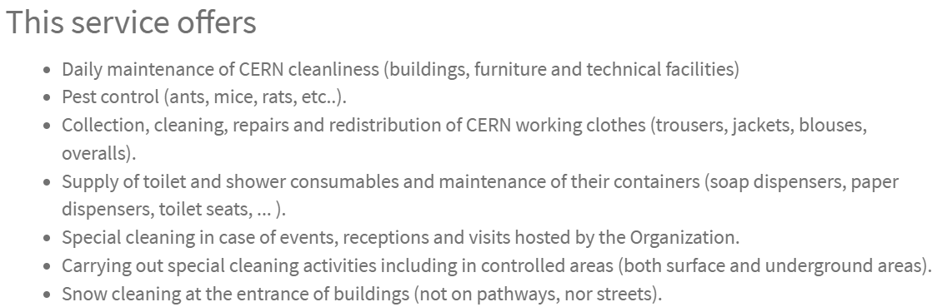
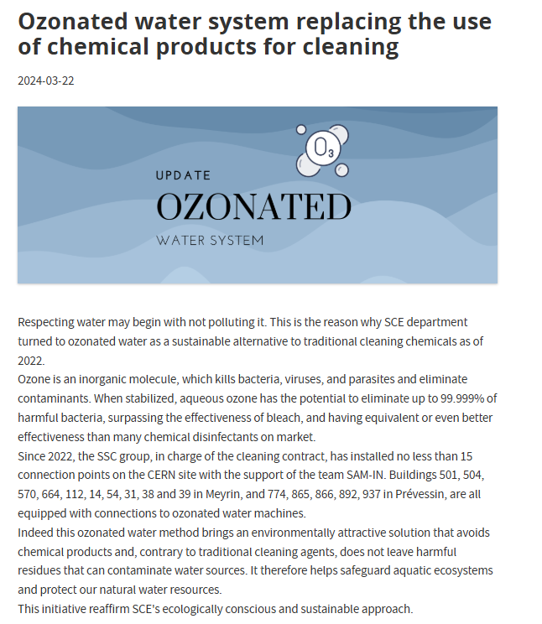
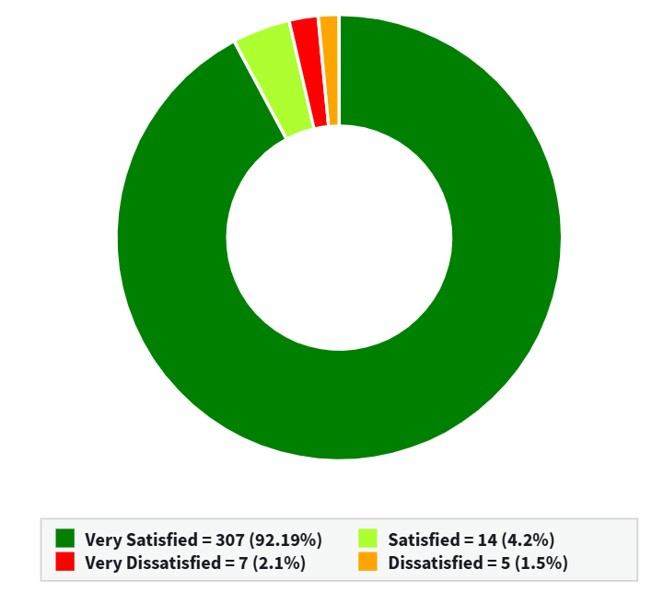
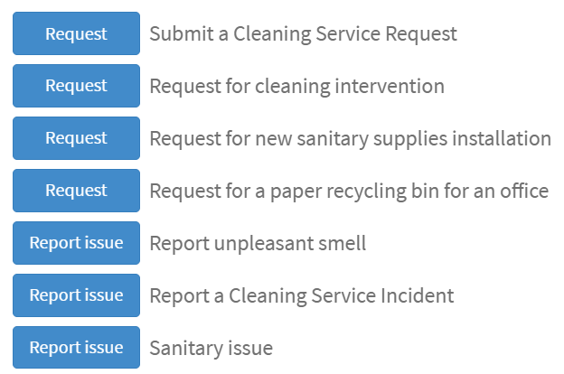
CLEANING
2’658 tickets resolved (2024)
Contact
333 feedbacks
Good to know: Stand-by service (FR + CH): 8h30-17h30 (for interventions <4h)

Slide 14
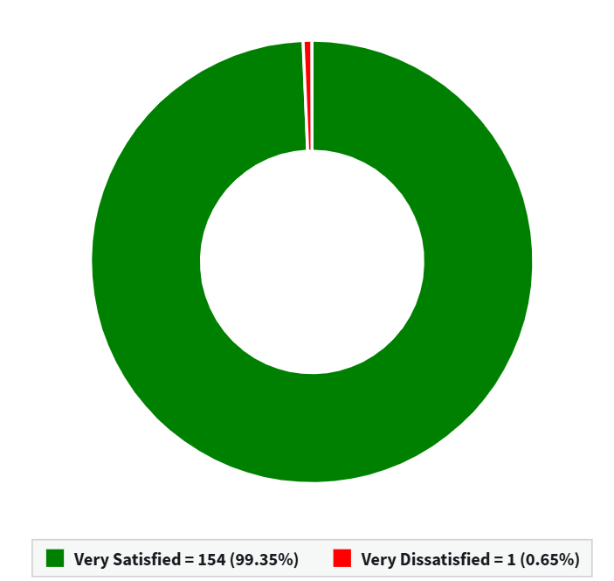
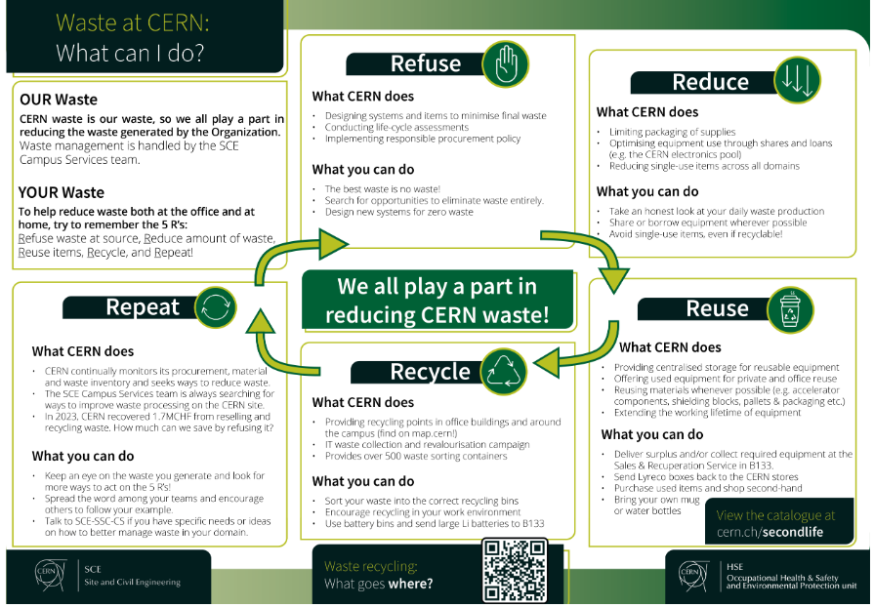
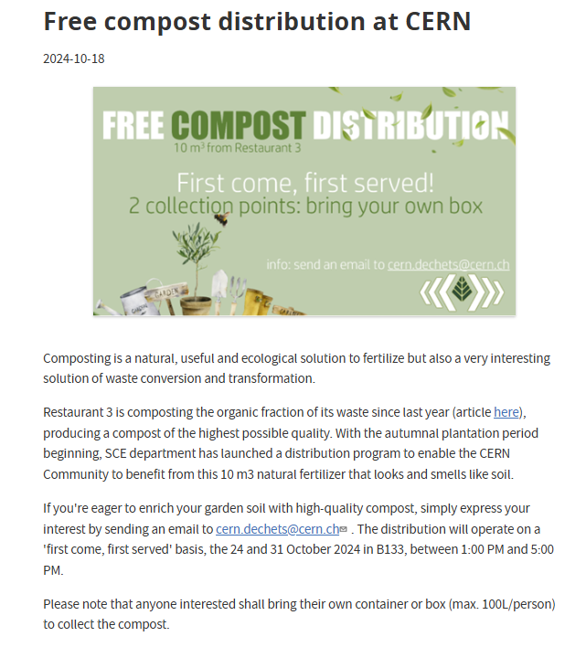
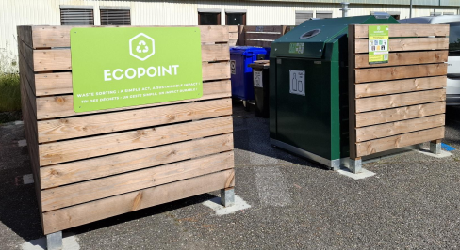
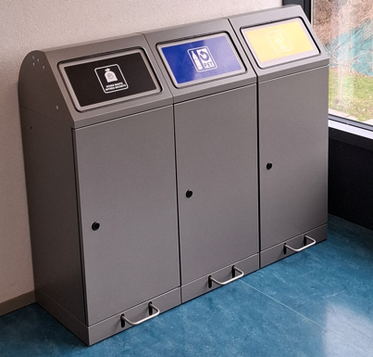
WASTE, RECUPERATION AND SALES
2’003 tickets resolved
(2024)
Good to know:
One contact: cern.dechets@cern.ch
Guideline: https://sce-dep.web.cern.ch/waste/what-goes-where
Want to equip your building with central sorting bins? Please contact us ☺
17/25 eco-points installed so far
SCE handyman to fill the gaps. 829 interventions in 2024, 13t collected
155 feedbacks

Slide 15
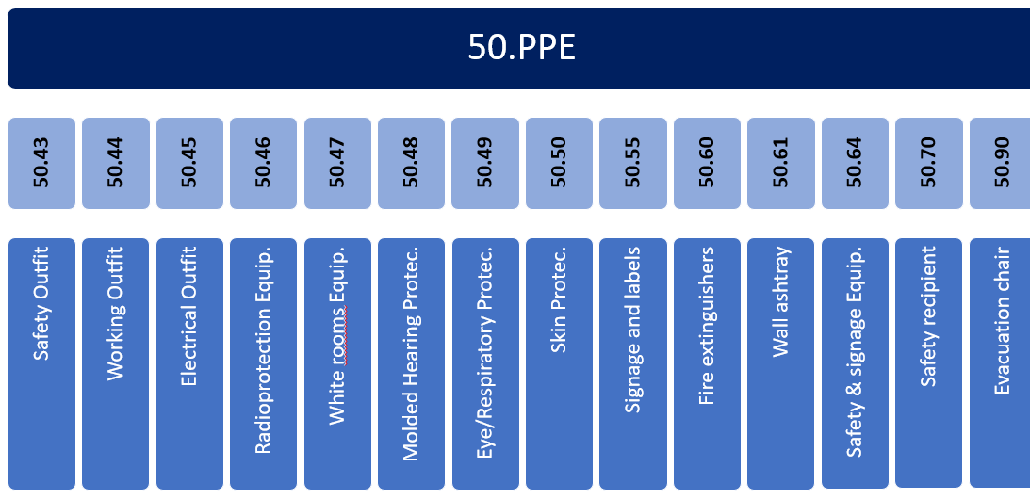
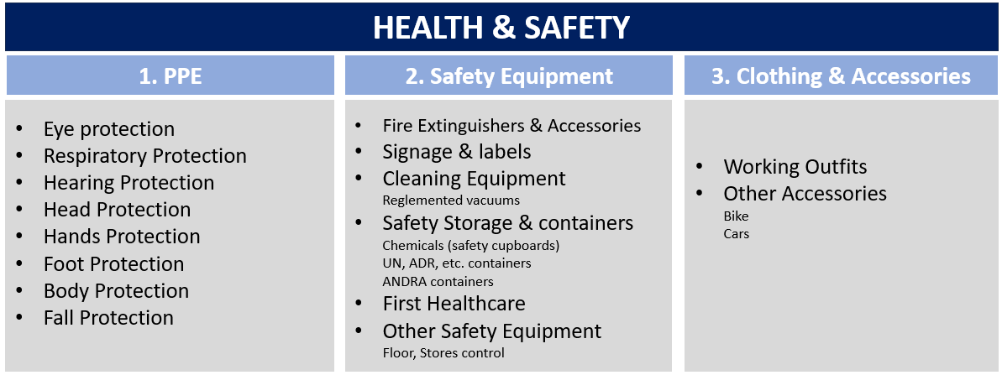
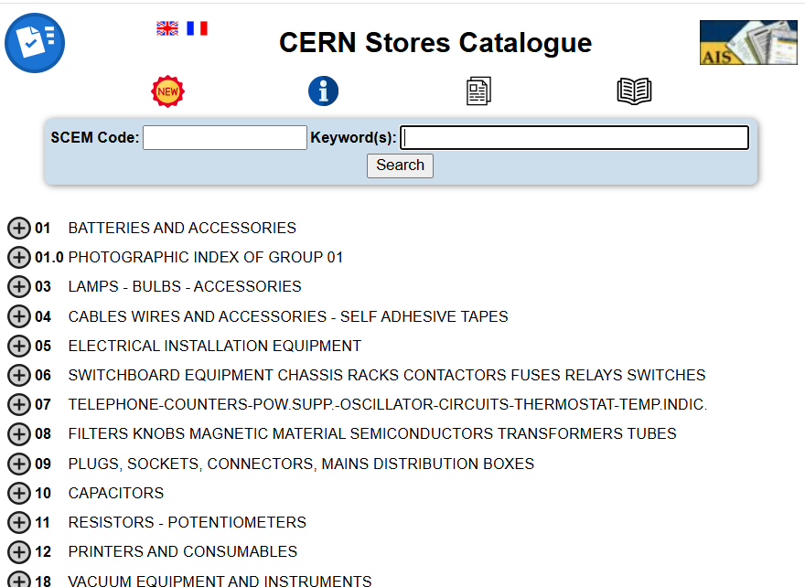
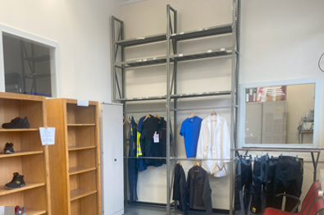
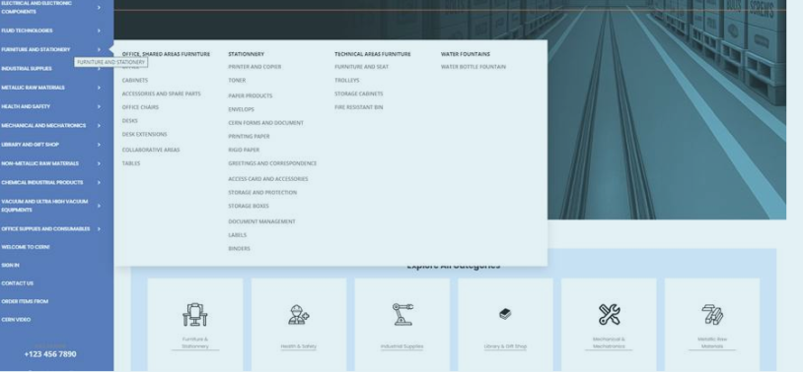
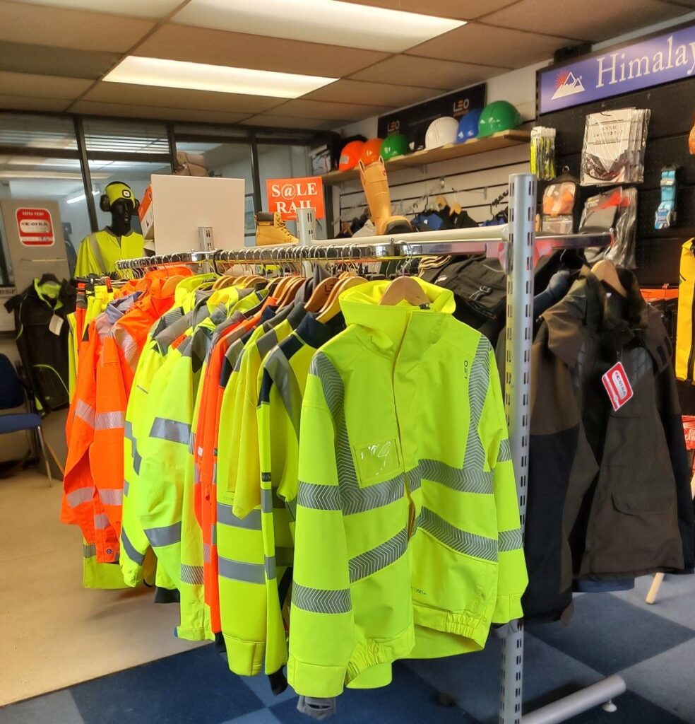
PPEs AND SAFETY EQUIPMENT AT CERN STORES
CERN Catalog & PPE controls (including self-rescue masks)
Now
2026
New structure
Catalogue tool
PunchOut + showroom

Slide 16
2024 CAMPUS OPERATIONS SUSTAINABILITY HIGHLIGHTS
Mobility
Waste/Recovery
Landscape
Campus Energy
Buildings
Water
Catering
+45% trips on shared bikes
+34% trips on car sharing
Car-pooling partnerships
19 EV-chargers (30% plan)
+500 covered bike places
-4% campus waste
10 Eco-points installed
2nd hand online catalogue
+2000 tons recycled items
Square Van Hove renewed
+215 new trees planted
Green parking in Prévessin
100% new fences
-8% emissions wrt 2023 due to gas heating optimizations
95% light fixtures of tertiary buildings replaced by LED
Recovery energy projects for Meyrin and Prévessin under construction
-8% emissions from renovation of buildings
Sustainability in BVFM tenders for new built
3000 m³ new retention basin in Prévessin
Increase of vegetarian offer and local supply
10 m³ compost production from R3 waste, distribution to CERN community

Slide 17
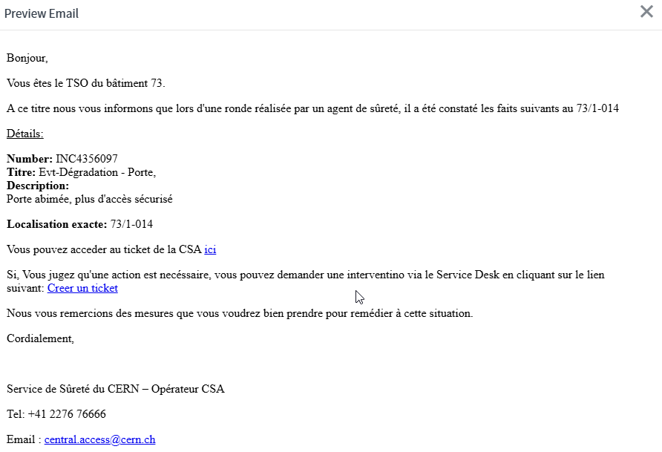
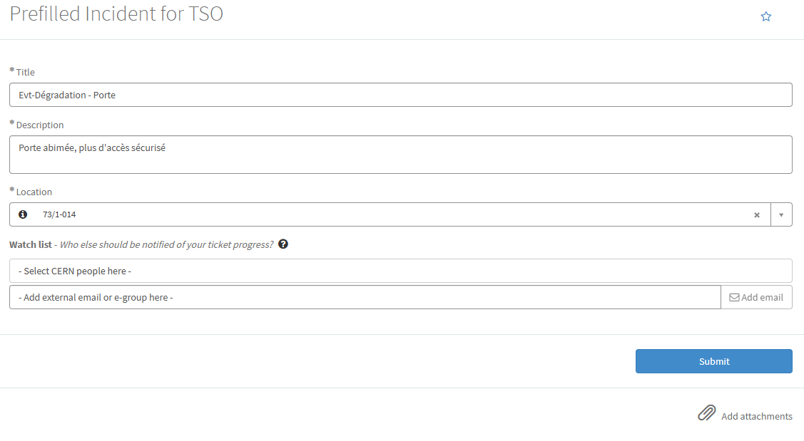


WHAT’S NEXT?
“Revaluation of the TSO role“ action plan
ServiceNow support to TSO (reporting, dashboard, proposition of action from security patrols)
New bulky waste collection round, typically once a month
Biodiversity monitoring: Take a walk between science and nature, CERNature App, GIS Environment portal, new sensors embedding EdgeAI
And much more….
CERN Campus App as communication channel for campus news. Stay tuned ☺

