Slide 1
TSO meet-up
Sharing my TSO role experience
Jérôme PANIGONI
5 June 2025

Slide 2
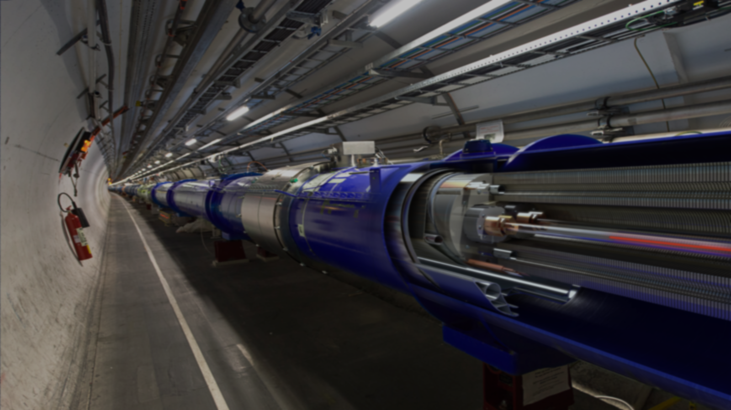

Jérôme Panigoni
EN/ACE/COS

Slide 3
Jérôme Panigoni
EN/ACE/COS
Mandate of the section :
Ensure coordination of the LHC site.
Manage the territorial coordination of activities to be carried out on the site during technical shutdowns of the accelerators.
Guarantee the operational management of access to the site and the corresponding underground zones.
Ensuring the good performance of the infrastructure and initiating, where necessary, any action aimed at maintaining it.
Assist all persons working on the site and establish rules to prevent damage to and theft of CERN property.
Provide technical and logistical support for activities in the accelerator buildings.
Our mission is to ensure a safe, efficient and fluid site for everyone

Slide 4
0
1
2
3
4
5
6
7
8
9
0
0
1
2
3
4
5
6
7
8
9
0
0
1
2
3
4
5
6
7
8
9
0
TSO of the LHC
«Building»

Slide 5
0
1
2
3
4
5
6
7
8
9
0
0
1
2
3
4
5
6
7
8
9
0
TSO of the LHC
0
1
2
3
4
5
6
7
8
9
0
«Building»

Slide 6
0
1
2
3
4
5
6
7
8
9
0
0
1
2
3
4
5
6
7
8
9
0
TSO of the LHC
0
1
2
3
4
5
6
7
8
9
0
Surface:
- Machine access buildings SD - SY + SX4/6 - SG4/6
- DTSO (HL-LHC) : 22 Bldg
«Building»
Underground:
Access only during Technical stop
Coordination manages planning and co-activities
TSU team (Site Manager)

Slide 7
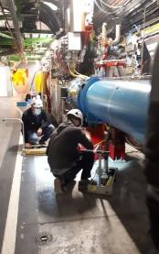
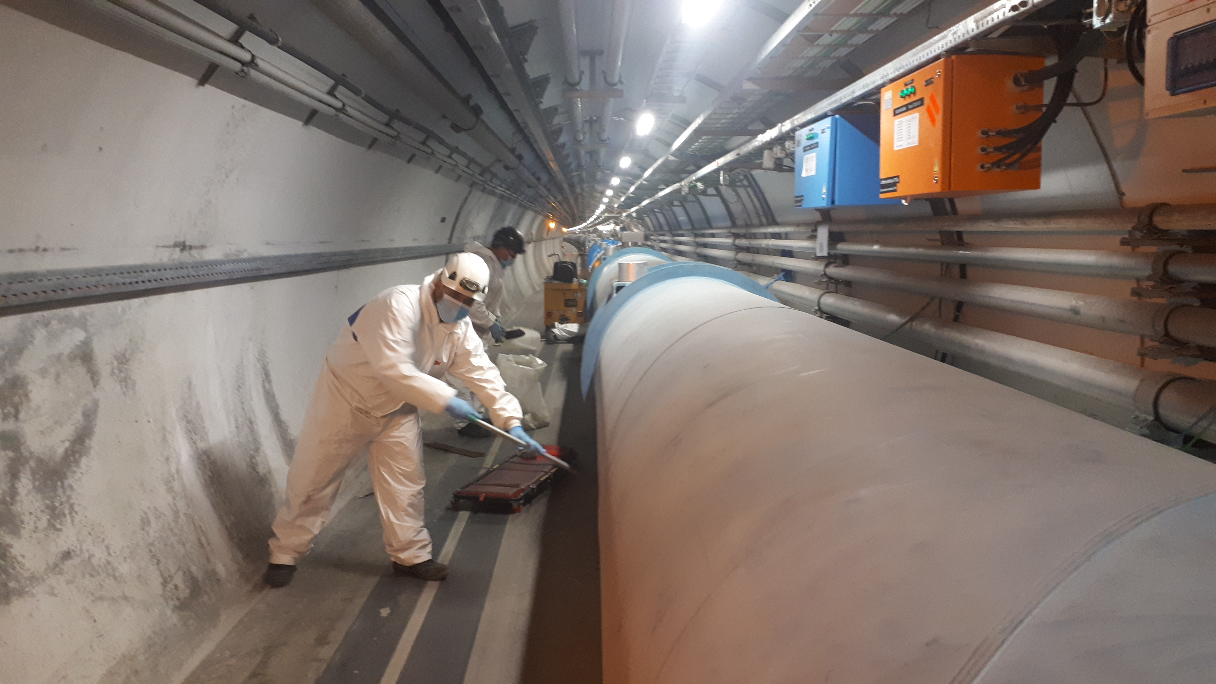
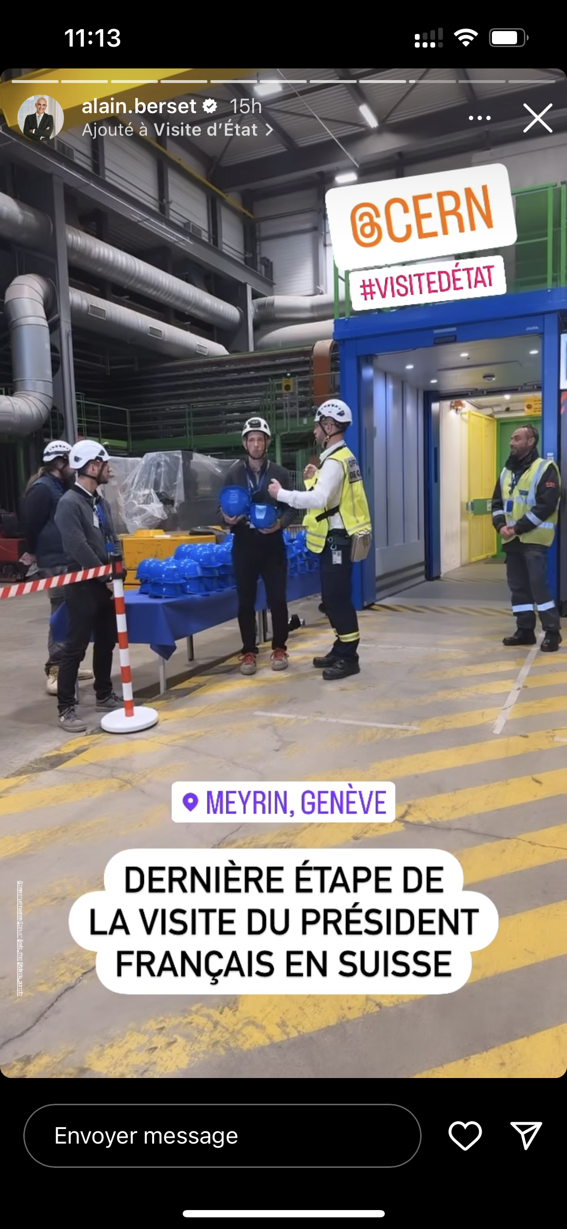
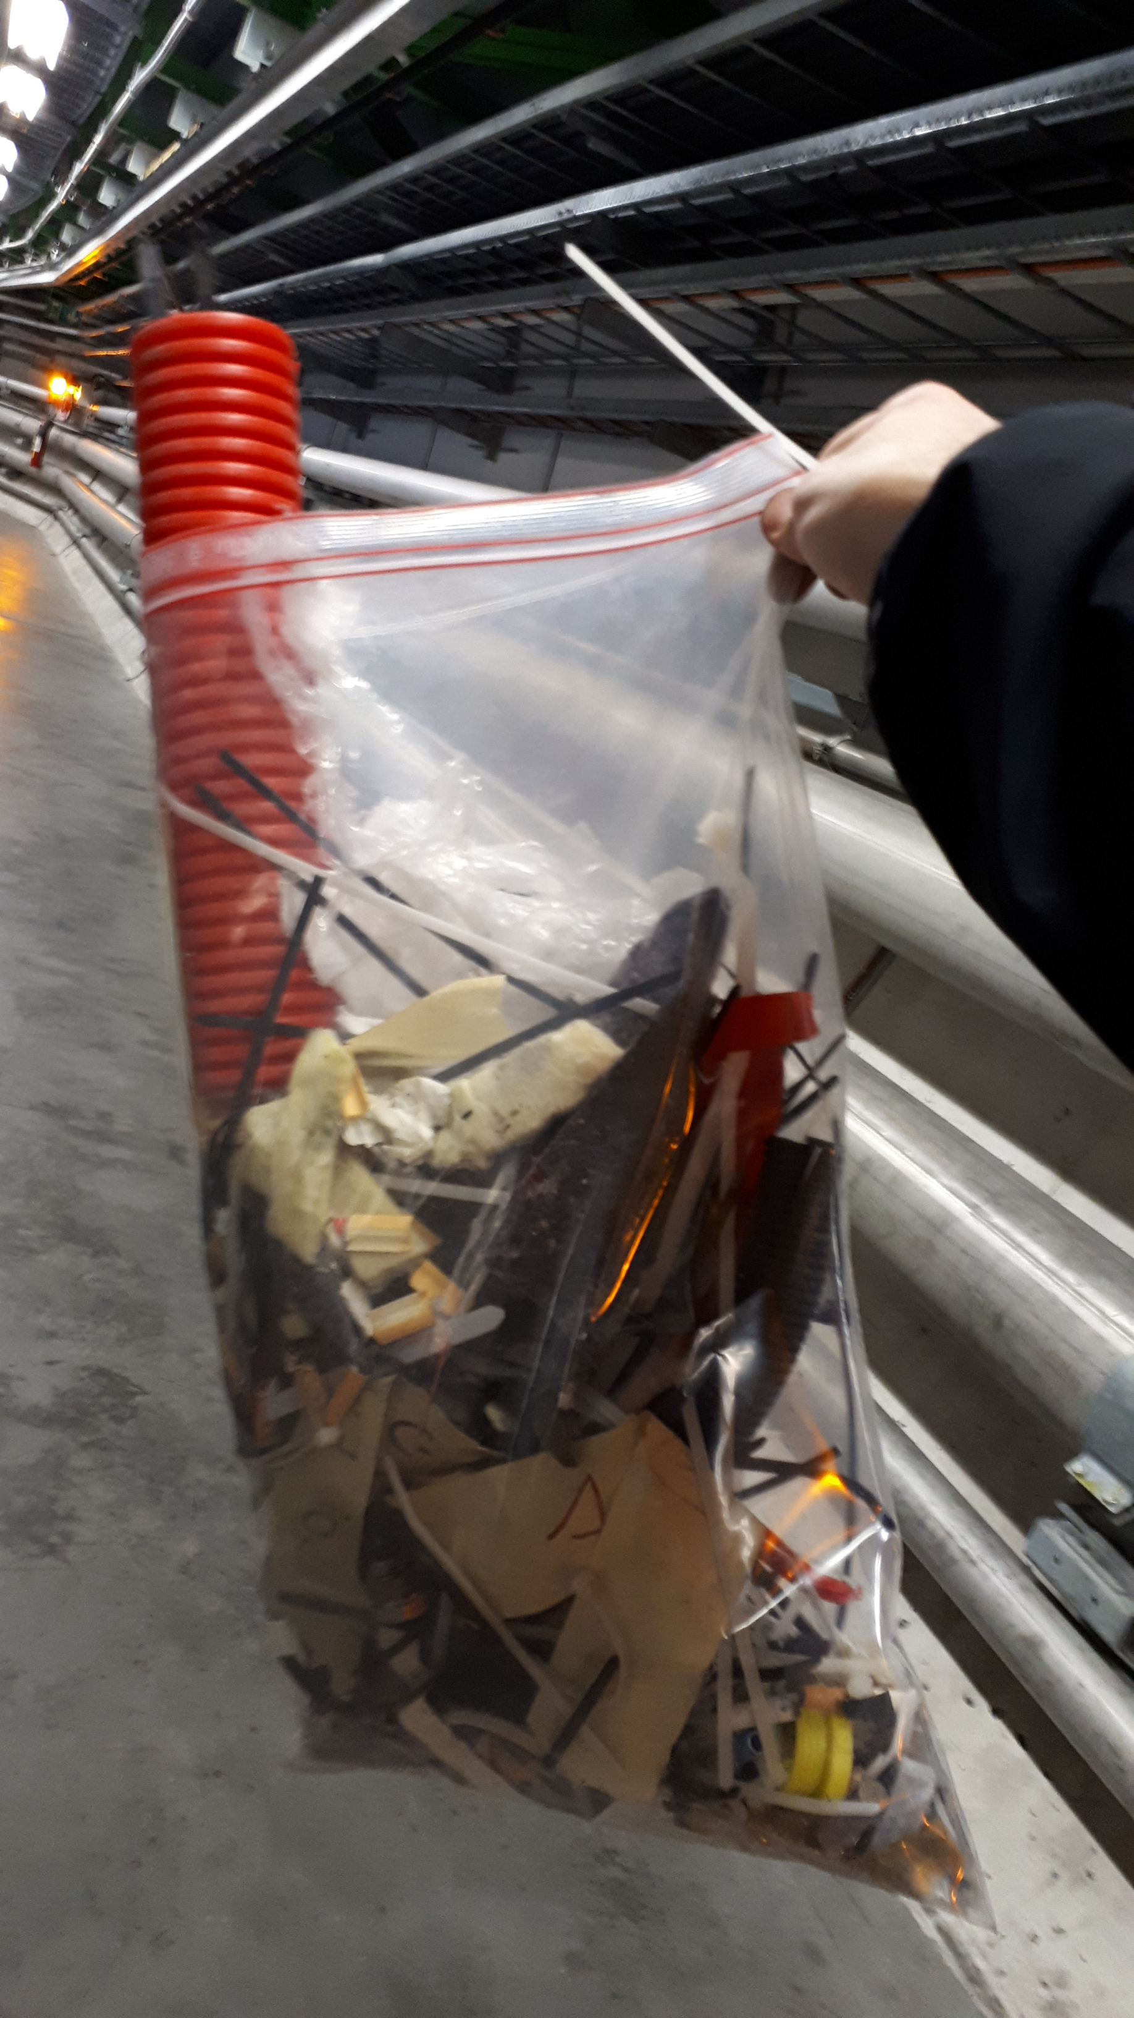
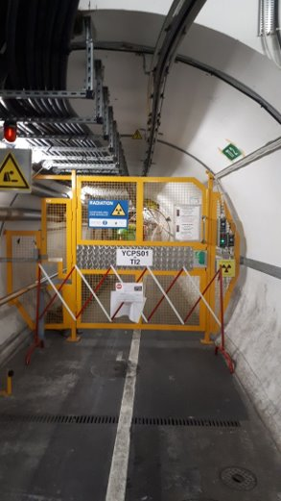
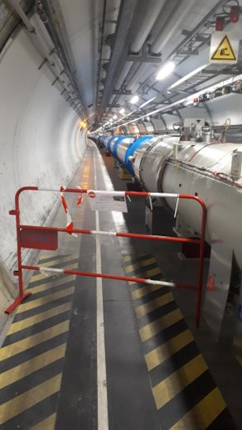
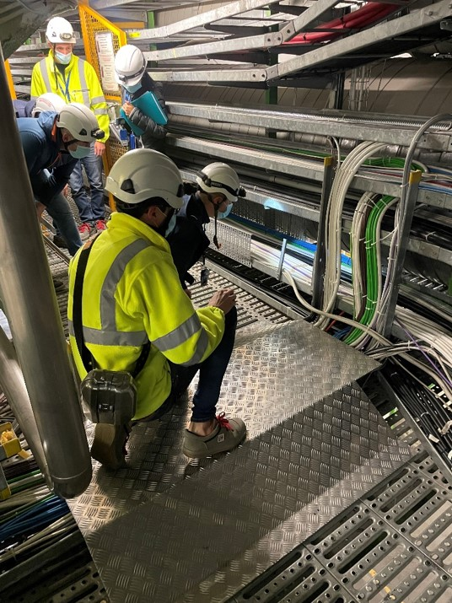
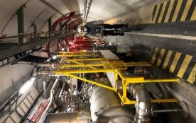
LHC
Territorial coordination
Site management
Follow-up of cleaning
Activity tracking
VIC
VIP/Protocol
Patrols
Safety markings

Slide 8
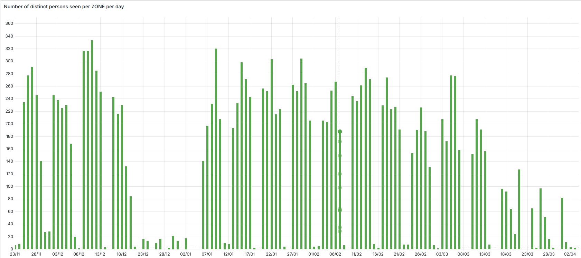
Presence in zone : Number of distinct persons per day in the LHC (excluding Experiments) EYETS 24/25
Courtesy by V. Rios (EN-AA-AC)
End physics run
DSO test
Year-end closure
Moyenne

Slide 9
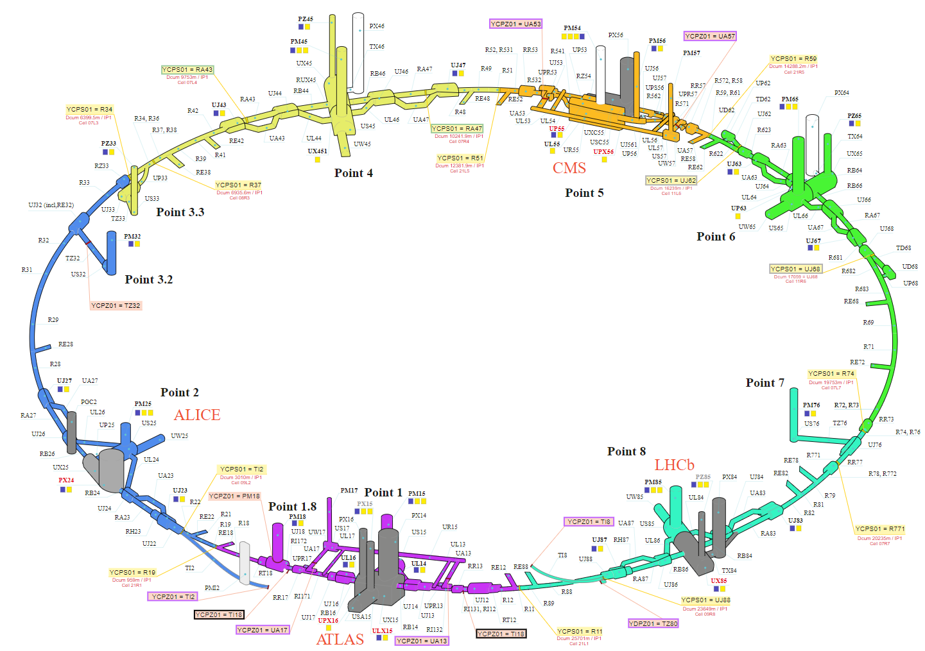
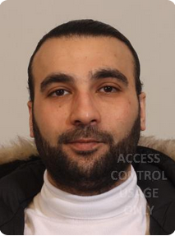



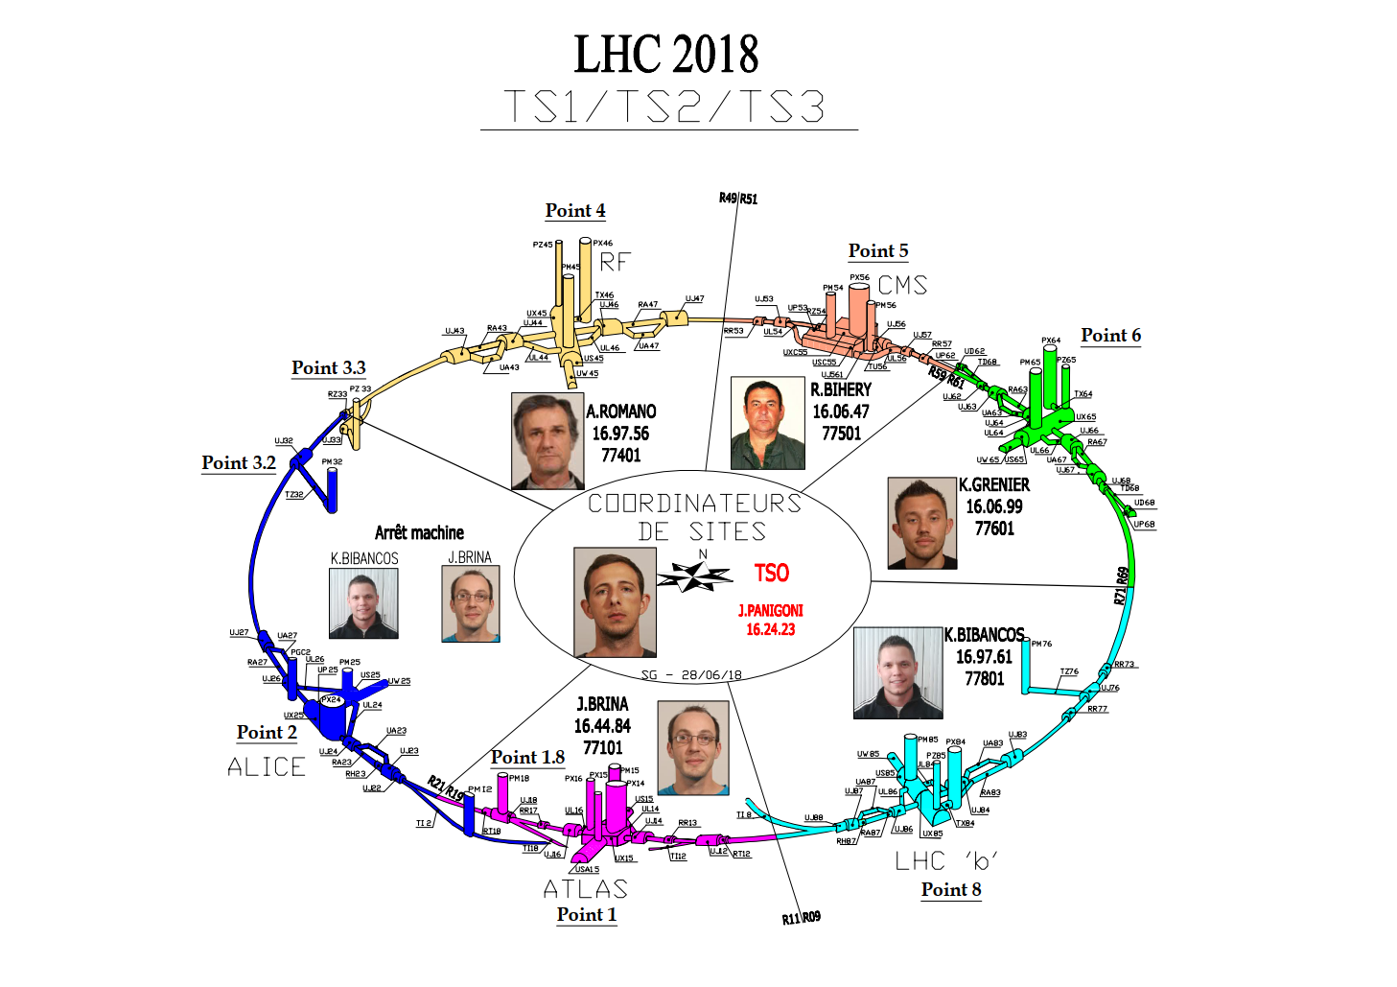
Technical Stop
M.Merimi
16.83.46
Sites managers
K.GRENIER
16.06.99
TSO
DTSO
J.PANIGONI
162423
N.MORNAND
168467
K.BIBANCOS
16.97.61
J.BRINA
16.44.84

Slide 10
My life as TSO: Illustrated examples
Planned emergency evacuation test
Underground defibrillators at LHC
Meeting point at all LHC sites

Slide 11
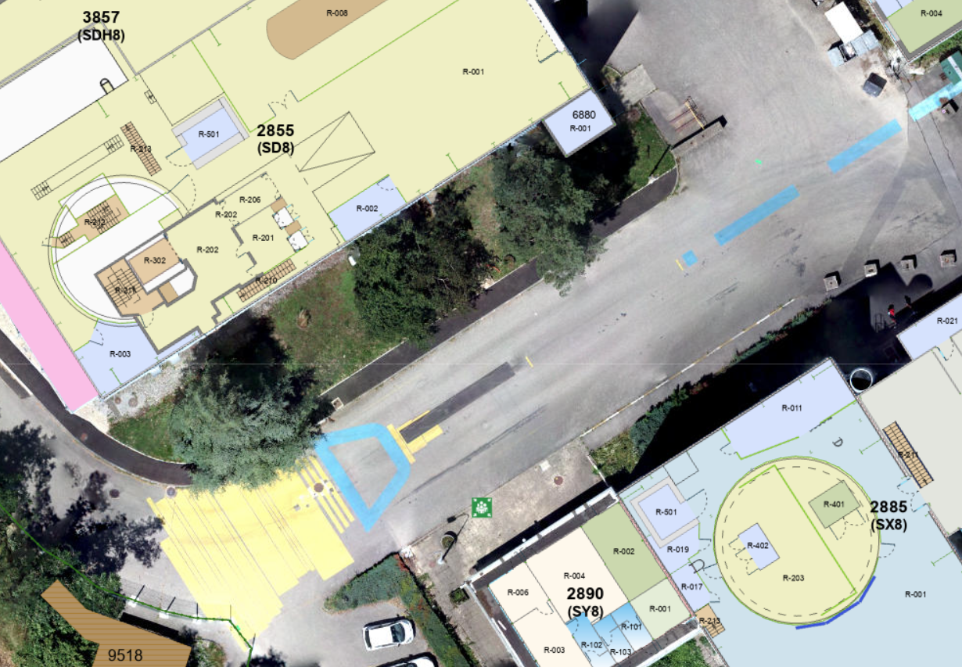
Observers' positions - Point 8 surface
1. Planned emergency evacuation test
During the evacuation :
Observe the progress of the evacuation, the occupants, etc. Do not respond to calls (except in the event of incidents that could have an impact on safety)
During the evacuation, make your way to the nearest assembly point as you go along.
The end of the evacuation is given by the TSO or the organiser and the fire chief (if present) at the assembly point.
Fill in the observation sheet , noting strengths and areas for improvement, and take photos.
N°5 :
2855/R-001
Exit PM85
N°6 :
Meeting point
Lift PM85

Slide 12
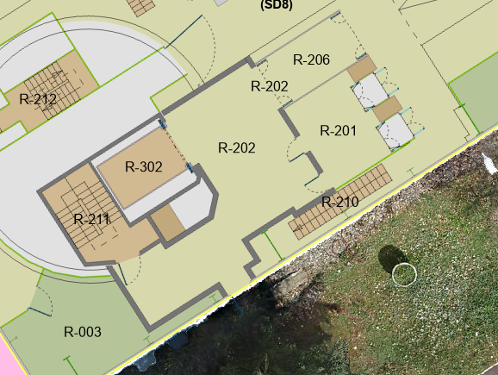
Observers' positions - Point 8 surface
N°5 :
2855/R-001
Exit PM85
Help with positioning the observers
Emergency evacuation door

Slide 13
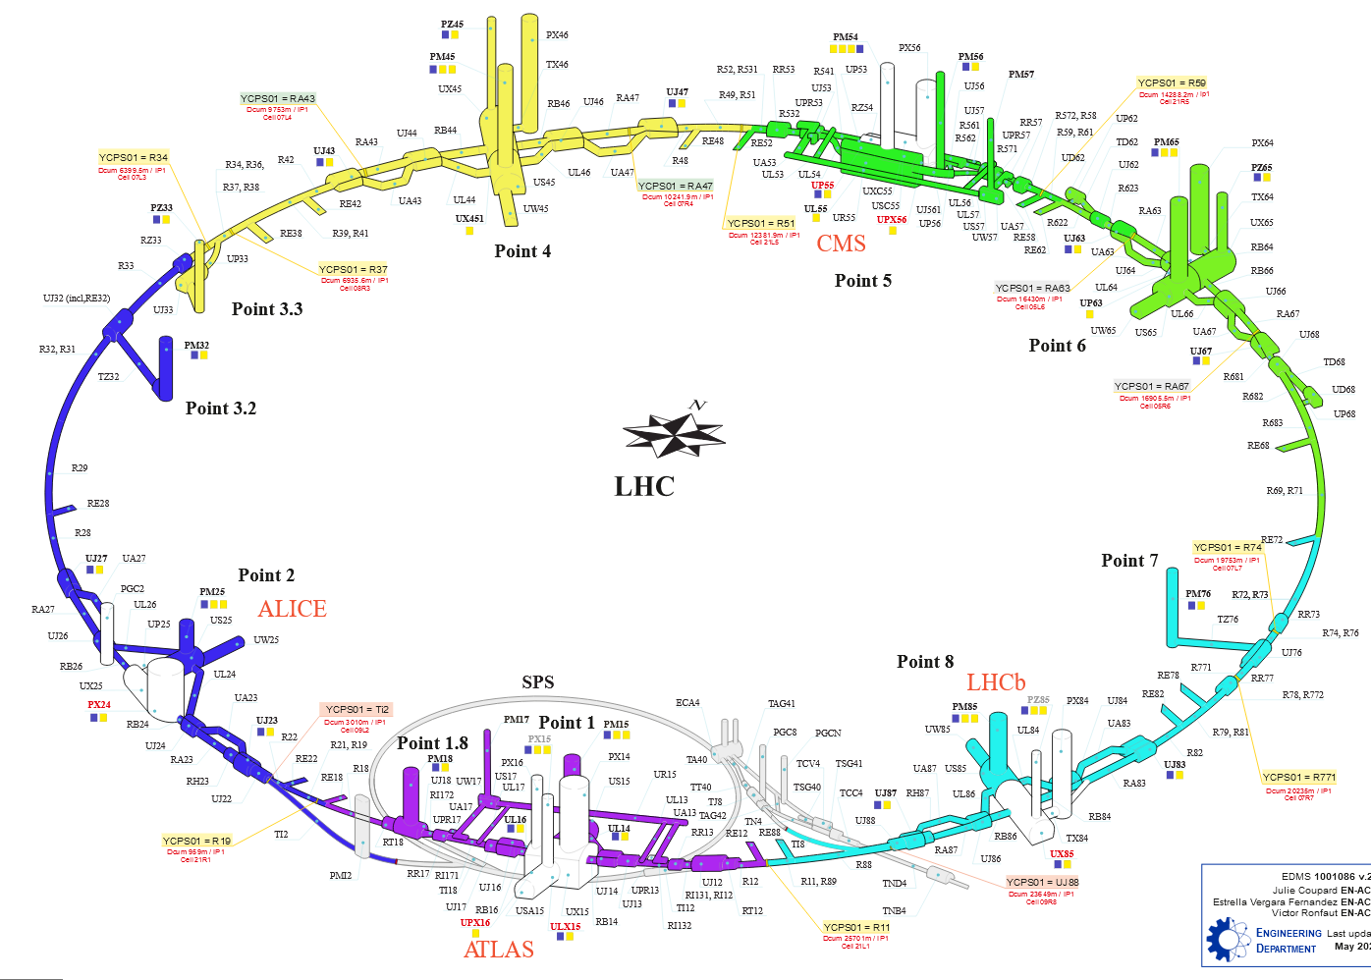
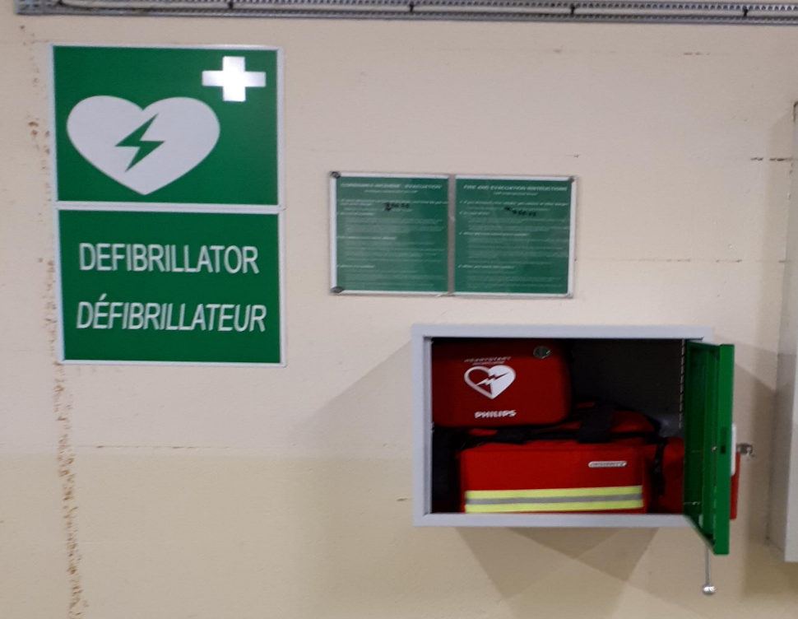

2. Underground defibrillators at LHC

Slide 14
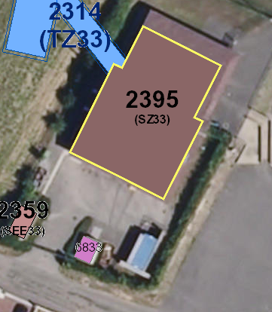
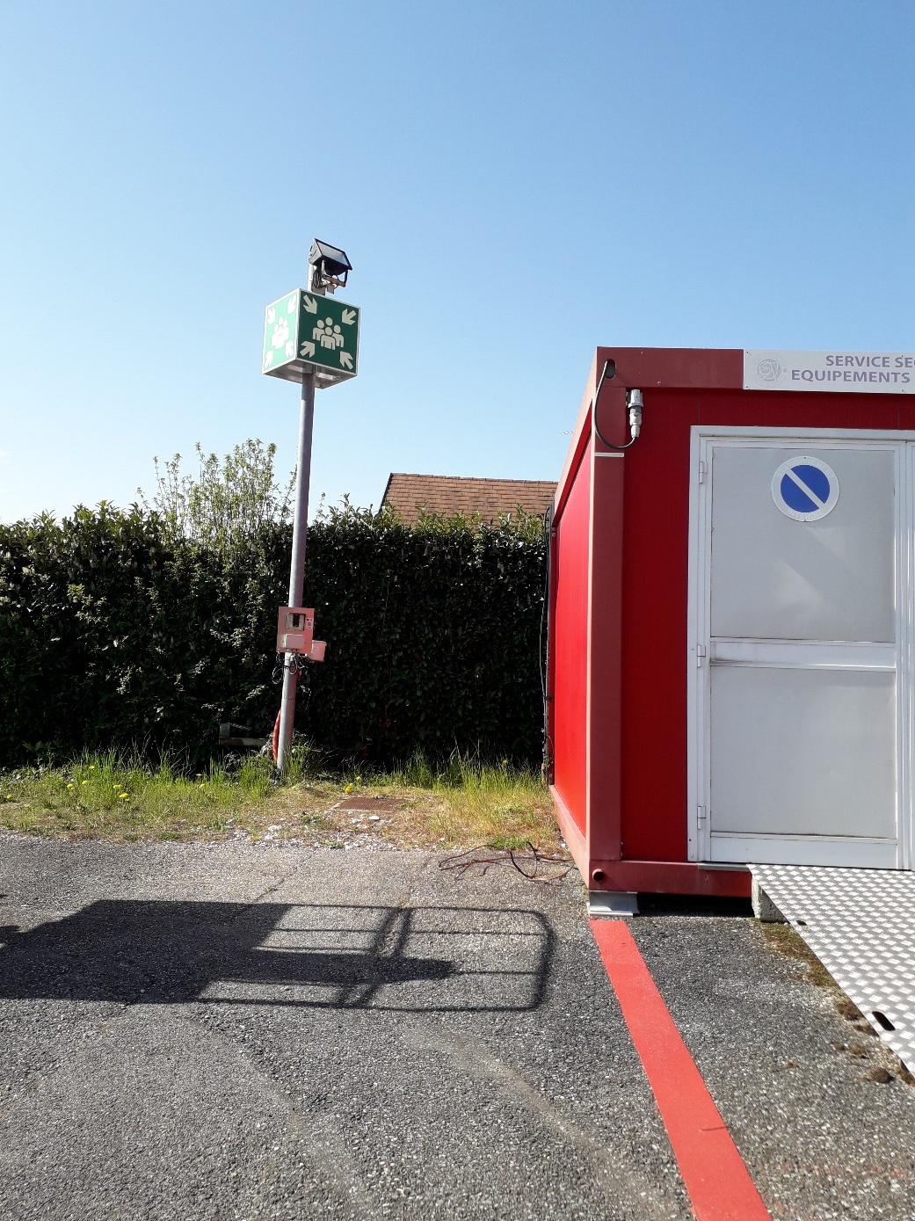
3. Assembly point at all LHC sites
LHC Pt3.3

Slide 15
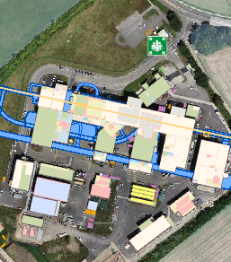

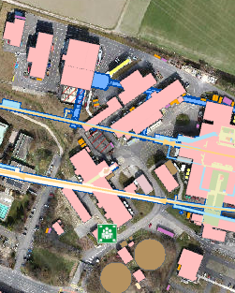

Slide 16
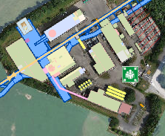
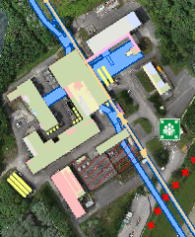
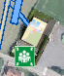
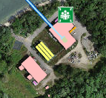
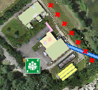
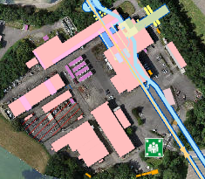
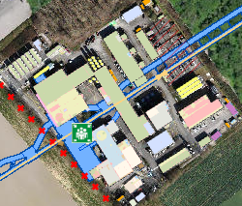

Slide 17
What I learnt from my experience
🧠 Knowledge of the area
🤝 Relationship skills
📇 A huge address book

