Slide 1
TSO meet-up
Sharing my TSO role experience
Joel Murray DAVIES
5 June 2025

Slide 2
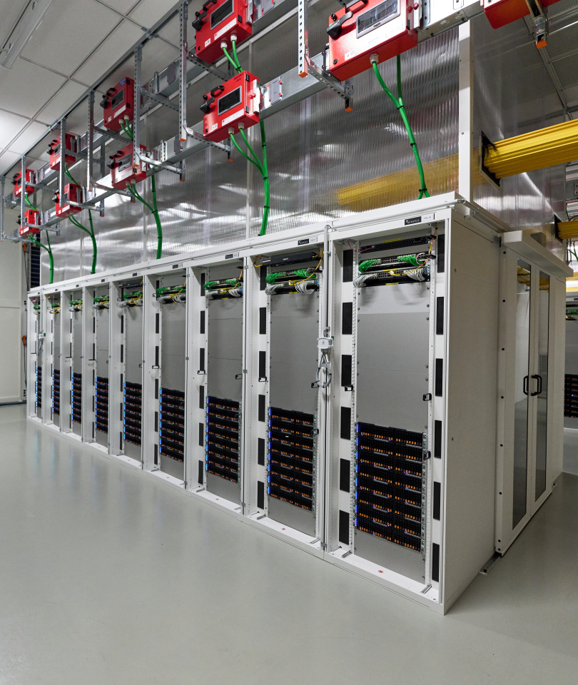
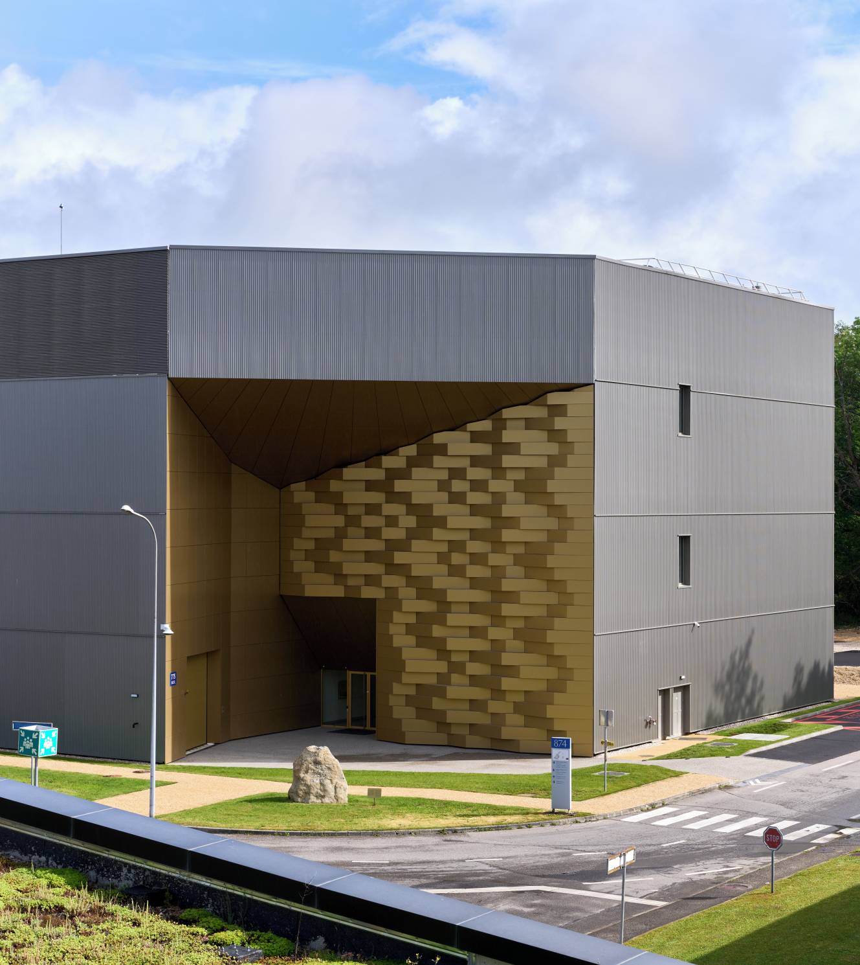
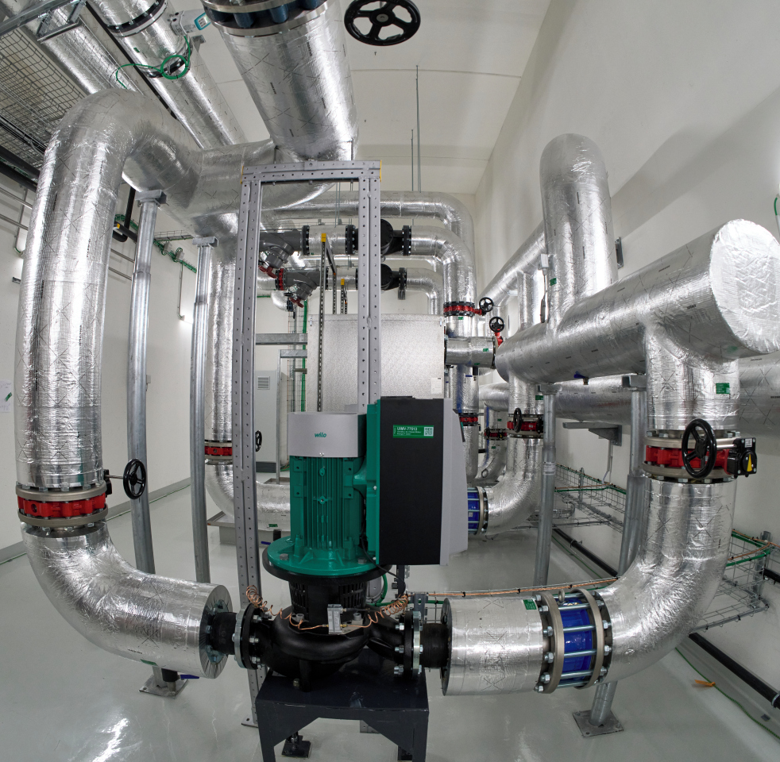
Introducing Building 775
Prévessin Data Centre
12MW computing facility
State of the art cooling and heat recovery system
Structural works
2.9 km² building footprint
3 floors, including technical terrace and lift
Technical infrastructure
Cooling
Electricity

Slide 3
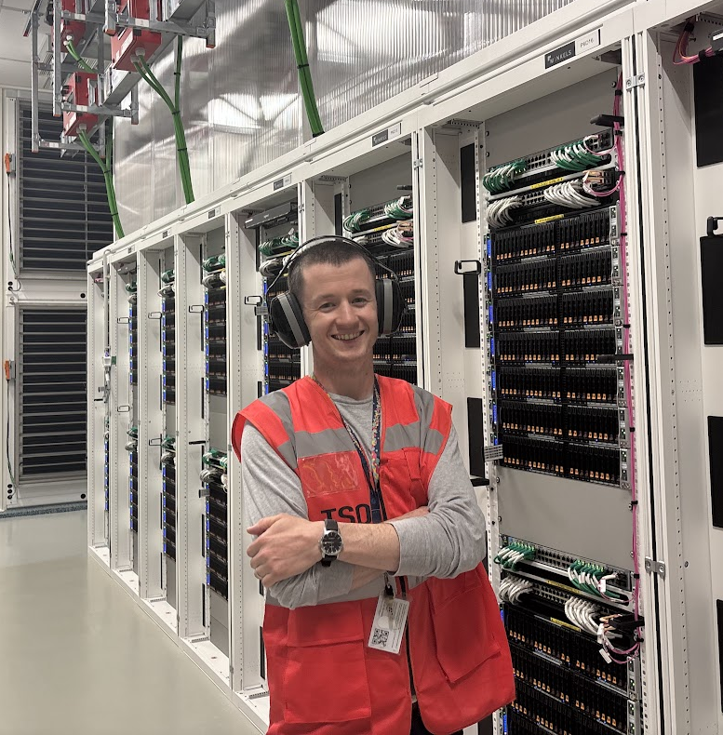
B775 Territorial Safety Officer
Computing Technician
Inspired by the IT-DSO, IT-FA group leader, and other TSOs at CERN.
Duty to become TSO due to alignment with technical responsibilities.
TSO training completed on 24/09/2024
Appointed TSO on 1/10/2024

Slide 4
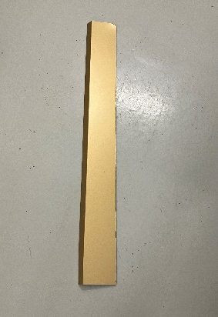
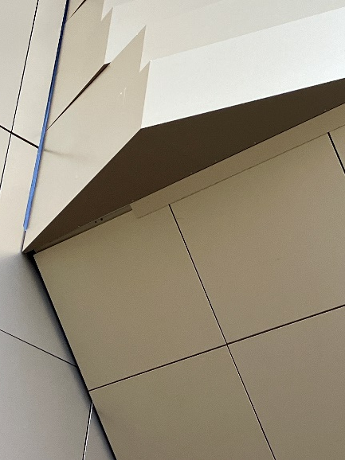
Incident – Façade Failure
November 15th, 2024, around 3 PM
Description: A piece of cosmetic façade (approx. 1m long, ~500g) fell from above the entrance.
No adverse weather or apparent external cause.
Façade was clipped and glued into place without the use of fasteners.

Slide 5
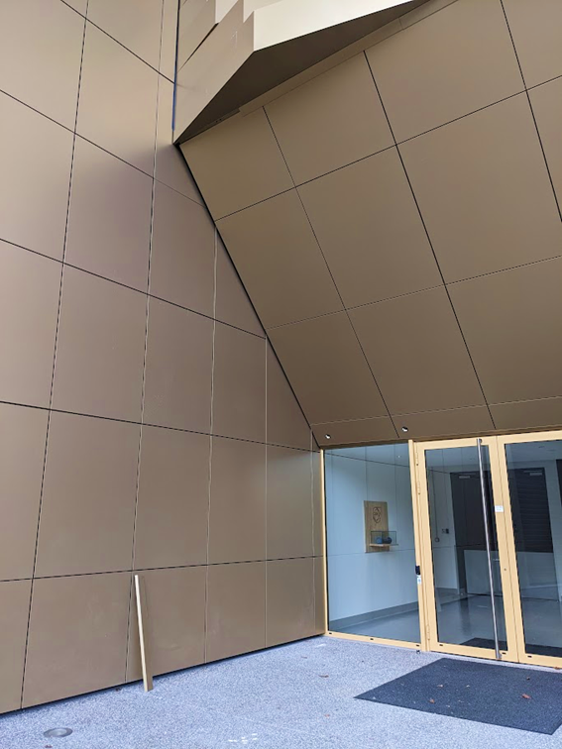
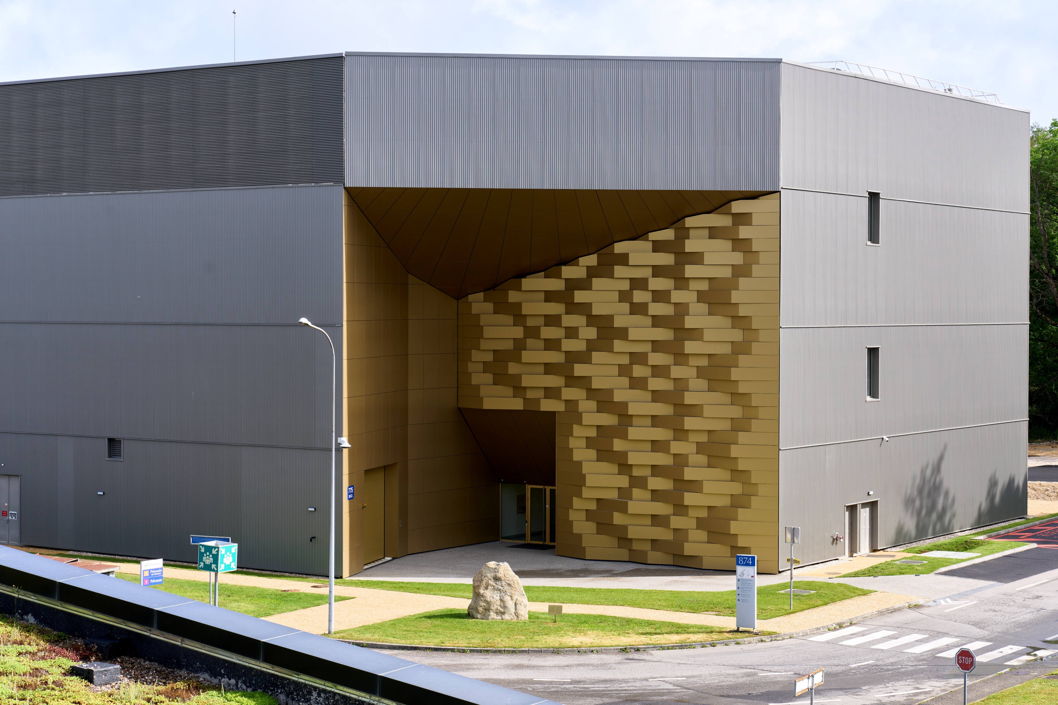
Incident – Façade Failure

Slide 6
Incident Response
Effective Reporting: Incident was quickly identified and reported.
Coordination: Liaised effectively with technical and safety teams. Area was cordoned off and the incident was analysed.
Hazard Prevention: Action to eliminate the immediate danger. Several other pieces of façade were identified as a potential danger and were removed.
Information Sharing: Operational teams informed throughout the process.
Maintenance of Safety & Access: Ensured both immediate and ongoing safety of the building.

Slide 7
What Went Well?
Quick reporting from the onsite technician.
Recent TSO training, sharp reflexes.
IT-DSO, HSE piquet, IT-FA group leader, TI Operator and the fire brigade mobilised quickly to analyse the situation, and to establish a plan to enable access.
Contractor responded quickly to remove pieces of façade with the potential to fail.
Contractor has since reviewed the installation of the façade pieces, and they’ll be reinstalled with rivets.
Despite not having an office in the building, nor on the Prévessin site, an effective response was made.

Slide 8
Future
Committed to upholding excellence in safety.
Soon to be TSO of:
B513 Meyrin Data Centre
B773 Prévessin Second Network Hub
B613 Tape Library Storage
For more information on safety in a data centre environment, please don’t hesitate to contact me: joel.murray.davies@cern.ch

