Slide 1
TSO meet-up
Closing words before we leave
Benoît Delille & Anna Cook
5 June 2025

Slide 2
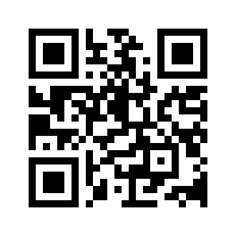
Your feedback is key! tso-proposals@cern.ch
And don’t forget the TSO Info Hub…
https://www.cern.ch/tso

Slide 3
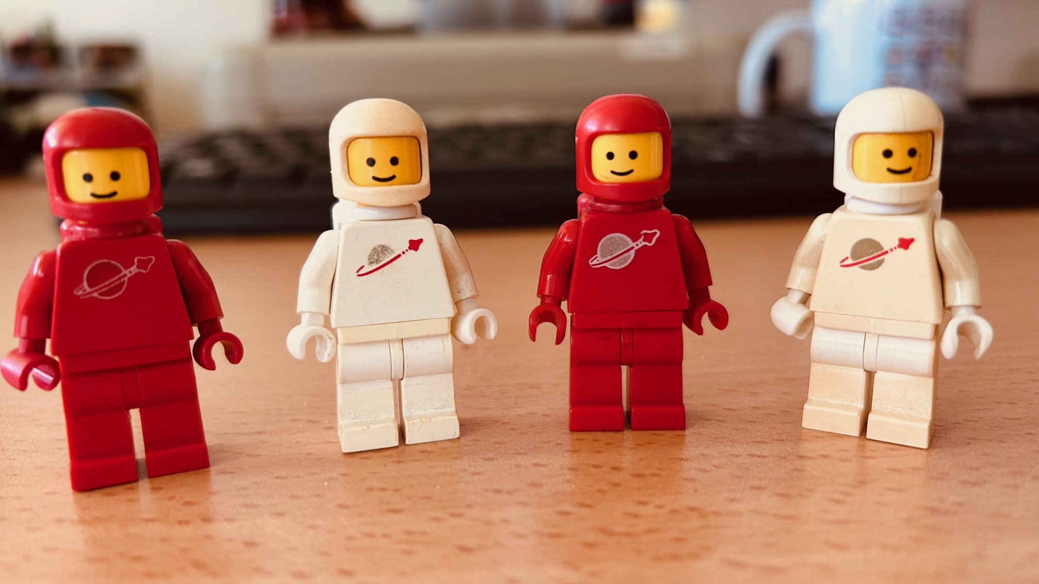
The TSO video…
Youtube: https://youtu.be/tjYieBJu66E
CDS: https://videos.cern.ch/record/2301624
Congratulations to Christel, Pauline, Jamie and Mathieu who deserve a special oscar

Slide 4

Don’t miss the CERN Safety day today until 3 p.m. !

Slide 5
Stands
Foyer/UBS area
Indoor air monitoring
Grab & Go
Electrical safety
Pre-Extension space
Environment
waste and biodiversity
CFRS: Life saving actions
STC: self-rescue masks
Fire Safety
Be ready be safe
Mezzanine
Mechanical Safety
Seismic Safety
Medical service / Prolians
Noise / Lasers
Road Safety

Slide 6
Thank you for being here today!
And now… time for the TSO group photo on the outside stairs of the Main Building

