Slide 1
TSO meet-up
The CERN Safety Policy Committee (SAPOCO)
Roberto Losito
5 June 2025

Slide 2
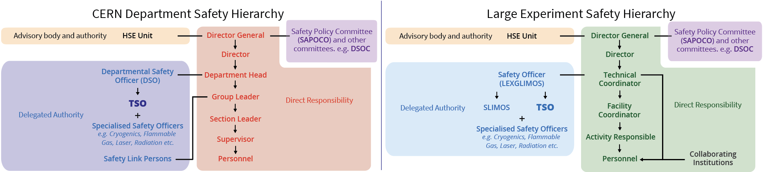
CERN’s Safety organisation
SAFETY REGULATION SR-SO: Responsibilities and organisational structure in matters of Safety at CERN

Slide 3
SAPOCO: mission
Advisory body to the Director-General on matters related to the CERN Safety Policy.
Advises the DG on the definition of the CERN Safety Policy and on appropriate measures for its implementation.
Contributes to the establishment and revision of the CERN Safety Rules, as specified by the relevant procedures.
Nominates the Chair of the Departmental Safety Officers’ Committee (DSOC).
Meets as often as necessary and at least three times a year.
https://hse.cern/content/sapoco

Slide 4
SAPOCO membership
Members of the SAPOCO are appointed by the Director-General
  Chair (Senior Staff);
  Head of the HSE Unit (ex officio);
  Chair of the DSOC (ex officio);
  two representatives of the Staff Association (nominated by the SA);
  a legal officer competent in matters of Safety;
  seven senior staff members representing those responsible for the technical activities of the Organization (nominated in consultation with the SAPOCO Chair and the Head of the HSE Unit).
Current membership:
Chair : Roberto Losito
Head of HSE Unit: Benoit Delille
Chair of the DSOC: Delphine Letant-Delrieux
Staff Association: Francois Duval, Nicolas Vauthier
Legal Advisor, Scientific Secretary: Angela Goehring-Crinon, Myriam Ayass
Finance and Human Resources: Lisa Bellini Devictor (IPT), Anne Kerhoas (HR)
Accelerator and Technology: Sebastien Evrard (EN), Rosario Principe (TE)
Research and Computing: Hans Danielsson (EP), Frank Glege (EP)
International Relations: Pauline Emery
Notes:
Except for the ex-officio members and the legal officer, members are appointed for two years, renewable once for another period of maximum period of two years.

Slide 5
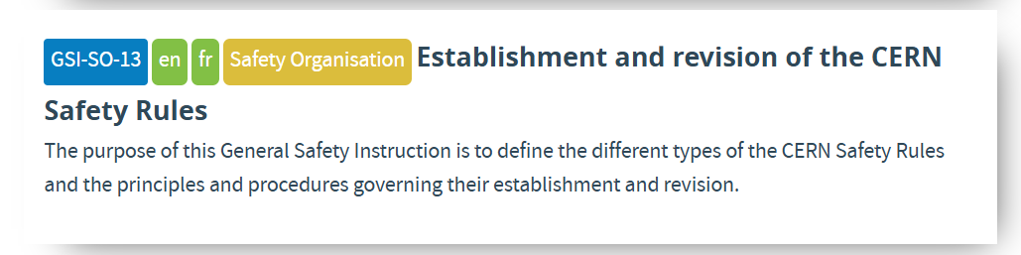
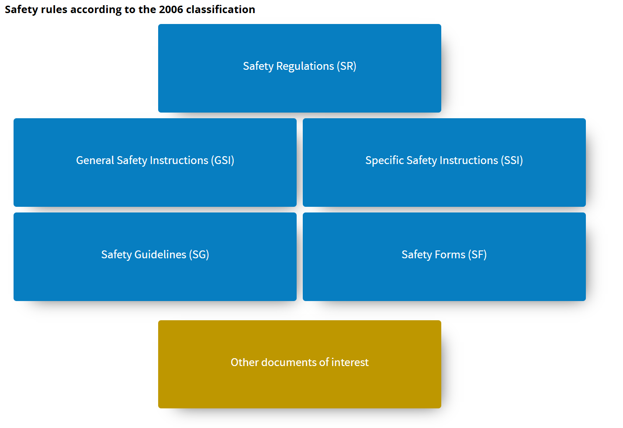
CERN Safety Rules
Approved by the Director General on recommendation from SAPOCO
Approved by the Head of HSE after consultation with DHs, DSOs, experts in the concerned domain, discussion with SAPOCO

Slide 6
Examples of recent topics discussed
Recurring topics
  Report from DSOC
  Report from Medical Service
  Annual Report of incidents and statistics
  Report on the update of Safety rules
Specific Topics
  Reports on Major incidents
  Reports form projects with impact on Safety (e.g. Electrical Safety Project (ESP), CERN 70 celebrations, etc.)
  Report on new safety training courses

Slide 7
Conclusion
SAPOCO is an asset for the Organization and has a relevant role to give an independent advice to the DG in matter of safety
Its scope is clearly around the Safety rules, their establishment and their implementation procedures
Whenever necessary, I’ll be happy to receive your feedback

