Slide 1
TSO meet-up
A few words from the chair of the DSOC
Delphine Létant-Delrieux
5 June 2025

Slide 2
Personal experience
2006-2021: TSO of bdg.10 (chemical lab) and bdg.101
  I know the role very well: limited allocated time, no dedicated budget, role not very well understood by the occupants (“concierge”), work in the shadows…
2021-now: DSO of TE Department
  Collaboration with TSOs on Safety aspects in TE buildings
  TSO’s role of major importance to ensure Safety (people, environment and assets) in CERN’s buildings
Since 2025: Chair of the Departmental Safety Officers Committee (DSOC)

Slide 3
DSOC mandate
Membership: DSOs, LEXGLIMOSes, representative from the Staff Association, HSE DH, representative from each group of the HSE Unit
Organisation: regular meetings (~ 6 times a year)
Mission and scope of work: support DH and TC in ensuring overall consistency with a view to the implementation of the CERN Safety Policy, the CERN Safety Rules, the CERN Safety Objectives and best practices
    Exchange platform: no executive role
Reporting: SAPOCO, Directors and Department Heads (annually)

Slide 4
DSOC TSO?
DSOs
LEXGLIMOSes
DSOC
TSOs
Concrete examples:
Guideline Li-ion batteries charging
Inventory of false floors to prioritise future consolidation interventions
Exchange/sharing of good and bad experiences in the Departments (including Experiments and Large Experiments) including REX
Propose and monitor the implementation of appropriate Safety measures in buildings
Keep the DSO/LEXGLIMOSes informed regarding all Safety aspects in buildings

Slide 5
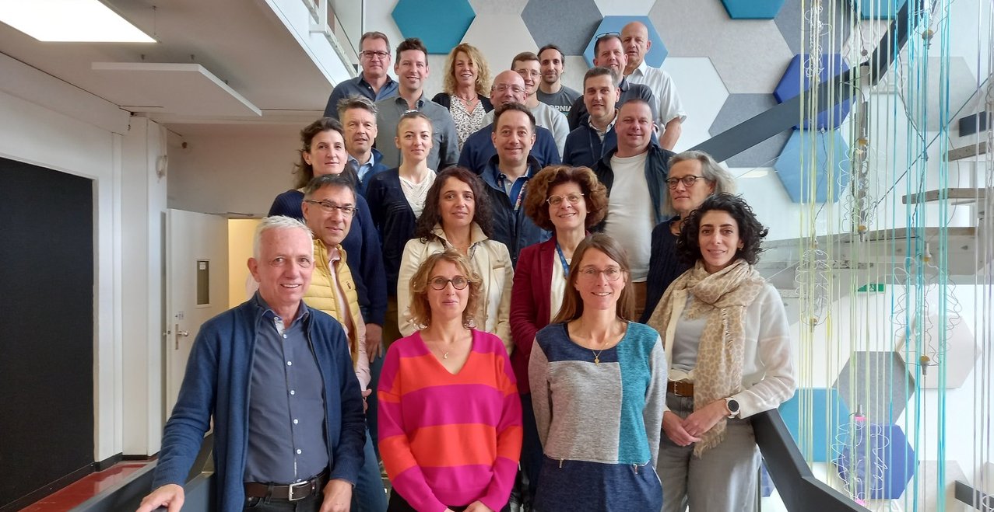
On behalf of the DSOC,
THANK YOU FOR YOUR COLLABORATION AND FOR YOUR INCREDIBLE WORK!!!

