Slide 1
Bubble nucleation vs phase mixing around the spinodal temperature
Tae Hyun Jung (IBS CTPU PTC)
Tomasz P. Dutka (KIAS), THJ (IBS), Chang Sub Shin (CNU),
$$2412.15864$$

Slide 2
Outline
Introduction
Flat potentials and spinodal temperature
What happens around the spinodal temperature?
Numerical simulation
Summary and conclusion

Slide 3
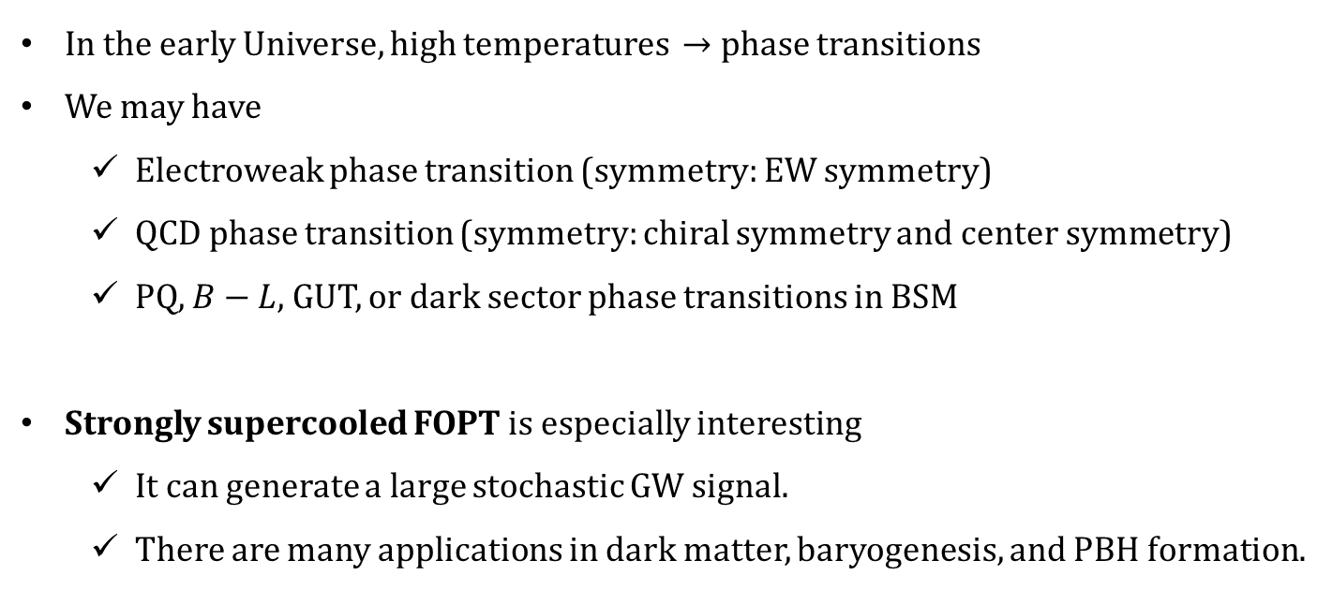
Introduction
In the early Universe, high temperatures $→$ phase transitions
We may have
  Electroweak phase transition (symmetry: EW symmetry)
  QCD phase transition (symmetry: chiral symmetry and center symmetry)
  PQ, $B−L$, GUT, or dark sector phase transitions in BSM
Strongly supercooled FOPT is especially interesting
  It can generate a large stochastic GW signal.
  There are many applications in dark matter, baryogenesis, and PBH formation.
Symmetry
restored
Bubble
nucleation
Bubble
expansion
Bubble
collision

Slide 4
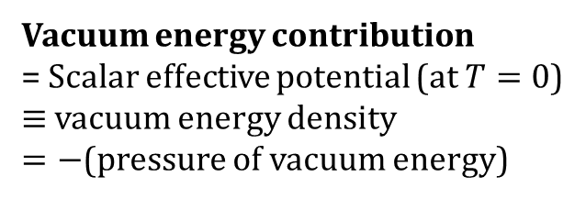
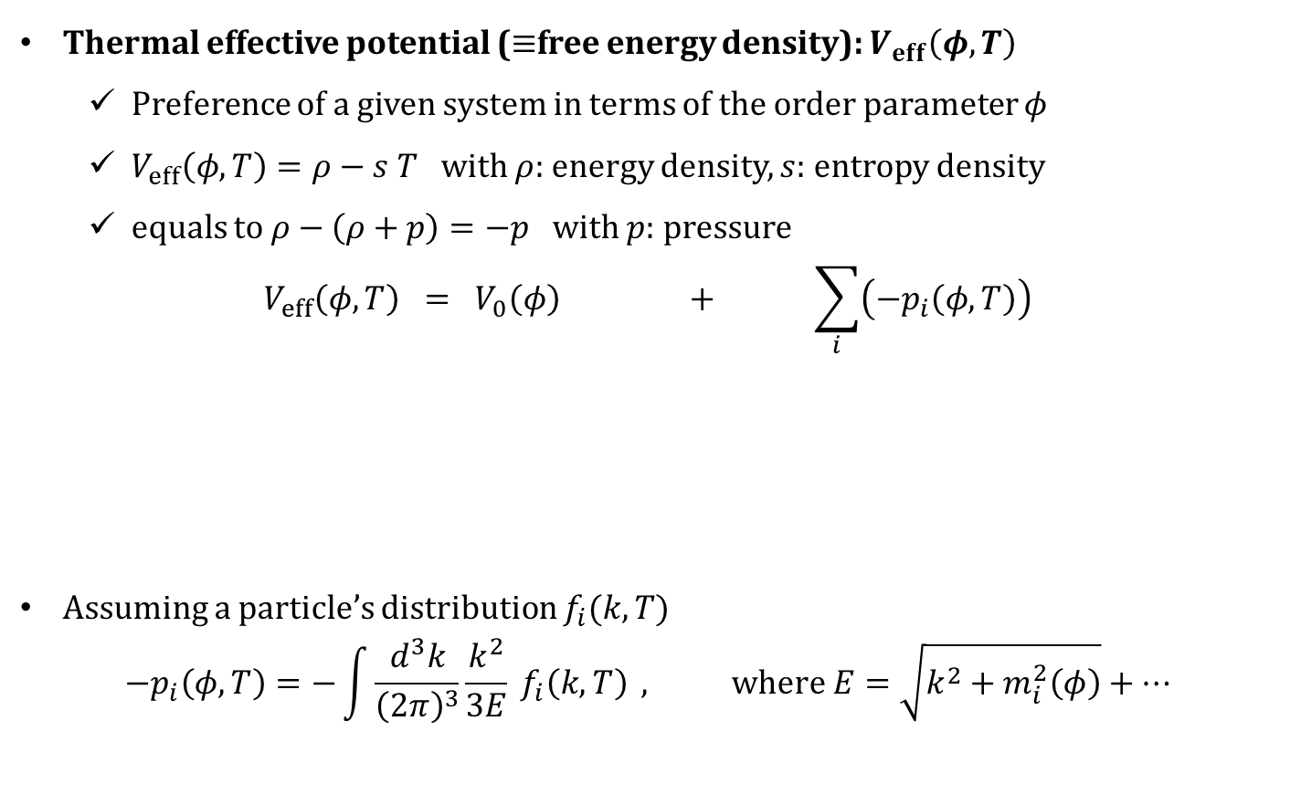
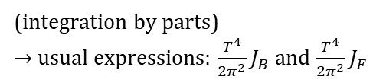
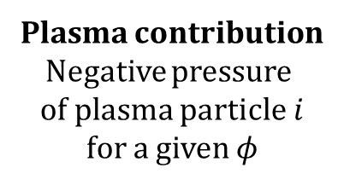
Thermal effective potential
Recall yesterday’s nice talks
for more precise calculations!
Thermal effective potential ($≡$free energy density): $V_{eff}\left(φ, T\right)$
  Preference of a given system in terms of the order parameter $φ$
  $V_{eff}\left(φ, T\right)=ρ−s T$ with $ρ$: energy density, $s:$ entropy density
  equals to $ρ−\left(ρ+p\right)=−p$ with $p$: pressure
$$V_{eff}\left(φ,T\right) = V_{0}\left(φ\right) + \sum_{i}{\left(−p_{i}\left(φ, T\right)\right)}$$
Assuming a particle’s distribution $f_{i}(k,T)$
$$−p_{i}\left(φ,T\right)=−\int{\frac{d^{3}k}{{\left(2π\right)}^{3}}\frac{k^{2}}{3E} f_{i}\left(k, T\right)} , where E=\sqrt{k^{2}+m_{i}^{2}\left(φ\right)}+…$$
Vacuum energy contribution
= Scalar effective potential (at $T=0$)
$≡$ vacuum energy density
$=−$(pressure of vacuum energy)
Plasma contribution
Negative pressure
of plasma particle $i$
for a given $φ$
(integration by parts)
$→$ usual expressions: $\frac{T^{4}}{2π^{2}}J_{B}$ and $\frac{T^{4}}{2π^{2}}J_{F}$

Slide 5
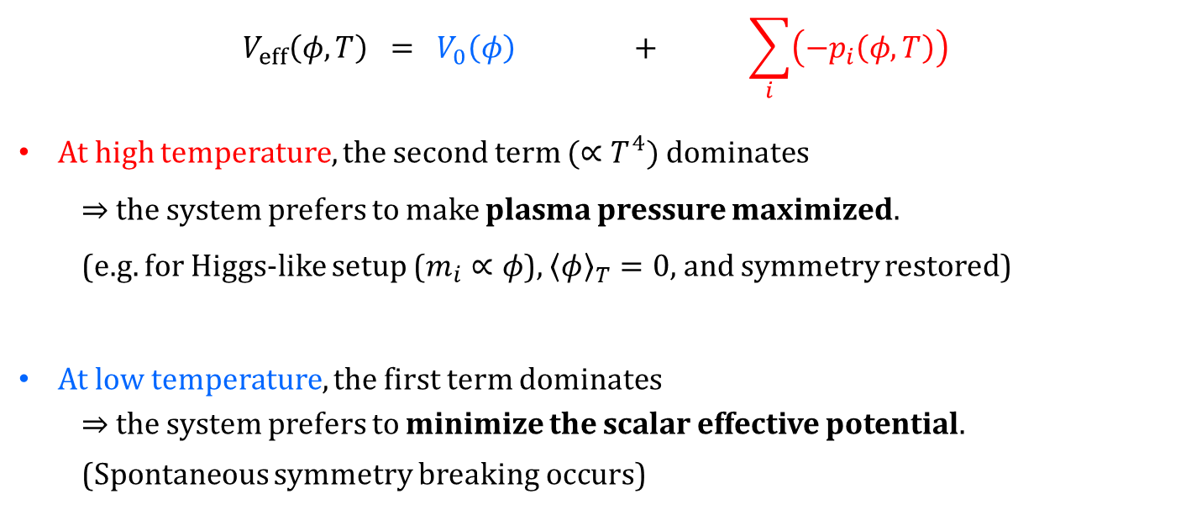
Thermal effective potential
$$V_{eff}\left(φ,T\right) = V_{0}\left(φ\right) + \sum_{i}{\left(−p_{i}\left(φ, T\right)\right)}$$
At high temperature, the second term $(∝T^{4})$ dominates
  $⇒$ the system prefers to make plasma pressure maximized.
  (e.g. for Higgs-like setup ($m_{i}∝φ$), ${\left\langle φ\right\rangle }_{T}=0$, and symmetry restored)
At low temperature, the first term dominates
$⇒$ the system prefers to minimize the scalar effective potential.
(Spontaneous symmetry breaking occurs)
Phase
transition

Slide 6
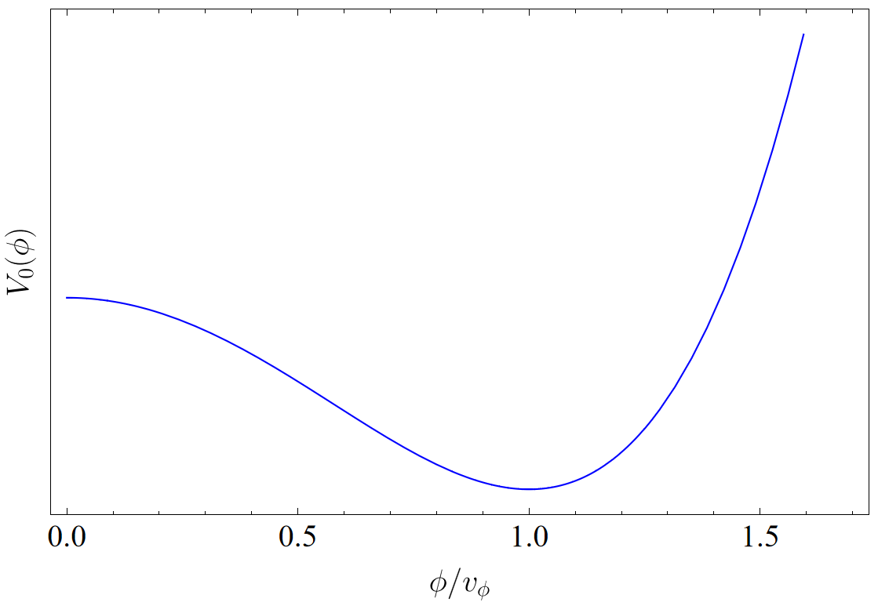
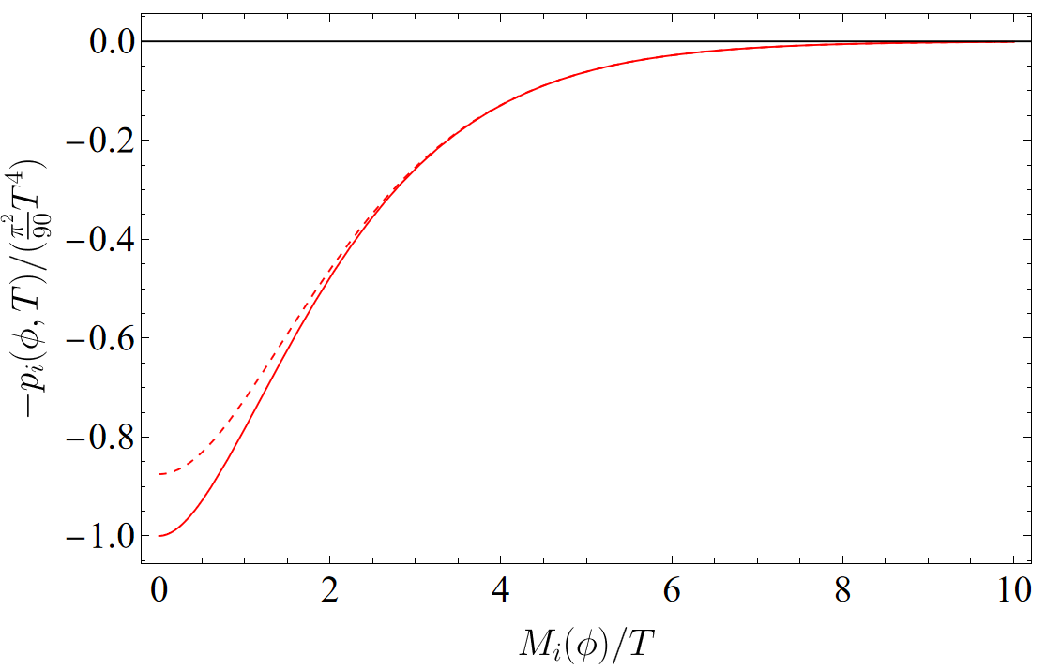
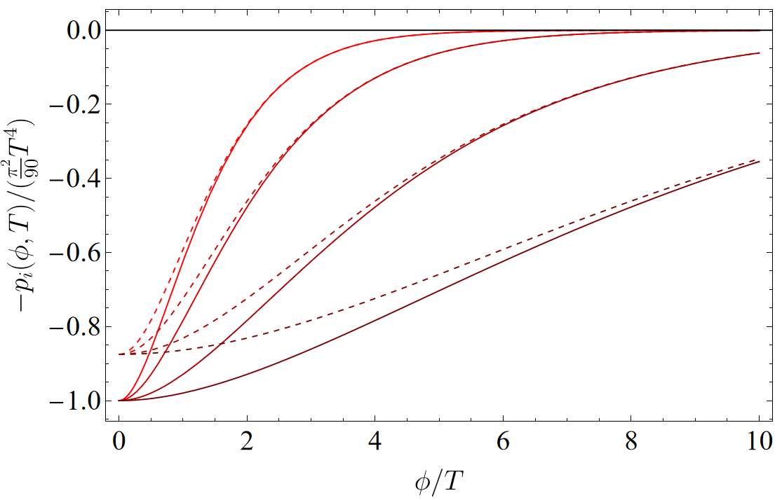
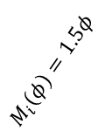

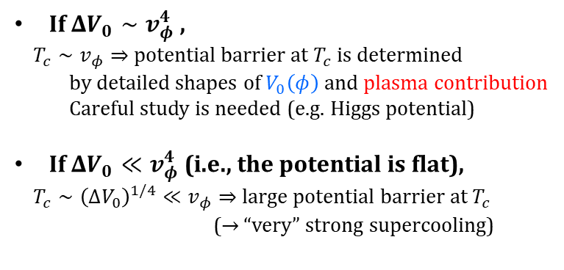

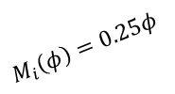

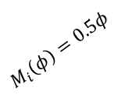
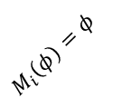
Thermal effective potential
$$V_{eff}\left(φ,T\right) = V_{0}\left(φ\right) + \sum_{i}{\left(−p_{i}\left(φ, T\right)\right)}$$
$$∼{\left(M/T\right)}^{3/2}\exp{(−M/T)}$$
(non-relativistic limit)
fermion
$$ΔV_{0}$$
$$−7/8$$
boson
If $ΔV_{0}∼v_{φ}^{4}$ ,
$T_{c}∼v_{φ}⇒$ potential barrier at $T_{c}$ is determined
by detailed shapes of $V_{0}\left(φ\right)$ and plasma contribution
Careful study is needed (e.g. Higgs potential)
If $ΔV_{0}≪v_{φ}^{4}$ (i.e., the potential is flat),
$T_{c}∼{\left(ΔV_{0}\right)}^{1/4}≪v_{φ}⇒$large potential barrier at $T_{c}$
($→$ “very” strong supercooling)
$$M_{i}\left(φ\right)=1.5φ$$
$$M_{i}\left(φ\right)=φ$$
$$M_{i}\left(φ\right)=0.5φ$$
$$M_{i}\left(φ\right)=0.25φ$$

Slide 7
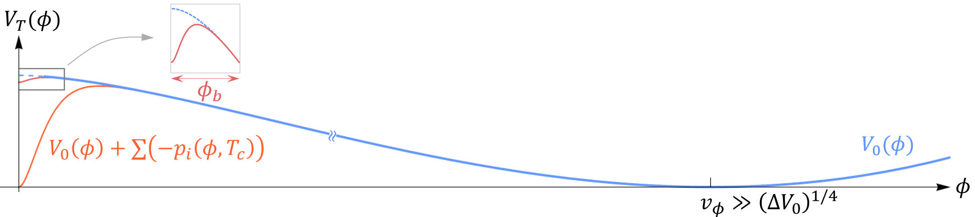


Very strong supercooling in flat potential
$$V_{eff}(φ)$$
Large barrier
at $T=T_{c}$
Structure separation
Scalar field gets trapped at the origin for a long period.
It causes a large supercooling and dilution factor.
This scenario is often called “thermal inflation”.
Lyth, Stewart, 95

Slide 8

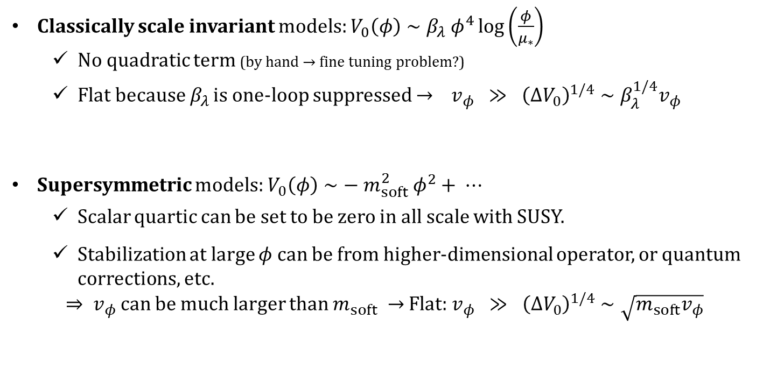
Examples of flat potential
Classically scale invariant models: $V_{0}\left(φ\right)∼β_{λ} φ^{4}\log\left(\frac{φ}{μ_{∗}}\right)$
  No quadratic term (by hand $→$ fine tuning problem?)
  Flat because $β_{λ}$ is one-loop suppressed $→$ $v_{φ} ≫ {\left(ΔV_{0}\right)}^{1/4}∼β_{λ}^{1/4}v_{φ}$
Supersymmetric models: $V_{0}\left(φ\right)∼− m_{soft}^{2} φ^{2}+ ⋯$
  Scalar quartic can be set to be zero in all scale with SUSY.
  Stabilization at large $φ$ can be from higher-dimensional operator, or quantum corrections, etc.
  $⇒ v_{φ}$ can be much larger than $m_{soft} →$ Flat: $v_{φ} ≫ {\left(ΔV_{0}\right)}^{1/4}∼\sqrt{m_{soft}v_{φ}}$
$β_{λ}=$ beta ftn of quartic coupling
$μ_{∗}≃$ scale where quartic vanishes
Recall Bogumila’s nice talk!

Slide 9
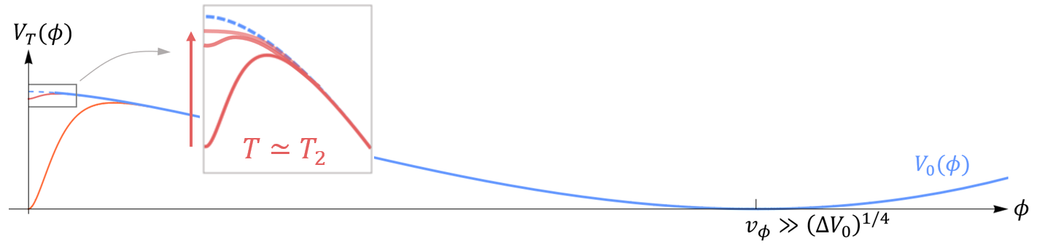
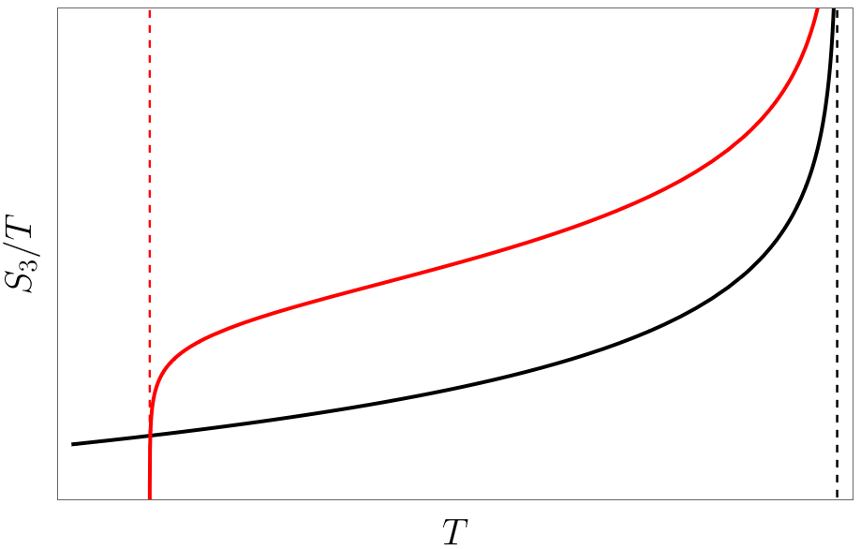
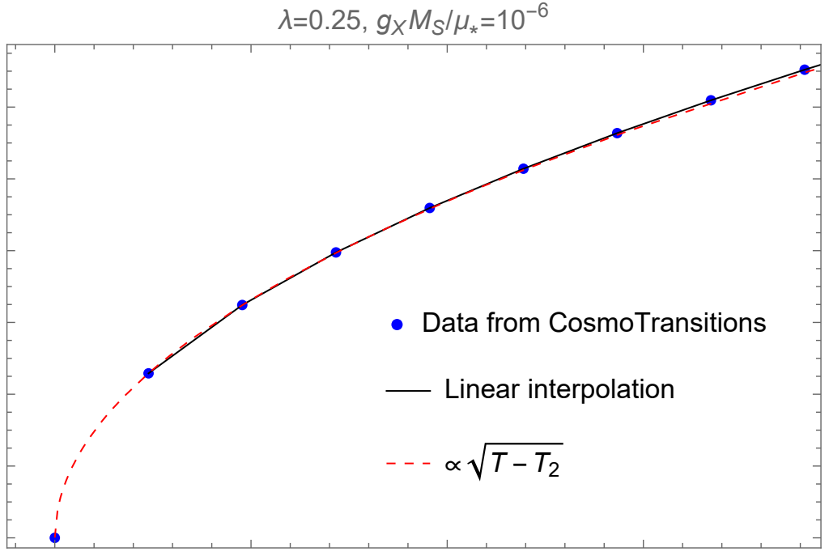
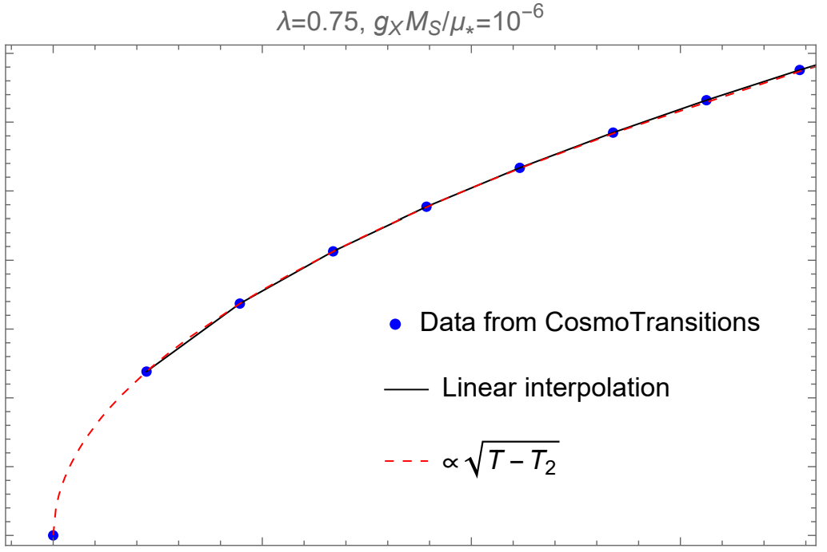

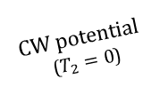
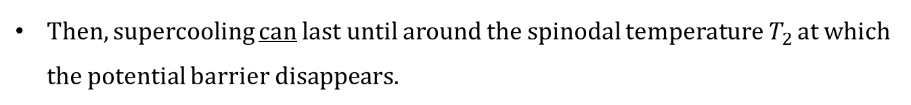

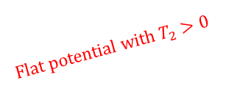








Spinodal temperature
Then, supercooling can last until around the spinodal temperature $T_{2}$ at which the potential barrier disappears.
Curvature flipping $(+)→(−)$
$$120$$
$$3$$
$$100$$
$$S_{3}/T$$
$$80$$
$$2$$
Flat potential with $T_{2}>0$
$$60$$
$$40$$
$$1$$
$$20$$
CW potential
($T_{2}=0$)
$$0$$
$$0$$
$$1.0000$$
$$1.0001$$
$1.000$2
$1.000$3
$$1.0000$$
$$1.0001$$
$1.000$2
$1.000$3
$$T/T_{2}$$
$$T/T_{2}$$
(weak coupling)
($O(1)$ coupling)
$$T_{2}$$
$$T_{c}$$
$⇒$ Phase transition proceeds around $T_{2}$

Slide 10
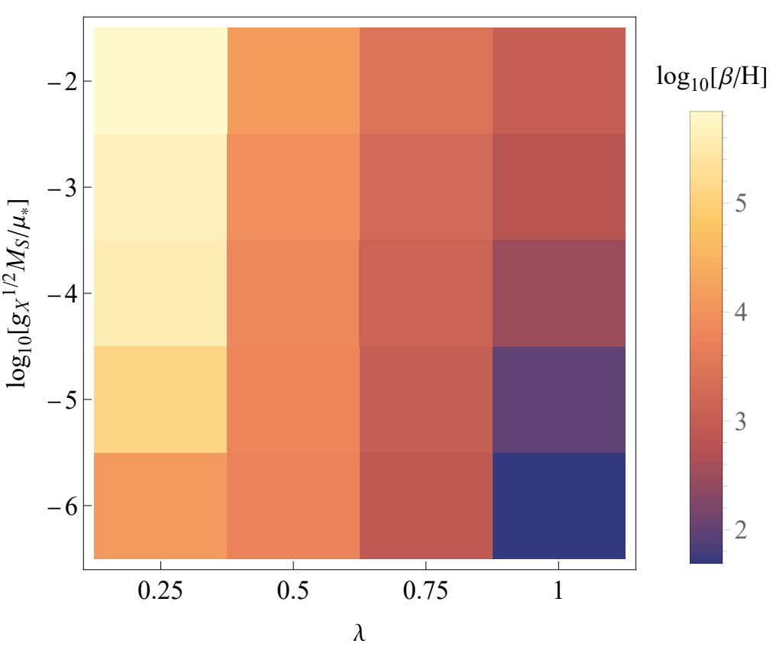

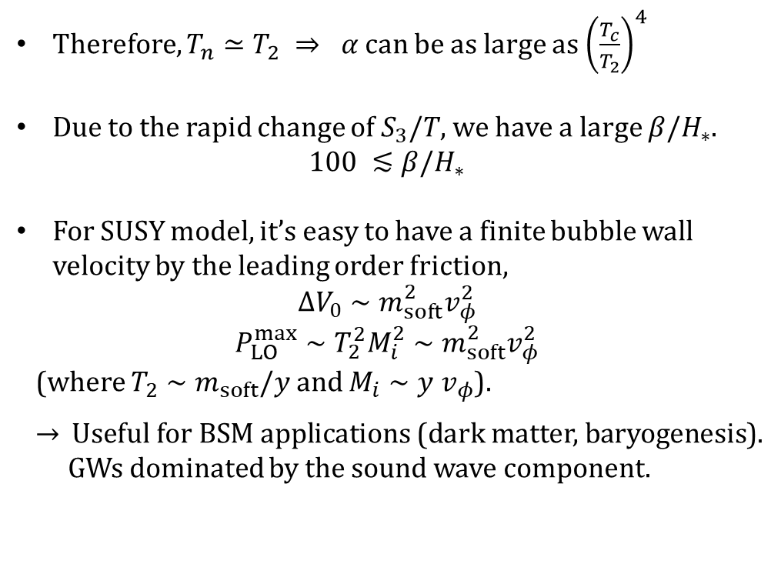

Gravitational waves
Therefore, $T_{n}≃T_{2} ⇒ α$can be as large as ${\left(\frac{T_{c}}{T_{2}}\right)}^{4}$
Due to the rapid change of $S_{3}/T$, we have a large $β/H_{∗}$.
$$100 ≲β/H_{∗}$$
For SUSY model, it’s easy to have a finite bubble wall velocity by the leading order friction,
$$ΔV_{0}∼m_{soft}^{2}v_{φ}^{2}$$
$$P_{LO}^{max}∼T_{2}^{2}M_{i}^{2}∼m_{soft}^{2}v_{φ}^{2}$$
(where $T_{2}∼m_{soft}/y$ and $M_{i}∼y v_{φ}$).
$→$ Useful for BSM applications (dark matter, baryogenesis).
GWs dominated by the sound wave component.
[Dutka, THJ, Shin, 2412.15864]
$$∼\log_{10} \left[T_{2}/v_{φ}\right]$$
$∼$Yukawa coupling
However, these stories are valid only when the bubble nucleation picture does not break down.

Slide 11
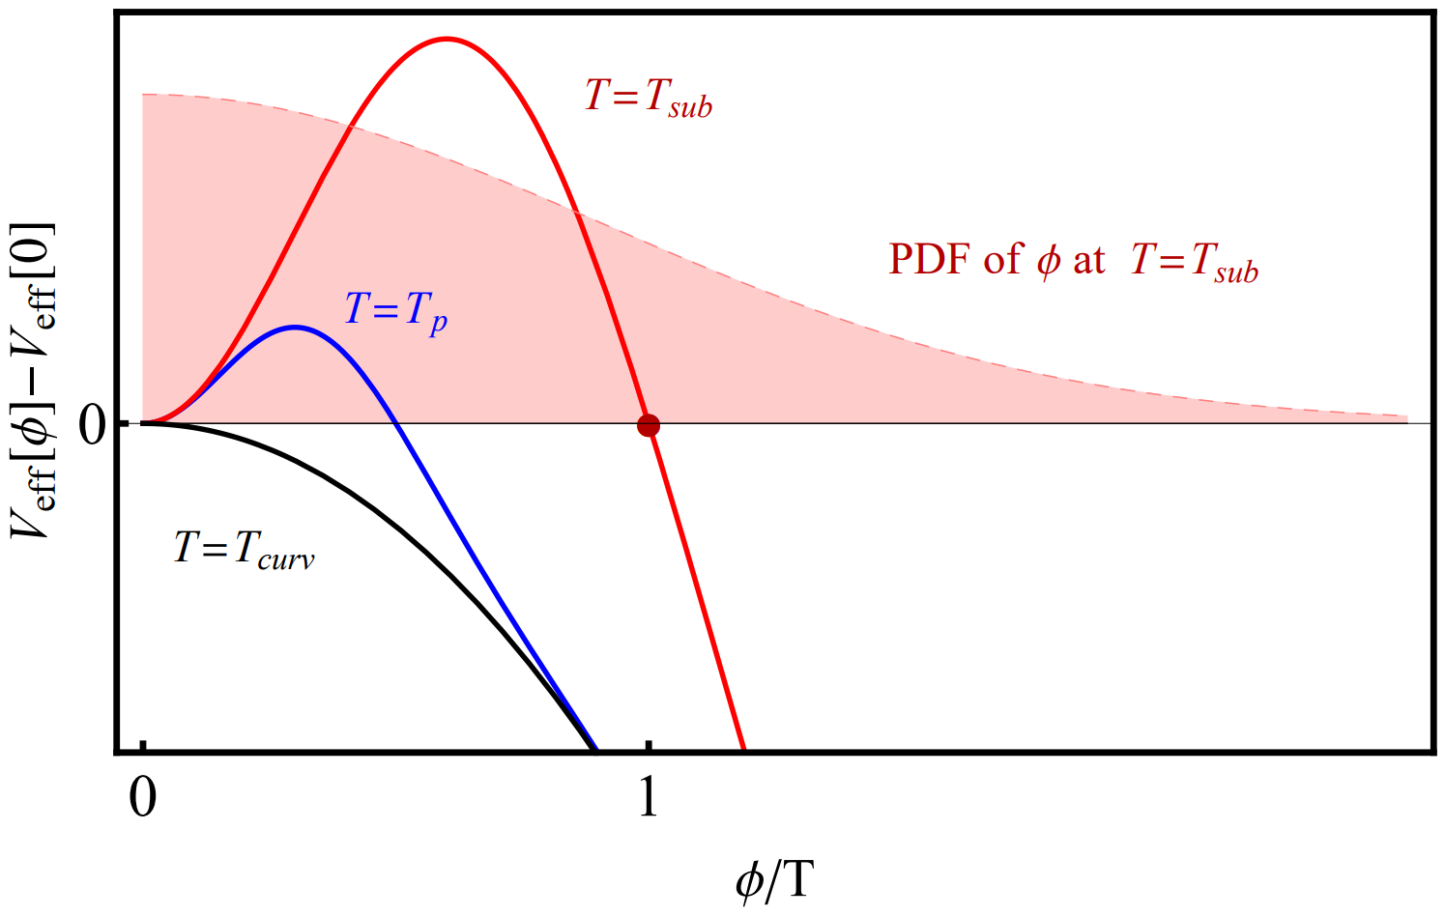


What happens around spinodal temperature?
Around $T_{2}$, the potential barrier disappears rapidly.
At the (would-be) percolation temperature $T_{p}$, the barrier width is already smaller than $T$ while we have the thermal fluctuation of $|φ|∼T$.
Therefore, in [Hiramatsu, Miyamoto, Yokoyama, 1412.7814], the authors concluded “the end of thermal inflation proceed through phase mixing and is therefore not accompanied by the formations of bubbles nor appreciable amplitude of gravitational waves.”
(would-be) percolation temperature
$$T_{2}$$
Schematic figure from
Hiramatsu, Miyamoto, Yokoyama,
1412.7814

Slide 12
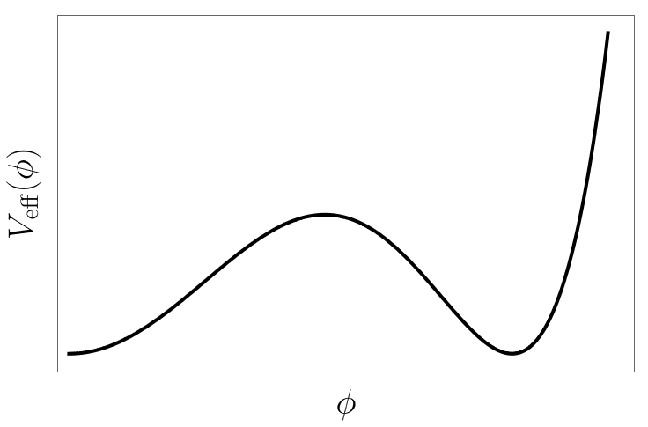
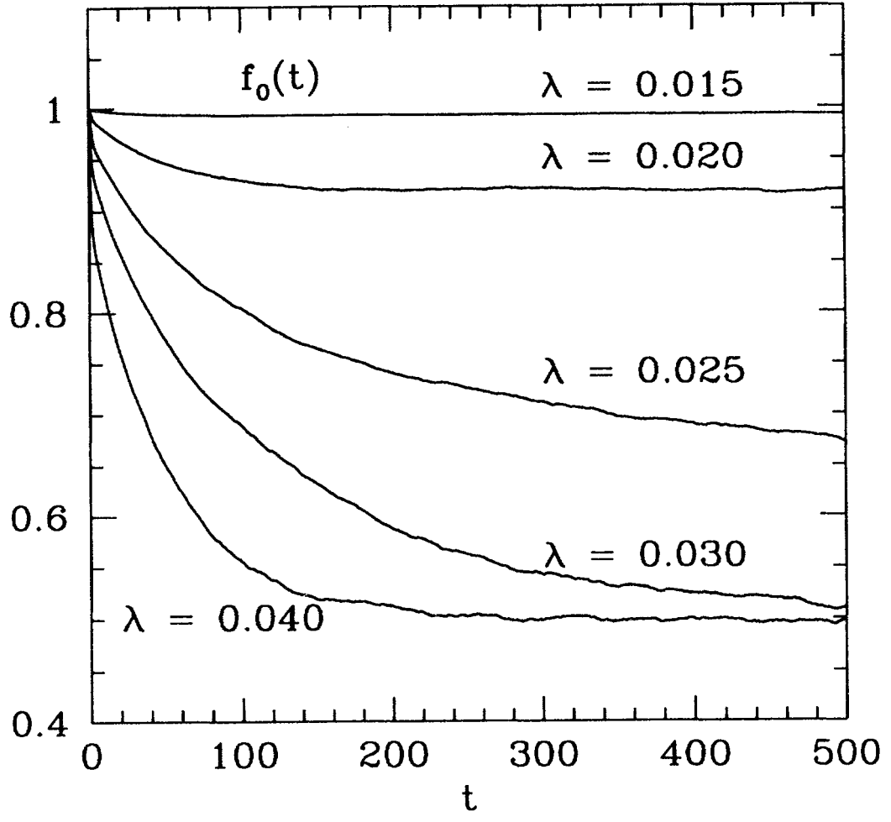


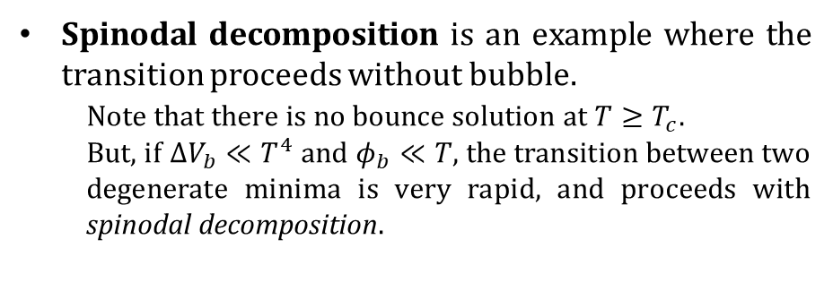

Transition without bubble
Spinodal decomposition is an example where the transition proceeds without bubble.
Note that there is no bounce solution at $T≥T_{c}$.
But, if $ΔV_{b}≪T^{4}$ and $φ_{b}≪T$, the transition between two degenerate minima is very rapid, and proceeds with spinodal decomposition.
Thermal fluctuation
$$T=T_{c}$$
$${ΔV}_{b}$$
$$φ_{b}$$
Ex) EW spinodal decomposition
0.5
Borrill, Gleiser, hep-ph/9410235
(before Higgs discovery)

Slide 13
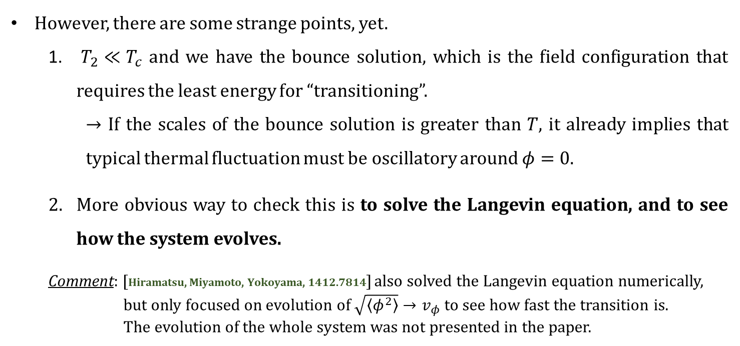
What happens around spinodal temperature?
However, there are some strange points, yet.
  $T_{2}≪T_{c}$ and we have the bounce solution, which is the field configuration that requires the least energy for “transitioning”.
  $→$ If the scales of the bounce solution is greater than $T$, it already implies that typical thermal fluctuation must be oscillatory around $φ=0$.
  More obvious way to check this is to solve the Langevin equation, and to see how the system evolves.
Comment: [Hiramatsu, Miyamoto, Yokoyama, 1412.7814] also solved the Langevin equation numerically,
but only focused on evolution of $\sqrt{\left\langle φ^{2}\right\rangle }→v_{φ}$ to see how fast the transition is.
The evolution of the whole system was not presented in the paper.

Slide 14
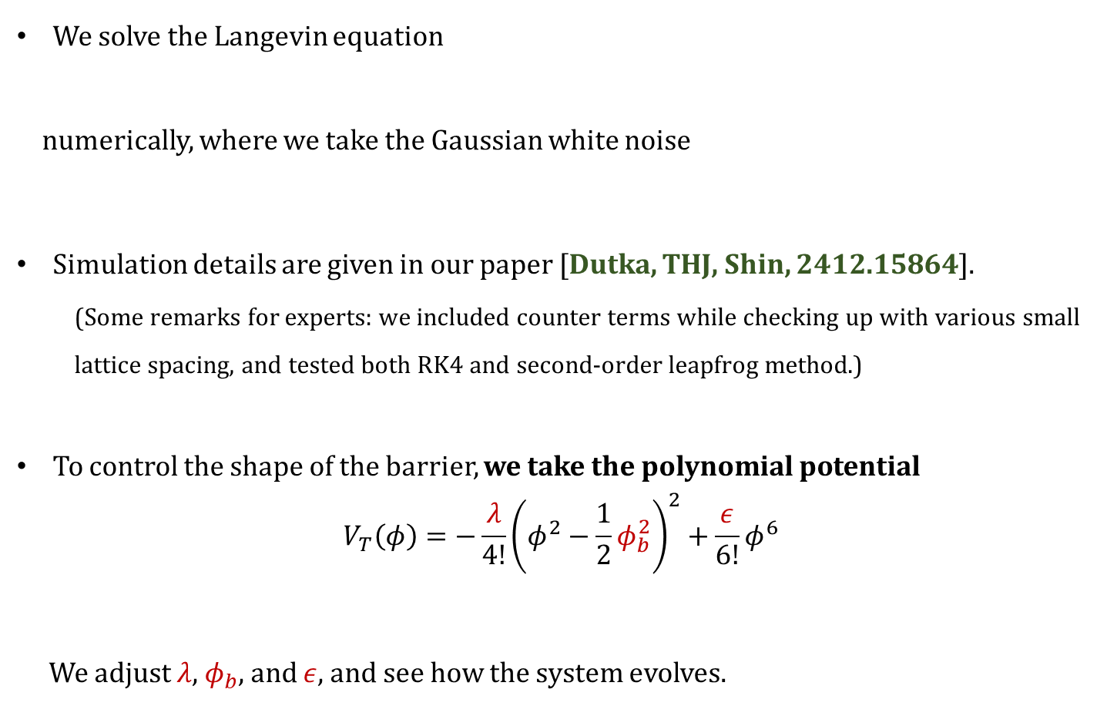

What happens around spinodal temperature?
We solve the Langevin equation
numerically, where we take the Gaussian white noise
Simulation details are given in our paper [Dutka, THJ, Shin, 2412.15864].
(Some remarks for experts: we included counter terms while checking up with various small lattice spacing, and tested both RK4 and second-order leapfrog method.)
To control the shape of the barrier, we take the polynomial potential
$$V_{T}\left(φ\right)=−\frac{λ}{4!}{\left(φ^{2}−\frac{1}{2}φ_{b}^{2}\right)}^{2}+\frac{ε}{6!}φ^{6}$$
We adjust $λ$, $φ_{b}$, and $ε$, and see how the system evolves.
Flipped Mexican hat
Stabilize the potential at a large $φ_{vev}$

Slide 15
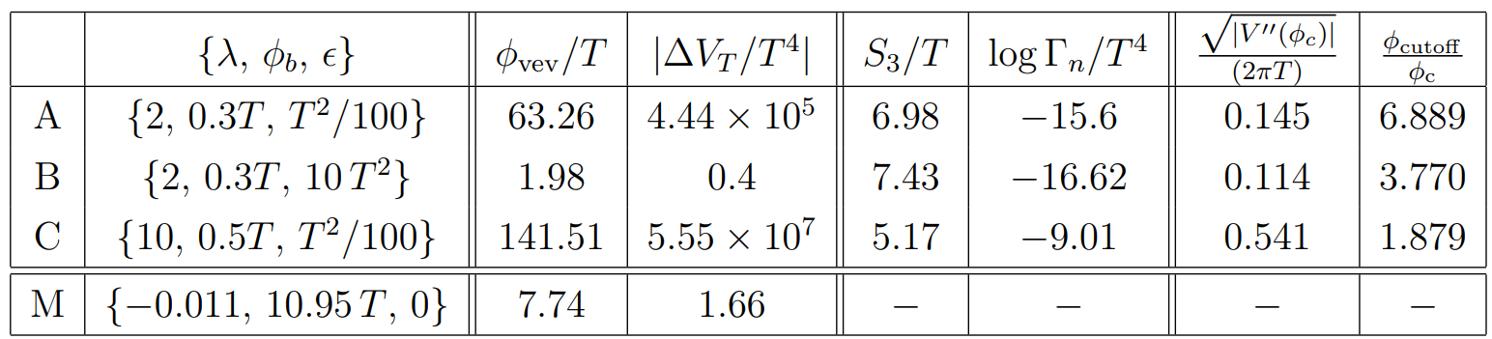
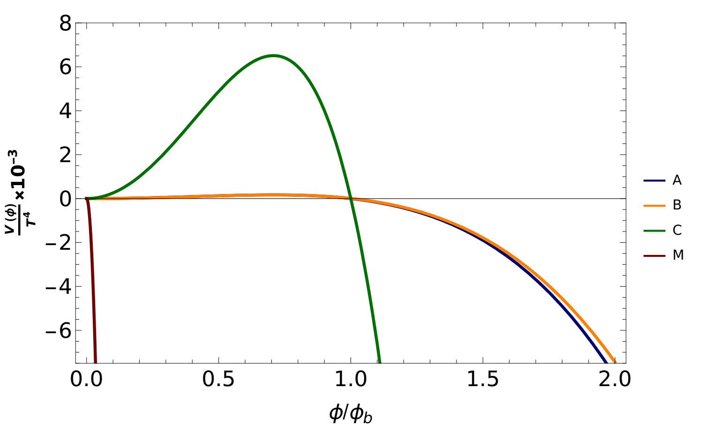




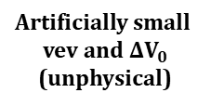

Benchmark parameters
Steepness around the barrier
Nucleation rate
from BubbleDet
barrier width
determines vev and $ΔV_{0}$
Representative
Artificially small
vev and $ΔV_{0}$
(unphysical)
(enough to conclude)
(spinodal decomposition)
(large bubble nucleation rate)
Larger $Γ_{n}$
(phase mixing)
Mexican hat
without barrier
$$×{10}^{−3}$$
$$V_{eff}(φ)/T^{4}$$
$$φ/φ_{b}$$
[Our numerical results are uploaded in Tomasz Dutka’s YouTube channel – link provided in our abstract]

Slide 16
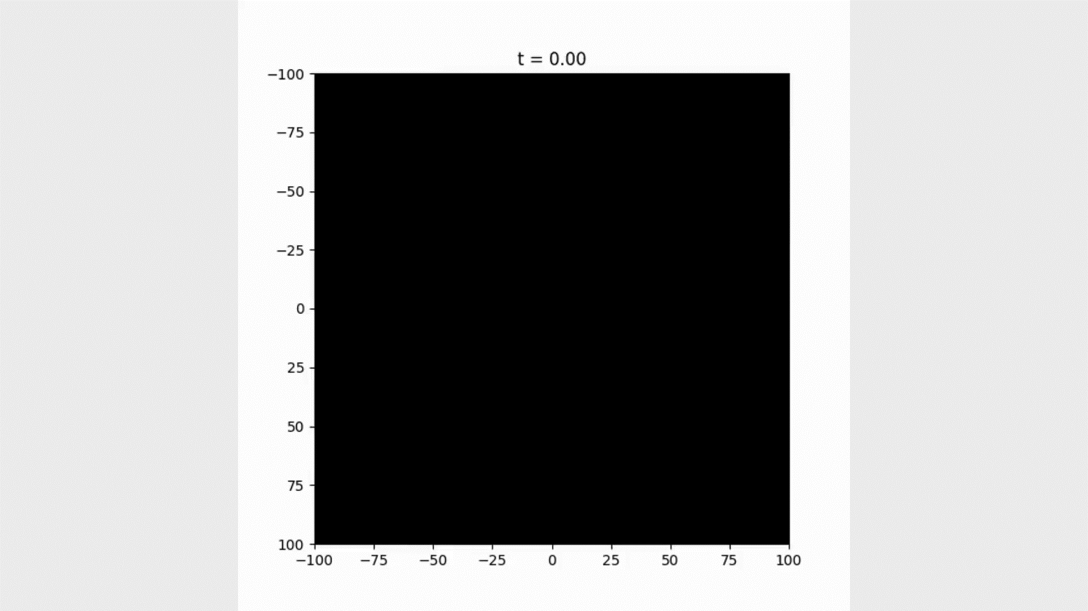
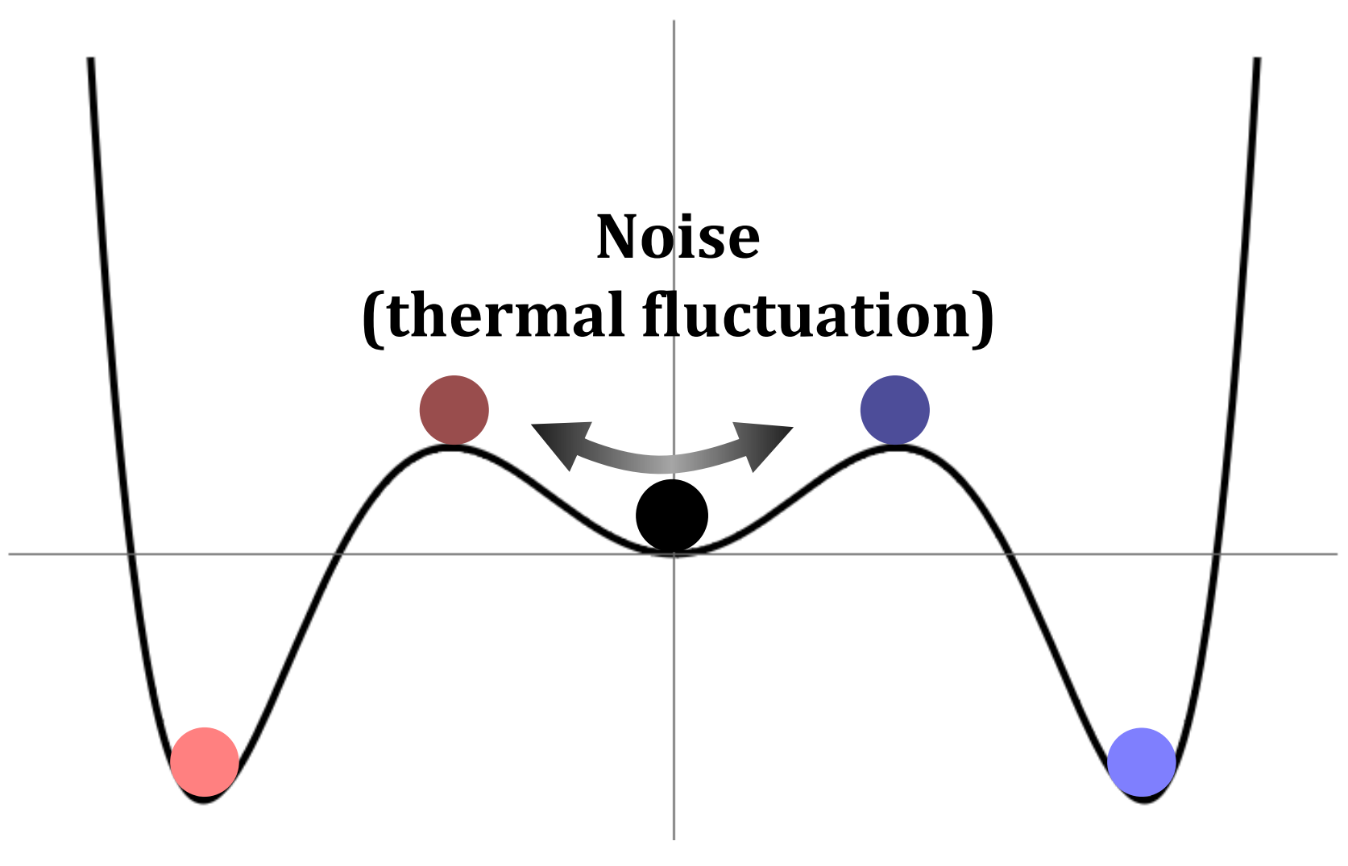
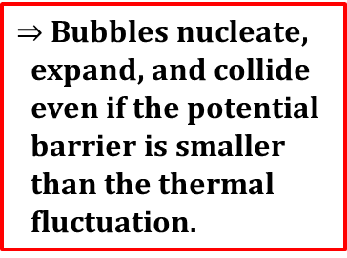
Results: Benchmark A
[Dutka, THJ, Shin, 2412.15864]
$⇒$ Bubbles nucleate,
expand, and collide
even if the potential
barrier is smaller
than the thermal
fluctuation.
Color scheme
Thermal fluctuation does not feel a large tachyonic instability.

Slide 17
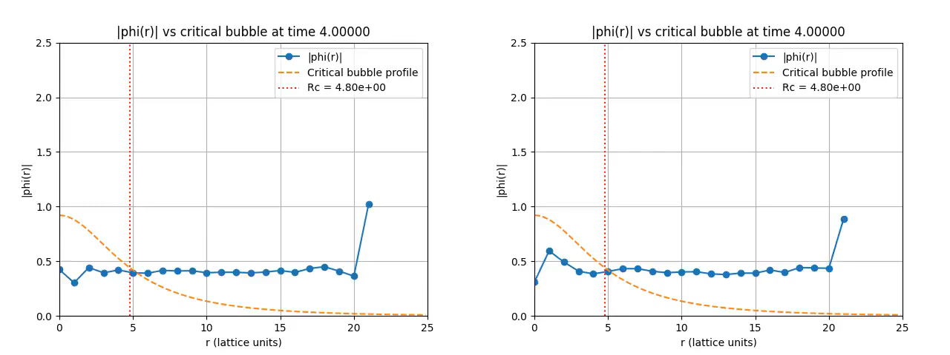


Results: Benchmark A
[Our numerical results are uploaded in Tomasz Dutka’s YouTube channel – link provided in our abstract]
It is fun to see that bubble nucleates via thermal fluctuation as expected!
[Tomasz Dutka’s simulation]
$${\left\langle \left|φ\left(r\right)\right|\right\rangle }_{r−surface}$$
$${\left\langle \left|φ\left(r\right)\right|\right\rangle }_{r−surface}$$
One of the bubble centers
Middle of nowhere
$y$-axis: ${\left\langle \left|φ\left(r\right)\right|\right\rangle }_{r−surface}=\frac{1}{4π}∫dΩ \left|φ\left(r\right)\right|$

Slide 18
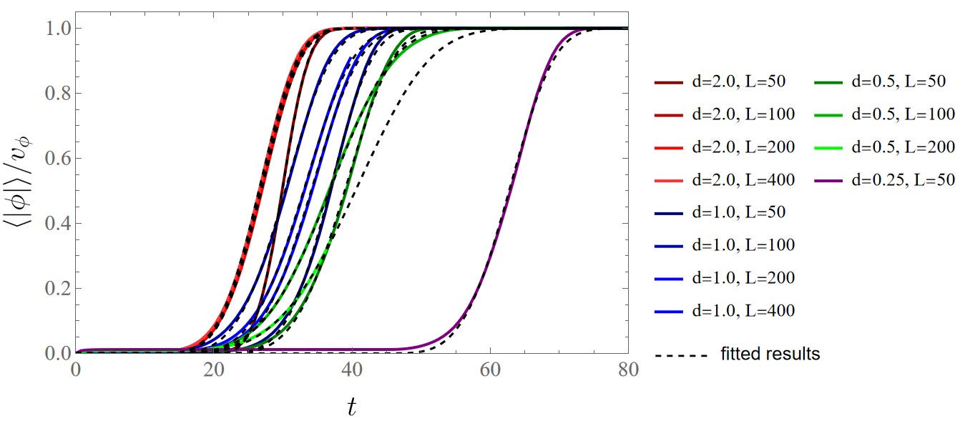
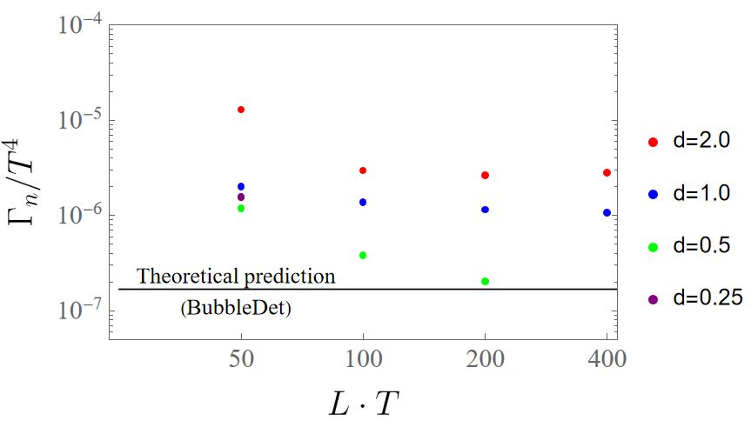
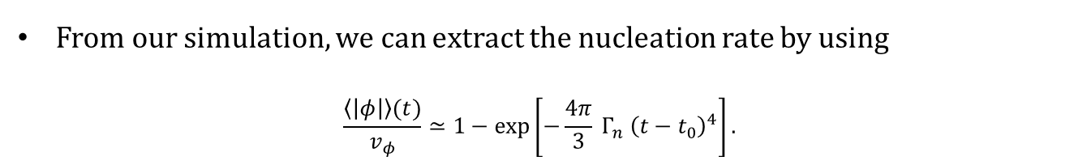

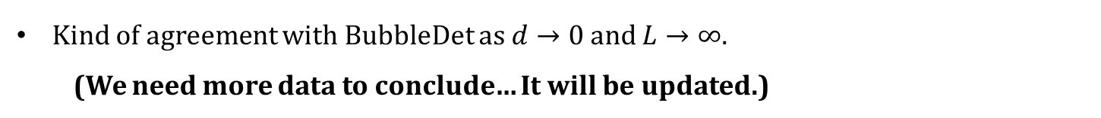
Results: Benchmark A
From our simulation, we can extract the nucleation rate by using
$$\frac{\left\langle \left|φ\right|\right\rangle (t)}{v_{φ}}≃1−\exp\left[−\frac{4π}{3} Γ_{n} {\left(t−t_{0}\right)}^{4}\right].$$
(for the constant $T$ and a large lattice box)
preliminary
preliminary
?
Kind of agreement with BubbleDet as $d→0$ and $L→∞$.
(We need more data to conclude… It will be updated.)

Slide 19
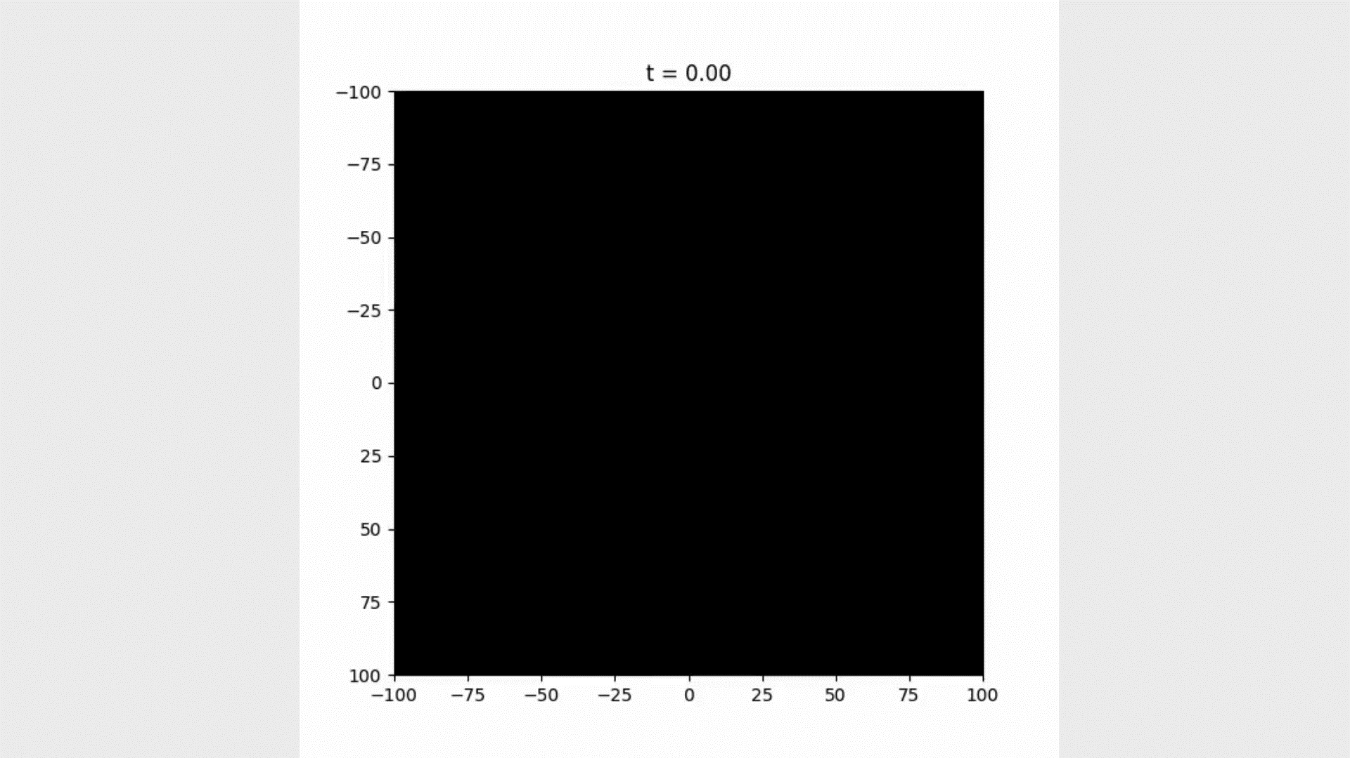

Results: Benchmark B
[Dutka, THJ, Shin, 2412.15864]
Bubbles are nucleated, but deformed by thermal noise
due to too small driving force.
After bubbles’ filling the space,
it becomes the spinodal decomposition.
!! Caution !!
1. This parameter set is unphysical.
(large $ε$)
2. Our simulation is not proper
for the bubble expansion study
Don’t be too serious about this result.
Color scheme

Slide 20
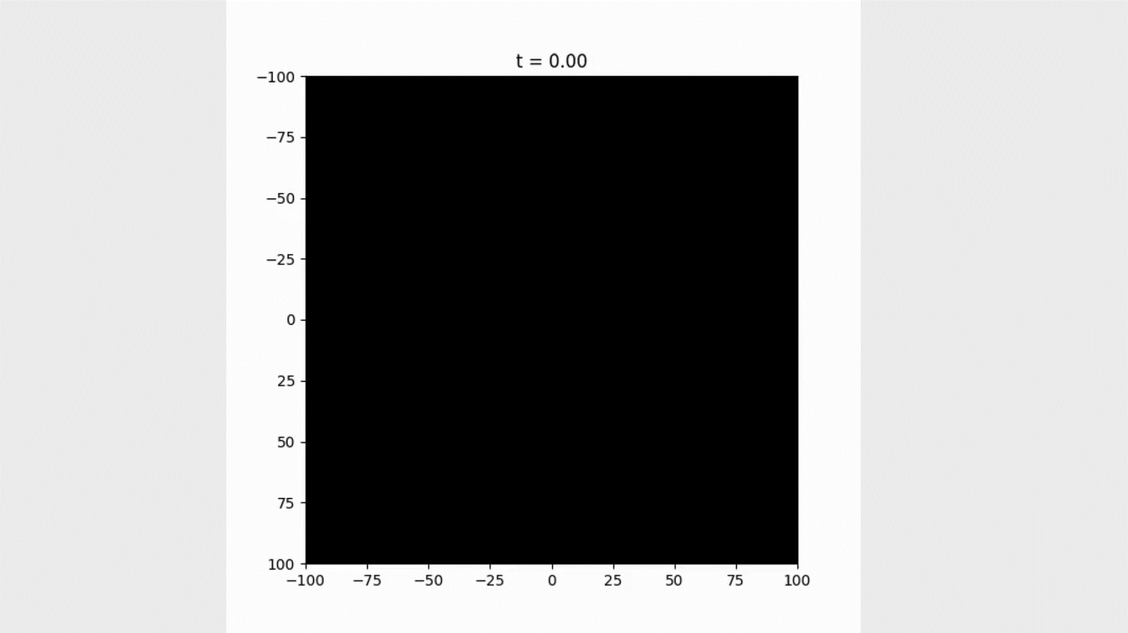
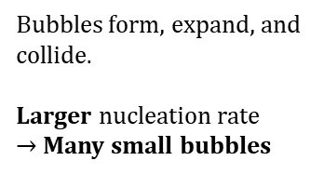
Results: Benchmark C
[Dutka, THJ, Shin, 2412.15864]
Bubbles form, expand, and collide.
Larger nucleation rate
$→$ Many small bubbles
Color scheme

Slide 21
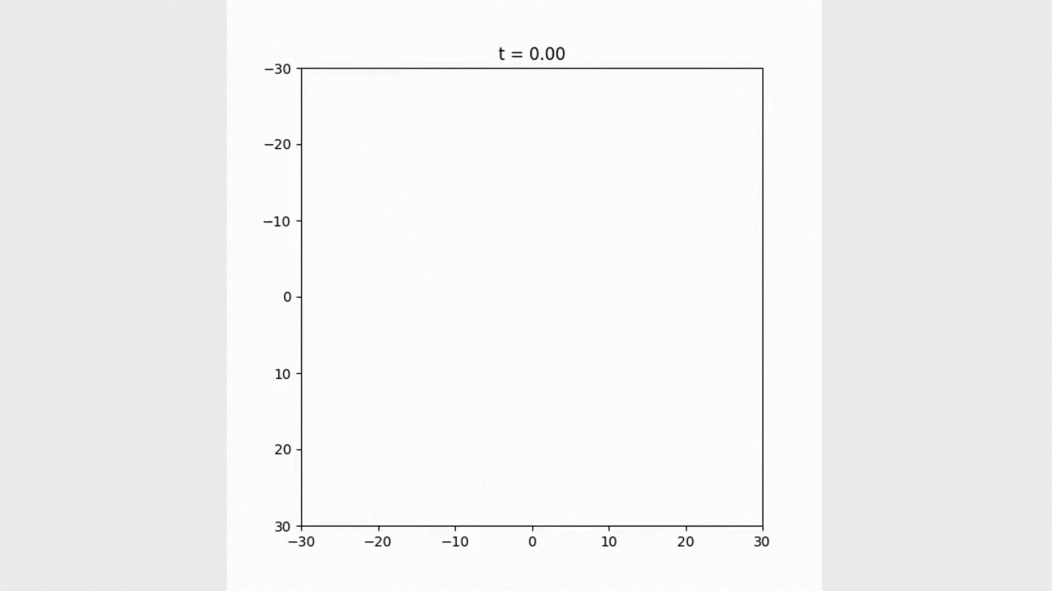
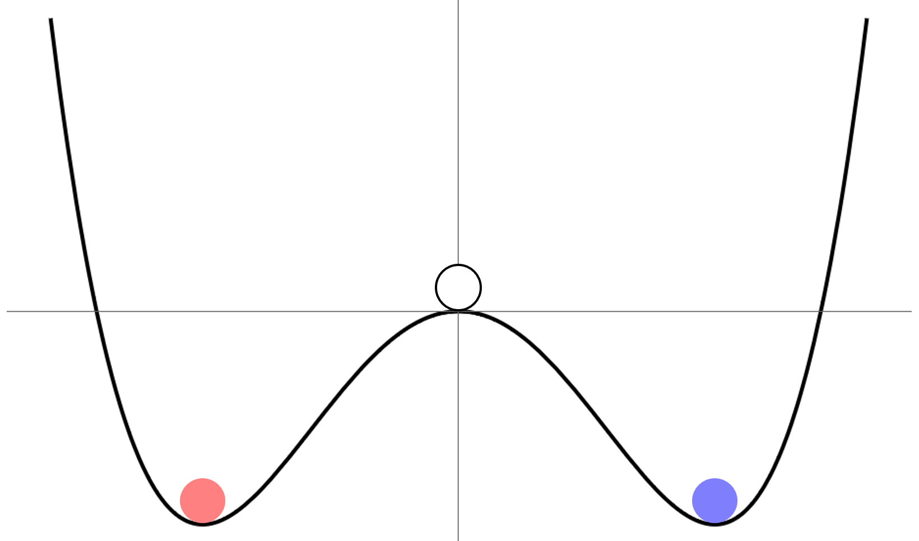
Results: Benchmark M
[Dutka, THJ, Shin, 2412.15864]
It shows how it looks like
for the phase mixing scenario
driven by tachyonic instability
Color scheme
(Sorry! We changed the color scheme for this benchmark)

Slide 22
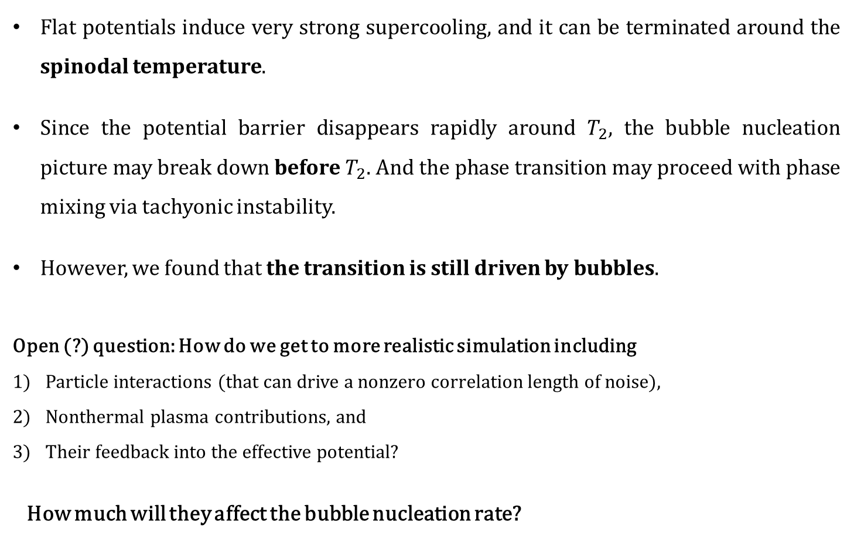
Summary and conclusion
Flat potentials induce very strong supercooling, and it can be terminated around the spinodal temperature.
Since the potential barrier disappears rapidly around $T_{2}$, the bubble nucleation picture may break down before $T_{2}$. And the phase transition may proceed with phase mixing via tachyonic instability.
However, we found that the transition is still driven by bubbles.
Open (?) question: How do we get to more realistic simulation including
Particle interactions (that can drive a nonzero correlation length of noise),
Nonthermal plasma contributions, and
Their feedback into the effective potential?
How much will they affect the bubble nucleation rate?
[Hiramatsu, Miyamoto, Yokoyama, 1412.7814]
Thank you!

