Slide 1





RCS Longitudinal Beam Dynamics Update
E. Lamb, S. Albright, L. Thiele, H. Demerau, A. Grudiev,
D. Amorin, U. Von Rienen, R. Calaga
HEMAC 18th February
Funded by the European Union (EU). Views and opinions expressed are however those of the author(s) only and do not necessarily reflect those of the EU or European Research Executive Agency (REA). Neither the EU nor the REA can be held responsible for them.
‹#›

Slide 2

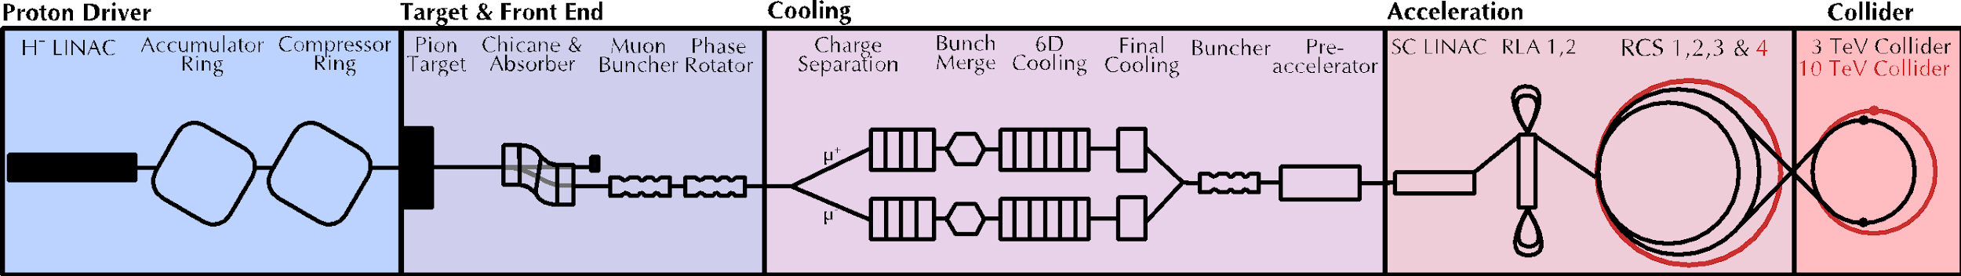
Introduction
Taking over from F. Batsch since November 2024
Longitudinal beam dynamics for the RCS chain
Short, intense proton bunch
Protons produce pions which decay into muons which are captured
Ionisation cooling of muon in matter
Acceleration to collision energy
Collision
2
2

Slide 3
Introduction
Open points and challenges:
Longitudinal matching from previous accelerator and between RCS?
How to define a reasonable synchronous phase?
Transient beam loading and counter-rotating bunches and multi-turn effects?
This presentation:
Benchmarking of previous results
Longitudinal matching between RCS by modifying φ_{s}
‹#›
‹#›

Slide 4
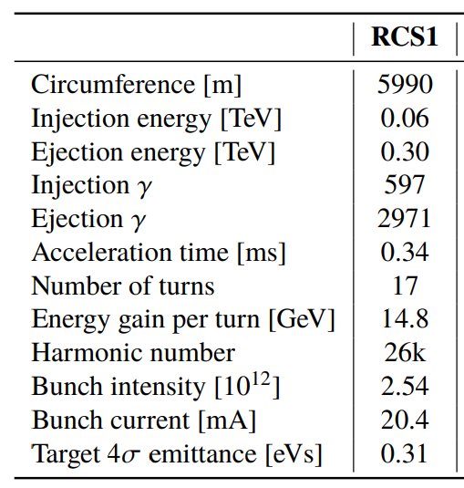
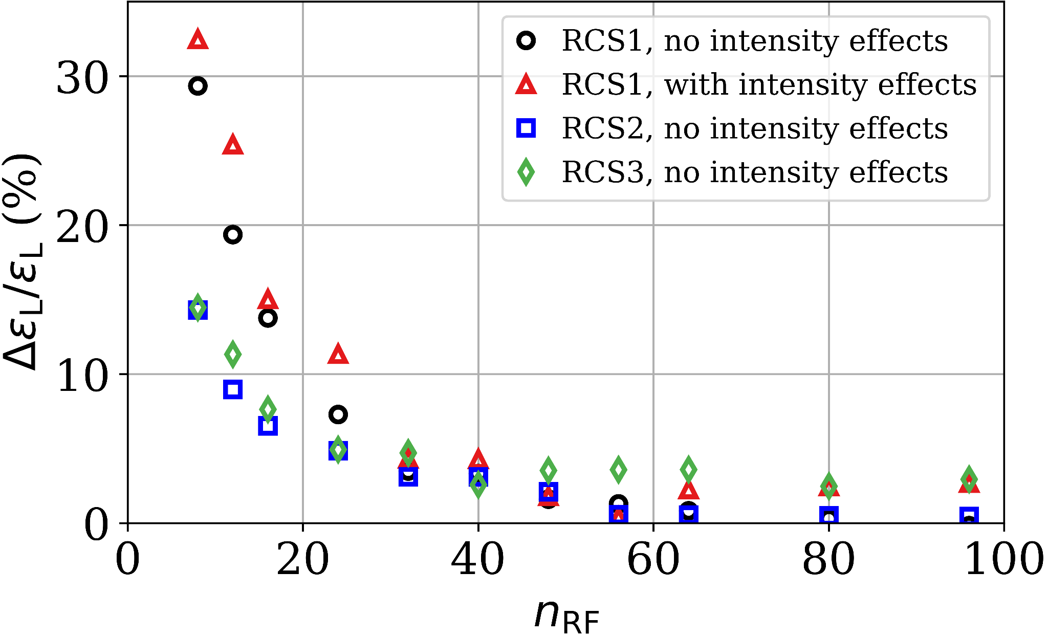
Benchmarking
Longitudinal beam dynamics simulated with BLonD [1], important to benchmark previous results
Inherited scripts and code
    New BlonD version
    Merge of muon features into BLonD
    Sanity check
The limit of stability, for stable synchrotron oscillations is Q_{s} <1/π ~ 0.32 [2]
RCS1: Q_{s} 1.44
By increasing n_{RF}, ΔQ_{s} between RF station is smaller
[3]
‹#›
‹#›
Notes:
Improve plots here

Slide 5
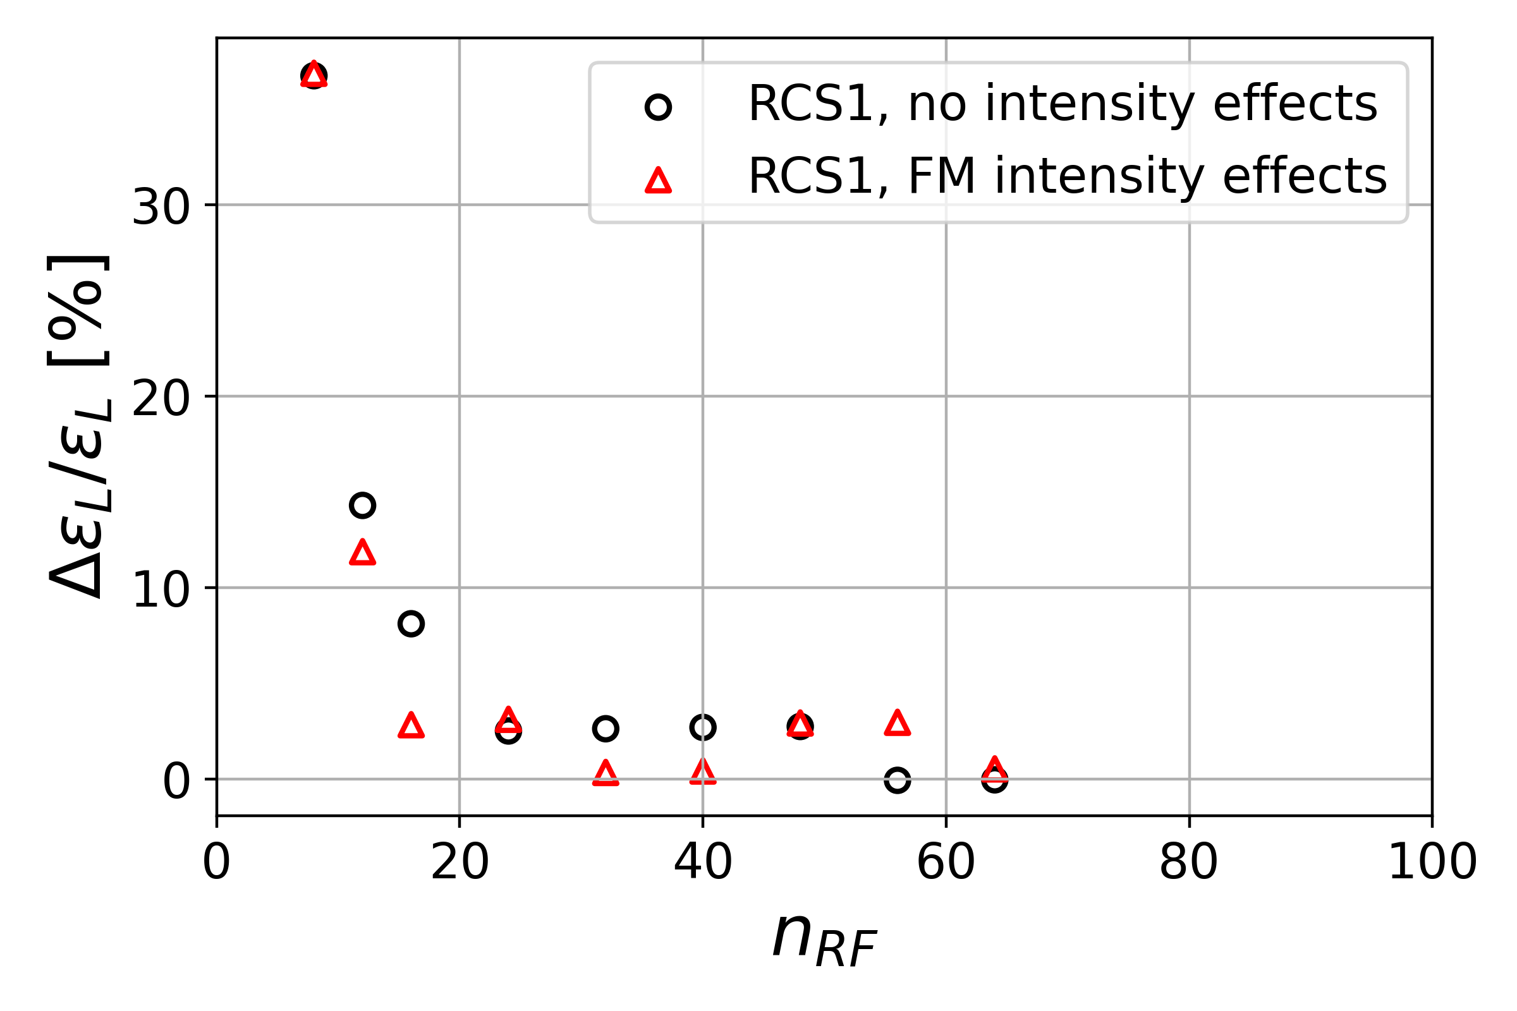
Benchmarking
The limit of stability, Q_{s} <1/π (0.32)
RCS1: Q_{s} 1.44
By increasing n_{RF}, ΔQ_{s} between station is smaller
Using BLonD, reproduction of overall trend from [3] in n_{RF} vs longitudinal emittance growth, with fundamental mode only
Possible difference due to definition of emittance, ε_{L} used
Confident to study beam dynamics with this framework
‹#›
‹#›
Notes:
Improve plots here

Slide 6
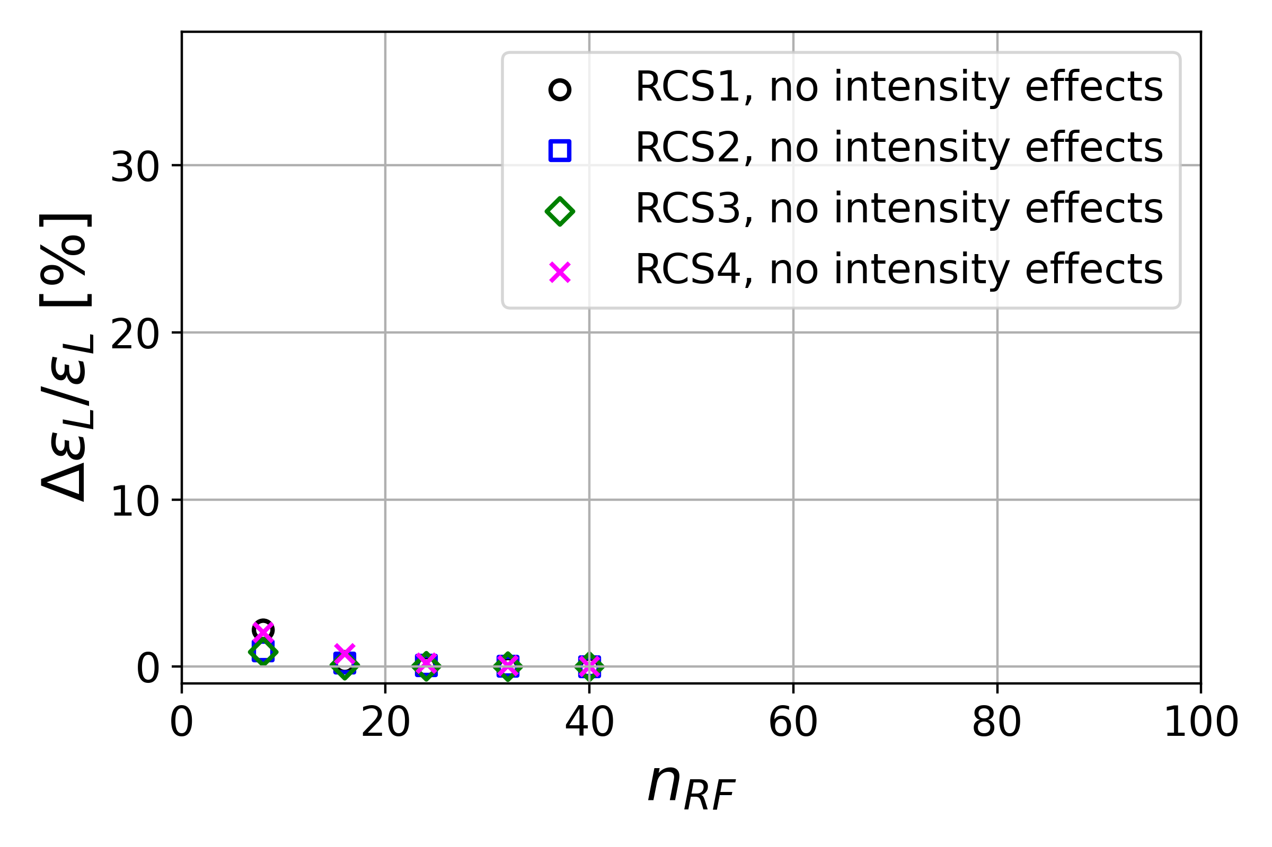
New optics
With most recent RCS optics, the momentum compaction factor 𝛼_{c}, is smaller
Q_{s} ∝ √|η₀|
RCS1: 2.4e-3 → 4.7e-4
RCS1: Q_{s} 1.44 → 0.63
Now ~ half n_{RF} is adequate
‹#›
‹#›
Notes:
Improve plotshere

Slide 7
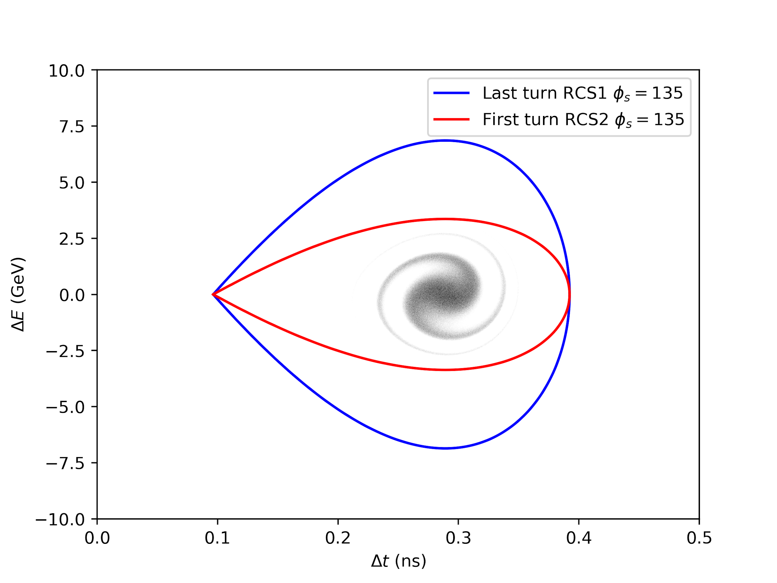
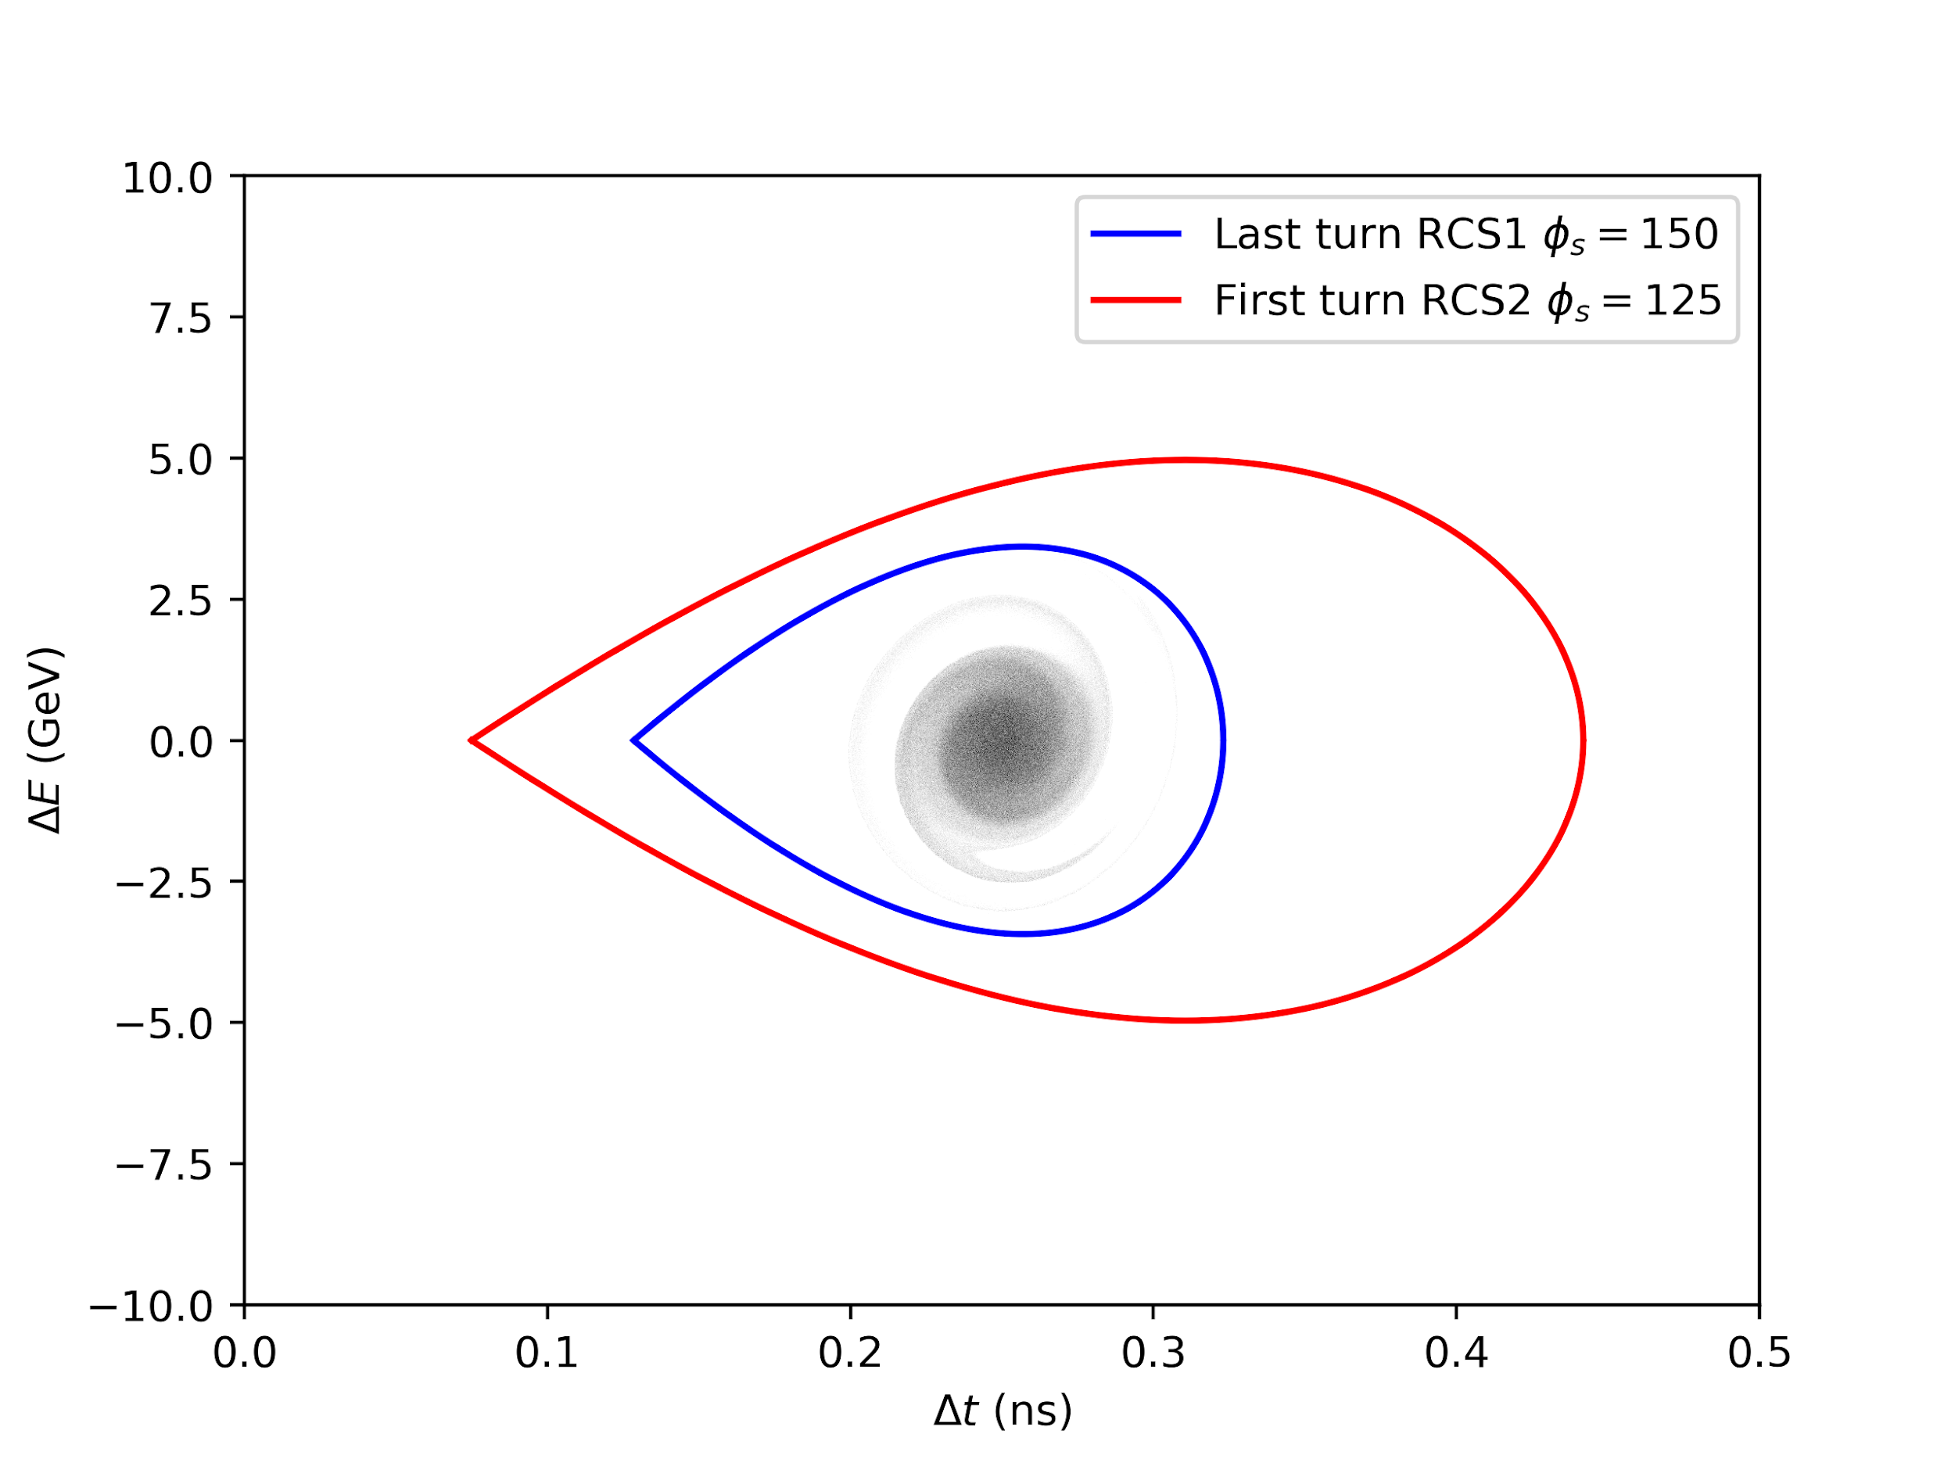
Longitudinal matching
Study so far has assumed matched distributions on injection for each RCS
Reality, transfer through machines is difficult
Given the same RF frequency 1.3GHz, and a linear ramp with no flat bottom / flat top - the separatrices are mismatched
Previously, φ_{s} =135 for all RCS was assumed
φ_{s} can be used to alter the bucket shape to improve matching
‹#›
‹#›
Notes:
Improve legend sizes , add separatrices examples

Slide 8
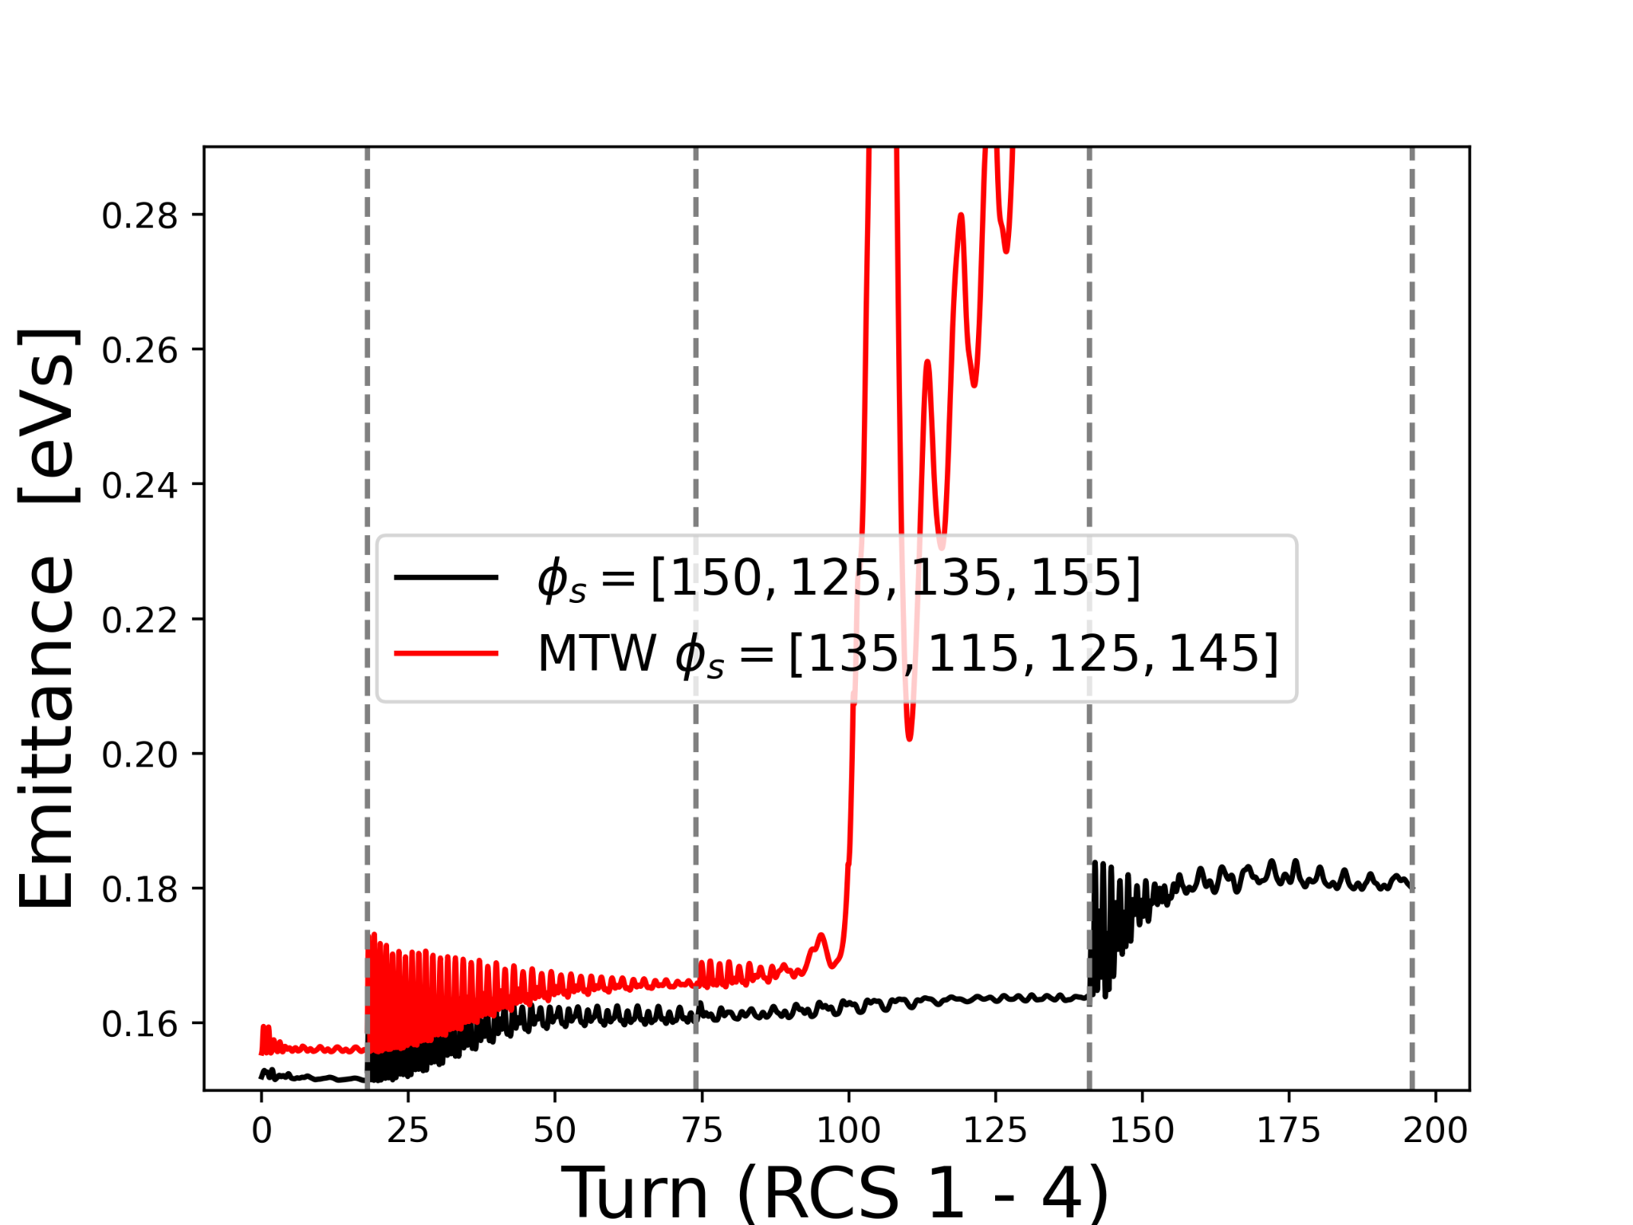
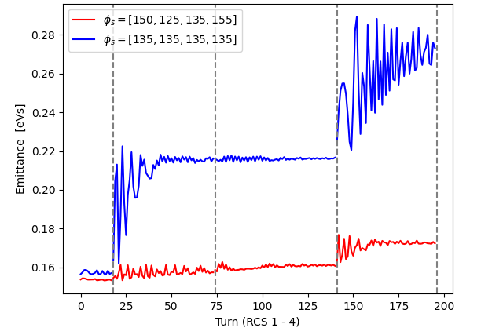
Longitudinal matching
Study so far has assumed matched distributions on injection for each RCS
Reality, transfer through machines is difficult
Given the same RF frequency, and a linear ramp with no flat bottom/ flat top - the separatrices are mismatched
With no intensity effects, an optimal phase scheme can be easily found
‹#›
‹#›
Notes:
Improve legend sizes , add separatrices examples

Slide 9
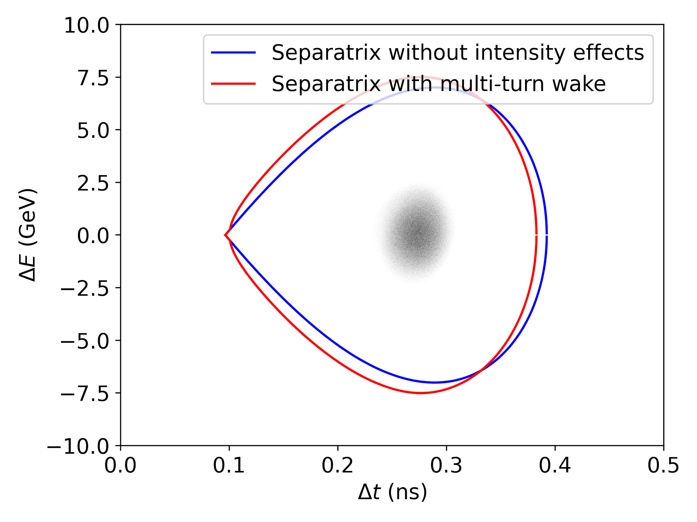
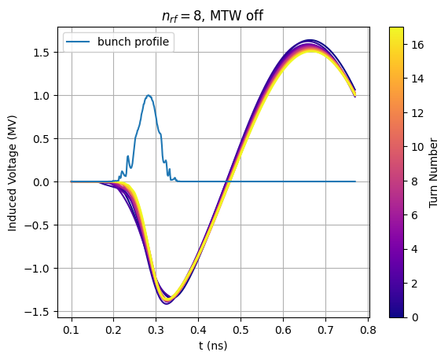
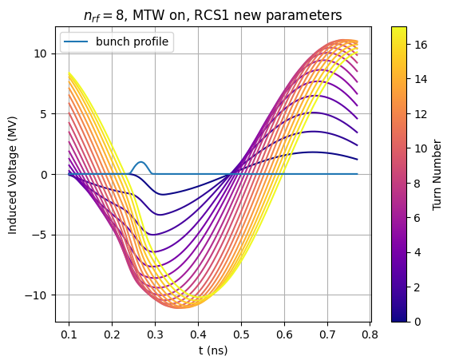
Longitudinal matching
The separatrix is altered through intensity effects
Considering the FM (fundamental cavity mode) beam interaction, the induced voltage differs depending on single-turn or multi-turn-wake
φ_{s} can still be used to improve matching, but depends on the intensity effects present
+
+
‹#›
Notes:
Improve legend sizes , add separatrices examples

Slide 10
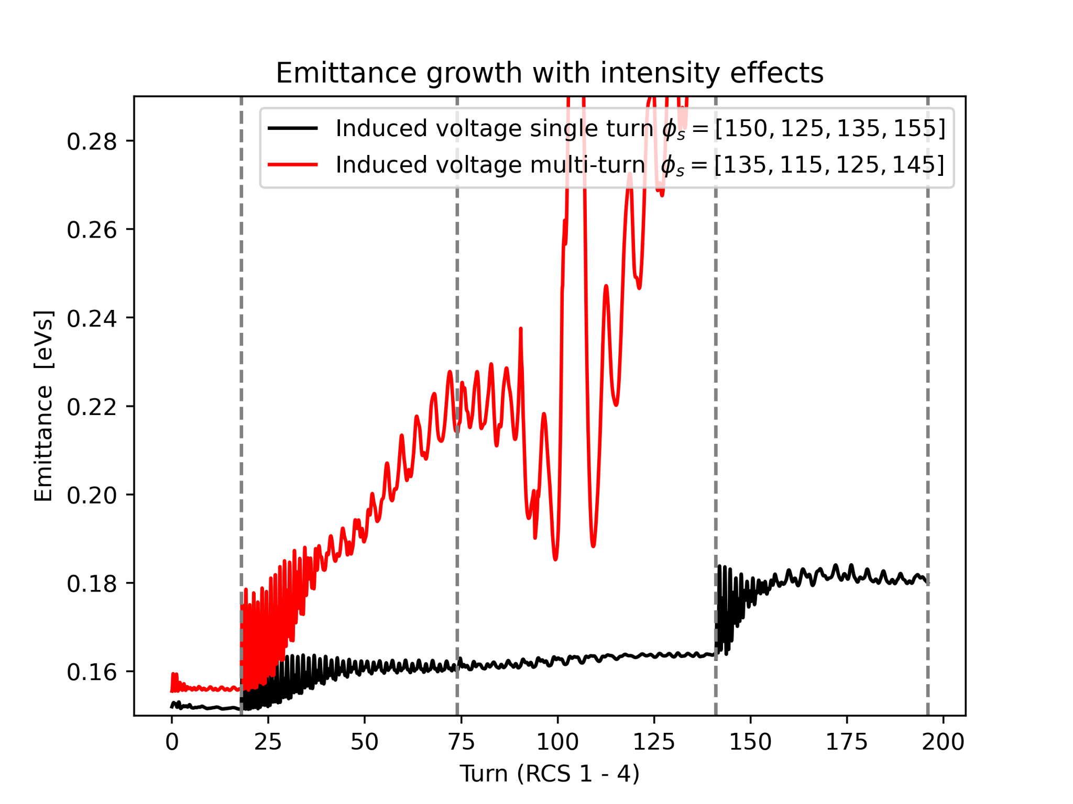
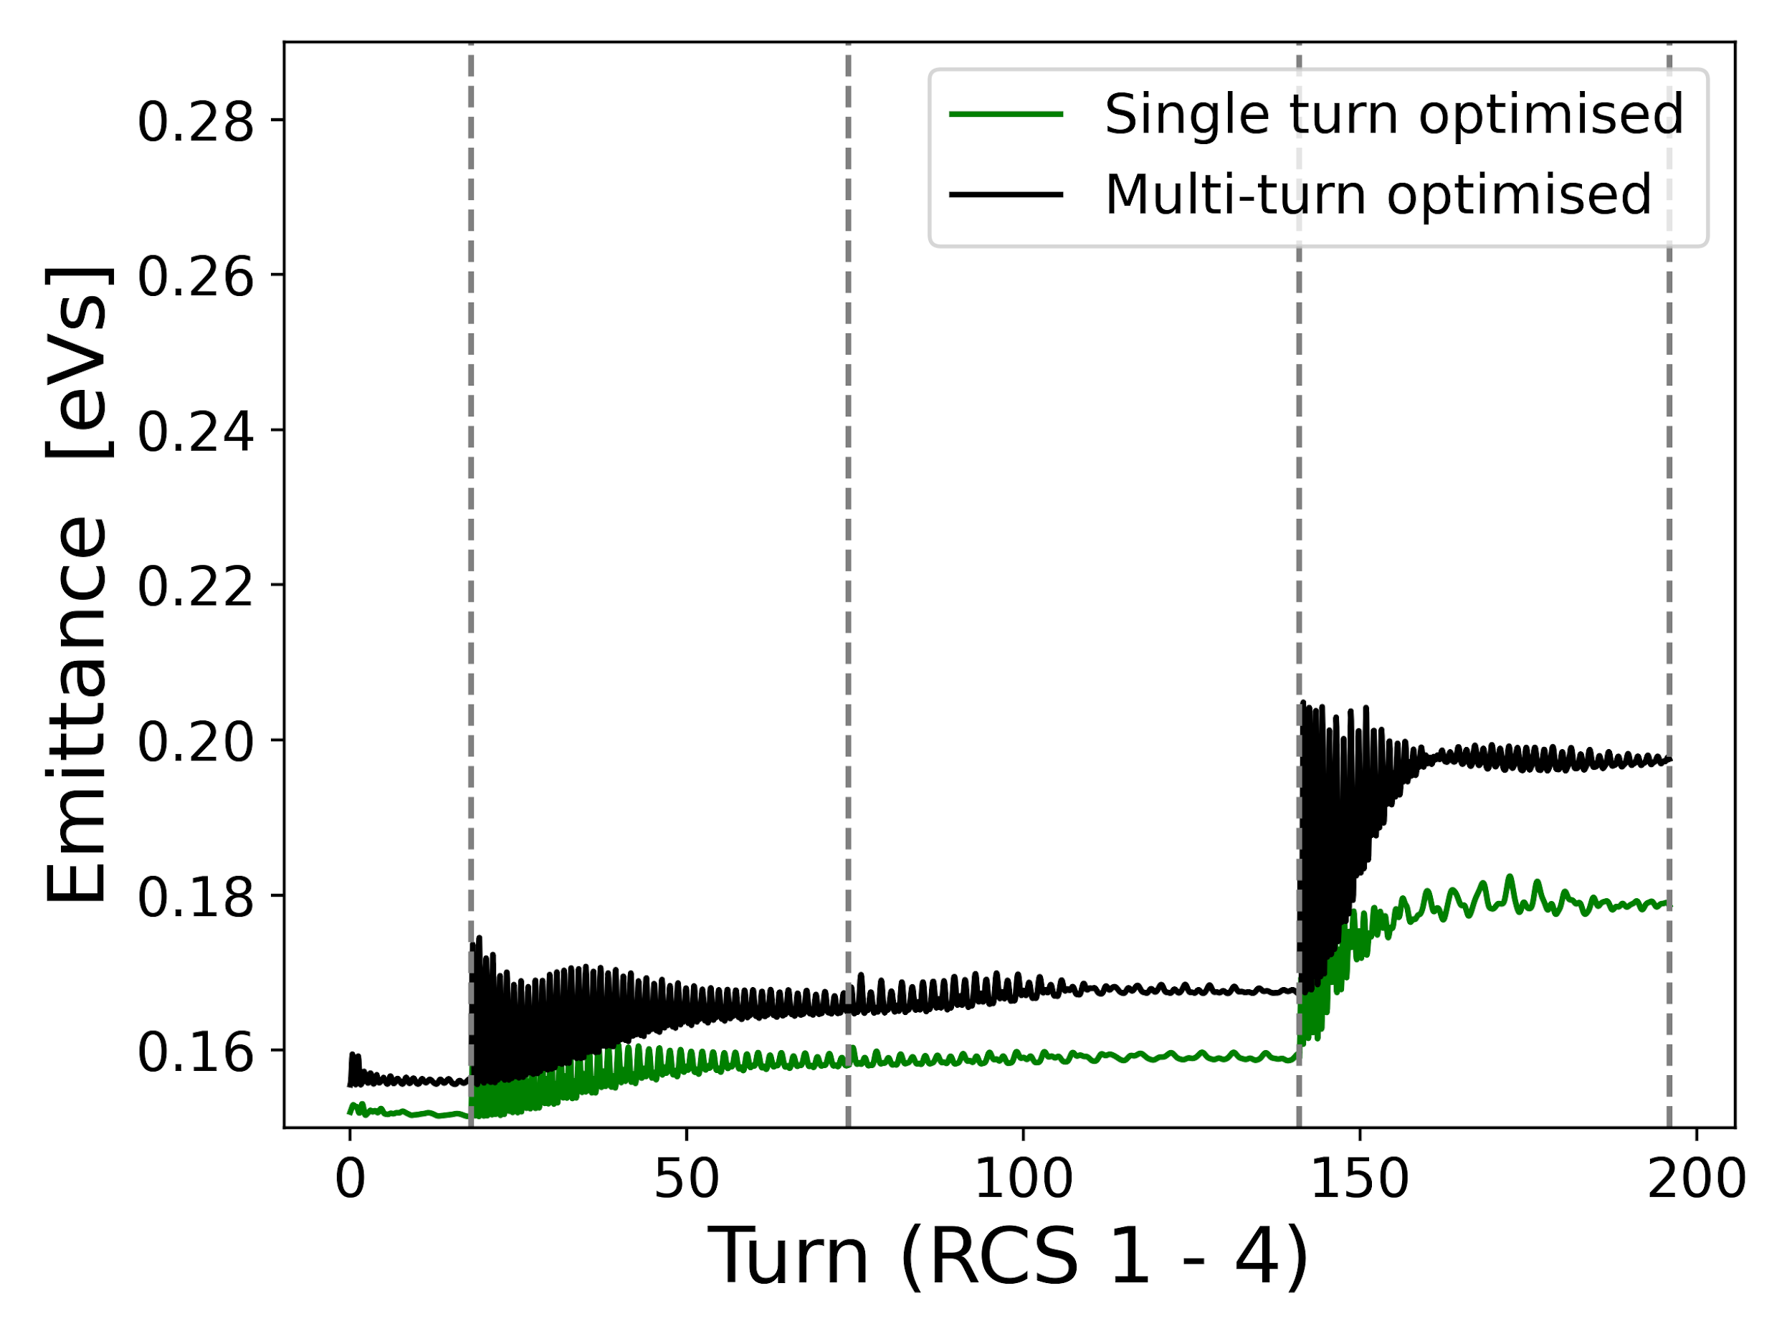
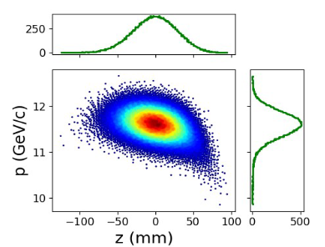
Longitudinal matching
The separatrix is altered through intensity effects
Additionally to a phase scheme, an offset of the minimum potential of the bunch has to be found iteratively for dipole oscillations
With intensity effects, either multi-turn or single turn, the optimal matching differs
Next to consider injection from RLA2
Distribution from RLA2 [4]
Further studies needed
‹#›
‹#›
Notes:
Try and show the filling factor and separatrices here

Slide 11
Conclusions
Simulations show good agreement with those of F. Batsch in BlonD
Longitudinal matching can easily be addressed for no intensity effects with a φ_{s} scheme
Further investigation of longitudinal matching with intensity effects, and for counter-rotating bunches
To investigate how the choice of synchronous phase effects the powering requirements and if it can be further optimised
Injection of distribution from RLA2 to be considered
‹#›

Slide 12
References
[1] CERN, “Beam longitudinal dynamics code (blond).” http://blond.web.cern.ch.
[2] T. Suzuki, “Equations of motion and Hamiltonian for synchrotron oscillations and synchro-betatron coupling”, KEK-
REPORT-96-10, 1996.
[3] F. Batsch, H. Damerau, I. Karpov, D. Amorim, C. Carli, A. Chance, A. Grudiev, E. Metral, and D. Schulte, “Longitudinal beam dynamics and rf requirements for a chain of muon RCS’s,” Proceedings of the International Particle Accelerator Conference (IPAC), 2023.
[4] A. Aaksoy, ‘Beam Dynamics for RLA2 for the Muon Collider’ https://indico.cern.ch/event/1456536/contributions/6131257/attachments/2955755/5197393/mucol_rla_28-10-24_aaksoy.pdf
‹#›

