Slide 1


Optics Update
HEMAC Meeting, 18/02/2025
L. Soubirou, A. Chance

Slide 2
Recap and overview
Last update : Milestone n°5 (11/2024). Unrealistic QP gradient and very big apertures (>100mm for RCS 1&2 of Greenfield)
Work on different cell types :
  Normal FODO
  Hybrid FODO
  Combined function magnets (for normal RCS only)
Focus on feasibility (QP gradients, magnet lengths) and optimization towards minimization of the magnet apertures
  Beam size dominated by dispersion => focus on minimizing D_{x} .
Study for Greenfield and CERN-siting

Slide 3
Types of cell
DIPOLES
DIPOLES
« Normal » FODO
QP NC Foc
QP NC Defoc
Interconnexion length
L_{cell}
QP SC
Foc
QP SC
Defoc
DIPOLES
DIPOLES
« Hybrid » FODO
QP NC Foc
QP NC Defoc
DIPOLES
k_{f}
DIPOLES
-k_{d}
Combined Functions
Insertion
Insertion
L_{sss}

Slide 4
Normal and Hybrid FODO cell
« Normal » FODO (normal conducting QP):
  Old approach: minimizing total length of QP.
    Unrealistic gradient + aperture too large
  New optimization approach: QP occupy the maximum total length possible and we see « the best we can do » at minimizing D_{x} -> highlight limitation of normal FODO cells.
  Constraints : B_{pole, QP NC} < 1T, L_{dip, SC} > 2m, aperture margin (diam) Δx=20mm
« Hybrid » FODO (normal and superconducting QP) :
  Same approach: NC QP + SC QP at maximum occupancy
  Constraints : B_{pole, QP NC} < 1T, G_{QP, SC} < 400 T/m, L_{dip, SC} > 2m, L_{quad, SC/NC} > 0.75m,
  aperture margin (diam) Δx=20mm

Slide 5
Combined Functions magnet cell
Configuration only studied for normal RCS.
Goal : minimizing D_{x}.
Parameter to be optimized :
  Bending field B_{bend, inj} and B_{bend, ext}
  Phase advances µ_{x} and µ_{y} (or equivalently quadrupolar strength k_{f} and k_{d} in dipoles)
Constraints :
  B_{pole} = B_{bend} + G*r < 1.8 T
  µ_{x}, µ_{y} < 120°
  Assumes the gradient follows the reference trajectory when computing the apertures

Slide 6
Normal RCS
Greenfield RCS1 and CERN RCS 1, 2

Slide 7
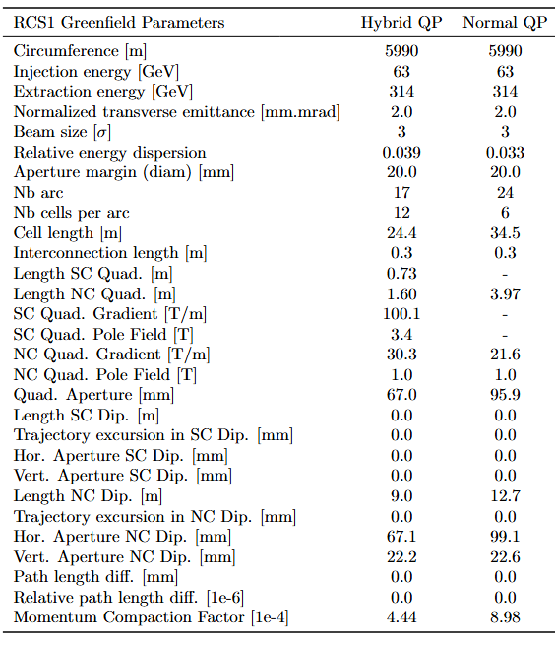
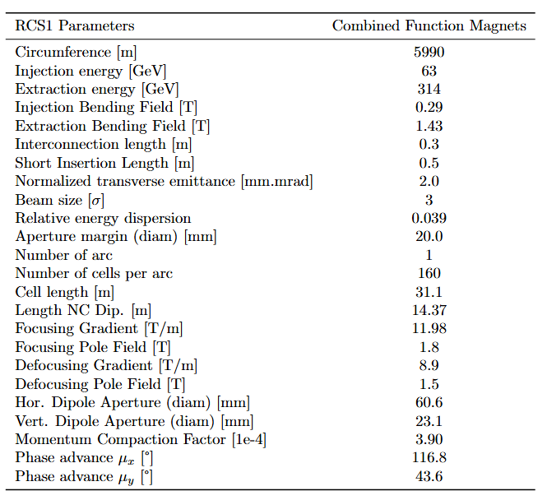
Greenfield RCS1
Limiting factor
FODO

Slide 8
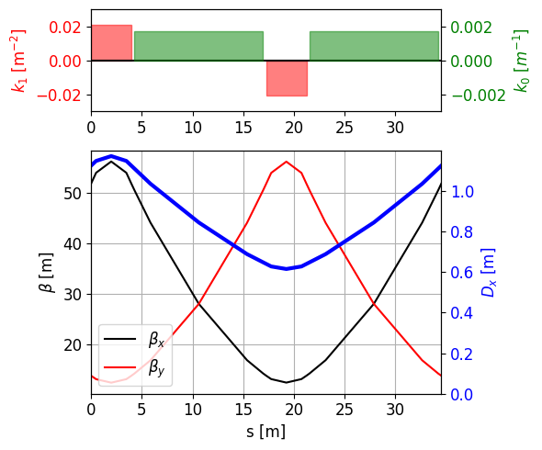
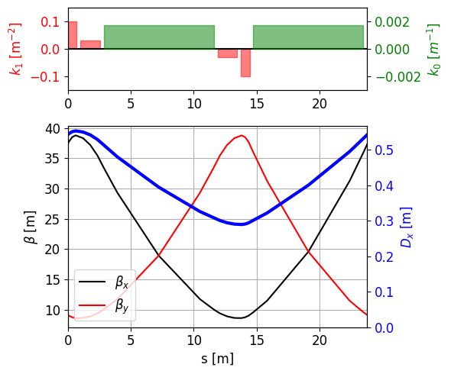
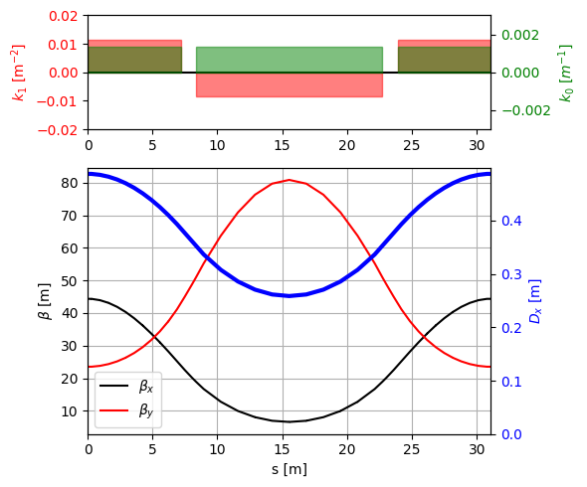
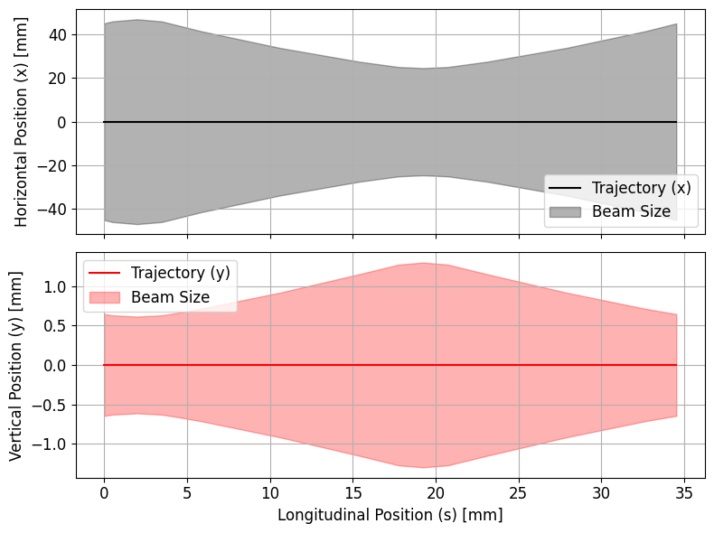
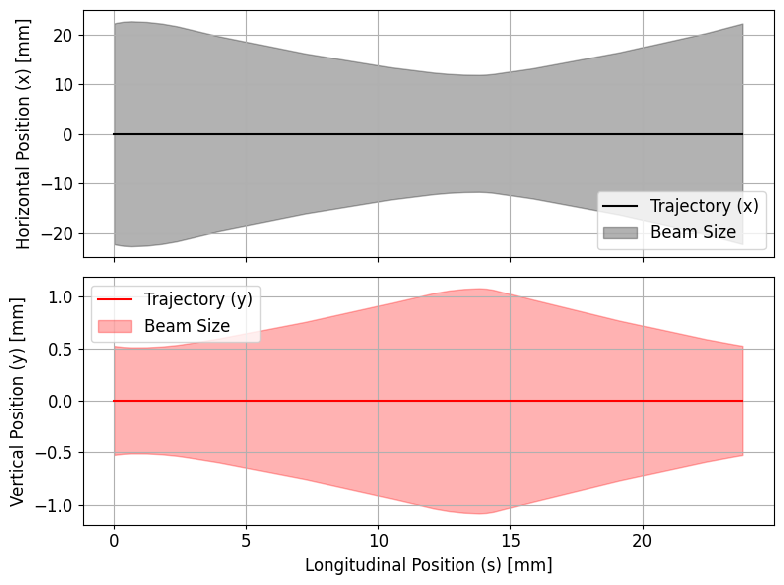
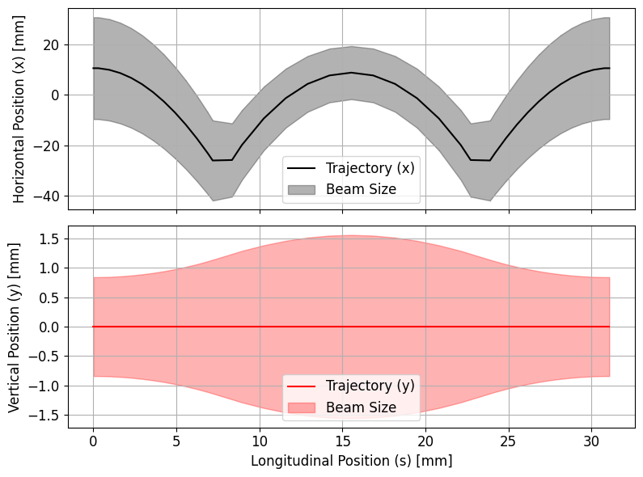
« Normal » FODO
« Hybrid » FODO
Combined Functions
Effect of sagitta !

Slide 9
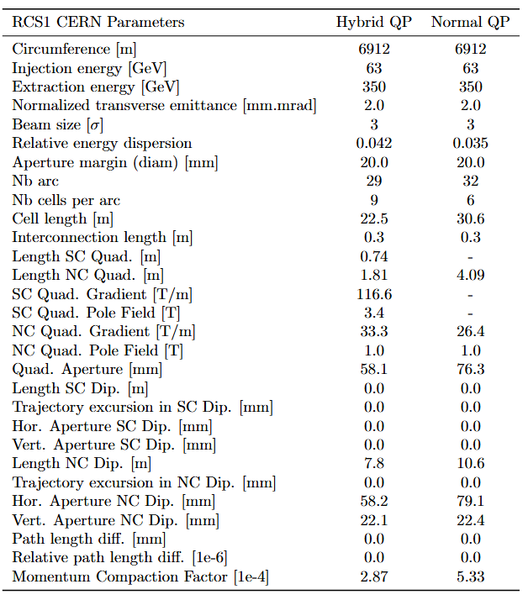
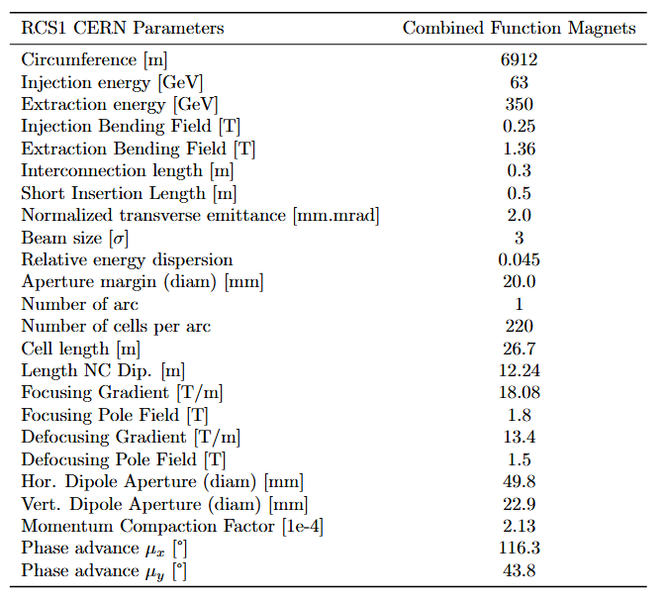
CERN RCS 1
Limiting factor
FODO

Slide 10
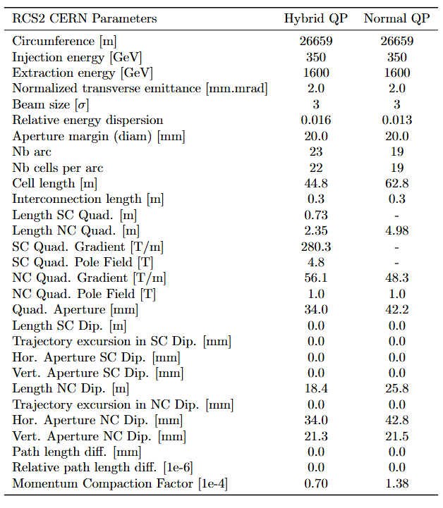
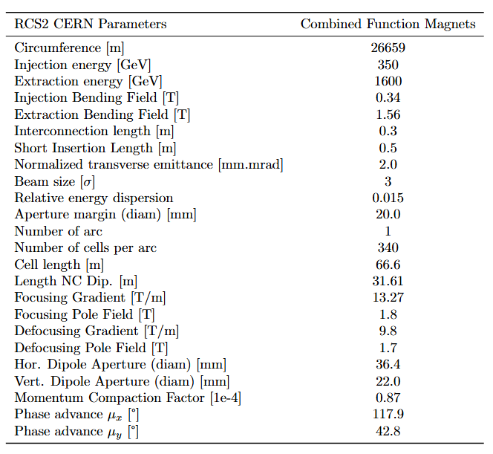
CERN RCS 2
Limiting factor
FODO

Slide 11
Hybrid RCS: FODO Cells
Greenfield RCS 2,3,4 and CERN RCS 3

Slide 12
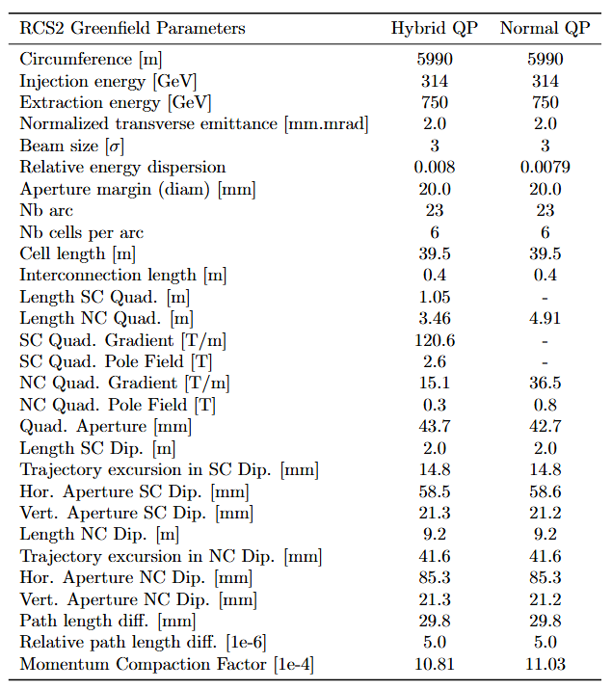
Greenfield RCS 2
No difference between Normal and Hybrid FODO.
Limitations: L_{dip,SC} = 2 m.
  Restricts maximum n_{c}: 41.6mm of trajectory excursion out of 85.3mm total aperture.

Slide 13
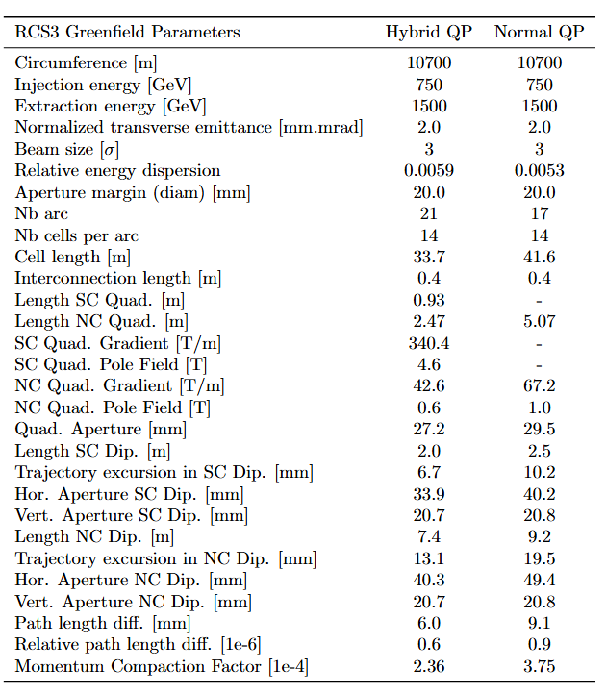
Greenfield RCS 3
No such constraint on RCS3 (larger energy and bigger machine): rather small trajectory excursion.
Limitations:
  Hybrid : L_{dip,SC}
  Normal : B_{QP, NC}
Global parameters for RCS 2/3 do not look optimized for apertures.

Slide 14
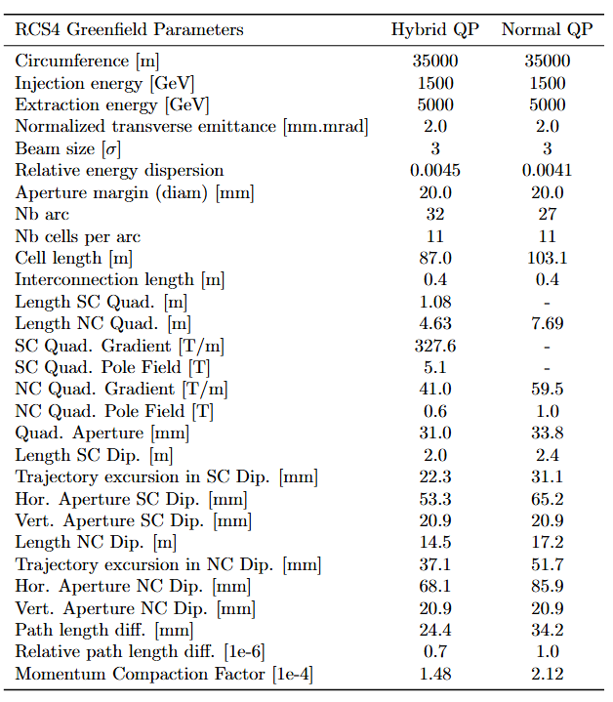
Greenfield RCS 4
Same case as RCS 2
Limitations:
  Hybrid : L_{dip,SC} .
    Restricts maximum n_{c}: 37mm of trajectory excursion out of total 68mm aperture.
  Normal : B_{QP, NC} .

Slide 15
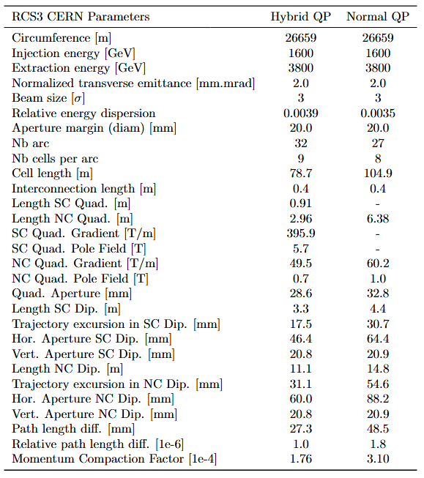
CERN RCS 3
Limitations:
  Hybrid: B_{QP, SC}
  Normal : B_{QP, NC}

Slide 16
Summary on horizontal apertures: Greenfield
Greenfield |  | Normal FODO | Hybrid FODO | Combined Functions
RCS 1 | Apert. NC Dipole | 99.1 | 67.1 | 60.6
 | Apert. SC Dipole | / | / | /
RCS 2 | Apert. NC Dipole | 85.3 | 85.3 | -
 | Apert. SC Dipole | 58.6 | 58.5 | -
RCS 3 | Apert. NC Dipole | 49.4 | 40.3 | -
 | Apert. SC Dipole | 40.2 | 33.9 | -
RCS 4 | Apert. NC Dipole | 85.9 | 68.1 | -
 | Apert. SC Dipole | 65.2 | 53.3 | -
Without the contribution of the sagitta !!
RCS 1 : Combined functions and Hybrid FODO much better than Normal FODO (the sagitta is not taken into account)
RCS 2 : No improvement made with Hybrid FODO (limiting RCS)
RCS 3 and 4 : Better performance with Hybrid FODO

Slide 17
Summary on horizontal apertures: CERN-siting
CERN |  | Normal FODO | Hybrid FODO | Combined Functions
RCS 1 | Apert. NC Dipole | 79.1 | 58.2 | 49.8
 | Apert. SC Dipole | / | / | /
RCS 2 | Apert. NC Dipole | 42.8 | 34.0 | 36.4
 | Apert. SC Dipole | / | / | /
RCS 3 | Apert. NC Dipole | 88.2 | 60.0 | -
 | Apert. SC Dipole | 64.4 | 46.4 | -
Without the contribution of the sagitta !!
RCS 1 : Combined functions and Hybrid FODO much better than Normal FODO
RCS 2 : Equivalent apertures for Hybrid and combined functions, averall small apertures for all cells.
RCS 3 : Better performance with Hybrid FODO.

Slide 18
Conclusion on limitations
Normal FODO: limitations on B_{pole, QP NC} = 1T(except RCS2 Greenfield)
Hybrid FODO:
  For normal RCS or “low energy machines” (Greenfield RCS1 and CERN RCS1, 2) : limitations on L_{QP, SC} = 0.75m .
  For hybrid RCS or “high energy machines” (Greenfield RCS2, 3, 4 and CERN RCS3): limitations on L_{dip, SC} = 2m .
Combined Functions: limitations on B_{pole} = 1.8T.

Slide 19
Discussion
List of constraints
Open Questions
Magnet lengths:
  L_{dip, SC} > 2m
  L_{quad, SC/NC} > 0.75m
Field and gradients :
  B_{pole, QP NC} < 1T
  G_{QP, SC} < 400 T/m
Combined functions:
  B_{pole} = B_{bend} + G*r < 1.8 T
Do the constraints look realistic ?
For combined functions, would it be possible to bend NC magnets ?
Open question on magnet design : would it be worth decreasing magnet lengths to decrease dipole apertures ?
Discussion on the siting

