Slide 2
HFM WP 3.3
Nb₃Sn 5-m long block
Jose Ferradas Troitino and Susana Izquierdo Bermudez
J. C. Pérez, E. Fernandez, A. Haziot, E. Todesco, N. Peray, N. Lusa, B. Pellet

Slide 3
Outline
Introduction
  Previous block designs with flared ends (built)
  Scaling in length
  Main challenges for flared block-type coils fabrication
  Objectives
Technical options
Recap on proposal
Additional slides

Slide 4
Outline
Introduction
  Previous block designs with flared ends (built)
  Scaling in length
  Main challenges for flared block-type coils fabrication
  Objectives
Technical options
Recap on proposal
Additional slides
Focus for today

Slide 5
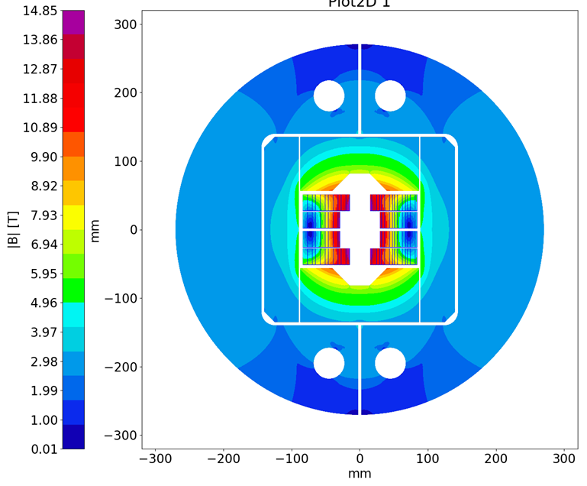
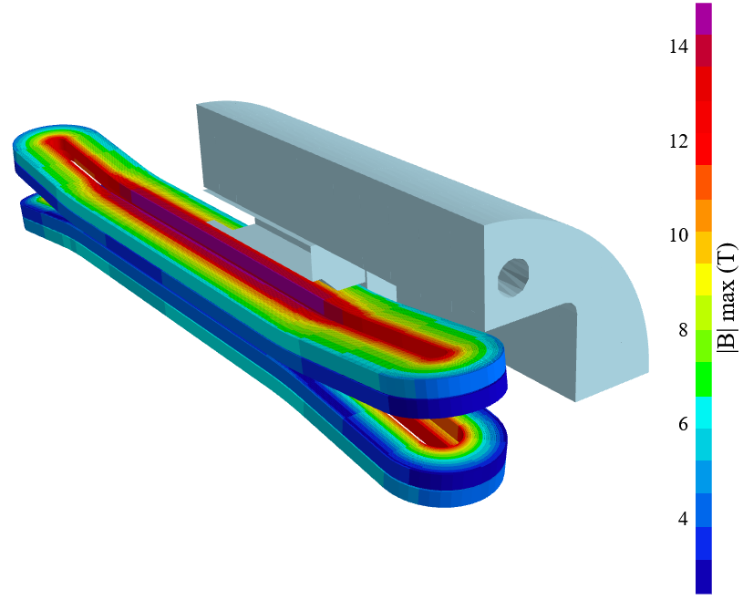
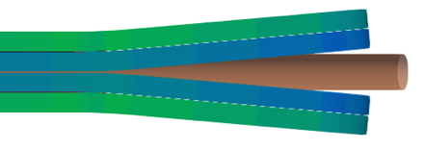
Introduction
Among the options for FCC-hh main dipoles, CERN is exploring (within HFM) a block-type design with flared ends:
  Interesting option to build 14 T magnets using only 2 double-layer coils (design allows for the use of large cables thanks to the topology of coil ends)
  Limited experience today at an accelerator scale, only built R&D or one-of-a-kind magnets of this type so-far.

Slide 6
Outline
Introduction
  Previous block designs with flared ends (built)
  Scaling in length
  Main challenges for flared block-type coils fabrication
  Objectives
Technical options
Recap on proposal
Additional slides

Slide 7

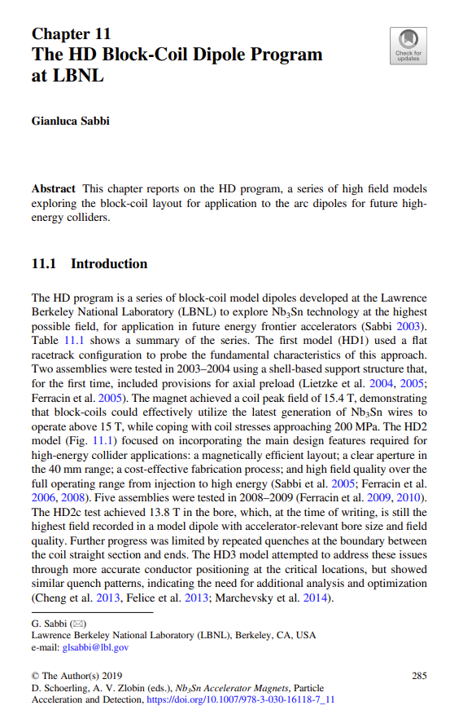
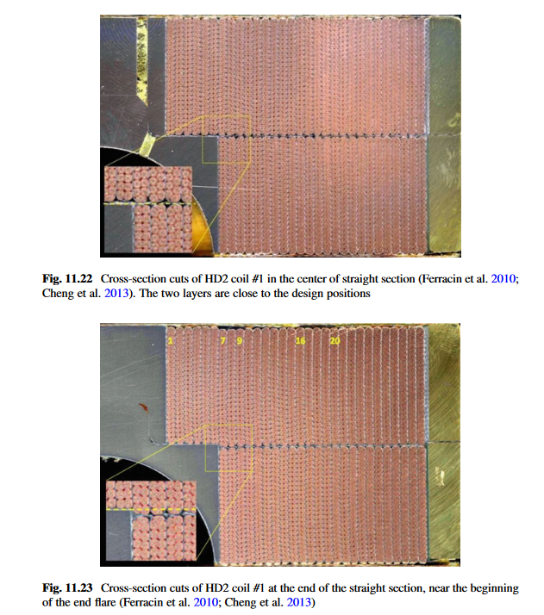
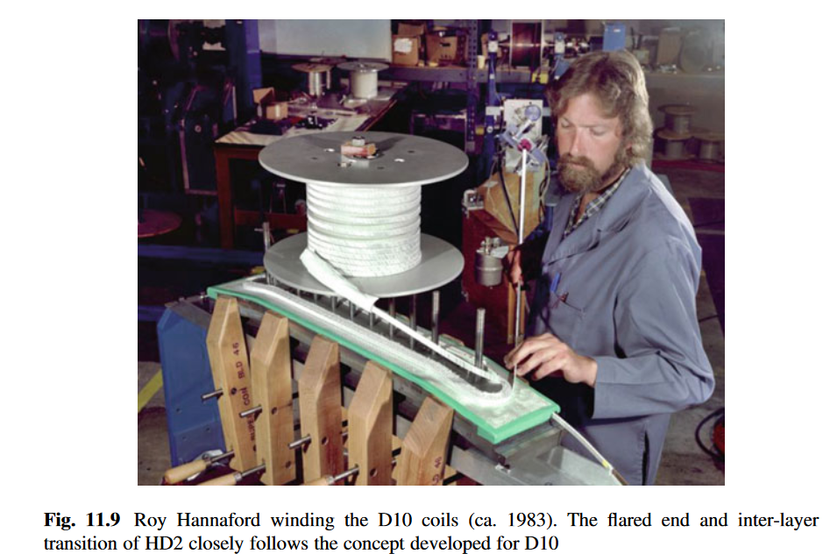
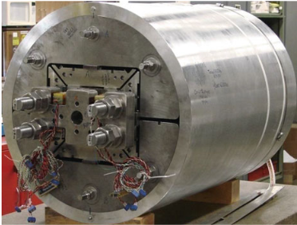
Built magnets (LBNL)
https://doi.org/10.1007/978-3-030-16118-7_11
D10* (1980s) first Nb₃Sn magnet fabricated at LBNL.
  Reached a bore field of 8 T (no iron).
  Magnet length < 1 m
HD program in LBNL early 2000s.
  HD1 flat racetracks (8 mm bore, B_{p} = 15.3 T, B₀ = 16 T, 4.5 K)
  HD2 with flared ends (36 mm bore, B_{p} = 14.5 T, B₀ = 13.8 T, 4.5 K)
  HD3 with flared ends (43 mm bore, B_{p} = 14.2 T, B₀ = 13.4 T, 4.5 K)
  The transition between the straight section and ends, in the corner of the pole, spotted as a critical area
  Magnet length ≈ 1 m

Slide 8
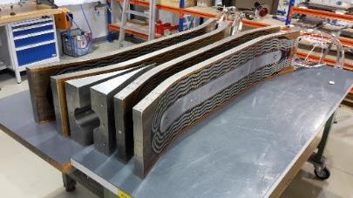
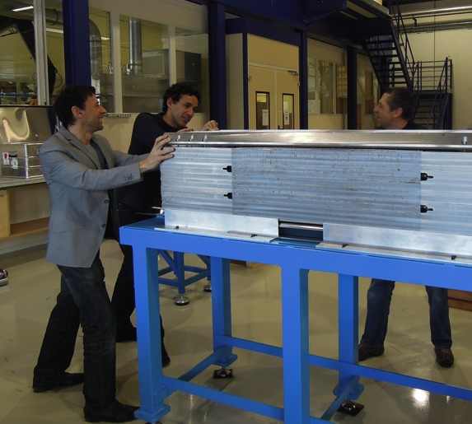
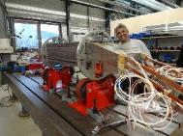
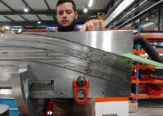
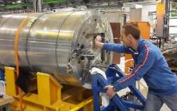
Built magnets (CERN & SACLAY)
At CERN, in collaboration with CEA, we built FRESCA2. Length ≈ 1.5 m. The people that built FRESCA are still around, and there are several lessons learnt to be fed in the next generation block coil:
    One of the biggest challenge is how to handle flared ends during RHT. This will get more critical when going to longer coils.
    Assembly of end wedges, likely we will want to impregnate them today (not done in FRESCA2)
    Bore deformation during RHT
    Coil geometry and matching during assembly
    Quench Heaters
Transition between the straight section and the flared ends was as well the limiting spot during training, with signs of mechanical movement.

Slide 9
Outline
Introduction
  Previous block designs with flared ends (built)
  Scaling in length
  Main challenges for flared block-type coils fabrication
  Objectives
Technical options
Recap on proposal
Additional slides

Slide 10


The scaling in length for coil fabrication
With the HL-LHC experience with 11 T and MQXF, we are in a relatively good shape in terms of 5-8 m coil fabrication technology for cos-theta coil configuration.
  However, the scale-up in length was far from trivial: there were things to learn that only showed up when building longer coils.
Short/long/not reaching requirements
T₀, aperture selection
MQXFAM1
A08b
A05
A10
A13
MQXFSM1
MQXFA03
A06
A11
MQXFAP1
A07
MQXFS1
MQXFAP2
A04
A08
MQXFA-CM1
T₀’
T₀’ + 4
T₀’ + 7
MQXFBP3
B03
MQXFS4
MQXFBP1
MQXFBP2
B02
BP2b-Q2
MQXFS3
MQXFS5
MQXFS6
MQXFS7
MQXFS8
2013 | 2014 | 2015 | 2016 | 2017 | 2018 | 2019 | 2020 | 2021 | 2022 | 2023

Slide 11
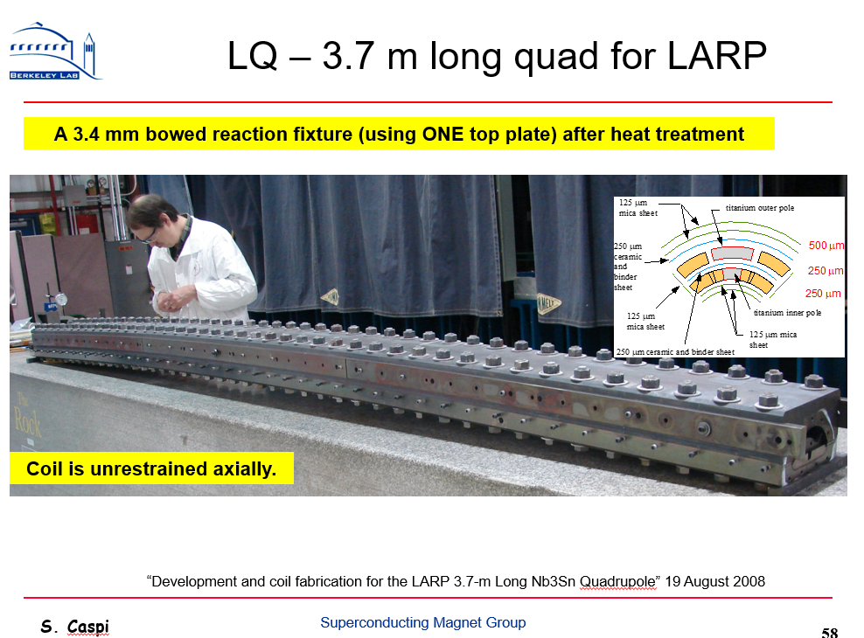
The scaling in length for coil fabrication
Note however that the concerns regarding the scaling in length were present from the beginning, well before MQXF.
In 2004 the US DOE established the LHC Accelerator Research Program (LARP) with the goal of developing the technology for future upgrades of the LHC
  Studies for the scaling in length were already present at an early stage. The main logic being that ‘Big’ issues could be intercepted as soon as possible!

Slide 12
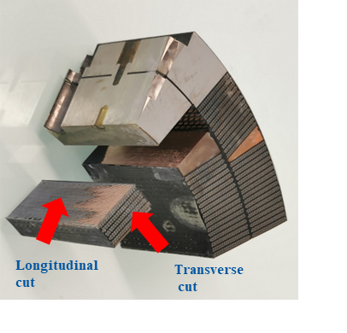
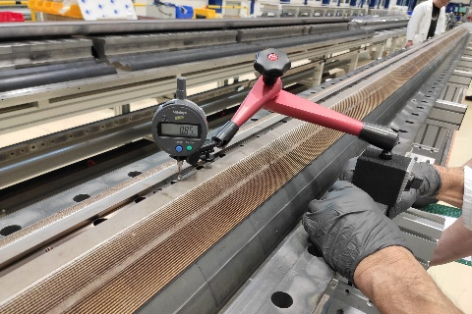
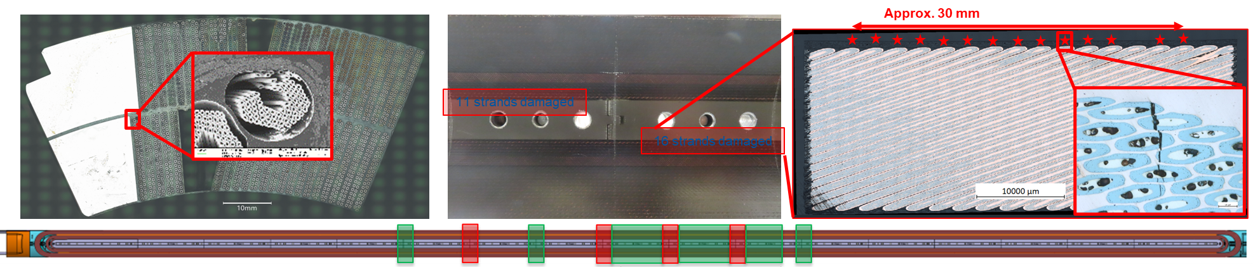
Microscopic / Macroscopic effects
Vertical pole deviation along the length (reacted coil)
Microscopic (linked to macroscopic effects) issues may take longer to understand…
MQXFB prototype magnets were limited, due to conductor damage in the pole-to-pole transition S. Izquierdo Bermudez et al, IEEE, vol 33, 2023
Root cause was coil fabrication, mitigated by removing the ceramic binder in the outer layer to reduce longitudinal, radial and azimuthal friction between coil and the reaction N. Lusa et al, IEEE Vol 34, 2024

Slide 13
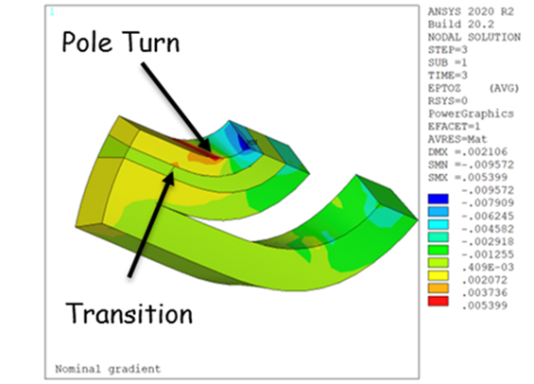
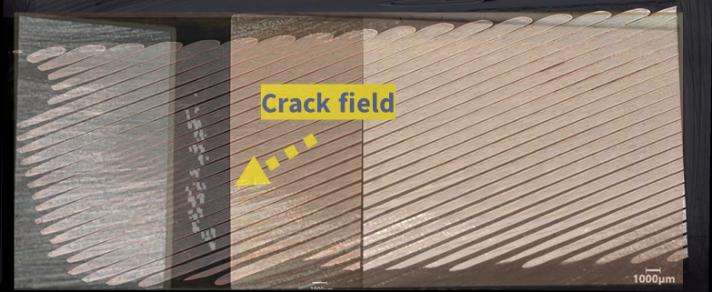
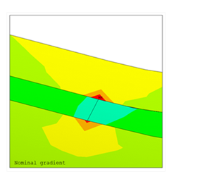
Microscopic / Macroscopic effects
Some other similar issues are still being investigated (which did not show up neither on short coils for the moment)
Broken filaments in MQXFA wedge-spacer transitions. The current understanding is that lack of end support in some MQXFA magnets created a high axial strain in the turns close to the transition. The cause for the lack of support is a combination of coil size and force interception during loading.
→ This is a reminder that the correct management of axial forces remains a challenge in view of manufacturing long accelerator quality magnets

Slide 14
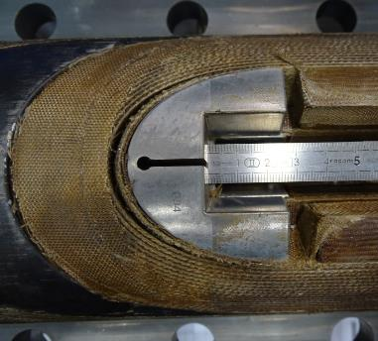
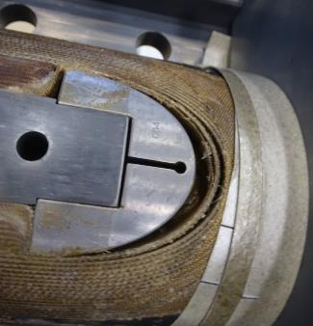
Microscopic / Macroscopic effects
Another example: The very high compaction of 11 T coils was always present since the short models, but when going to long coils it became a real source of concern.
The iteration of the insulation thickness solved this problem, which remained always a concern (see CERN-0000218573)

Slide 15
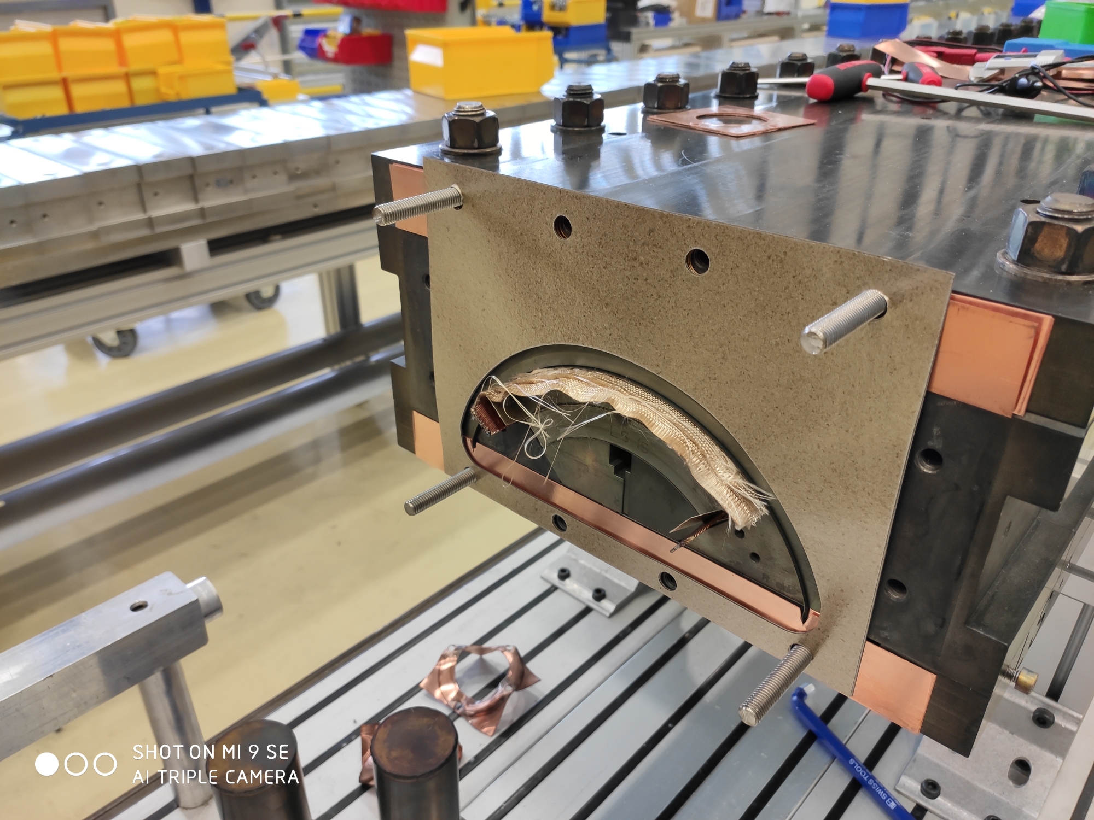
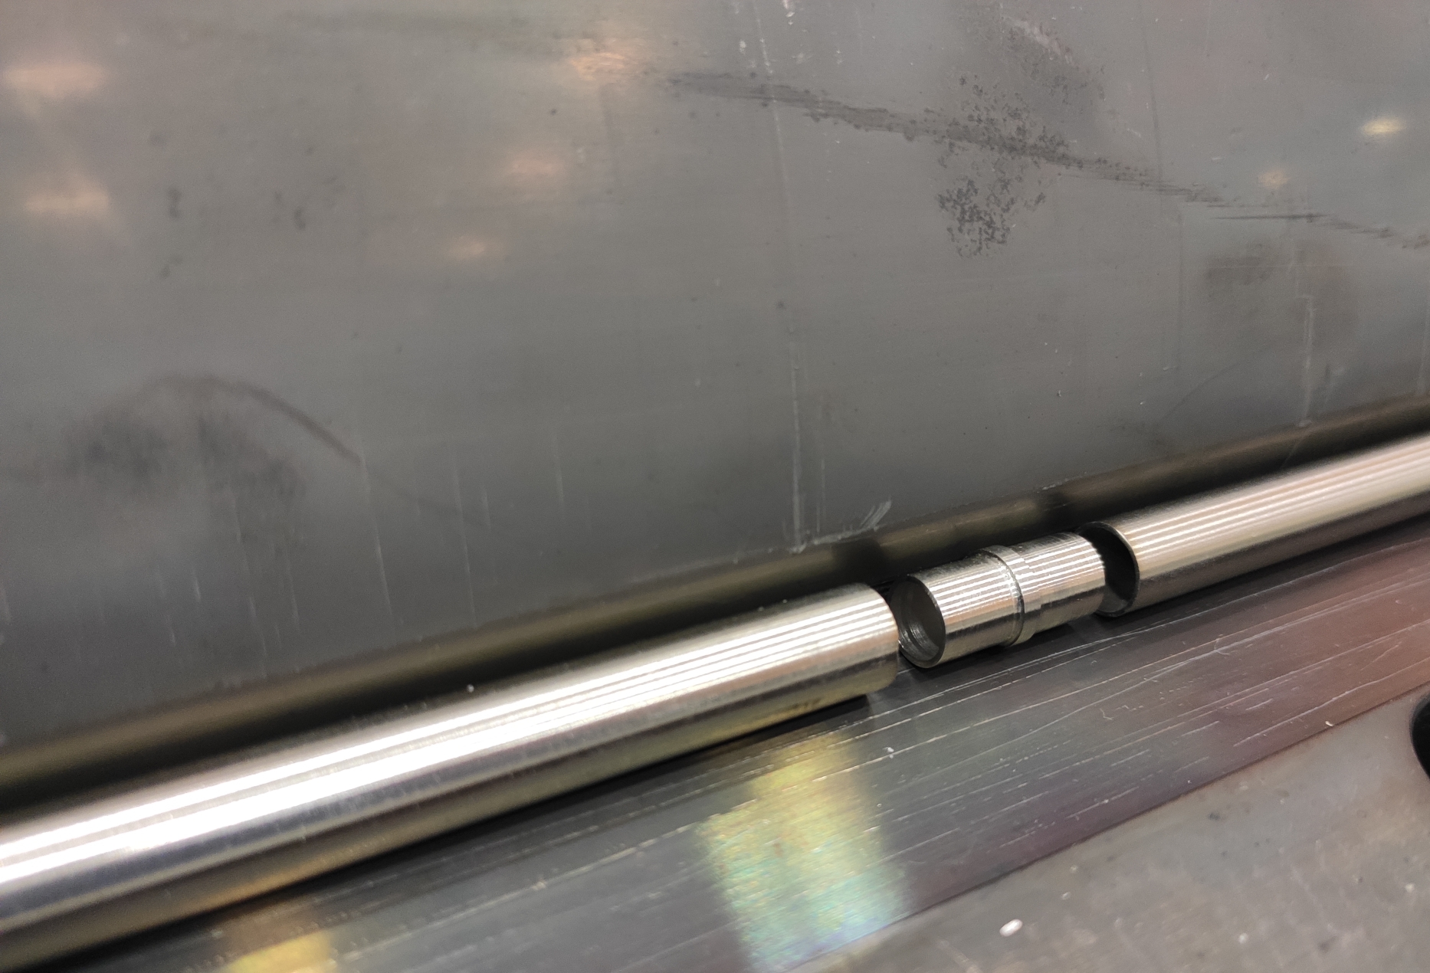
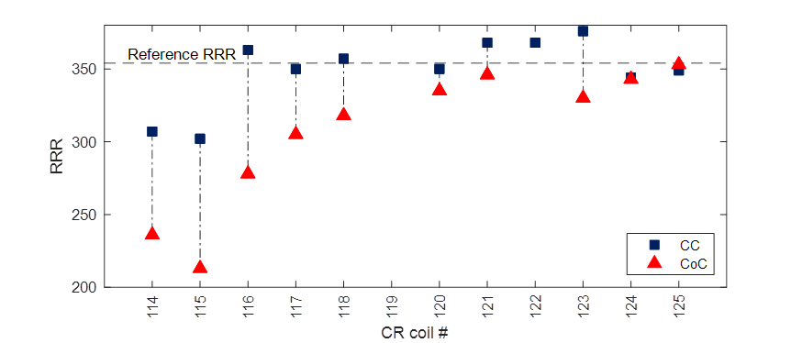
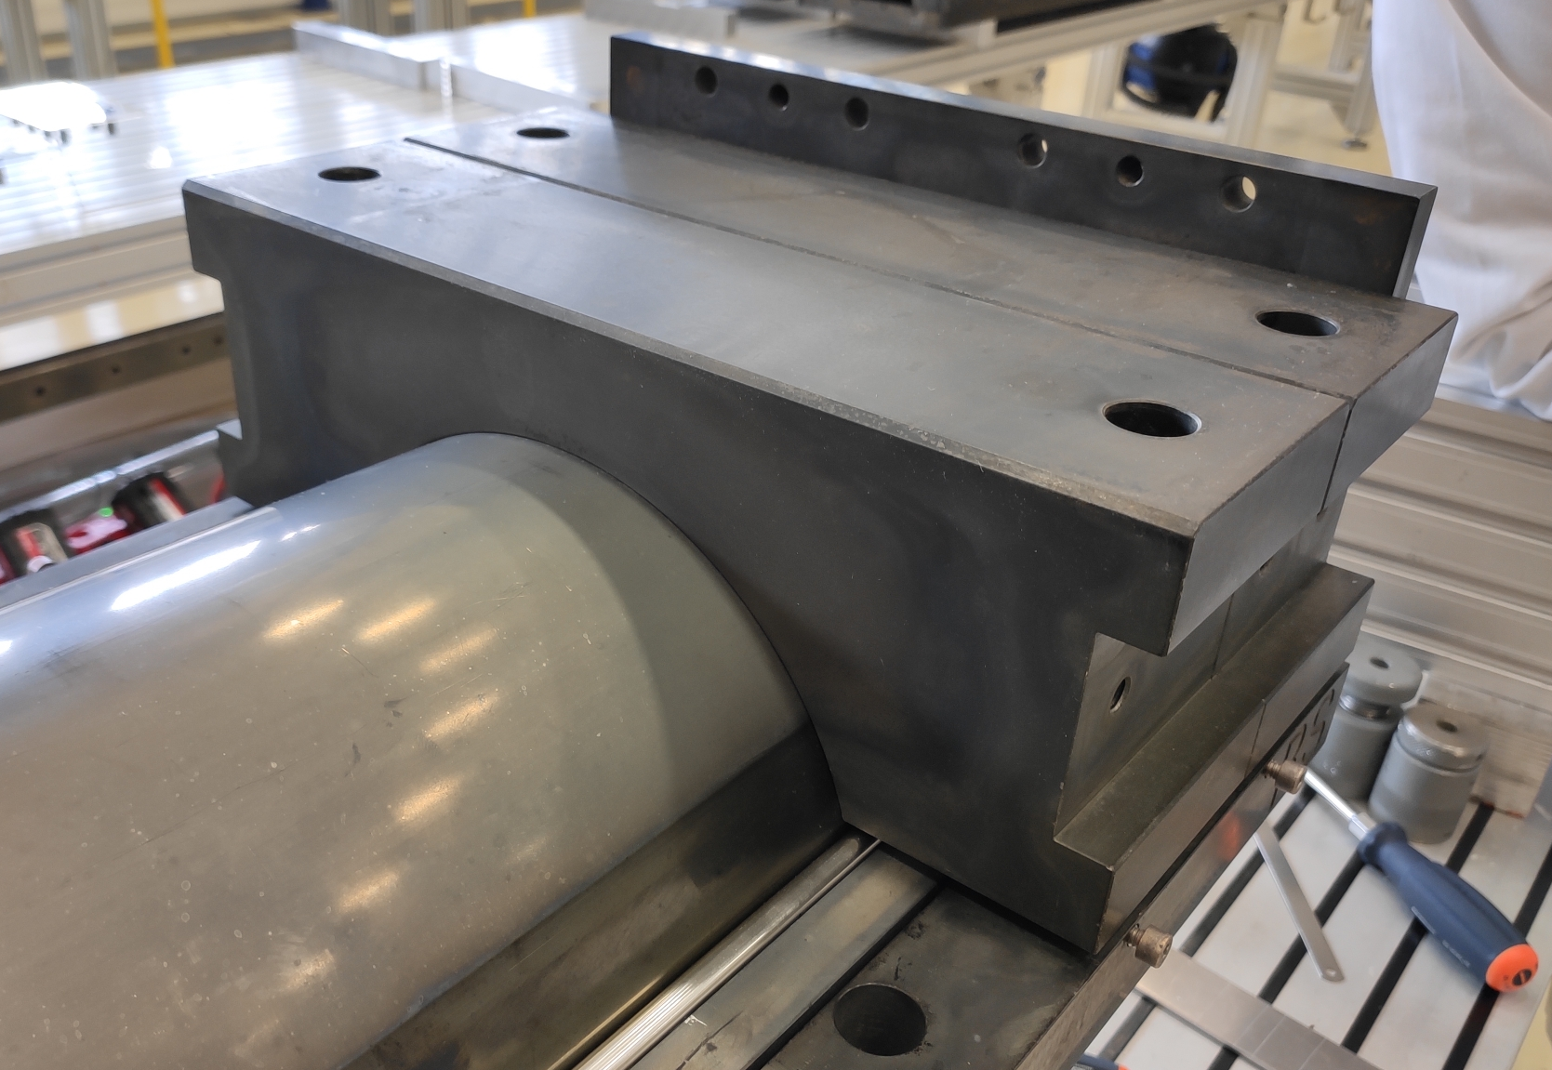
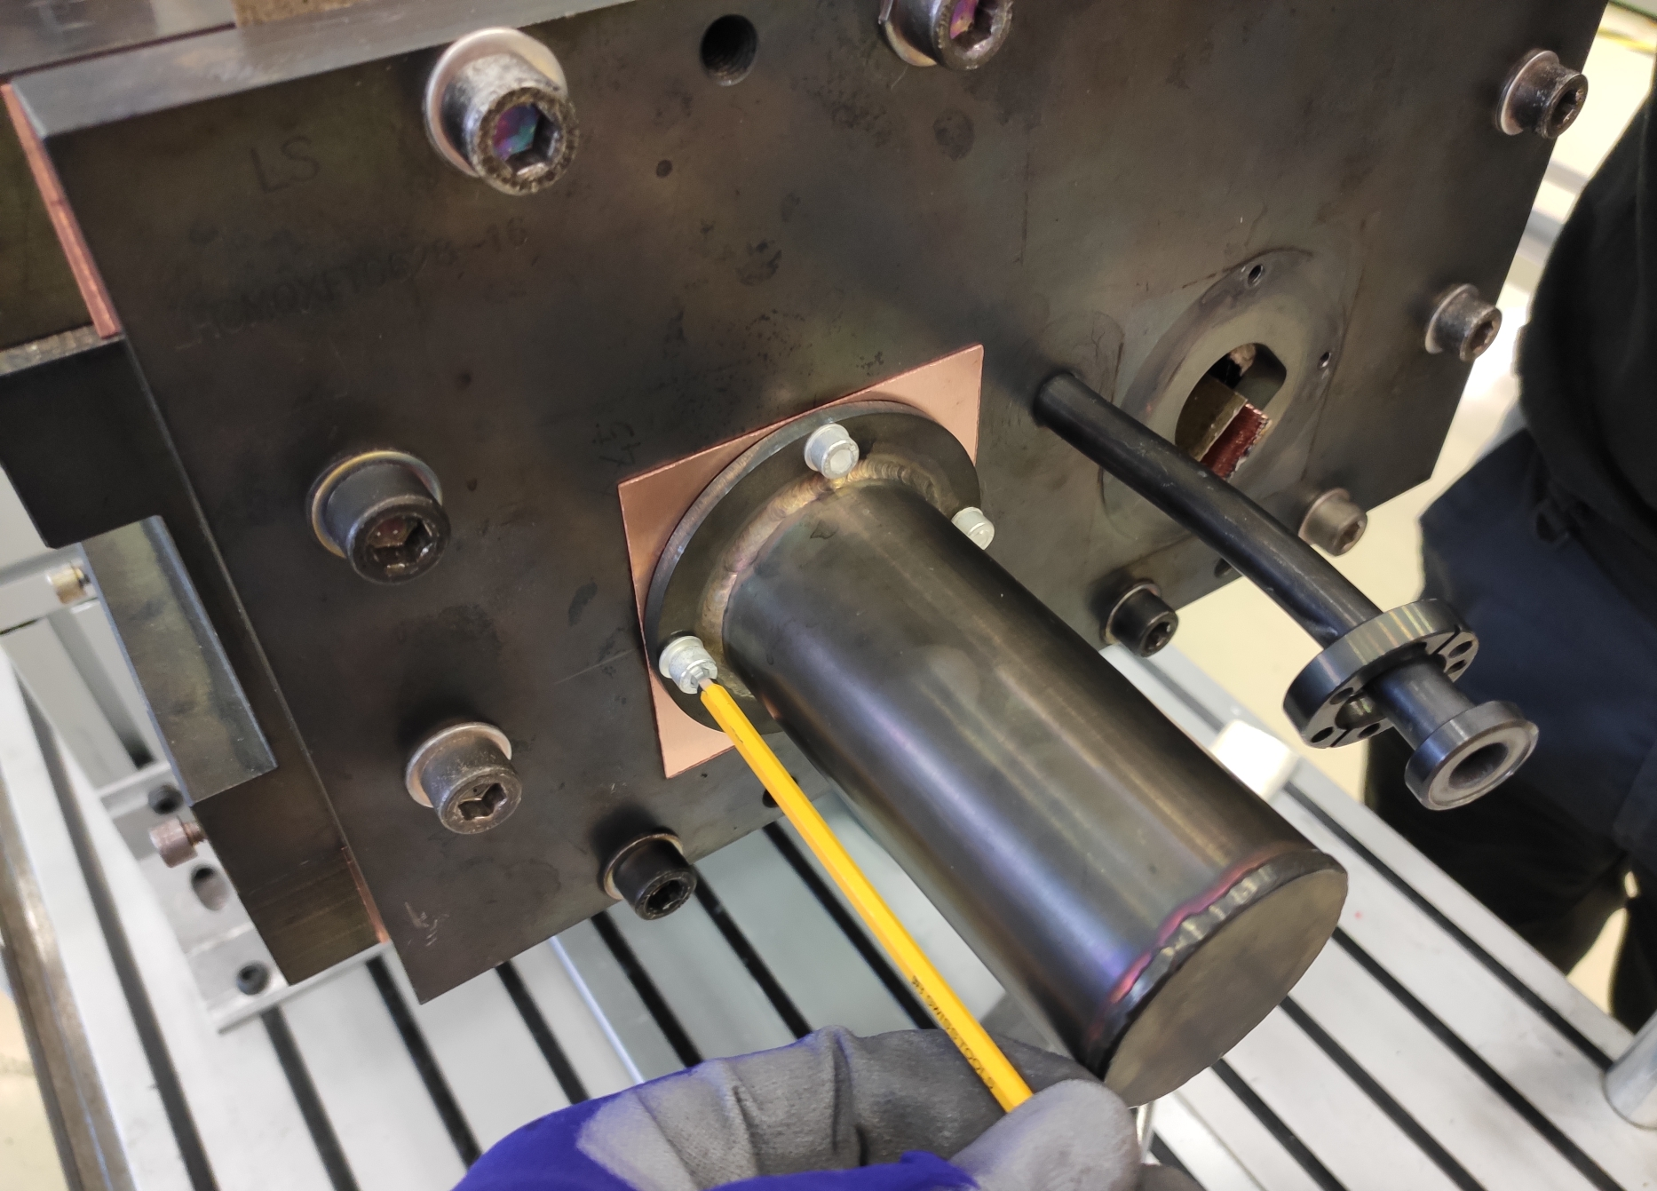
Improvements
  Less critical things were also improved along the process, for example, reduced RRR difference between CS and NCS, mainly thanks to argon action
    Stainless steel tubes on the base plate as metallic joints (from MQXFBP3 coils)
    Fitted copper shims to seal the extremities (from MQXFBP3 coils)
    Increased Ar flow both in the retort (750 l/h) and in the mould (500 l/h) (from MQXFB02 coils)
MQXFB02 coils
MQXFBP3 coils

Slide 16
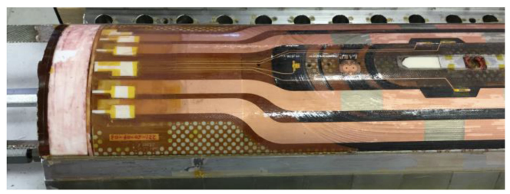
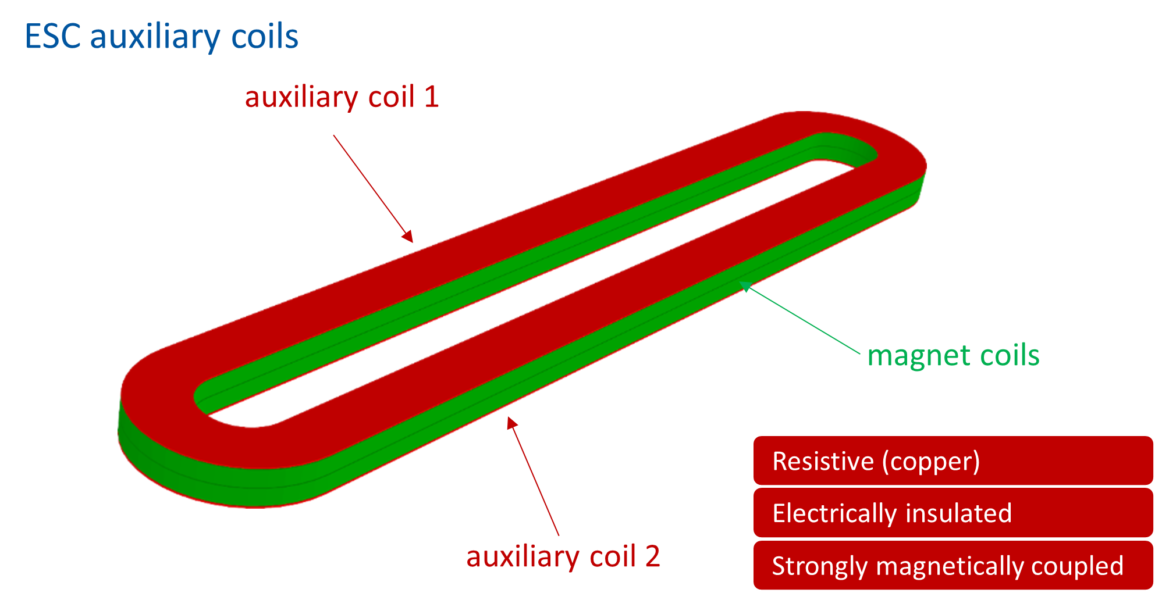
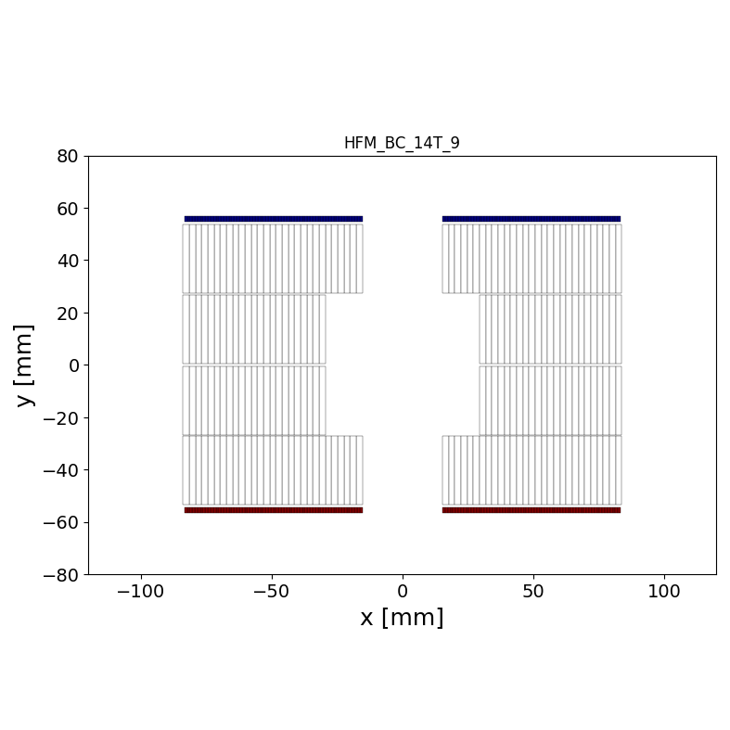
Electrical integrity
We have been through a tough experience with HL-LHC quench heaters regarding the robustness of the coil-to-quench-heater insulation and implementation
      Internal / external QHs, inner layer / outer layer
      Wiring and connections
      Insulation cracks, bubbles, blistering…
      Corrective actions – mini swap, encapsulated trace (coverlay), understanding and adjusting test levels
    Ideally, we want to get rid of QH and whatever we choose, we would like to have it outside the impregnated coil.
    Important to consider the integration of whatever system in view of long coils, already from the beginning.

Slide 17
Outline
Introduction
  Previous block designs with flared ends (built)
  Scaling in length
  Main challenges for flared block-type coils fabrication
  Objectives
Technical options
Recap on proposal
Additional slides

Slide 18
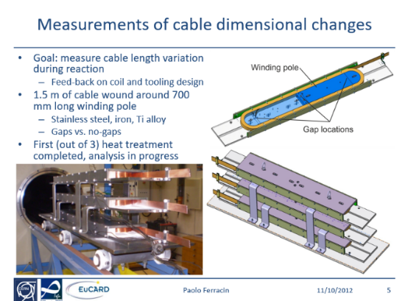
Challenges for flared block-type coils
One of the key questions to address in block-type coils is how to handle dimensional changes during heat treatment:
  Our current understanding is that the flared (inclined) geometry creates a fixed point for the conductor in the ends during RHT. This creates an additional constraint, not present in other designs.
  The reaction tooling is thus segmented and both ends shall move freely to accommodate dimensional changes.
Length is a critical parameter!
Various efforts made at mock-up scale, and not fully conclusive. Nothing on larger scale!
(M. Durante et al., "Geometrical Behavior of Nb3Sn Rutherford Cables During Heat Treatment," in IEEE Transactions on Applied Superconductivity, vol. 26, no. 4, pp. 1-5, June 2016, Art no. 4802705, doi: 10.1109/TASC.2016.2530166 link)
The topic is already being addressed for short models with BOND, see next slide. It is the core of our efforts today!

Slide 19
Tooling & components design
Coil components and coil fabrication tooling design is well on track.
The 3D design will be completed by end of April.
First tooling delivered is expected by late summer 2025.
Impregnation
Winding
Reaction
* Technical discussions organized in “Sharing experience on Nb₃Sn Magnet & Tooling engineering WG”
Courtesy of N. Peray

Slide 20
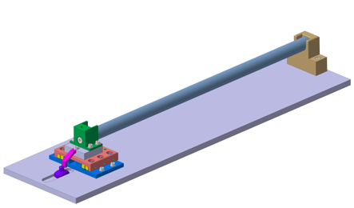
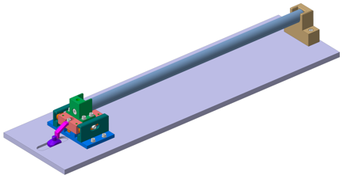
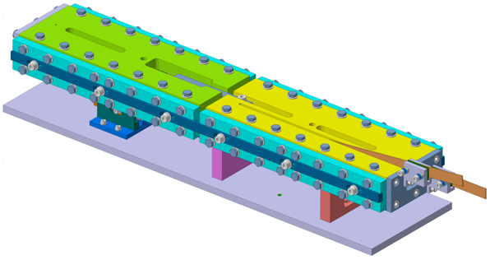
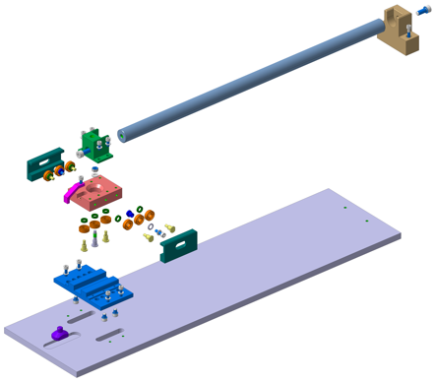
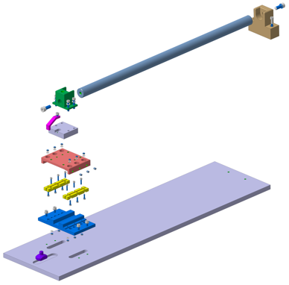
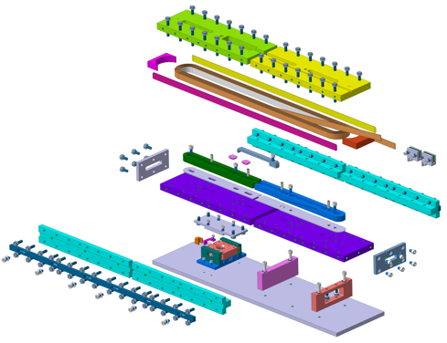
Mock-up design of sliding reaction tooling
Thanks to the experience gained during the construction of the Racetracks, FRESCA2 and MQXF magnets, BOND tooling designed to compensate for dimensional variations during heat treatments.
Racetrack coil mock-up with integrated sliding system
Linear ceramic bearing
Circular ceramic bearing
The basic concepts will be validated using simplified mock-ups that replicate conditions close as possible to those that will be used during coil manufacturing.
Courtesy of N. Lusa, J. Ferradas & B. Pellet

Slide 21
Outline
Introduction
  Previous block designs with flared ends (built)
  Scaling in length
  Main challenges for flared block-type coils fabrication
  Objectives
Technical options
Recap on proposal
Additional slides

Slide 22
Summary for today
There are various aspects that most of the times cannot be fully studied based purely on short model coils.
HL-LHC experience has shown us that the scaling in length was far from being trivial.
We should have in mind long coil features as soon as possible in the 14T BOND coil development.

Slide 23
Objectives
We thus propose to inject as early as possible a first scaling in length in the 14T BOND coil production → a 5-m long version that can be vertically tested at CERN.
Goal of the 5 m long magnet:
  Understand coil fabrication features where length is a critical aspect. Such that when the moment arrives to build an accelerator quality block type dipole, we have anticipated ‘as much as we could’
    We are not worried about field quality.
    We are not targeting a specific field/aperture. We just want to be as close as reasonably possible to the final object (recall, we want to address the critical aspects in coil fabrication).

Slide 24
Outline
Introduction
  Previous block designs with flared ends (built)
  Scaling in length
  Main challenges for flared block-type coils fabrication
  Objectives
Technical options
Recap on proposal
Additional slides

Slide 25
Cable
BOND cable: 40 strands x 1.1 mm (50 mm aperture by “slightly opening up” both layers and coils)
The strand that is today our best choice for this proposal is MQXF, 40 strands x 0.85 mm:
  MQXF strand is smaller in diameter and it has more copper
  MQXF rectangular cable would be ~ 5 mm smaller cable in width
Conductor parameters |  | 5-m long block | BOND
Strand diameter | (mm) | 0.85 | 1.10
Layout |  | RRP 108/127 | RRP 162/169
Effective filament diameter | (µm) | 55 | 64
Cu/NonCu ratio |  | 1.2 | 0.9
No. of strands in cable |  | 40 | 40
Bare cable thickness | (mm) | 1.525 | 1.98
Bare cable width | (mm) | 18.150 | 23.045
Bare cable thickness (reacted - 4.5%) | (mm) | 1.594 | 2.06
Bare cable width (reacted - 1.2%) | (mm) | 18.363 | 23.275
Insulation thickness | (mm) | 0.15 | 0.15
Insulated cable width (reacted) | (mm) | 18.663 | 23.575
Insulated cable thickness (reacted) | (mm) | 1.894 | 2.36
Astrand | (mm²) | 0.567 | 0.950
Asc | (mm²) | 0.258 | 0.500
Acu | (mm²) | 0.310 | 0.450
Goal: optimize the use of MQXF UL (750 m). Ideally, an integer multiple of MQXF UL
 |  | MQXFB | BOND | Options for 5 m
lm | m | 7.2 | 1.08 | 4.74 | 4.74 | 4.74
UL | m | 750 | 136 | 750 | 375 | 250
Lcoil | m | 7.48 | 1.31 | 5 | 5 | 5
Nturns |  | 50 | 52 | 76 | 38 | 25
Nturns*2*lm |  | 720 | 112 | 720 | 360 | 239
1.05*Nturns*2*Lcoil |  | 785 | 143 | 798 | 399 | 266
1 coil / UL
2 coil / UL
3 coil / UL

Slide 26
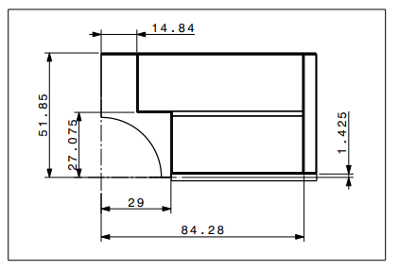
Coil options (2D)
Keep external envelope
14 T - BOND
Scale to a smaller aperture

Slide 27
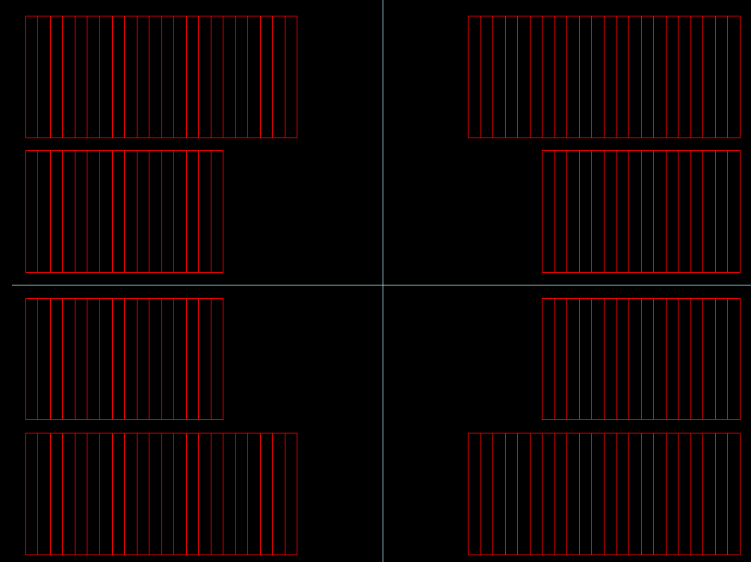
Coil options (2D)
Some brainstorming! To be representative of BOND coil manufacturing while scaling to a smaller aperture:
  We try to keep the main coil features:
    Same logic for insulation layers and pole geometry – (i) BOND accounts for 0.5 mm fiberglass in between the conductor and any metallic part, (ii) it accounts as well for at least a 4 mm thick pole tip and a 5 mm rail.
    We keep the main materials for the components ~ We do not introduce changes at the coil level (even though they could be beneficial for a non-FQ optimized magnet). For example, an iron pole is not considered.
    Vertical distance between top and bottom coil (between insulated conductor) = 4 mm in BOND.
    2 mm thick interlayer. This is in BOND due to the use of the 40-strand cable.
    We believe that these 2 last points are less critical in how representative we are for the 5-m long coil production.
Most important (1st order)
Less important (2nd order)
This leaves us with the usual free parameters for the coil design:
Number of turns protruding in upper layer
X-distance to origin (~ aperture)
Midplane & interlayer distances

Slide 28
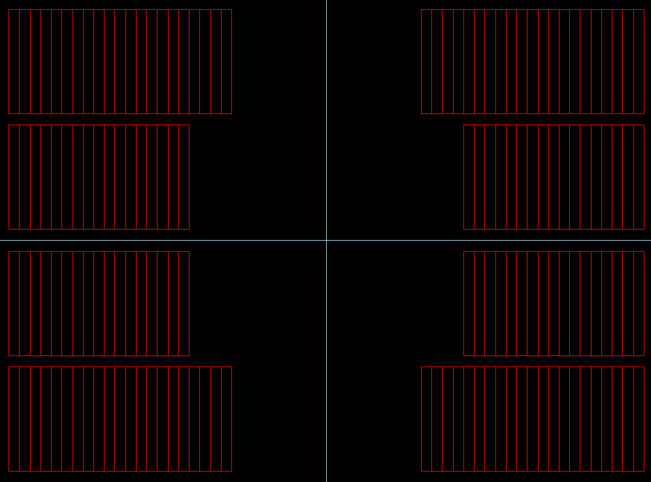
Coil options (2D)
Let’s imagine that we try to reproduce exactly BOND, and we keep same distances in between coils and layers.
Option A) We keep the same (absolute value) number of turns protruding on top of the pole in layer 2
Option B) We scale the number of turns protruding as a function of the coil width (6 out of 29 in BOND, 4 out of 22 in 5 m coil)
On the contrary, we could remove the less important constraints (previous slide) and:
Option C) Try to find an optimum magnetic design
Option A – 6 turns protruding
38 turns in total
Option B – 4 turns protruding
38 turns in total
Option C – Optimization

Slide 29
Coil options (2D)
At the same time, both options A and B could accommodate an aperture ranging from 40 mm to 30 mm.
Reducing the aperture, decreases the bending radius at the pole tip for the upper layer.
40 mm aperture:
Upper layer bending radius = 12.6 mm
35 mm aperture:
Upper layer bending radius = 10 mm
BOND:
Upper layer bending radius ~ 15 mm
40 mm aperture:
Upper layer bending radius = 16.4 mm
35 mm aperture:
Upper layer bending radius = 14 mm
BOND:
Upper layer bending radius ~ 15 mm
Option A – 6 turns protruding
38 turns in total
Option B – 4 turns protruding
38 turns in total
Option C – Optimization

Slide 30
Option A & B

Slide 31
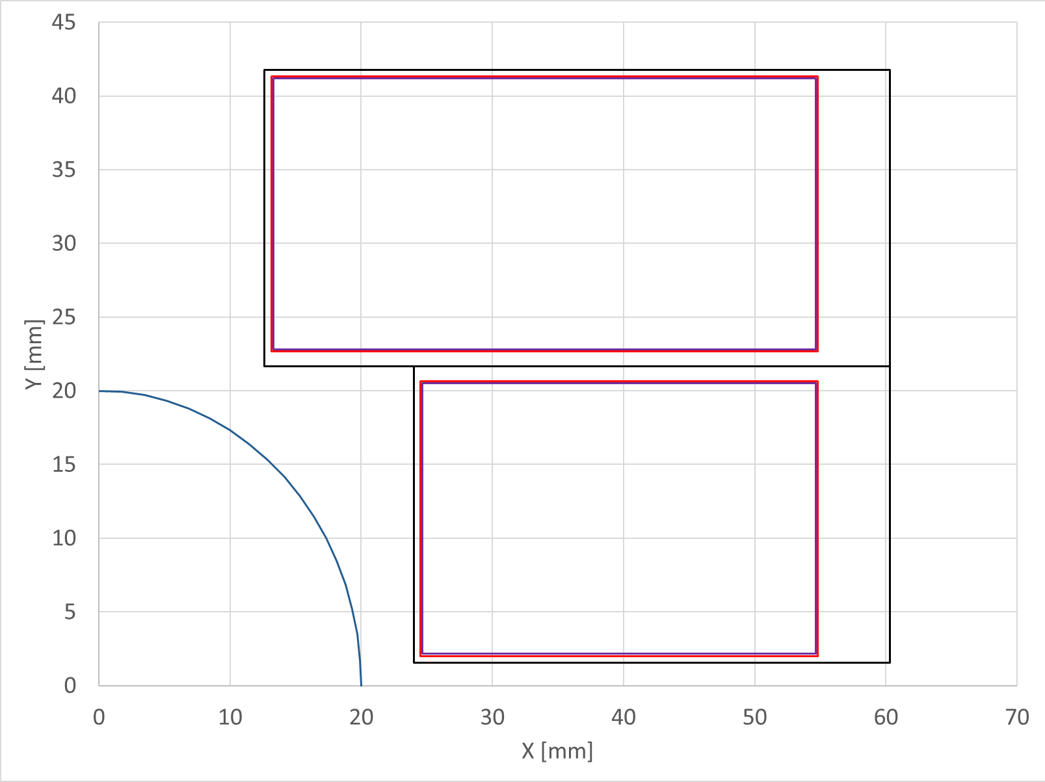
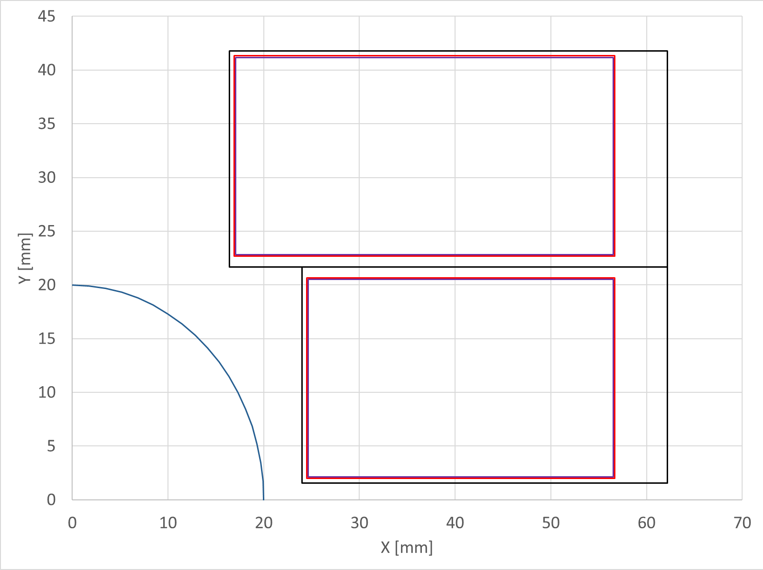
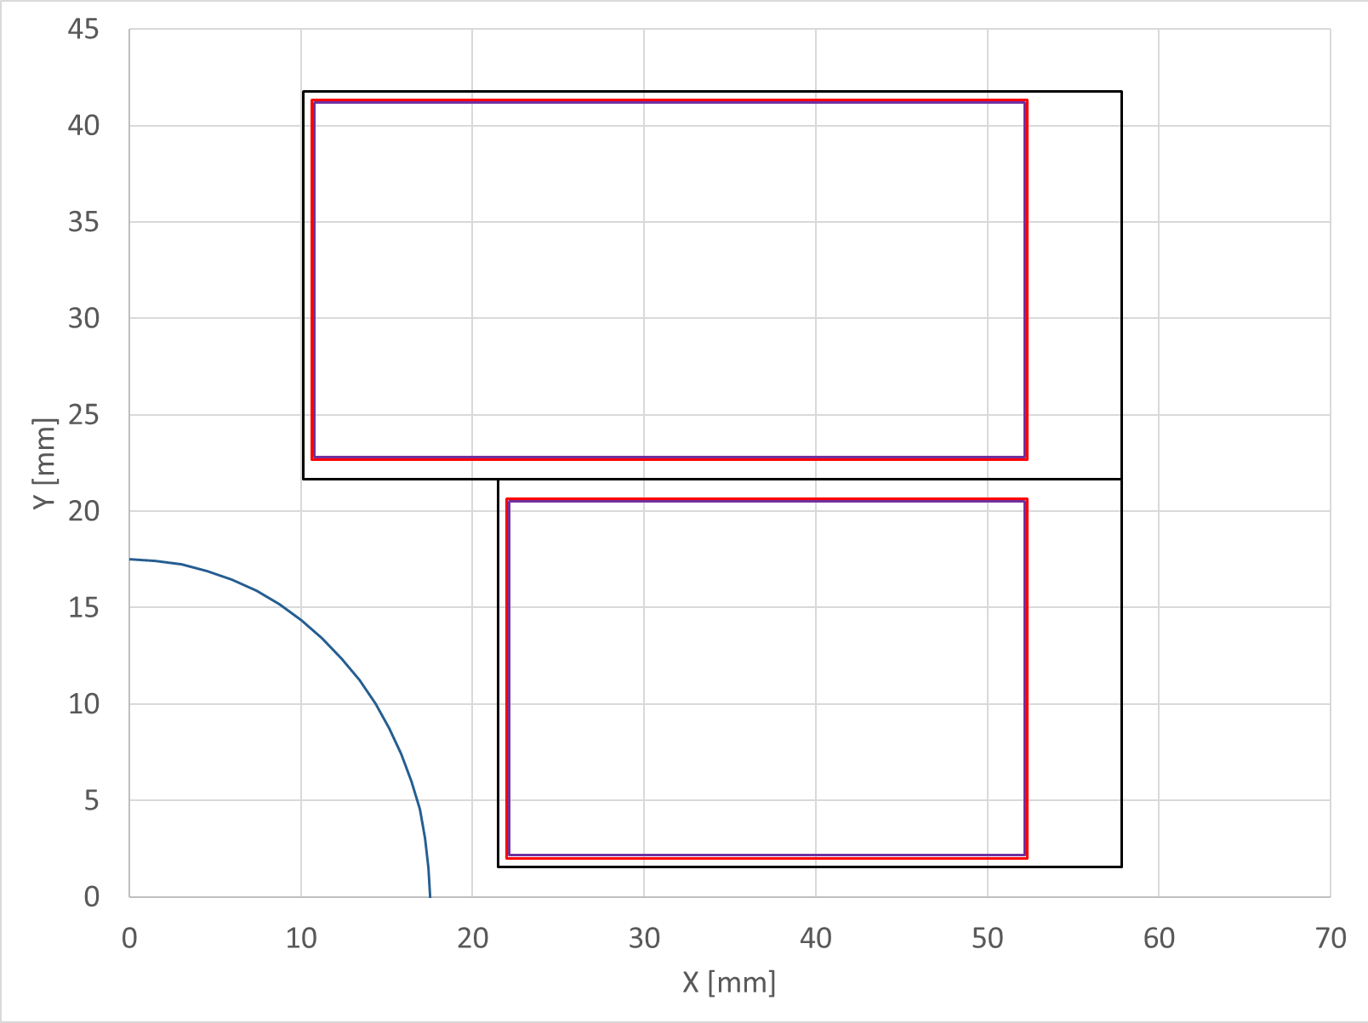
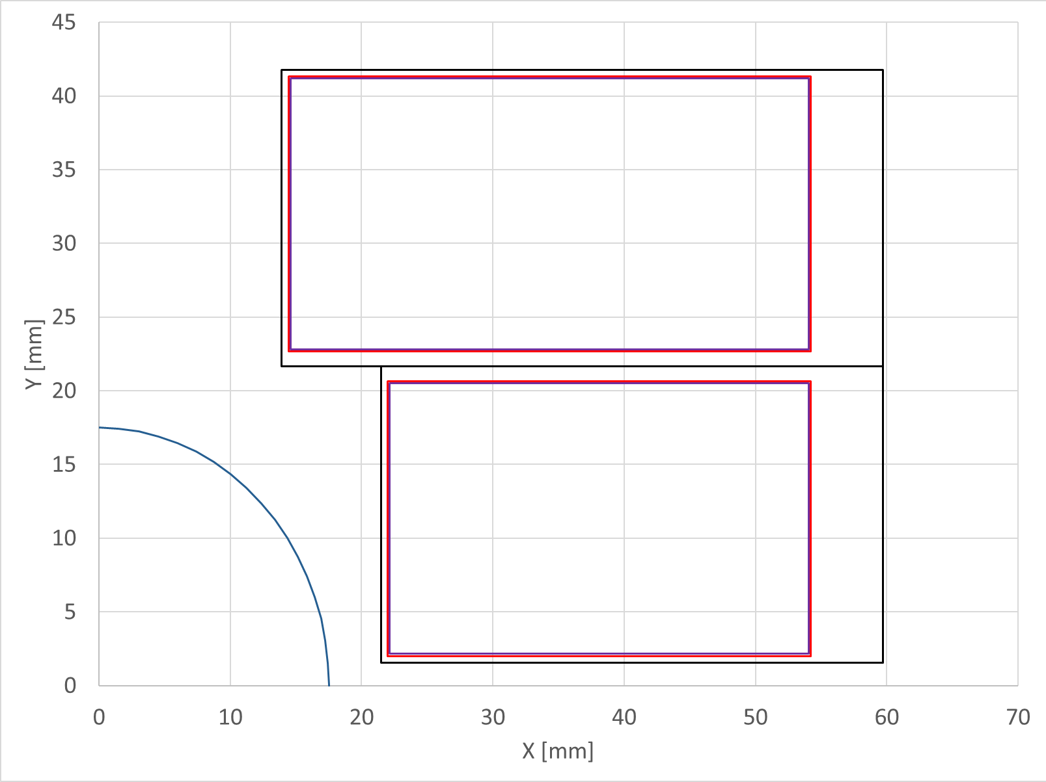
Impregnated coil
Insulated conductor
Bore

Slide 32
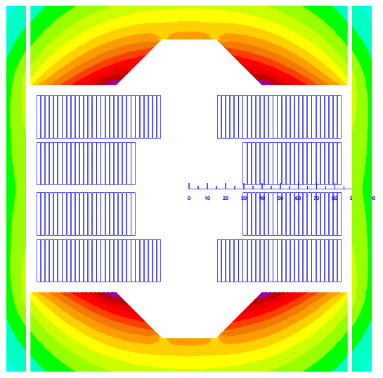
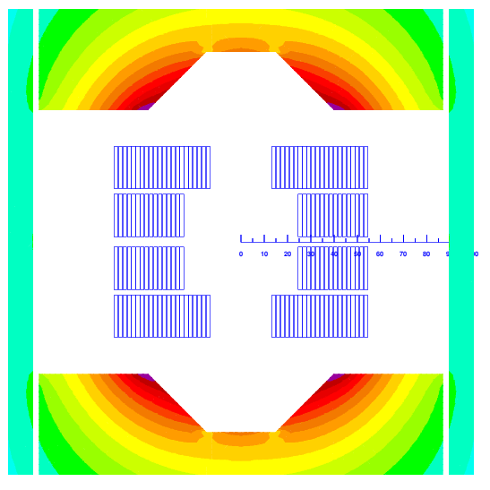
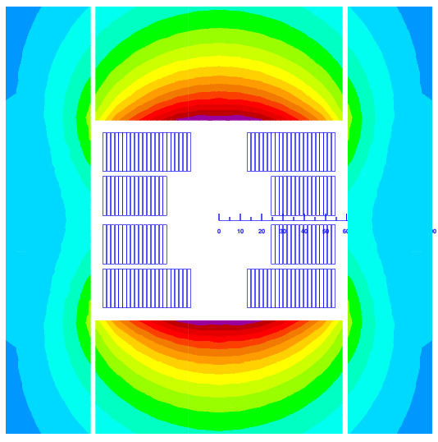
From BOND to 5-m long block
For all conceptual computations, the yoke OD is kept the same as in BOND (OD = 540 mm).
BOND
5-m coil in BOND iron
5-m coil in conceptual iron
≈ 15 mm
≈ 35 mm
*Plots for Option A – 40 mm

Slide 33
Load lines
Smaller aperture (dotted lines) allows us to bring a bit down the loadline.

Slide 34
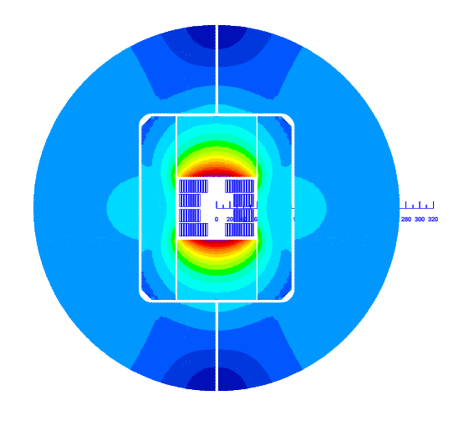
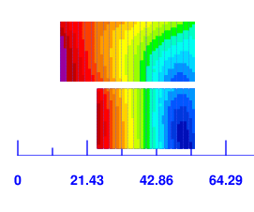
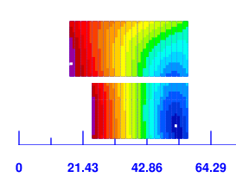
Main magnet parameters
Name |  | Bond_5m Single | Bond_5m Single | Bond_5m Single | Bond_5m Single | Bond_14T Single
 |  | Option A - 40 mm | Option A - 35 mm | Option B - 40 mm | Option B - 35 mm | Baseline
Aperture | (mm) | 40 | 35 | 40 | 35 | 50
Field | (T) | 12.00 | 12.00 | 12.00 | 12.00 | 14.00
Yoke outer diameter | (mm) | 540 | 540 | 540 | 540 | 540
Cable data
Material |  | Nb3Sn | Nb3Sn | Nb3Sn | Nb3Sn | Nb3Sn
Process |  | RRP | RRP | RRP | RRP | RRP
No. strands | (adim) | 40 | 40 | 40 | 40 | 40
Strand diameter | (mm) | 0.850 | 0.850 | 0.850 | 0.850 | 1.100
Cu/NonCu | (adim) | 1.2 | 1.2 | 1.2 | 1.2 | 0.9
RRR | (adim) | 150 | 150 | 150 | 150 | 150
Bare cable thickness (R) | (mm) | 1.59 | 1.59 | 1.59 | 1.59 | 2.06
Bare cable width (R) | (mm) | 18.363 | 18.363 | 18.363 | 18.363 | 23.275
Insulation thick radial (5 Mpa) | (mm) | 0.150 | 0.150 | 0.150 | 0.150 | 0.150
Insulated cable surface | (mm²) | 35.35 | 35.35 | 35.35 | 35.35 | 55.64
Filling factor | (adim) | 0.292 | 0.292 | 0.292 | 0.292 | 0.360
Coil design
Insulated cable surface (one aperture) | (mm²) | 5373 | 5373 | 5373 | 5373 | 11572
Equivalent coil width | (mm) | 34.5 | 36.1 | 34.5 | 36.1 | 53.4
Coil efficiency | (T mm / A) | 0.00075 | 0.00073 | 0.00075 | 0.00074 | 0.00073
N. layers | (adim) | 2 | 2 | 2 | 2 | 2
N. turns/pole | (adim) | 38 | 38 | 38 | 38 | 52
Operational parameters
Current (Inom) | (kA) | 16.470 | 16.143 | 16.320 | 15.910 | 20.005
Peak Field | (T) | 13.14 | 13.16 | 12.82 | 12.74 | 14.85
Bp/B0 |  | 1.09 | 1.10 | 1.07 | 1.06 | 1.06
Short sample current @ 1.9 K | (kA) | 19.810 | 19.480 | 20.120 | 19.850 | 24.199
Short sample current @ 4.5 K | (kA) | 17.640 | 17.360 | 17.950 | 17.660 | 21.602
Short sample field @ 1.9 K | (T) | 15.40 | 15.48 | 15.32 | 15.38 | 17.55
Short sample field @ 4.5 K | (T) | 13.97 | 14.02 | 13.90 | 13.94 | 15.93
j overall⁷ | (A/mm²) | 466 | 457 | 462 | 450 | 360
j strand | (A/mm²) | 726 | 711 | 719 | 701 | 526
j superconductor | (A/mm²) | 1596 | 1565 | 1582 | 1542 | 1000
Loadline fraction @1.9 K | (%) | 83.1 | 82.9 | 81.1 | 80.2 | 82.7
Loadline fraction @4.2 K | (%) | 93.4 | 93.0 | 90.9 | 90.1 | 92.6
Stored energy/m | (MJ/m) |  |  |  |  | 1.031
Inductance/m | (mH/m) |  |  |  |  | 4.72
Field quality |  | Rref = 13.333 | Rref = 11.66 | Rref = 13.333 | Rref = 11.66
Harmonic b3 @ Inom | (10⁻⁴) | -65.00 | -70.00 | 37.00 | 10.30 | -3.49
Harmonic b5 @ Inom | (10⁻⁴) | 0.80 | 3.80 | -9.00 | -5.40 | 2.78
Harmonic b7 @ Inom | (10-4) | 0.70 | -1.35 | -0.28 | -1.17 | 0.88
Protection
Coil energy density | (J/mm³) |  |  |  |  | 0.0891
j copper | (A/mm²) | 1330 | 1304 | 1318 | 1285 | 1111
Temperature margin @ 1.9 K | (K) |  |  |  |  | 3.99
Time margin | (ms) |  |  |  |  | 74.00
Hot spot Temperature | (K) |  |  |  |  | 114.00
MIITS | (MAAS) |  |  |  |  | 75.00
Although it is not trivial to anticipate what is more representative, focusing on coil production aspects:
  One option is to keep the same number of turns protruding (compared to BOND) and maximize the aperture.
These designs are far from being optimal solutions, reference values at 12 T are provided in the table. The Outer magnet dimensions needs to be re-worked later.

Slide 35
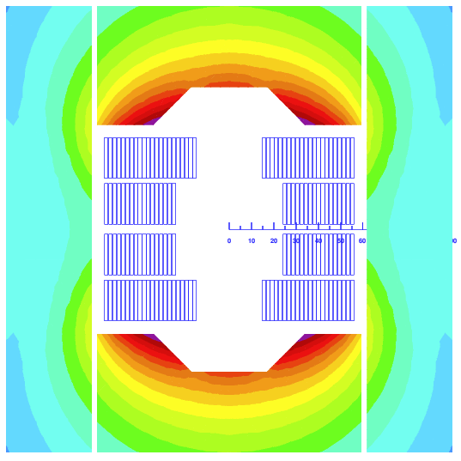
Option C
How much different does a good FQ version look like?

Slide 36




The following layouts provide reasonable field quality (within 10 units):
  Brown circle shows a 35 mm aperture. Blue circle shows the aperture considering 4 mm pole tip.
Option C
39 turns
1 mm interlayer
1.2 mm midplane
5 turns protruding
Best of all, but less interlayer and midplane than BOND
1 more turn
Option D
39 turns
2 mm interlayer
2 mm midplane
5 turns protruding
Fair approximation, we need to “open up” a bit the coil.
1 more turn
Option E
38 turns
2 mm interlayer
2 mm midplane
6 turns protruding
Coil very far away
Option F
38 turns
2 mm interlayer
2 mm midplane
4 turns protruding
Only 2 mm pole tip, or we should go to 30 mm ap.
NOTE:
6 and 4 turns protrusion can be done with 38 turns
5 turns needs to be done by adding /removing one turn

Slide 37



Load lines
Option C
Option D

Slide 38


Main magnet parameters
Name |  | Bond_5m Single | Bond_5m Single | Bond_5m Single | Bond_5m Single | Bond_14T Single
 |  | Option C | Option D | Option E | Option F | Baseline
Aperture | (mm) | 35 | 35 | 35 | 35 | 50
Field | (T) | 12.00 | 12.00 | 12.00 | 12.00 | 14.00
Yoke outer diameter | (mm) | 540 | 540 | 540 | 540 | 540
Cable data
Material |  | Nb3Sn | Nb3Sn | Nb3Sn | Nb3Sn | Nb3Sn
Process |  | RRP | RRP | RRP | RRP | RRP
No. strands | (adim) | 40 | 40 | 40 | 40 | 40
Strand diameter | (mm) | 0.850 | 0.850 | 0.850 | 0.850 | 1.100
Cu/NonCu | (adim) | 1.2 | 1.2 | 1.2 | 1.2 | 0.9
RRR | (adim) | 150 | 150 | 150 | 150 | 150
Bare cable thickness (R) | (mm) | 1.59 | 1.59 | 1.59 | 1.59 | 2.06
Bare cable width (R) | (mm) | 18.363 | 18.363 | 18.363 | 18.363 | 23.275
Insulation thick radial (5 Mpa) | (mm) | 0.150 | 0.150 | 0.150 | 0.150 | 0.150
Insulated cable surface | (mm²) | 35.35 | 35.35 | 35.35 | 35.35 | 55.64
Filling factor | (adim) | 0.292 | 0.292 | 0.292 | 0.292 | 0.360
Coil design
Insulated cable surface (one aperture) | (mm²) | 5514 | 5514 | 5373 | 5373 | 11572
Equivalent coil width | (mm) | 36.7 | 36.7 | 36.1 | 36.1 | 53.4
Coil efficiency | (T mm / A) | 0.00075 | 0.00071 | 0.00067 | 0.00074 | 0.00073
N. layers | (adim) | 2 | 2 | 2 | 2 | 2
N. turns/pole | (adim) | 39 | 39 | 38 | 38 | 52
Operational parameters
Current (Inom) | (kA) | 15.456 | 16.280 | 17.450 | 15.860 | 20.005
Peak Field | (T) | 12.78 | 12.89 | 13.20 | 12.66 | 14.85
Bp/B0 |  | 1.06 | 1.07 | 1.10 | 1.05 | 1.06
Short sample current @ 1.9 K | (kA) | 19.330 | 19.950 | 20.600 | 19.800 | 24.199
Short sample current @ 4.5 K | (kA) | 17.225 | 17.770 | 18.340 | 17.670 | 21.602
Short sample field @ 1.9 K | (T) | 15.53 | 15.36 | 15.15 | 15.39 | 17.55
Short sample field @ 4.5 K | (T) | 14.05 | 13.91 | 13.76 | 13.94 | 15.93
j overall⁷ | (A/mm²) | 437 | 461 | 494 | 449 | 360
j strand | (A/mm²) | 681 | 717 | 769 | 699 | 526
j superconductor | (A/mm²) | 1498 | 1578 | 1691 | 1537 | 1000
Loadline fraction @1.9 K | (%) | 80.0 | 81.6 | 84.7 | 80.1 | 82.7
Loadline fraction @4.2 K | (%) | 89.7 | 91.6 | 95.1 | 89.8 | 92.6
Stored energy/m | (MJ/m) | 0.379 | 0.425 |  |  | 1.031
Inductance/m | (mH/m) | 2.88 | 2.89 |  |  | 4.72
Field quality |  | Rref = 11.66 | Rref = 11.66 | Rref = 11.66 | Rref = 11.66
Harmonic b3 @ Inom | (10⁻⁴) | 2.84 | 5.66 | -0.40 | 6.80 | -3.49
Harmonic b5 @ Inom | (10⁻⁴) | 0.15 | -3.30 | -4.80 | -8.00 | 2.78
Harmonic b7 @ Inom | (10-4) | 0.60 | 0.01 | 0.90 | -4.00 | 0.88
Protection
Coil energy density | (J/mm³) | 0.0686 | 0.0770 |  |  | 0.0891
j copper | (A/mm²) | 1248 | 1315 | 1409 | 1281 | 1111
Temperature margin @ 1.9 K | (K) | 4.41 |  |  |  | 3.99
Time margin | (ms) | 63 |  |  |  | 74.00
Hot spot Temperature | (K) |  |  |  |  | 114.00
MIITS | (MAAS) |  |  |  |  | 75.00
Mechanics
Forces x | (MN/m) | 3.309 | 3.483 |  |  | 5.937
Forces y | (MN/m) | -1.304 | -1.372 |  |  | -2.680
Fx/2*Wcable | (MPa) | 88.7 | 93.3 | 0.0 | 0.0 | 125.9
Just a very first order look at a design with:
  ~ 20 % margin at 12 T, 1.9 K
  Peak field to bore field ratio ~ 1.06 / 1.07 (Closer to BOND)
  Field quality at nominal (not fully optimized) within 10 units
  12.5 mm minimum bending radius (top pole)
As previously mentioned, outer magnet dimensions and iron in general needs to be further re-worked (rod holes, etc).

Slide 39




Does a mirror make sense?
One would consider it only if we are very short in strand/cable (i.e., we use 1.1 mm strand)
44 strands, 1.1 mm, 52 turns
v1m1
v1m2
v1m3
v1m4
* Slide from Susana

Slide 40
Outline
Introduction
  Previous block designs with flared ends (built)
  Scaling in length
  Main challenges for flared block-type coils fabrication
  Objectives
Technical options
Recap on proposal
Additional slides

Slide 41
Proposal
Design and manufacturing of a single aperture 5-m long block-type magnet:
MQXF flat cable (no keystone)
Use a single MQXFB unit length of conductor to manufacture ~ 2 block coils
Aperture scaled down, proposal is 35 mm (from 50 mm)
Option C as a starting point (lays in between the purely “coil construction” proposals). It looks like an attractive option for a test-bed. In case one turn more is a problem we could check one less or a shorter coil.
The idea is to go as fast as reasonably possible:
Ideally wind & react a short coil before doing the manufacturing drawings of the long (the engineering design of the tooling can start before)
Next steps:
Detailed conceptual design for the baseline option (2D/3D electromagnetic and mechanical studies with iron and OD optimization).

Slide 42
Discussion
Comments from Attilio:
Check maximum OD for vertical testing and which test station to use. 20kA short sample limit.
Make iron smaller, there is too much iron - Yes, we need to optimize it.
Mold to fit in 11 T oven. We would not like to touch the MQXF one while in production.
Questions on whether we want to machine the rails or not. It would be nice to have something repeatable without machining. We could think on using for the rail a softer material or a material easier to machine in house.
How to measure the coils? We want to check Metrascan.
Any experience on expansion during RHT for rectangular cable? We have RMC-QXF, maybe we can check something from Elena’s work.
Instrumentation? Yes, a lot.
Wedge impregnated
Protection? Not sure if we could get rid of QH immediately, ESC may not be mature enough at that time. For a short model is easy because you have the dump. Design will have the place for QH in the tooling and coil, but whatever we do we want them outside the impregnated coil.

Slide 43
Outline
Introduction
  Previous block designs with flared ends (built)
  Scaling in length
  Main challenges for flared block-type coils fabrication
  Objectives
Technical options
Recap on proposal
Additional slides

Slide 44
Additional slides

Slide 45

Notes
EOS workspace created in: \\eosproject-smb\eos\project\w\wp33-5m-long-block-coil
Work on-going and planning on infrastructure (20/2/2025):

Slide 46

Very quick preliminary look on protection
5-m long block Option C
T_{margin} = 4.4 K
E_{margin} = 15.5 mJ/cm³
E_{density} = 0.0686 J/mm³
E_{stored} = 0.38 MJ/m
All conductors quenched t=0

Slide 47





Very quick preliminary look on protection
MQXF
T_{margin} = 5 K
E_{margin} = 21.2 mJ/cm³
E_{density} = 0.0832 J/mm³ E_{stored} = 1.2 MJ/m

Slide 48
BOND Magnet development plan
Analysis
Iterative engineering design
First Single Aperture Magnet #1 assembly
Trial Copper Coil
Powering tests Magnet #2
1st Nb₃Sn Coil Winding
Double Aperture Magnet #1 assembly
Q1_2025
Q2_2025
Q3_2025
Q4_2025
Q1_2026
Q2_2026
Q3_2026
Q4_2026
Double Aperture Magnet Magnet #1 powering tests
Today
Insulated Nb₃Sn Cable delivery
Single Aperture Magnet #2 assembly
First dummy copper cable at CERN
Coil 3D CAD Design
3D CAD Winding, reaction & splicing tooling
Cold Powering Tests Magnet #1

Slide 49
BOND baseline
 |  |  | SINGLE APERTURE BOND
 |  |  | 2025 |  |  |  |  |  |  |  |  |  |  |  |  |  |  |  |  |  |  |  |  |  |  |  | 2026
 | Category | Sub-category | Jan |  | Feb |  | Mar |  | Apr |  | May |  | Jun |  | Jul |  | Aug |  | Sep |  | Oct |  | Nov |  | Dec |  | Jan |  | Feb |  | Mar |  | Apr |  | May |  | Jun |  | Jul |  | Aug |  | Sep |  | Oct |  | Nov |  | Dec
 | 2D / 3D Conceptual design
 | Coil design | 3D CAD
 |  | Drawings |  |  |  |  |  |  |  | No parallelized for the moment
 |  | Manufacturing
 |  | Reception at CERN
 | Winding & Reaction tooling | 3D CAD
 |  | Drawings |  |  |  |  |  |  |  |  | No parallelized for the moment
 |  | Manufacturing
 |  | Reception at CERN
 | Impregnation tooling | 3D CAD
 |  | Drawings |  |  |  |  |  |  |  |  |  | No parallelized for the moment
 |  | Manufacturing
 |  | Reception at CERN
 | Magnet structure | 3D CAD
 |  | Drawings
 |  | Manufacturing
 |  | Reception at CERN
 | Conductor | Copper run
 |  | Nb3Sn run
 |  | Nb3Sn insulation
 |  | Insulated Nb3Sn delivery
 | Trial / copper coil | Winding
 |  | Reaction
 |  | Impregnation
 |  | Finishing
 | Nb3Sn Coil 1 | Winding
 |  | Reaction
 |  | Impregnation
 |  | Finishing
Launch manufacturing drawings 5-m long block

Slide 50
Other aspects – open ideas
Some open questions:
- Shall we think on making the manufacturing tooling compatible with a 40x1.1 strand coil?

Slide 51







Winding tests at CERN
44 strands x 1.1 mm
Initial tests performed
Final tests
  Easy-way bending tests
  Experimental validation and consolidation of the new baseline
  Additional winding test to explore the impact of the winding tension.
    R_{easy-way} = 12 mm
    R_{easy-way} = 13 mm
    R_{easy-way} = 14.8 mm
    For our baseline cable architecture (44 strands x 1.1 mm), all tests were successfully completed.
  Combined easy-way and hard-way bending tests → Focus on 44 strands x 1.1 mm
    R_{easy-way} = 13 mm & R_{hard-way} from 275 to 450 mm
      Strand instabilities and pop-outs identified.
    R_{easy-way} = 15 mm & R_{hard-way} 350 and 450 mm
      For 450 mm → feasible. In general, cable stable.
      No pop-outs identified.
    Decision made to take a safety margin and to align with previous experience (FRESCA2) → increase the R_{hard-way} to 750 mm (small impact in coil length, ~52 mm)
Courtesy of D. Pulikowski, PhD. Thesis
[https://cds.cern.ch/record/2641140/files/CERN-THESIS-2018-181.pdf]
    New design baseline: R_{easy-way} = 15 mm & R_{hard-way} = 750 mm
Courtesy of E. Fernandez Mora

Slide 52


Coil options (3D)
For the flared-end geometry, we propose to use the same strategy for the definition of the parameters as in BOND. Today for the short we have:
  Curvature radius = 750 mm
  Angle = 7 Deg
  Straight ramp = 178.4 mm

Slide 53



Impact of the V-pad insert
We also check what is the impact of the V-pad notch
5-m coil in conceptual iron
5-m coil in BOND-type iron

Slide 54
5-m length coil demonstration plan: Option 1
CAD Impregnation Tooling
Cold Powering Tests Magnet #1
1-m length coils
CAD Winding & Reaction tooling
Trial Copper Coil
Coil CAD Design
1st Nb₃Sn Coil
To be modified, with the BOND HFM baseline
Q3_2024
Q4_2024
Q1_2025
Q2_2025
Q3_2025
Q4_2025
Q1_2026
Q2_2026
Q3_2026
Start Coil CAD Design
Start CAD Winding & Reaction tooling
1st Nb₃Sn Coil
5-m length coils
CAD Impregnation Tooling
Trial Copper Coil
Timeline if we are reasonably confident with the design of the short coil tooling (i.e., the overall concept is fine, and we don’t expect huge changes from short to long)

Slide 55
Name |  | Bond_5m Single | Bond_5m Single | Bond_5m Single | Bond_5m Single | Bond_5m Single | Bond_5m Single | Bond_5m Single | Bond_5m Single | Bond_14T Single
 |  | Option A - 40 mm | Option A - 35 mm | Option B - 40 mm | Option B - 35 mm | Option C | Option D | Option E | Option F | Baseline
Aperture | (mm) | 40 | 35 | 40 | 35 | 35 | 35 | 35 | 35 | 50
Field | (T) | 12.00 | 12.00 | 12.00 | 12.00 | 12.00 | 12.00 | 12.00 | 12.00 | 14.00
Yoke outer diameter | (mm) | 540 | 540 | 540 | 540 | 540 | 540 | 540 | 540 | 540
Cable data
Material |  | Nb3Sn | Nb3Sn | Nb3Sn | Nb3Sn | Nb3Sn | Nb3Sn | Nb3Sn | Nb3Sn | Nb3Sn
Process |  | RRP | RRP | RRP | RRP | RRP | RRP | RRP | RRP | RRP
No. strands | (adim) | 40 | 40 | 40 | 40 | 40 | 40 | 40 | 40 | 40
Strand diameter | (mm) | 0.850 | 0.850 | 0.850 | 0.850 | 0.850 | 0.850 | 0.850 | 0.850 | 1.100
Cu/NonCu | (adim) | 1.2 | 1.2 | 1.2 | 1.2 | 1.2 | 1.2 | 1.2 | 1.2 | 0.9
RRR | (adim) | 150 | 150 | 150 | 150 | 150 | 150 | 150 | 150 | 150
Bare cable thickness (R) | (mm) | 1.59 | 1.59 | 1.59 | 1.59 | 1.59 | 1.59 | 1.59 | 1.59 | 2.06
Bare cable width (R) | (mm) | 18.363 | 18.363 | 18.363 | 18.363 | 18.363 | 18.363 | 18.363 | 18.363 | 23.275
Insulation thick radial (5 Mpa) | (mm) | 0.150 | 0.150 | 0.150 | 0.150 | 0.150 | 0.150 | 0.150 | 0.150 | 0.150
Insulated cable surface | (mm²) | 35.35 | 35.35 | 35.35 | 35.35 | 35.35 | 35.35 | 35.35 | 35.35 | 55.64
Filling factor | (adim) | 0.292 | 0.292 | 0.292 | 0.292 | 0.292 | 0.292 | 0.292 | 0.292 | 0.360
Coil design
Insulated cable surface (one aperture) | (mm²) | 5373 | 5373 | 5373 | 5373 | 5514 | 5514 | 5373 | 5373 | 11572
Equivalent coil width | (mm) | 34.5 | 36.1 | 34.5 | 36.1 | 36.7 | 36.7 | 36.1 | 36.1 | 53.4
Coil efficiency | (T mm / A) | 0.00075 | 0.00073 | 0.00075 | 0.00074 | 0.00075 | 0.00071 | 0.00067 | 0.00074 | 0.00073
N. layers | (adim) | 2 | 2 | 2 | 2 | 2 | 2 | 2 | 2 | 2
N. turns/pole | (adim) | 38 | 38 | 38 | 38 | 39 | 39 | 38 | 38 | 52
Operational parameters
Current (Inom) | (kA) | 16.470 | 16.143 | 16.320 | 15.910 | 15.456 | 16.280 | 17.450 | 15.860 | 20.005
Peak Field | (T) | 13.14 | 13.16 | 12.82 | 12.74 | 12.78 | 12.89 | 13.20 | 12.66 | 14.85
Bp/B0 |  | 1.09 | 1.10 | 1.07 | 1.06 | 1.06 | 1.07 | 1.10 | 1.05 | 1.06
Short sample current @ 1.9 K | (kA) | 19.810 | 19.480 | 20.120 | 19.850 | 19.330 | 19.950 | 20.600 | 19.800 | 24.199
Short sample current @ 4.5 K | (kA) | 17.640 | 17.360 | 17.950 | 17.660 | 17.225 | 17.770 | 18.340 | 17.670 | 21.602
Short sample field @ 1.9 K | (T) | 15.40 | 15.48 | 15.32 | 15.38 | 15.53 | 15.36 | 15.15 | 15.39 | 17.55
Short sample field @ 4.5 K | (T) | 13.97 | 14.02 | 13.90 | 13.94 | 14.05 | 13.91 | 13.76 | 13.94 | 15.93
j overall⁷ | (A/mm²) | 466 | 457 | 462 | 450 | 437 | 461 | 494 | 449 | 360
j strand | (A/mm²) | 726 | 711 | 719 | 701 | 681 | 717 | 769 | 699 | 526
j superconductor | (A/mm²) | 1596 | 1565 | 1582 | 1542 | 1498 | 1578 | 1691 | 1537 | 1000
Loadline fraction @1.9 K | (%) | 83.1 | 82.9 | 81.1 | 80.2 | 80.0 | 81.6 | 84.7 | 80.1 | 82.7
Loadline fraction @4.2 K | (%) | 93.4 | 93.0 | 90.9 | 90.1 | 89.7 | 91.6 | 95.1 | 89.8 | 92.6
Stored energy/m | (MJ/m) |  |  |  |  | 0.379 | 0.425 |  |  | 1.031
Inductance/m | (mH/m) |  |  |  |  | 2.88 | 2.89 |  |  | 4.72
Field quality |  | Rref = 13.333 | Rref = 11.66 | Rref = 13.333 | Rref = 11.66 | Rref = 11.66 | Rref = 11.66 | Rref = 11.66 | Rref = 11.66
Harmonic b3 @ Inom | (10⁻⁴) | -65.00 | -70.00 | 37.00 | 10.30 | 2.84 | 5.66 | -0.40 | 6.80 | -3.49
Harmonic b5 @ Inom | (10⁻⁴) | 0.80 | 3.80 | -9.00 | -5.40 | 0.15 | -3.30 | -4.80 | -8.00 | 2.78
Harmonic b7 @ Inom | (10-4) | 0.70 | -1.35 | -0.28 | -1.17 | 0.60 | 0.01 | 0.90 | -4.00 | 0.88
Protection
Coil energy density | (J/mm³) |  |  |  |  | 0.0686 | 0.0770 |  |  | 0.0891
j copper | (A/mm²) | 1330 | 1304 | 1318 | 1285 | 1248 | 1315 | 1409 | 1281 | 1111
Temperature margin @ 1.9 K | (K) |  |  |  |  | 4.41 |  |  |  | 3.99
Time margin | (ms) |  |  |  |  | 63 |  |  |  | 74.00
Hot spot Temperature | (K) |  |  |  |  |  |  |  |  | 114.00
MIITS | (MAAS) |  |  |  |  |  |  |  |  | 75.00
Mechanics
Forces x | (MN/m) |  |  |  |  | 3.309 | 3.483 |  |  | 5.937
Forces y | (MN/m) |  |  |  |  | -1.304 | -1.372 |  |  | -2.680
Fx/2*Wcable | (MPa) | 0.0 | 0.0 | 0.0 | 0.0 | 88.7 | 93.3 | 0.0 | 0.0 | 125.9

Slide 56





The HL-LHC Nb₃Sn magnets
MQXF
HL-LHC MBH 11 T
30 large aperture (150 m) and more powerful quadrupoles around ATLAS and CMS to decrease the beam size and increase the integrated luminosity by a factor 10
Construction of pre-series and series magnets on-going, joint effort between CERN (7.2 m length magnets) and US-AUP (4.2 m length magnets)
4 pairs of shorter (33 m) and more powerful dipole bending magnets to free up space for the new collimators (2x5.5 m length 11 T dipoles to replace 14.3-m-long LHC MB dipole)
Initially planned for 2020, now de-scoped
E. Todesco
F. Savary

Slide 57


The 12 T challenge – current density
LHC MB
NbTi, B_{p} = 8.6 T
w_{eq} = 27 mm
J_{strand} = 475/616 A/mm²
HL-LHC MBH 11 T
Nb₃Sn, B_{p} = 11.7 T
w_{eq} = 28 mm
J_{strand} = 770 A/mm²
HL-LHC MQXF
Nb₃Sn, B_{p} = 11.3 T
w_{eq} = 36 mm
J_{strand} = 715 A/mm²

Slide 58
The 12 T challenge – e.m. forces
≈ 2 times more force/stress than in the LHC-MB dipoles, in a brittle conductor
LHC MB
NbTi, B_{p} = 8.6 T
F_{x} = 3.4 MN/m
σ_{θ,em} = 50-60 MPa
F_{z} = 265 kN
HL-LHC MBH 11 T
Nb₃Sn, B_{p} = 11.7 T
F_{x} = 7.2 MN/m
σ_{θ,em} = 100-110 MPa
F_{z} = 450 kN
HL-LHC MQXF
Nb₃Sn, B_{p} = 11.3 T
F_{x} = 6.8 MN/m
σ_{θ,em} = 100-110 MPa
F_{z} = 1200 kN
F_{x} per half magnet; F_{z} per aperture

Slide 59
The 12 T challenge – protection
T_{hot} ≈ 100 K higher than in the LHC-MB dipoles, half the time margin
LHC MB
NbTi, B_{p} = 8.6 T
J_{overall}(I_{nom}) = 356/442 A/mm²
J_{cu}(I_{nom}) = 763/932 A/mm²
e_{m} (I_{nom}) = 71 J/cm²
HL-LHC MBH 11 T
Nb₃Sn, B_{p} = 11.7 T
J_{overall}(I_{nom}) = 522 A/mm²
J_{cu}(I_{nom})= 1440 A/mm²
e_{m} (I_{nom})= 124 J/cm²
HL-LHC MQXF
Nb₃Sn, B_{p} = 11.3 T
J_{overall}(I_{nom})= 462 A/mm²
J_{cu}(I_{nom}) = 1311 A/mm²
e_{m} (I_{nom})= 120 J/cm²

