Slide 1
BGC Regular Meeting
BGC Integration v4
L.Margerison 07.02.2025

Slide 2
Summary of decisions from 24.01.2025
Decided configuration
Gas jet at 45 degrees to horizontal
2x optical viewing assemblies
1 for horizontal one for vertical
Both mounted vertically
Clashes that occurred
First round of changes to integrate the decided upon configuration

Slide 3
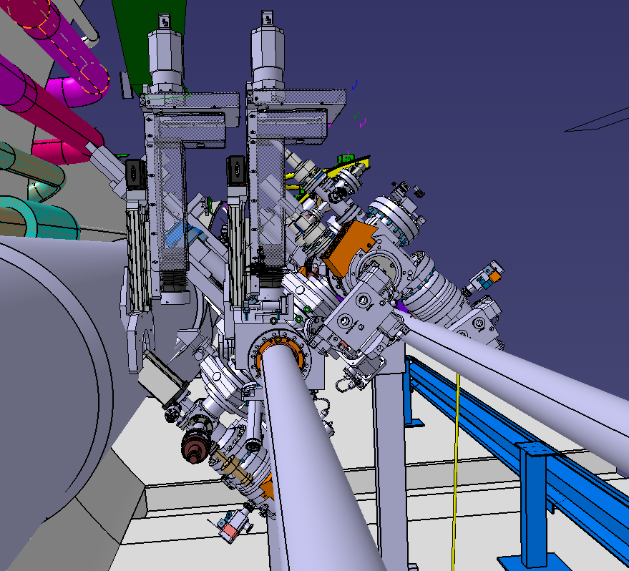


Detailed Model – Modified v4 Configuration
v4 Configuration
Gas Injection at 45 degrees
Two optical assemblies
Key integration areas for work
Turbo pump
Optical collaboration units
Gas dump assembly
Optical assembly
Gate valve

Slide 4
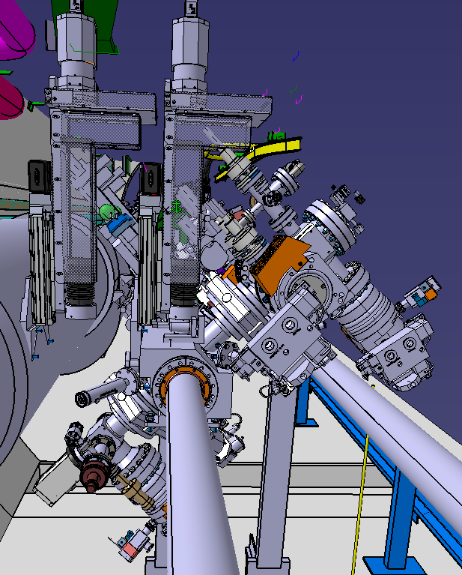
Detailed Model – Modified v4 Configuration
v4 Configuration
Gas Injection at 45 degrees
Two optical assemblies
Key integration areas for work
Turbo pump
  Will rotate and move so not colliding with beam line 1
Optical collaboration units
  Added 2nd unit and moved to reduce clashes
Gas dump assembly
  Moved to be in line with gas injection
Optical assembly
  Looks to be sufficient space, needs work detailing integration with chamber and the other optical assembly
Gate valve
  Will look into DN40 valve currently DN63

Slide 5
Optical aperture vs Injection chamber length
May need to move gate valve further from chamber body to not collide with current optical aperture
If a larger optical aperture is desired this may come at the cost of moving the gate valve, and extending injection chamber length
Study and discussion to determine this trade off

Slide 6
Next steps/conclusions
Investigate DN40 Gate Valve between 3rd skimmer and main chamber
  If possible, what can the max diameter of the optical port be?
Rearrange turbo molecular pumps on injection chamber so they do not clash with other systems/beam line
Detail optical assembly of the 2 systems
From findings from issues with v3 BGC at 1st turbomolecular pump – make updates to v4 (bigger pump etc)

