Slide 1






BGC Meeting
CI update
CI team
7.02.2025

Slide 2

Contents
Pulse jet injection on JEREMY test stand
Updates on Version 4.1
Updates on Cross-section study
Plans
7.02.2025

Slide 3
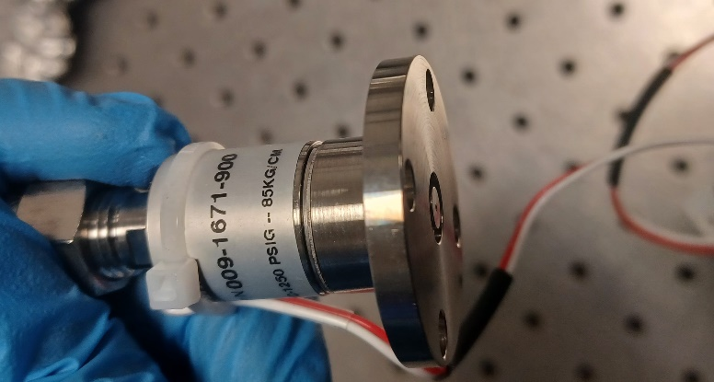
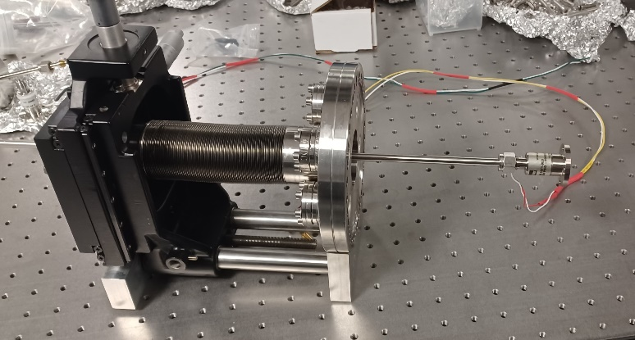
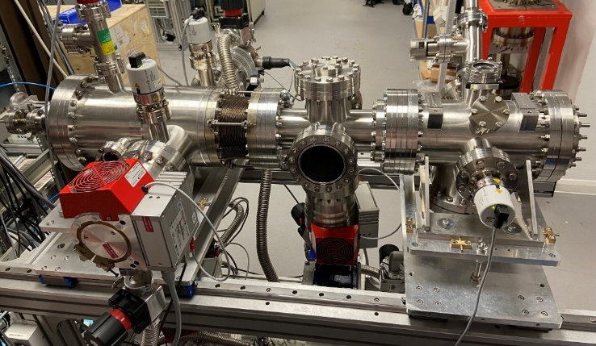
Solenoid valve
Pulse jet valve mounted on 3D modular
JEREMY Test stand
Nozzle-1st | 1st-2nd | 2nd-3rd | 3rd-IP | IP-4th
3-11 | 24.75 | 250.33-290.33 | 150.18 | 172.68
minimum distances (nozzle at 3mm, bellows at 80mm)
3 | 27.75 | 278.08 | 428.26 | 600.94
Sizes / mm
Nozzle | 1st Skim | 2nd Skim | 3rd Skim | 4th Skim
0.5 | 0.36 | 2 | 0.4x30 | 4x60
11th BGC Collaboration Meeting

Slide 4
JEREMY setup with pulse jet
Operating parameters:
Solenoid valve nozzle: 0.5mm
Operating voltage: 25V
Inlet pressure: 2bar and 3bar
Pulse period:1s
Pulse width or duty cycle: 10ms and 30ms
7.02.2025

Slide 5
Preliminary observations:
Pressure levels vary, if the duty cycle increases from 10ms to 30ms
For 10ms duty cycle, the pressure levels are better as compared to 30ms.
Unlike, normal nozzle for continuous operation, for pulse jet, results are not consistent on repeated attempts.
7.02.2025

Slide 6
Planned experiments:
0.1mm nozzle pulse jet to be tested.
At different operating conditions with variation of inlet pressure, duty cycle and periodicity of the pulse are planned.
A comparison study between 0.5mm and 0.1mm nozzle sizes will be done, to estimate the density and record the pressure levels.
For understanding of pulse jet phenomenon at different chambers, simulation study could be a better option.
7.02.2025

Slide 7
Planned experiments:
0.1mm nozzle pulse jet to be tested.
At different operating conditions with variation of inlet pressure, duty cycle and periodicity of the pulse are planned.
A comparison study between 0.5mm and 0.1mm nozzle sizes will be done, to estimate the density and record the pressure levels.
For understanding of pulse jet phenomenon at different chambers, simulation study could be a better option.
7.02.2025

Slide 8
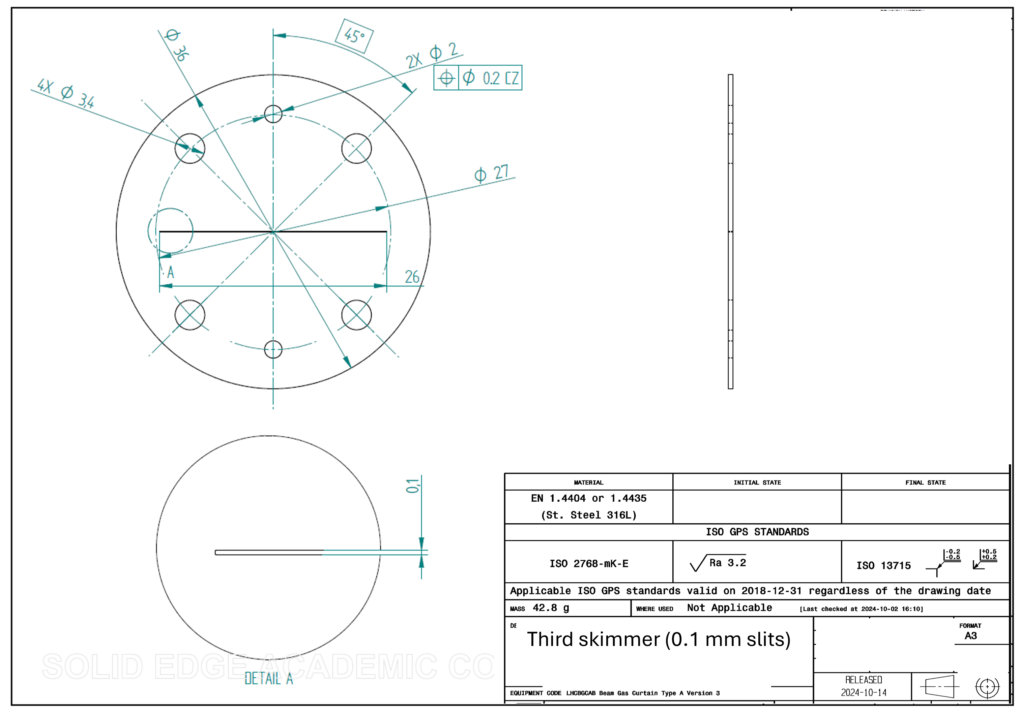
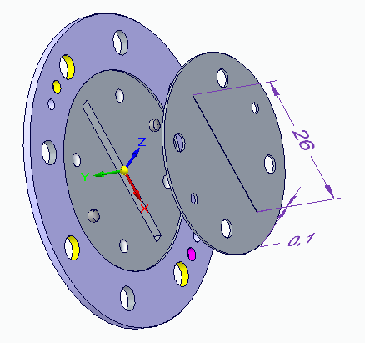
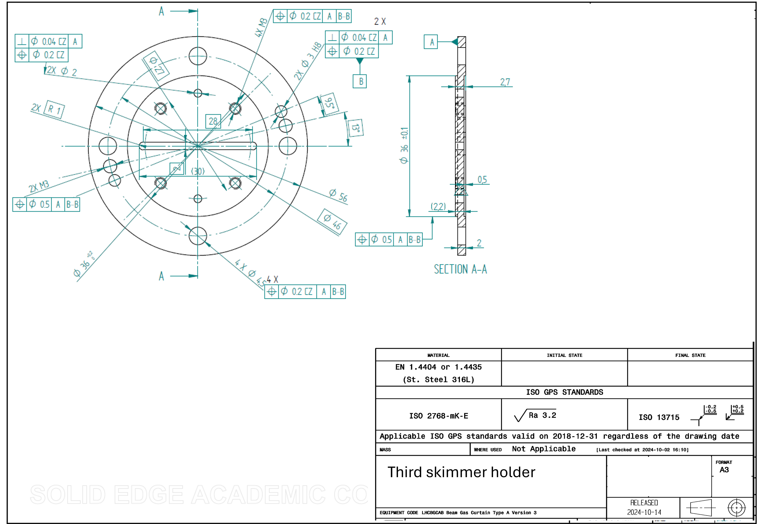
Version 4.1
This design will only for v4.1 BGC@EBTS.
Send out for feasibility and quotation.
Gerhard/Lauren will investigate 0.1 mm or small slit 3rd skimmer with designs compatible for the LHC.
7.02.2025

Slide 9
Cross-section
In slow progress with Ion data, but not proton.
I get all the access for CERN virtual Linux computer. ChatGPT and DeepSeek help coding for Timber data access.
Will schedule meeting with Danielle, Peter and Serban next week for discussions.
7.02.2025

Slide 10
Planned journal articles
2025:
  “Measurements at 7 TeV with protons and lead ions”,
    lead by Ondrej and Hao, submitted to PRL.
  “Simulation and experimental studies into a supersonic gas jet curtain for beam profile monitoring”,
    mainly about the simulation method,
    analytical calculation for continuum flow + quitting surface for transition + Monte Carlo simulation for molecular beam tracking.
    Lead by Hao, in preparation for Vacuum or Nucl Instr Meth A, In progress, aiming end of February.
  BGC@EBTS results from 2023
    lead? Still unclear, need clarification from Sameed and Adriana.
    Potentially Nucl Instr Meth A or Rev Sci Instr.
  “MOGA simulation”, in progress
    lead by Oliver, potentially Vacuum.
  “V3 with full technical details”
    Mechanical design and gas flow test
    Optical system and resolution test
    LHC measurements in details (Visible and UV)
    Phys Rev AB, Lead by Danielle and Hao.
  “Cross section study”
    lead by Hao/Shakti/Oliver, Phys Rev C?
7.02.2025

