Slide 1
R2E
Clustering Algorithm
Daniel Prelipcean
2025.03.05

Slide 2
Objective
The Timepix3 measured data arrives at pixel level, implying that clustering (=grouping of pixels) has to be applied in order to reconstruct individual particle tracks.
The pixel information contains:
  Time over Threshold (ToT):
    energy deposition measurement (to be calibrated to energy)
    in units of 25 ns
    stored in 10 bits (goes up to 2^10 =1024)
  Time of Arrival (ToA):
    in units of 25 ns
    stored in 16 bits (goes up to 40 000)
  fast ToA (fToA): in units of 1.5625 ns
    stored in bits (goes up to 2^
  Column (x), Row (y): pixel indices (spatial location)
  Unix/Epoch Timestamp: 1 s resolution

Slide 3
R2E clustering algorithm: v3
Previous version (v2) explained in more detail in: https://indico.cern.ch/event/1173051/
Long story short for v3:
Select a snapshot on Epoch Timestamp, i.e. 1 second interval.
1D DBSCAN on ToA+fToA to identify time clusters
2D DBSCAN on pixel matrix to identify spatial clusters
Note:
  Works well on rather low fluxes 1e2 particles/(cm^2 s)
  For higher fluxes, pixels are from different particle interactions are clustered together if:
    Spatially close (connected), even if quite spread apart in time (if time window in step 2 is too large)
      In extreme cases: Artificial Pile up: Overlapping particles in space.
    Close in time and disconnected in space, but nearby each other (if too many particles in step 3)
Due to b, several correction procedures are applied on the once clustered data.

Slide 4
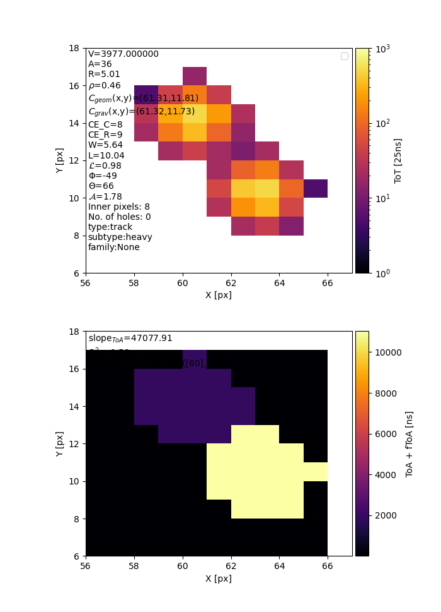
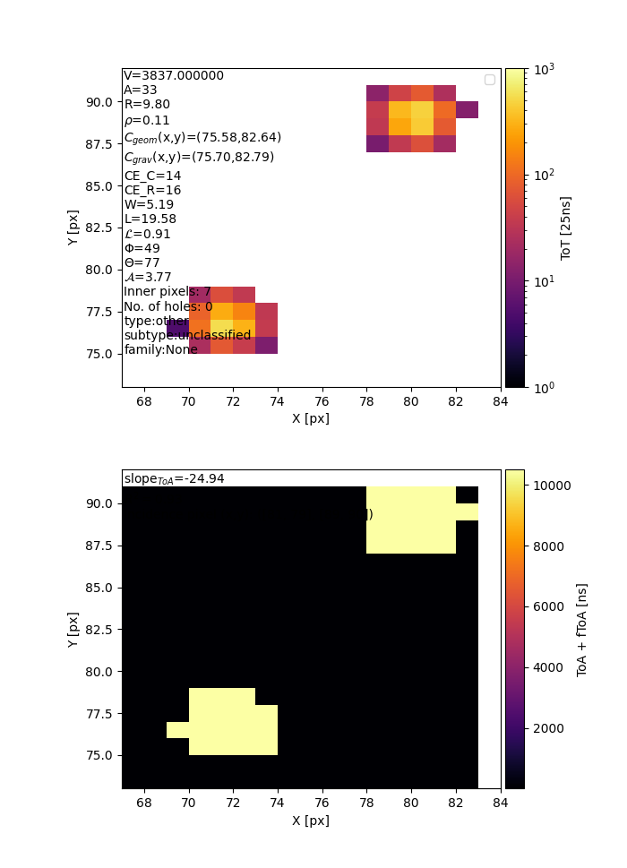
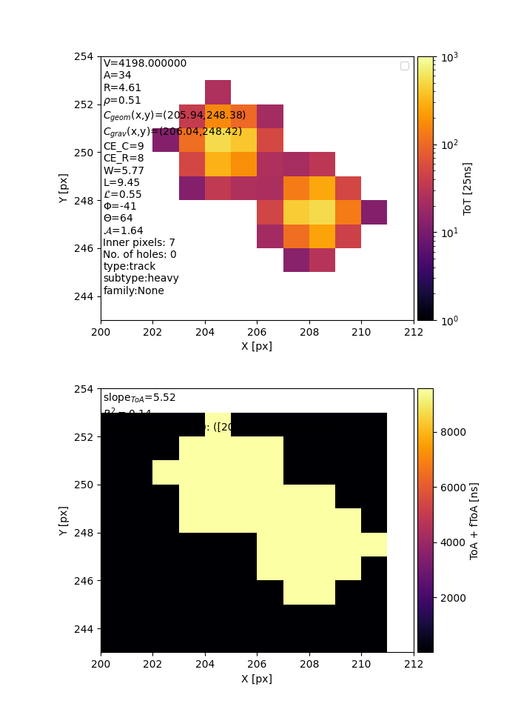
Examples of wrongly clustered tracks that have to be corrected for

Slide 5
Correction procedures
On the output after the first clustering:
Timewise splitting:
  Look at the ToA+fToA information for the pixels inside a cluster:
  if too spread apart = more than 200 ns (empirical value), then apply a 1D DBSCAN to identify time clusters and split cluster.
Spatial splitting:
  Look at the spatial information for the pixels inside a cluster:
  if disconnected, split into individual subclusters.
Pile up splitting:
  Check if the same pixel is fired twice
  If yes, discard from analysis.
Note: hits that are connected and with the same ToA information will not be split.

Slide 6
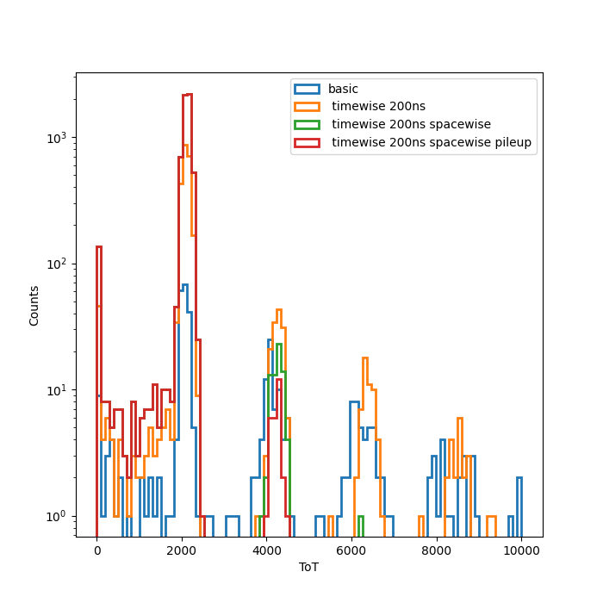
Results

Slide 7


