Slide 1
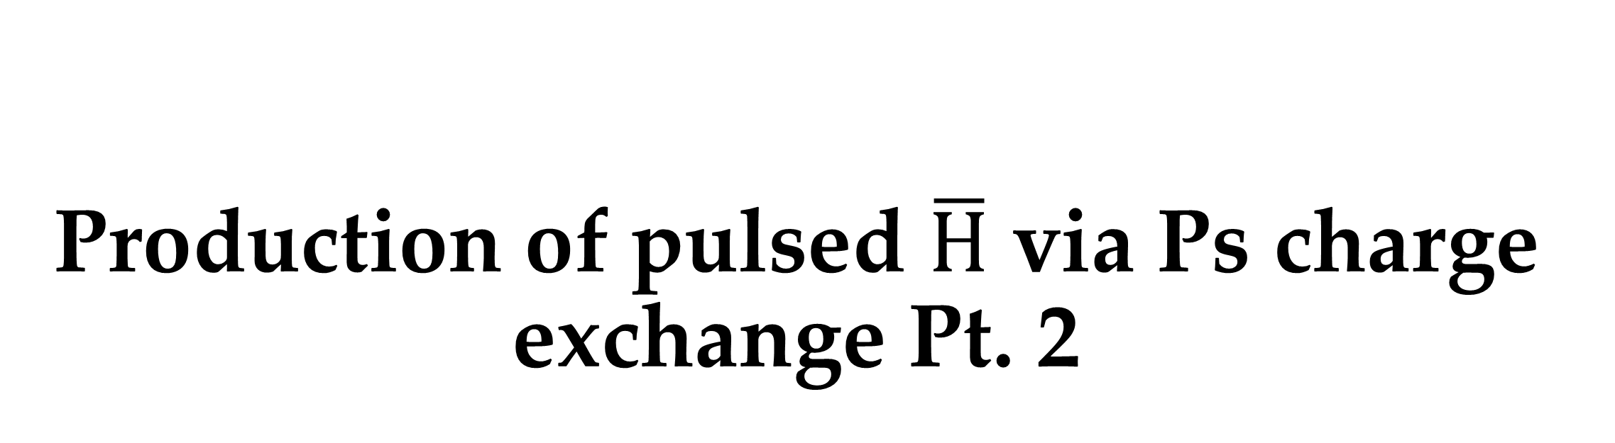
Production of pulsed $\overline{H}$ via Ps charge exchange Pt. 2
For part 1, see Hiroshima 2019
Ross E. Sheldon
ASACUSA Collaboration Meeting, ICL
03/04/2025

Slide 2
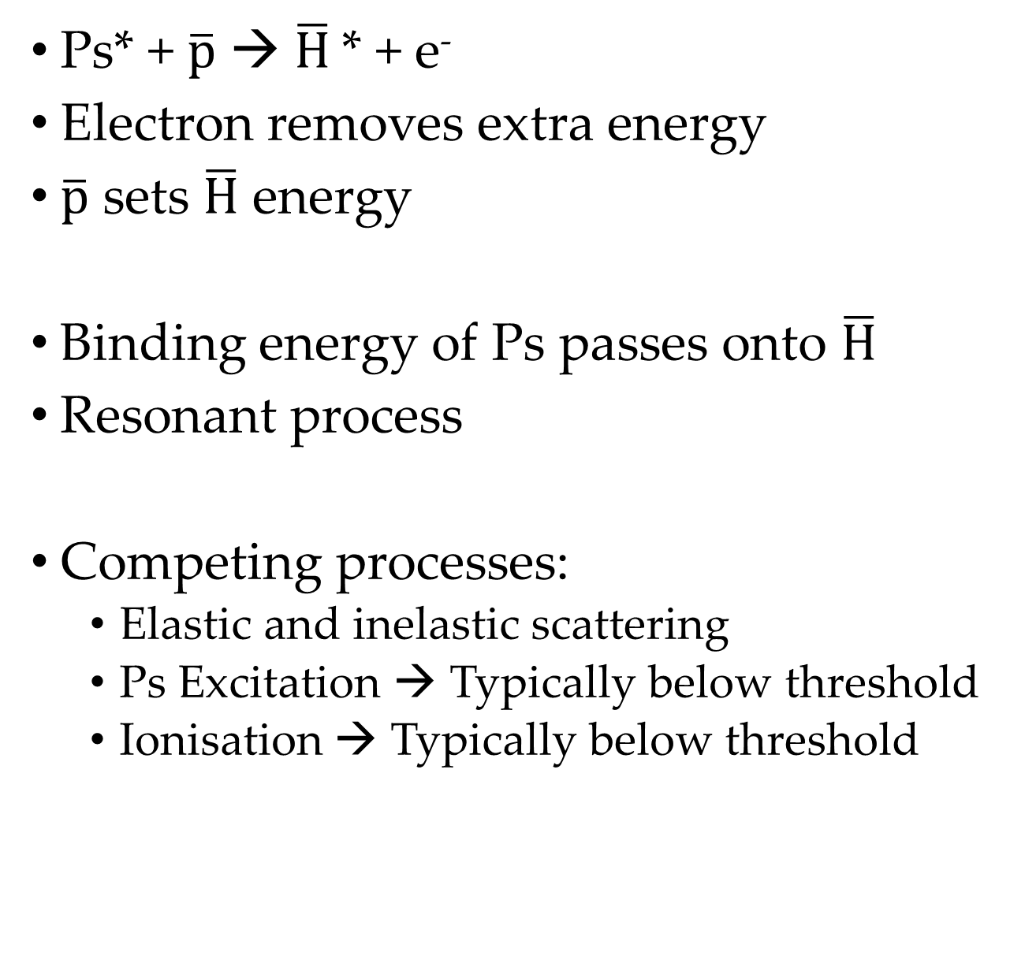
Charge exchange
Ps* + $\overline{p}$ → $\overline{H}$* + e⁻
Electron removes extra energy
$\overline{p}$ sets $\overline{H}$ energy
Binding energy of Ps passes onto $\overline{H}$
Resonant process
Competing processes:
  Elastic and inelastic scattering
  Ps Excitation → Typically below threshold
  Ionisation → Typically below threshold
Notes:
﻿

Slide 3
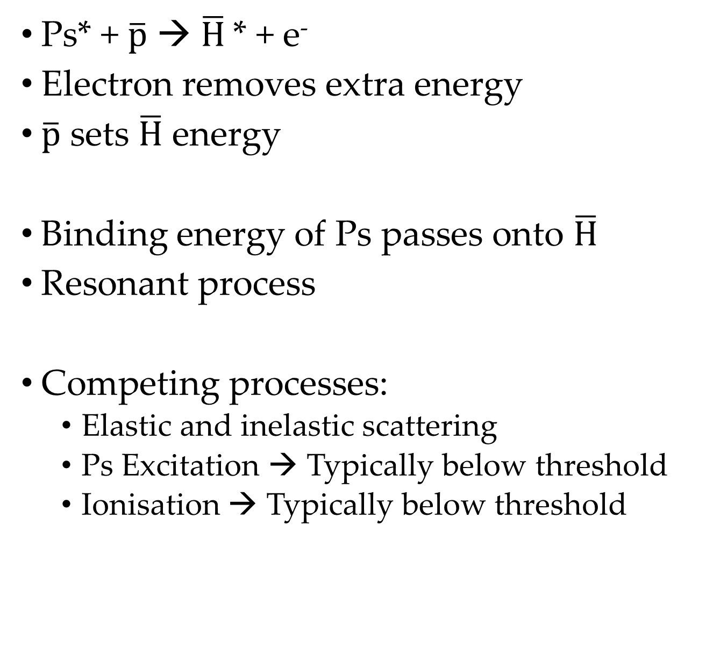

Charge exchange
Ps* + $\overline{p}$ → $\overline{H}$* + e⁻
Electron removes extra energy
$\overline{p}$ sets $\overline{H}$ energy
Binding energy of Ps passes onto $\overline{H}$
Resonant process
Competing processes:
  Elastic and inelastic scattering
  Ps Excitation → Typically below threshold
  Ionisation → Typically below threshold
Narrower n distribution
Pulsed $\overline{p}$ → pulsed $\overline{H}$
Forward directed, short, monoenergetic
Notes:
﻿

Slide 4
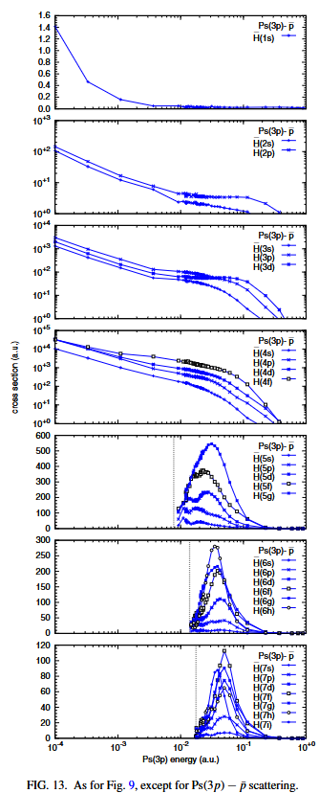

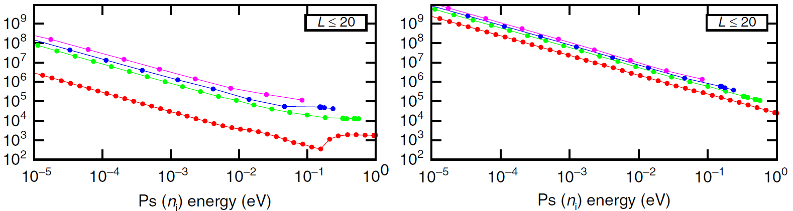
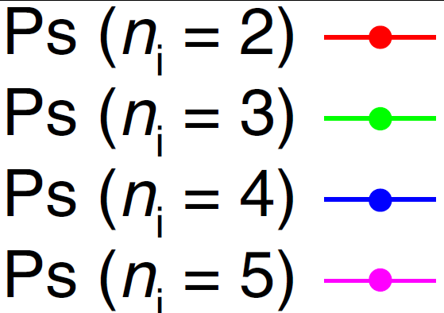
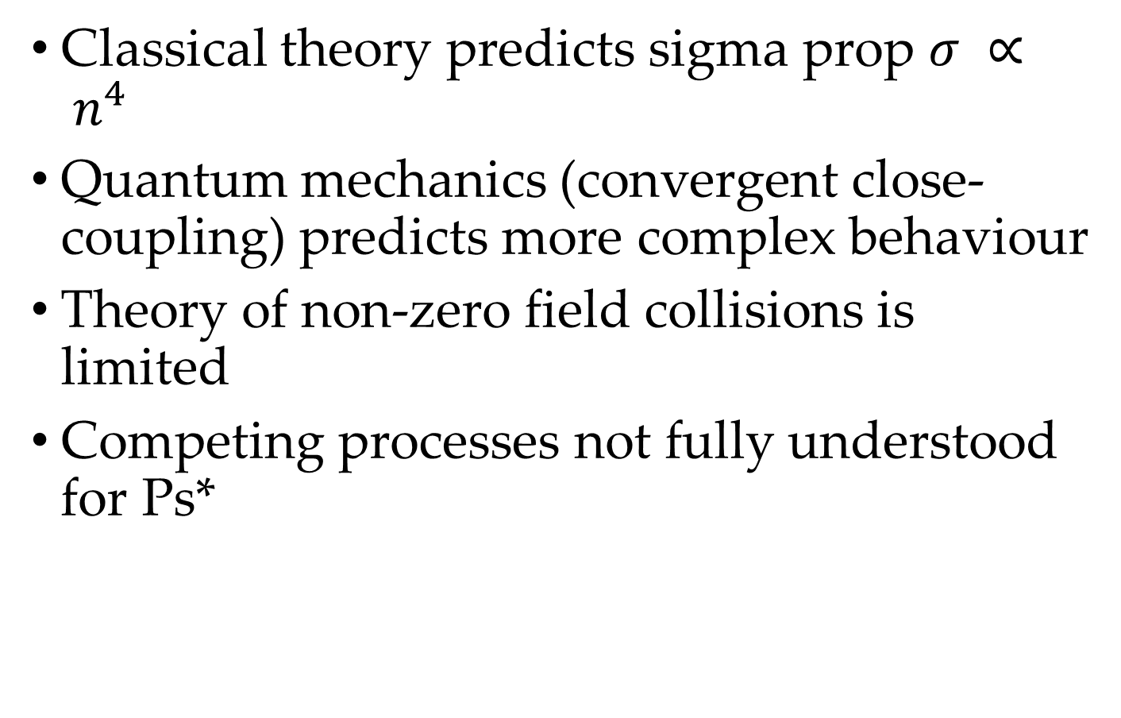
Classical vs Quantum
N. Charlton et al. PRA 107 (2023)
Classical theory predicts sigma prop $σ ∝ n^{4}$
Quantum mechanics (convergent close-coupling) predicts more complex behaviour
Theory of non-zero field collisions is limited
Competing processes not fully understood for Ps*
A. S. Kadyrov et al Nat. Comms. (2017)
Antihydrogen
Elastic scattering
Notes:
﻿

Slide 5
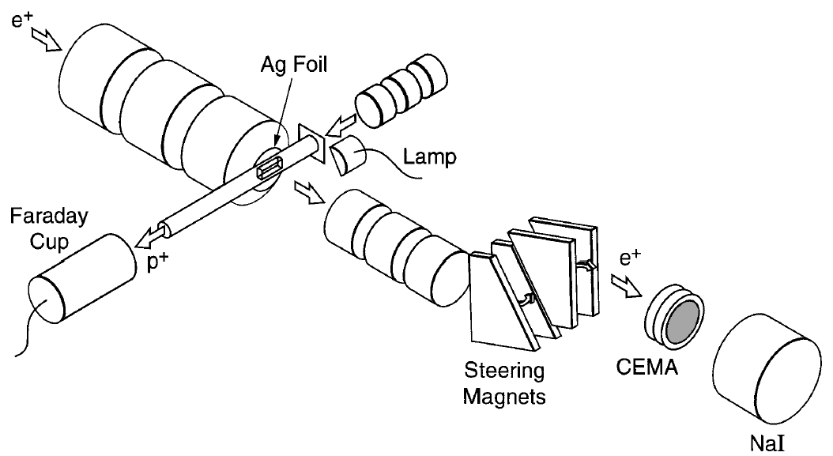
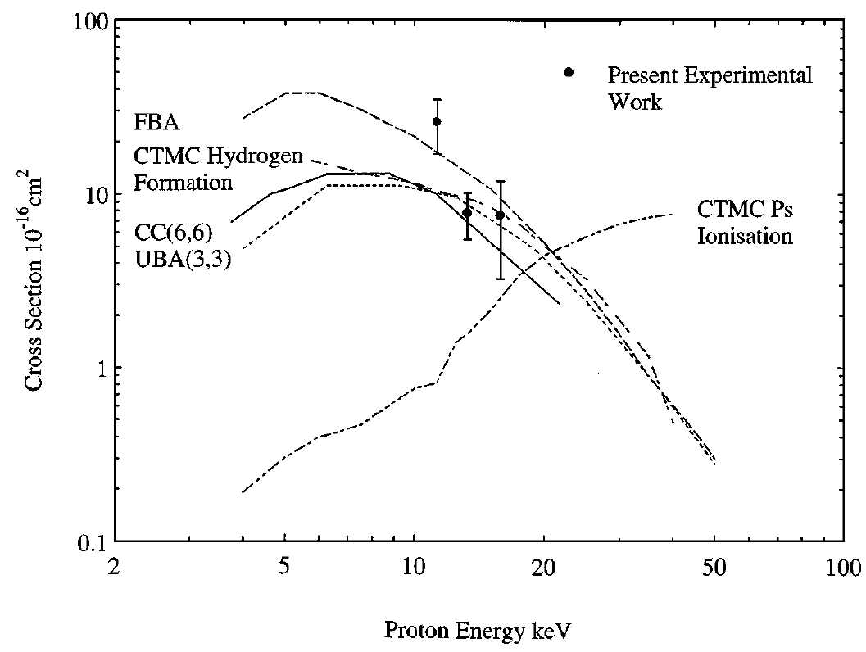
What has been measured?
J. P. Merrison et al. PRL 78 1997
p: ~1 mA, 12.8-17.3 keV
o-Ps: 0.73x10⁶, ~ 300 meV
Cross-sections at very high energies agree with contemporary theory

Slide 6
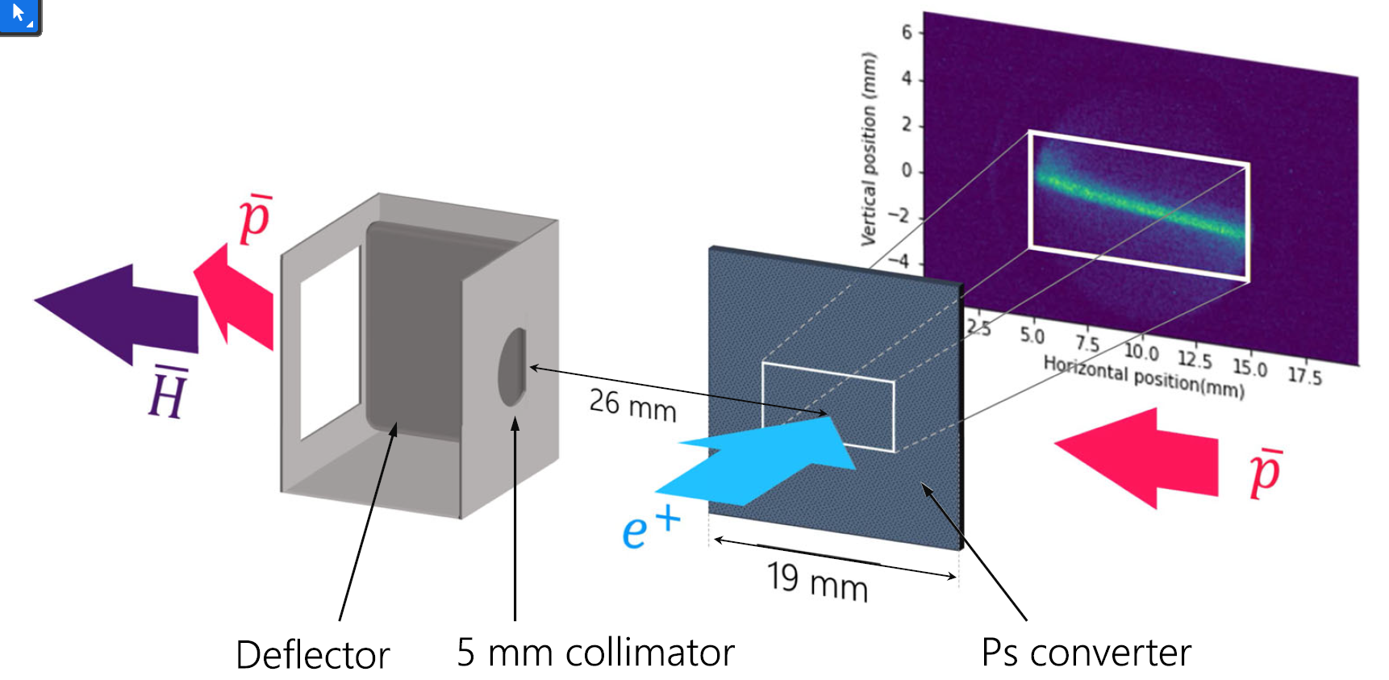
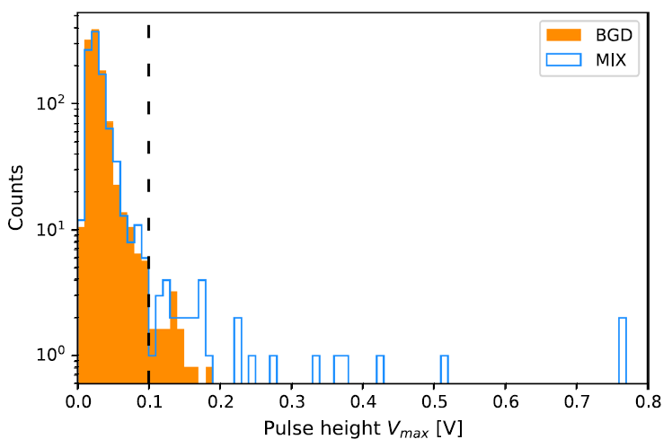
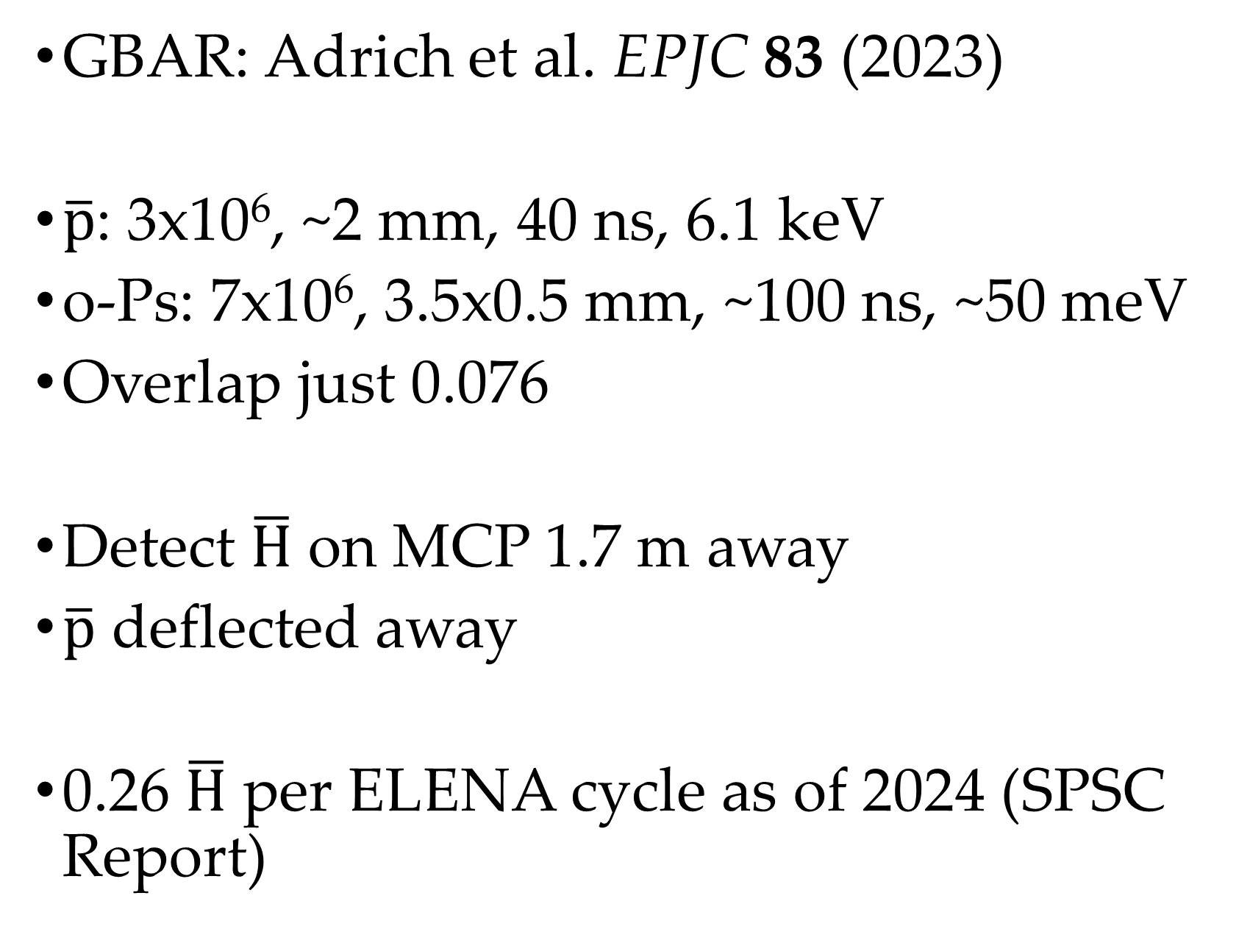
What has been measured?
GBAR: Adrich et al. EPJC 83 (2023)
$\overline{p}$: 3x10⁶, ~2 mm, 40 ns, 6.1 keV
o-Ps: 7x10⁶, 3.5x0.5 mm, ~100 ns, ~50 meV
Overlap just 0.076
Detect $\overline{H}$ on MCP 1.7 m away
$\overline{p}$ deflected away
0.26 $\overline{H}$ per ELENA cycle as of 2024 (SPSC Report)
Notes:
Can’t yet measure cross-sections but close apparently
SPSC 5x better Ps density (more e+ and Ps cavity) and better pbar handling

Slide 7
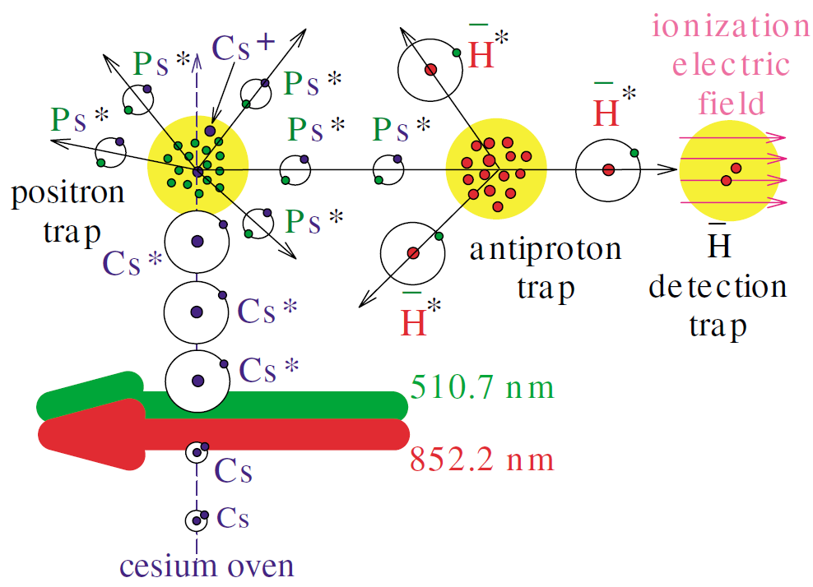
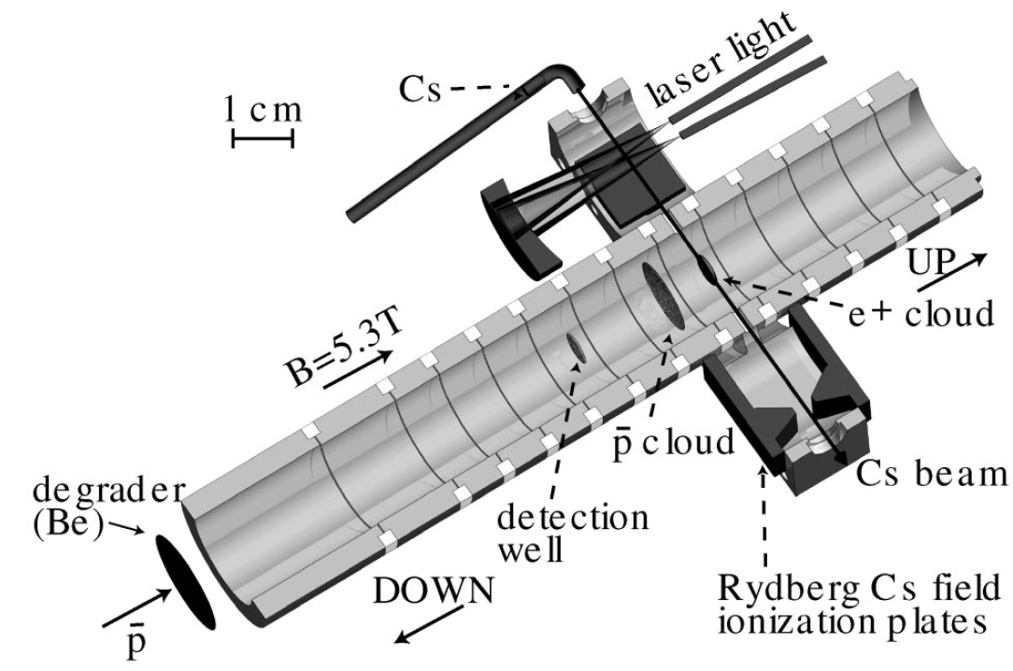
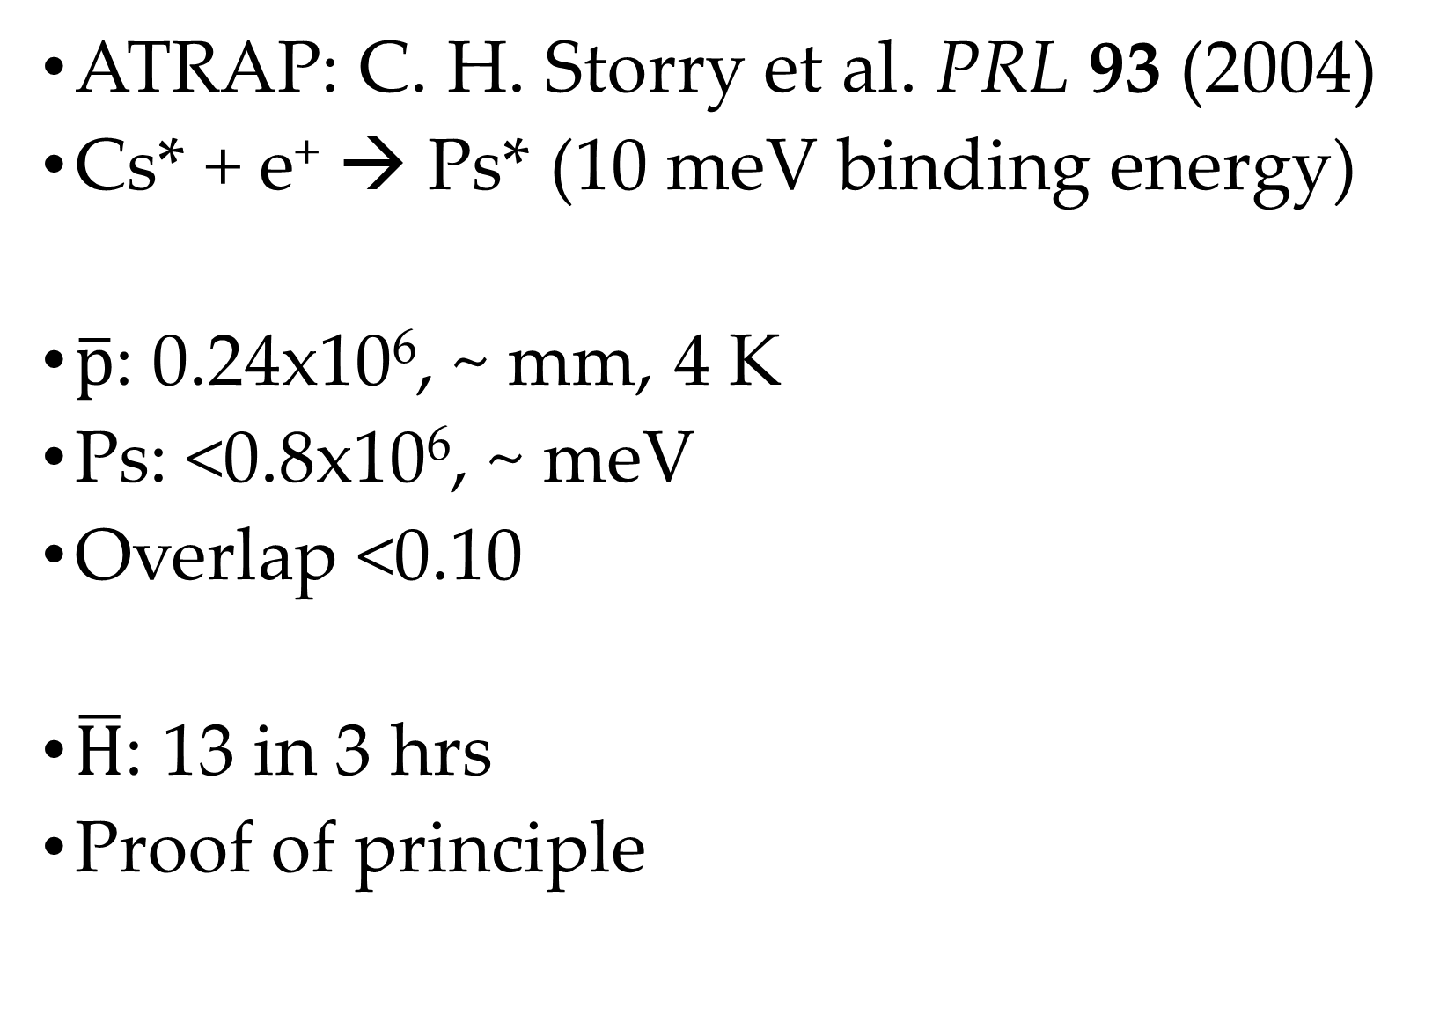
What has been measured?
ATRAP: C. H. Storry et al. PRL 93 (2004)
Cs* + e⁺ → Ps* (10 meV binding energy)
$\overline{p}$: 0.24x10⁶, ~ mm, 4 K
Ps: <0.8x10⁶, ~ meV
Overlap <0.10
$\overline{H}$: 13 in 3 hrs
Proof of principle

Slide 8
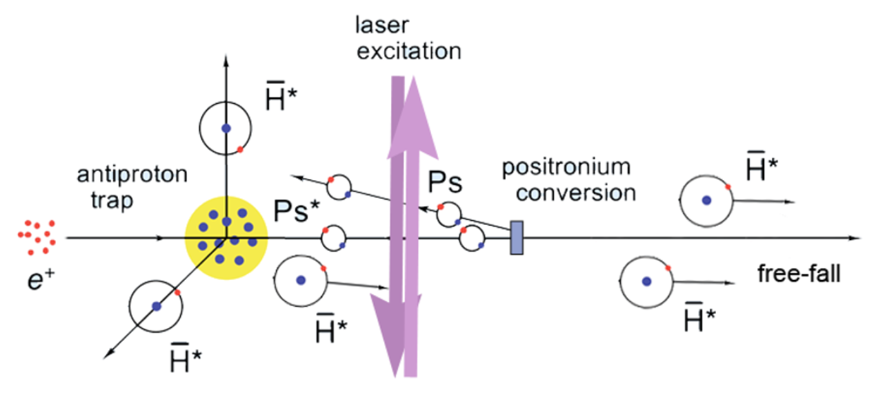
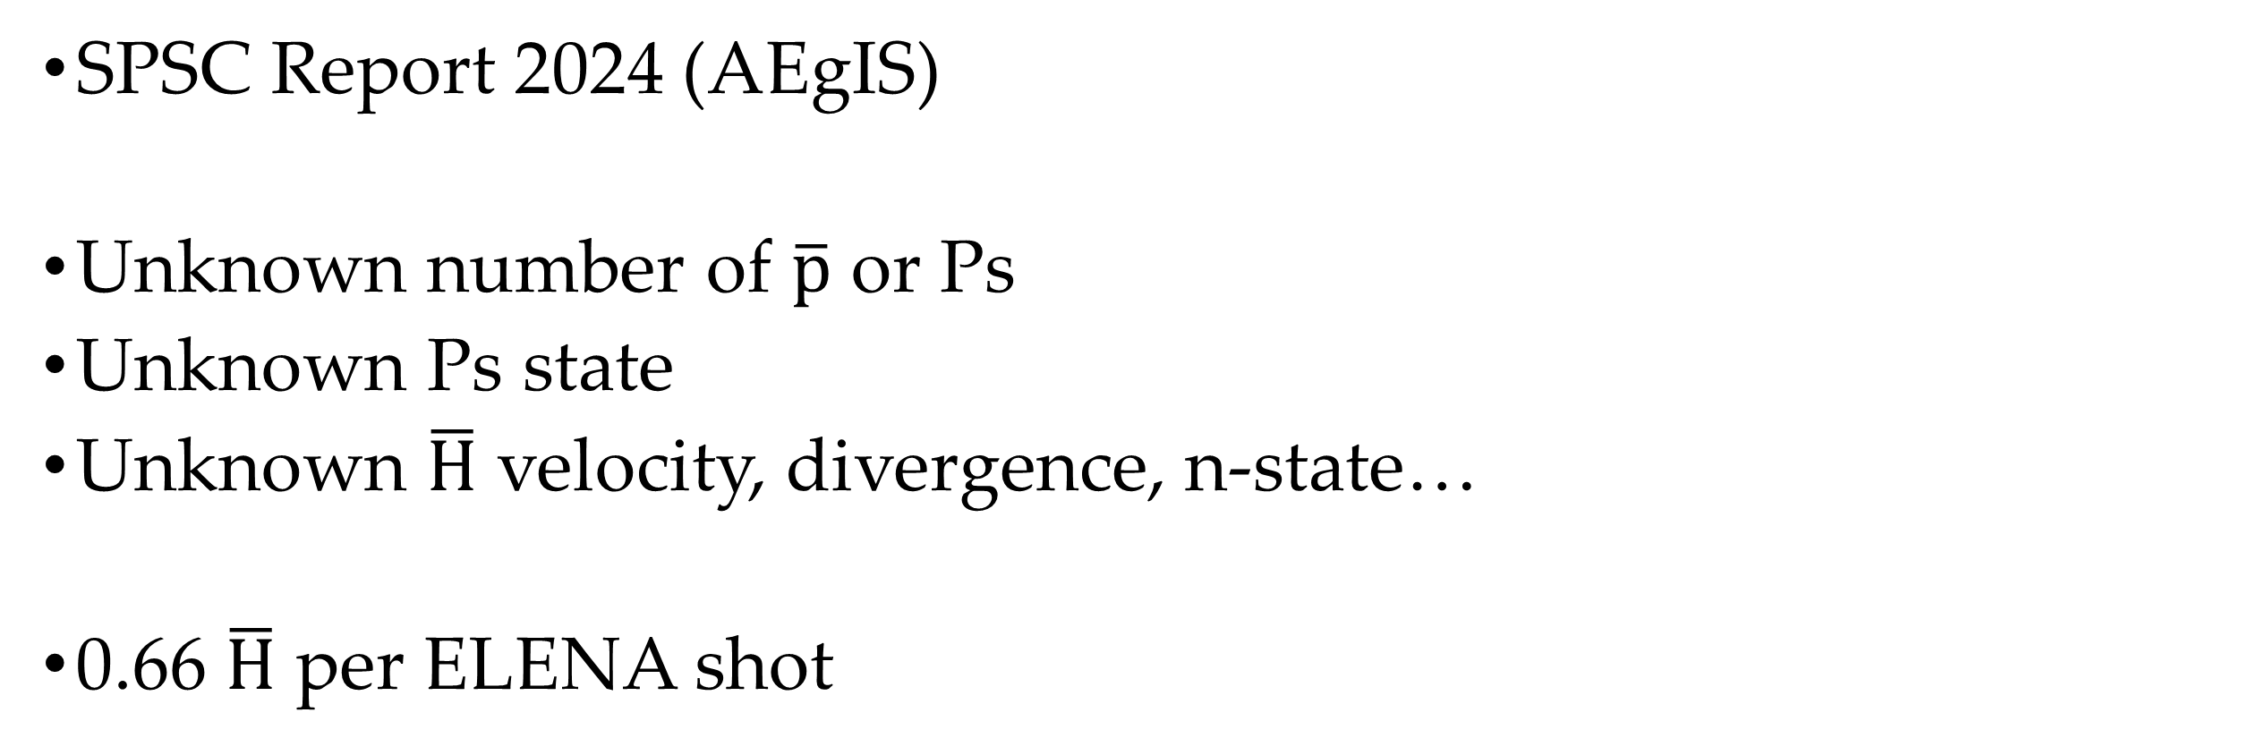
What has been measured?
SPSC Report 2024 (AEgIS)
Unknown number of $\overline{p}$ or Ps
Unknown Ps state
Unknown $\overline{H}$ velocity, divergence, n-state…
0.66 $\overline{H}$ per ELENA shot

Slide 9
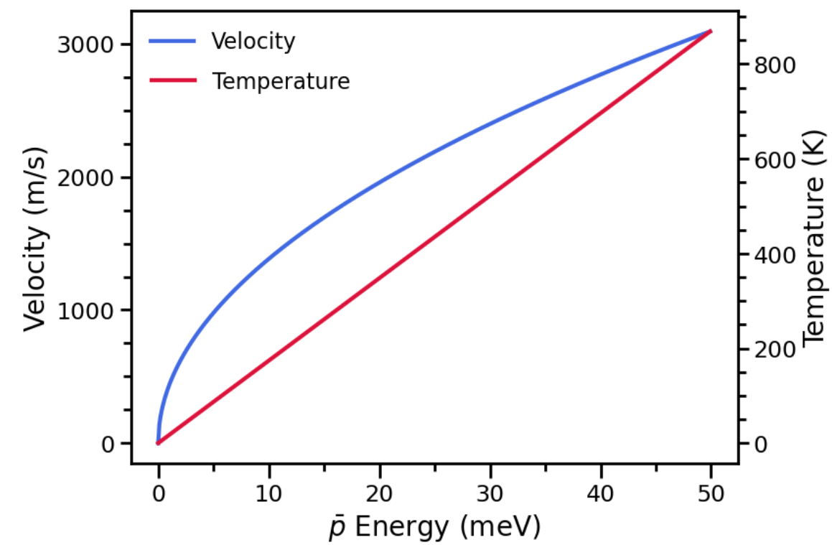
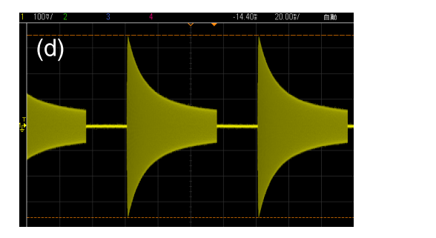
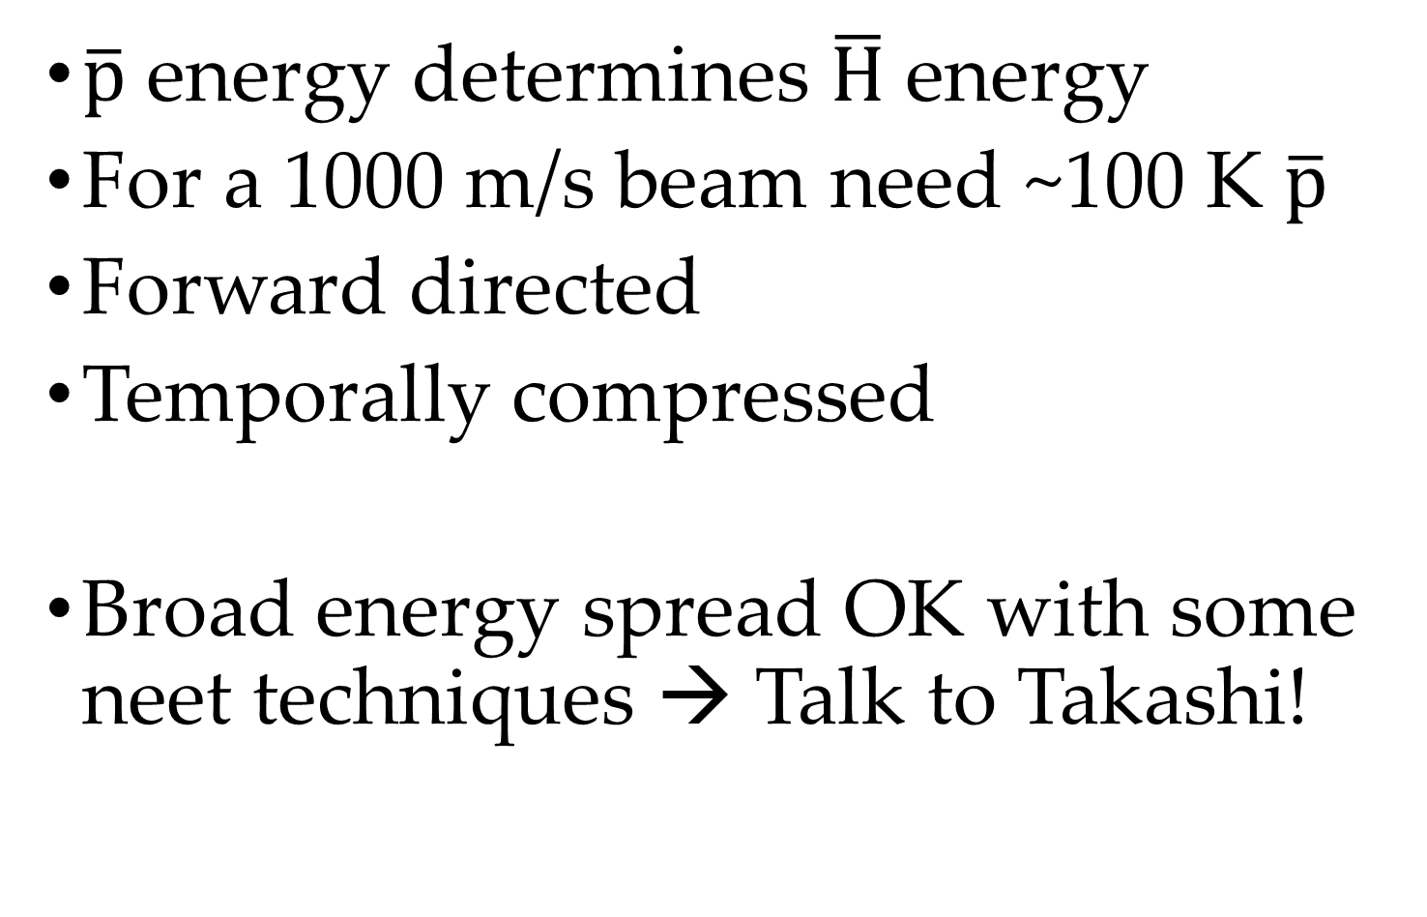
Requirements - $\overline{p}$
$\overline{p}$ energy determines $\overline{H}$ energy
For a 1000 m/s beam need ~100 K $\overline{p}$
Forward directed
Temporally compressed
Broad energy spread OK with some neet techniques → Talk to Takashi!
  T. Oda et al., Phys. Rev. Applied 14, 054032 (2020)

Slide 10
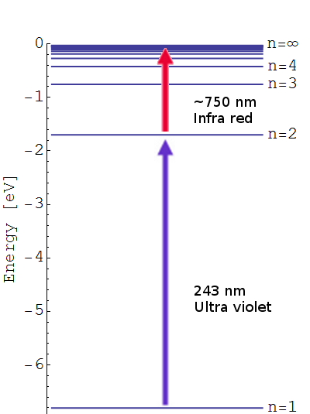
Excited state Ps
https://antimattergravity.com/2014/11/30
Excited states of Ps n > 2 do not self-annihilate
n = 8 fluoresces in ~1µs
Ps production efficiency ~30-70%
Excitation efficiency gives ~50% loss per required photon

Slide 11
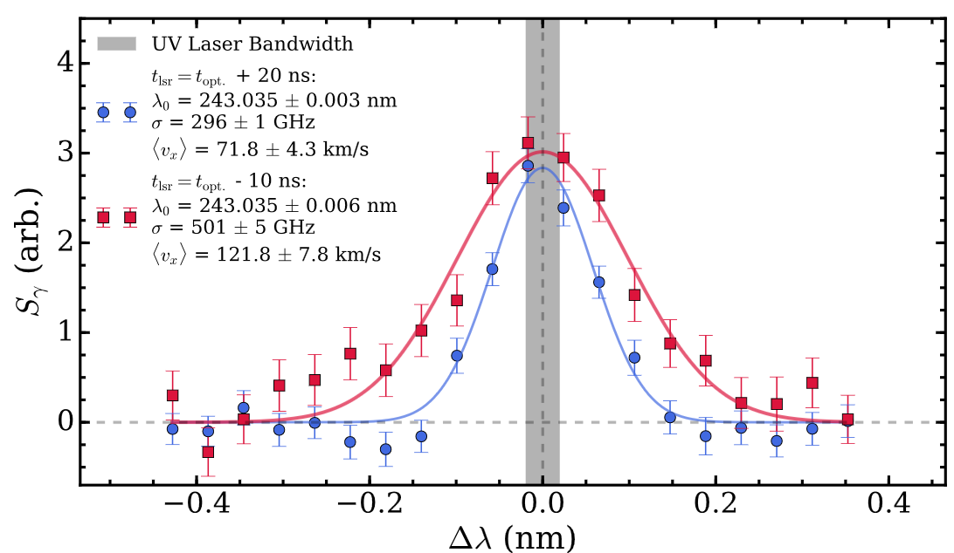
Requirements - Ps
Dense Ps (spatial and temporal)
  High number of positrons (current system 10⁷ per 70 s)
  Focus positrons to ~µm spot size electrostatically
  High production efficiency target (e.g. metals @ ~80%)
  Slow Ps (e.g. SiO₂ @ ~30%))
Excited state
  Pulsed lasers
  Rydberg state excitation maximum 25% efficient currently
  Doppler selection of laser limiting factor (need big bandwidth)
Notes:
Could confine Ps in insulator cavity
Ge photoactivated Ps emission

Slide 12

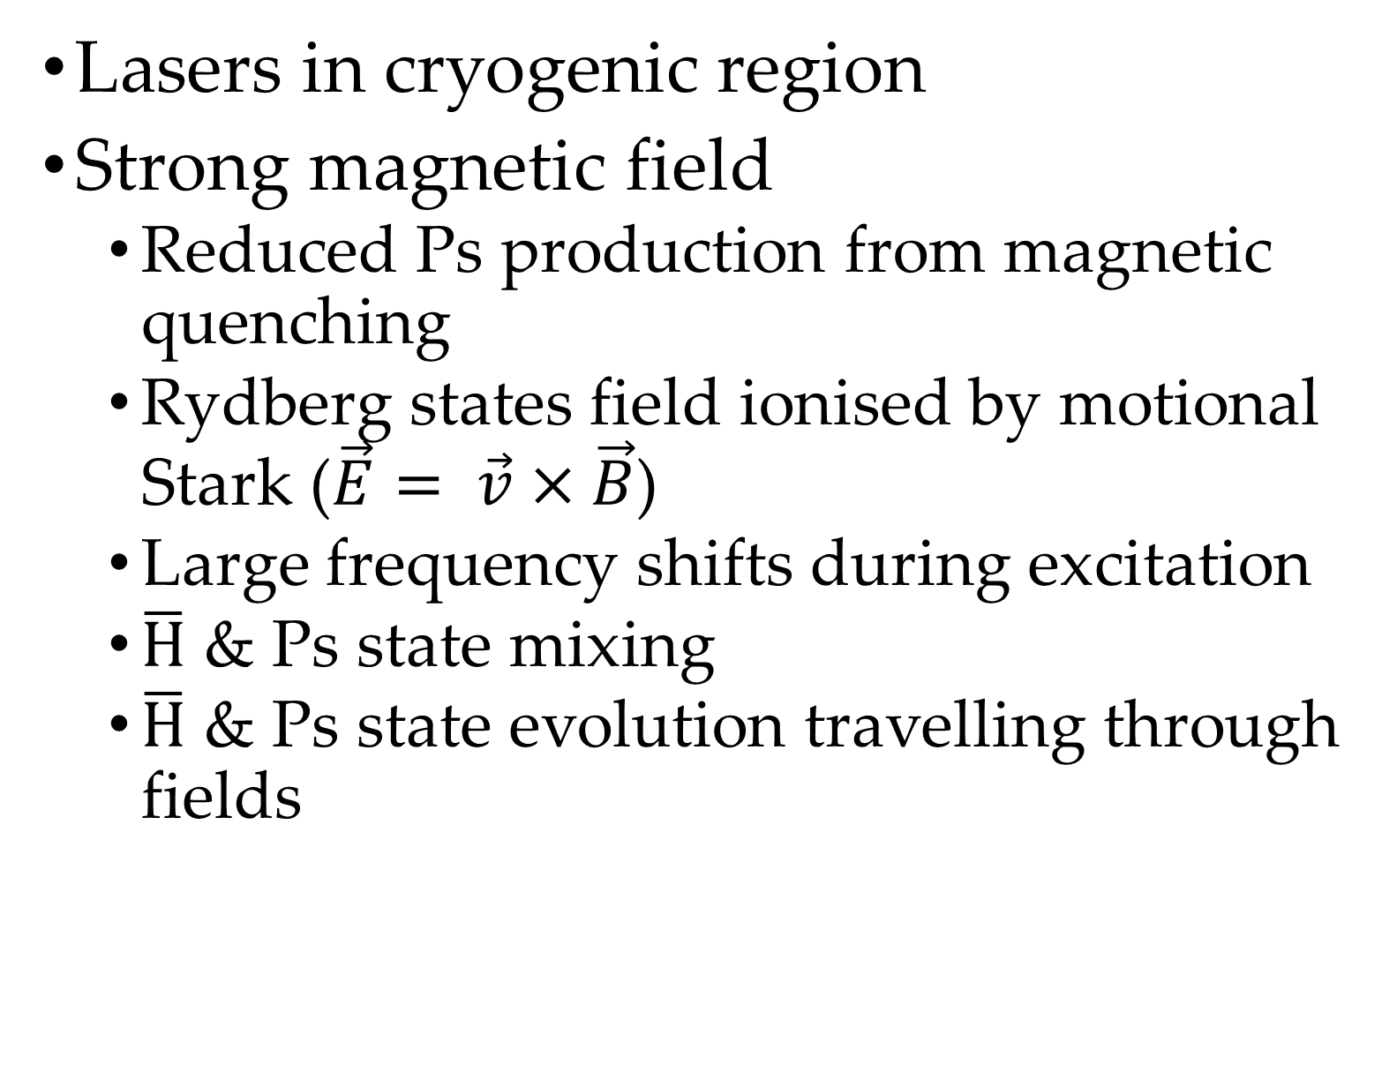


Scenario 1 – In trap
Lasers in cryogenic region
Strong magnetic field
  Reduced Ps production from magnetic quenching
  Rydberg states field ionised by motional Stark ($\vec{E}= \vec{v}×\vec{B}$)
  Large frequency shifts during excitation
  $\overline{H}$ & Ps state mixing
  $\overline{H}$ & Ps state evolution travelling through fields
$$\vec{B}$$
$$\overline{p}$$
Coldbore
Lasers
Ps
e⁺
$\overline{H}$
Ps converter

Slide 13


Scenario 2 – In flight
Intense $\overline{p}$ pulse outside the cusp
Temporal and spatial compression
$$\overline{p}$$
Lasers
Ps
e⁺
$\overline{H}$
Ps converter

Slide 14
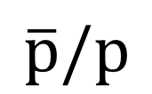
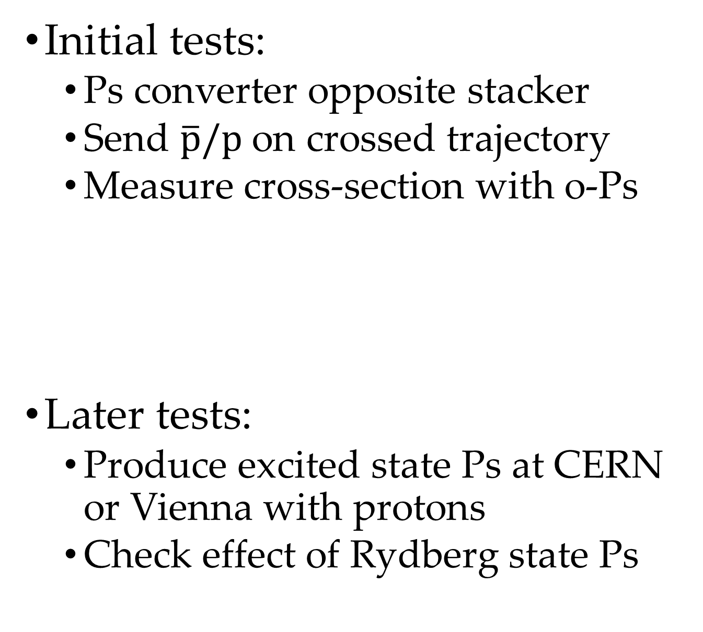
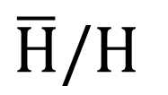
Testing
Field ioniser/
deflector
MCPs
Initial tests:
  Ps converter opposite stacker
  Send $\overline{p}/p$ on crossed trajectory
  Measure cross-section with o-Ps
Later tests:
  Produce excited state Ps at CERN or Vienna with protons
  Check effect of Rydberg state Ps
$\overline{H}/H$
Stacker
e⁺
Ps converter
Ps
$$\overline{p}/p$$
MUSASHI/
Proton source

Slide 15



Conclusions
Need to measure this process to establish worthwhile
Requires development of $\overline{p}$ beam
Requires development of dense excited state Ps
$$\overline{p}$$
Ps
e⁺
Lasers
$\overline{H}$
Ps converter

Slide 17
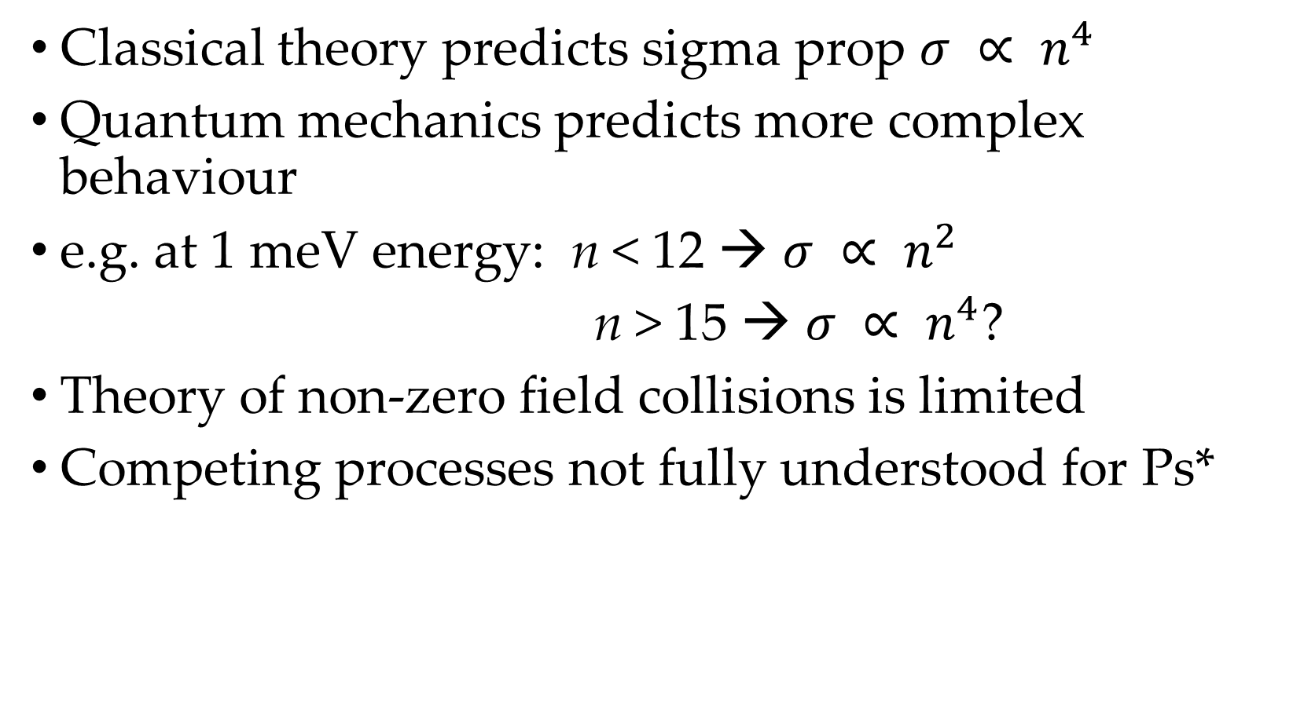
Classical vs Quantum
Classical theory predicts sigma prop $σ ∝ n^{4}$
Quantum mechanics predicts more complex behaviour
e.g. at 1 meV energy: n < 12 → $σ ∝ n^{2}$
n > 15 → $σ ∝ n^{4}$?
Theory of non-zero field collisions is limited
Competing processes not fully understood for Ps*
Ps(n) | Lifetime (ns) | Cross section @ 100 meV (arb.) | Production efficiency (%)
1 | 142 |  | ~30 - 70
2S | 1136 |  | ~5
3-5 | < 100 |  | ~20
>20 | > 5000 |  | ~20
Notes:
﻿

