Slide 1
A quick look to SwissFEL Tools
+ some ideas for CLEAR
Alexander Malyzhenkov
12 February 2025
(Some slides are courtesy of SwissFEL Team
please don’t share without real need outside of CERN)

Slide 2
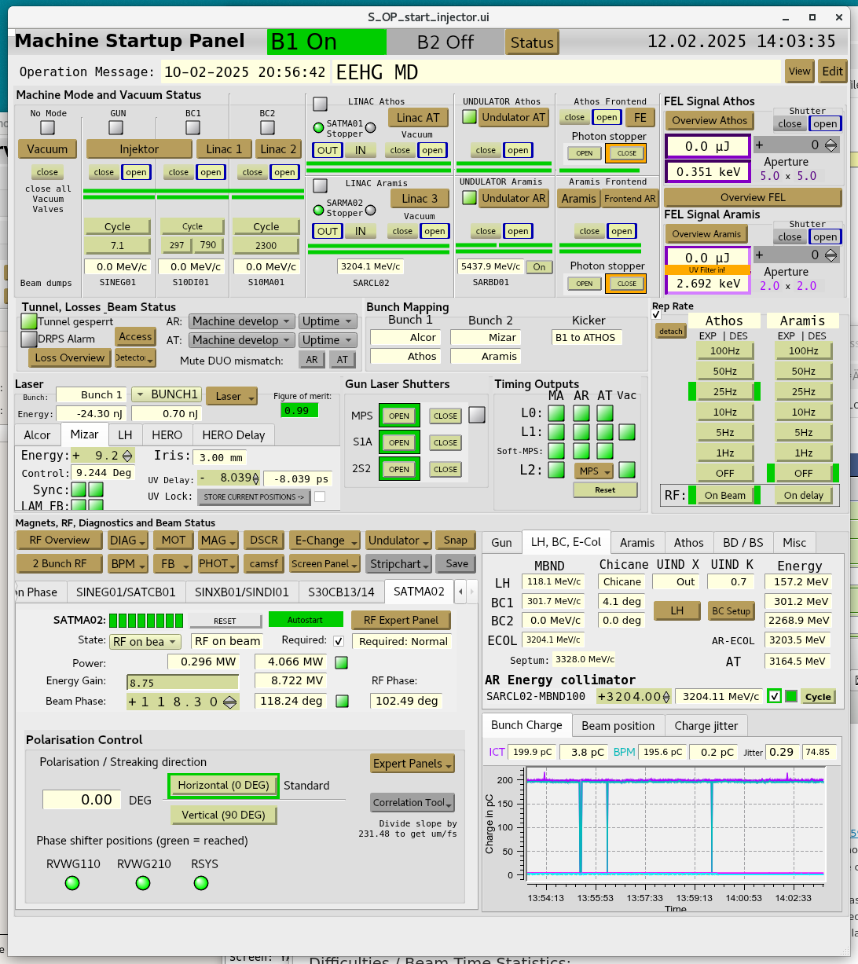
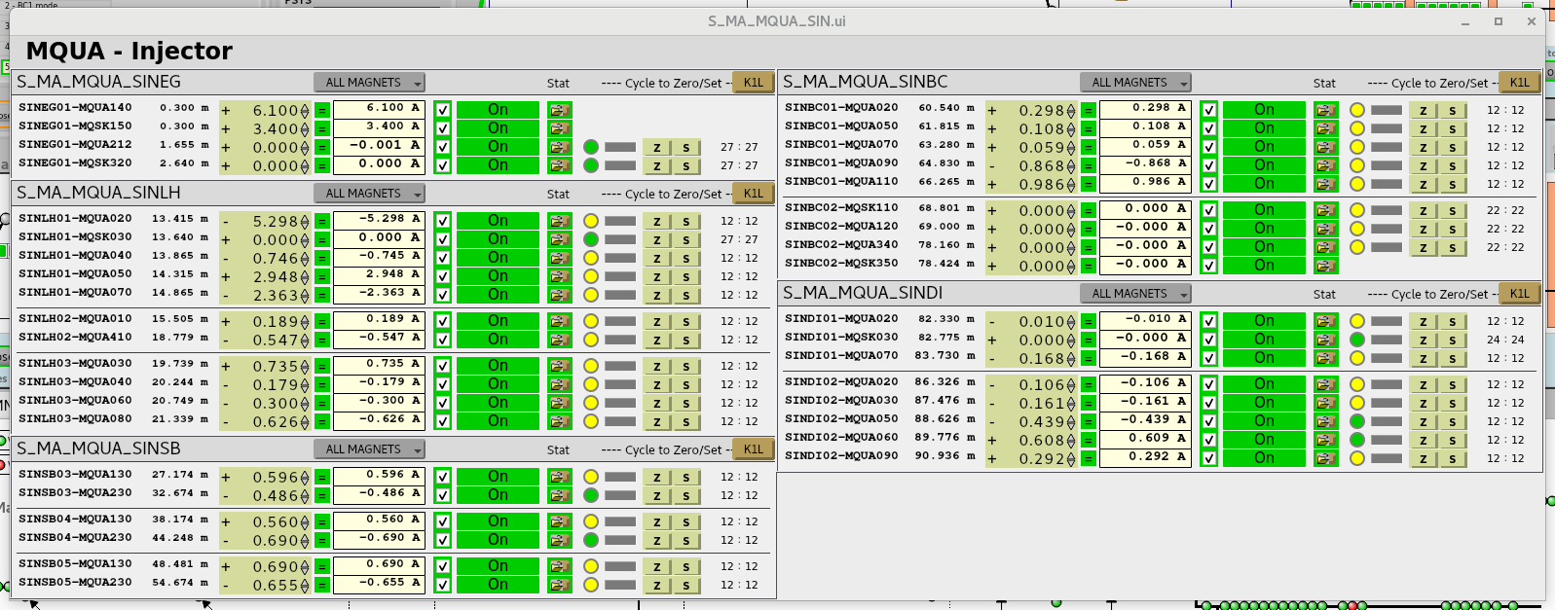
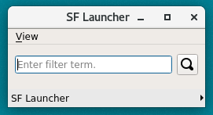
Main start-up panel
Sub-system panel:
magnets
Alternative way to launch

Slide 3
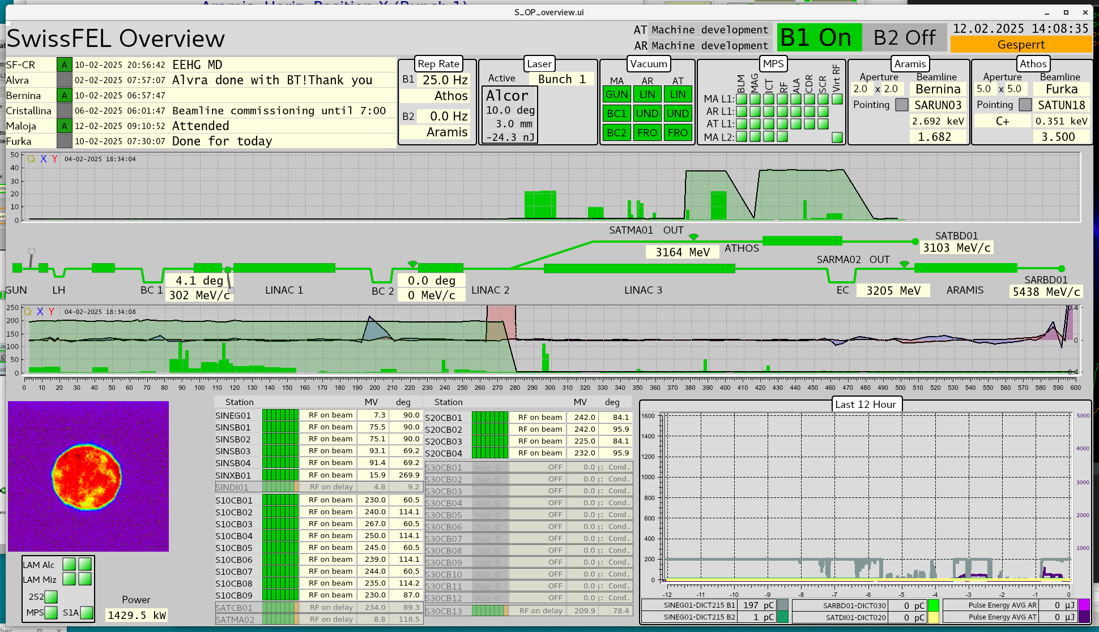
Main overview panel
Color scheme:
Green status (all good)
Red status (error)
Additional warnings if something critical happened

Slide 4
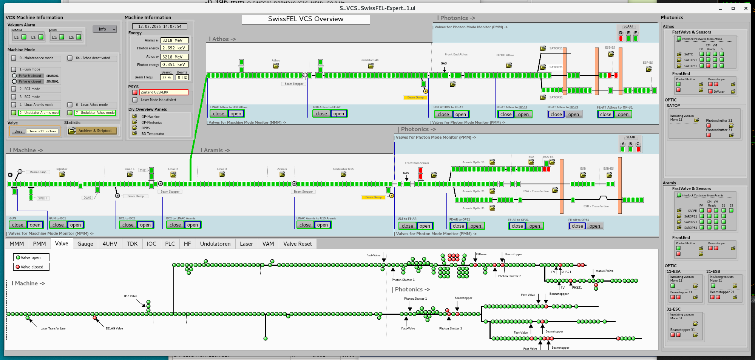
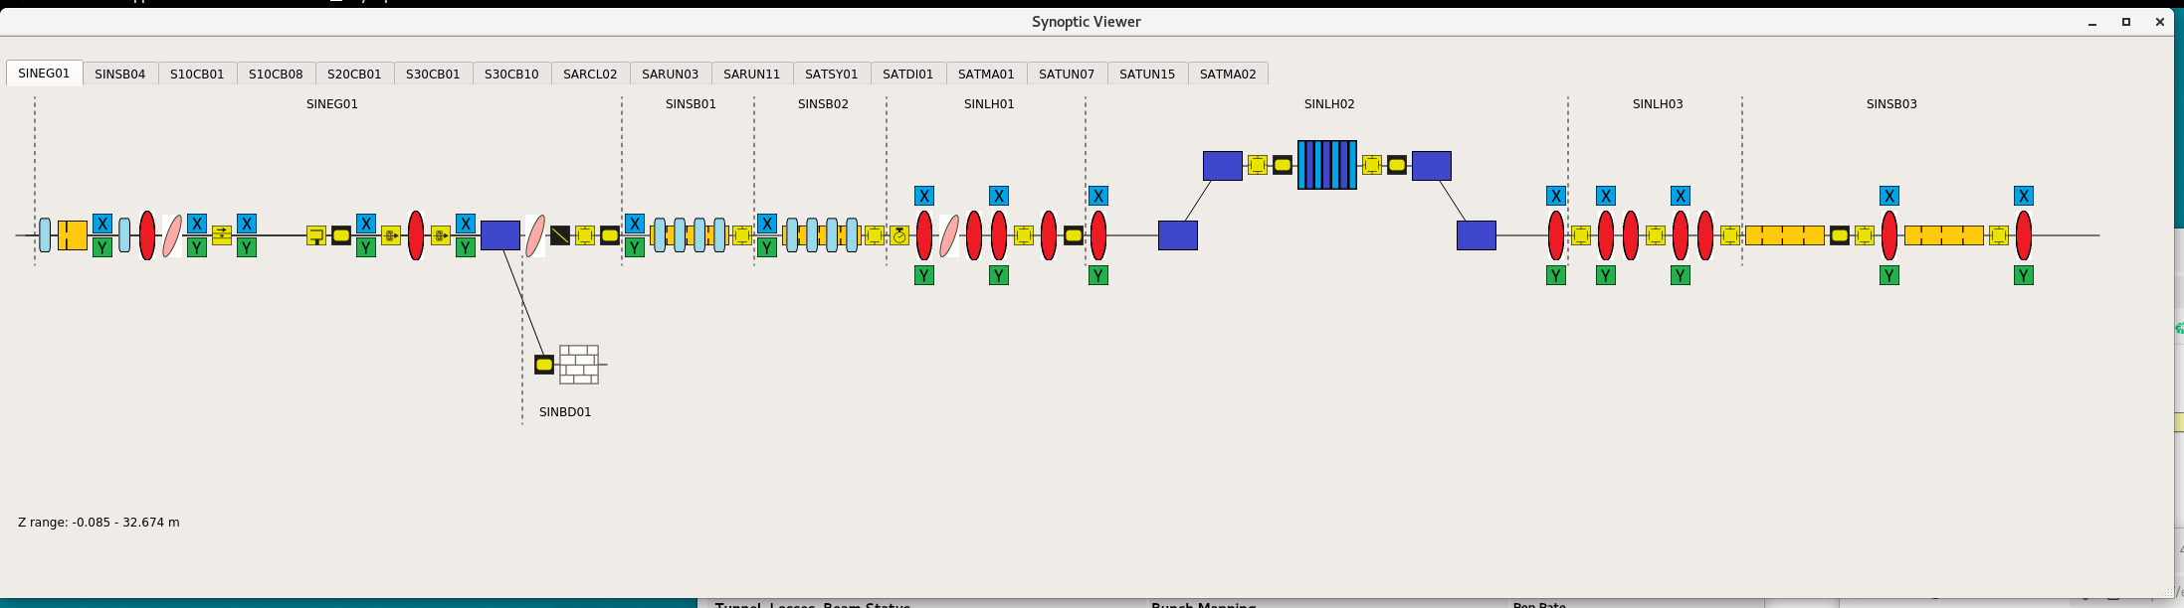
Other examples
Sub-system panel:
Vaccuum system
Overview panel with information (interactive)

Slide 5
Take away points:
Everything at SwissFEL is based on ”Epics” – we cannot follow this at CLEAR
Main control system should be crash free (Matlab –> Python /Java /C++ )
If it crashes it should not change the machine settings to nominal? – it should be able to monitor the active status during the re-start?
It would be nice to have a central simple unit to open all the existing tools in the intuitive way, ideally not by searching a line in the Matlab among numerous folders
It would be nice to have overview panel always opened on one screen, including essential sub-systems status, collimators, scatterers etc.

