Slide 1


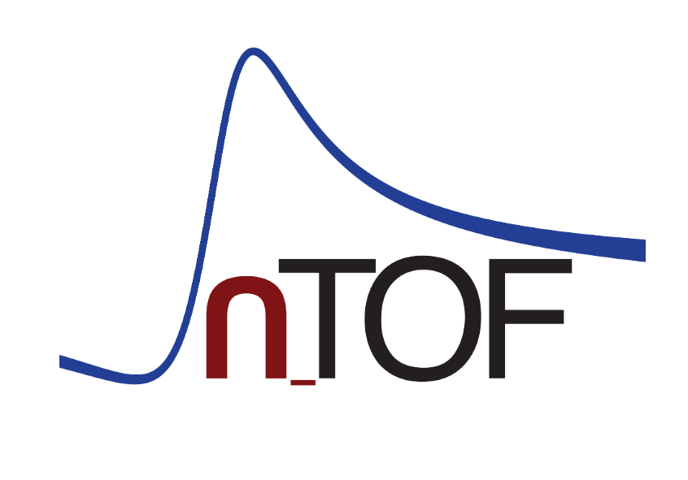
DAQ related conclusions from the n_TOF detector WG
Nikolas Patronis
Department of Physics, University of Ioaanina
https://npl.physics.uoi.gr

Slide 2
n_TOF detector developments
Full report here: https://cds.cern.ch/record/2917870
Detector developmets:
  (n,γ): 7 detectors (Stilbene, d-stilbene, LaBr3/LaCl3, HPGe, High Eff TED, Highly Segmented TAC)
  Fission: 3 detectors (FiFI, Compact Fission Detector, X-Y uMegas)
  (n,lcp): 4 detectors (High Solid angle Si detector array, GEMpix, DDX, High eff. Silicon telescope)
  (n,el), (n,n’), (n,xn): 3 detectors (LaBr3/LaCl3, HPGe, Stilbene)
  Other: 3 detectors (Diamond, Re-TOF, Fibres neutron detector)

Slide 3
New Physics avenues:
n_TOF is expanding in all dimensions!

Slide 4
DAQ related conclusions
General conclusions:
  Increasing need to record an ever-expanding array of observables
  High efficiency comes with higher detector volumes and highly segmented detection setups
Examples of previous DAQ challenging cases:
  Fission chamber coupled with TAC: 45 channels (2022), data transfer issues
  Re-TOF/PPAC: 51 channels (2024)
  Stilbene, LaBr3: Rate of digitalization on the limit

Slide 5
DAQ related conclusions
Considering some future detector setups, e.g. :
  High solid angle silicon detector array (>160 channels)
  Highly Segmented Calorimeter (>200 channels)
In general:
    Segmentation/granularity is the way to overcome γ-flash issues
    Higher solid angle/detection efficiency is always welcome
    Higher sampling rate is welcome ( e.g. LaBr3, Stilbene, plastic)
Our recommendations/our wishful thinking:
  256 channels for each EAR
  4Gs/s
  Data transfer bandwidth 2-3 times faster than the existing one
  Upgrades across the entire CERN data storage chain
Future setups with more and specific needs can be operated with individual/dedicated DAQ systems based on FPGA’s or ASIC (e.g. iTED)
More channels & higher sampling rate is welcome

Slide 6
Thank you!

