Slide 1
Development of high-speed digitizers for physical instrumentation
Ing. Tomáš Kulhánek

Slide 2
Overview
Direct digitalization of detector signals and Time Interleaved Sampling
The goal of the work and Current status
Development of the digitizer module with 20 GS/s
Digitizer module connection
DAQ software

Slide 3
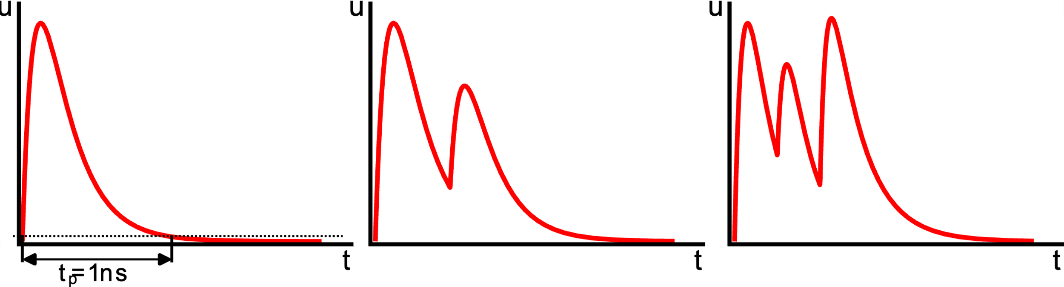

Direct digitalization of detector signals
Digitization without signal processing in the analog domain
Only analog amplification
Processing in the digital domain
  Saving the waveform
  Waveform analysis
Required of very fast analog conversion
  up to tens of 10 GS/s
Fs = 40 GS/s
Ts = 25 ps
➞
40 samples/puls

Slide 4

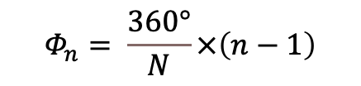
Time Interleaved Sampling
For sample rates higher than 10 GS/s
$$Φ_{n}= \frac{360°}{N}×\left(n−1\right)$$
$$F_{total}= N×F_{S}$$

Slide 5
The goal of the work and Current status
  The goal of the work
Universal digitizer for use in particle physics
Digitizer with a sampling frequency of 40 GS/s
Modular system
  One channel 40 GS/s
  Multiple channels 10 GS/s
Universal DAQ software
  Multi-platform
  GUI/Console
  Integration into a large system
  Current status
Prototype for design verification
  Topology
  Components
  Circuits parts
Work on the design of the 20 GS/s module
First units expected for testing in September this year

Slide 6
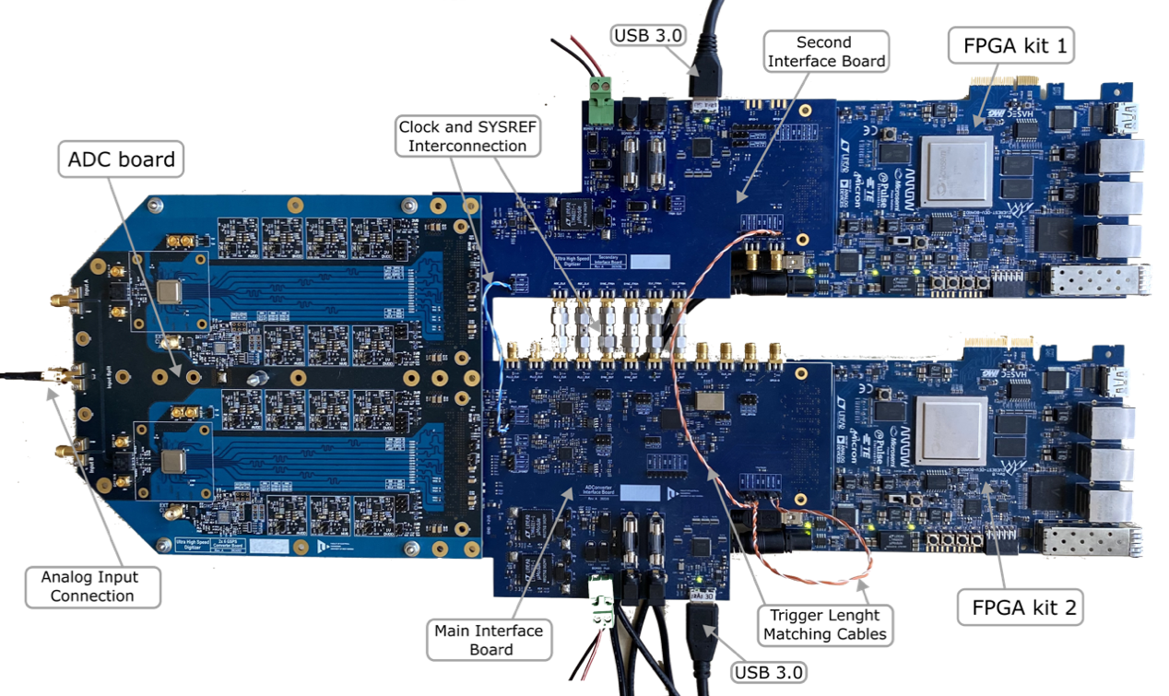
Current status - Prototype for tests
2x 4 GS/s
ADC Board
  2x AD9213
Interconnection Boards
  2x 6 Lanes JESD204B
PolarFire DevKits

Slide 7
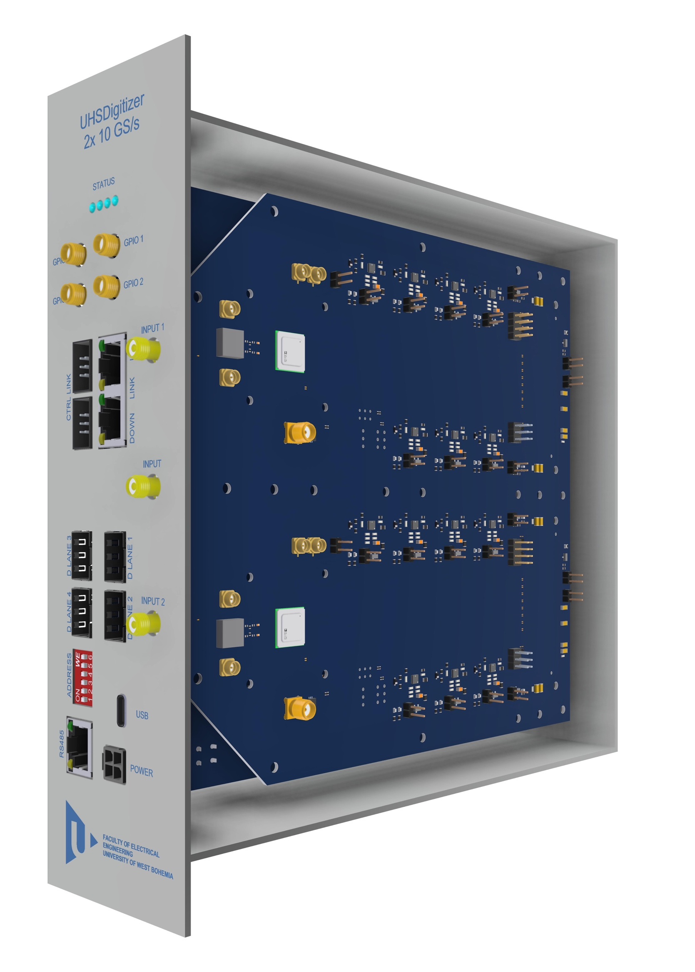
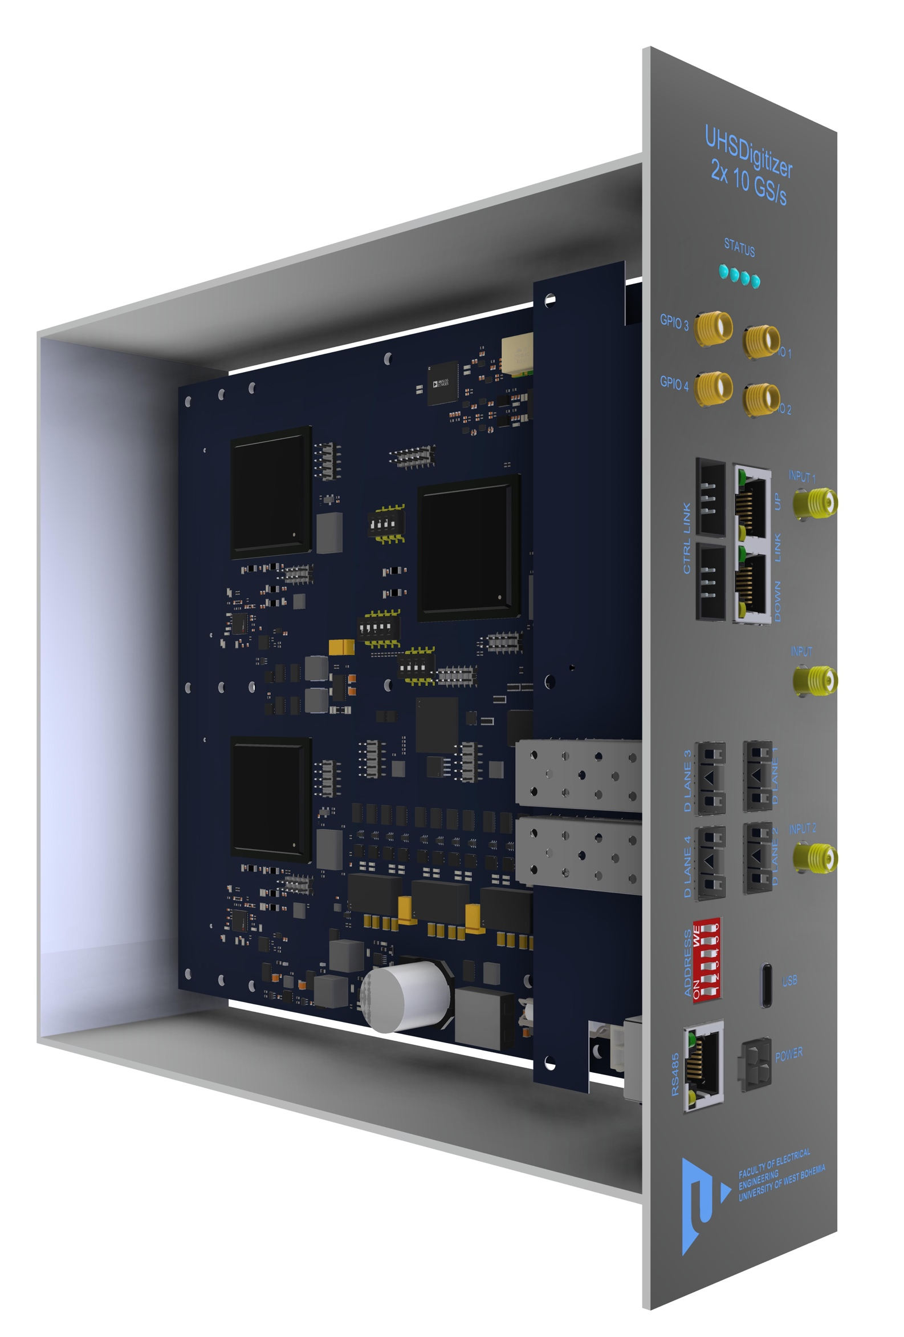
Main part – Digitizer module 20 GS/s
Sampling rate
  1x 20 GS/s
  2x 10 GS/s
12 bit resolution
Interconnect bus for Clock and Synchronization
Communication
  USB 3.0
  Optical fibre
GPIO connectors
  Clock In/Out
  Trigger In/Out
Diagnostic Interface RS485

Slide 8
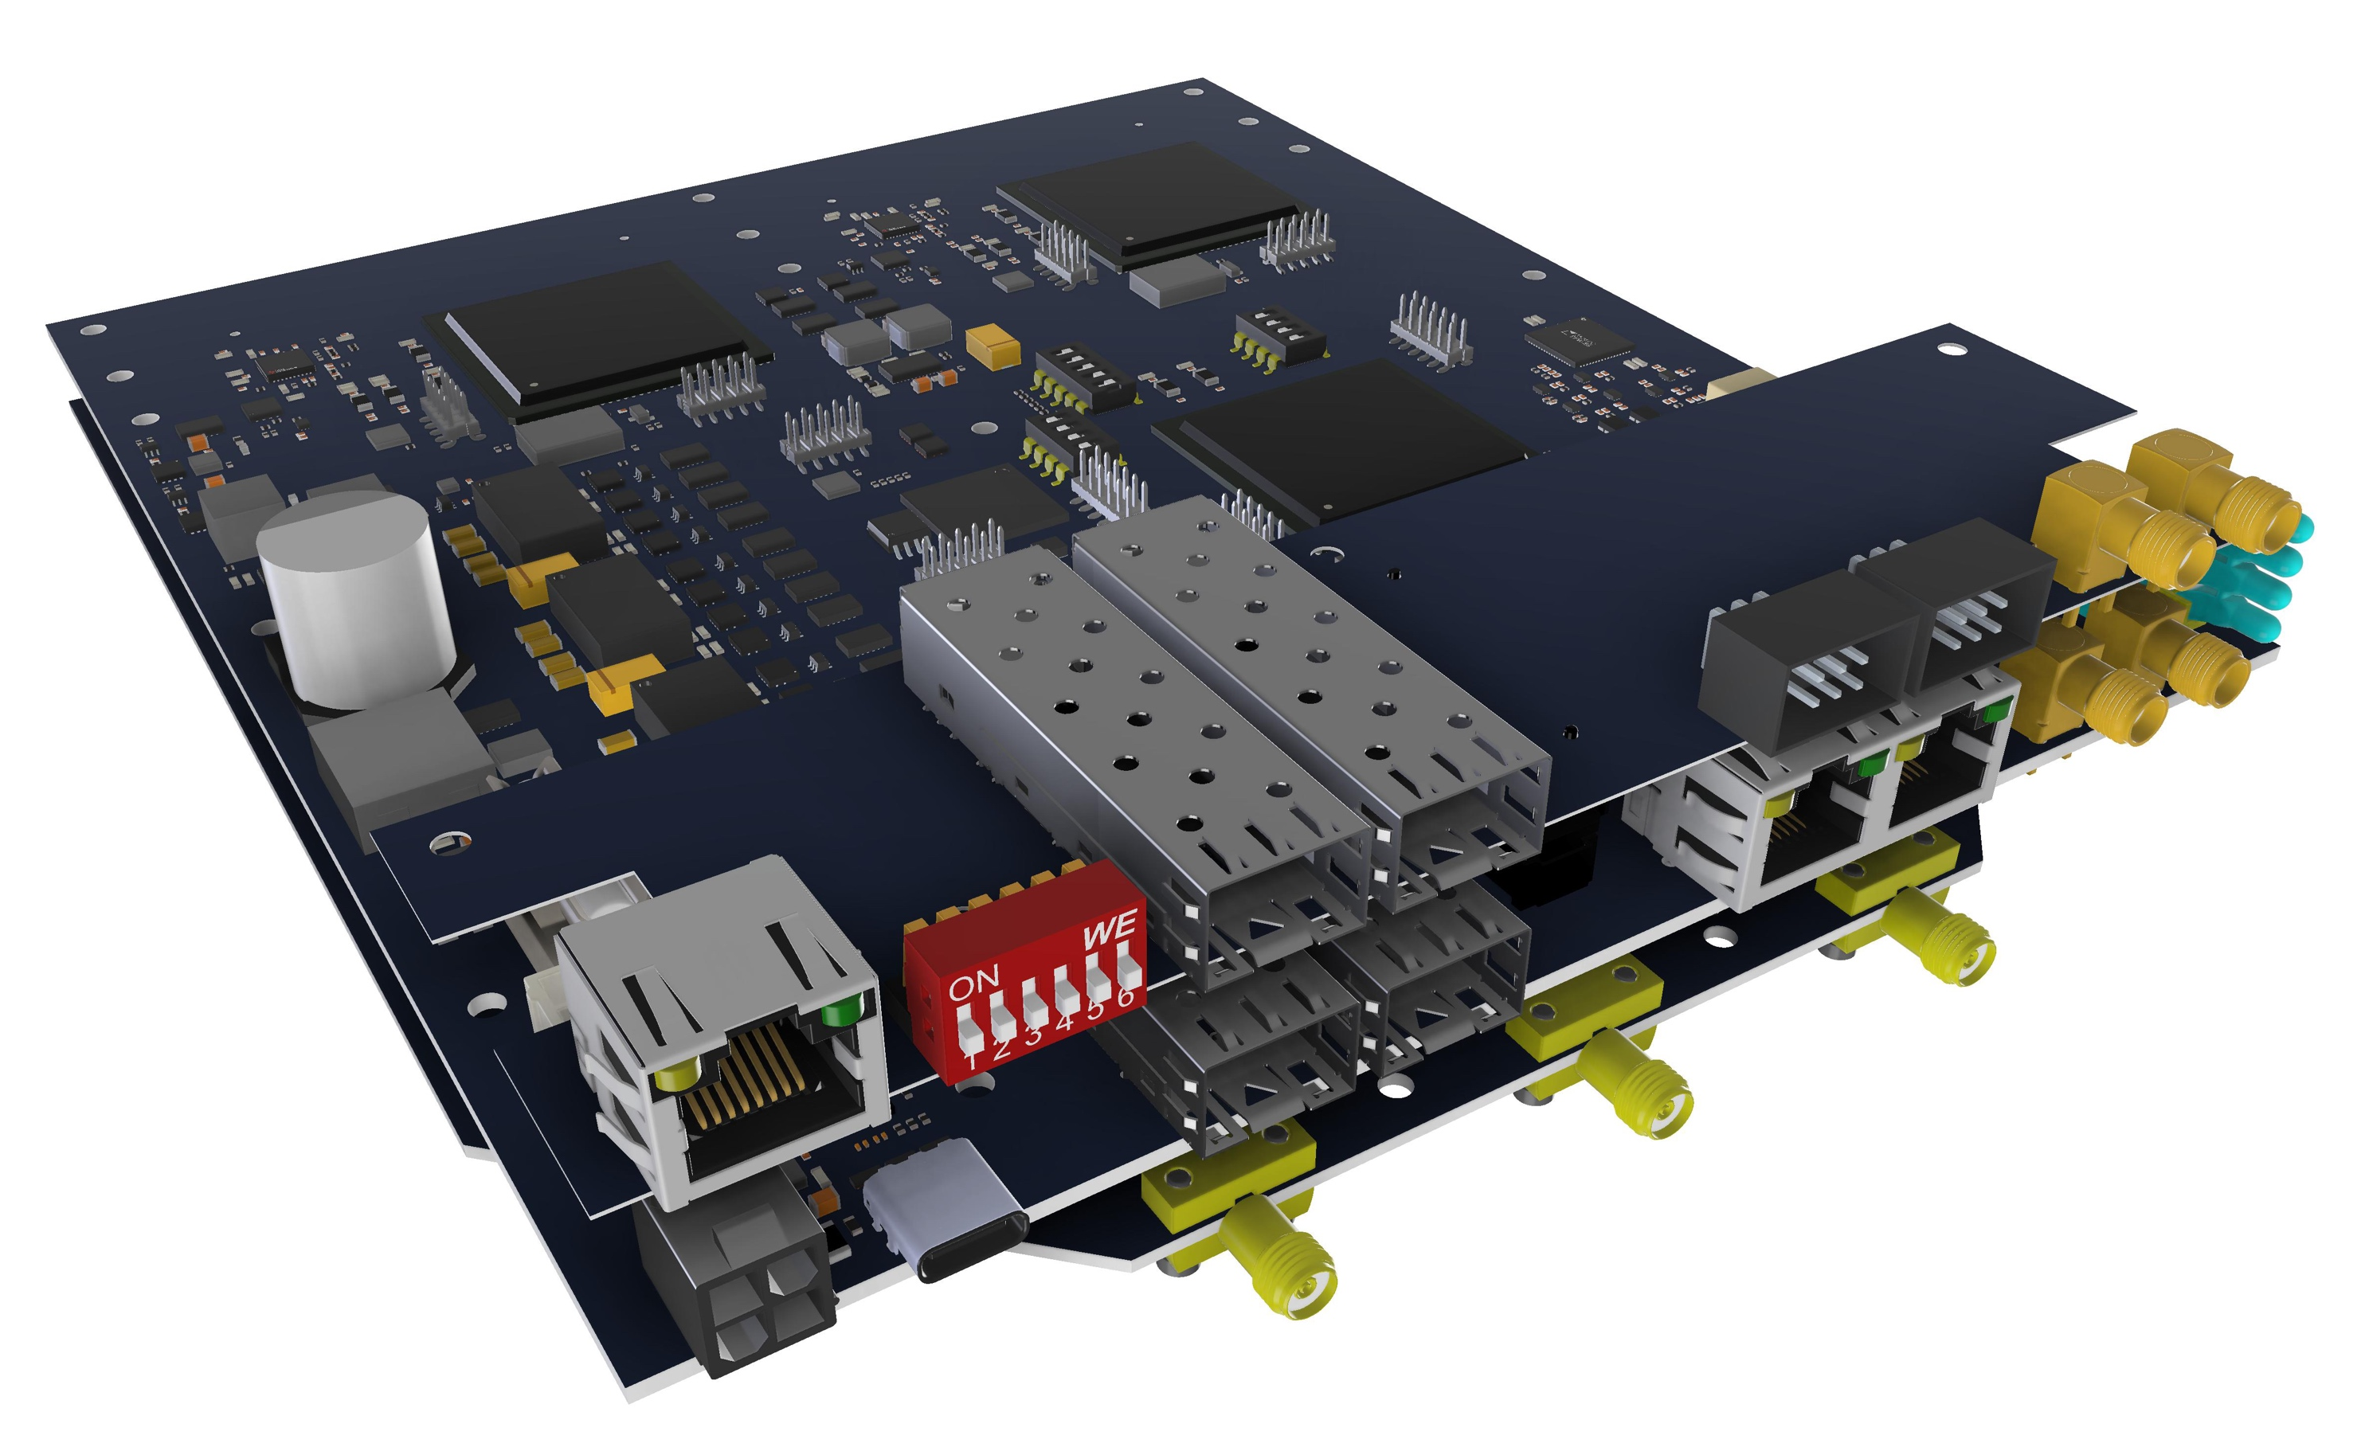
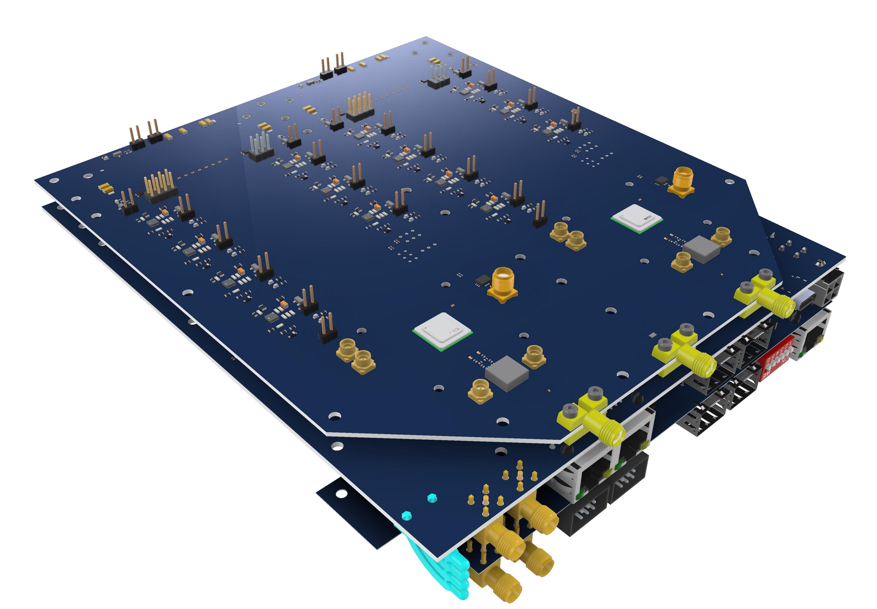
Main part – Digitizer module 20 GS/s
3x PCB
  ADC Board
  FPGA Board
  Extension Board

Slide 9
Digitizer module connection
Analog signal from detector
  500 mV p-p
  Different types
    PMT
    Semiconductor
Synchronization with Accelerator
  Bunch or Orbit clock at LHC
Synchronization with other detectors
Communication to DAQ

Slide 10
Digitizer 40 GS/s
Connection of 2 modules 20 GS/s
  Clock
  Synchronization
  Data

Slide 11
Digitizer multi-channels 10 GS/s
Multiple 2 channel modules with 10 GS/s
Precise synchronization of all modules

Slide 12
Digitizer in „laboratory on the table“
For small experiments or tests
1 or 2 channel (20 GS/s or 10 GS/s)
Communication with USB 3.0

Slide 13
Communication to DAQ
USB 3.0 for small experiments
Optical fibre
  PCIe card in PC/server
  Various digitizer chain arrangement options

Slide 14
DAQ software
Dedicated PC Application
  GUI (Window) applicaion
  Console application
  Web application
Possibility of integration into a large DAQ systém
  Control Link
  Data Link

Slide 15
Development of high-speed digitizers for physical instrumentation
Thank you for your attention
Ing. Tomáš Kulhánek
tkulhane@fel.zcu.cz

