Slide 1
Winding
High-field solenoid technology for the Muon Collider
ABDEL HAFIZ Mahmoud
07/03/2025

Slide 2
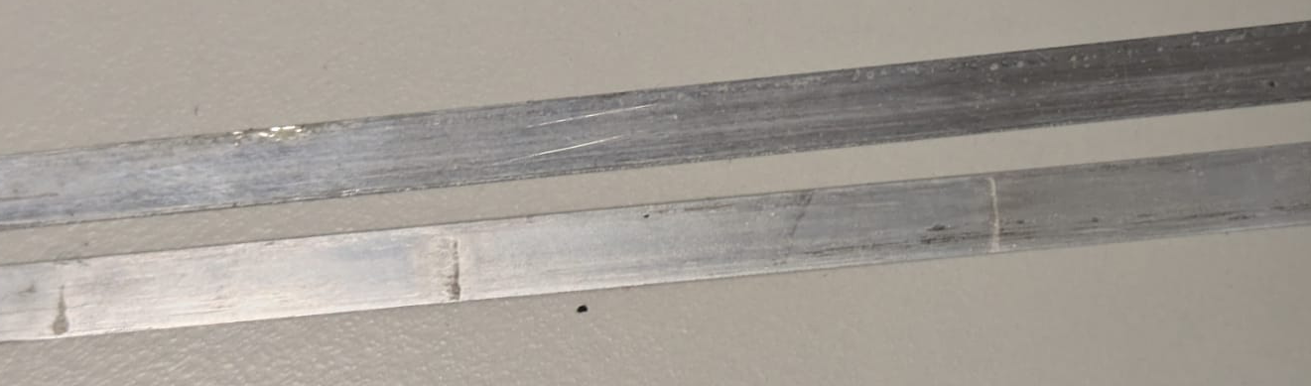
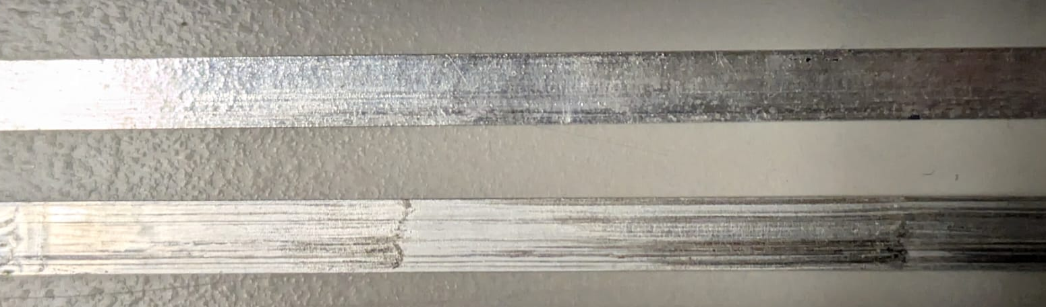
Coating
Coating is overall great
  Homogeneity (microscope) study in progress
  Quality of the coating (purity) degrades over time
    Wipes getting dirtier over time
      Replace them every time
    Tape is not the same
      Tape on top : Theva TPL 4421 80 microns
      Tape on bottom : Faraday MMT 50 microns
      Effect on the amount of flux removed ?
      To be investigated

Slide 3
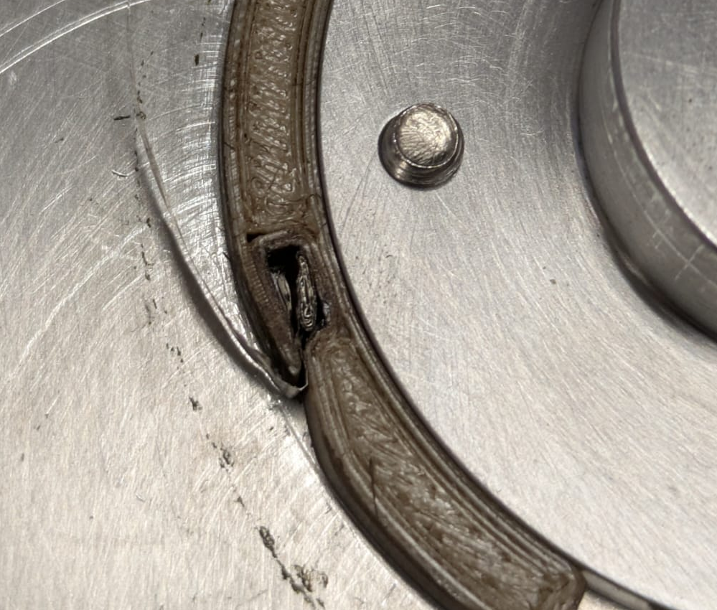
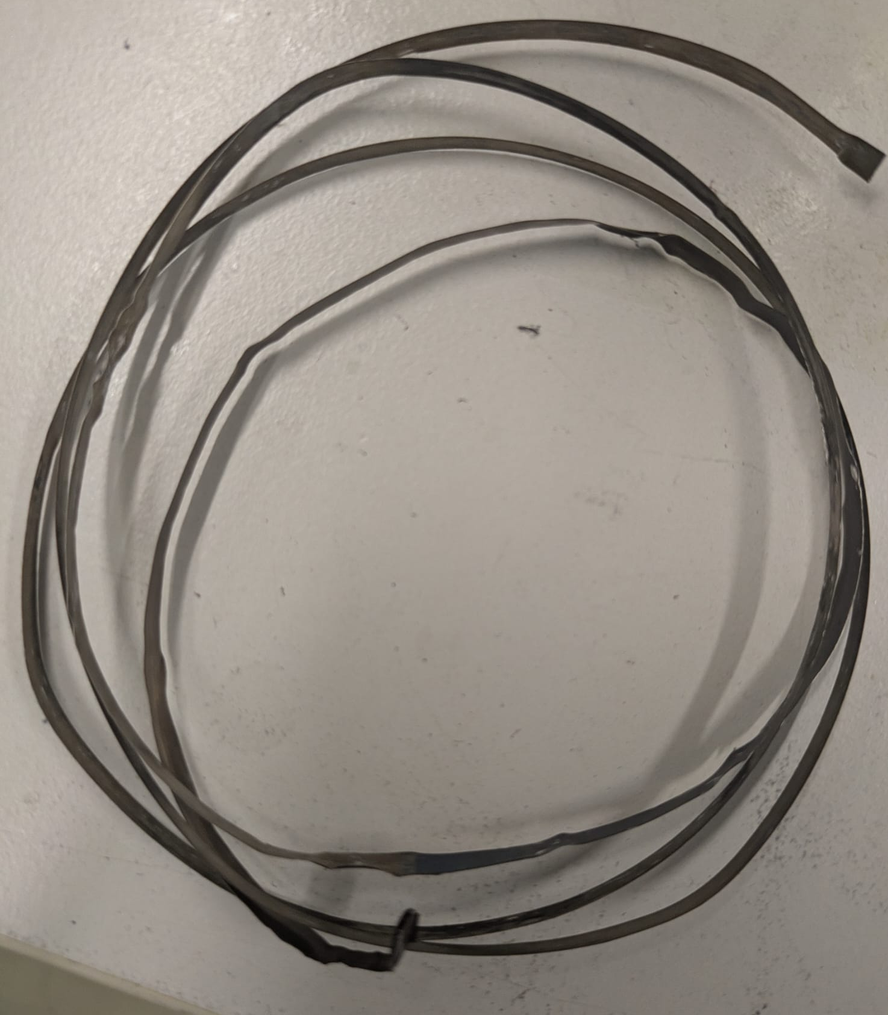
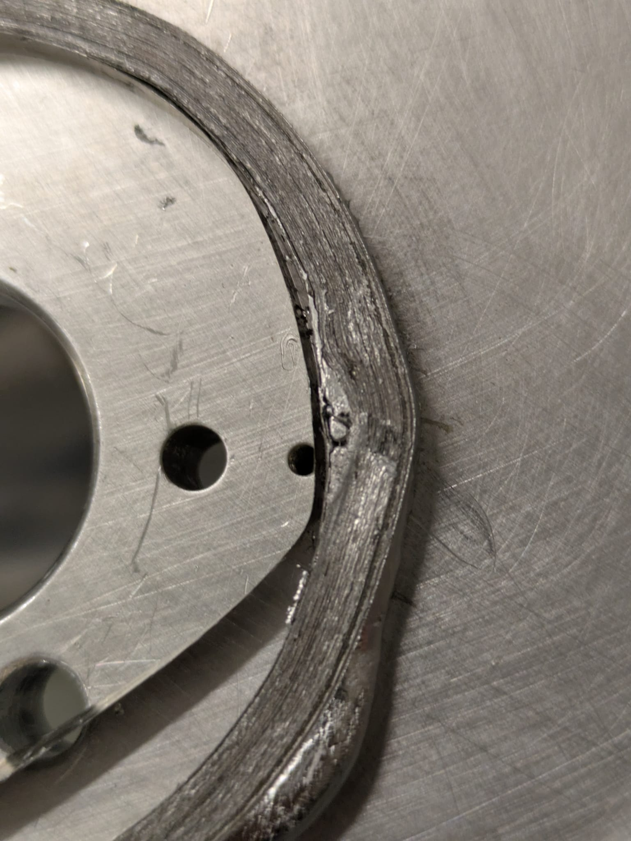
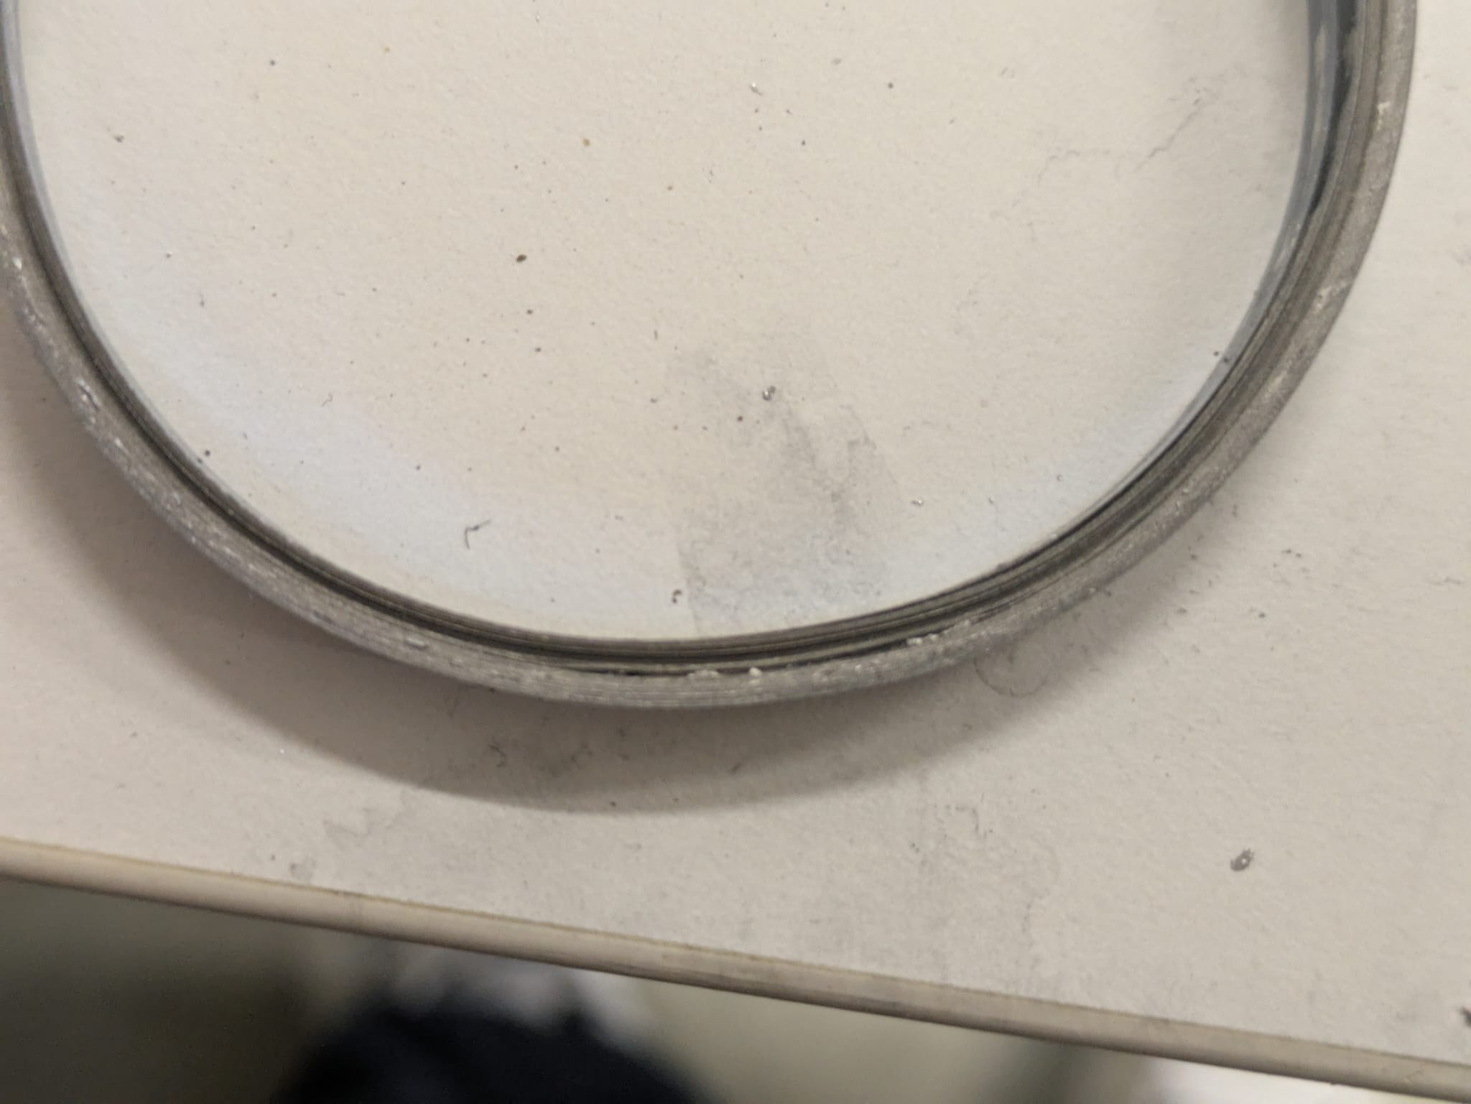
Hot winding
Removing mandrel
First turns (stay in the bath during heating)
  Steel too rigid (bad idea)
  Hastelloy
Winding → tensile force about 2kg
  Wipe → lack of solder ?
  Without wipe
    Filling factor to be determined

Slide 4
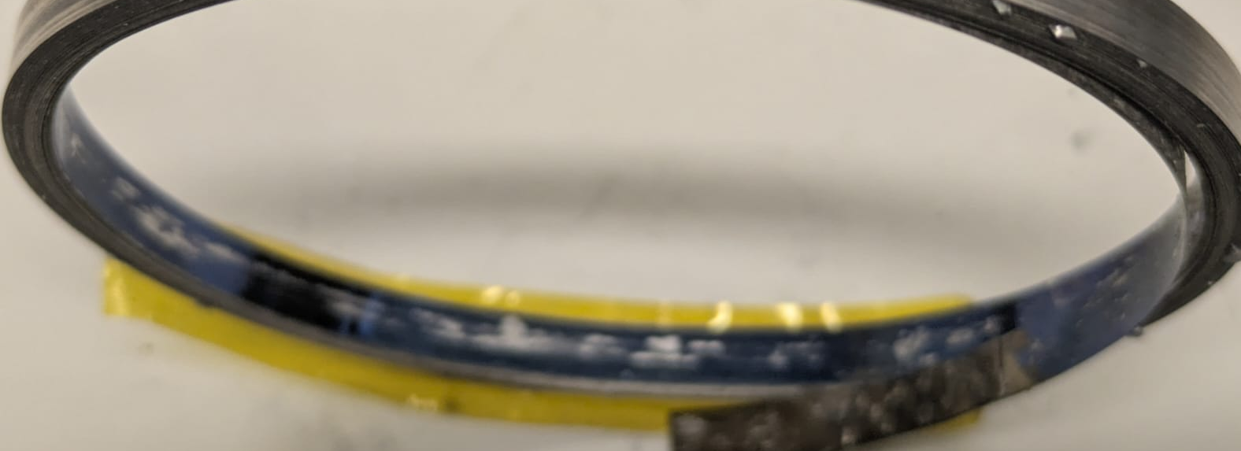
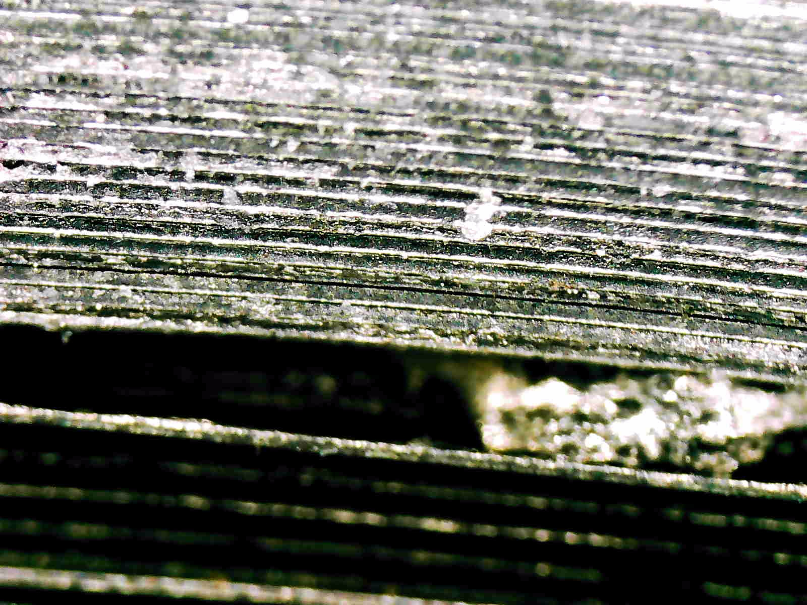
Hot winding
Dissolution of copper ?
Bring current from inner to outer part
  Welding → gap
  Holes → weak mechanically
  Do nothing ? Eddy current
    I will do a better scheme next time
LASER welding tests are in progress
Last pancake was sticking to the plate
Waiting for the new mandrels
! Temperature is decreasing over time (from 200°C to 195°C) after 30 turns in 2’30’’

Slide 5
