Slide 1


Working with neural networks
at CERN
Roope Niemi

Slide 2
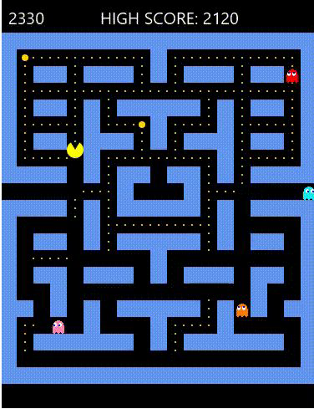


Who I am & how I got here
●Sotungin lukio 2008-2011
●2012-2017: non-IT work
●2017-2022: Studies at University of
Helsinki, Kumpula (Computer Science, Data
Science)
●2021-2024: Work at Nokia, applying to
CERN a few times
●September 2024 → Software engineer / data
scientist (QUEST) at CERN
06/02/2025 2

Slide 3

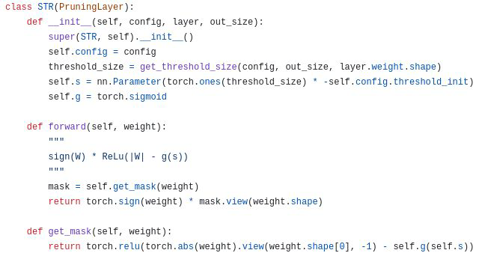
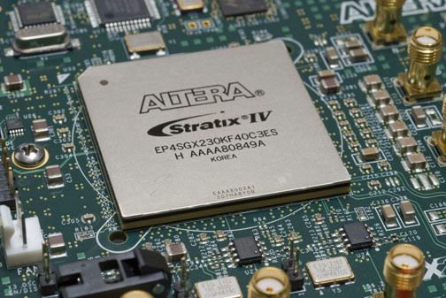
What I do
●Optimize neural networks for
hardware, so they are fast and
accurate → design methods to
train compressed neural
networks
●Programming with Python,
read scientific papers,
implement algorithms from
them and compare them to
other algorithms. Possibly
improve them
06/02/2025 3

Slide 4
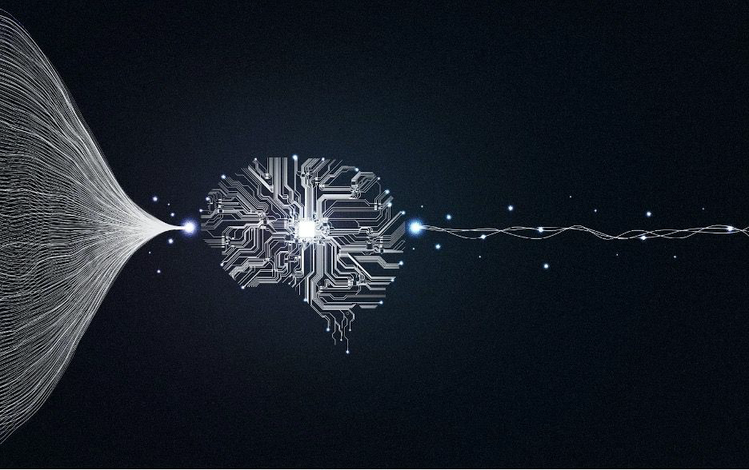
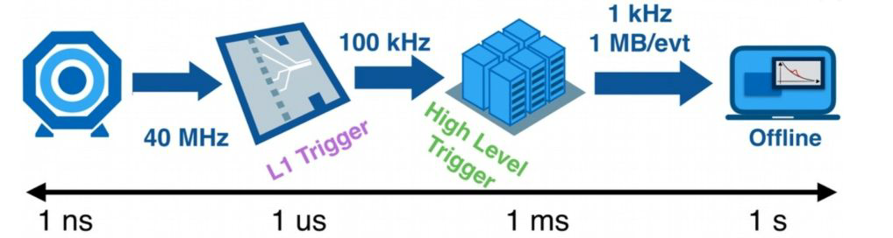
Triggers
●A lot of data from particle collisions.
ATLAS has data volume of over 60TB/s
●Use triggers to save only relevant data.
Has to be quick, but sensitive enough to
signs of rare processes
●Selection based on heuristics such as
energy, charge, direction, momentum
●Use neural networks to get better results
than traditional rule-based methods?
●A good neural network means nothing if it
cannot be run efficiently in hardware
06/02/2025 4

Slide 5
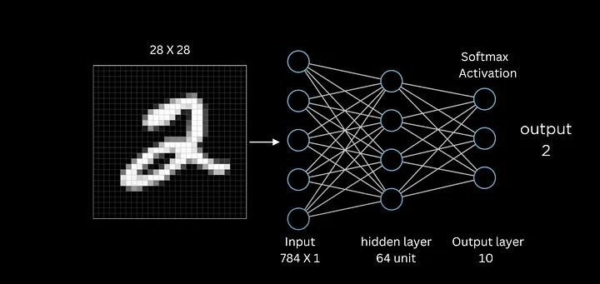
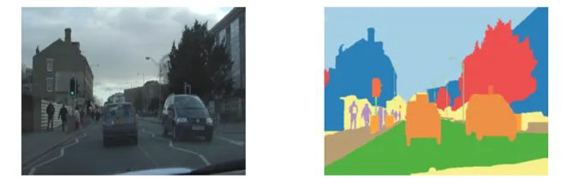
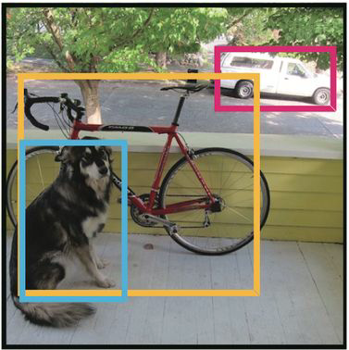
Neural networks
●Neural networks learn from data
●Can be trained to do tasks such as
classification, text, image or video
generation, regression, pattern
recognition
06/02/2025 5

Slide 6
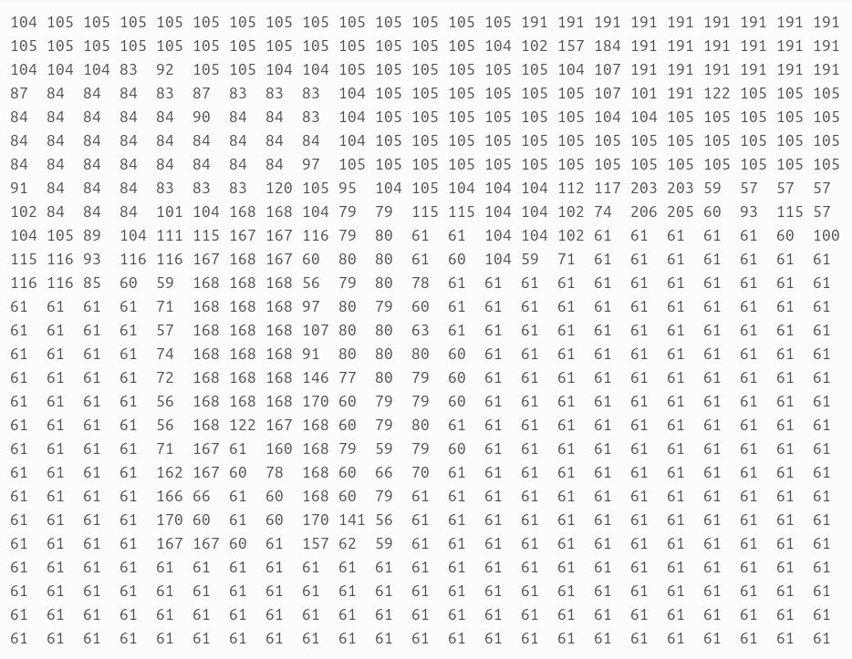
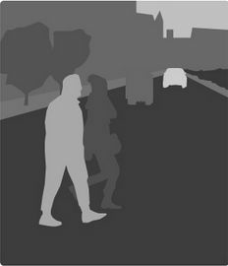
Neural networks
●Everything is numbers
●Neural networks produce an output by
doing mathematical operations such as
multiplication and addition
06/02/2025 6

Slide 7
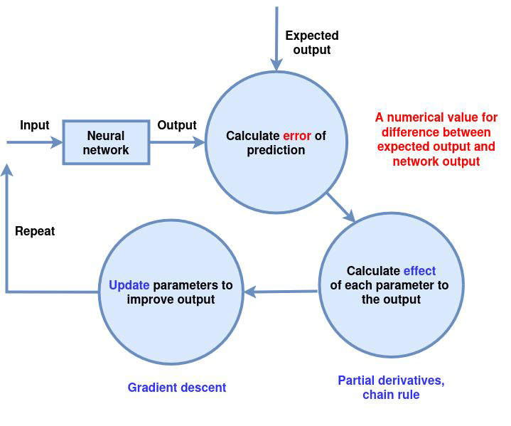
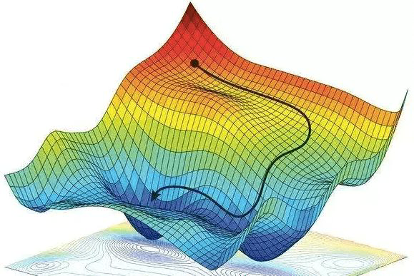
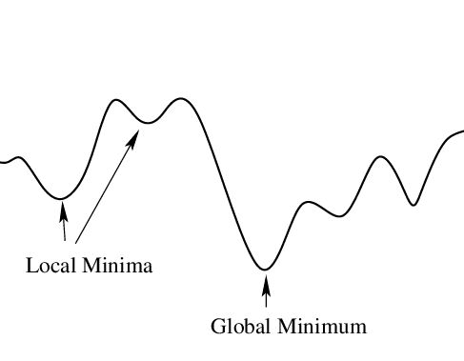
Neural networks
●In the beginning, the neural
network produces outputs that
make no sense
●During training the neural
network learns to produce better
outputs
06/02/2025 7

Slide 8
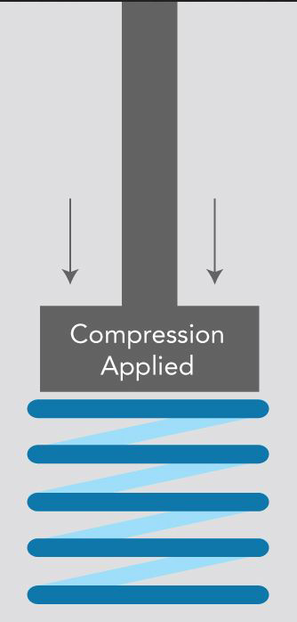
Neural networks
●Bigger neural networks can be
more powerful, but slow
●In limited-resource or
low-latency environments, this
won’t do.
●Use compression to make them
faster and use fewer resources
06/02/2025 8

Slide 9
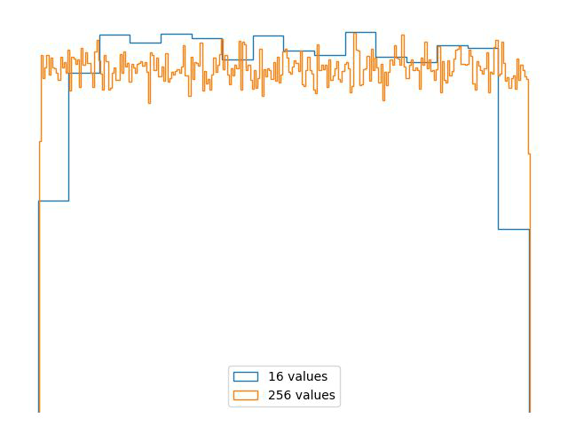
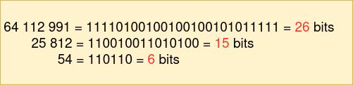
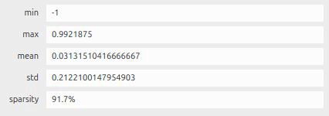
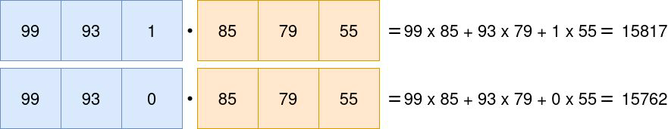
Compressing neural networks
●Restrict parameters to be one of
2,4,16,256 etc. values
●Teach neural network to work with
fewer parameters
06/02/2025 9

Slide 10
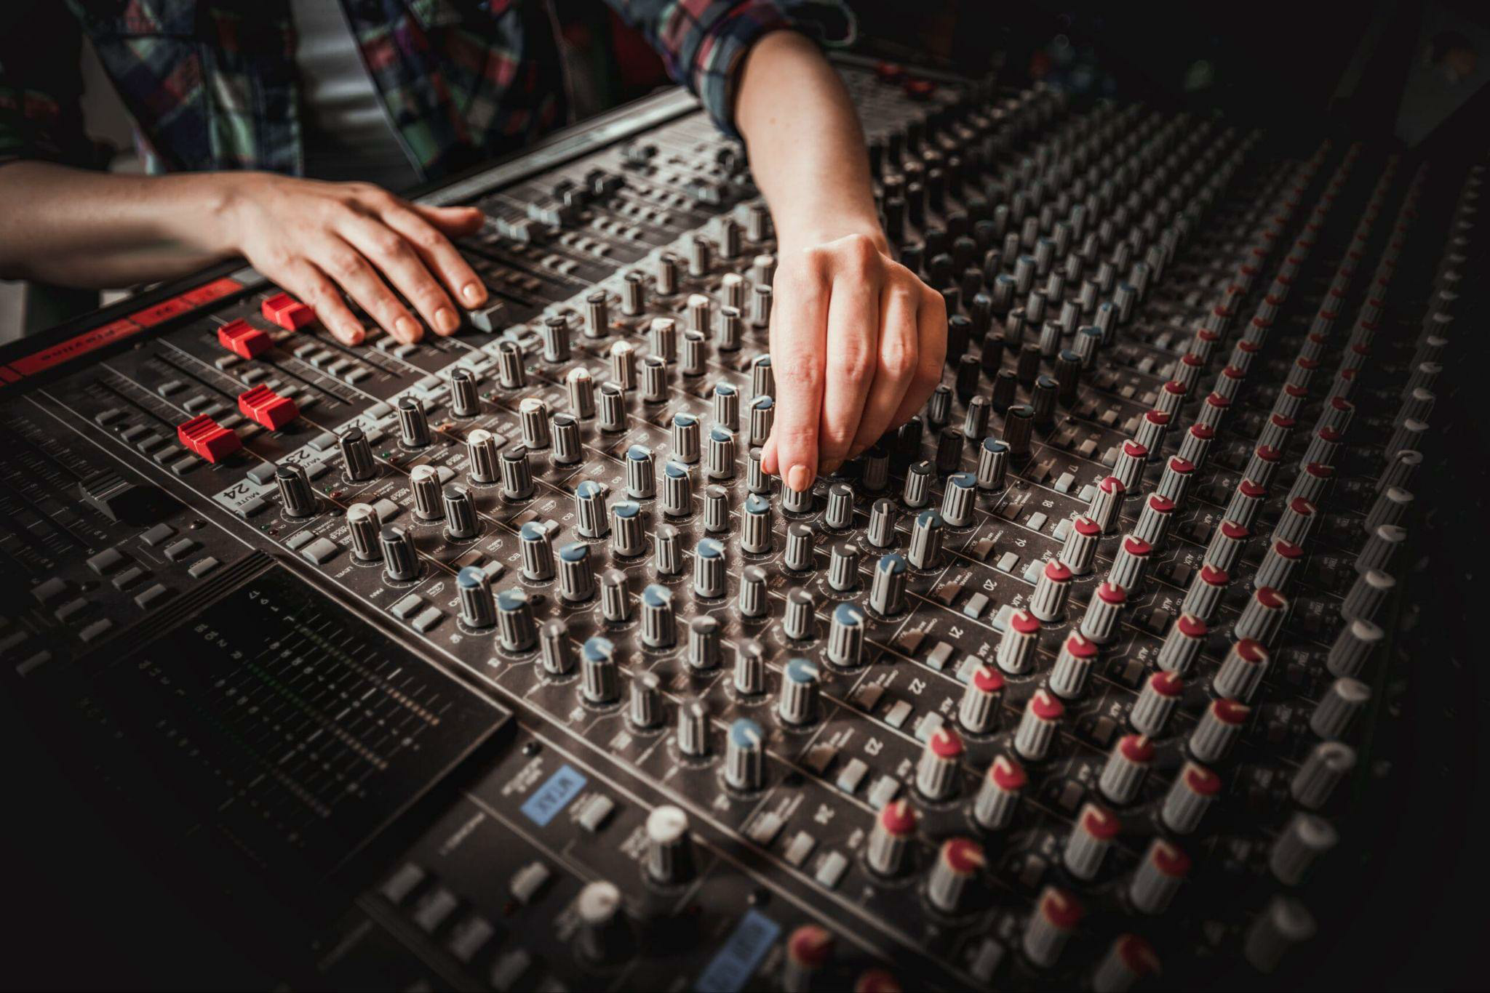
Optimizing (compressed) neural networks
●Hyperparameters: a set of parameters that
configure the neural network architecture and
how it is trained
●Neural networks are a black box. Training can
take a long time. Have to wait until training
ends to see how well a set of
hyperparameters work automate
●With compressed neural networks that run
directly on hardware, have to also consider
requirements by hardware
06/02/2025 10

Slide 11
AI use cases

Slide 12
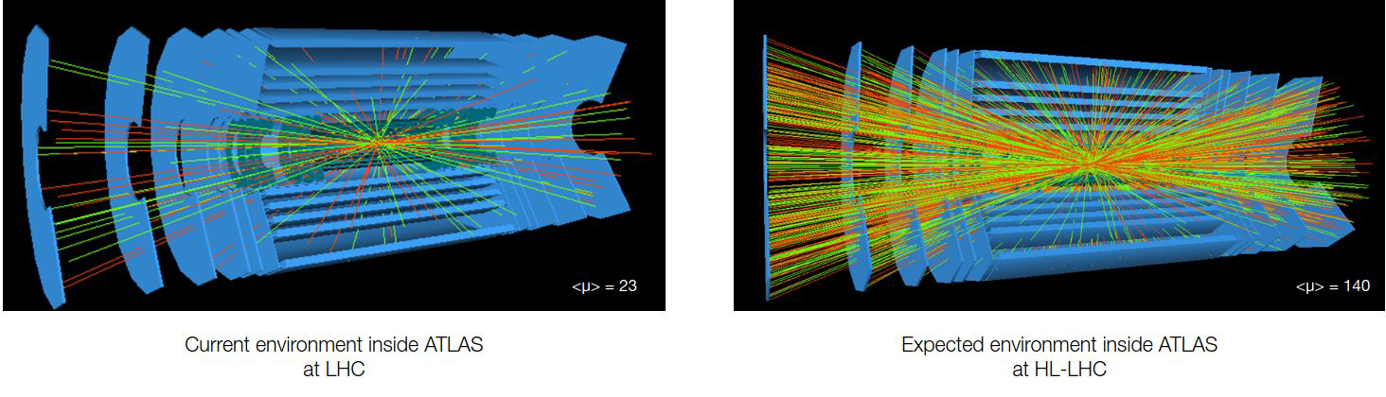
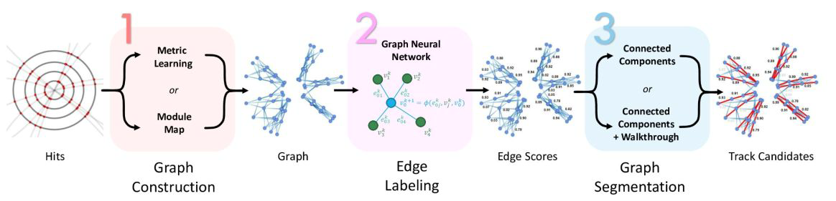
Track reconstruction
Offline:
-spacepoint formation
-track seeding
-track following
-track fitting
Online:
-pattern recognition
-latency O(10)us
Neural networks
06/02/2025 12

Slide 13
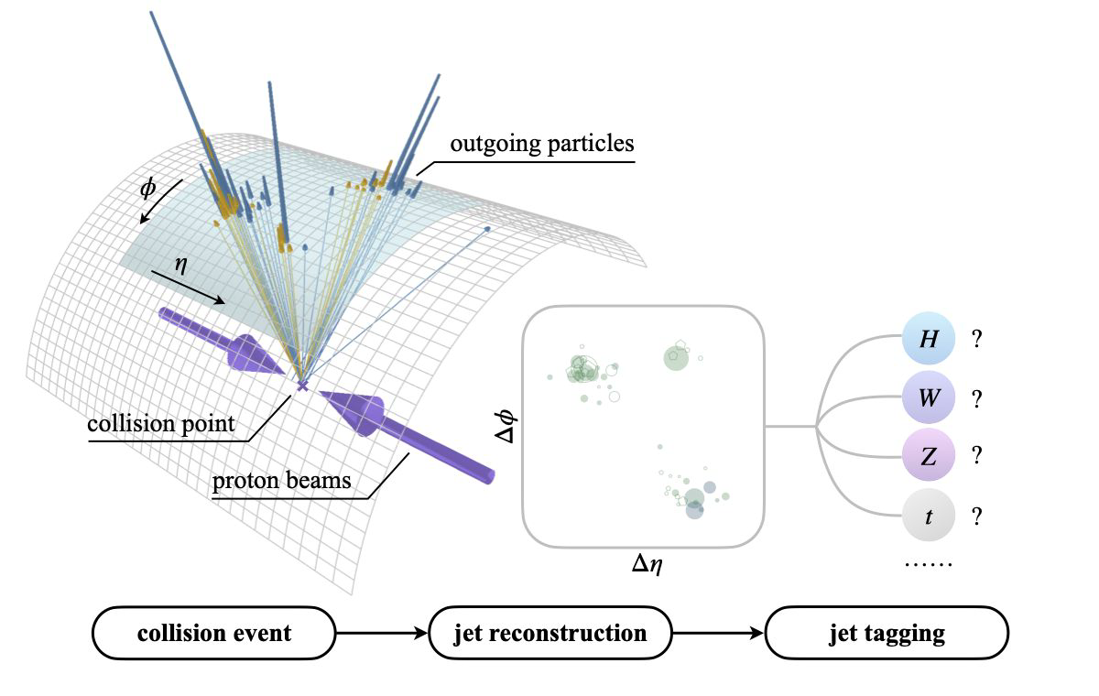
Jet tagging
Identify the type of the particle
that initiates the jet.
Challenge: particles can radiate,
radiated particles produce more
particles
Neural network:
-use measured particle
properties and particle pair
interactions to identify particle
types
06/02/2025 13

Slide 14
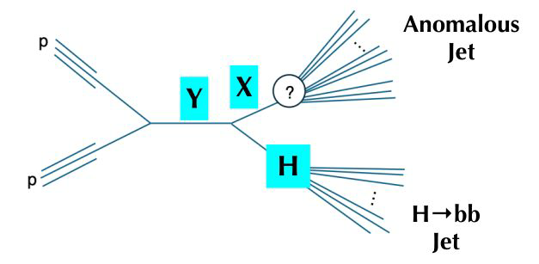
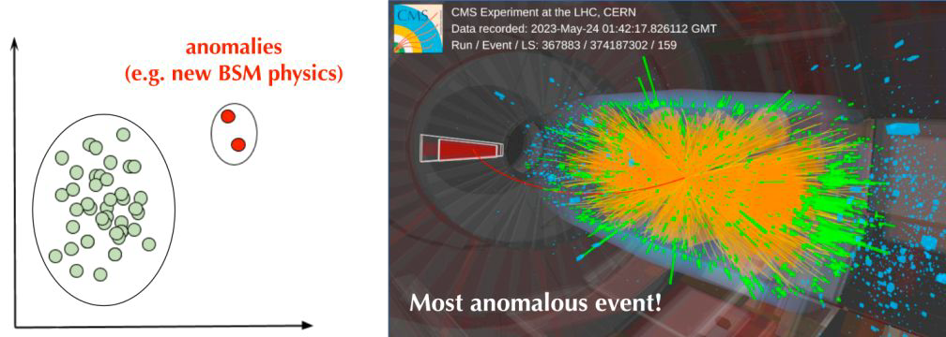
Anomaly detection
-What if the trigger discards events that
show new physics?
-Same input as Global Trigger, has to run
in 50ns
-Find events that are very unusual
06/02/2025 14

Slide 15
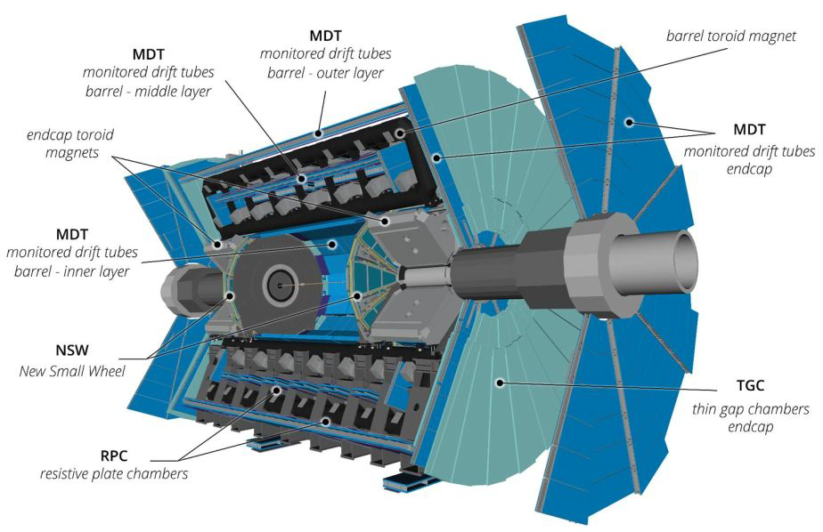
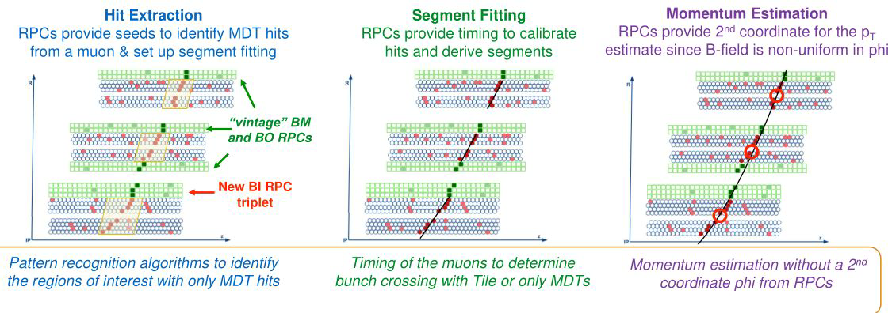
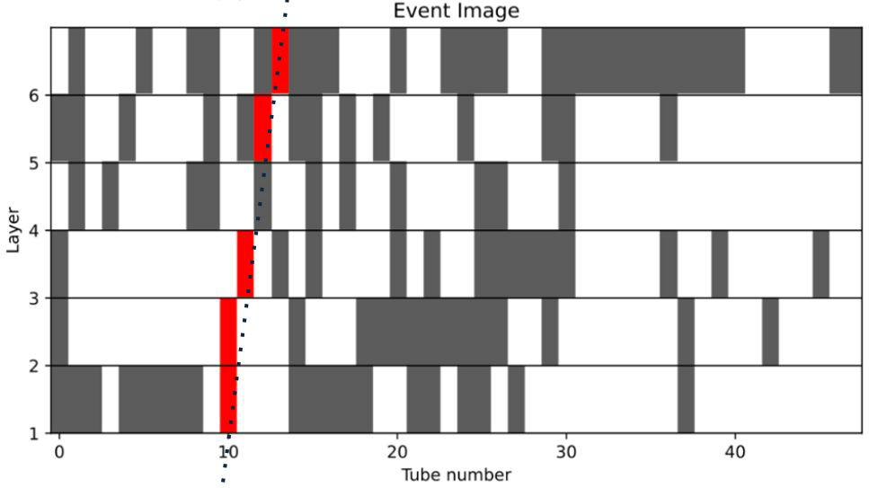
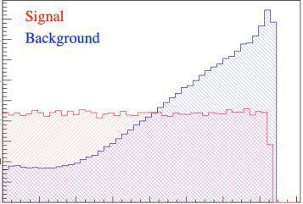
L0 Muon trigger
For cases with reduced RPC performance:
-Pattern recognition neural networks,
distinguish muon hits from backgrounds
-Momentum estimation
06/02/2025 15

Slide 16
Additional

Slide 17
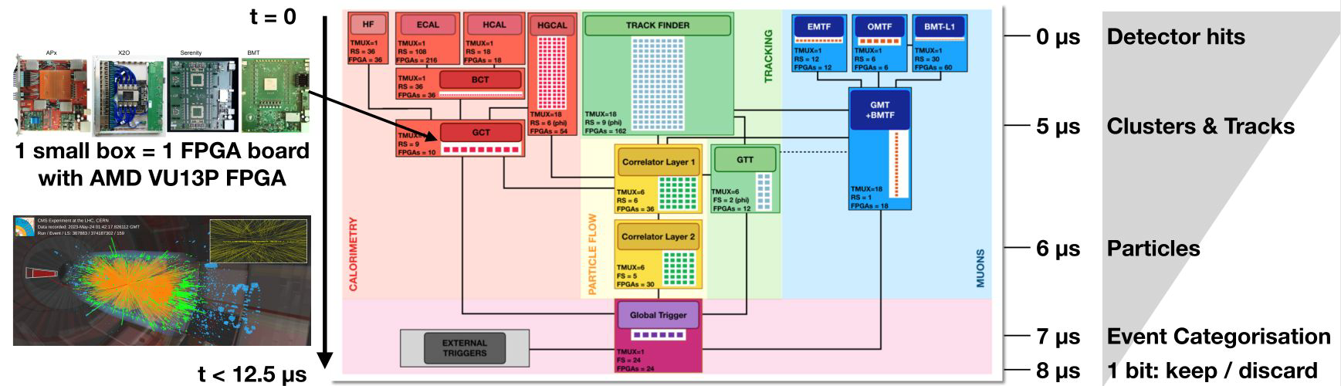
AI where?
06/02/2025 17

