Slide 1
Particle accelerators
Crash course
Pablo Arrutia
April 2025

Slide 2
Introduction

Slide 3
Disclaimer
CERN provides fantastic lecture resources through the CERN Accelerator Course (CAS).
A lot of the material in this presentation is taken from their resources: https://cas.web.cern.ch/
Their lectures are taught by world-leading experts on each and every aspect accelerators.
I am just trying to cover the surface… Check their stuff for a deeper dive!

Slide 4
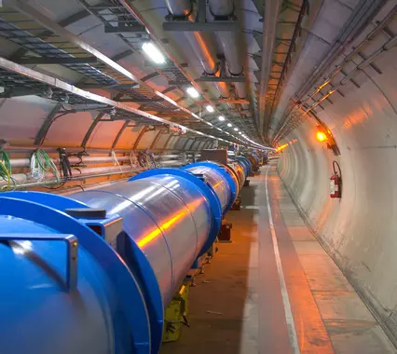
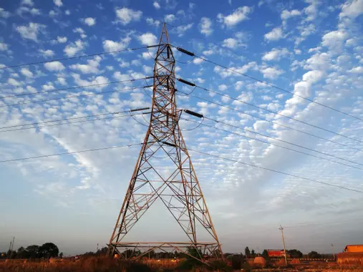
What is a particle accelerator?
A particle accelerator is a device that uses electromagnetic fields to accelerate charged particles to high speeds. (Wikipedia)
An accelerator ‘converts’ many slow and dispersed charges (electricity) into a few fast and concentrated charges (particle beam).

Slide 5
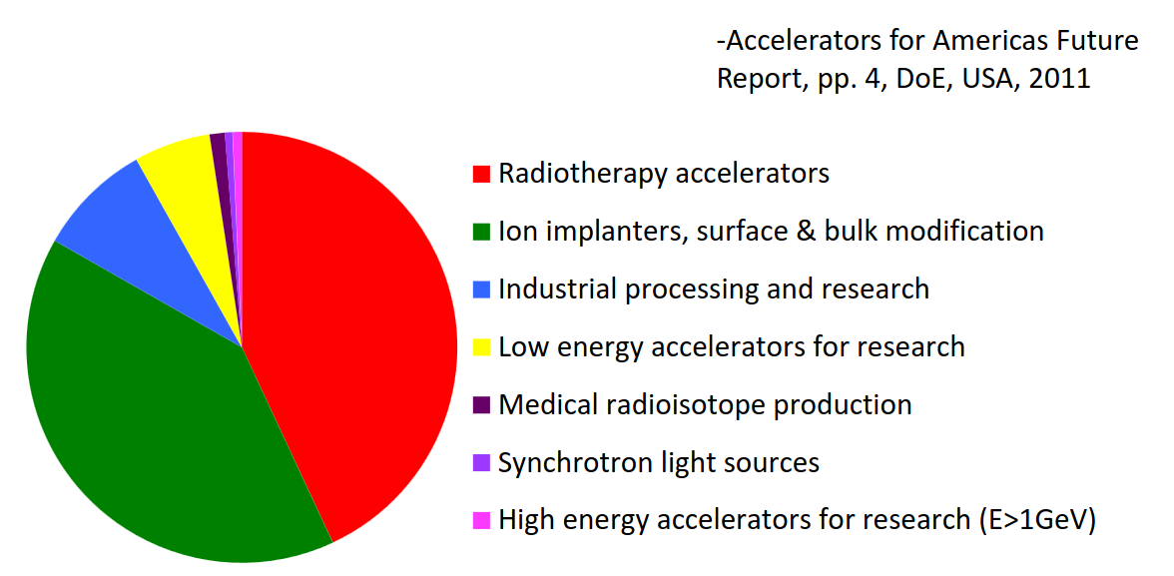
What for?
More than 30k particle accelerators in use
ref

Slide 6
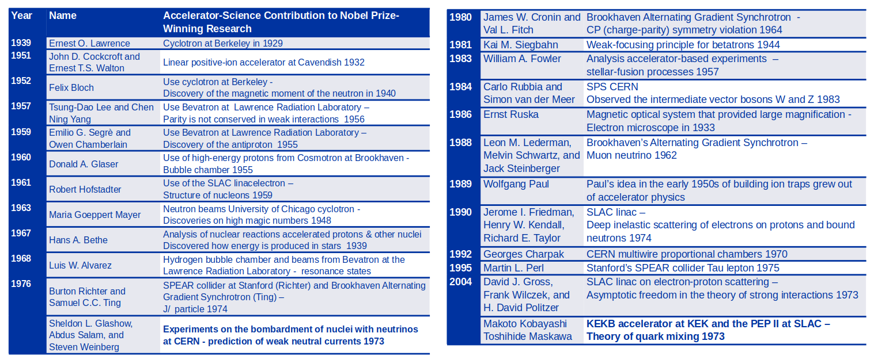
Fundamental physics
25 Nobel prizes with direct contributions from accelerators
2013, François Englert and Peter W. H iggs "for the theoretical discovery of the Higgs mechanism

Slide 7
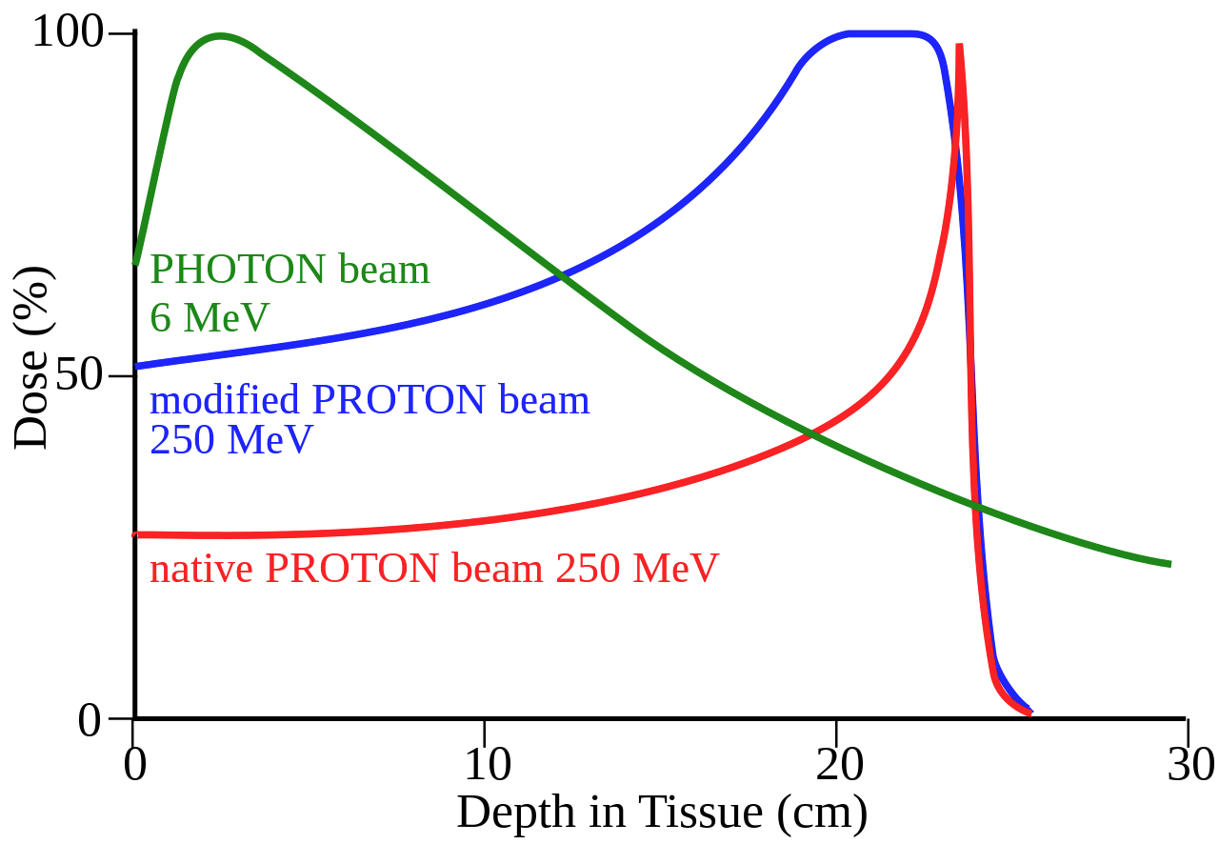
Cancer therapy
Deep tumour
Cancer is the second most common cause of death.
Accelerators employed for photon (radiotherapy), electron and proton treatments.
Proton therapy allows cellular damage to be confined to the tumor area, unlike conventional radiotherapy.
CERN collaborates with treatment centers (e.g. CNAO–MedAustron) and develops new designs (NIMMS).

Slide 8
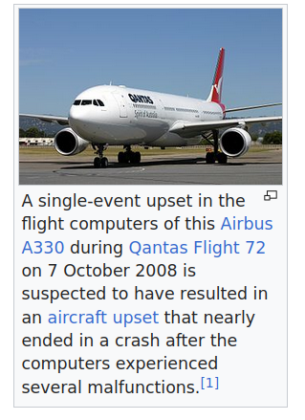
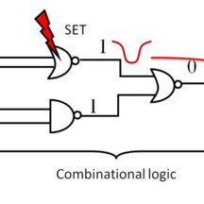


Space travel
In satellites, aircraft, and spacecraft, cosmic rays can damage electronic components.
We can use accelerators to simulate these conditions.
At CERN, the PS extracts a lead beam to the East Area (HEARTS–CHIMERA).

Slide 9
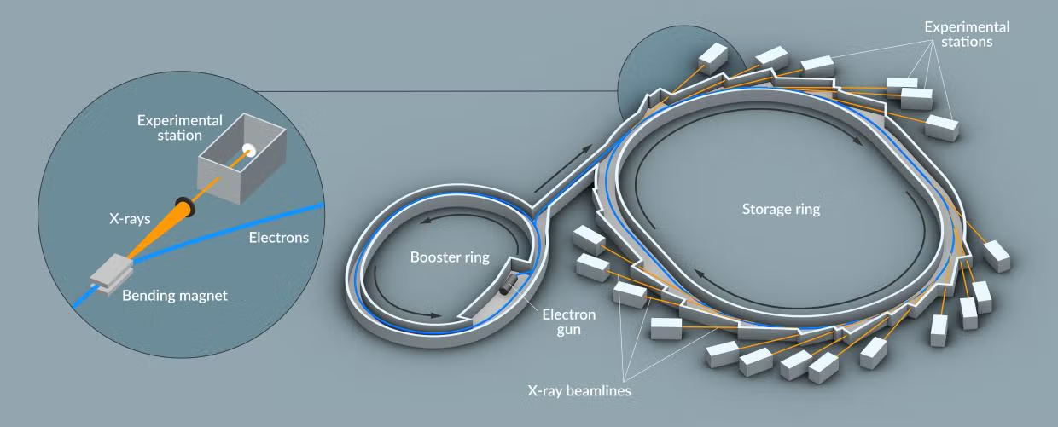
Light sources
Electron accelerators used to produce intense pulses of X-ray light, serving as microscopes “on steroids”.

Slide 10
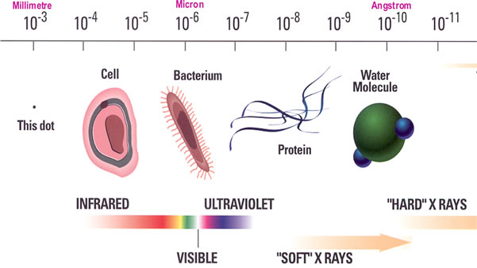
Light sources
Electron accelerators used to produce intense pulses of X-ray light, serving as microscopes “on steroids”.

Slide 11
Let’s build a particle accelerator

Slide 12
Beam pipe/Vacuum

Slide 13
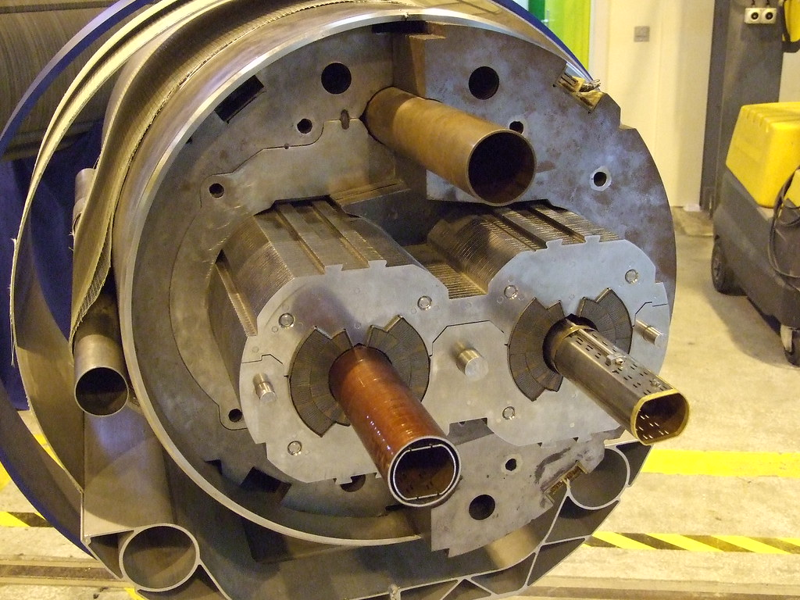
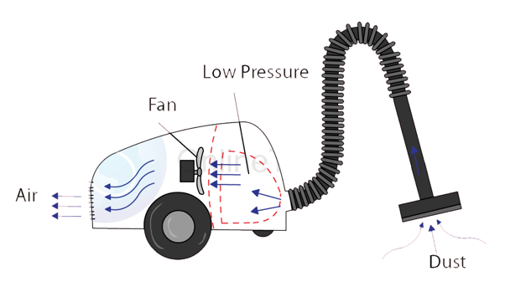
Beam pipe/Vacuum
Particle beams are transported inside a beam pipe with good vacuum to avoid collisions.
Beam pipes
20-30% below atmospheric pressure

Slide 14
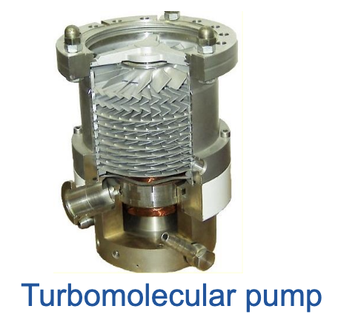
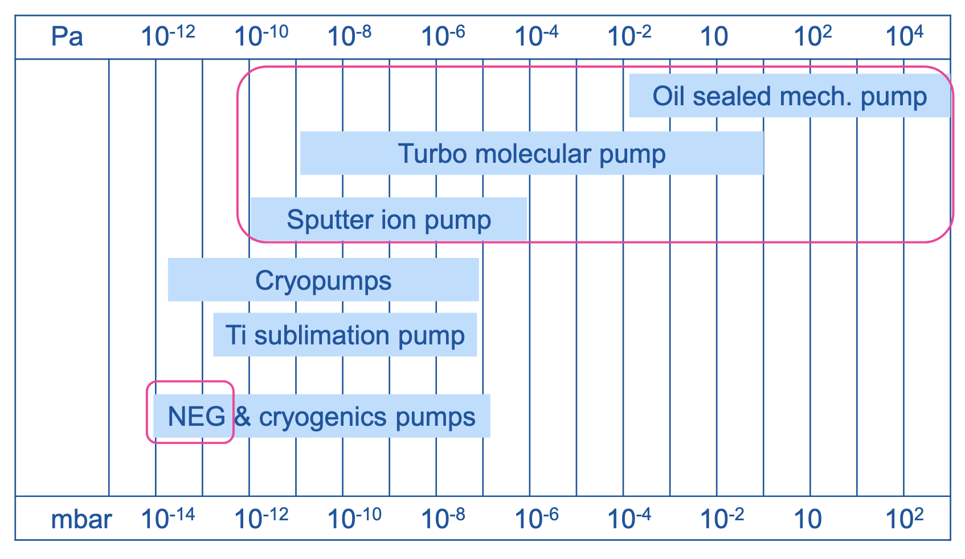
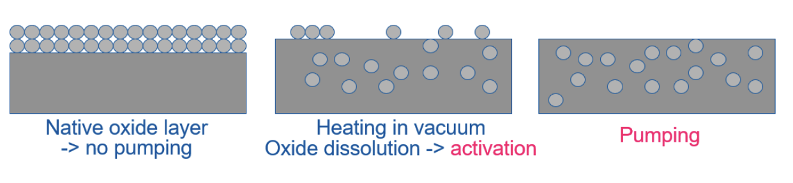
Beam pipe/Vacuum
Approx. pressure in the Moon
Atmospheric pressure
NEG pump

Slide 15
Particle sources

Slide 16
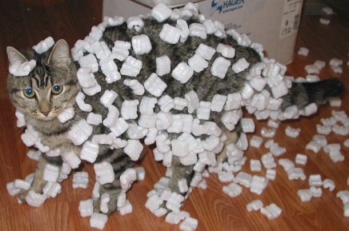
Particle sources
The matter that surrounds us is (primarily) neutral, but we need to obtain charged particles.

Slide 17
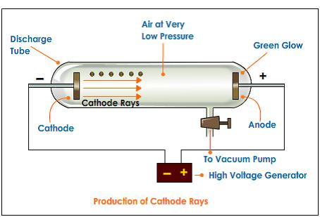
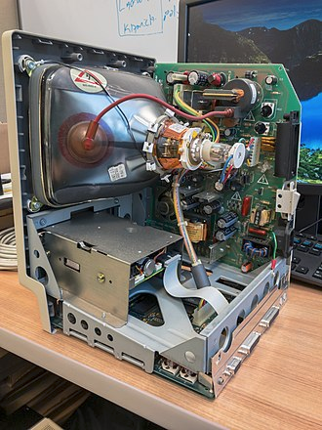
Sources, history
Cathodic ray sources (end of 19th century):

Slide 18
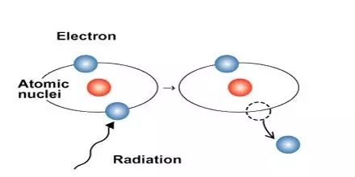
Sources: general strategy
Decouple nucleus and electrons, overcoming the work function.
Extract the nucleus or electrons with electric fields.

Slide 19
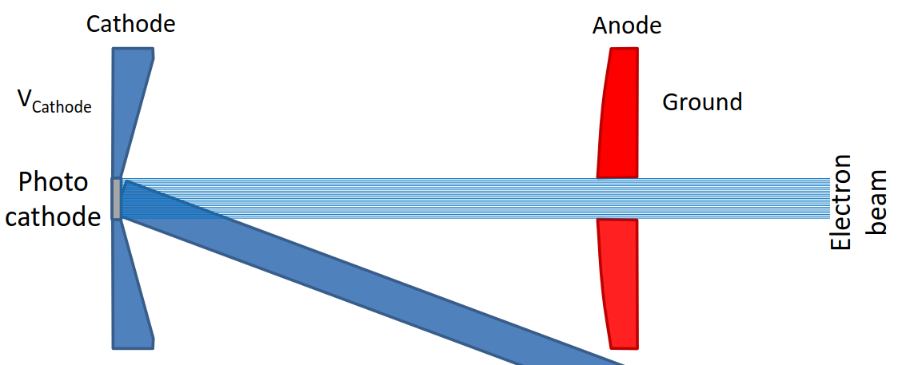
Sources: electrons
A typical electron source will use the thermionic or photoelectric effect to produce electrons:
Electric force
Laser

Slide 20
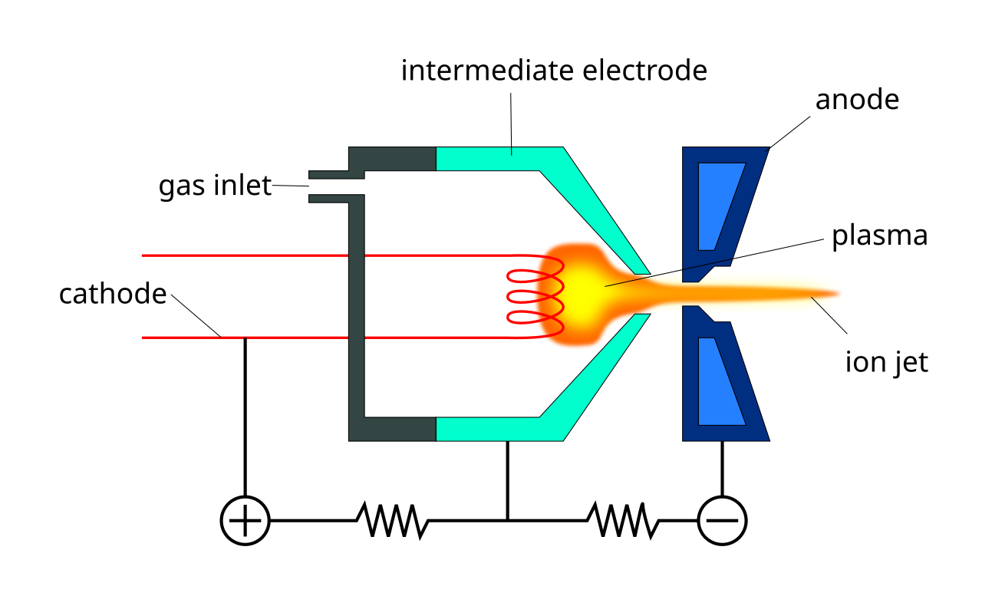
Sources: protons/ions
A typical proton/ion source will have a material inlet, a production container and an extraction mechanism:

Slide 21
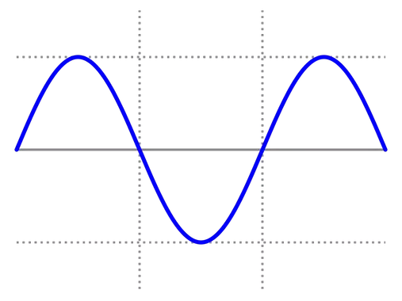
Acceleration

Slide 22
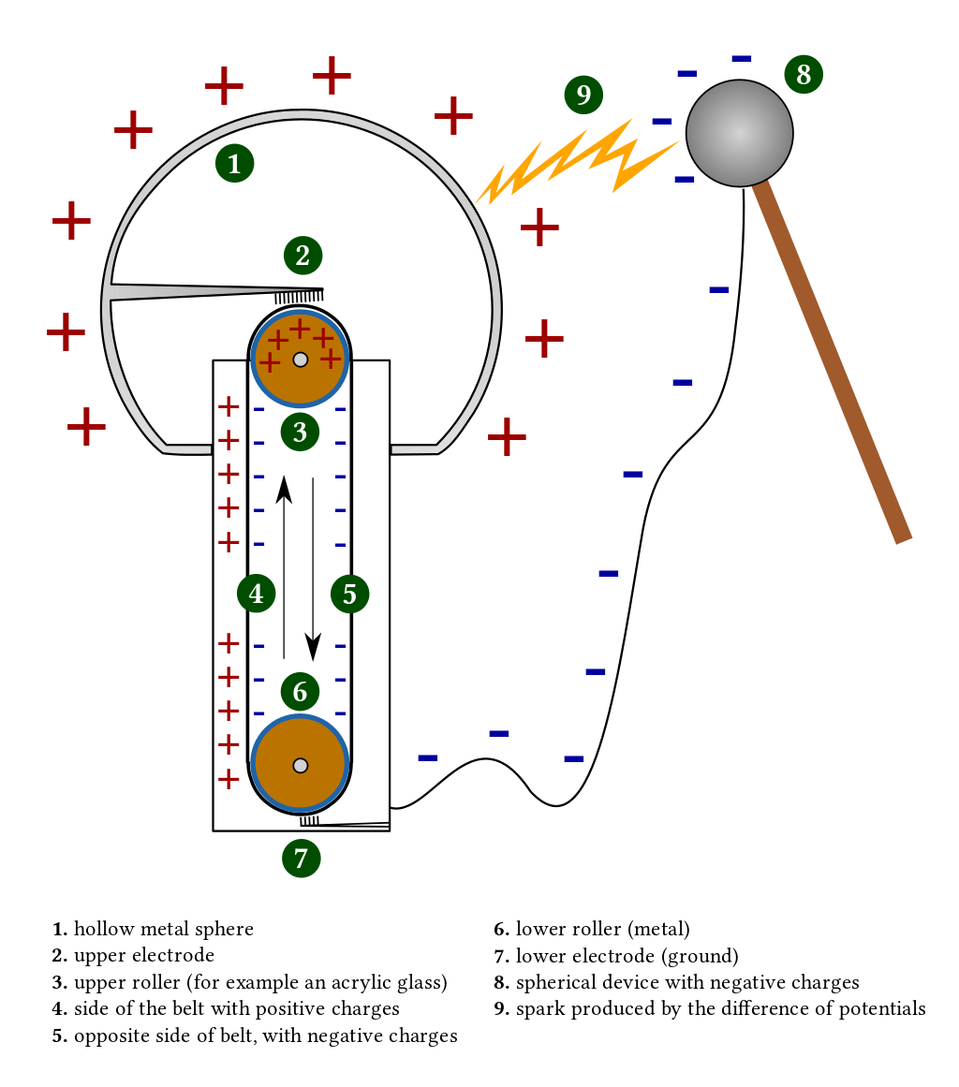
Acceleration, history
Voltage difference -> acceleration.
Robert Van de Graaff (1929), and John Cockcroft/Ernest Walton (1932) created the first electrostatic accelerators.
You thought I was kitting?

Slide 23
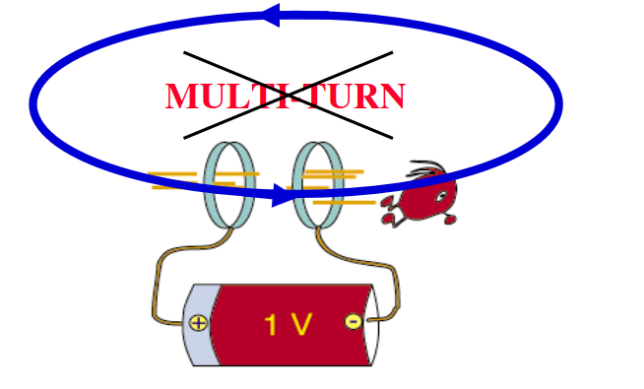
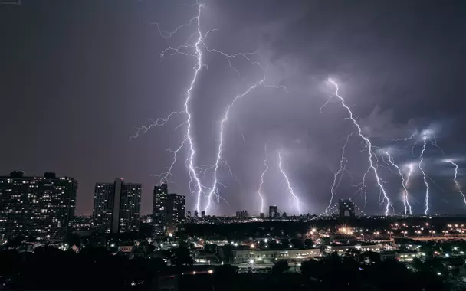
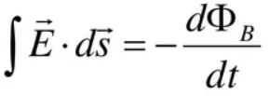
Acceleration, history
Electrostatic accelerators have a fundamental limitation…
They can only be traversed once!
Electric discharge
0

Slide 24
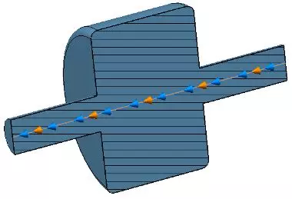
Acceleration, RF cavity
Solution: alternate the electromagnetic field using radiofrequency technology, avoiding accumulation of charge and allowing multi-turn acceleration.
Beam
Cavity E-field
Cavity E-field
Beam

Slide 25
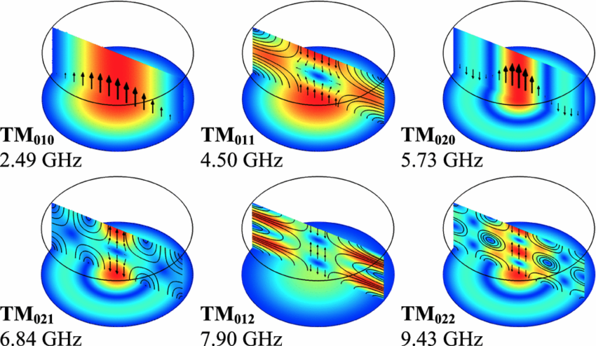
Acceleration, RF cavity
The cavity geometry will determine the frequency of the possible RF modes, which we must coordinate with the revolution frequency of the beam.

Slide 26
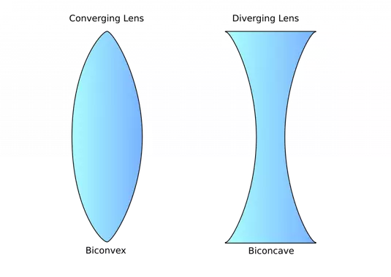
Magnets

Slide 27
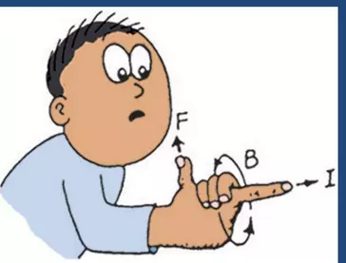
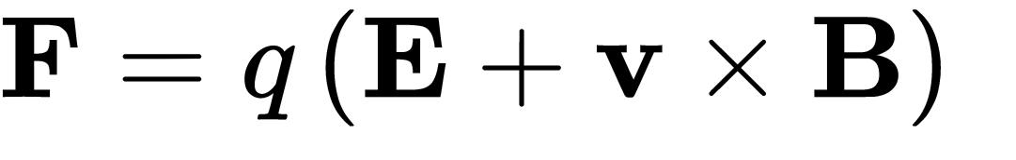
Magnets
Lorentz force
Can both bend and accelerate
Can only bend, but can never accelerate

Slide 28
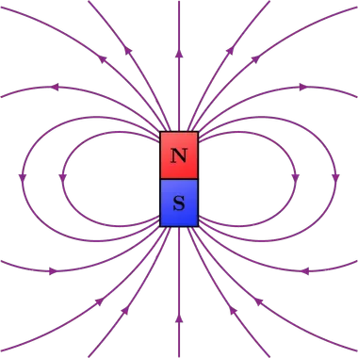
Magnets, dipole
F
But the exerted force increases with the particle’s speed :)
v
B

Slide 29
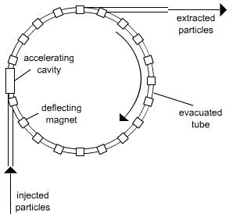
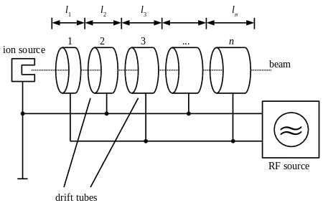
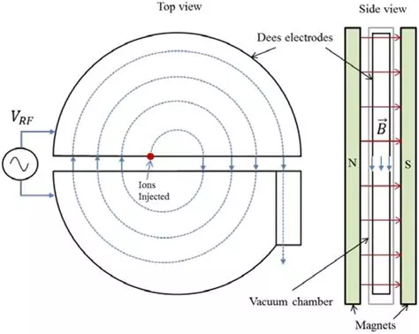
Magnets, accelerator types
Linac
(No dipoles)
Synchrotron
(Dipole field increases with particle energy)
Cyclotron
(Fixed-field dipoles)

Slide 30
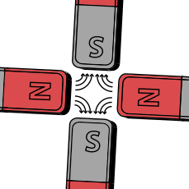
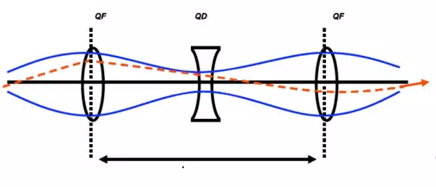
Magnets, quadrupoles
A particle beam tends to defocus transversely, like a beam of light...
We need focusing magnets (quadrupoles) that re-focus the beam before it becomes too big and is lost on the beam pipe.
F
Quadrupole

Slide 31
Injection and extraction

Slide 32
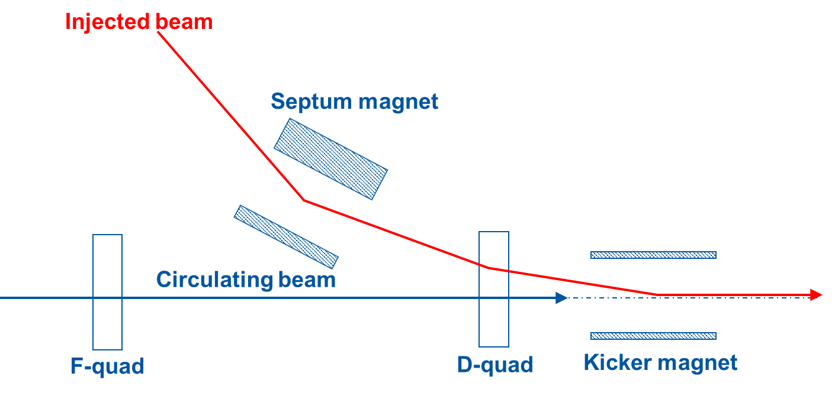
Injection and extraction
intensity
injected
beam
kicker field
t
Kickers produce fast pulses, rising their field within the particle-free gap in the circulating beam (temporal separation)

Slide 33
Injection and extraction
intensity
injected
beam
kicker field
t
Kickers produce fast pulses, rising their field within the particle-free gap in the circulating beam (temporal separation)
Septa compensate for the relatively low kicker strength, and approach closely the circulating beam (spatial separation)

Slide 34
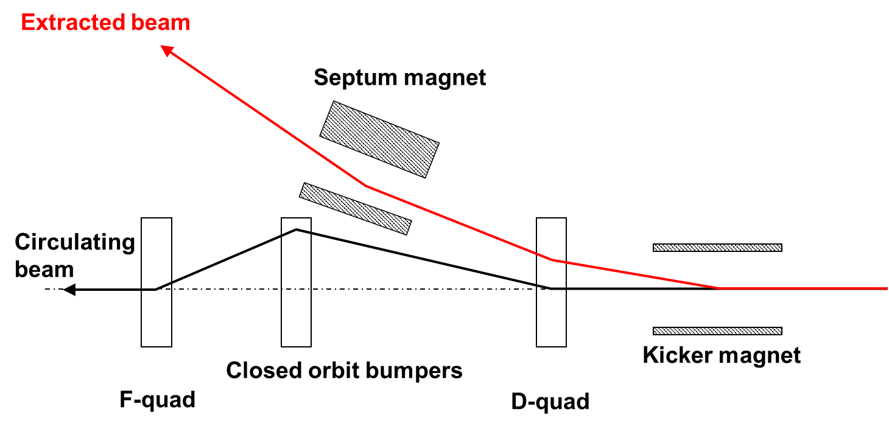
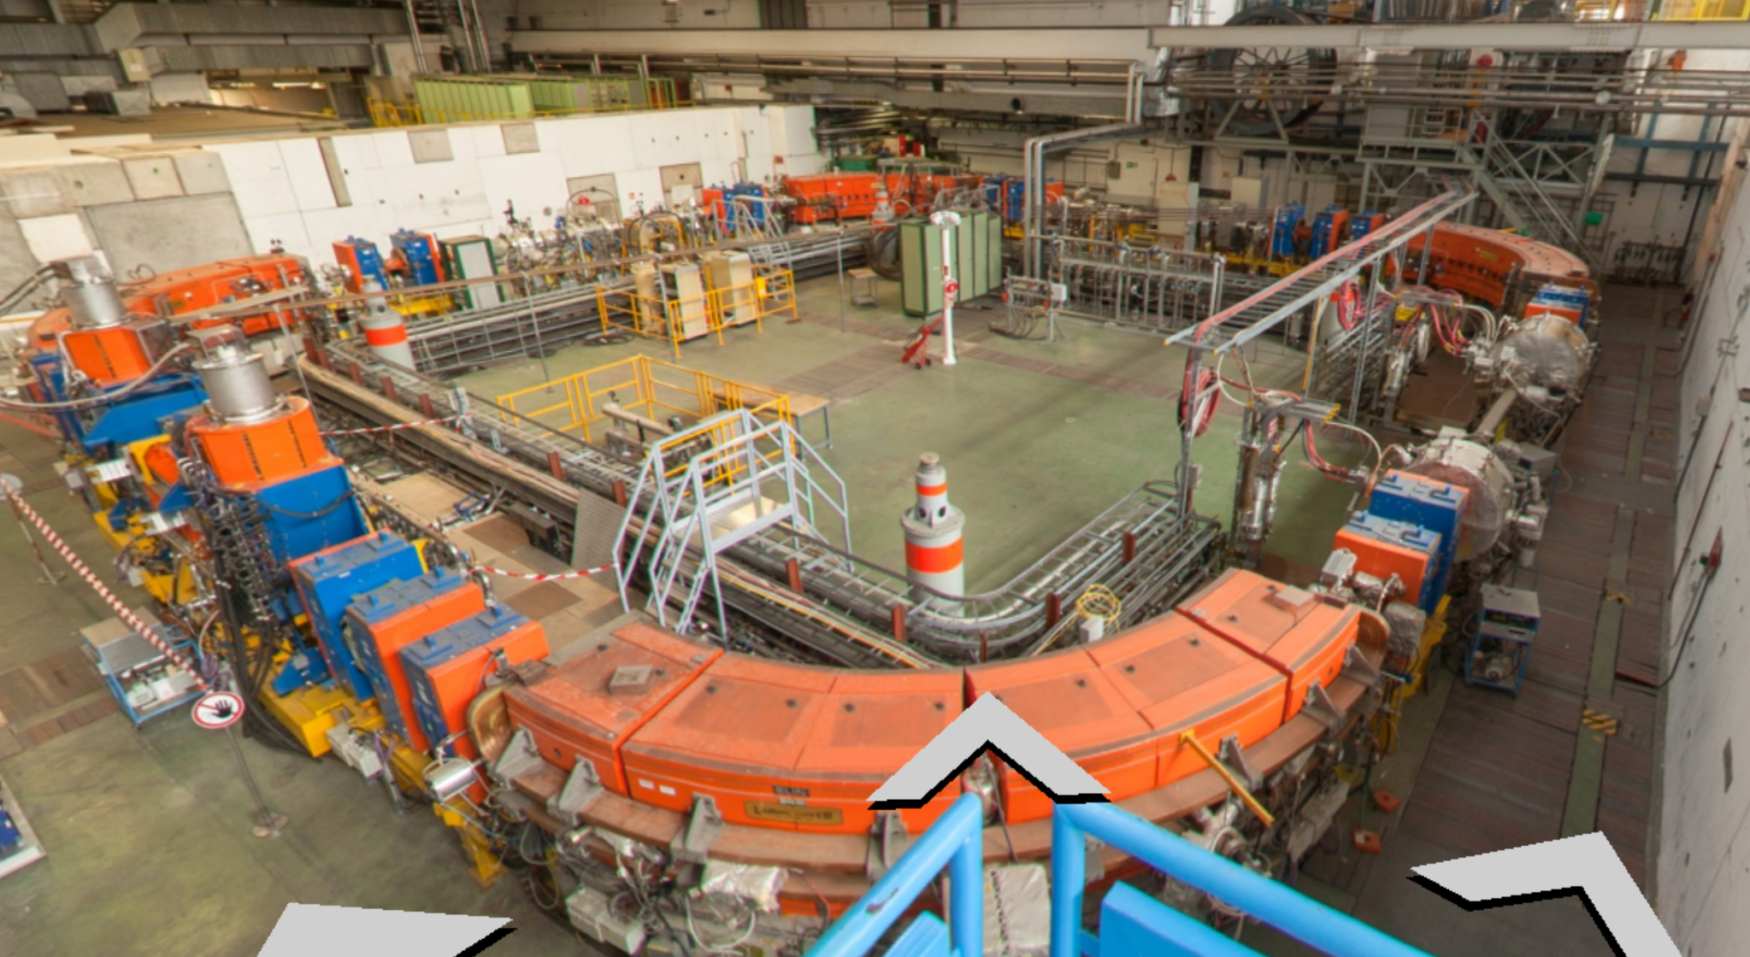
Example: LEIR extraction
Septum
Kicker
Gis link and panoramic

Slide 36
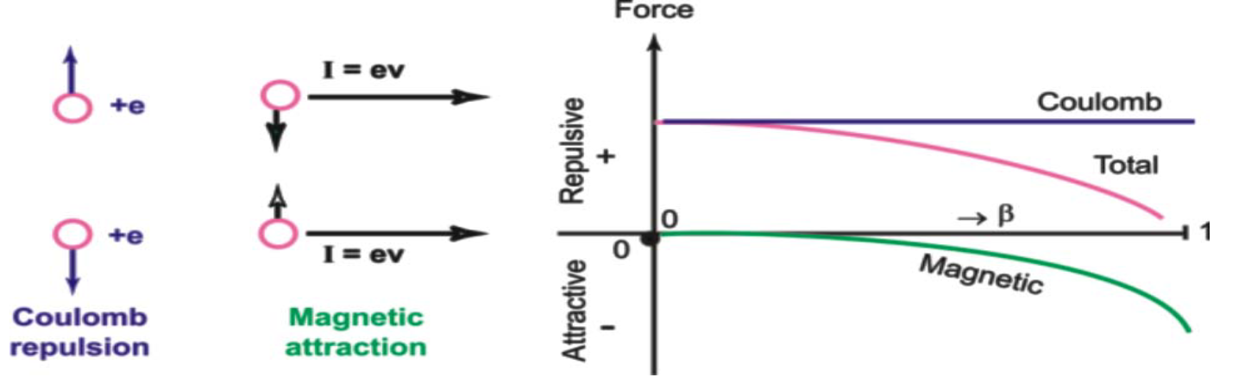
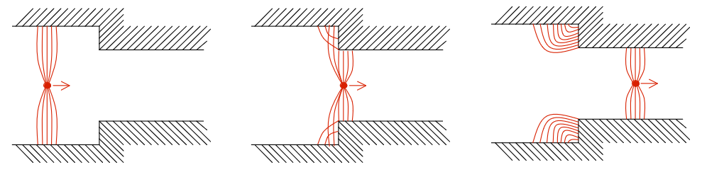
Two examples of limitations
Space charge
(~low energies)
Impedance coupling
(~high energies)

Slide 37

Colliders

Slide 38
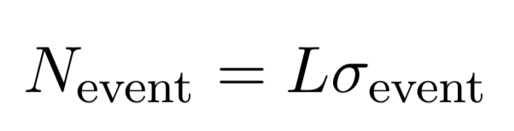
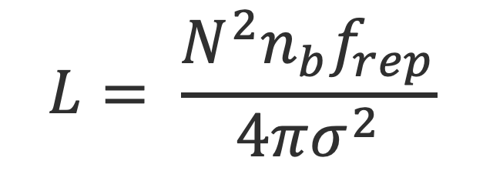
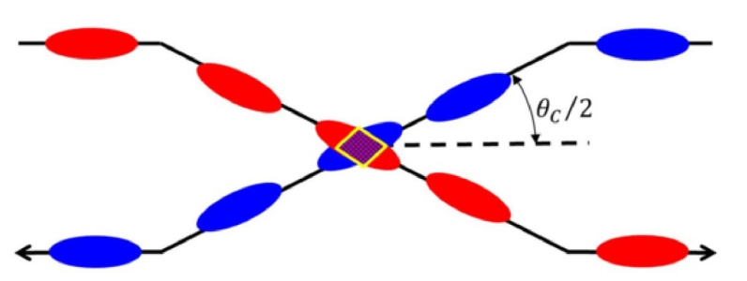
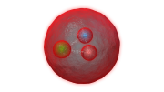
Colliders, luminosity
The main figure of merit of a collider is its luminosity L:
From accelerator
From nature
Luminosity
Cross section
Likelihood of given event type

Slide 39
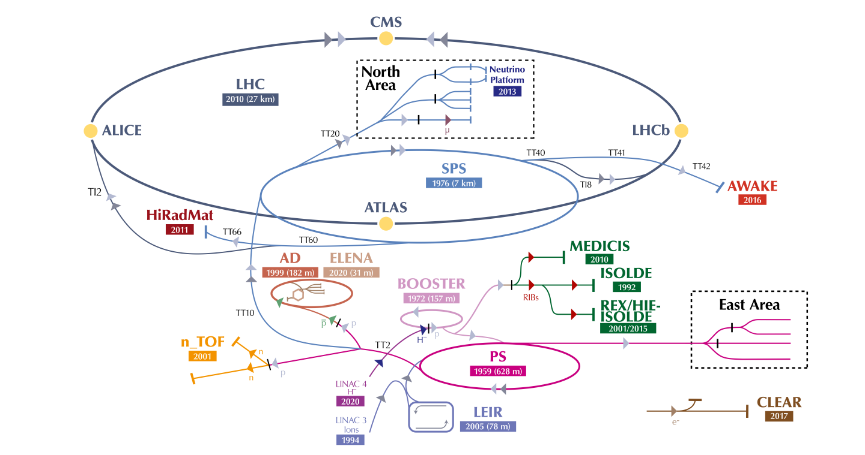

Slide 40
The future

Slide 41
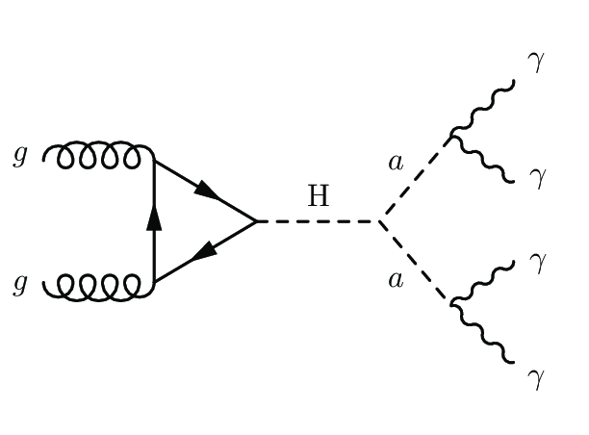
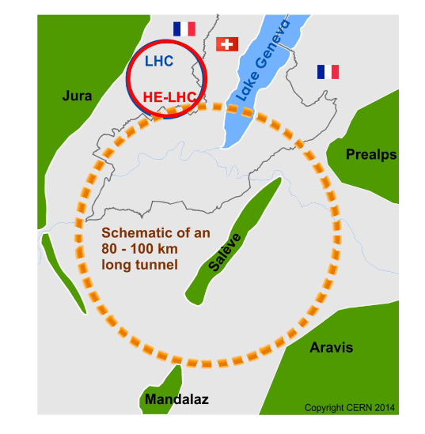
Fundamental physics
Detailed study of the matter we know could reveal deviations from theoretical predictions.
FCCee will collide electrons and positrons at an unprecedented rate to probe the properties of the Higgs boson like never before.

Slide 42

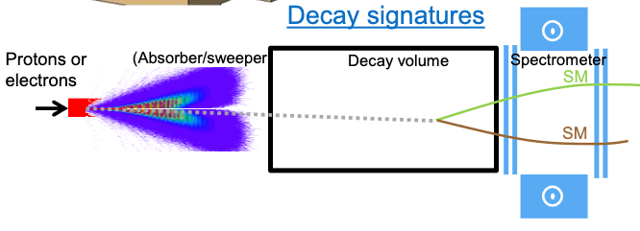
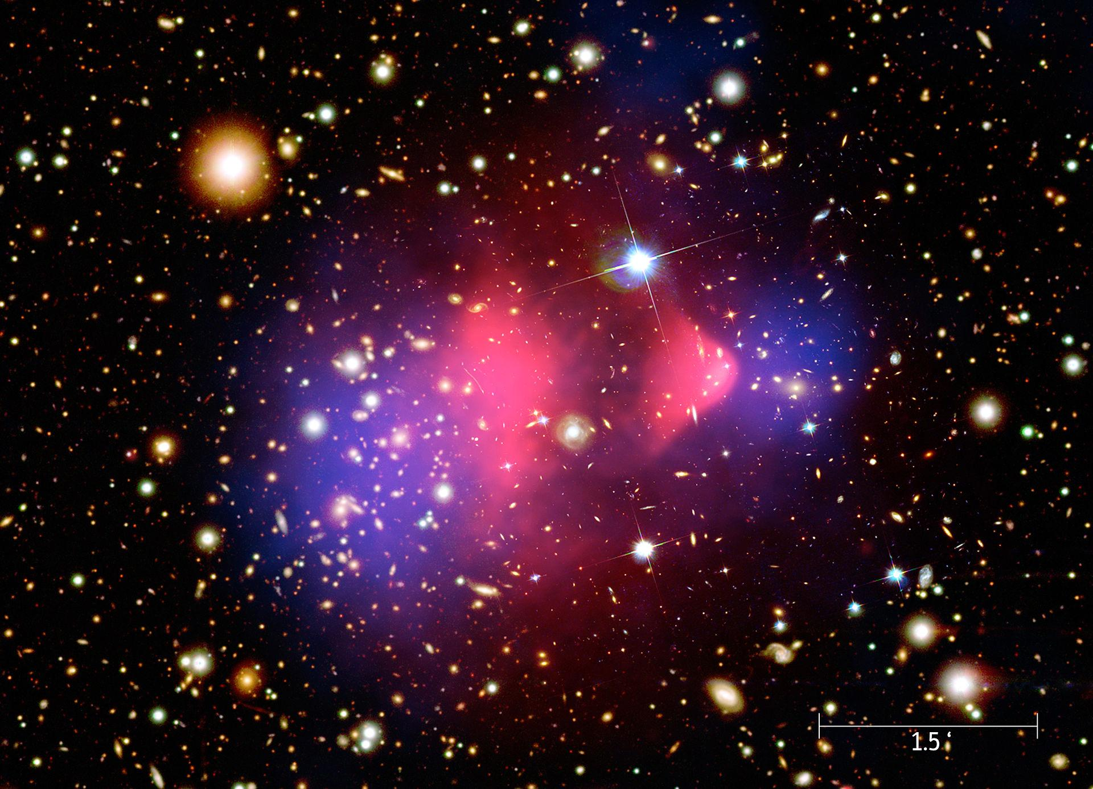
Fundamental physics (ii)
Dark matter offers a possible explanation to several mysterious observations.
SHiP will be hosted at CERN to search for long-lived dark-matter particles that would rarely interact with regular matter.
Bullet cluster
SPS
Dark matter Visible matter

Slide 43


Cancer therapy
FLASH: A full session in in 100 ms?!
Mini-pig, Vozenin et al
Lausanne, Switzerland

Slide 44

Cancer therapy (ii)
Mixed beams: treatment with a Carbon beam while performing live diagnostics with He beam.

Slide 45


Other cool stuff
Fuel-waste cleaning on ships
Perfecting ice-cream crystallization

Slide 46
Thank you :)

Slide 47


Slide 48


Colliders, LHC
The most powerful accelerator ever created:
27 km in circumference, 100m underground.
3e14 protons circulate at 7 TeV (comparable to an Airbus a380 at 100 km/h).
1232 dipoles produce a magnetic field of 8.3 T with superconducting cables cooled to 1.9 K (colder than outer space) with a current of 11,800 Amperes!
Vacuum comparable to that of the Moon, in a volume the size of a cathedral.

Slide 49

Isabel Bejar Alonso

