Slide 1


Experiments with cold antimatter at CERN
Dr. Fredrik Parnefjord Gustafsson

Slide 2
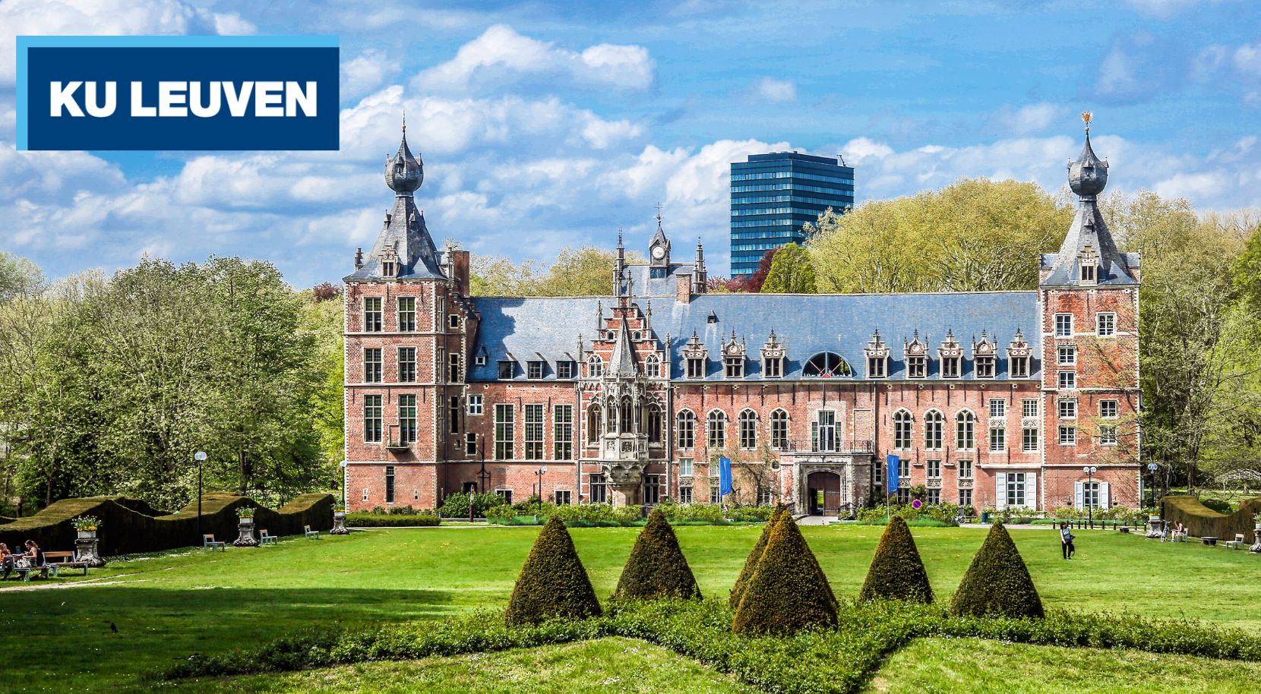
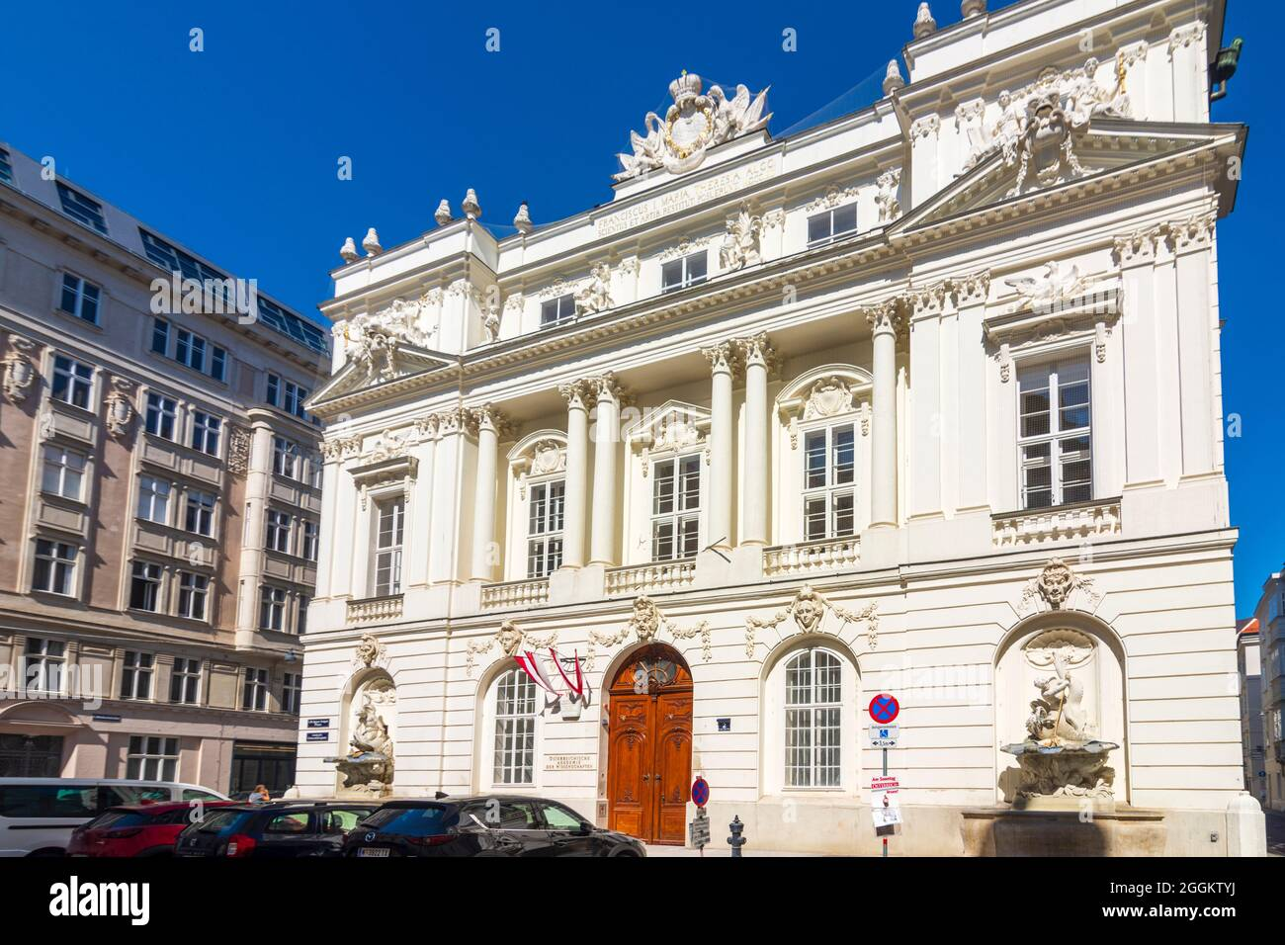

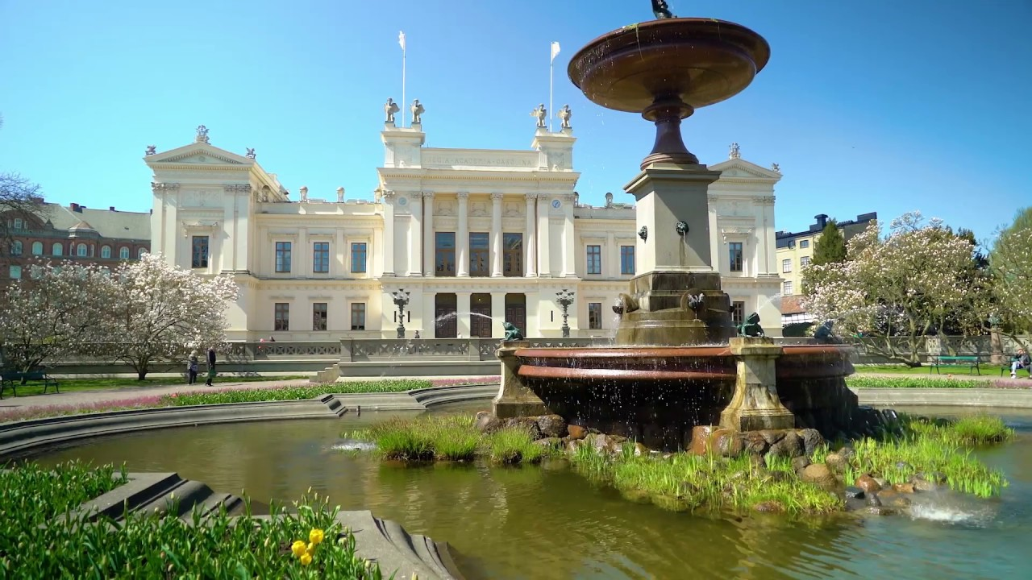

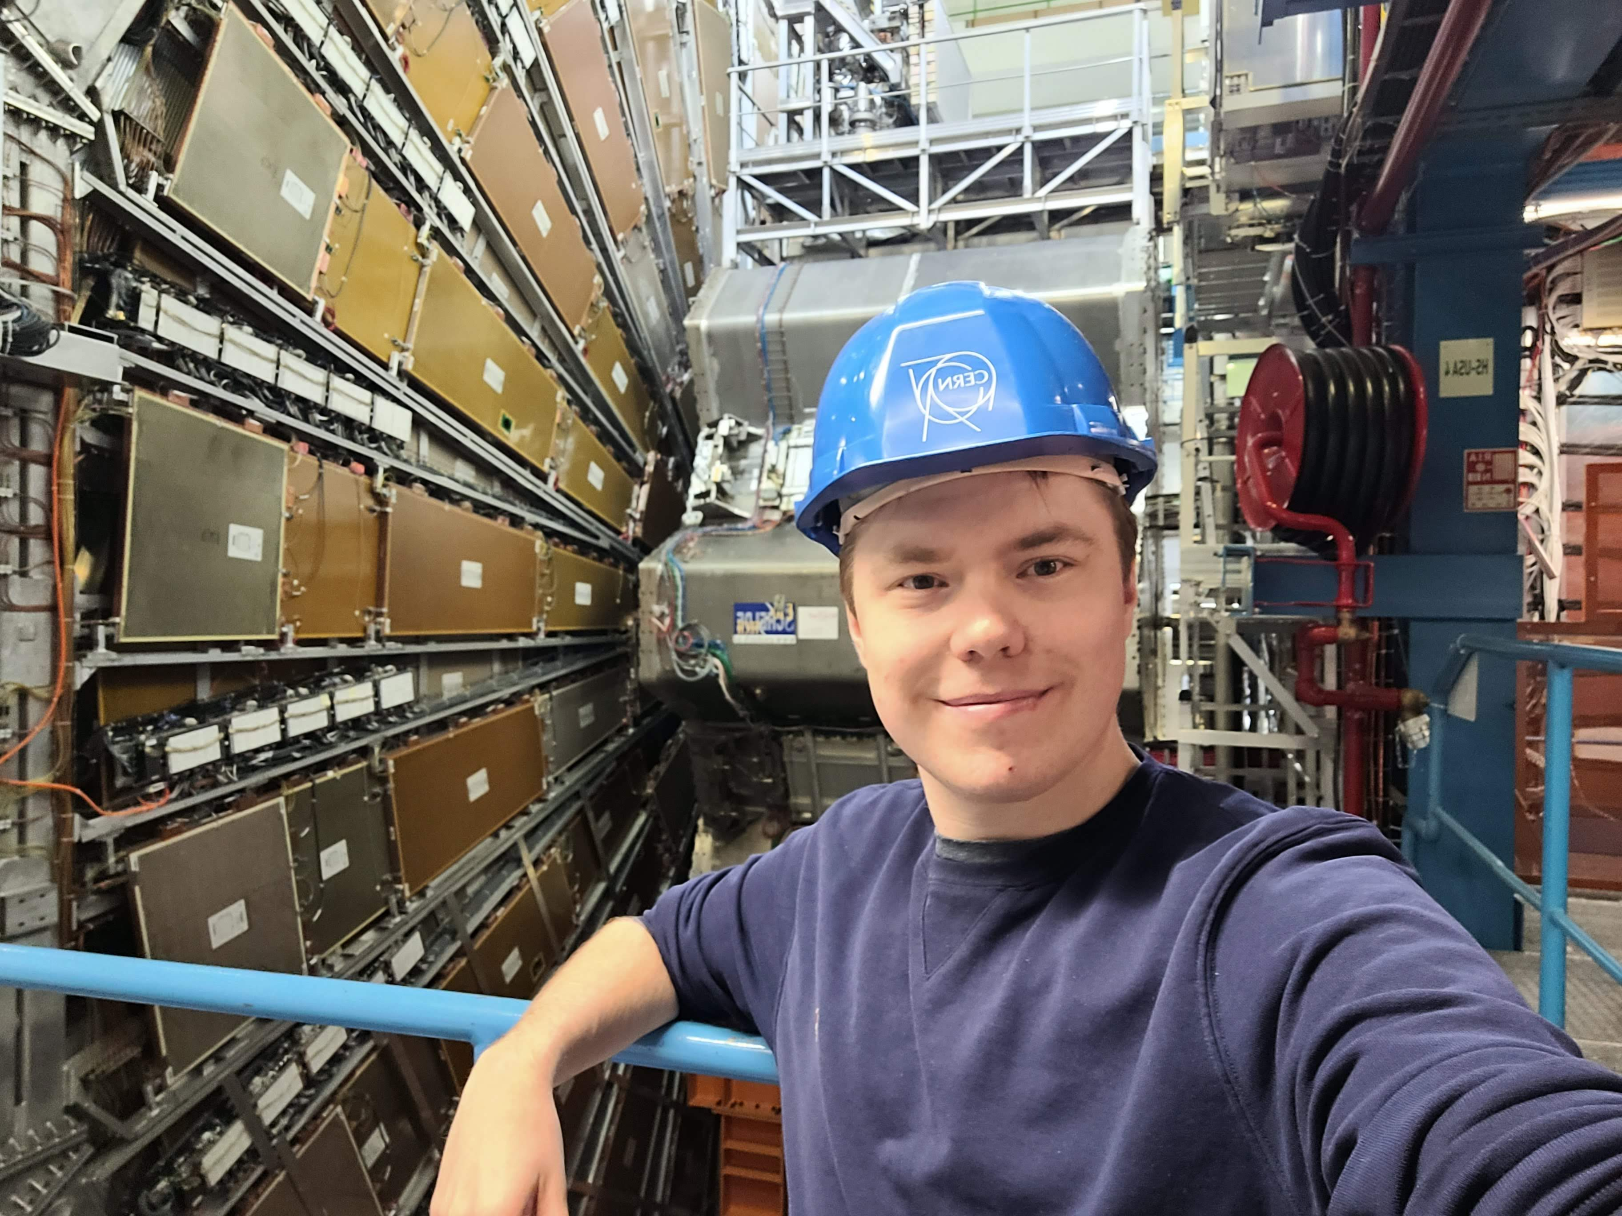


My History
PhD in Nuclear Physics,
KU Leuven Belgium (2017-2021)
PostDoc at Stefan Meyer institute in Austria (2021-2022)
Physics at Lund university, Sweden (2011-2017)
Senior fellow at CERN (2023- ..)

Slide 3
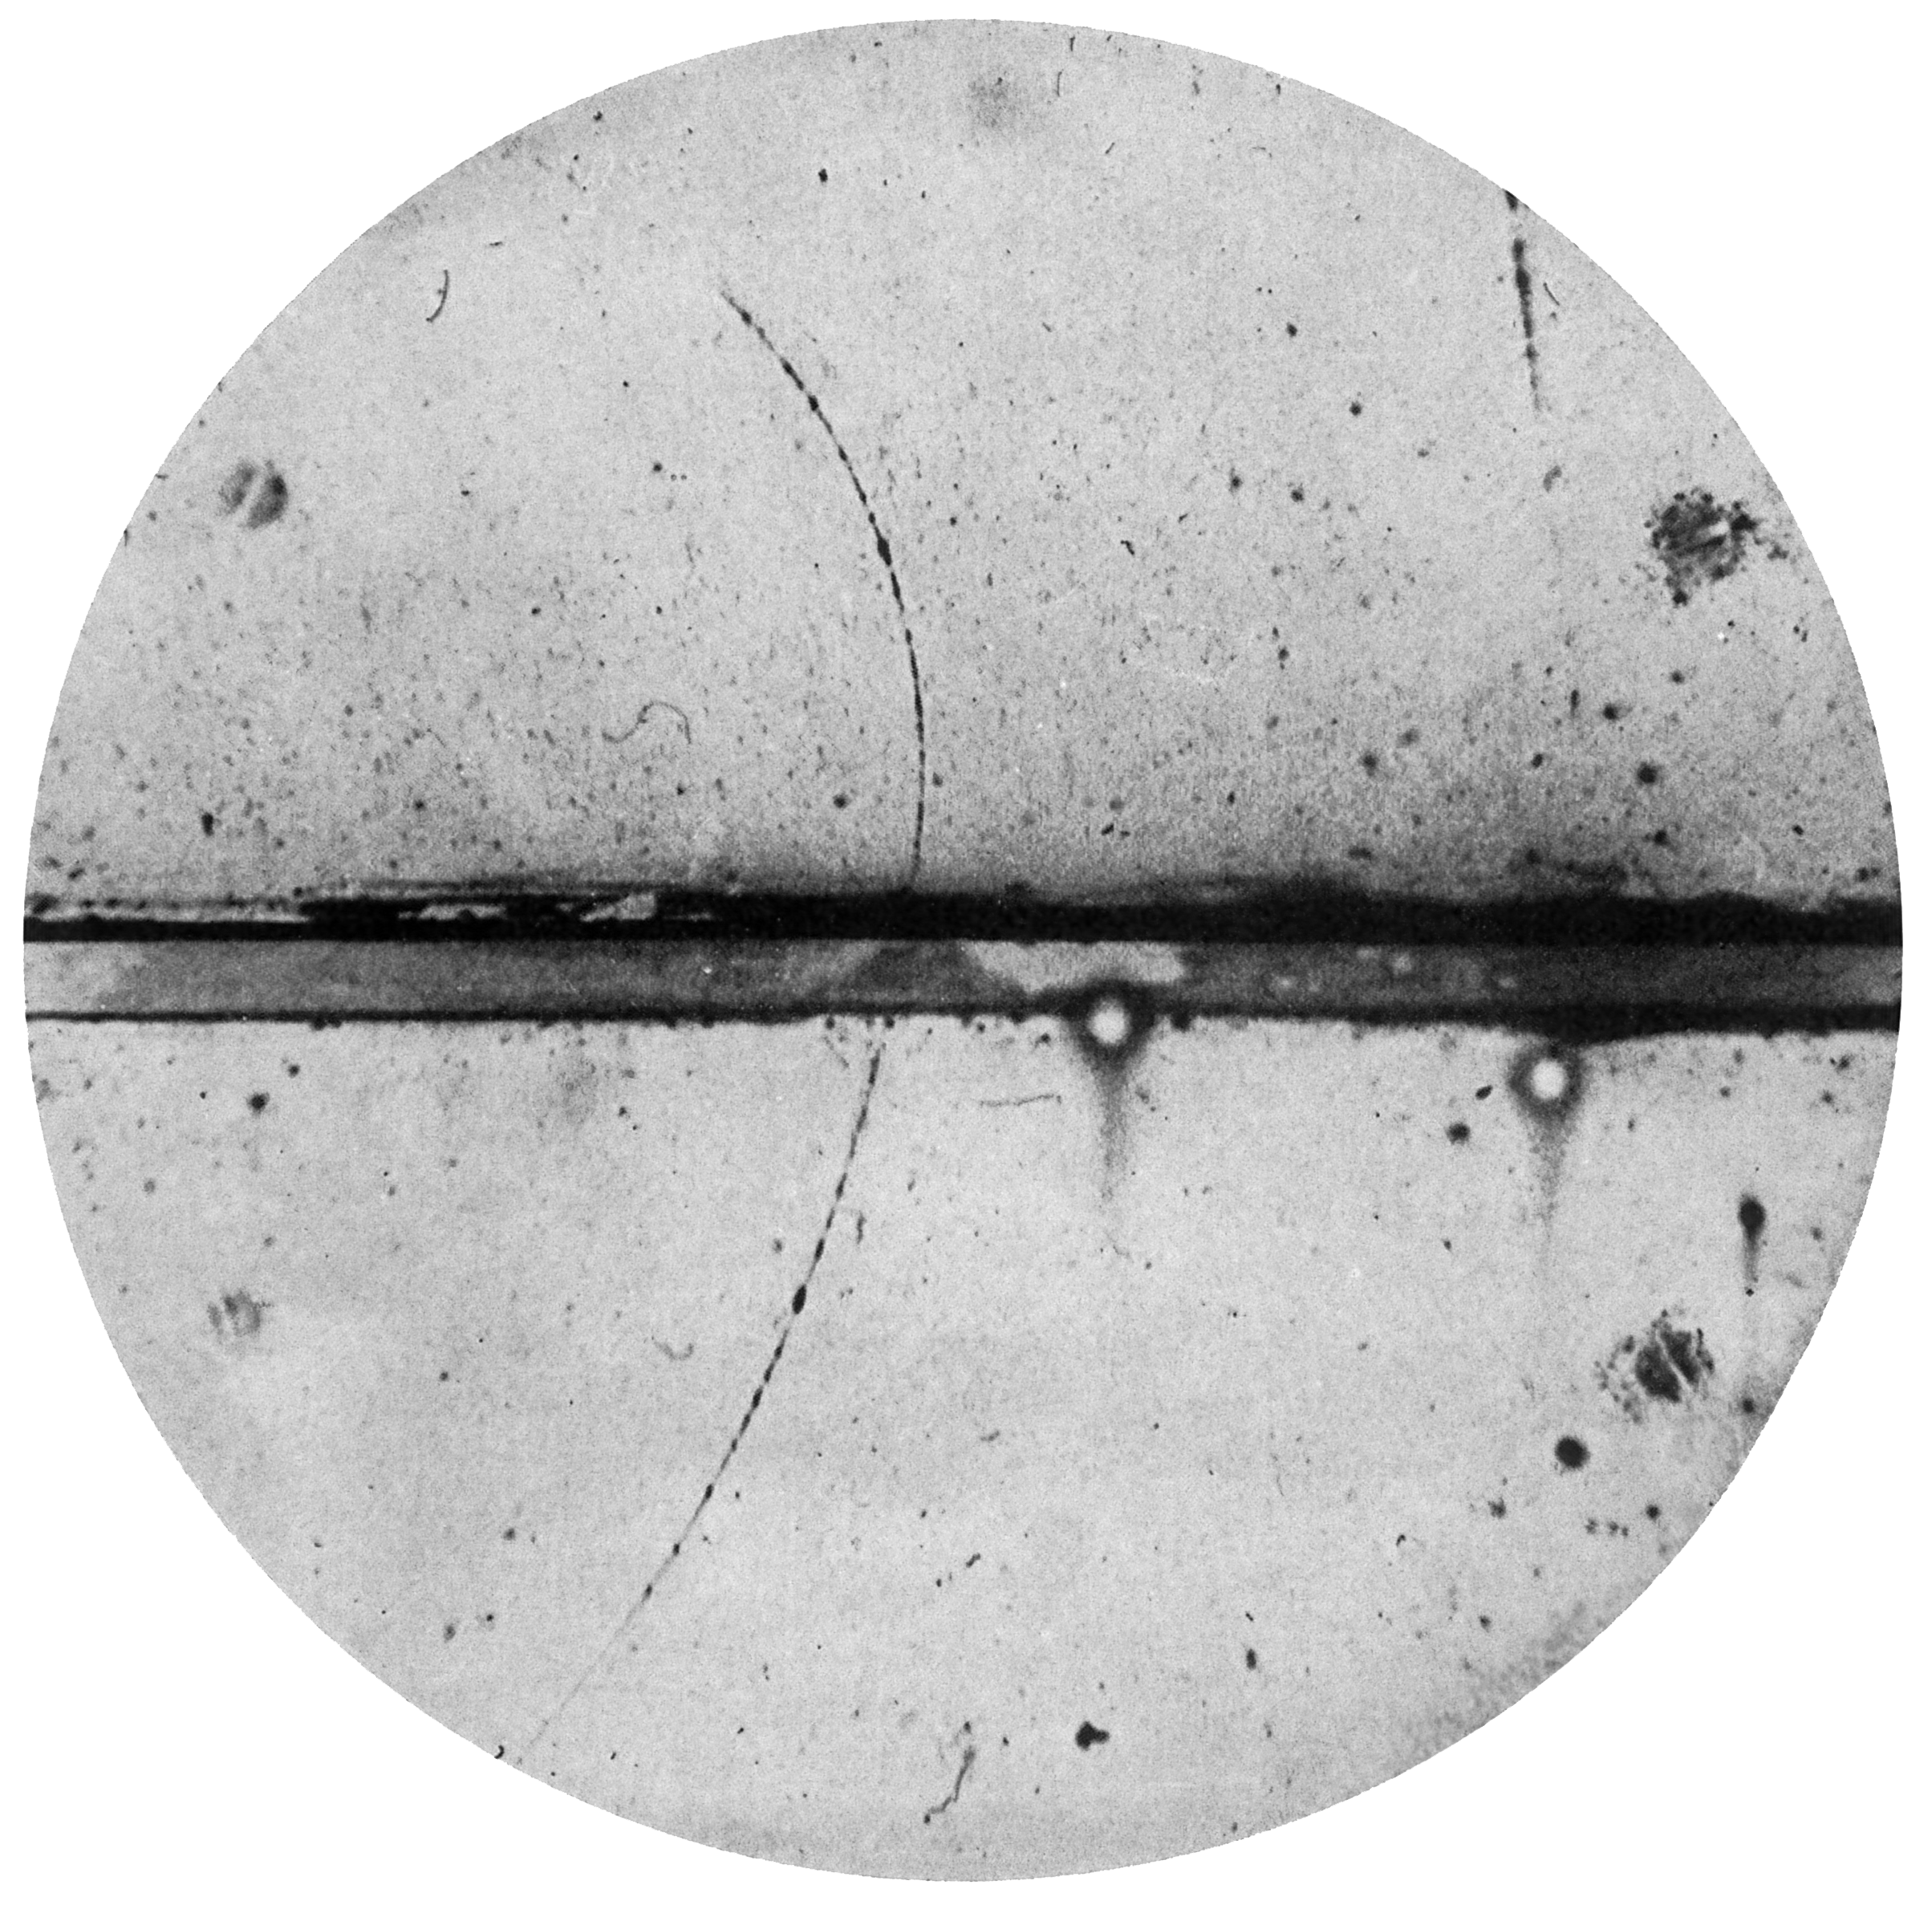
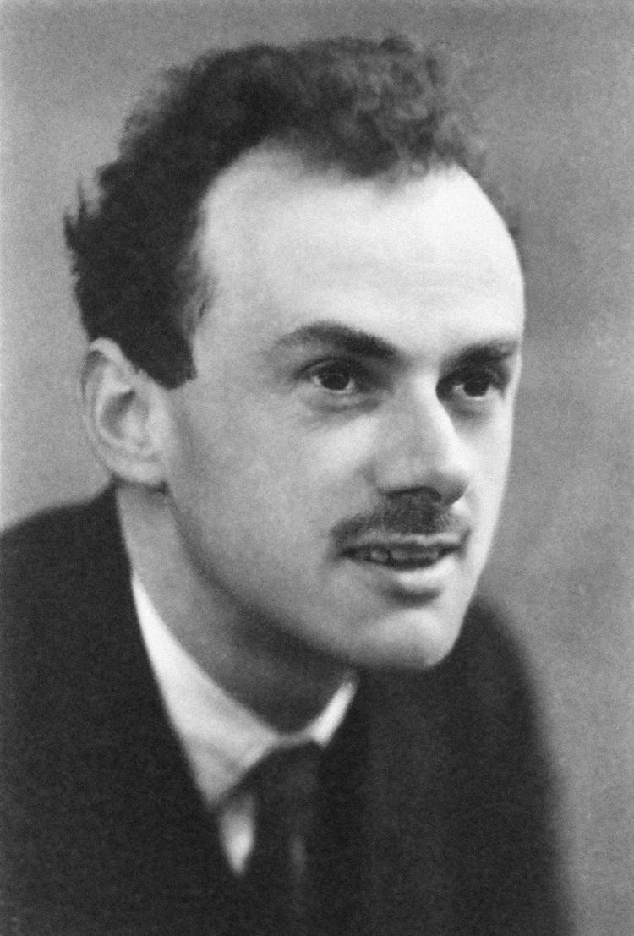
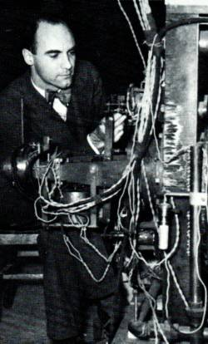
What is antimatter?
Quantum mechanics
+
Theory of special relativity
(Physics of the very small things)
(Physics of very fast things)
(Anti-elektron/positron)
Two solutions
e⁺
Matter
Antimatter?
Theory confirmed!
Positron discovery
Awarded Carl David Anderson the Nobel Prize in 1936
Notes:
Emphasize that this was a surprise at the time – Dirac's theory predicted something new, and experiment confirmed it.

Slide 4
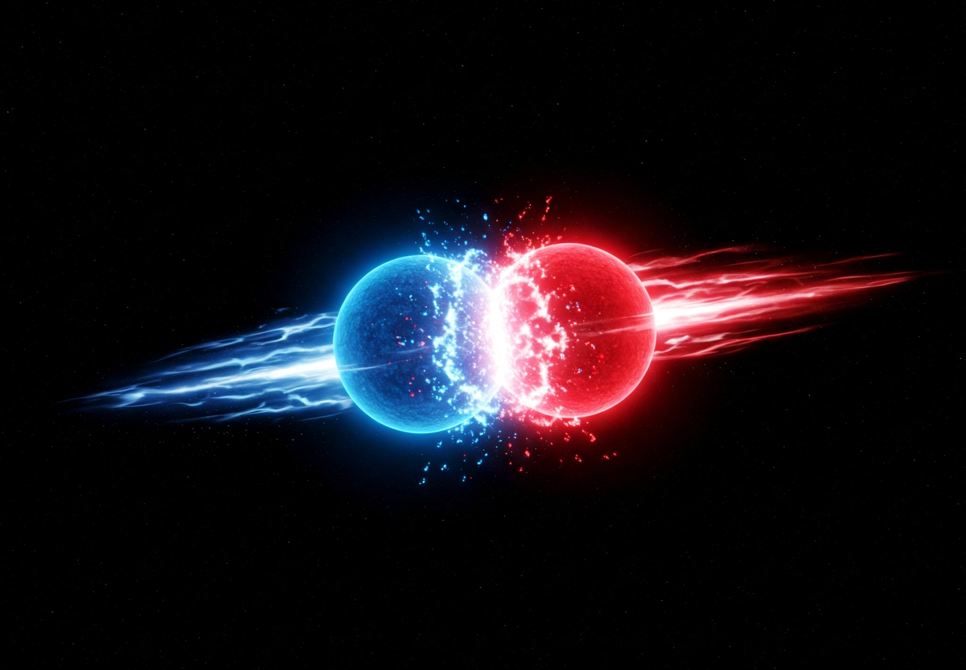
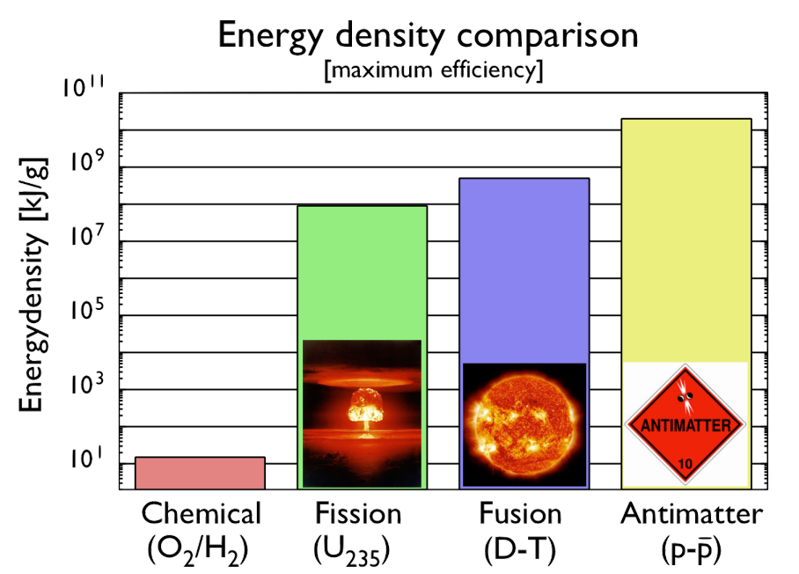



Annihilation av antimateria
Annihilation
$$e^{−}$$
$$e^{+}$$
$$E=mc^{2}$$

Slide 5
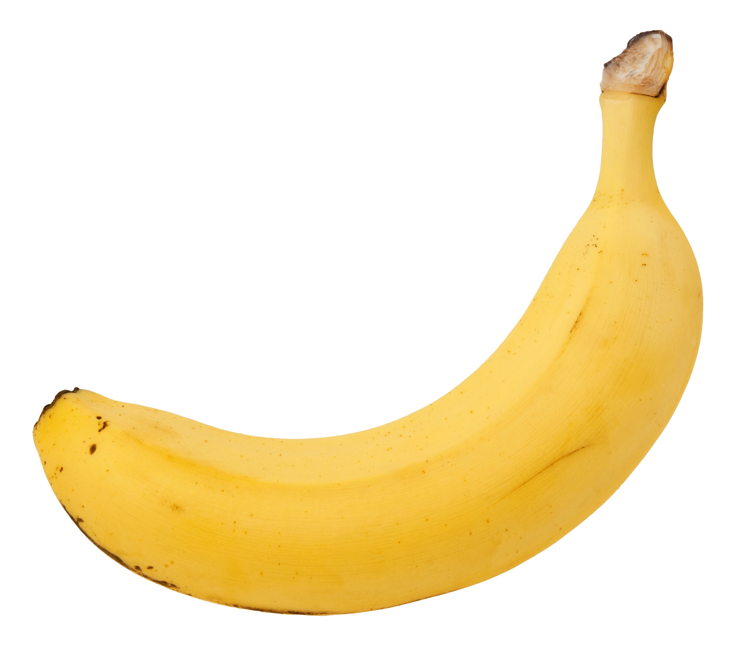
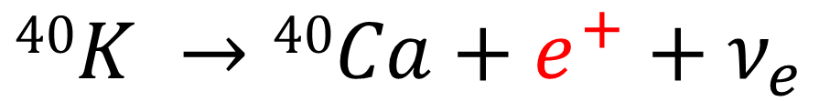
Where can we find antimatter?
Roughly 0.5 gram potassium inside a banana, with 50$μ$g potassium-40
Positron
$$40K →40Ca+e^{+}+ν_{e}$$
One banana generates roughly one anti-electron (positron) per hour.

Slide 6
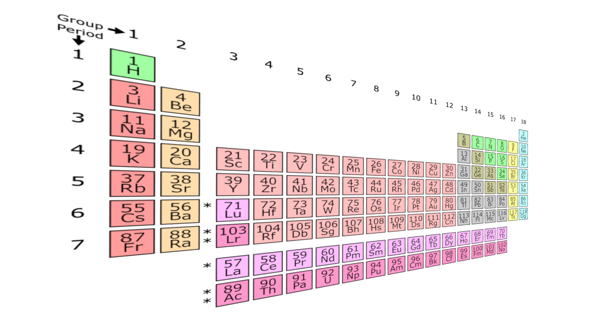
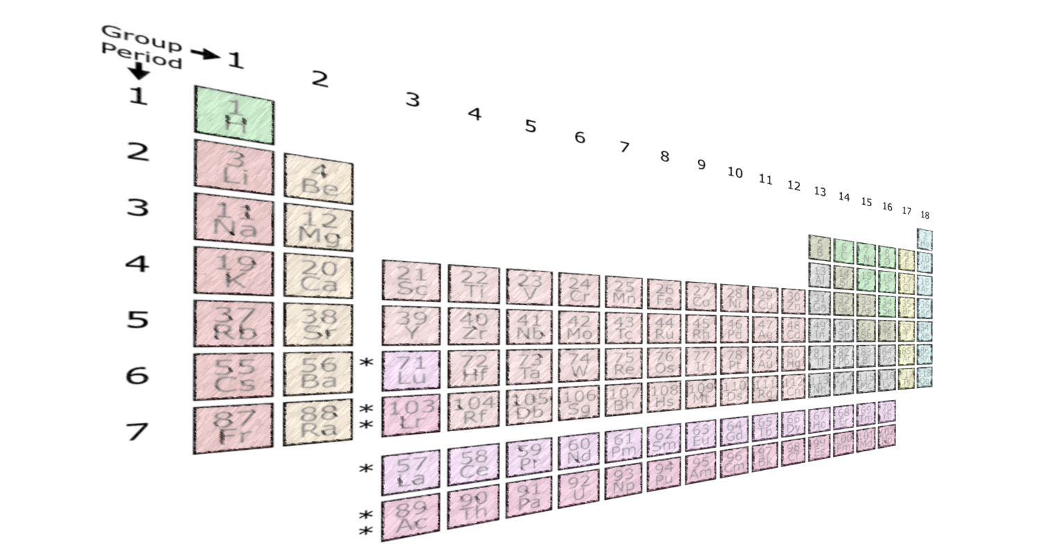
For every matter particle there is an equivalent antimatter particle…
Elements in our universe
Anti- elements in our universe?

Slide 7
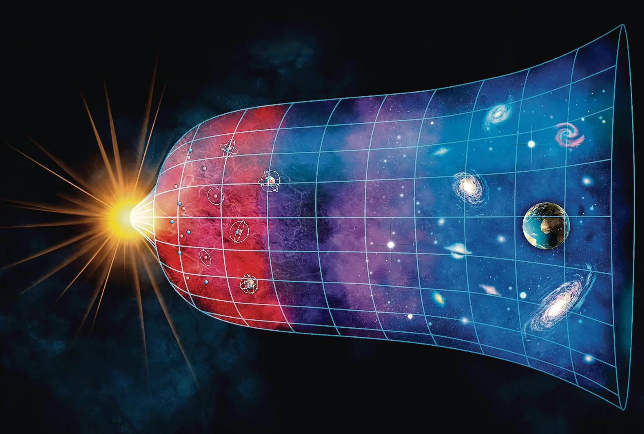
What happened to all the antimatter?
(1,000,000,001:1,000,000,000)
Why is the symmetry broken?
Notes:
Where $n_{b}$ and $n_{\overline{b}}$ are number densities of baryons and antibaryons and $n_{γ}$the number density of cosmic background radiation photons

Slide 8
How do we studying the difference between matter and antimatter?
Hydrogen
Antihydrogen
Electron
Antielectron
-
+
Proton
Antiproton
+
-
For accurate studies we need cold antimatter…
8
Notes:
So far no difference has been found yet: Same masses, lifetimes, g-factors, |charge|,... The hydrogen atom is the best understood physical system.
A neutral system is excellent for testing gravity.
Any observed difference between the properties of $H$and $\overline{H}$would reveal a broken fundamental symmetry in our universe.

Slide 9
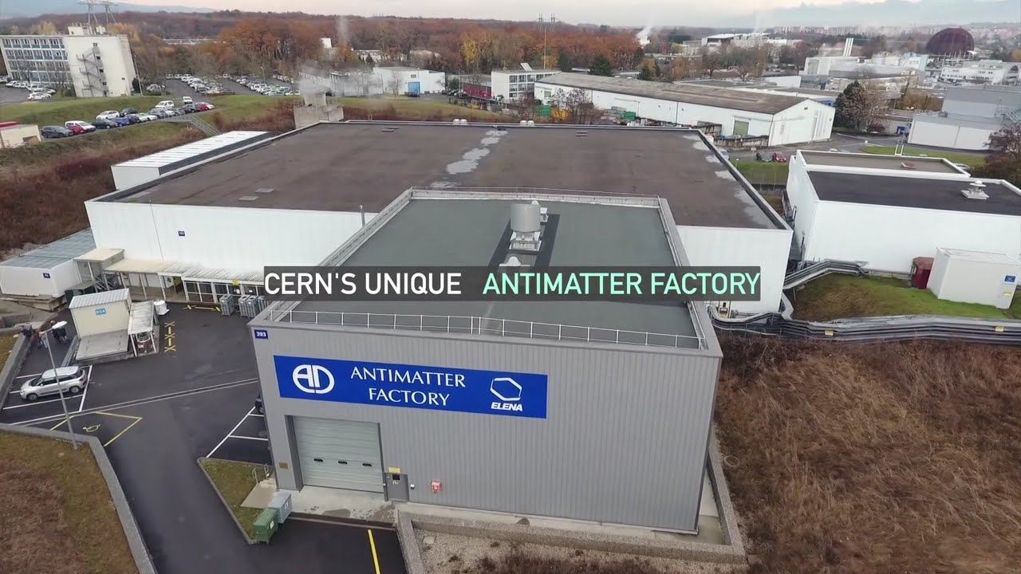
Antimatter Factory

Slide 10
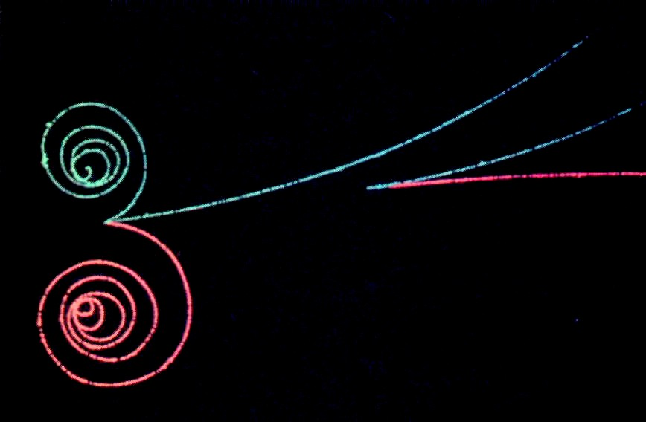
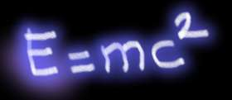



Skapelse av antimateria från energi
Creation of matter/antimatter
$$e^{−}$$
Energi
$$e^{+}$$
$$E=mc^{2}$$

Slide 11
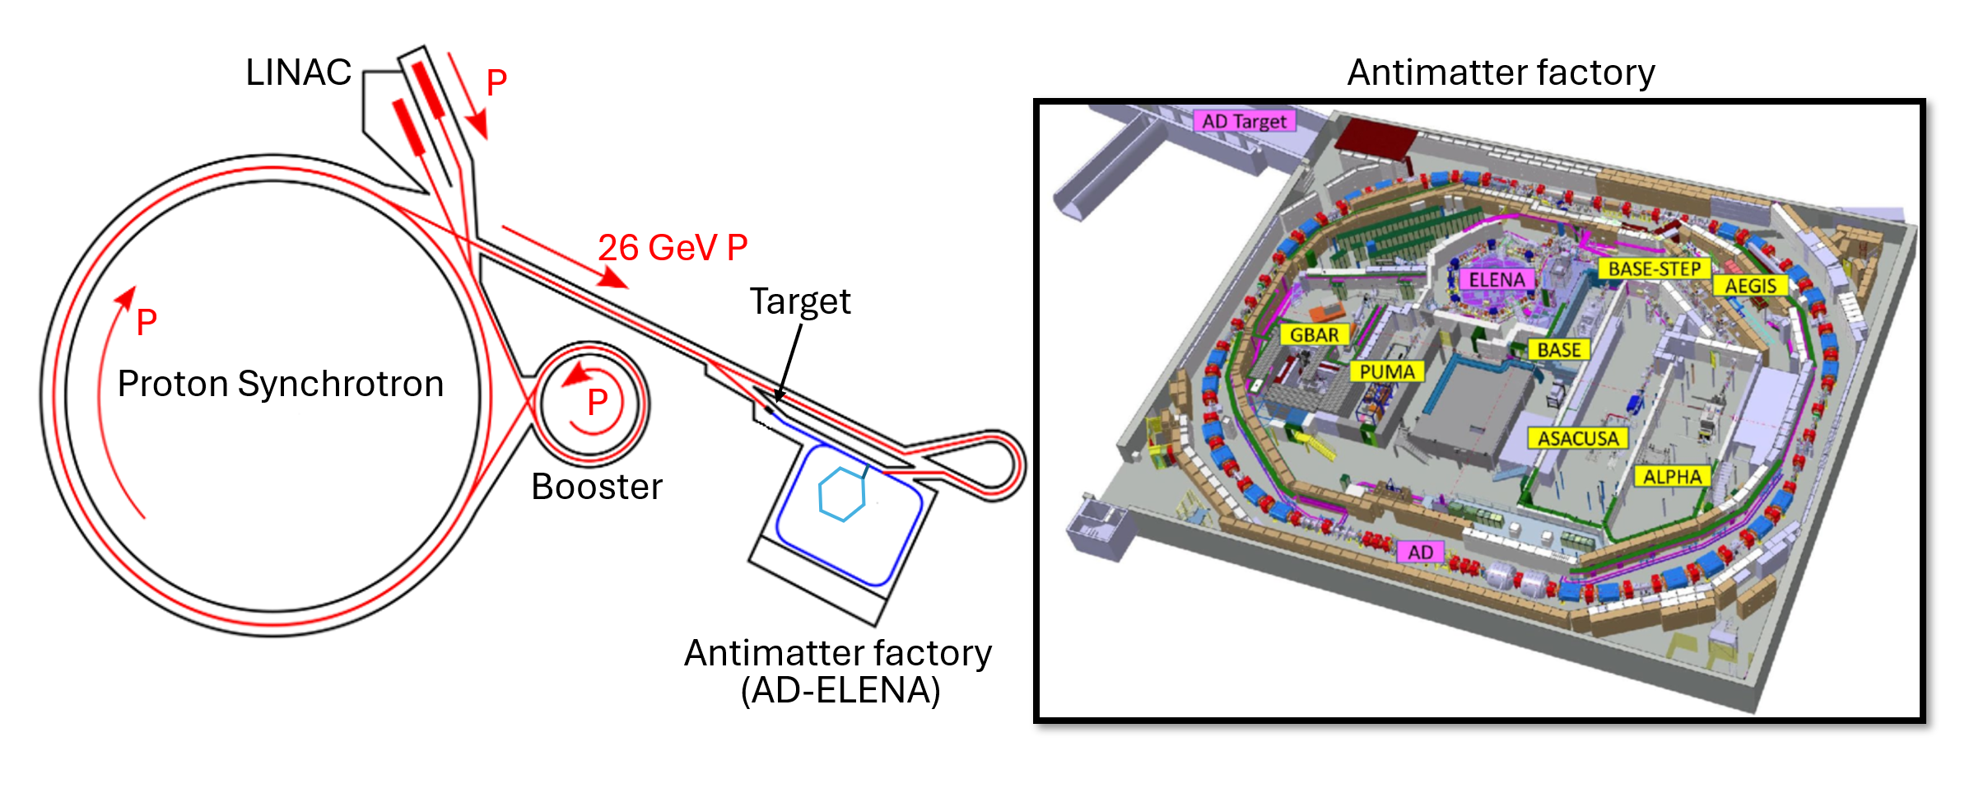
The Antiproton Decelerator (AD) at CERN
Notes:
PS accelerate 26 GeV protons into a Iridium target
ASACUSA is based in the antiproton decelerator hall at CERN
The AD is located here in the CERN acc complex off the PS
AD delivered 10 million at 5.3 MeV every 100s
In the work presented here for antihydrogen I will be talking about antiprotons from the AD
ELENA – Extra Low Energy Antiproton Ring
ELENA delivers 4 bunches about 7-8 million at 100 keV
RFQD decelerated about 30% of those to 115 keV
Cusp experiment is that concerned with measuring the GS-HFS located at the end of long beamline
Also have PbarHe which is in the same area
AD delivers 10 million antiprotons at 5.3 MeV every 100s
Antiprotons are then further decelerated by ELENA which deliver 4 bunches with 7-8 million antiprotons at 100 keV to experiments at AD.
Precision measurements of antiprotons and antihydrogen are now routinely performed here.
Precision measurments are performed at each experiment for BSM searches
CPT symmetry
Weak equivalence principle

Slide 12
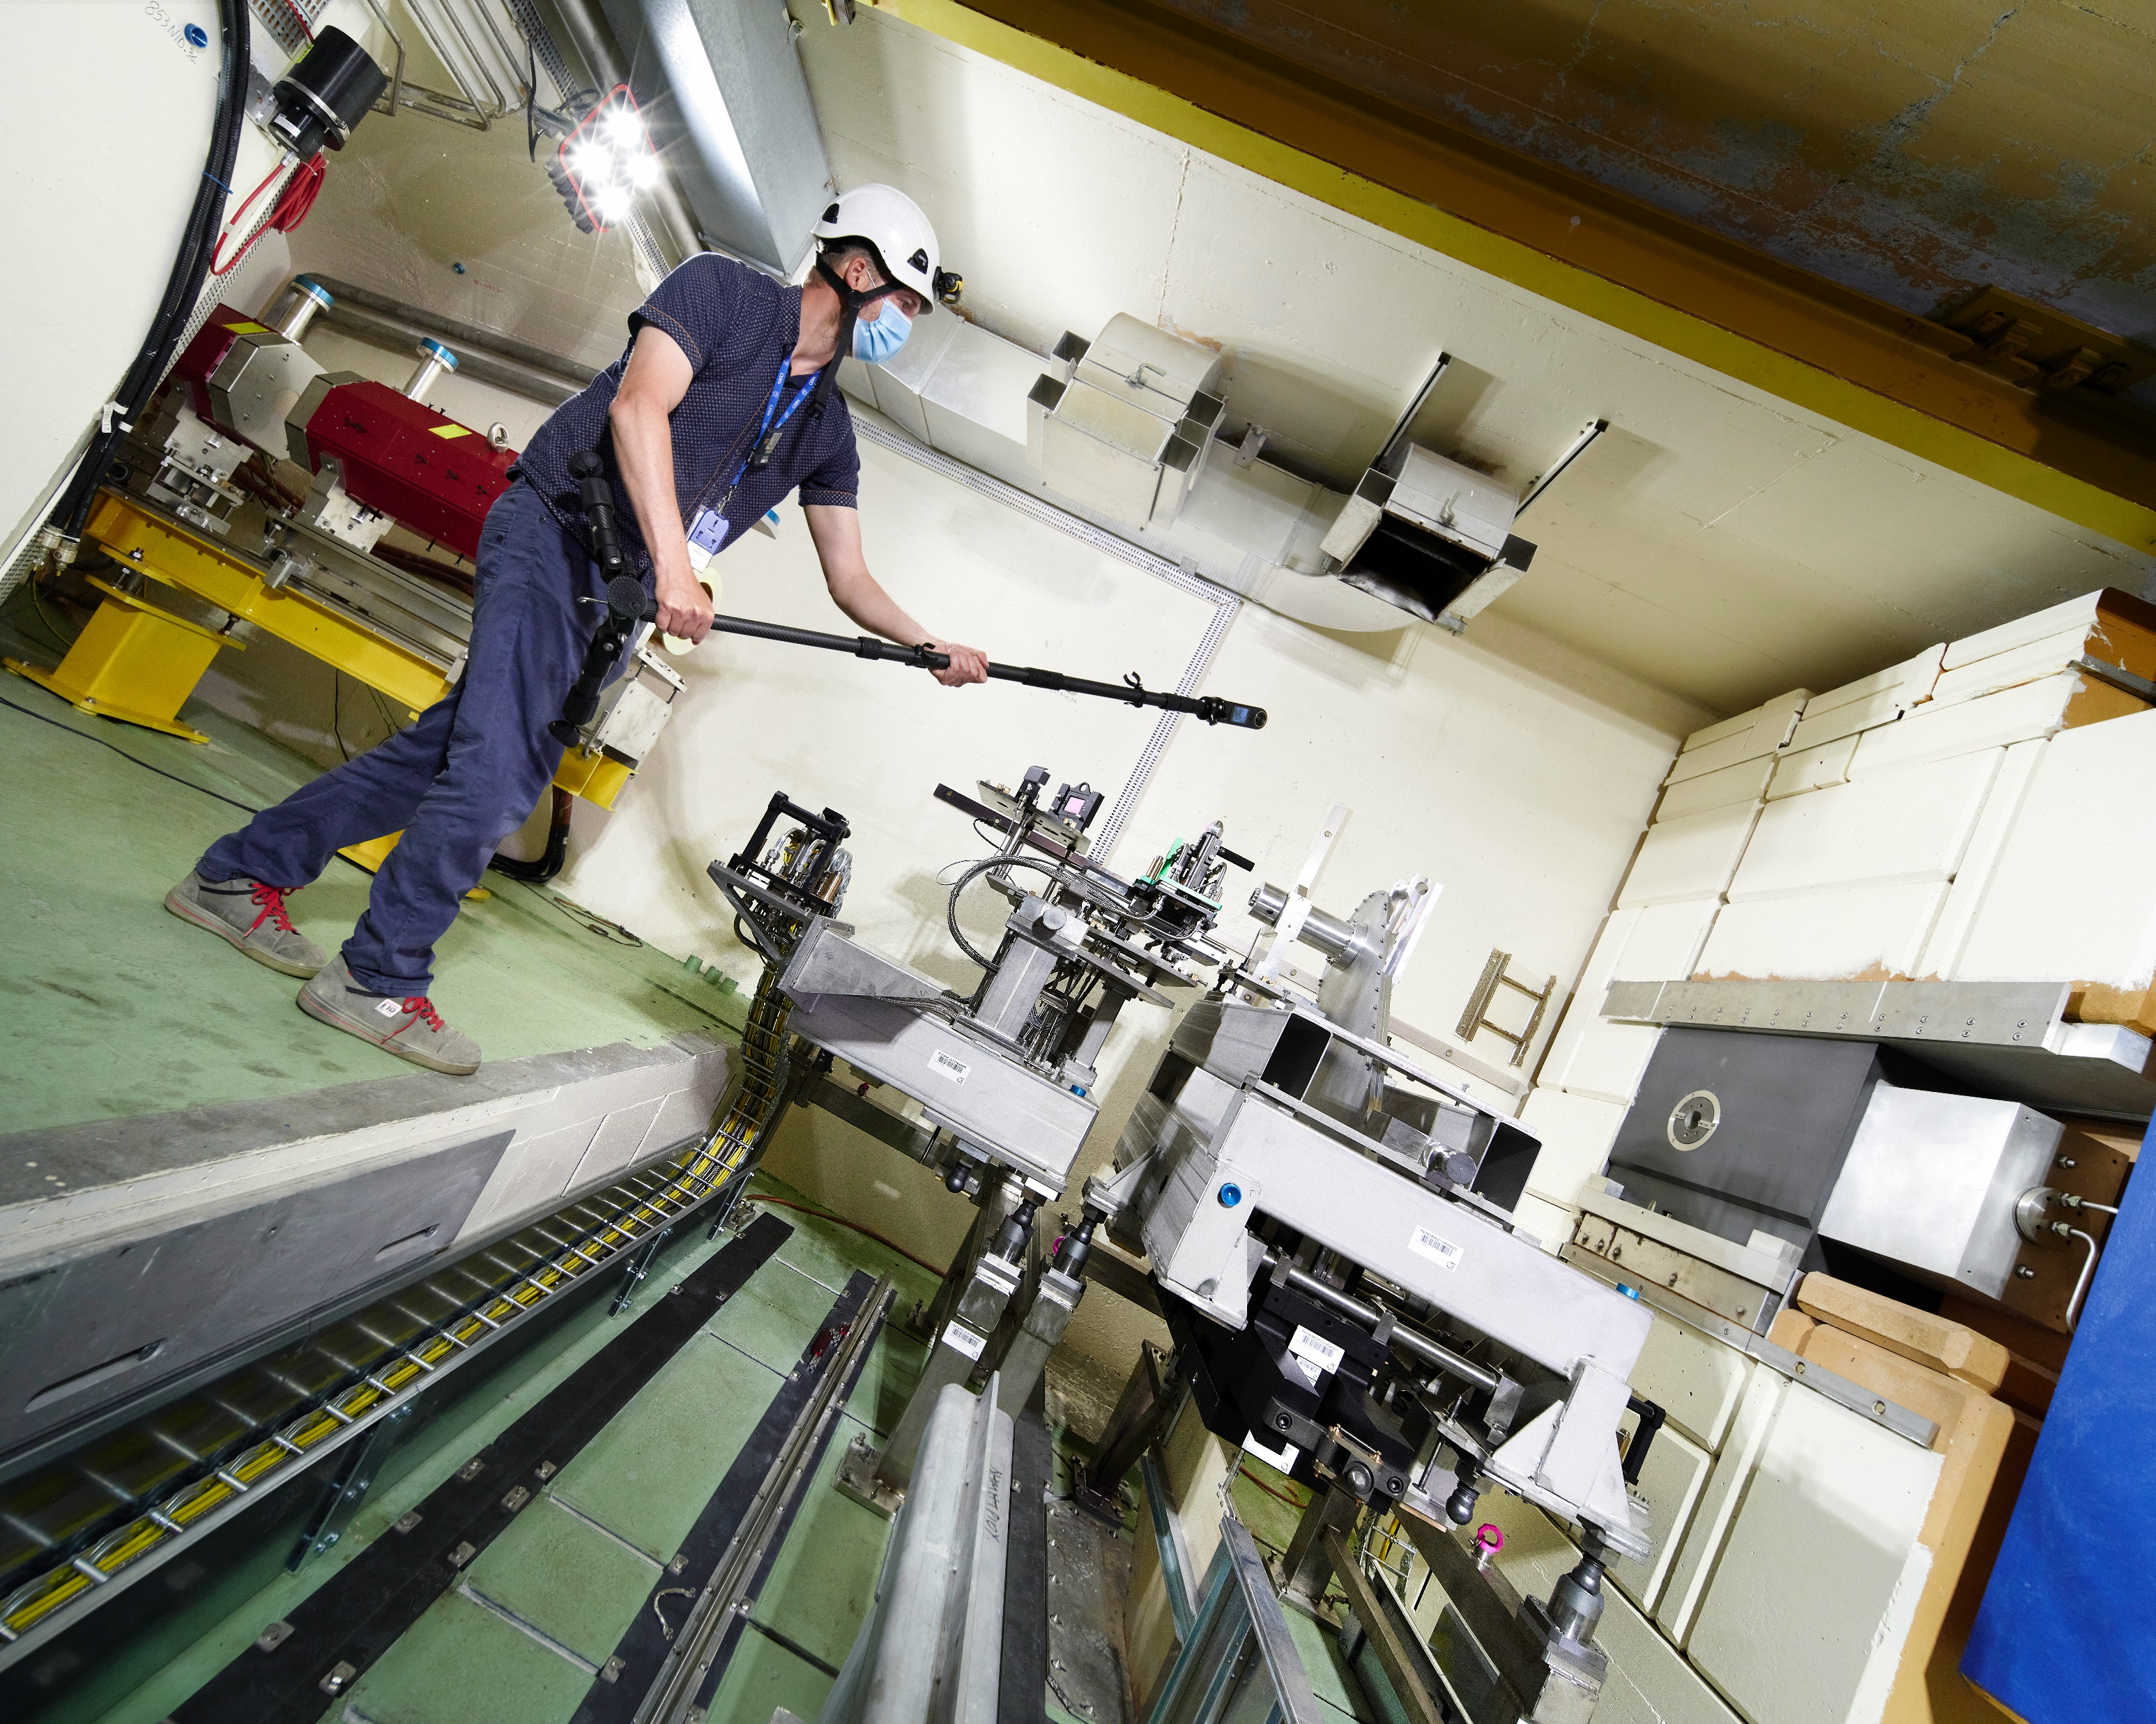
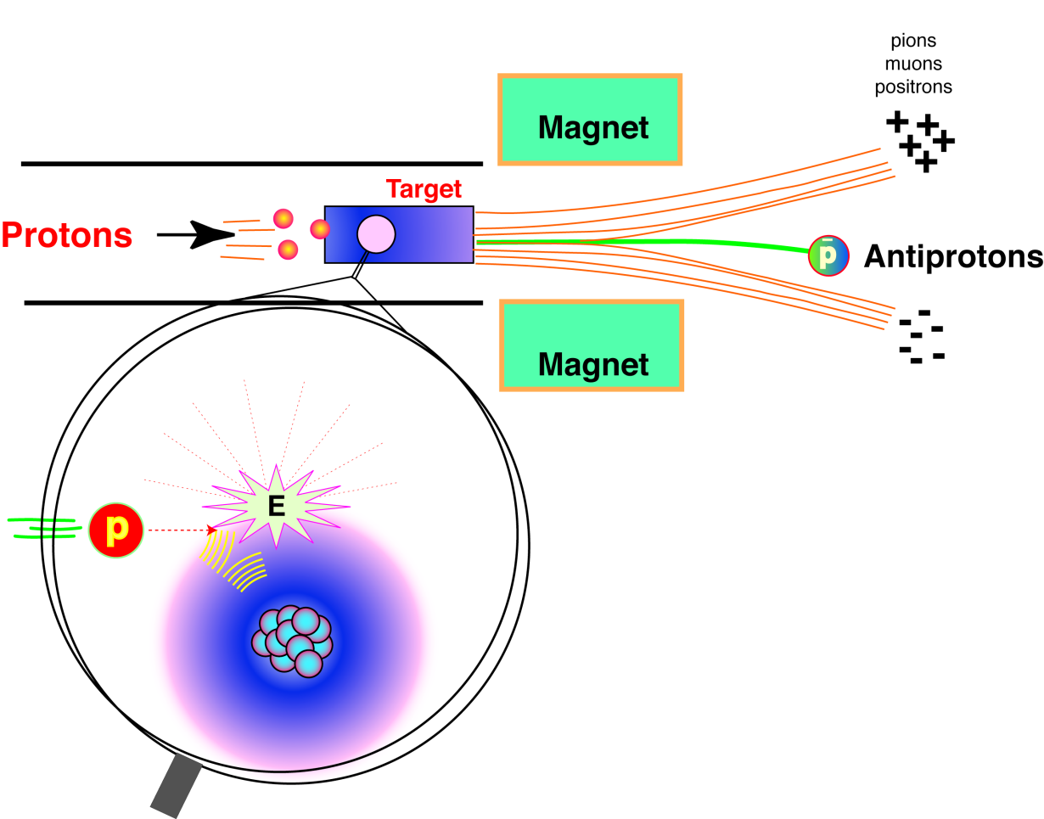

Slide 13
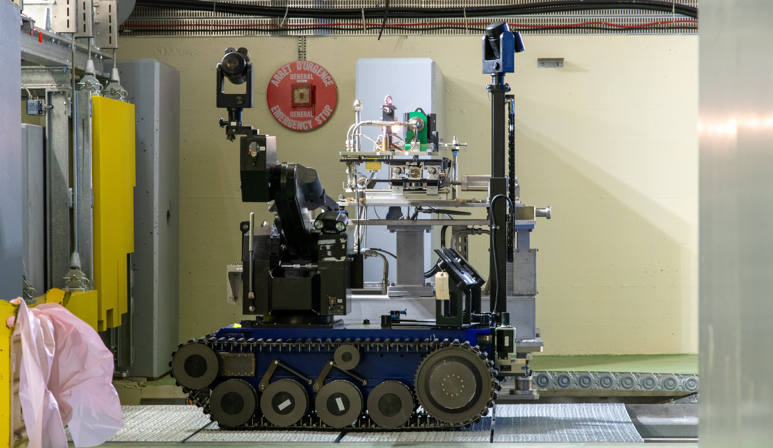

Slide 14
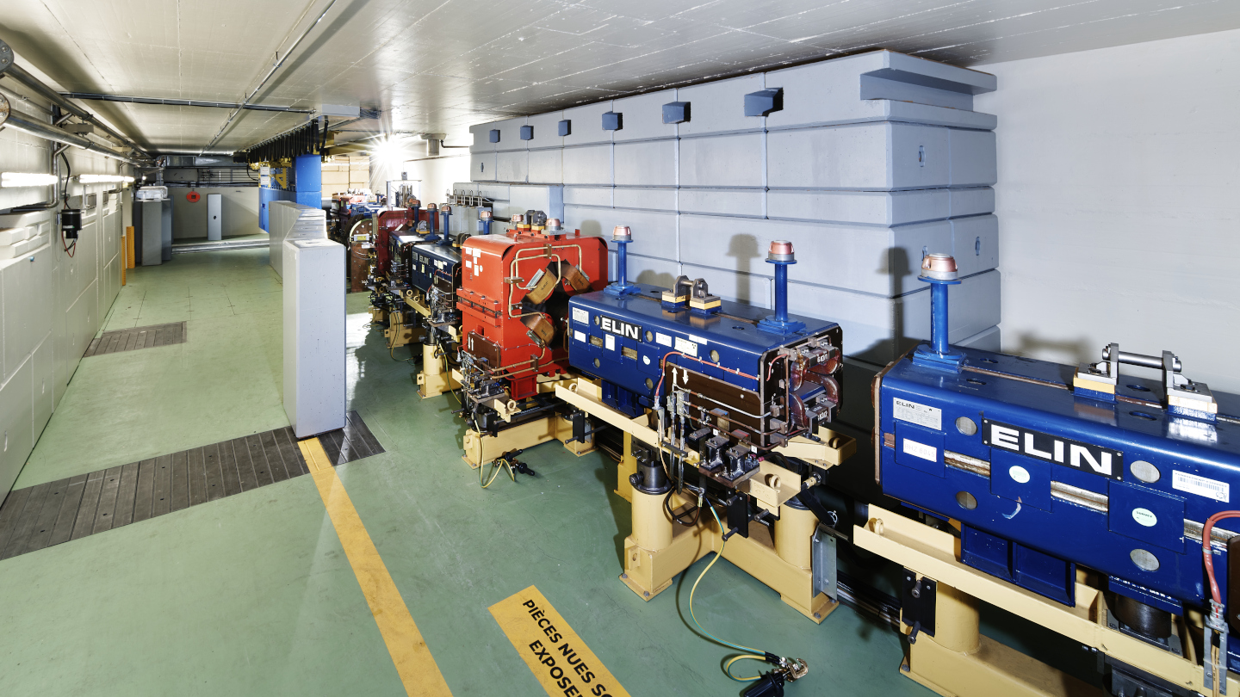

Slide 15
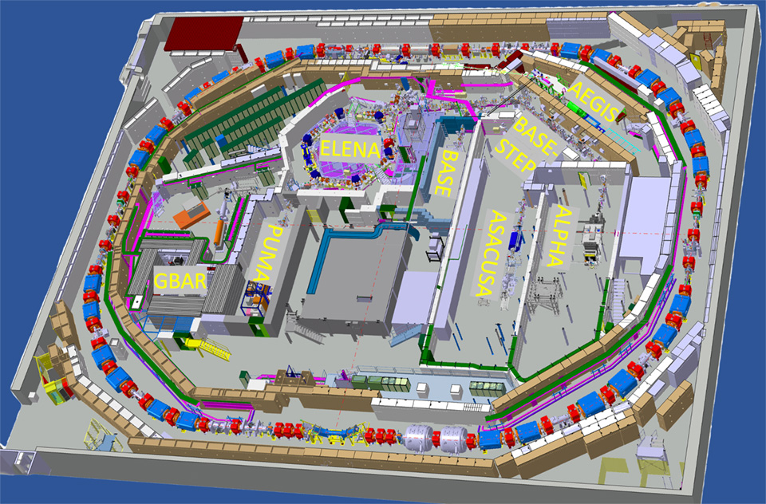
The Antiproton Decelerator (AD)
Injection from target
AD
Antiproton Decelerator
Start: 2000
Length: 182 m
Energy: 5.3 MeV

Slide 16
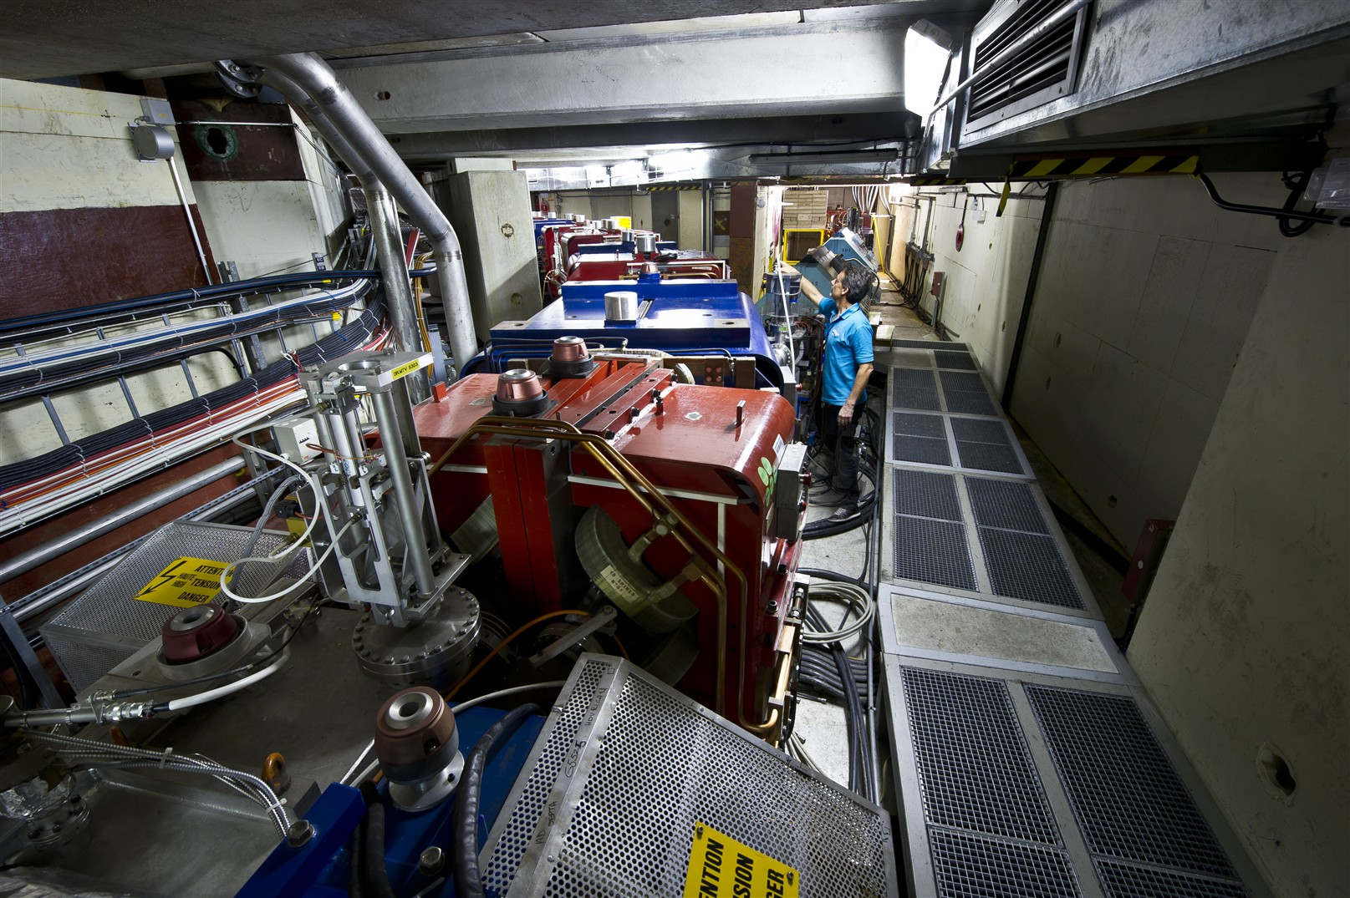

Slide 17
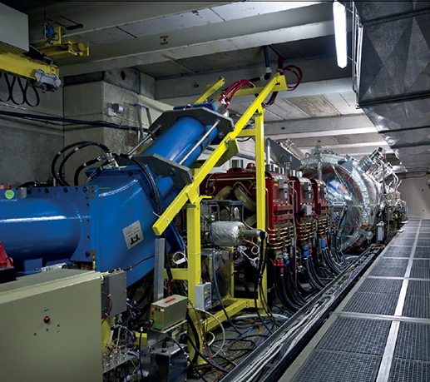
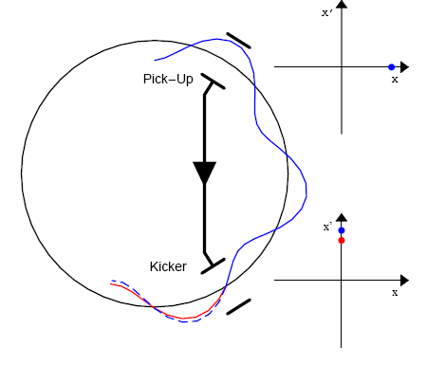
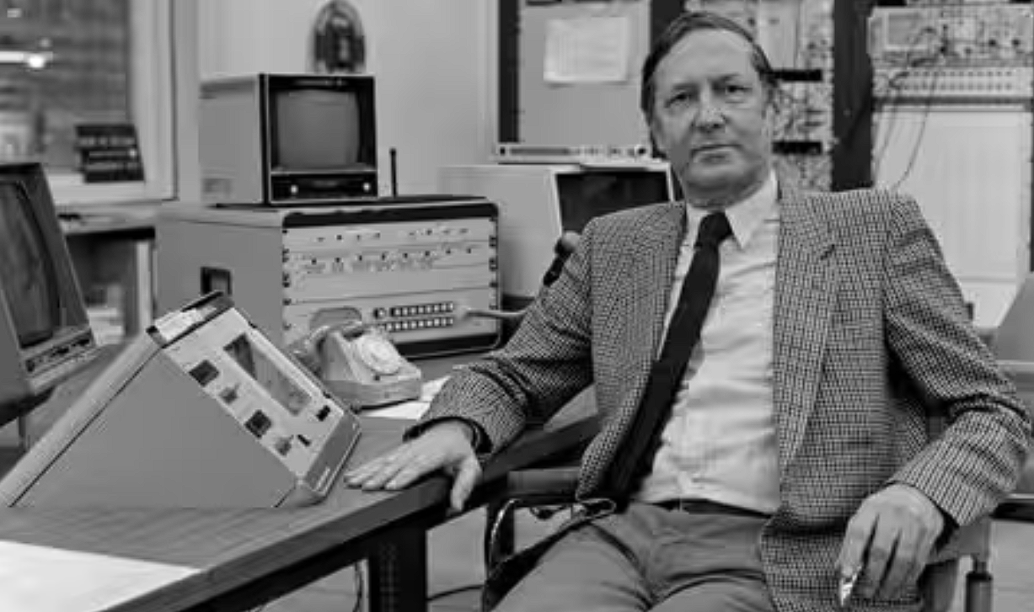
Cooling of antiprotons at AD
2. Stochastic cooling*
1. RF deceleration
cavities
AD
3. Electron cooling
*Invented by Simon Van der Meer (Nobel Prize -84)
Notes:
RF Cavities: Provide the main decelerating force. They generate electric fields timed to oppose the antiprotons' motion, removing kinetic energy on each pass. This is what reduces the beam's average energy from GeV down to MeV.
Cooling (Stochastic & Electron): Manages the beam quality. They reduce the spread in energy and direction around that decreasing average energy, making the beam dense and controllable. They counteract the "heating" effects of deceleration and collisions.
Think of it like this:
RF Cavities = Brakes (Slowing the whole car down)
Cooling = Suspension & Steering (Keeping the car stable and on the road while braking)

Slide 18
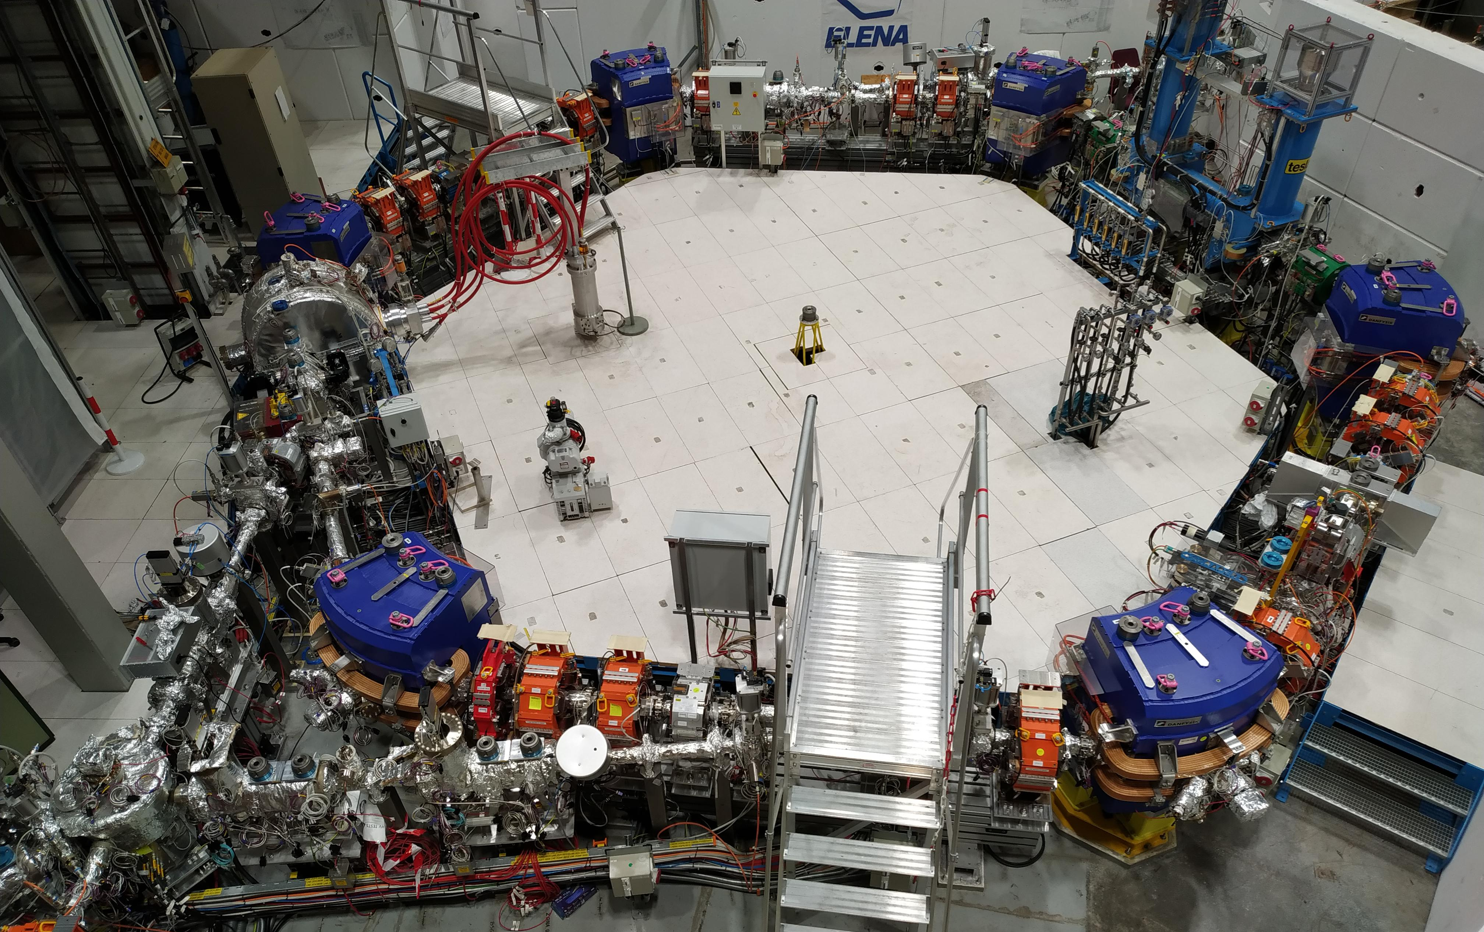

ELENA
Extra Low
ENergy Antiproton ring
Start: 2021
Length: 30 m
Energy: 0.1 MeV
3$×$10⁷ antiprotons/pulse every 2 min

Slide 19
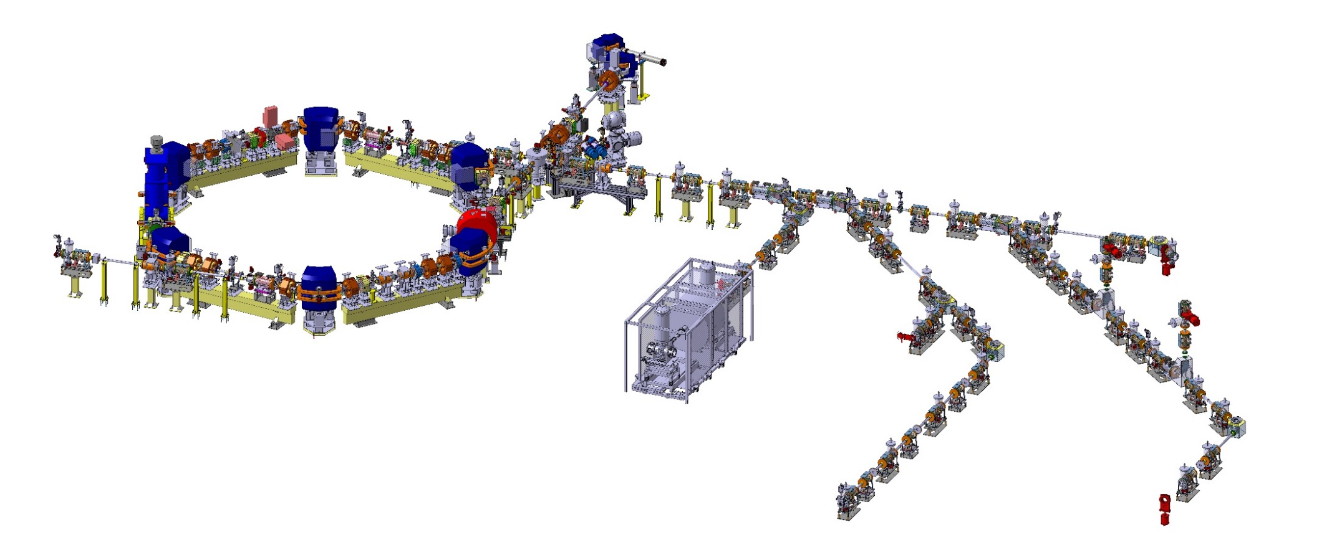


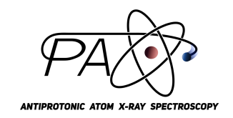




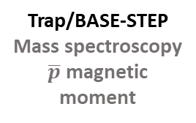
Experiments at the Antimatter factory
Antiprotons @1 MeV
Antiprotons @ 0.1 MeV
ELENA
Antiprotons for experiments
ALPHA ASACUSA AEGIS BASE GBAR PUMA pAX
Trap
Antihydrogen trapping
Spectroscopy
Gravity
Beam
Antiprotonic atoms
Collisions
Antihydrogen
Spectroscopy
Beam
Pulsed production
of antihydrogen
Gravity
Positronium
Trap/BASE-STEP
Mass spectroscopy
$\overline{p}$ magnetic moment
Trap
Antimatter gravity
Lamb-shift
Movable trap
for antiprotons
Study of exotic nuclei
Cyclotron trap
X-ray spectroscopy on target

Slide 20
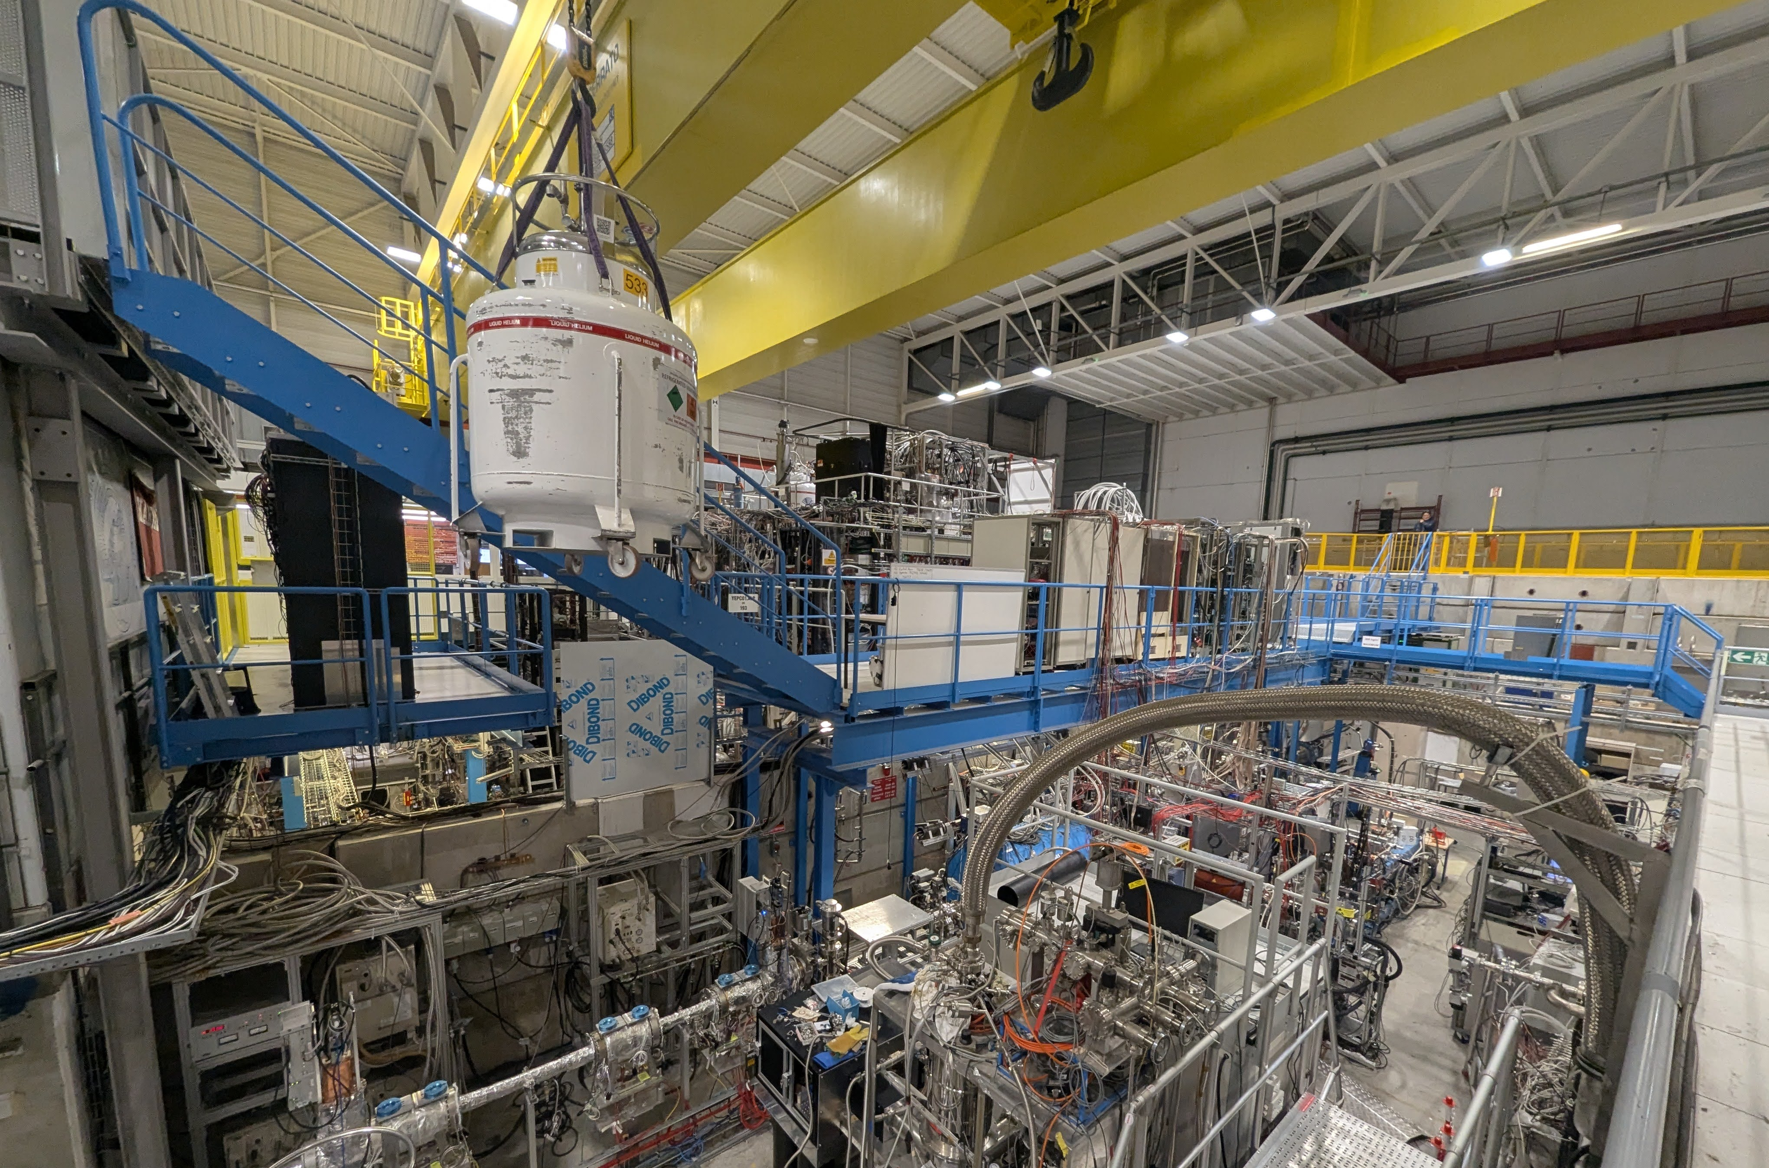

Slide 21
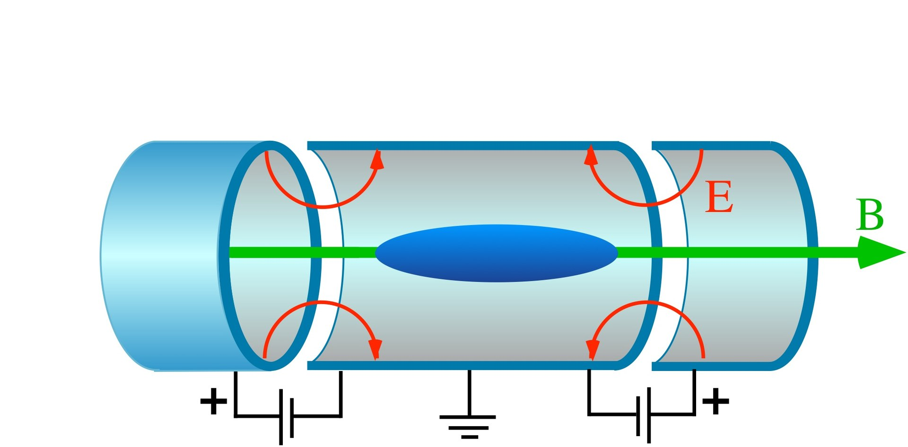



Trapping antiprotons
$$\overline{p}$$
10 keV
100 keV
$$\overline{p}$$
Degrador or drift tube
$$\overline{p}$$

Slide 22
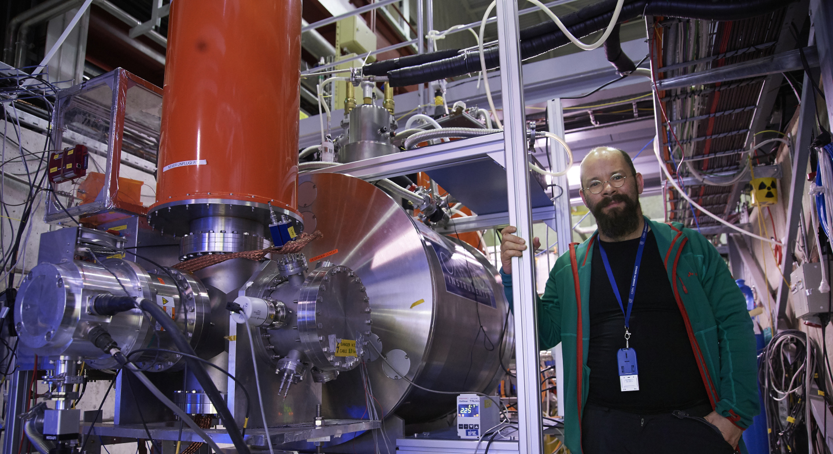
(Baryon Antibaryon Symmetry Experiment)

Slide 23
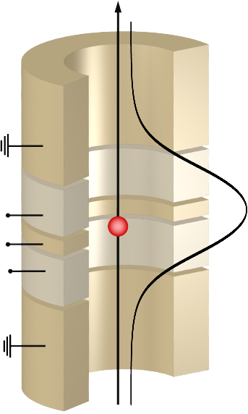
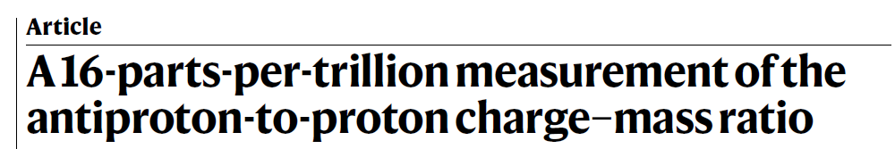
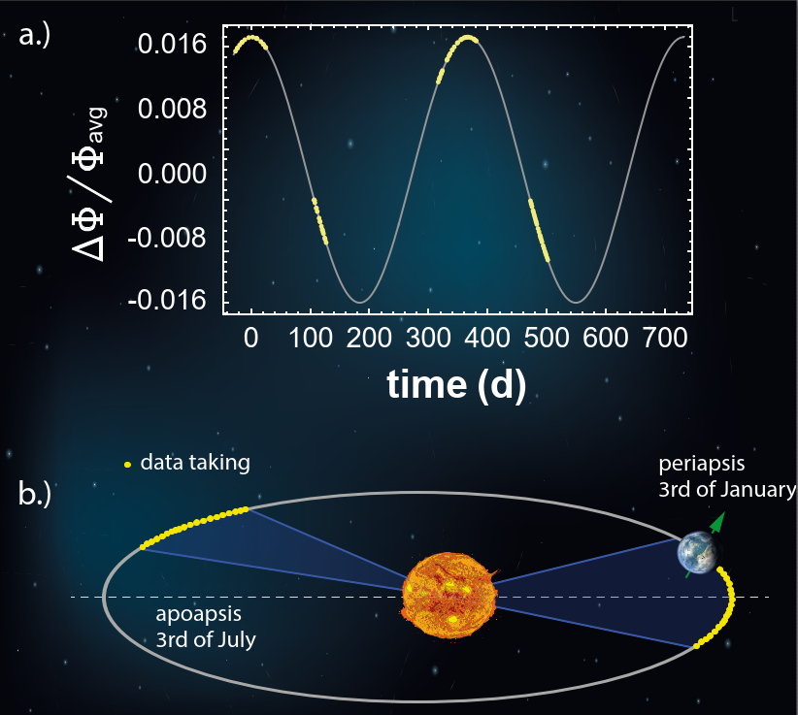

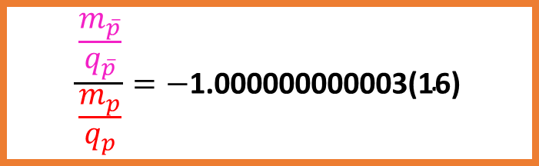
The BASE experiment
$$\frac{\frac{m_{\overline{p}}}{q_{\overline{p}}}}{\frac{m_{p}}{q_{p}}}=−\text{1.000000000003(16)}$$
$$\overline{p}$$

Slide 24
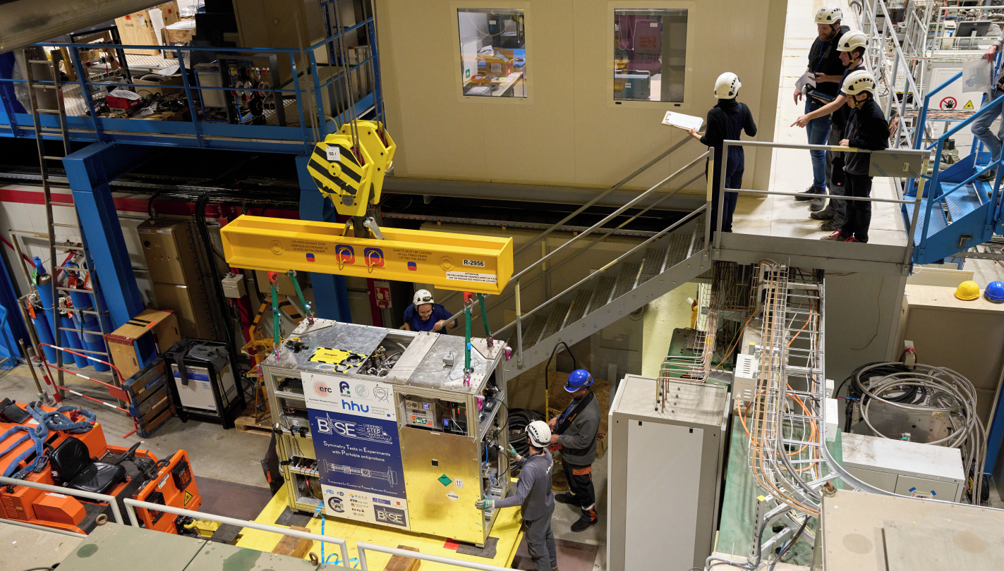
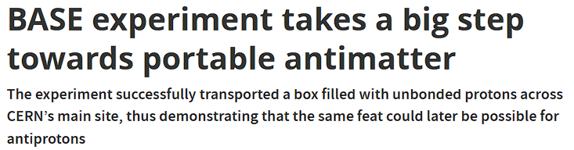


Slide 25

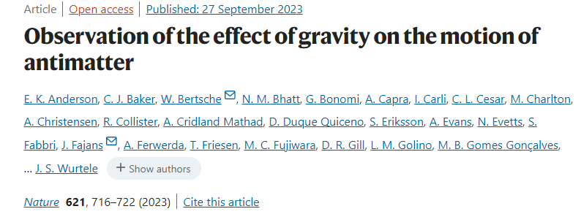
Anomolous antimatter gravity?
Could a difference in the influence of gravity explain the antimatter/matter assymmetry we see?
$$\overline{g}=0.75±0.13 \left(stat+sys\right)±0.16 \left(sim\right)g$$

Slide 26
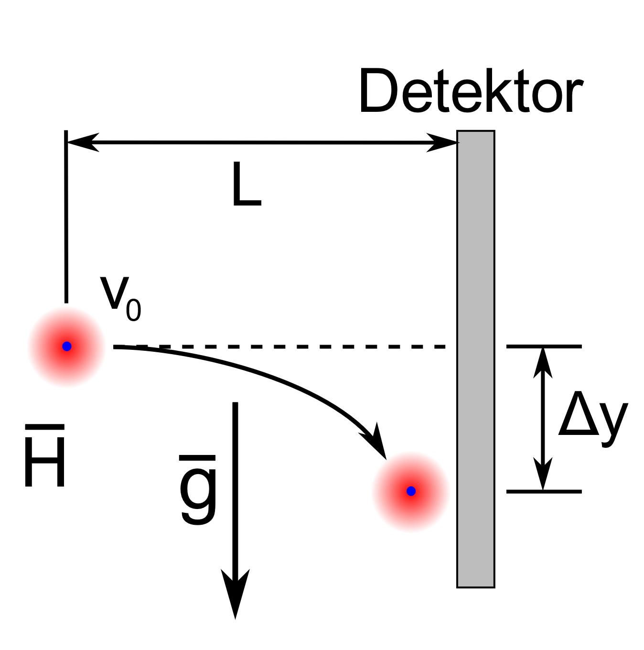




The gravitational influence on antimatter
Measurement of $\overline{g}$ to <1% precison:
laser excitation
$$e^{+}$$
$${Ps}^{∗}$$
Ps converter
Antiprotons
$$H^{∗}$$

Slide 27
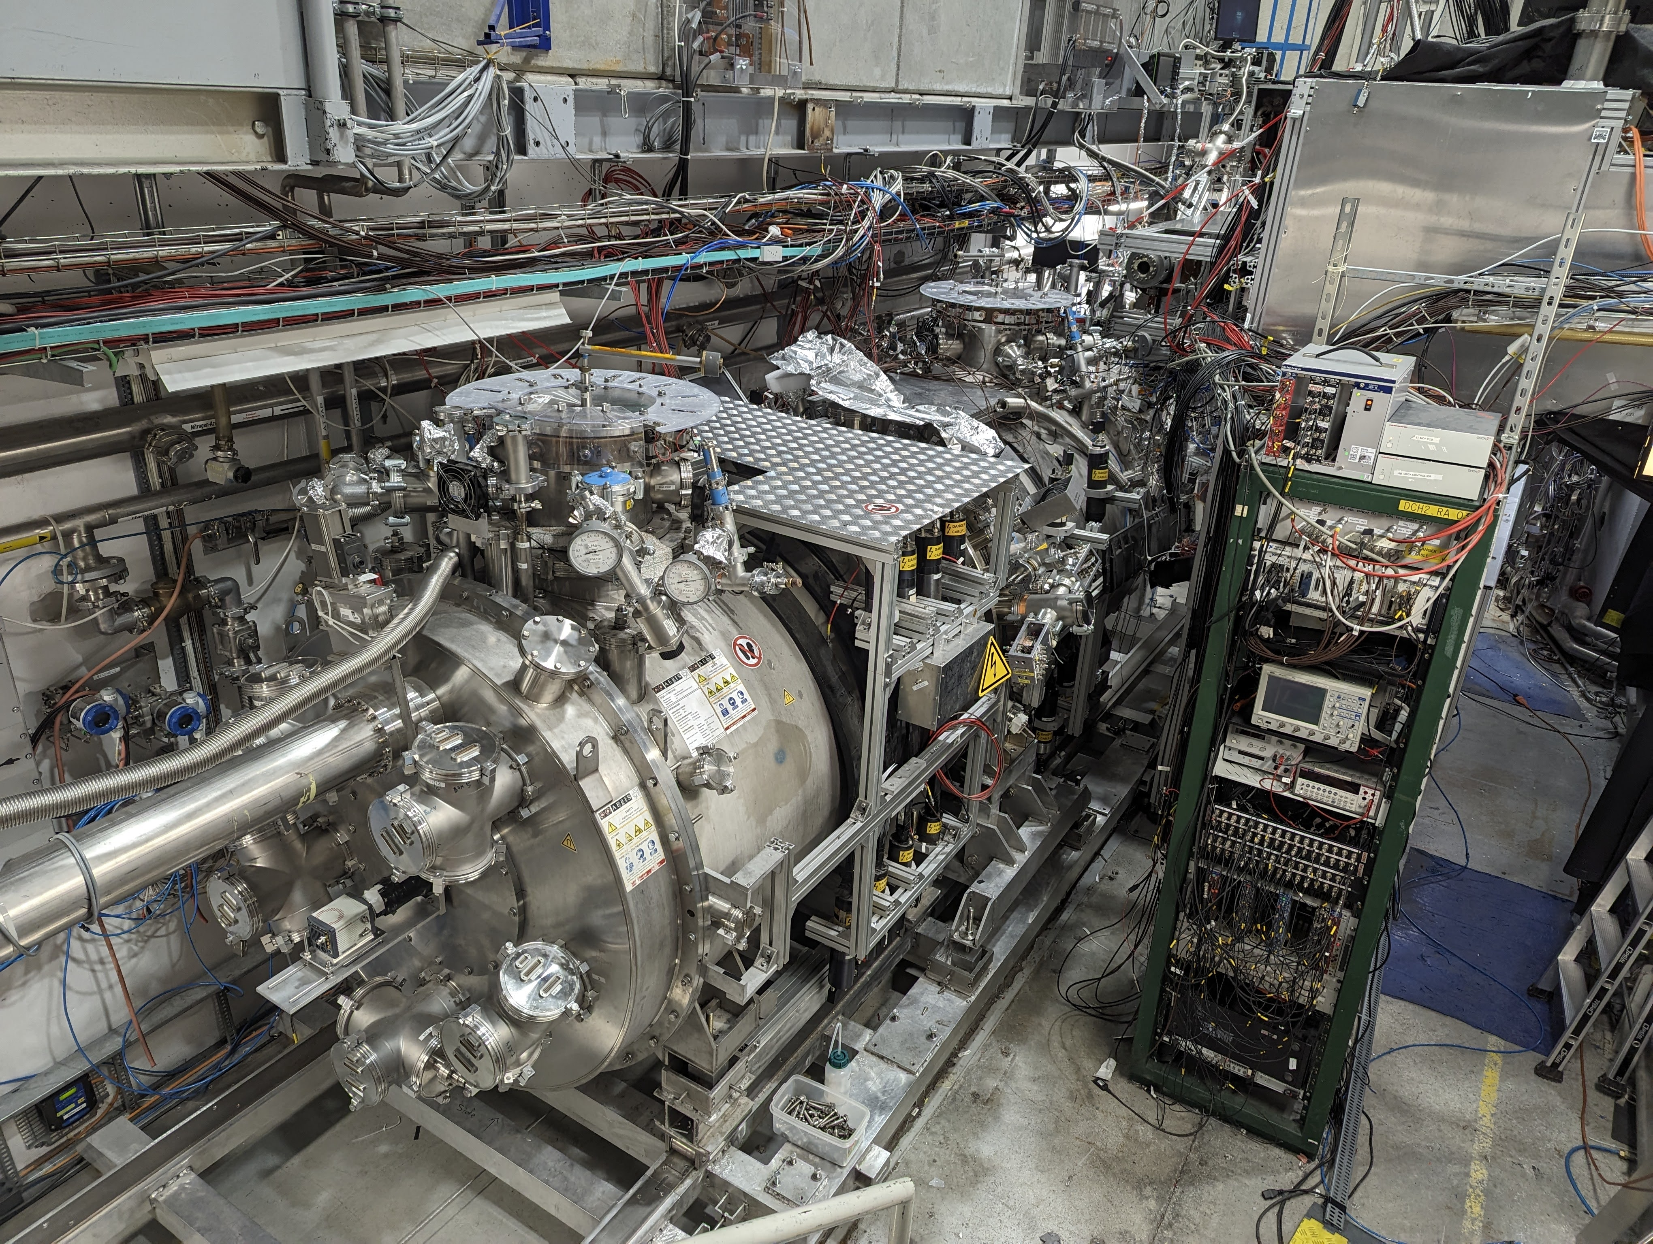

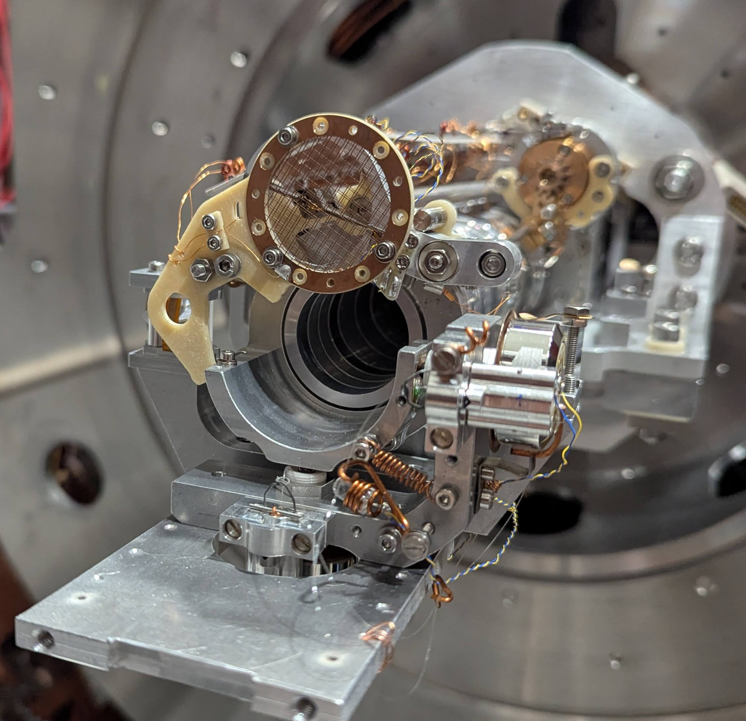
The AEGIS experiment

Slide 28
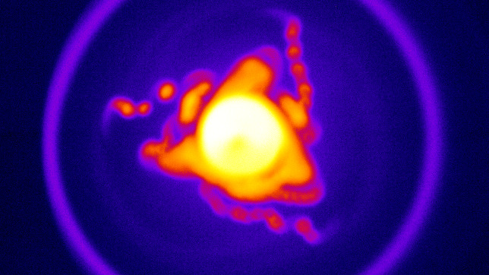


Slide 29





The AEgIS experiment
3.5 m
$$e^{+}$$
Antihydrogen
+
1T trap
5T trap
Antiproton
-
100 keV
Antiprotons ($\overline{p}$ )
from ELENA
Laser access

Slide 30



AEgIS gravity module
Timing
scintillators
Back view
The Optical PHoton and ANtimatter IMager (OPHANIM)
60 CMOS sensors, 30.8 cm² coverage, 0.8 um pixels
World-record-breaking pixel count: 3.84 Gpx ¹

Slide 31



Autonomous control system for AEgIS
Volponi, M., et al. "TALOS (Total Automation of LabVIEW Operations for Science): A framework for autonomous control systems for complex experiments." Review of Scientific Instruments 95.8 (2024).

Slide 32





This flexibility allows for the development of new techniques
$\overline{p}$
Ion trajectory
Gas injection
1.035m
0.545m
$\overline{p}$
ELENA
MCP
Notes:
We developed a nested trap
procedure for positive ions
Can we trap recoil fragments?

Slide 33

Manipulation of antimatter plasma
Animation by Jakub Zilenski

Slide 34





My focus: Antiprotonic atoms
Typical atom:
$\sim$10 000 fm
$$\overline{P}$$
$$e^{−}$$
Bohr radius $∝\frac{m_{e}}{m_{p}}$
Antiprotonic atom:
1-10 fm
<50 fm
1/2000
Nucleus
Infinite range
Gravity
Electromagnetic
Weak
Strong
Limited range $\sim$ fm

Slide 35


Laboratory for testing extreme physics
Electric field: ~10²⁰ V/m
Magnetic field: ~10⁸ T
Sensitive tool for studying the surface of the nucleus
$$\overline{p}$$
35

Slide 36

Thank you for your attention
p-
e-
Questions?

Slide 37








In the near future...
$$\overline{n}$$
Anti-molecules?
$$\overline{p}$$
Anti-deuteron factory?
Anti-matter fusion?
+
+
+
Energy
³$\overline{He}$
$$\overline{n}$$
²$\overline{H}$
²$\overline{H}$

Slide 38

Anti- elements in our universe?
?

Slide 39








Proton and the antiproton
$$P (uud)$$
$$\overline{P} (\overline{u}\overline{u}\overline{d})$$
$$π$$
Annihilation
$$π$$
$$π$$
Lifetime: Infinite
Spin: 1/2
Charge: +1e
Magnetic moment: +$\text{2.793}μ_{0}$
Mass: ~ $2000 m_{e}$
Lifetime: Infinite
Spin: 1/2
Charge: -1e
Magnetic moment: -$\text{2.793}μ_{0}$
Mass: ~ $2000 m_{e}$
Notes:
Antimatter counterpart of the proton
Exotic particle with infinite lifetime!
Antiproton is a stable negatively charged hadron 1836x heavier than the electron.

