Slide 1
Phase Feed-Forward
Piotr Skowroński (CERN)
Philip Burrows (Oxford Univ.)
Fabio Marcellini (LNF Frascati)
Alexandra Andersson (CERN)
Andrea Ghigo (LNF Frascati)
et al.

Slide 2
CLIC Phase Feed-Forward System
Phase Feed-Forward system will increase the drive beam stability and correct phase variation along pulse from
10° (max) to the required 0.1° at 12GHz
  Measure phase offset before turn around
  Correct it after turn around
The current CLIC design based on a 4-bend chicane, each bend equipped with a fast kicker so the “height” of the chicane is changing, and thus TOF together with it
Phase monitor

Slide 3
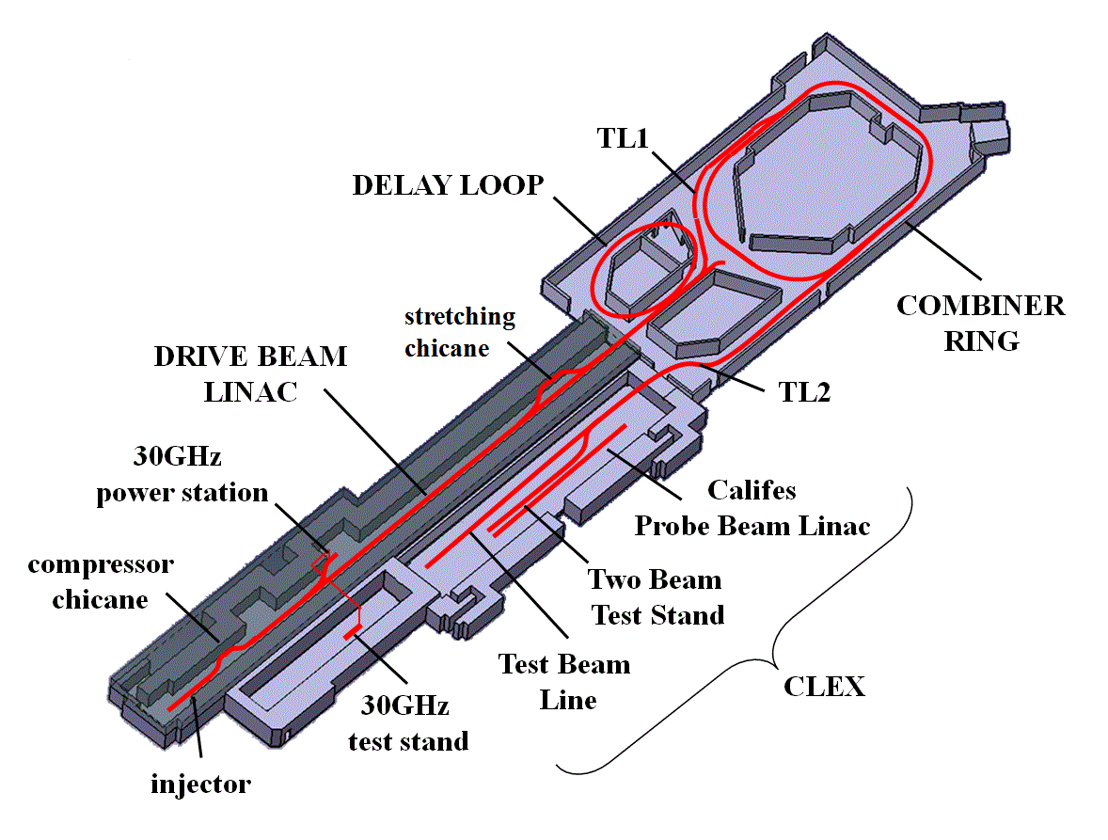
Setup in CTF3
A prototype system will be implemented in CTF3
Phase will be measured just before DL
Correction will be done in the dog-leg chicane of TL2 using 2 kickers

Slide 4
First-stage system design specifications
Uncombined beam: 3 GHz bunch spacing
  Correction for combined beam may be possible too, if phase errors are small
Train length: 280ns
  System useable also up to 420ns
Pulse to pulse 'slow' feed-back correction of mean phase sag with wide phase correction range
Feed-forward correction of higher-frequency components
  With smaller range in phase correction (few degrees) and bandwidth (30MHz)
    Defined by the amplifier performance that could be delivered
    within 1 – 1.5 years
  R&D on amplifier with the CLIC specs starting now, to be installed in the second-stage

Slide 5
Phase monitor
Phase measurement at 12 GHz using monopole mode of custom resonant cavity
Three monitors will be made
  the first will be available around October 2011 for testing
2 or 3 monitors will be tested in series
with beam in 2012
Electronics will output baseband analogue signals
  Amplitude
  Phase
  Amplitude/Phase
Output signal bandwidth 50-100 MHz, with latency about 5ns
First version of electronics available soon for testing

Slide 6
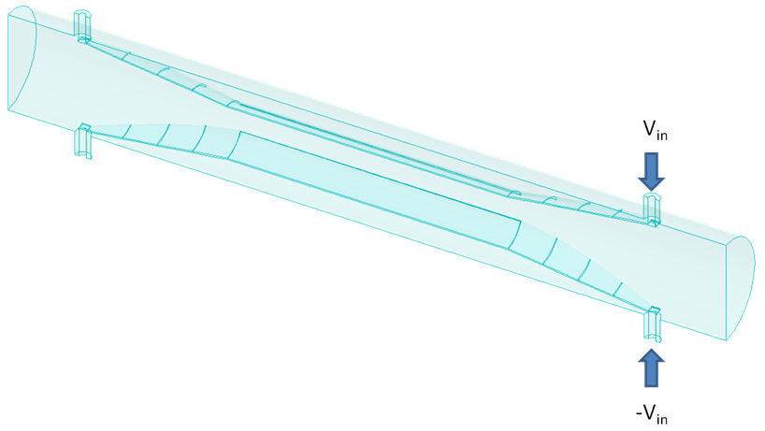
Kicker
Longitudinal space available in the beam line max 120cm
Radial space:
  Flanges max 18cm
  Connectors max 25cm
  diameter
  Determined by surrounding
  quadrupole aperture
Total kicker strip length c. 100cm
  80cm + 10cm tapers at each end
Kicker sensitivity: +/-1.35 kV
  equivalent to +/- 1mrad = +/- 34 degrees (12GHz)
Alignment not very critical:
  mm transverse
  few degrees azimuth ok, but will put a rotatable flange on one end, and fiducial marks near feed-throughs
Kicker fabrication possible by Spring 2012
Possibly use an external dipole corrector for the 'slow correction', if required

Slide 7
Kicker amplifier
Bandwidth ~ 30MHz (eventual target: 70MHz)
To be located in CLEX gallery extension
  Roughly '6u' sub-rack size
Cable run from amplifier to kicker about 15m
Feedback board will digitise phase monitor signals using FONT approach
  details will be decided later
Latency considerations:
  Design for total latency c. 380ns
  If required, can add latency by circulating beam in the combiner ring

Slide 8
Summary
Phase monitors – LNF Frascati
Phase monitor read-out system – CERN
Amplifiers – Oxford University
Kickers – LNF Frascati
Tentative Schedule
  1st monitor ready in October 2011
    Tests with the readout electronics in the lab and later with the beam
  Remaining monitors installed during 1st half of 2012
  3 monitors installed in chain for performance checks
  Kickers ready mid 2012
  Installation during winter shutdown 2013
Oxford team will work on amplifier with CLIC specs
  When ready to be installed in CTF3
    It will provide feed-forward correction over the full range and with the full bandwidth

