Slide 1
Next structure for TBTS experimental area
TB module prototype schedule
G. Riddone, 18.08.2011

Slide 2
TBTS accelerating structures
At present TD24
Future
  TD24 with WFM x2 (3 under fabrication at Mecachrome via CEA-Saclay + 1 under adjudication, bonding at Thales): assembly will start mid of September 2011
  Fall back solution: T24 (ready)

Slide 3
Two-beam module prototype - LAB
Status
Positioning tests going on first two supporting/alignment systems
Pieces for RF structure mock-up received and under assembly
DB magnet and BPM mock-ups available
Equipment for thermal tests (foreseen at the end of this year) at CERN
Frame for transport tests under development
Sequence of tests “0-0 modules”
Positioning/alignments tests
Assembly RF structures
Installation of RF structures, DB magnets and BPM mock-ups available
Thermal tests
Transport tests

Slide 4
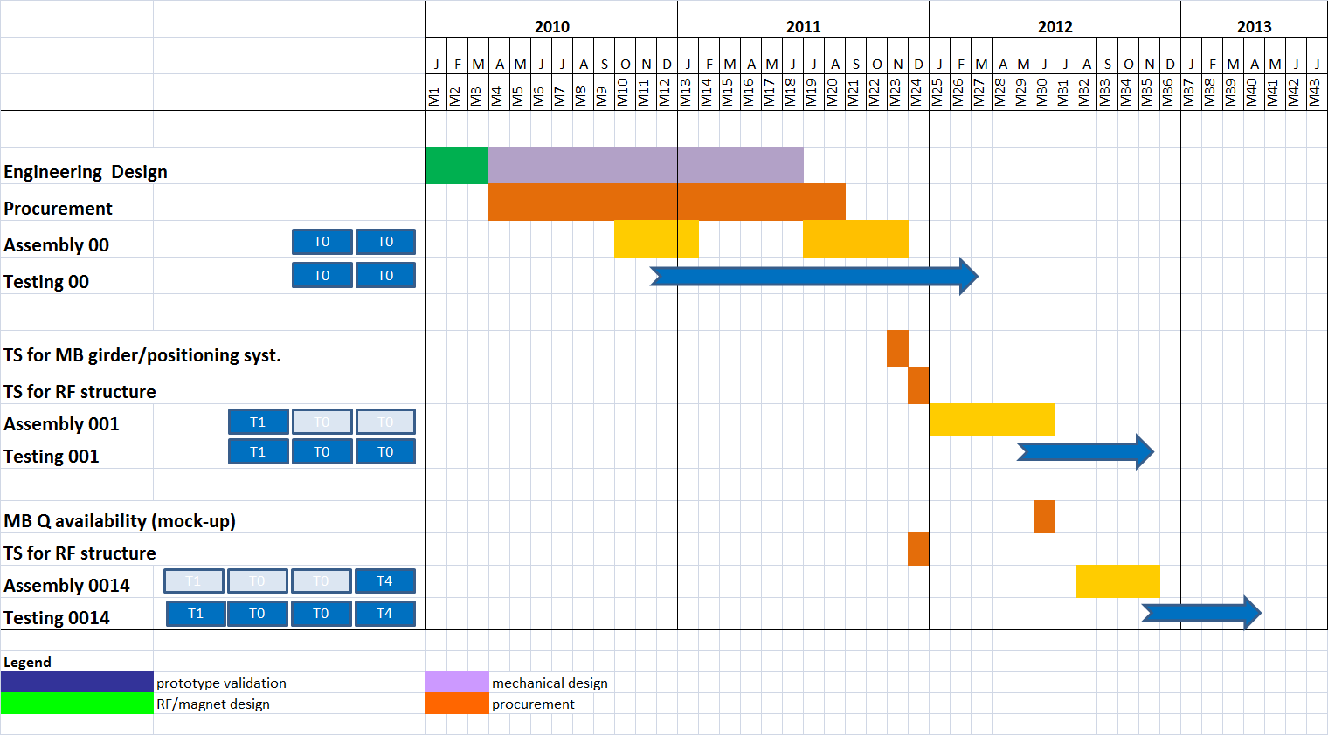
TB Module prototypes - LAB

Slide 5
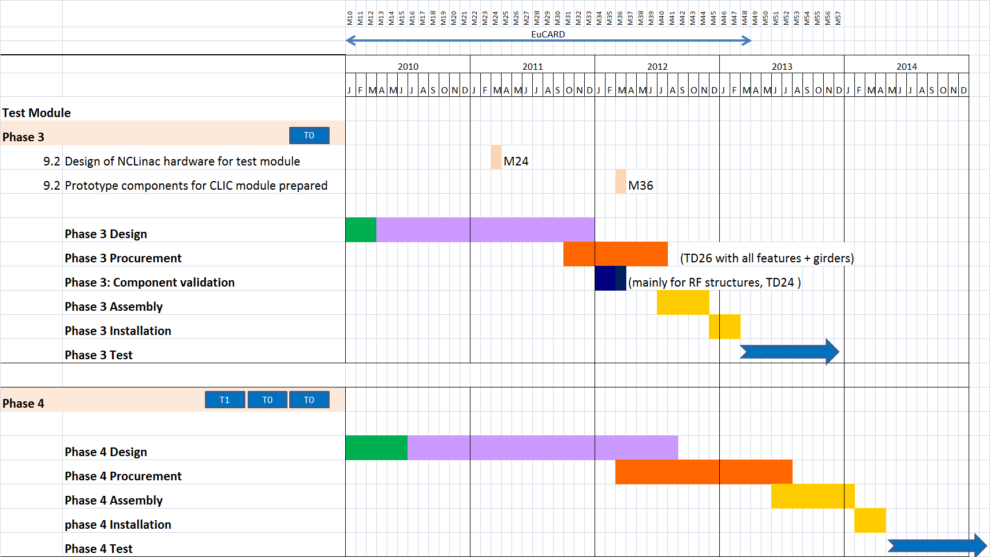
TB Module prototypes - CLEX

