Slide 1
IPv4/6 usage of
LHC[OPN/ONE]

Slide 2
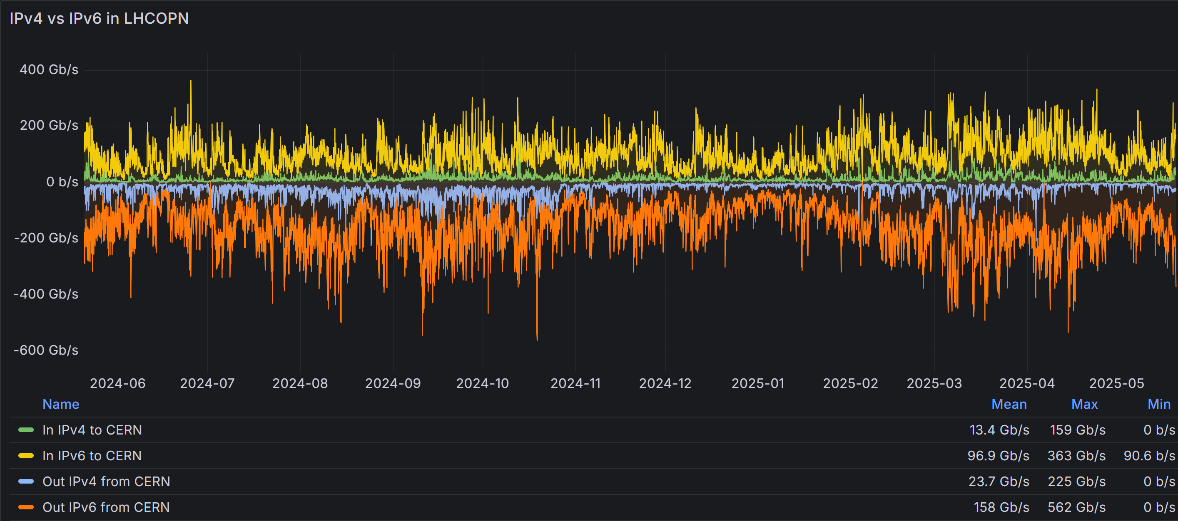
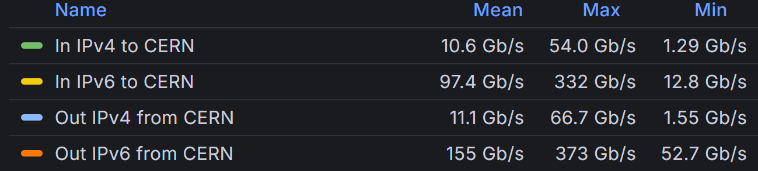
last month
last month

Slide 3
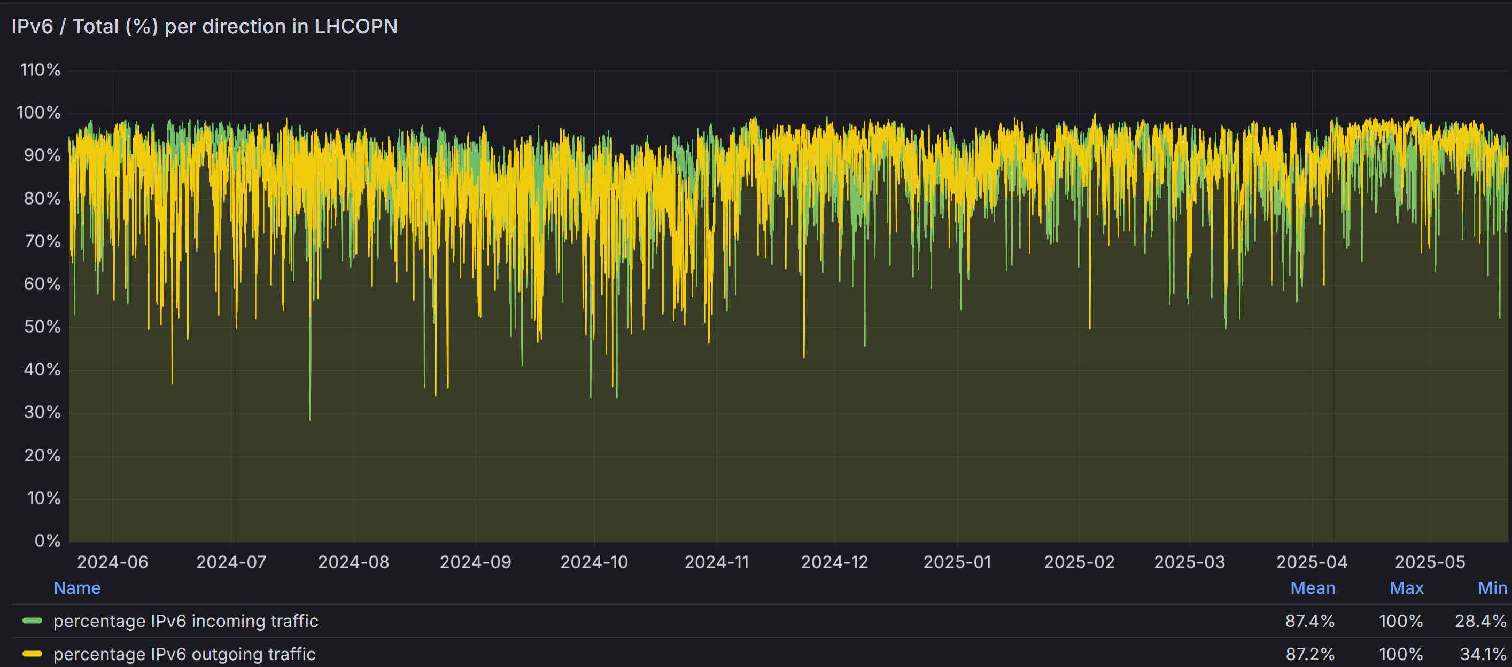

Slide 4
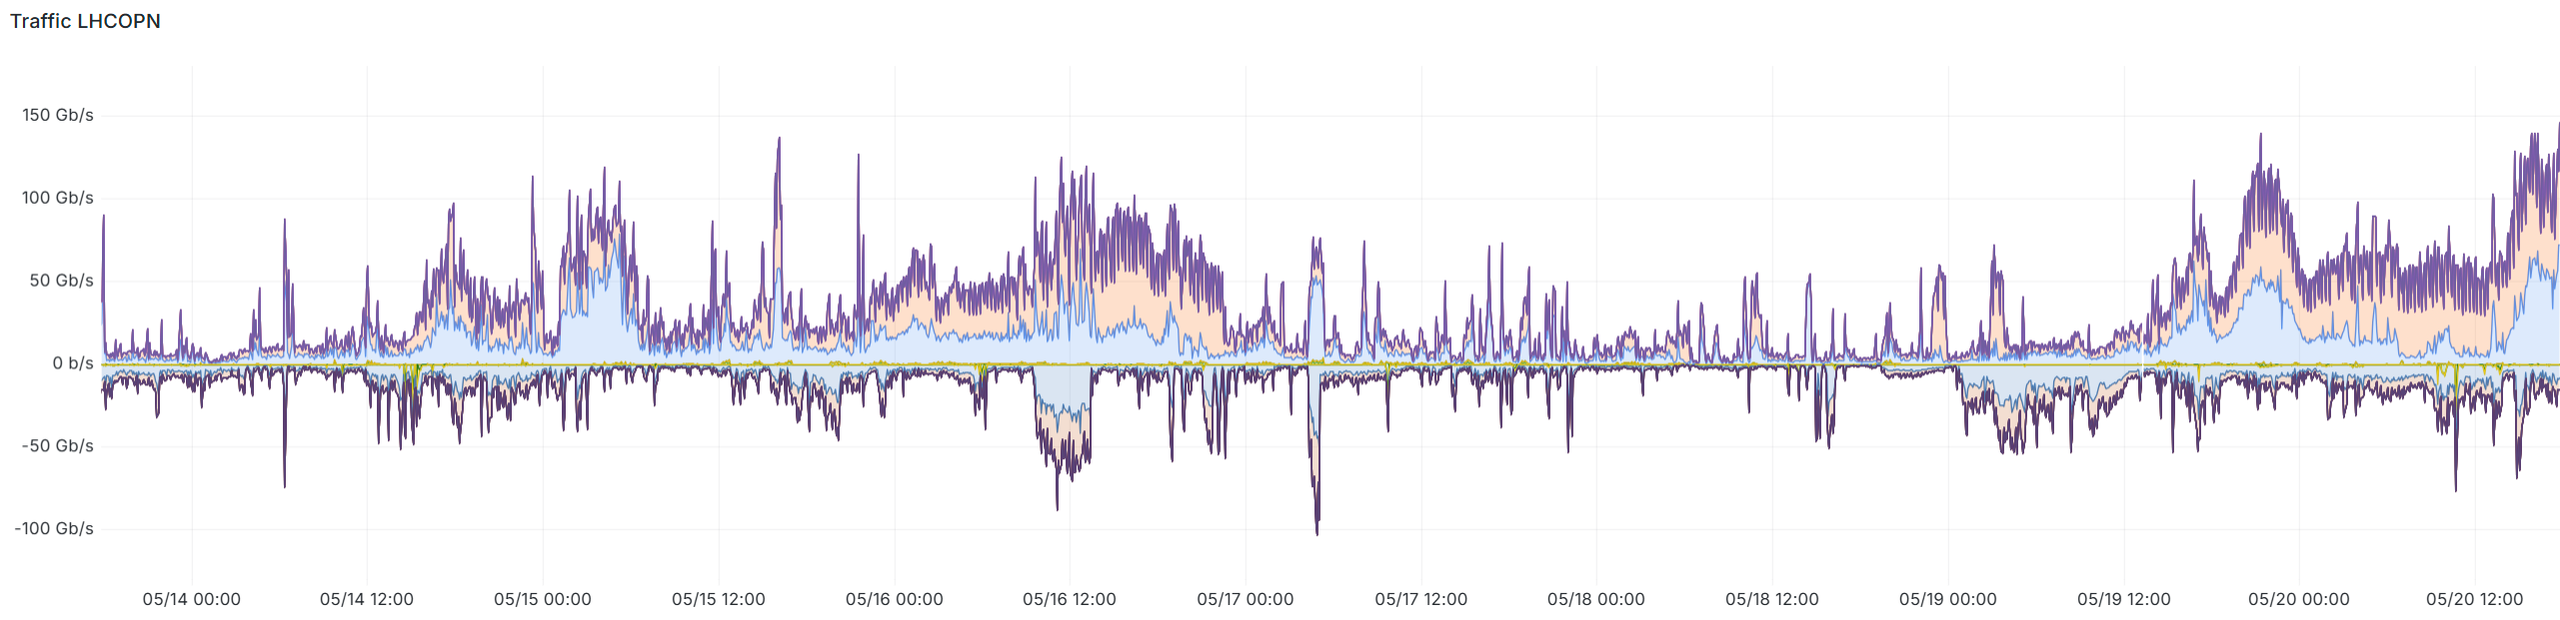
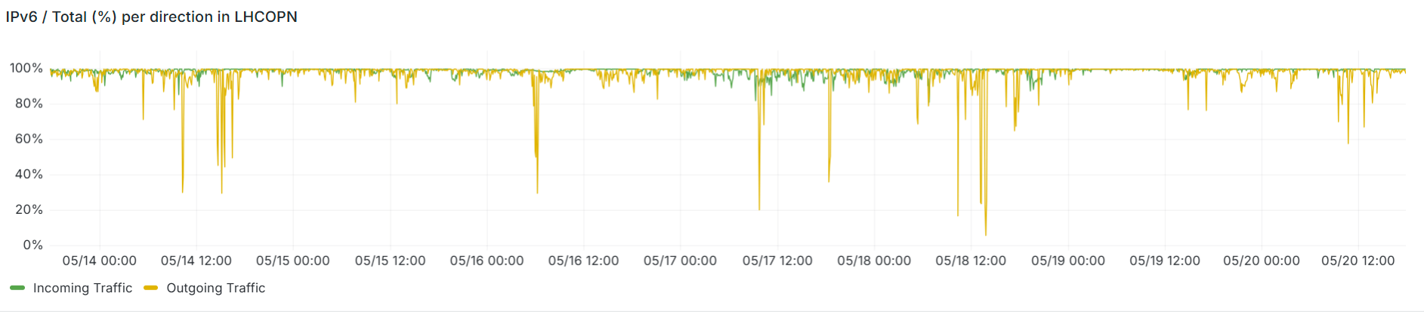
evaluated bursts
Other areas include besids NLT1 + CERN:
  BNL
  Russian (KIAE/JINR)
  PIC
  CNAF
  RAL
  (NDGF)
Even the third + fourth area : NLT1 + CERN

Slide 5
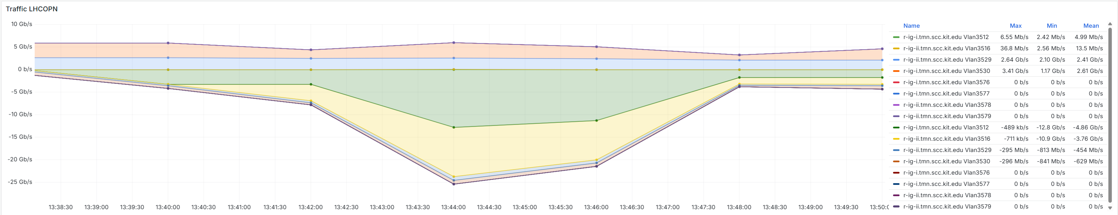
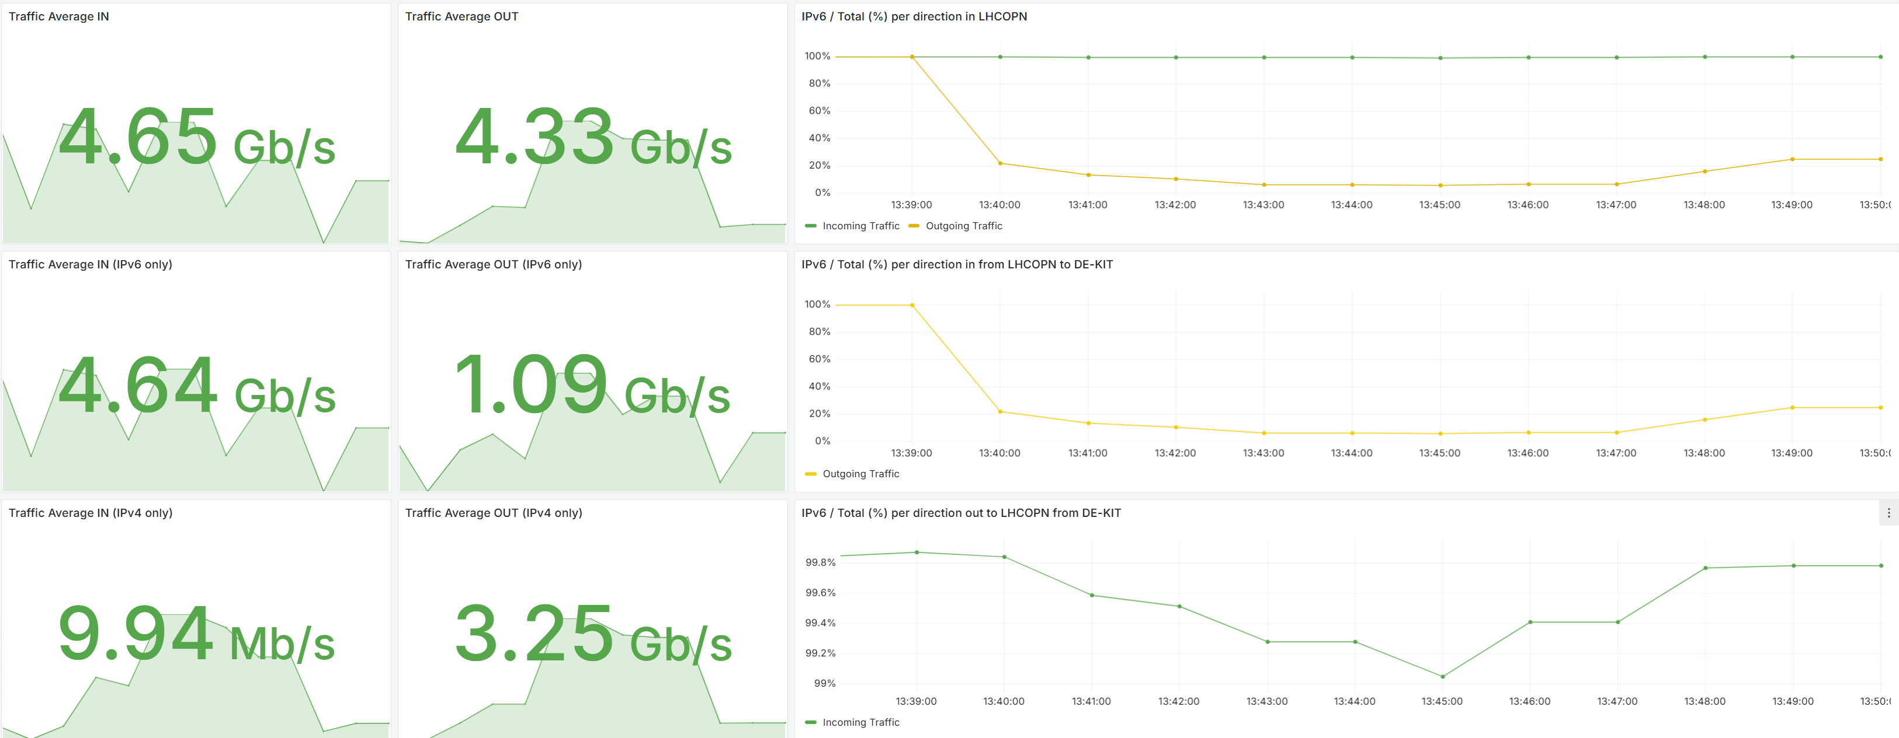
IPv4 burst at 18 May 13:30 to 13:50

Slide 6
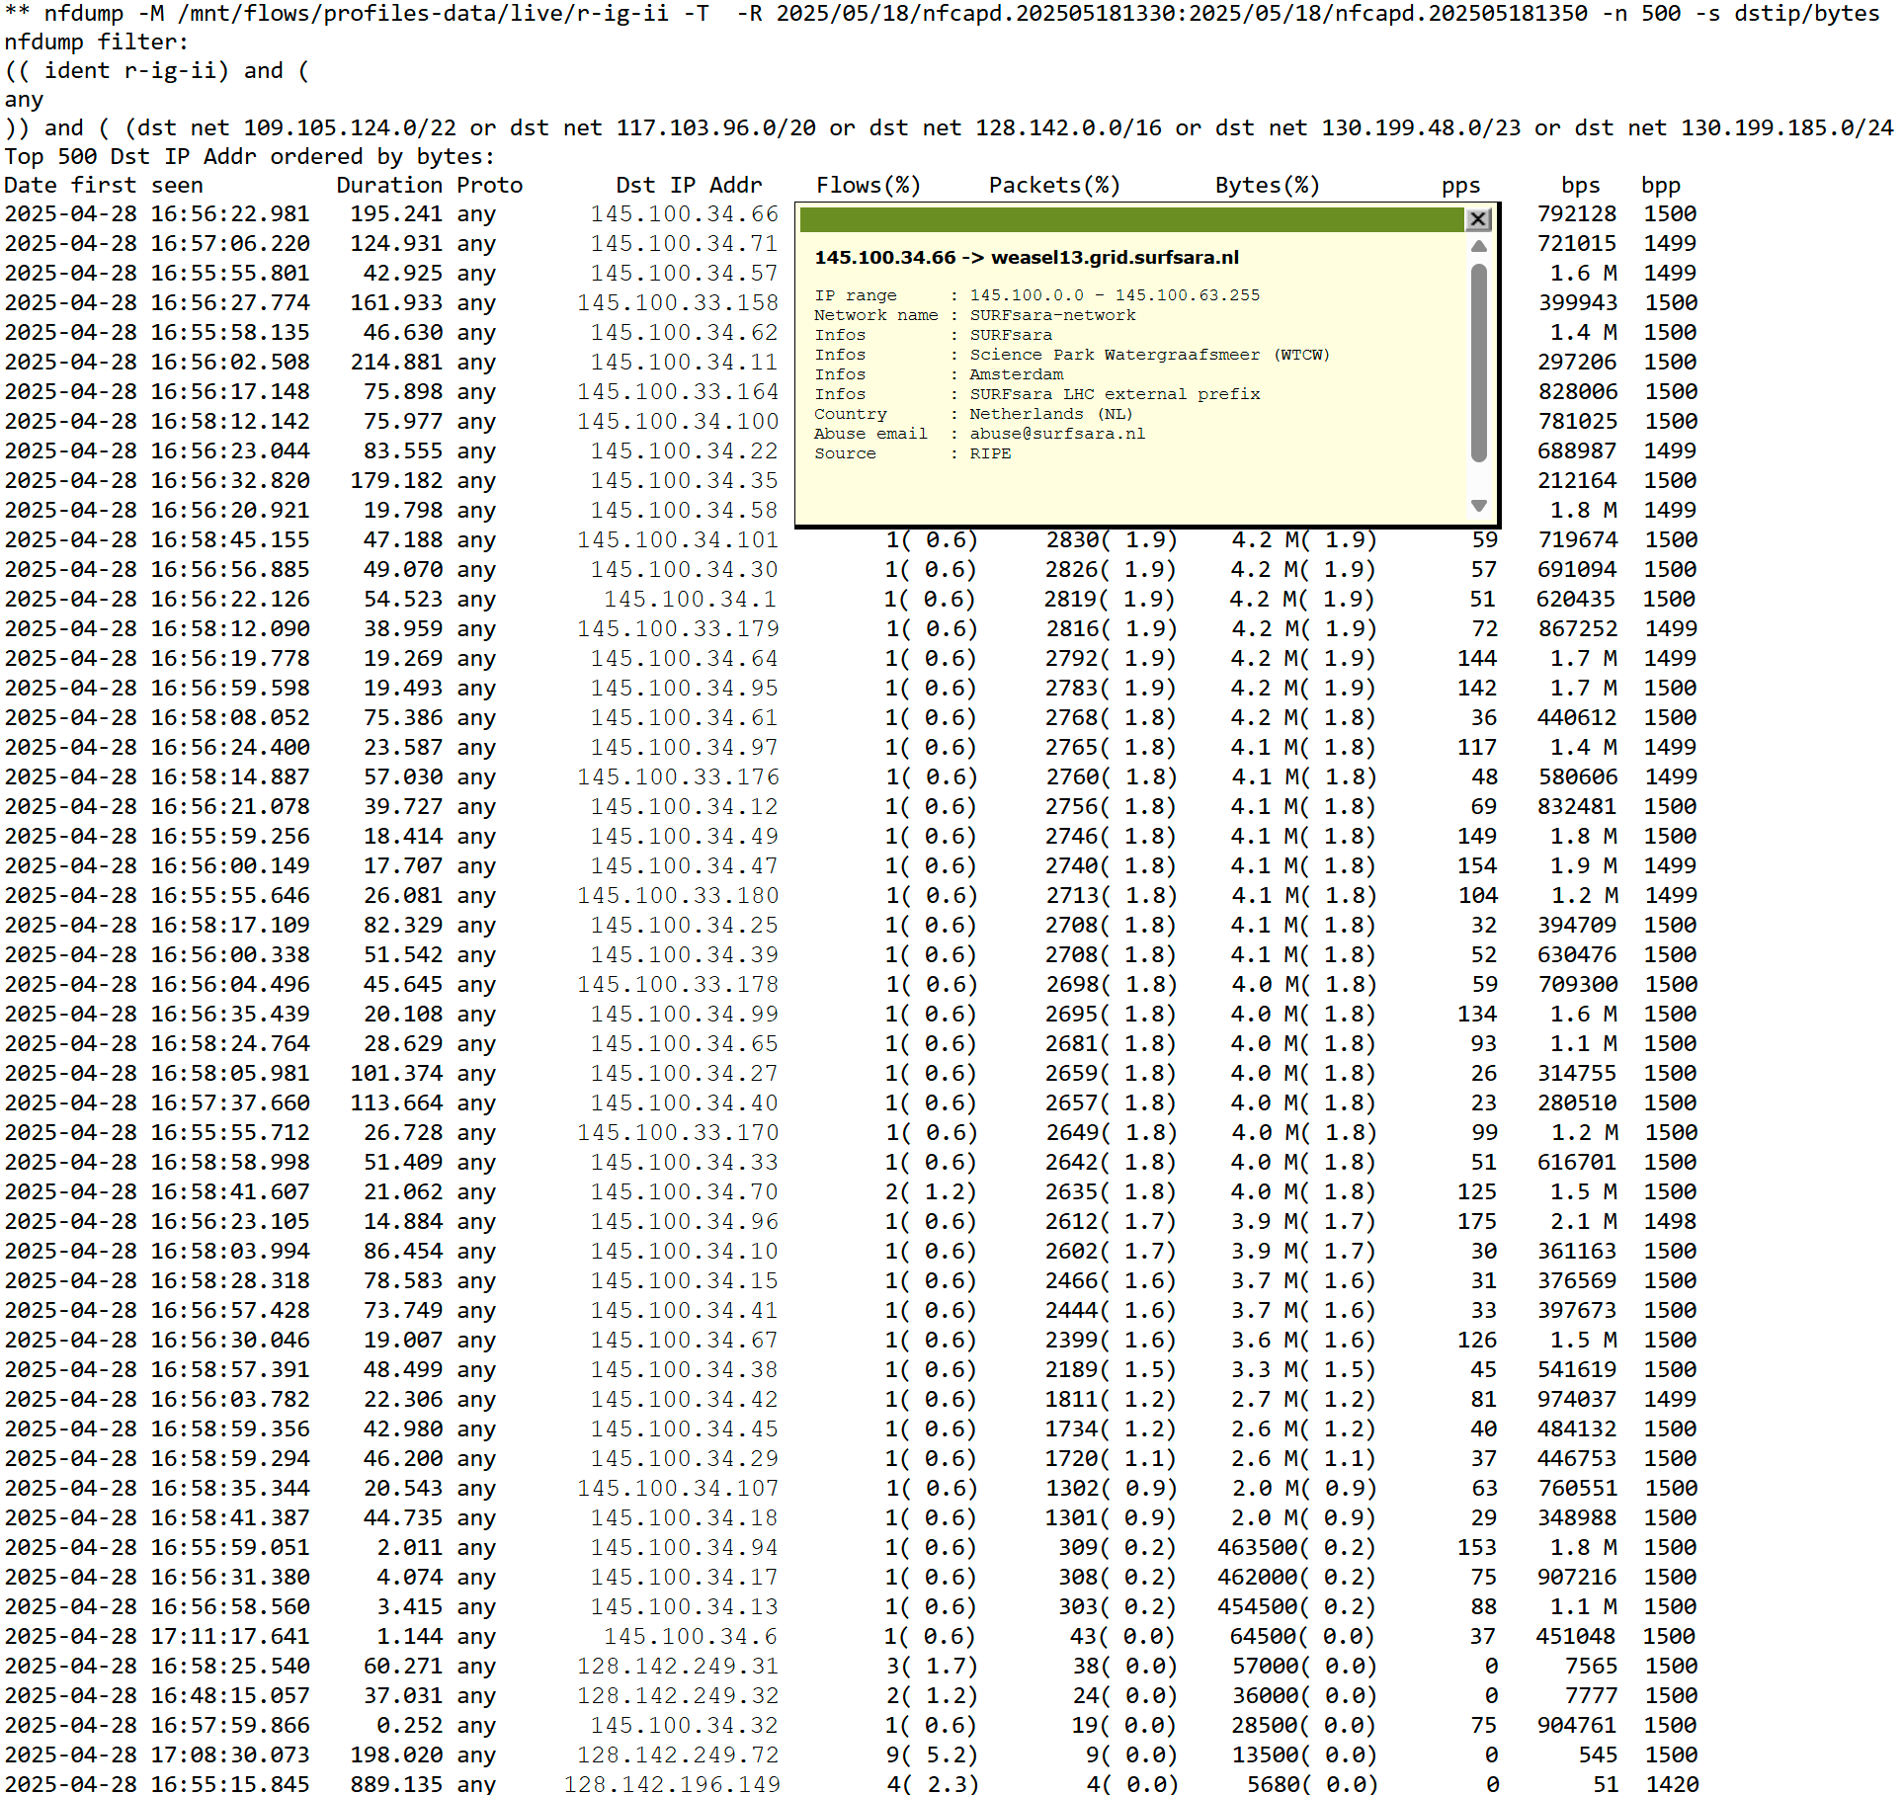
IPv4 burst at 18 May 13:30 to 13:50
145.100.x.x → NLT1 surf part
128.142.x.x → CERN

Slide 7
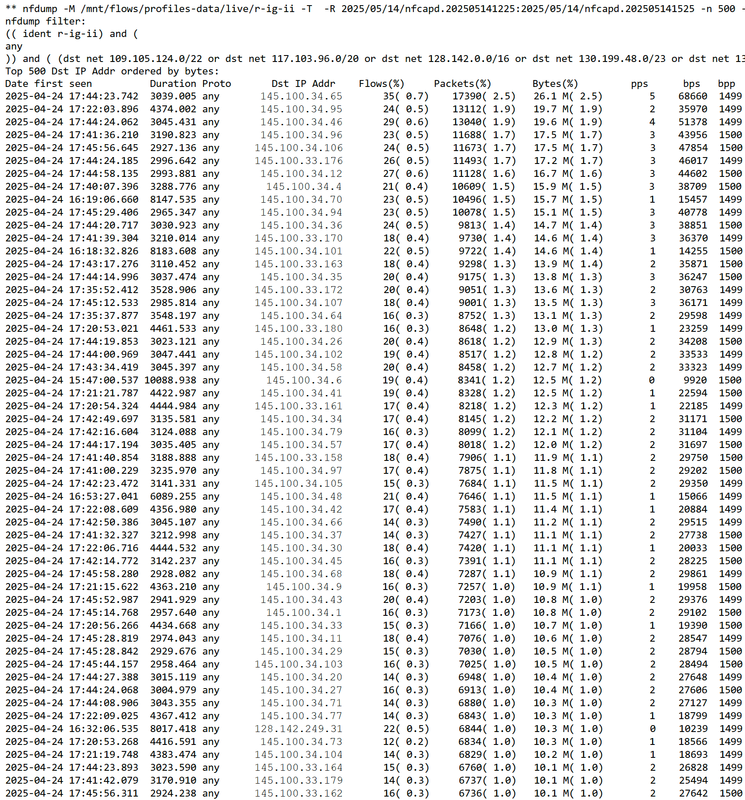
IPv4 burst at 14 May 14:25 to 15:25
same candidats:
145.100.x.x → NLT1 surf part
128.142.x.x → CERN

Slide 8
Turn off IPv4 at LHCOPN
T0 connected T1 (star based network)
Is there still backup service T1 to T1 to T0 ?
Some T1 to T1 via CERN (LHCOPN), other like DE-KIT to FNAL via LHCONE

Slide 9
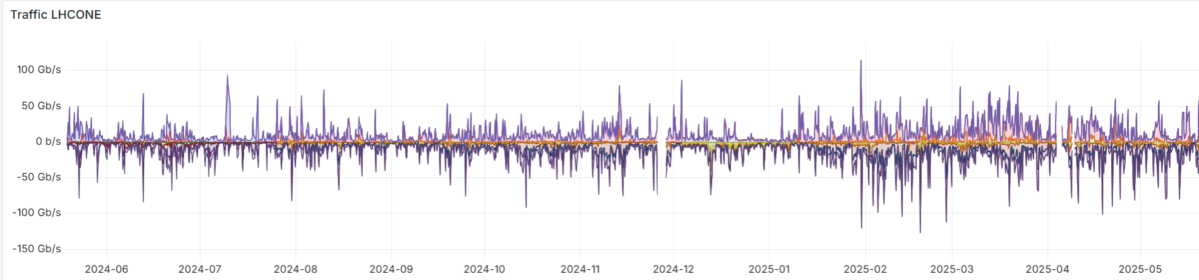
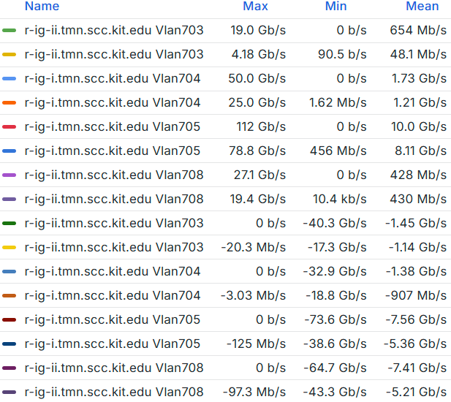
IPv4/6 LHCONE usage at KIT
in / out %
r-ig-I r-ig-II mean
704 + 703 IPv4 in/out 3,6Gb/s 4,9Gb/s 16,41%
705 + 708 IPv6 in/out 19,0Gb/s 25,5Gb/s 83,59%

Slide 10
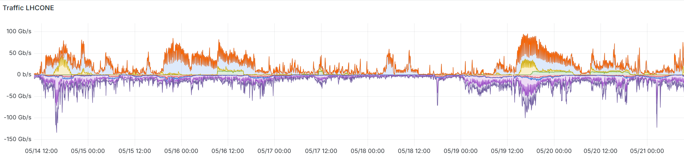
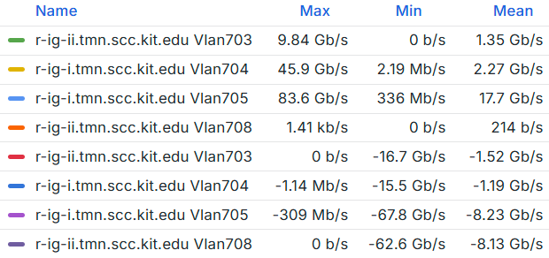
IPv4/6 LHCONE usage at KIT
mean %
r-ig-I r-ig-II in / out
704 + 703 IPv4 in/out 3,6Gb/s 2,7Gb/s 10,35%
705 + 708 IPv6 in/out 17,7Gb/s 16,4Gb/s 89,65%

