Slide 1
Exploring the extremes with NUSTAR
Alexander Herlert (FAIR/GSI)
Theme Meeting on FAIR-Science
Panjab University, Chandigarh, India
April 23, 2025

Slide 2
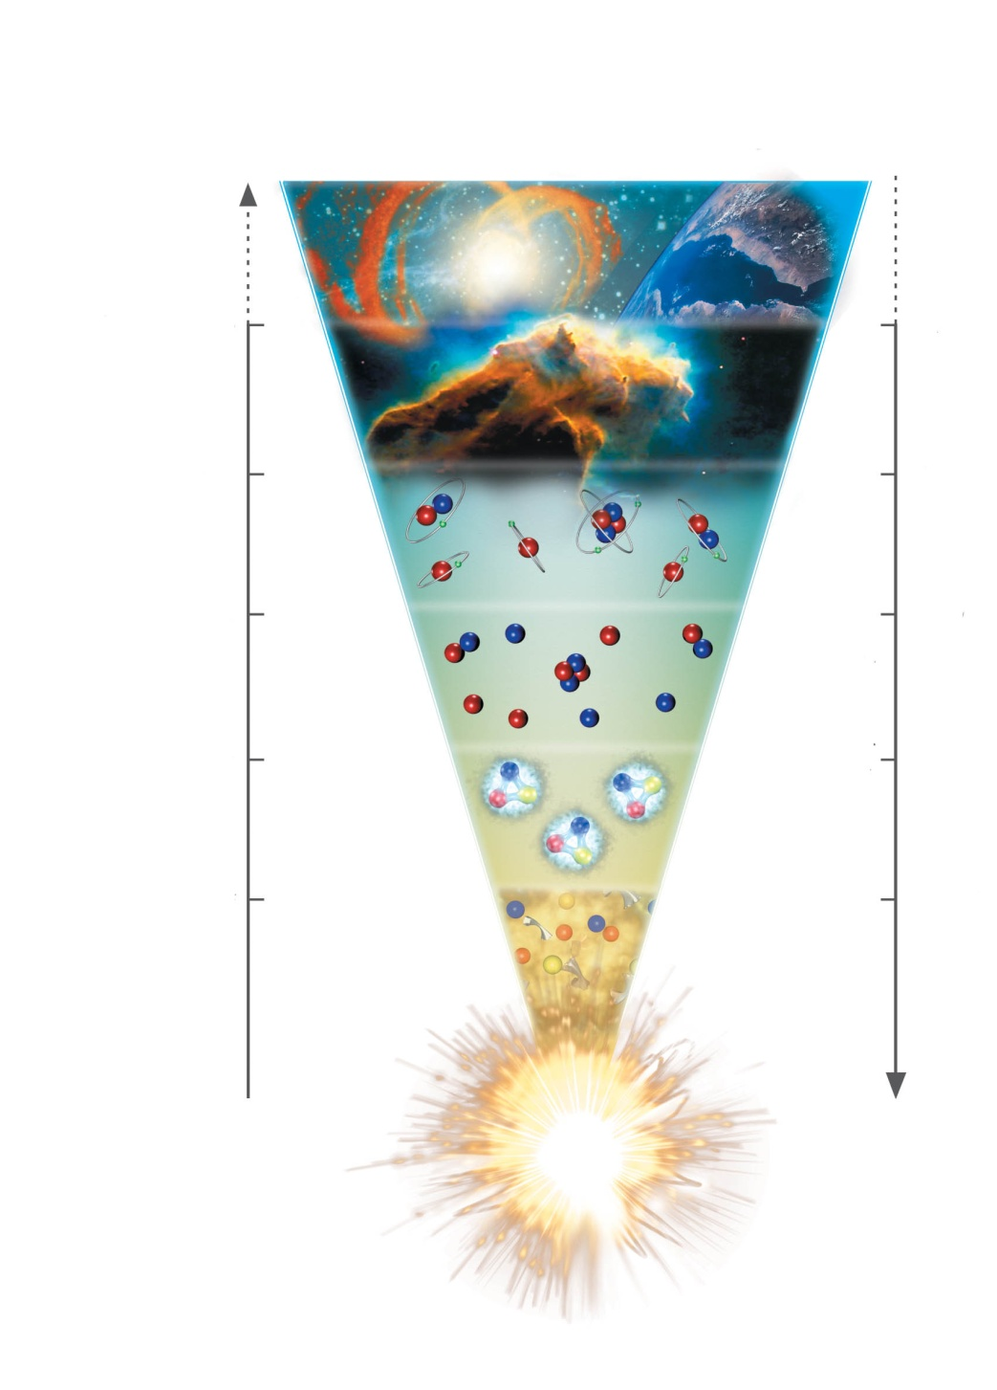

Understanding the universe
Molecules / matter / cells / organisms
15 billion years
Heavy elements
1 billion years
Light atoms and elements
300.000 years
Time
Temperature
light nuclei
3 minutes
Protons / neutrons
1/1000 seconds
Quarks / elektrons
Expansion

Slide 3
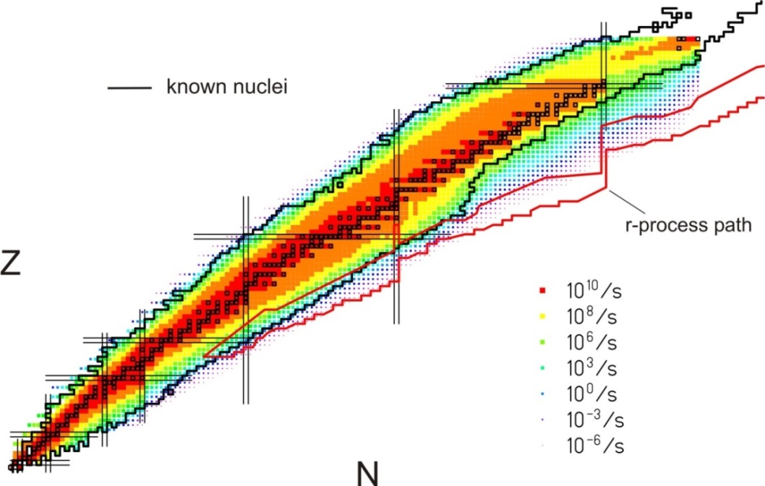
Big physics questions …
What are the limits for existence of nuclei?
  Where are the proton and neutron drip lines situated?
  Where does the nuclear chart end?
How does the nuclear force depend on varying proton-to-neutron ratios?
  What is the isospin dependence of the spin-orbit force?
  How does shell structure change far away from stability?
How to explain collective phenomena from individual motion?
  What are the phases, relevant degrees of freedom, and symmetries
  of the nuclear many-body system?
How are complex nuclei built from their basic constituents?
  What is the effective nucleon-nucleon interaction?
  How does QCD constrain its parameters?
Which are the nuclei relevant for astrophysical processes
and what are their properties?
  What is the origin of the heavy elements?

Slide 4
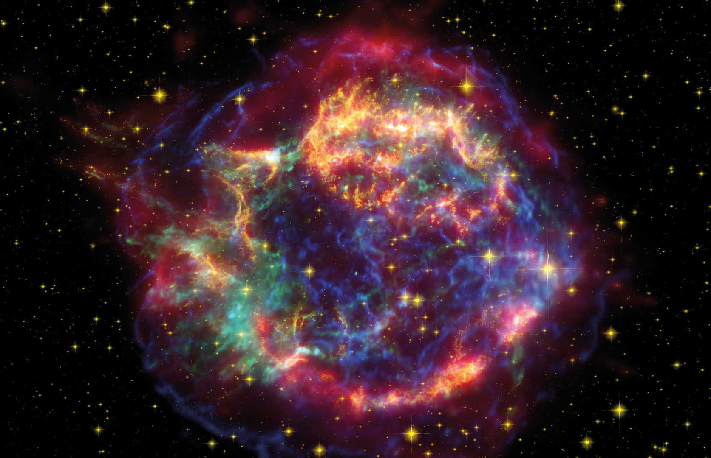
Overarching physics case: the creation of the (heavy) chemical elements
… requiring information
Reactions in stellar environments
Equation of State
Limits of existence
Lifetimes
Masses
P_{xn} values
Fission
… with theory support
for impact
4

Slide 5

Overarching physics case: the creation of the (heavy) chemical elements
… requiring information
Reactions in stellar environments
Equation of State
Limits of existence
Lifetimes
Masses
P_{xn} values
Fission
… with theory support
for impact
5

Slide 6
NUSTAR sub-collaborations
Experiment | Description
HISPEC/ DESPEC | In-beam γ-spectroscopy at low and intermediate energy, n-decay, high-resolution γ-, β-, α-, p-, spectroscopy
MATS | In-trap mass measurements and decay studies
LaSpec | Laser spectroscopy
R³B | Kinematically complete reactions with relativistic radioactive beams
ILIMA | Large-scale scans of mass and lifetimes of nuclei in ground and isomeric states
Super-FRS EC | High-resolution spectrometer experiments
SHE | Synthesis and study of super-heavy elements
ELISe(*) | Elastic, inelastic, and quasi-free e⁻-A scattering
EXL(*) | Light-ion scattering reactions in inverse kinematics
(*) NESR required – alternative/intermediate “operation” within MSV under discussion.
SHE at GSI

Slide 7





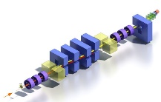

The NUSTAR toolbox – a complementary approach
 | Super-FRS EC | HISPEC/ DESPEC | LaSpec | MATS | R³B | ILIMA | SHE
Masses |  | Q-values, isomers |  | dressed ions, highest precision | unbound nuclei | bare ions, mapping study | precision mass of SHEs
Half-lives | ps...ns-range | ground state and isomers μs...s |  |  | resonance width, decay up to 100ns | bare ions, ms…years | μs...days
Matter radii | interaction x-section |  |  |  | interaction cross sections
Charge radii | charge-changing cross sections |  | mean square radii |  | charge-changing cross sections |  | mean square radii
Single-particle structure | high resolution, angular momentum | high-resolution particle and γ-ray spectroscopy | magnetic moments, nucl. spins | evolution of shell str., pairing int., valence nucl. | quasi-free knockout, short-range & tensor correlations | evolution of shell closures, pairing corr. | shell structure of SHEs
Collective behavior |  | electromagnetic transition strength | quadrupole moments | halo structure | dipole response, fission | changes in deformation
EoS |  |  |  |  | polarizability, neutron skin
Exotic Systems | bound mesons, hypernuclei, nucleon resonances | rare and exotic e.m. and particle decays |  |  | n-rich hypernuclei | exotic decay modes

Slide 8
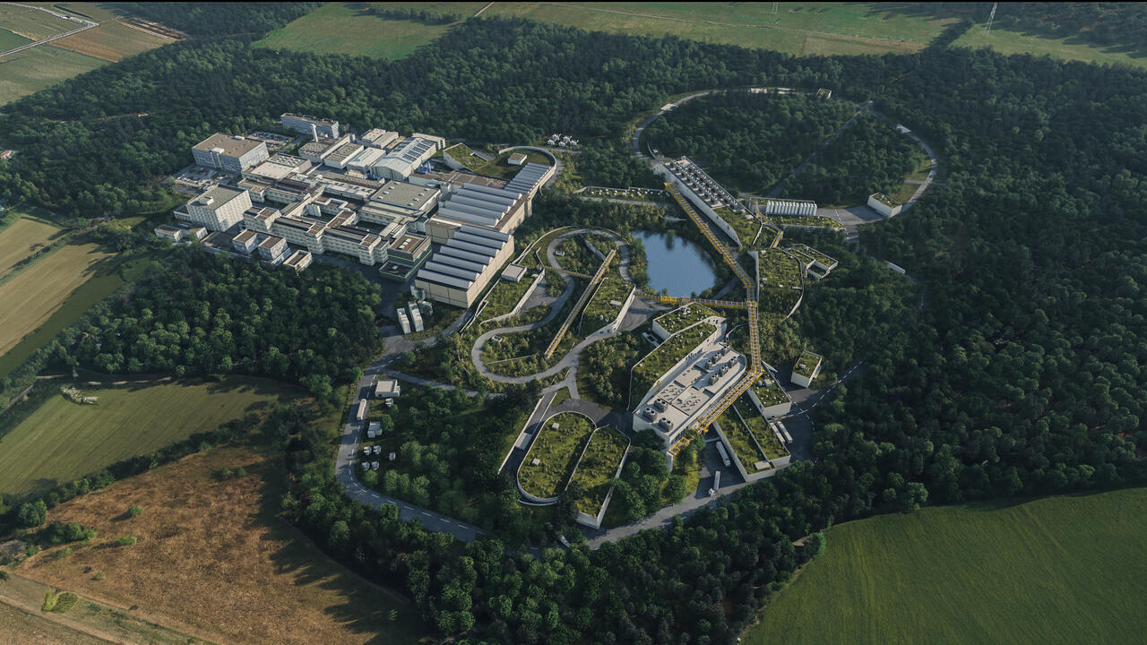
© GSI/FAIR, Zeitrausch

Slide 9
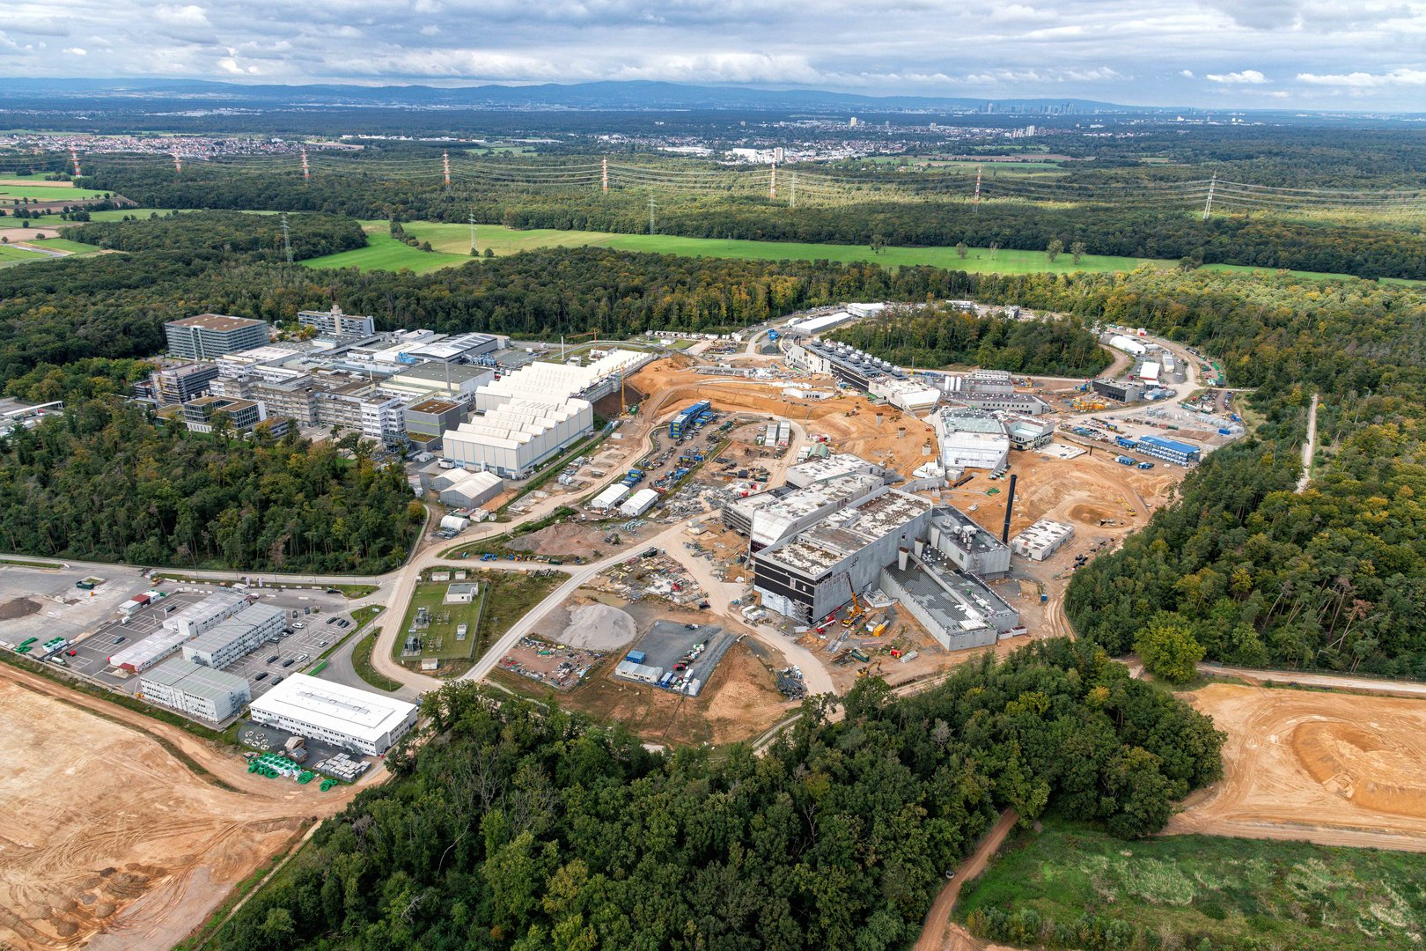
© D. Fehrenz, GSI/FAIR (September 2024)

Slide 10
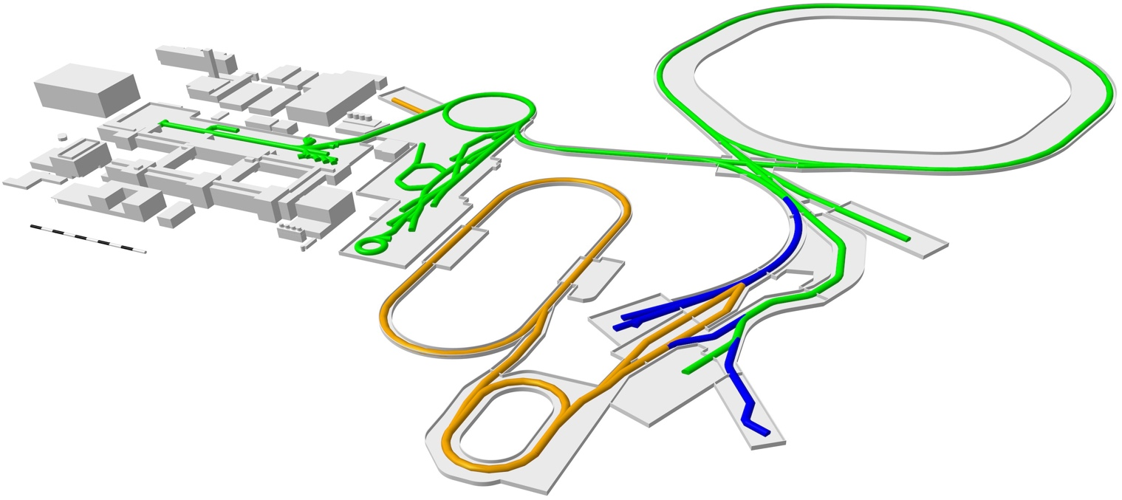
FAIR – 2028 and beyond
APPA Laser
SIS100
UNILAC
SIS18
HITRAP
ESR
SPARC
until 2028
CBM
FAIR 2028
CRYRING
PANDA
Super-FRS
APPA Cave
HESR
First Science +
after 2028
Next steps
ILIMA
NUSTAR LEB
MSV completion
NUSTAR HEB
CR

Slide 11
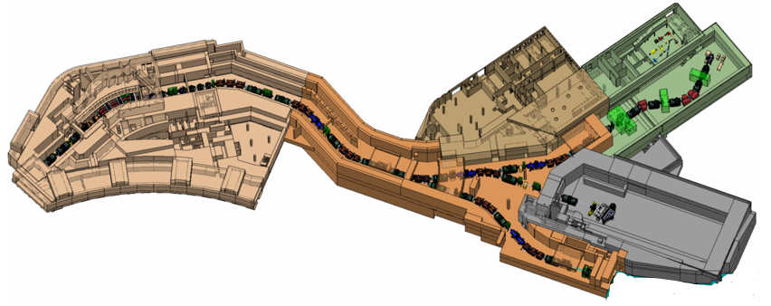
NUSTAR @ FAIR in 2028
SIS100
UNILAC
SHE
SIS18
ESR
until 2028
ILIMA
FAIR 2028
CRYRING
Super-FRS EC
Super-FRS
Super-FRS
First Science +
DESPEC
after 2028
Next steps
NUSTAR LEB
MSV completion
NUSTAR HEB
R³B
NUSTAR at the Super-FRS (R³B, Super-FRS EC and DESPEC) with SIS100 beams, plus SHE experiments at UNILAC and ILIMA at the low-energy rings of GSI

Slide 12
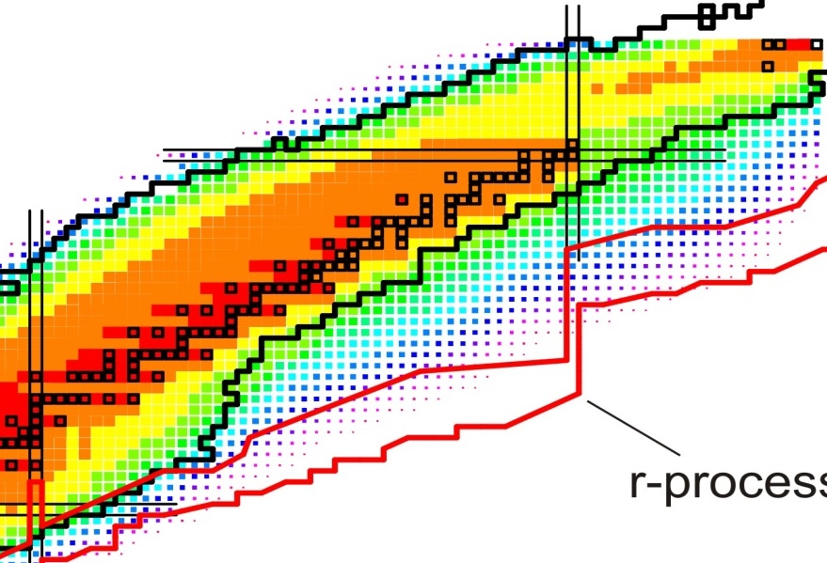
The Super-FRS (fragment separator)
MATS
LaSpec
FAIR FS++LEB
HISPEC/
DESPEC
r-process path
3rd waiting point
Super-FRS
Understanding the 3rd
r-process abundance peak by studying neutron-rich isotopes towards the N=126 shell closure and their ground-state and decay properties
R³B
Super-FRS EC
DESPEC
FAIR ES/FS
(Early Science and
First Science)

Slide 13
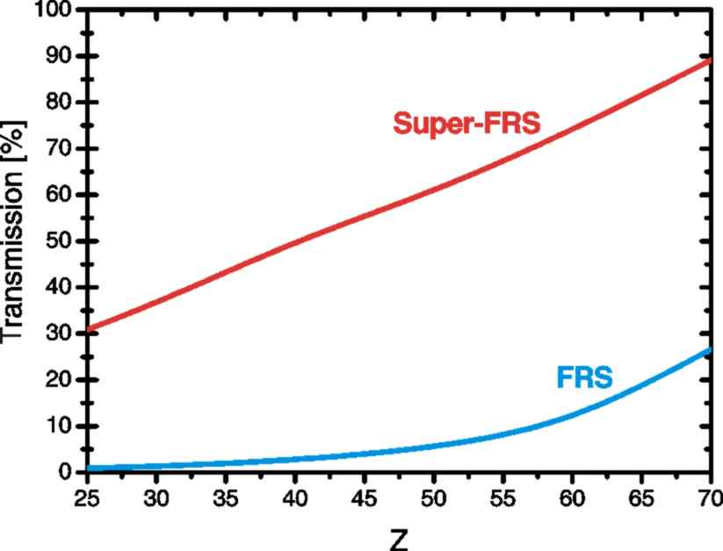
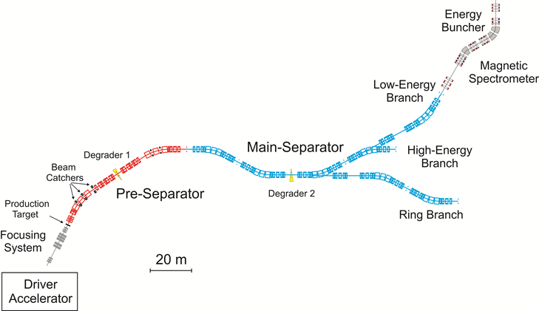
The Super-FRS (fragment separator)

Slide 14
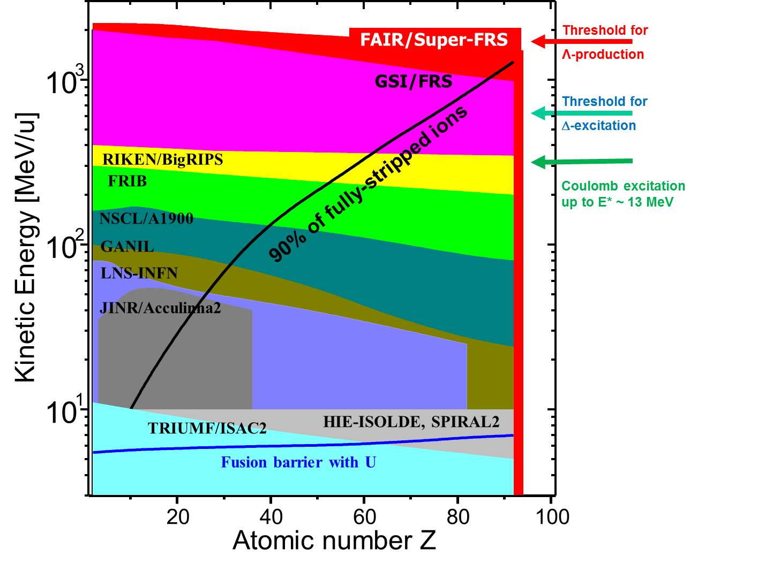
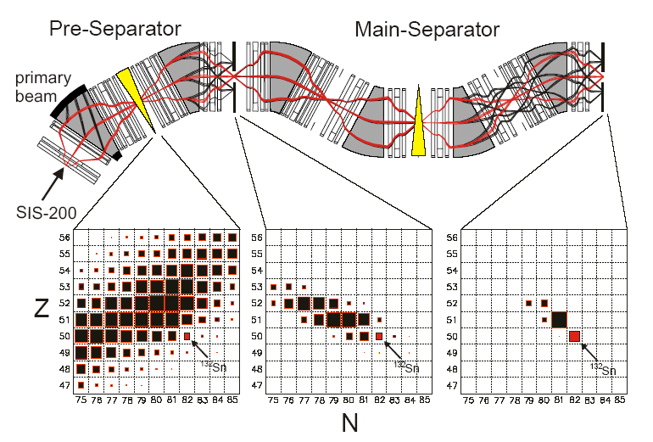
The Super-FRS (fragment separator)

Slide 15
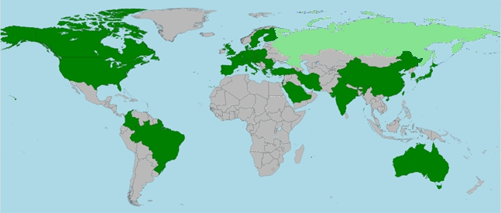
NUSTAR sub-collaborations and members
>640 NUSTAR members
(incl. students, engineers)
EXL
22
ELISe
15
R³B
HISPEC/ DESPEC
Super-FRS
EC
227
> 1000 listed “interested” scientists
> 640 registered members
(incl. students, etc.)
~ 428 senior members
(PhD holders w/o Russia)
> 140 institutes from 35 countries
MATS
234
ILIMA
48
179
SHE
67
LaSpec
75
40
Status: March 6, 2025
Notes:
=RUNDEN(WURZEL(B5/PI());2)

Slide 16
NUSTAR Collaboration senior members
NUSTAR collaboration senior members (PhD holders without Russia) for collaboration common fund from
HISPEC/DESPEC, MATS, LaSpec, R3B, ILIMA, Super-FRS EC
> 1000 listed “interested” scientists
> 640 registered members (incl. students, etc.)
~ 428 senior members (PhD holders w/o Russia)
> 140 institutes from 35 countries (w/o Russia)
Secured funding and expression of interest in funding from 22 countries (incl. Russia)
(incl. 10 FAIR partner countries)
428 senior
members
(PhD holders)
Status: March 6, 2025

Slide 17

NUSTAR Collaboration senior members
NUSTAR collaboration senior members (PhD holders without Russia) for collaboration common fund from
HISPEC/DESPEC, MATS, LaSpec, R3B, ILIMA, Super-FRS EC
> 1000 listed “interested” scientists
> 640 registered members (incl. students, etc.)
~ 428 senior members (PhD holders w/o Russia)
> 140 institutes from 35 countries (w/o Russia)
Secured funding and expression of interest in funding from 22 countries (incl. Russia)
(incl. 10 FAIR partner countries)
428 senior
members
(PhD holders)
Indian partner institutes:
BARC Mumbai, IIT (ISM) Dhanbad, IIT Roorkee, IIT Ropar, IUAC Delhi, PU Chandigarh, TIFR Mumbai, Univ. Delhi, VECC Kolkata
Status: March 6, 2025

Slide 18
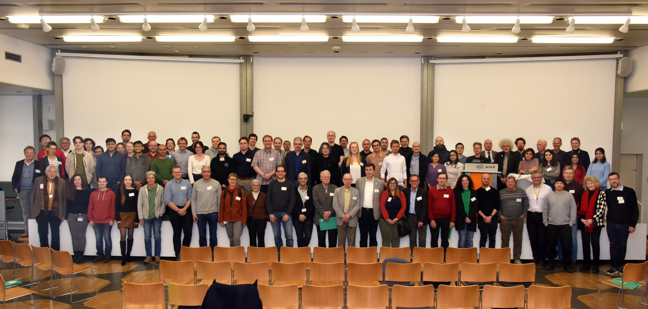
NUSTAR Collaboration
NUSTAR Annual Meeting 2025

Slide 19
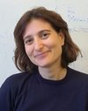
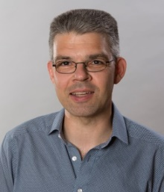
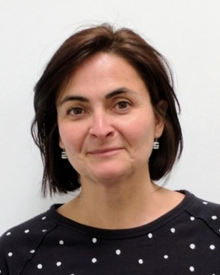
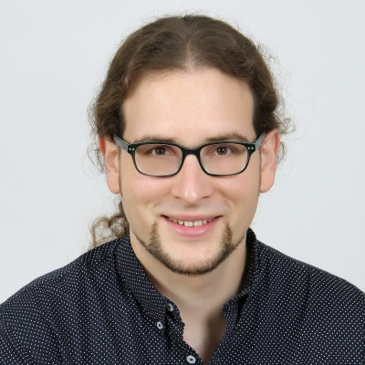
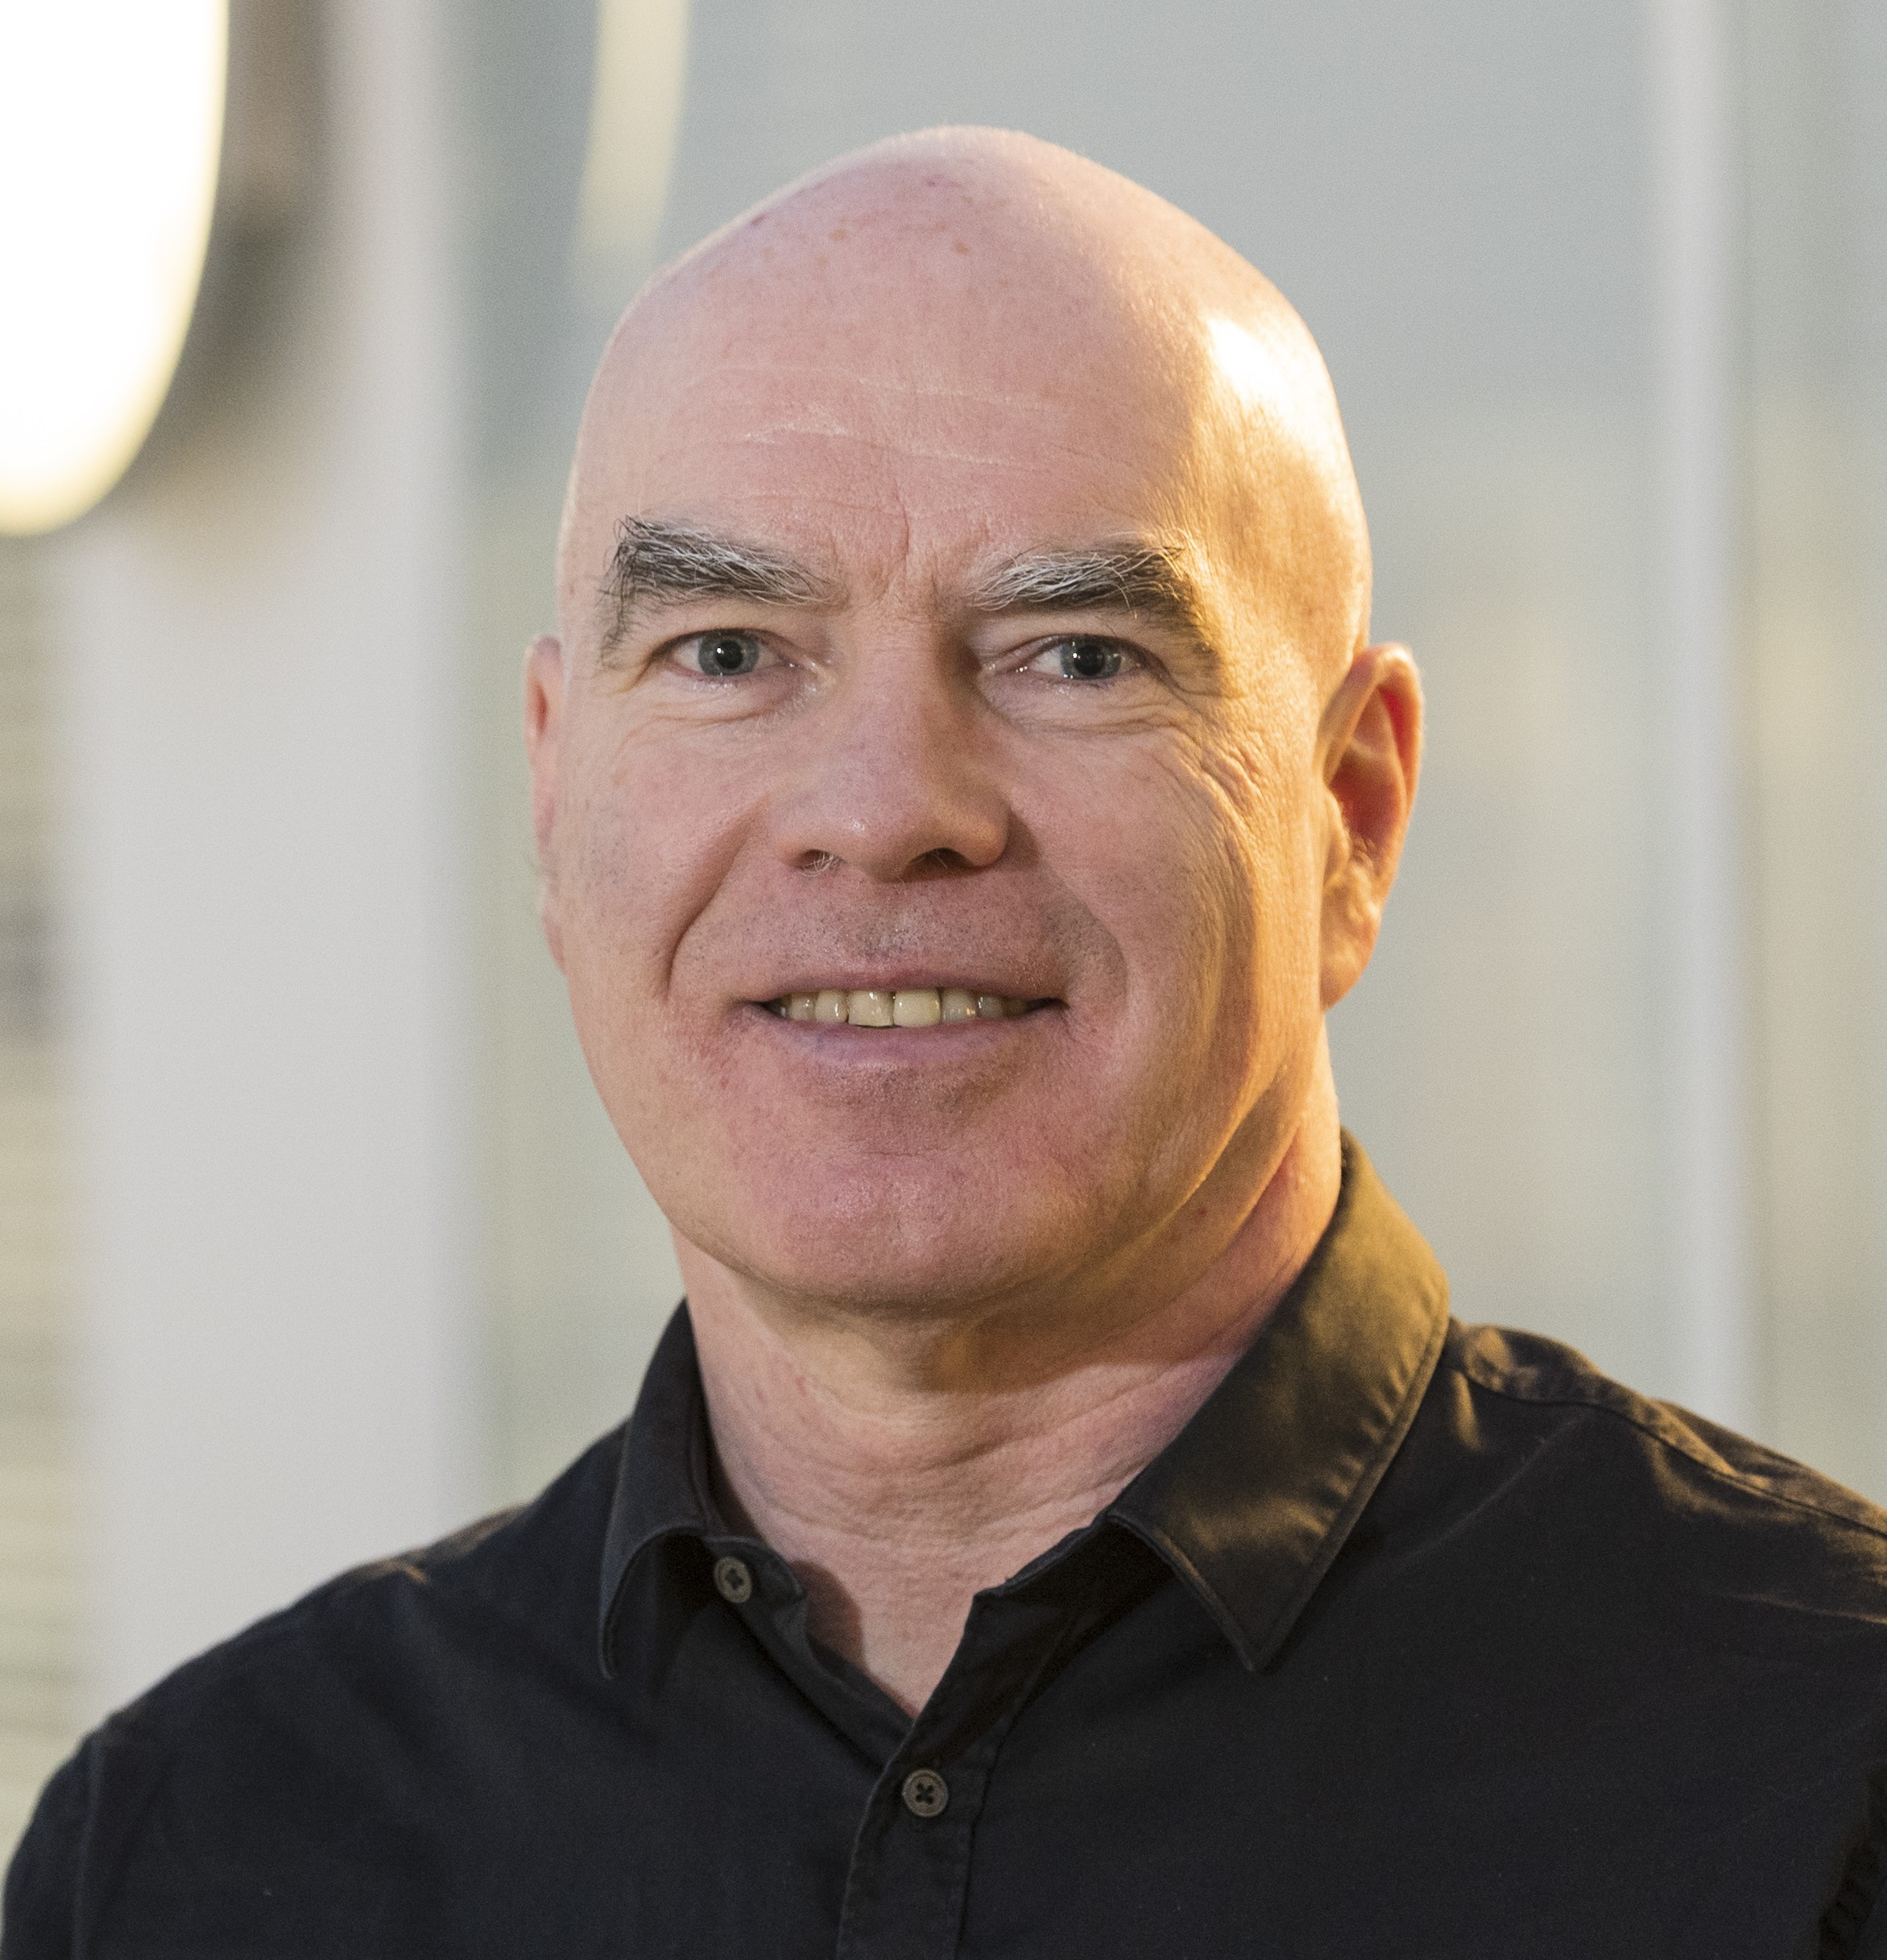
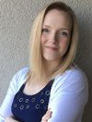
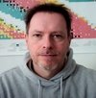
NUSTAR management
Board of Representatives (elected by Collaboration Board)
Giovanna Benzoni
(INFN Milano)
Michael Block
(GSI/HIM/Mainz,
Deputy
Spokesperson)
Lola Cortina
(IFIC Valencia)
Timo Dickel
(GSI)
Zsolt Podolyak
(Univ. Surrey,
Spokesperson)
Technical
Coordinator
Resource
Coordinator
Helena Albers (GSI/FAIR)
Alexander Herlert (GSI/FAIR)

Slide 20
NUSTAR project status (score card)

Slide 21
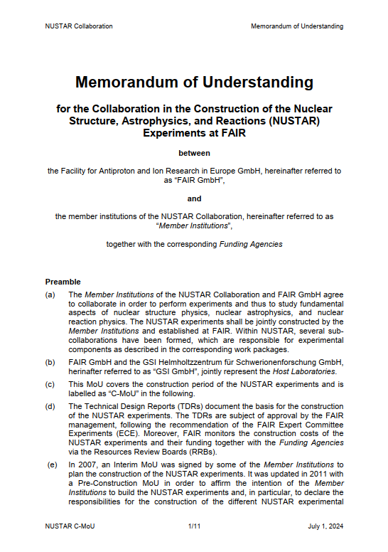
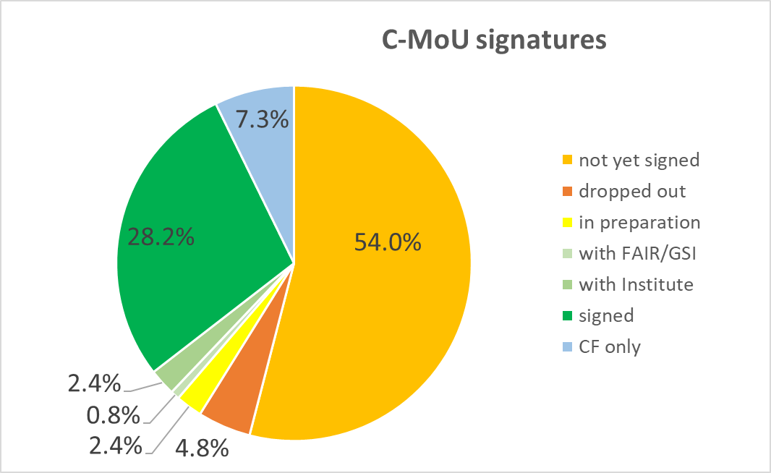
NUSTAR Construction MoU – final version
  Version from July 1, 2024
    Final version – endorsed by funding agencies at 13th FAIR-RRB meeting
    Collection of signatures in progress
Status: April 2025

Slide 22
NUSTAR Construction MoU – final version
  Version from July 1, 2024
    Final version – endorsed by funding agencies at 13th FAIR-RRB meeting
    Collection of signatures in progress
country | share (senior members) | comment / status
Germany | 32.3% | BMBF signed |  | wait for details for some institutes (one signed)
United Kingdom | 9.0% | UKRI-STFC signed
Spain | 7.8% | wait for details
Italy | 7.4% | INFN signed
France | 5.7% | CNRS signed |  | CEA: wait for details
USA | 4.0% | mostly no signature or CF contribution
Japan | 3.8% | wait for details (two signed)
China | 3.6% | wait for details
India | 3.3% | wait for details
Poland | 3.3% | wait for details
Finland | 3.1% | HIP signed
Sweden | 3.1% | VR signed |  | wait for details for some institutes (one signed)
Romania | 2.6% | ISS: signed | IFIN-HH: signed | IFA: wait for signature

Slide 23
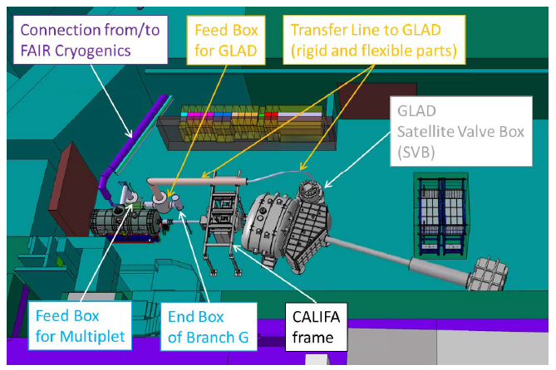
NUSTAR Construction Common Fund (C-MoU)
  About 2 MEUR to be collected for cave infrastructure components
    Call for Funds in progress
Example: Infrastructure for local cryogenics in HEC

Slide 24
FAIR & GSI Integrated Schedule
2024 2025 2026 2027 2028
Beam Time
Beam Time
To be confirmed
Beam Time
To be confirmed
Beam Time
FCC Construction & Procurement of Interior equipment
Equipment
Installation
commissioning
ACC operation
from new FCC
Injector Controls Upgrade: 1st version of new production system
Injector Controls Upgrade: finalization
Controls & BI Digitization UNILAC, SIS18, ESR, Cryring, HEBT
Civil Construction
FAIR Tech. buildings Infrastructure
FAIR Buildings Testing & Commissioning
HBO
Regular Operation of tech. buildings Infrastructure
FAIR Accelerator Procurement & Manufacturing
SFRS-ES
SIS100-FS
FAIR Accelerator Installation
HEBT/SFRS-ES
SIS100-FS
Cryo 2
Commissioning
HEBT-ES HW-Commissioning
Dry-Runs
SFRS HW-Commissioning
ES Beam Commissioning
Dry-Runs
SFRS Cooldown
HEBT & SIS100 -FS HW-Commissioning
FS Beam Commissioning
Dry-Runs
SIS100 Cooldown
Version Q1 2025

Slide 25
FAIR & GSI Integrated Schedule
2024 2025 2026 2027 2028
Beam Time
Beam Time
To be confirmed
Beam Time
To be confirmed
Beam Time
FCC Construction & Procurement of Interior equipment
Equipment
Installation
commissioning
ACC operation
from new FCC
Injector Controls Upgrade: 1st version of new production system
Injector Controls Upgrade: finalization
Controls & BI Digitization UNILAC, SIS18, ESR, Cryring, HEBT
Civil Construction
FAIR Tech. buildings Infrastructure
FAIR Buildings Testing & Commissioning
HBO
Regular Operation of tech. buildings Infrastructure
FAIR Accelerator Procurement & Manufacturing
SFRS-ES
SIS100-FS
FAIR Accelerator Installation
HEBT/SFRS-ES
SIS100-FS
Cryo 2
Commissioning
HEBT-ES HW-Commissioning
NUSTAR ES Commissioning and experiments
Dry-Runs
SFRS HW-Commissioning
ES Beam Commissioning
Dry-Runs
SFRS Cooldown
HEBT & SIS100 -FS HW-Commissioning
FS Beam Commissioning
Dry-Runs
SIS100 Cooldown
Version Q1 2025

Slide 26
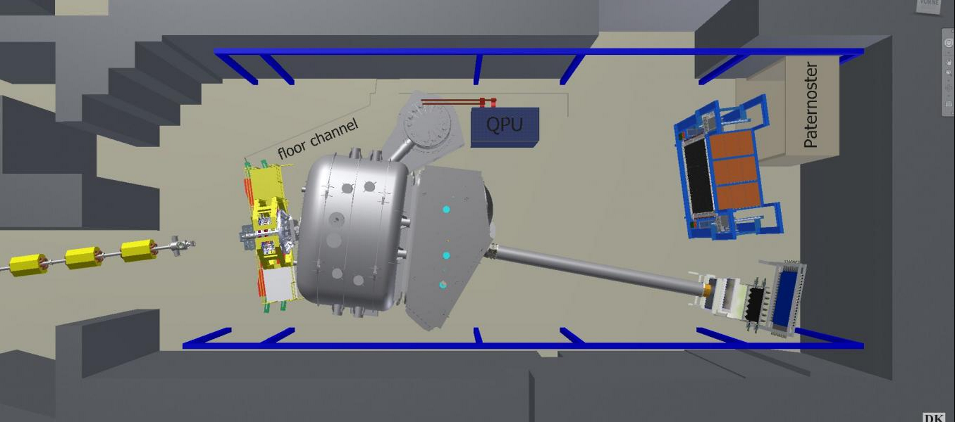
R³B in Cave C of GSI (Phase-0)
Full integration test and experiment runs in Cave-C
Move fully commissioned systems to FAIR High-Energy Cave

Slide 27
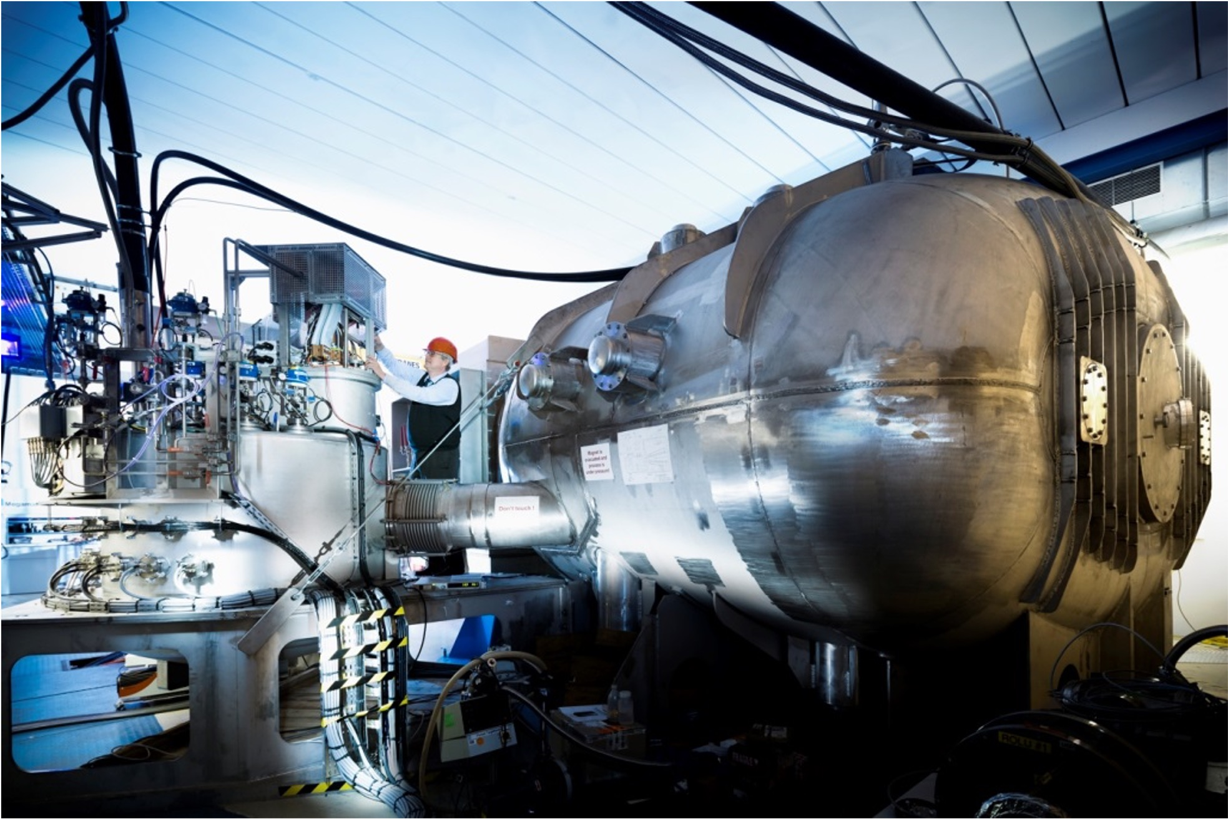
GLAD dipole magnet of R³B
(photo: © J. Hosan)

Slide 28
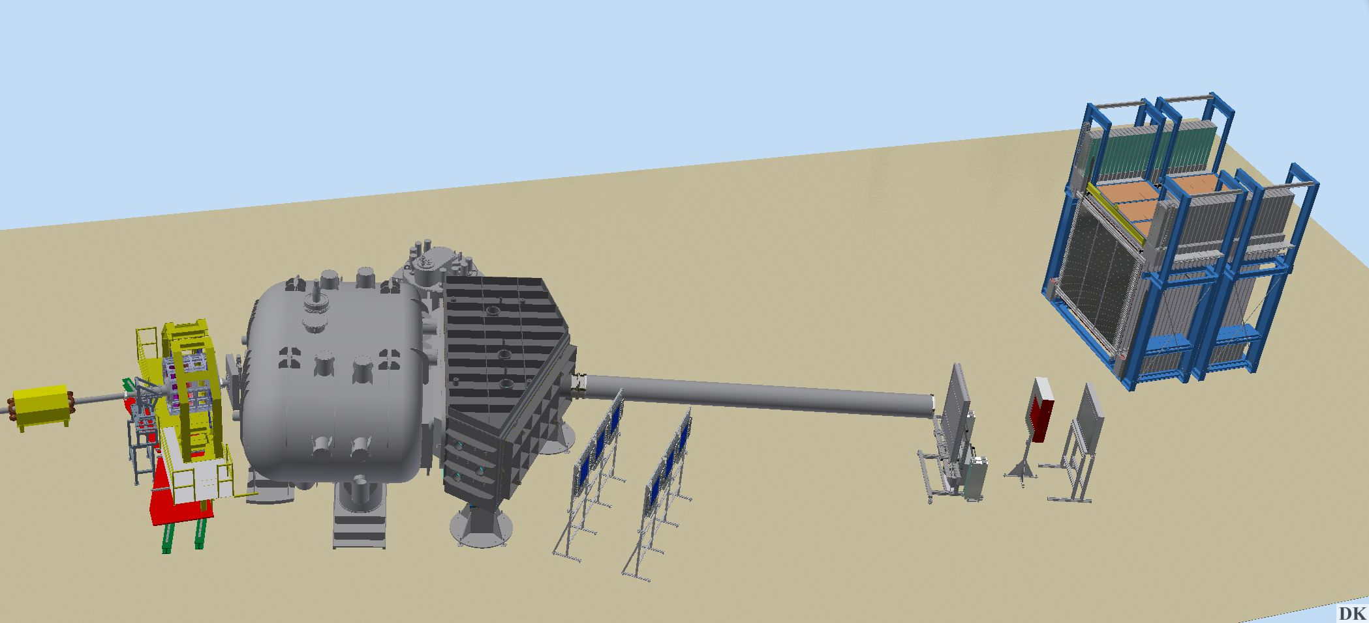
R³B experiment/collaboration
Complete kinematics, fixed target experiment to study Reactions with Relativistic Radioactive Beams with high acceptance, resolution and efficiency
CALIFA
Mechanical Struture
Detection system covering
(90-24 deg polar)
NeuLAND
New support platform
LH₂ target
Up to 15 m
2 m
3 m
See talk:
Lola Cortina
L3T (DSSSD)
GLAD
Delivered in 2016
Fully operational
Tracking detectors
Silicon detectors
Fiber detectors 2019
Gas detectors 2020

Slide 29
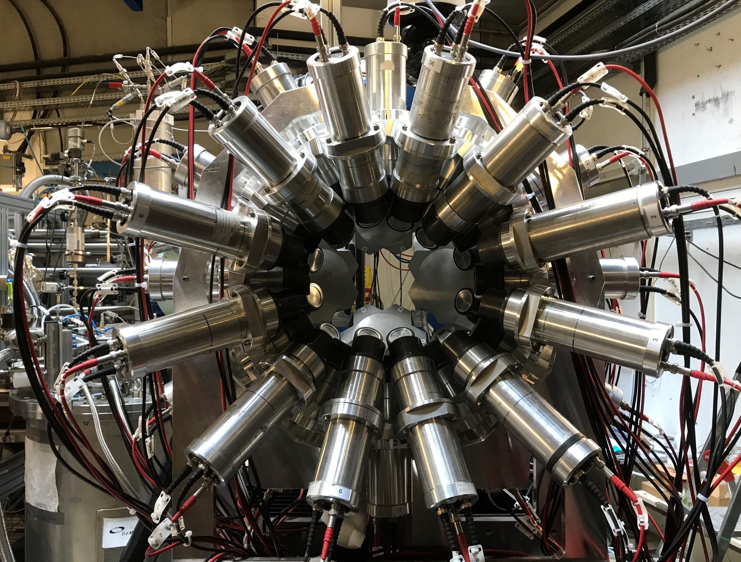
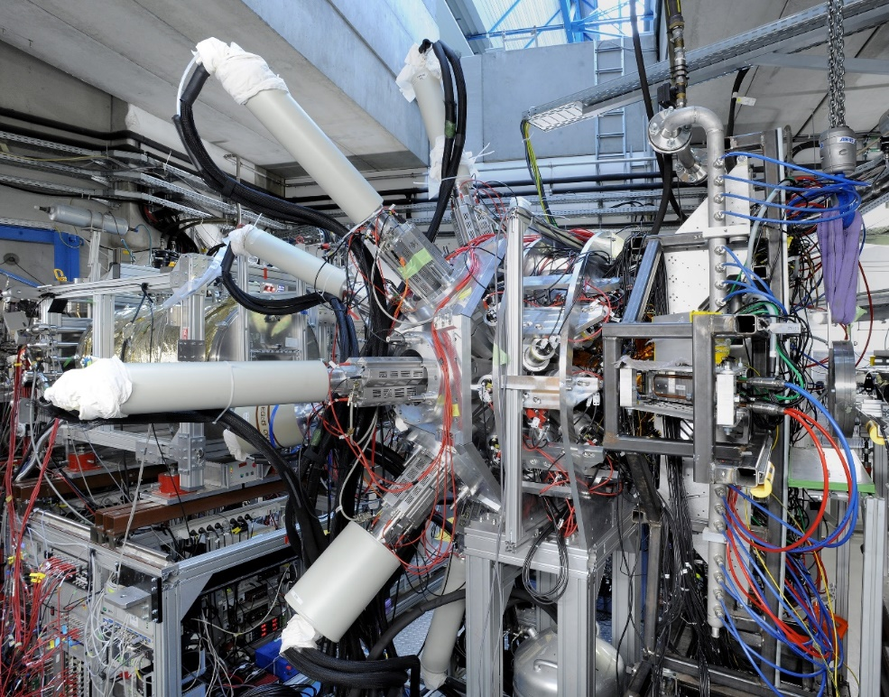
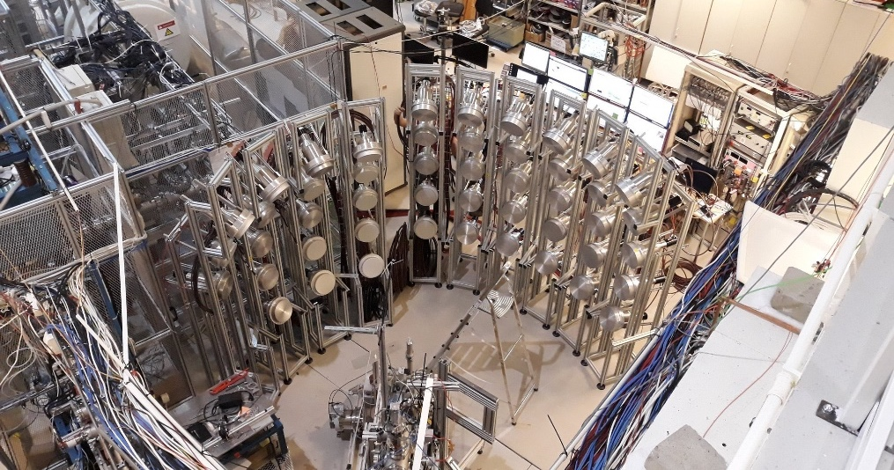
HISPEC/DESPEC Collaboration
FATIMA
Fast timing
array
High-resolution in-flight
and decay spectroscopy
The experiments - various configurations of state-of-the-art detector systems - will address multiple questions in nuclear structure, reactions, and astrophysics.
Complementary information will be obtained by means of high-resolution in-flight spectroscopy (HISPEC) and stopped-beam decay spectroscopy (DESPEC) at the FRS of GSI and at the Super-FRS facility at FAIR.
DEGAS
Germanium
detector
array
MONSTER
Neutron
detector

Slide 30
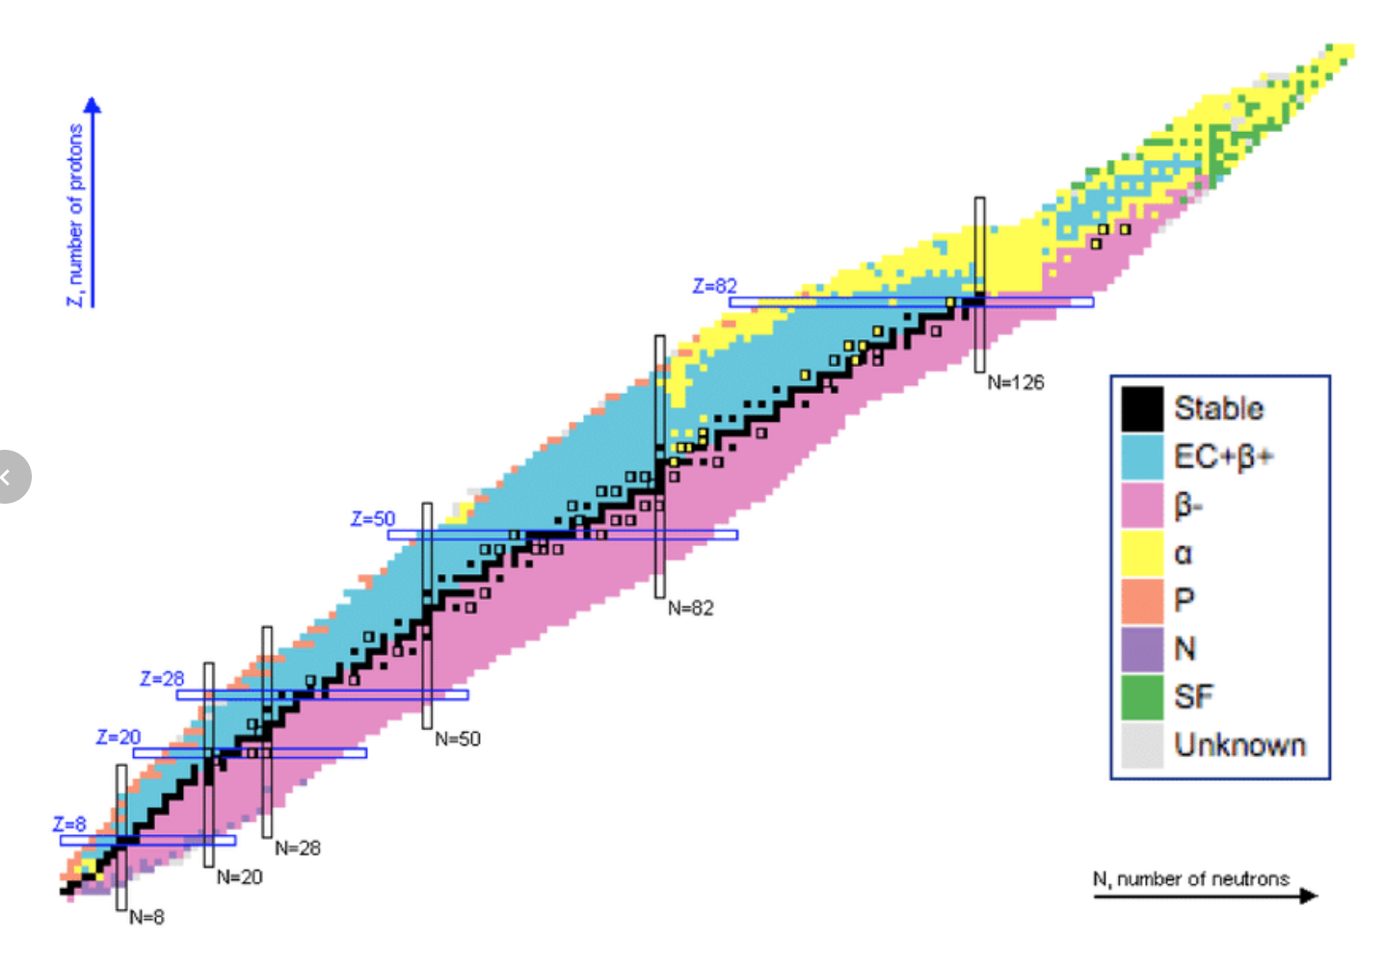
HISPEC/DESPEC physics goals
Shedding light on the evolution of shell structure and exotic nuclear shapes in uncharted nuclear territory
Spectroscopic information for the nucleosynthesis of heavy nuclei
  GSI/FAIR provides unique opportunities for key N~126 nuclei
Towards a full picture of the beta-decay process around third r-process peak
Nuclear structure around ¹⁰⁰Sn (and ¹³²Sn)
Close to ¹⁰⁰Sn
Comprehensive decay information from key nuclei at secondary beam yields as low as
  one ion per hour
Sensitive to nuclear lifetimes spanning
  13 orders of magnitude (10ps-100s)
Measurement of
  any mode of nuclear decay
Crossing N=126
Rare-earth region
See talk:
Jürgen Gerl
30

Slide 31
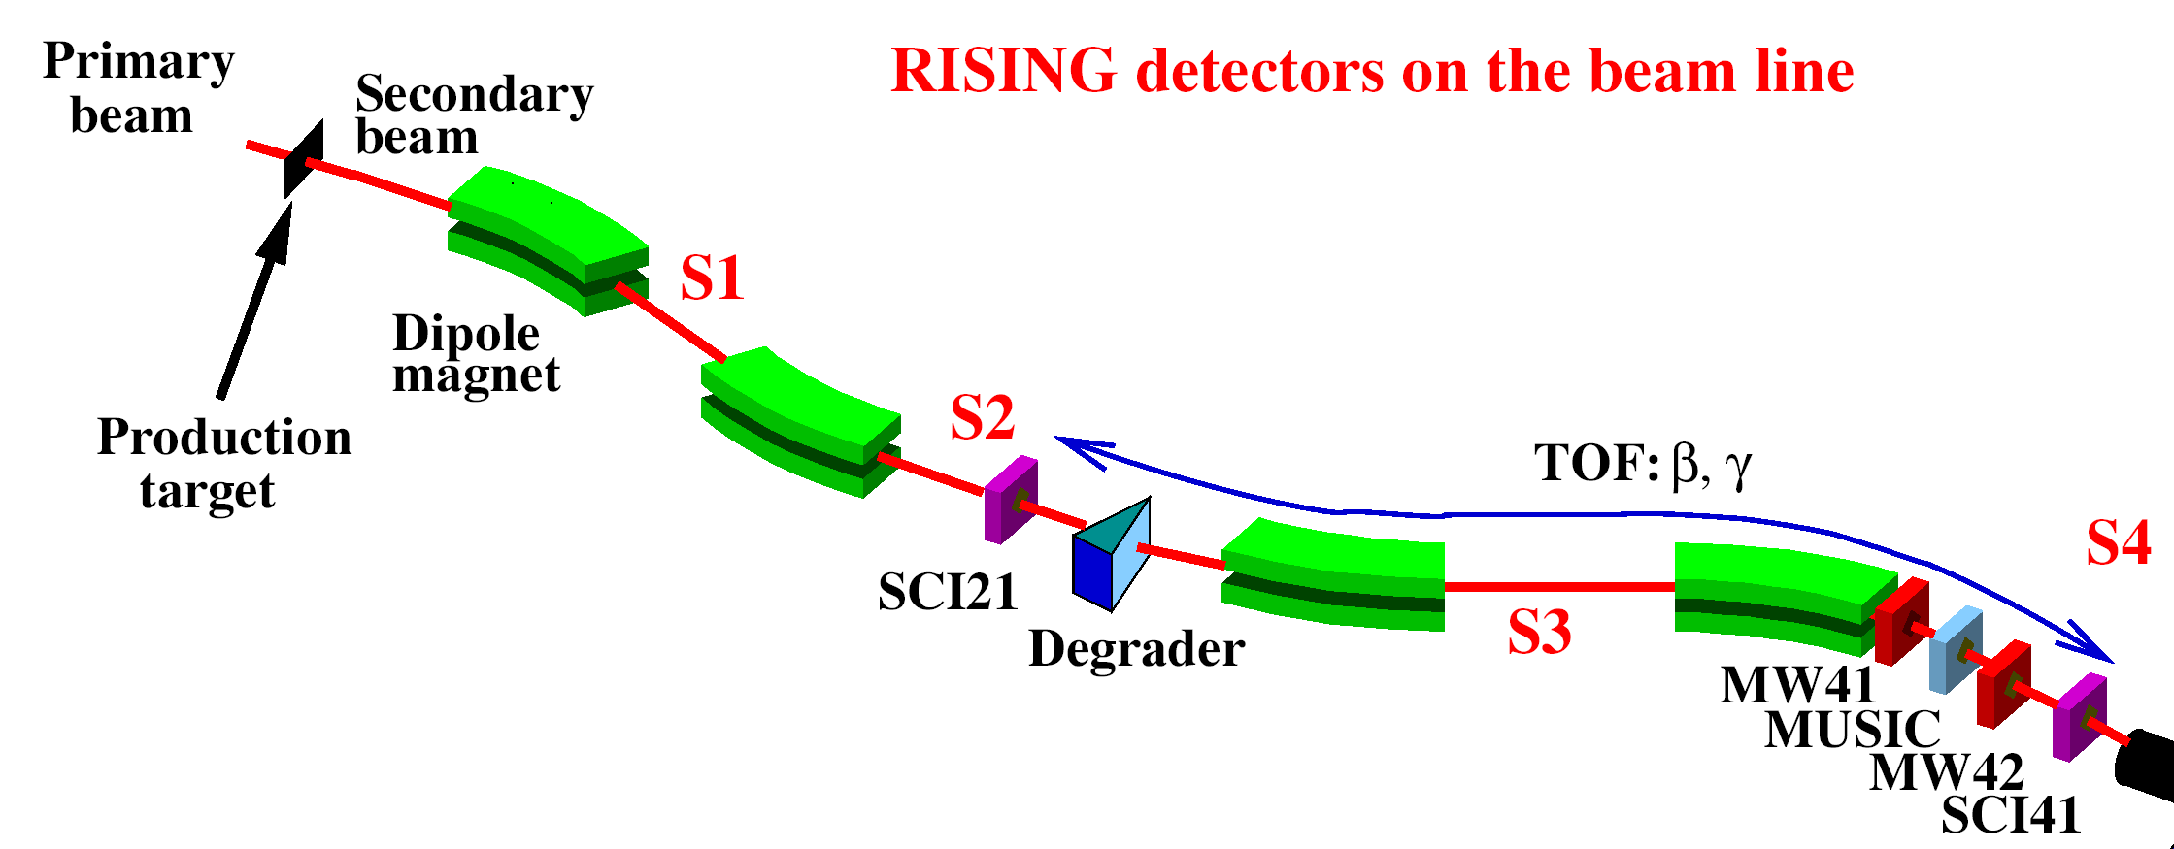
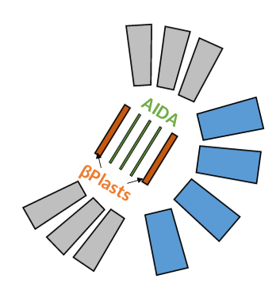
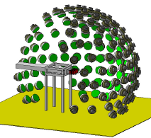
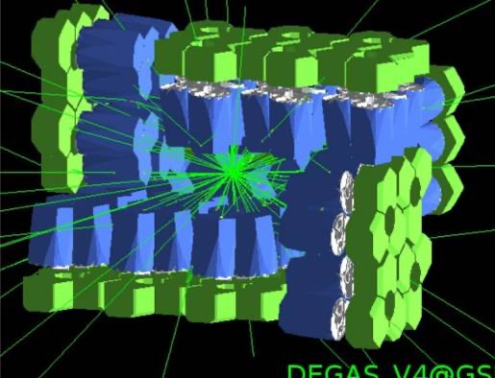
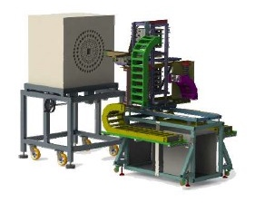
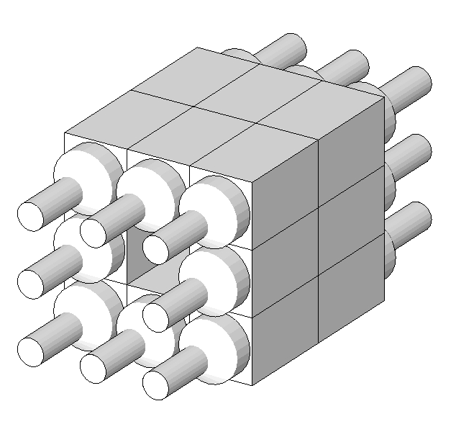
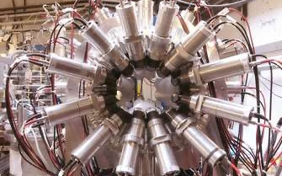
DESPEC Setup Overview
Exotic beams delivered by the FRagment Separator (FRS)
Ions stopped inside DESPEC setup
Flexible, modular detector suite tailored to physics goals
A.K. Mistry et al., The DESPEC
setup for GSI and FAIR,
NIM A, 166662 (2022)
The MOdular Neutron
SpectromeTER (MONSTER)
BEta-deLayEd Neutron
detector (BELEN)
48 ³He cylindrical counters
DESPEC
Ge Array
Spectrometer
(DEGAS)
Decay Total Absorption
γ-ray Spectrometer (DTAS)
NaI(Tl) modules
FAst TIMing Array
LaBr₃(Ce) modules
(FATIMA)

Slide 32
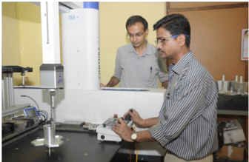
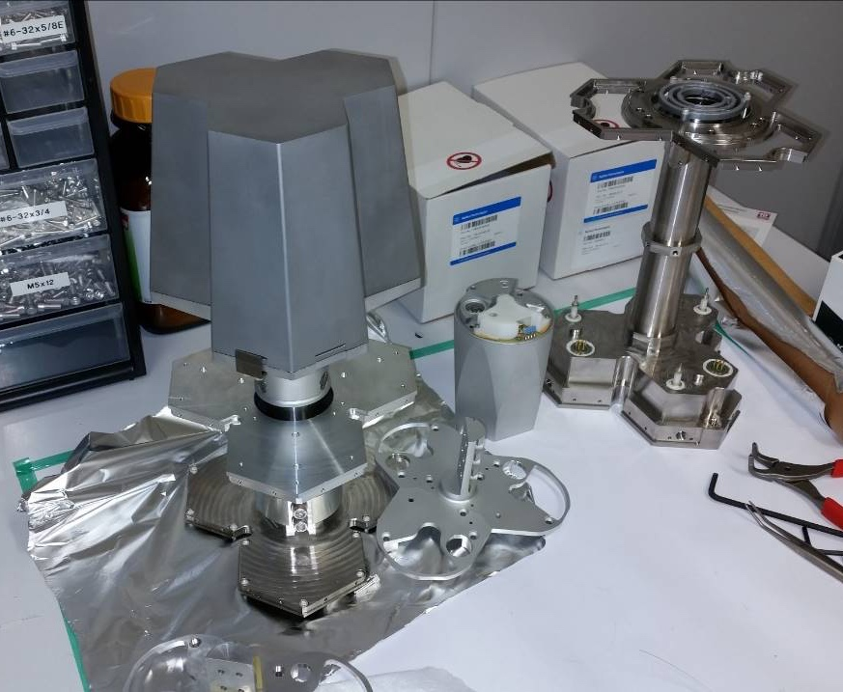
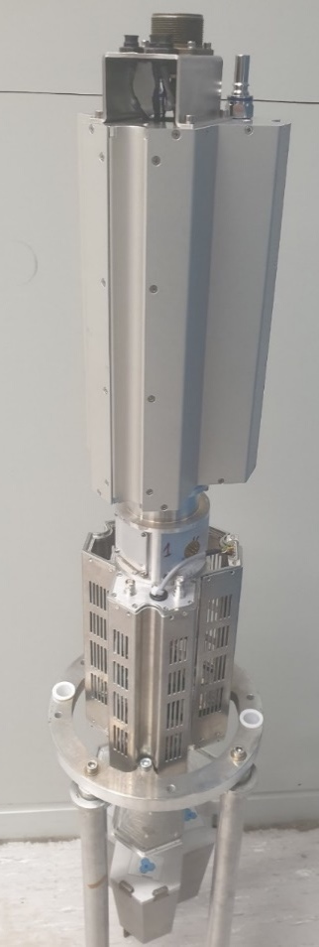
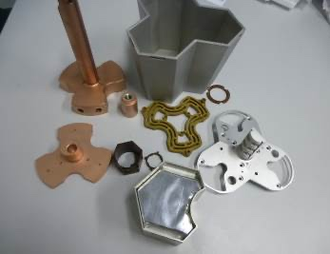
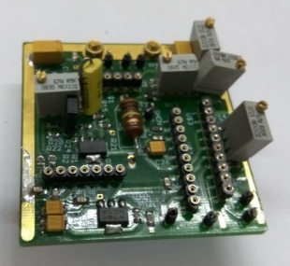
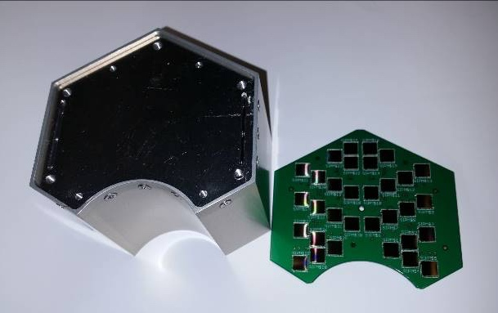
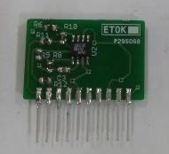
DEcay GAmma Spectrometer - DEGAS
Technological challenge:
Encapsulated HPGe crystals in a cryostat with electrical cooling.
Minimal thermal losses
High vacuum
Integrated front-end and control electronics
Imaging capability
...
Complex components
Ge detector head
Pre-amp + HV unit
BGO with SiPM readout
GSI - Germany
TIFR/Univ. Delhi - India
JSI - Slovenia
Notes:
Important for our understanding of the shell evolution at N=126 and to provide more robust theoretical predictions on the properties of the r-process path N~126 nuclei

Slide 33
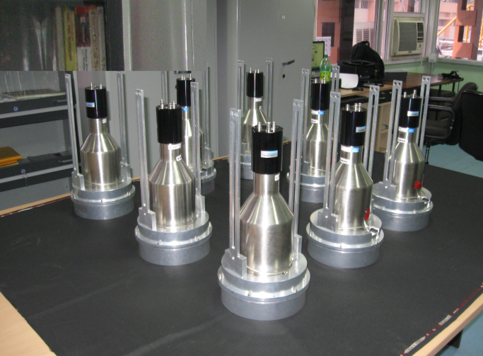
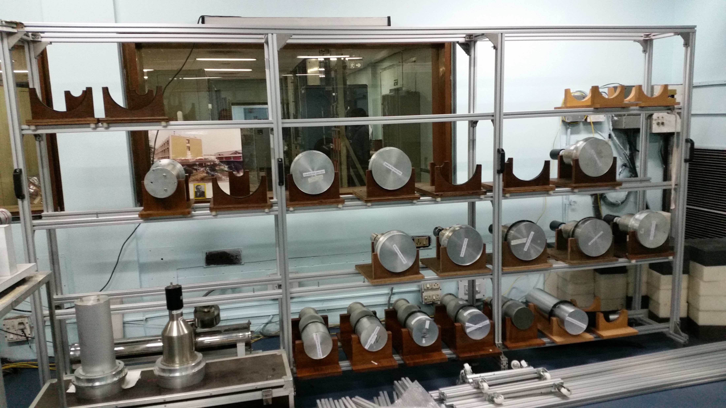
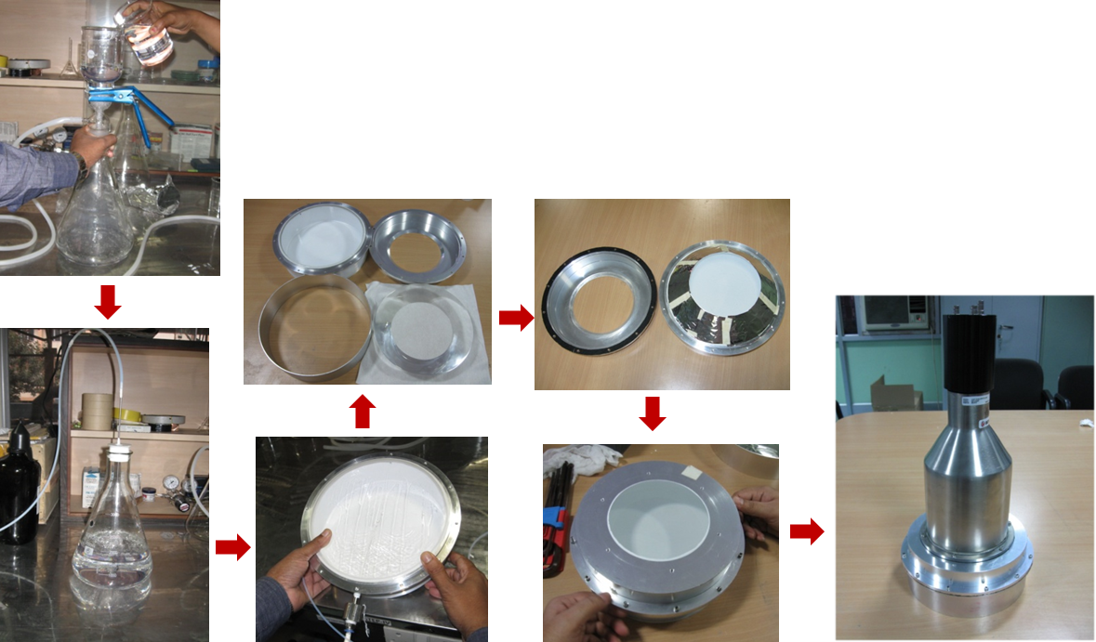
MOdular Neutron SpectromeTER - MONSTER
MONSTER for DESPEC@ FAIR
100 (8″×2″) Liquid scintillator based ToF detectors
Excellent time resolution
Versatile mechanical set-up
15 detector units made by VECC and in use
CIEMAT - Spain
VECC Kolkata – India
Univ. Valencia – Spain
JYFL Jyväskylä - Finland
Goal: Energy spectra of β-delayed neutrons using β-γ-n coincidences in most exotic nuclei

Slide 34
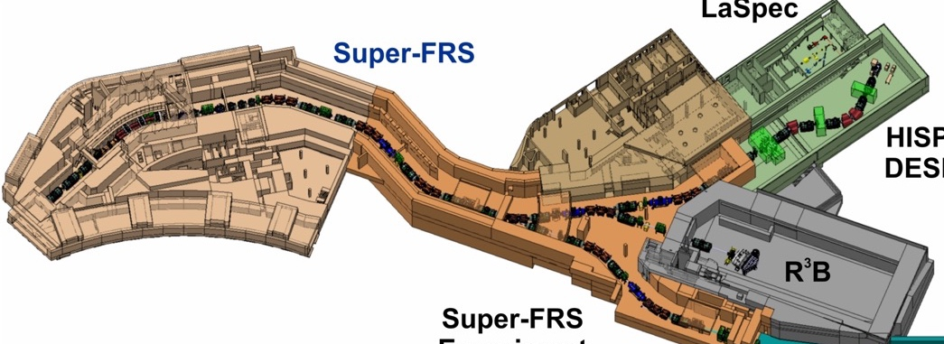
Overview of ES/FS at the Super-FRS
Key focal planes of the Super-FRS:
  FMF2 mid-point of Super-FRS main separator
  FHF1 (Super-FRS tunnel)
  and FHF2 (HEC) along high-energy branch
FHF1
FHF1 area inside
S-FRS tunnel
FHF2
FMF2
HEC

Slide 35



NUSTAR High-Energy Cave
Cave C at GSI
25m x 10m = 250 m²
HEC at FAIR
60m x 20m = 1200 m²
January 2025

Slide 36

Early Science setups: R³B in the HEC
CALIFA with 832 new crystals in the Backward Barrel
GLAD with new control system
PAS with full angular coverage and operation in vacuum
New beam diagnostic
NeuLAND significantly more double-planes
LH₂-target with different piping and safety system
New HI Fiber tracker
TRT with new barrel geometry and 4 x more acceptance
TOF-D with a new in vacuum operation
FOOT in-beam tracker with new electronics
Courtesy: R. Gernhäuser, R³B

Slide 37

NUSTAR Strategy towards Early Science
Handover “cave ready for installation”
HE Cave Handover from Super-FRS
NUSTAR Strategy towards Early Science
As soon as HEB cave is “empty”, handover MS from Super-FRS, installation of R³B can start
Mobile wall
Cryo Distribution Line
Local Cryo
Racks and cables (machine)
Multiplet (inc. connections to media)
Experiment Infrastructure
GLAD
CALIFA
Network
NEULAND
Closing of outside wall
Relocation of GLAD to High-Energy Cave takes ~ 12 months
Courtesy P. Hofmann
*Estimated dates - details being worked out in LCM Workshops

Slide 38

NUSTAR High-Energy Cave (HEC)
NeuLAND
ToF chamber
GLAD
CALIFA
© GSI/FAIR, Zeitrausch

Slide 39

First NUSTAR experiment at FAIR (2028)
R³B setup in the high-energy cave
Focusing on:
  Neutron skin measurements
  Fission
Make use of improvements:
  Super-FRS transmission
  Maximum gain for light to
  medium-heavy nuclei
  Cleaner beams
R³B specific improvements
  longer TOF => identification to high mass
  better angular resolution
Notes:
Needs commissioning (many things can be done before in Cave C):
-new tracker recoil detector; -new proton arm spectrometer; -new vacuum system for TOF wall; -new fibre tracker; Major improvement: longer TOF=> higher mass; also better angular resolution
Supper FRS: main gain in medium-heavy Ca-Sn

Slide 40
Neutron skin and dipole polarizability
Most precise constraints on the neutron pressure around saturation density from measurements of neutron skins and dipole polarizabilities
Relatively low ²³⁸U intensity
needed
-> sufficient for ~ ¹³²Sn
Elastic scattering
Neutron removal
Isotope shift
Important for the
Understanding of
neutron stars

Slide 41

Fission
Important for r process
measured Z (red) and A (green) fission yields in actinides and pre- actinides together with the neutron-rich (dark blue circles and dots) and other nuclei (light blue circles) that can be investigated at FAIR

Slide 42


Early Science setups in the Super-FRS tunnel
July 2024
FHF1
FHF1 area inside
S-FRS tunnel
HEC

Slide 43





Early Science: Compact setups FHF1/FMF2
Courtesy S. Pietri
Super-FRS EC
Ion Catcher
FHF1
HISPEC/DESPEC Setup
FMF2
FHF1
FMF2
HEC
Super-FRS EC Setups

Slide 44


Gamov-Teller Strength at N=50 and the puzzle of the ¹⁰⁰Sn mass
¹⁰⁰Sn mass:
New results on discrepancy of ¹⁰⁰Sn Q_{EC} values (Hinke et al. [1] and Lubos et al. [2])
  In recent work, Mougeot et al. [3] derive the mass of ¹⁰⁰Sn from mass measurements of ⁹⁹⁻¹⁰¹In and published ¹⁰⁰Sn QEC values
  → value of Hinke et al. is favored
  This work:
  Evolution of shifted two-neutron shell gap at N=50:
  → Value of Hinke et al. [1] is favored.
  Evolution of Gamov-Teller Strength at N=50:
  → Value of Lubos et al. [2] is favored.
First direct mass measurements of ⁹⁸Cd and ⁹⁷Rh with the FRS Ion Catcher
Overall situation unclear,
further experiments required
[1] C.Hinke et al., Nature 486 (2012) 341
[2] D.Lubos at al., PRL 122 (2019) 222502
[3] M.Mougeot et al., Nature Phys. 17 (2021) 1099
A. Mollaebrahimi et al., Physics Letters B 839 (2023) 137833

Slide 45
Next steps and MSV completion …
APPA Laser
SIS100
UNILAC
SIS18
HITRAP
ESR
SPARC
until 2028
CBM
FAIR 2028
CRYRING
PANDA
Super-FRS
APPA Cave
HESR
First Science +
after 2028
Next steps
ILIMA
NUSTAR LEB
MSV completion
NUSTAR HEB
CR

Slide 46



NUSTAR Low-Energy Cave
HISPEC/DESPEC, MATS, and LaSpec
January 2025
LEB cave

Slide 47
Super-FRS Ring Branch and CR storage ring
FAIR MSVC
Super-FRS
CR
ILIMA

Slide 48




“Schottky pickups”
“Heavy ion detector”
ILIMA@CR
Schottky pickups
also horizontal and vertical
Detector pockets
ToF detectors
“ToF detector”
TOF-2
TOF-1
16.8m

Slide 49



Superheavy elements (SHE) at GSI/UNILAC
What are the limits of atomic nuclei and of the periodic table of the element?
Does the structure of the periodic table hold in the heaviest elements?
→ Comprehensive investigation of production and of atomic, chemical, and nuclear properties of “accelerator-only” elements Z ~ 100 – 118.
Detailed studies of and with macroscopically available actinide elements with Z ≈ 90 – 100
120
Atomic number
110
-7
-6
Shell stabilization (MeV)
-5
100
SF
-4
α
-3
Decay mode
β⁺ EC
-2
-1
β⁻
0
Neutron number
140
150
160
170
Notes:
First bullet is activities where the experiments are carried out at GSI, second bullet is activities happening in Mainz / with sources from Mainz.

Slide 50













Laser Spectroscopy of Fermium Isotopes
new methods developed for laser spectroscopy
of the heaviest elements in gas cells
obtained change in nuclear charge radii for 8 fermium (Z=100) isotopes from isotope shifts measured by laser spectroscopy at GSI/ SHIP and JGU Mainz
comparison with theory calculations: smooth trend in charge radii without signatures of nuclear shell effects
$${δ\left\langle r^{2}\right\rangle }^{AA^{′}}=\left(∆ν^{AA^{′}}−\frac{A−A^{′}}{AA^{′}}M\right)\frac{1}{F}$$
J. Warbinek et al., Nature 634 (2024) 1075
Notes:
This slide will also be shown by Tetyana.

Slide 51





Masses of (Super)Heavy Nuclei
TRIGA-TRAP
SHIPTRAP
RIKEN MR-ToF
TRIGA-TRAP
Direct mass spectrometry beyond Z = 92 to map nuclear shell structure evolution
SHIPTRAP
Online with SHIPTRAP at GSI and offline
with TRIGA-TRAP at Mainz
TRIGA-TRAP will move to Super-FRS-LEB at FAIR -> MATS

Slide 52
Conclusion
NUSTAR core components are in operation (e.g. at GSI) as part of FAIR Phase-0
  Scientific results, further tests and commissioning, and training (e.g. of PhD students)
Installation and commissiong of NUSTAR components at FAIR in detailed planning
  Move and installation of equipment to start soon
Further funding of cave and common infrastructure required
  Collection of funds or in-kind via NUSTAR Construction MoU
Start of FAIR (Early Science) with SIS18 beam to Super-FRS target at the end of 2027
  First experiment campaigns in 2028 (R³B, DESPEC, Super-FRS EC)
Additional activities at ESR (ILIMA) and UNILAC (SHE) of GSI

Slide 53
Notes:
3 Oct. Germany unification day

Slide 54



Thank you!

