Slide 1
NUSTAR Physics Opportunities
Jürgen Gerl
GSI/FAIR
Darmstadt, Germany
Theme Meeting on FAIR Science, Chandigarh, 24 April 2025

Slide 2

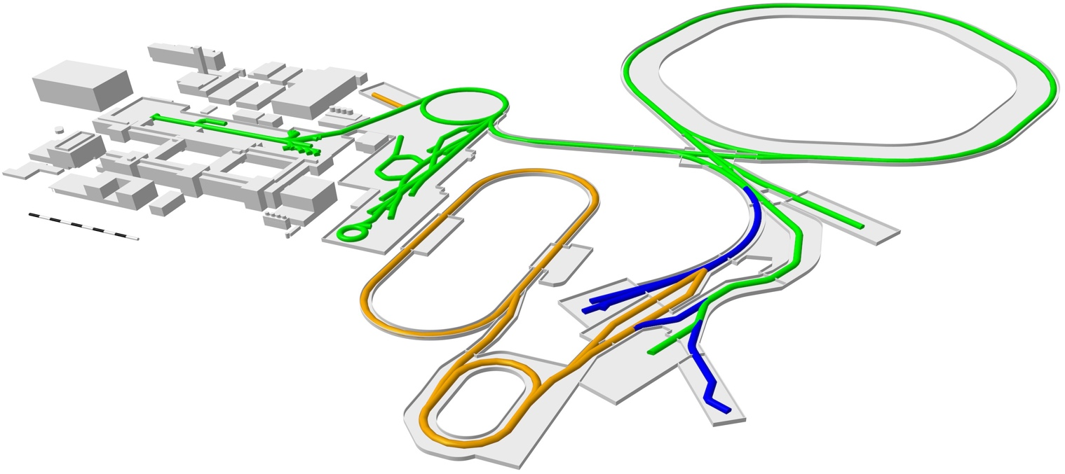
THE GSI/FAIR facility
APPA Laser
SIS100
UNILAC
SIS18
HITRAP
ESR
SPARC
until 2028
Super-FRS
FAIR 2028
CRYRING
PANDA
CBM
APPA Cave
HESR
First Science +
Next steps
ILIMA
MSV completion
CR
after 2028
NUSTAR HEB
NUSTAR LEB
Continuation of APPA, CBM and NUSTAR experiments in existing facility
APPA, NUSTAR and PANDA investigate options for further experiments at green lines

Slide 3
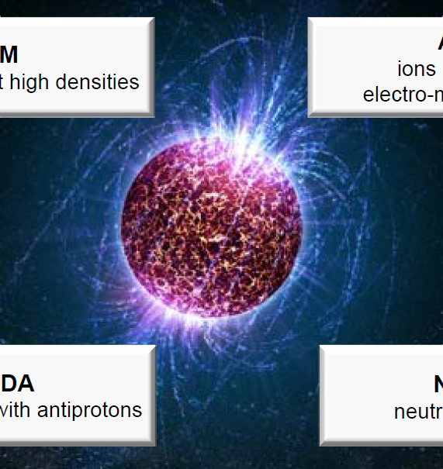
FAIR Scientific Pillars
NUSTAR
Nuclear Structure, Astrophysics and Reactions: Stars and nuclei
(900 scientists)
CBM
Compressed Baryonic Matter:
Inside neutron stars
(500 scientists)
PANDA
Antiprotonen-Annihilation in Darmstadt: Research with anti matter
(500 scientists)
APPA
Physics of Atoms, Plasma and Applications:
From atoms via planets to cancer therapy (720 scientists)

Slide 4
NUclear STructure Astrophysics and Reactions
What are the limits for existence of nuclei?
  Where are the proton and neutron drip lines situated?
  Where does the nuclear chart end?
How does the nuclear force depend on varying proton-to-neutron ratios?
  What is the isospin dependence of the spin-orbit force?
  How does shell structure change far away from stability?
How to explain collective phenomena from individual motion?
  What are the phases, relevant degrees of freedom, and symmetries
  of the nuclear many-body system?
How are complex nuclei built from their basic constituents?
  What is the effective nucleon-nucleon interaction?
  How does QCD constrain its parameters?
Which are the nuclei relevant for astrophysical processes
and what are their properties?
  What is the origin of the heavy elements?

Slide 5
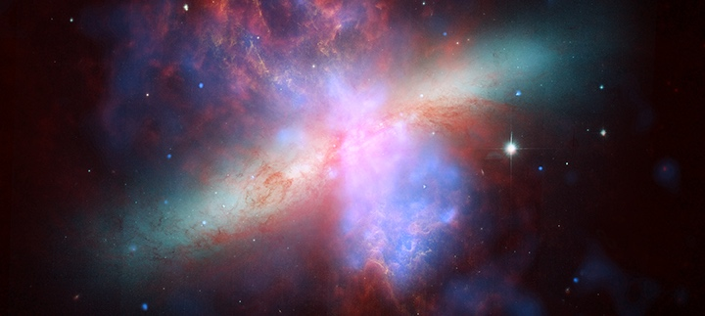
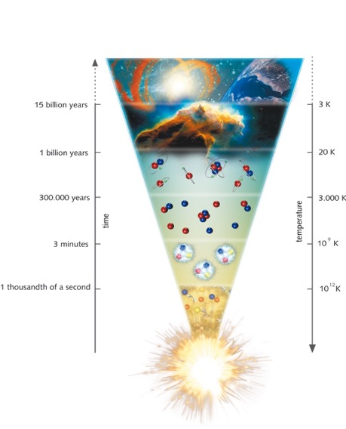
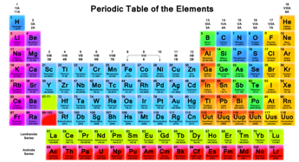

The Universe in the Lab
Example: Synthesis of the chemical elements
Where and how were the heavy elements
made in the universe? ← belongs to the top unanswered questions in physics

Slide 6
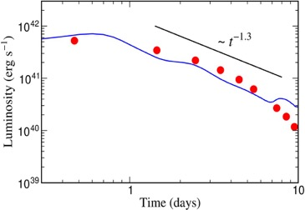
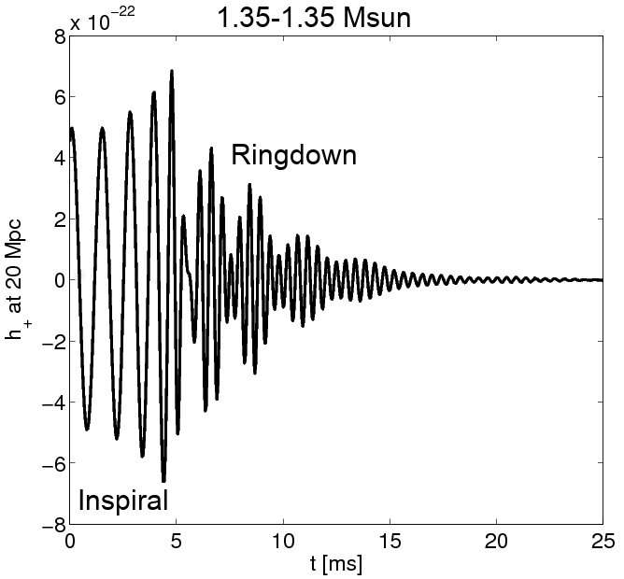
Further push of FAIR science motivation
… by multimessenger study of a neutron-star merger in summer 2017
Theoretical prediction by
GSI researchers (2010):
Neutron star mergers are the astrophysical site of the r-process producing the very heavy elements like Pt, Au and beyond,
thereby exhibiting a characteristic electromagnetic “Kilonova” signal.
Confirmation by Ligo, Virgo and other astronomer groups (2017)
via detection of both
gravitational and electromagnetic waves emerging from such an event.
FAIR was designed to study the properties of neutron star matter and to trace back the production paths of the heavy elements!
Metzger, Martinez-Pinedo, Arcones et al. (2010)
Metzger, Martinez-Pinedo, Arcones et al. (2010)
Cowperthwaite, et al. (2017)
Kilonova observations
Cowperthwaite, et al. (2017)
Kilonova observations
Electromagnetic “Kilonova” Signal
Electromagnetic “Kilonova” Signal
Gravitational Wave Signal

Slide 7

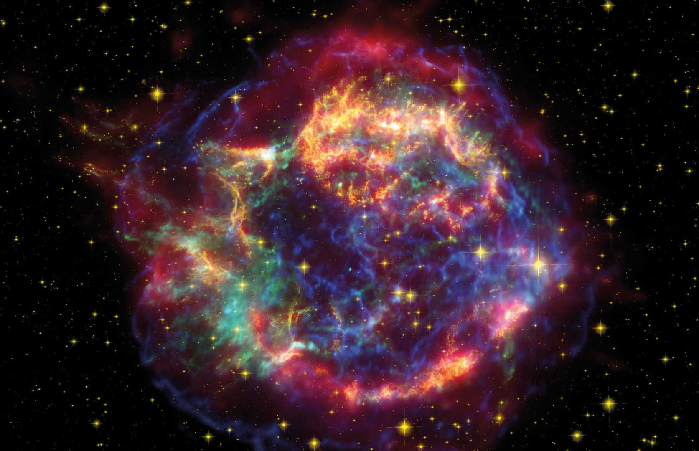
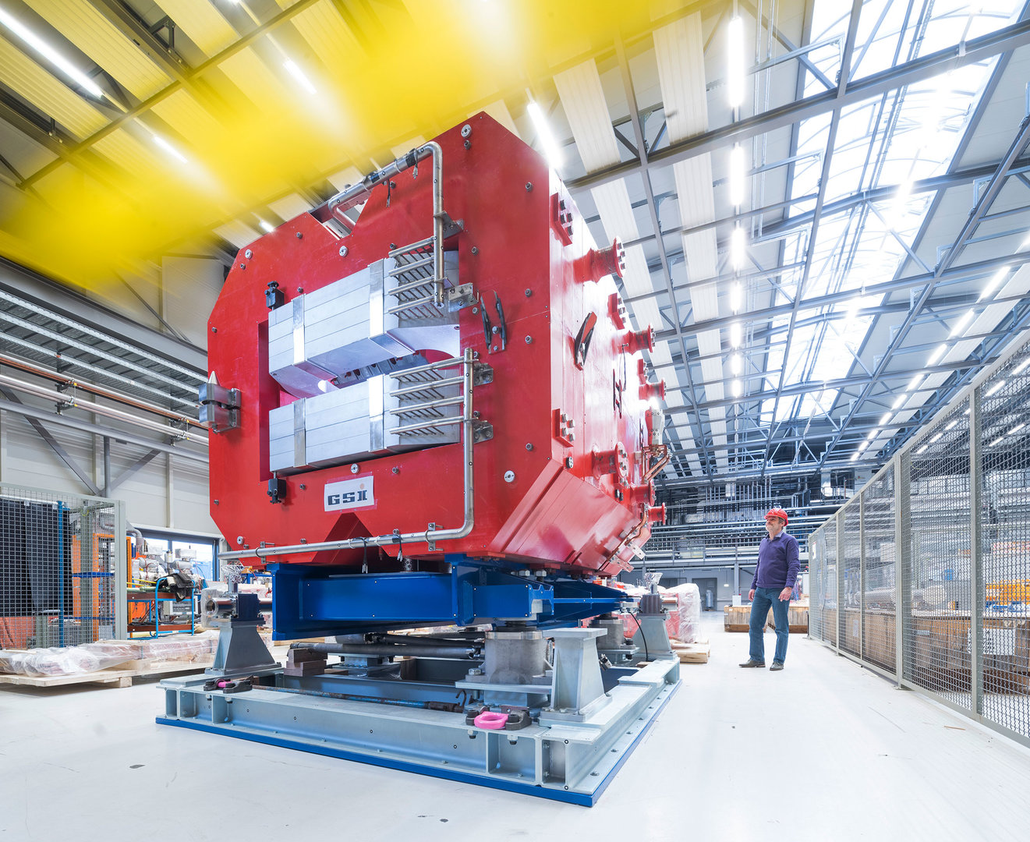
Overarching physics case: the creation of the (heavy) chemical elements
Big physics question requiring information on:
Equation of State
Limits of existence
Lifetimes
Masses
P_{xn} values
Fission
Reactions in star environments
with theory support for impact
Low energy reactions (ESR, CRYRING) ?

Slide 8
NUSTAR – The Project
DESPEC γ-, β-, α-, p-, n-decay spectroscopy
ELISE elastic, inelastic, and quasi-free e⁻-A scattering
EXL light-ion scattering reactions in invere kinematics
HISPEC in-beam γ spectroscopy at low and intermediate energy
ILIMA masses and lifetimes of nuclei in ground and isomeric states
LASPEC Laser spectroscopy
MATS in-trap mass measurements and decay studies
R3B kinematically complete reactions at high beam energy
Super FRS RIB production, identification and spectroscopy
SHE Nuclear physics and chemistry of super-heavy elements
The Approach
Complementary measurements leading to consistent answers
The Collaboration
> 850 scientists
184 institutes
39 countries

Slide 9
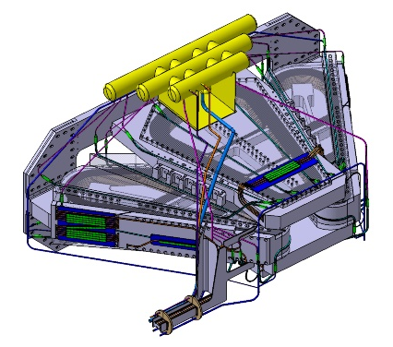
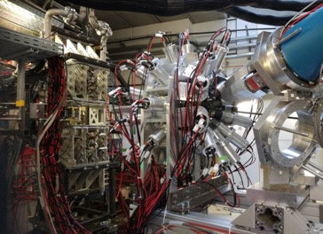
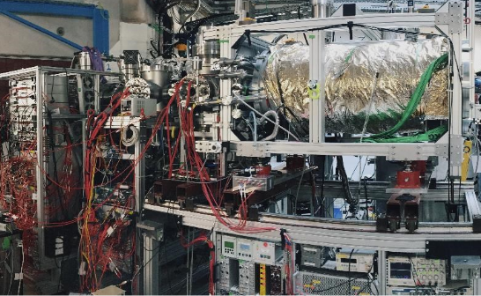
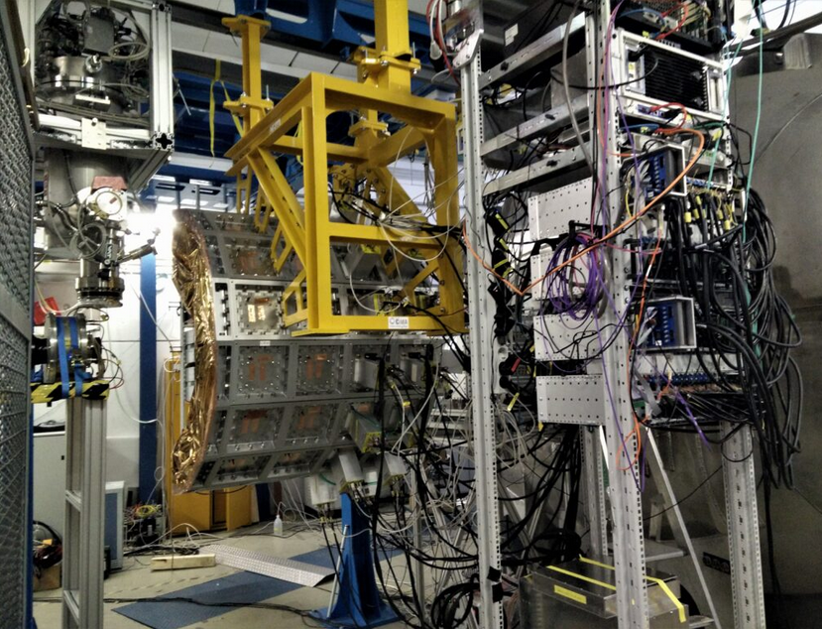
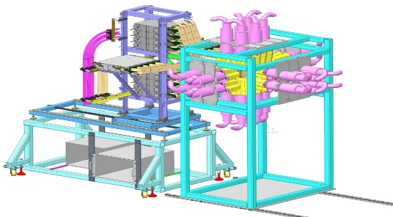
NUSTAR – The Project
Evolutionary approach:
Advancing instrumentation by continuous development and gaining experience by physics exploitation
The Approach
Complementary measurements leading to consistent answers
The Collaboration
> 850 scientists
184 institutes
39 countries
>50 instrumentation sub-projects (MSV)
several 1000 major components

Slide 10
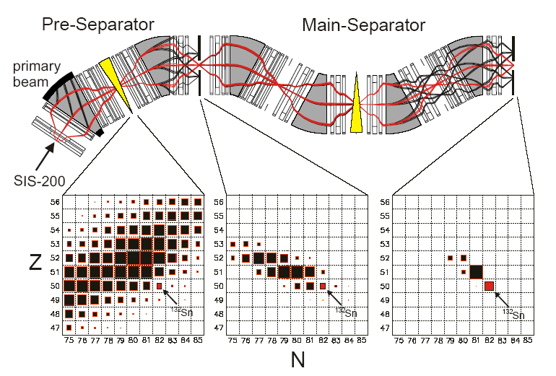
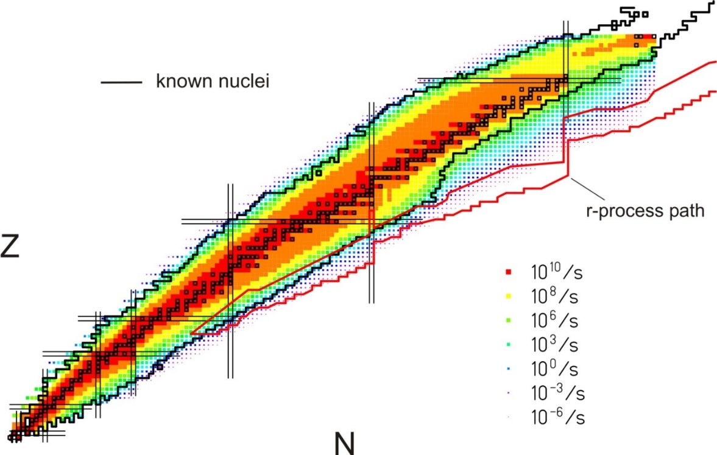
Super-FRS Uniqueness and Competitiveness
High energies for unique separation and unique experiments
Competitive intensities throughout the periodic table
Facility | U beam int. per spill at production target
previously at GSI | 1...2x10⁹
after the SIS18 upgrade at GSI | 8x10⁹
commissioning phase SIS100 | 2x10¹⁰
final full intensity with SIS100 | 3x10¹¹
Q=Z 95%
HIAF

Slide 11
Timeline 2021 –
2021-2022 FAIR-0 experiments (with equipment built for FAIR)
2023 No experiments (but there were tests)
2024-2025 FAIR-0 experiments
2026-2027 FAIR-0 experiments (G-PAC in Feb. 2025)
End 2027 -> Early Science (with SuperFRS)
End 2028 -> First Science (with SuperFRS and SIS100)

Slide 12
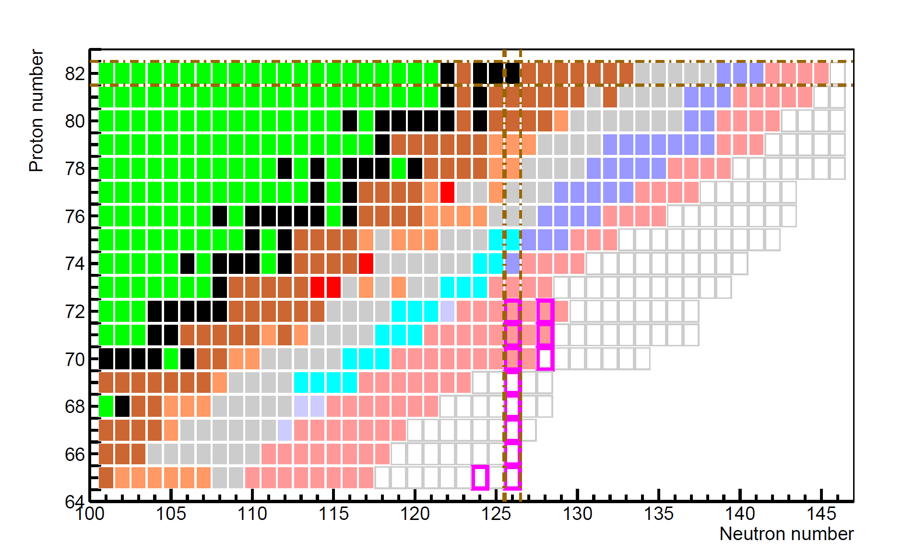
NUSTAR Early Science: New isotopes towards the r-process waiting points at the N=126 shell closure
Understanding the 3rd r-process abundance peak by studying neutron-rich isotopes towards the N=126 shell closure and their ground-state and decay properties
FAIR MSV
First Science
stable isotopes
mass & half-life known
half-life known
mass known
existence known
unknown isotopes
r process waiting point
ES (SIS18 Pb 2x10⁹ /cycle)
FS (SIS100 U 2x10¹⁰ /cycle)
FAIR MSV
Early Science
FAIR MSV
1 atom/d

Slide 13
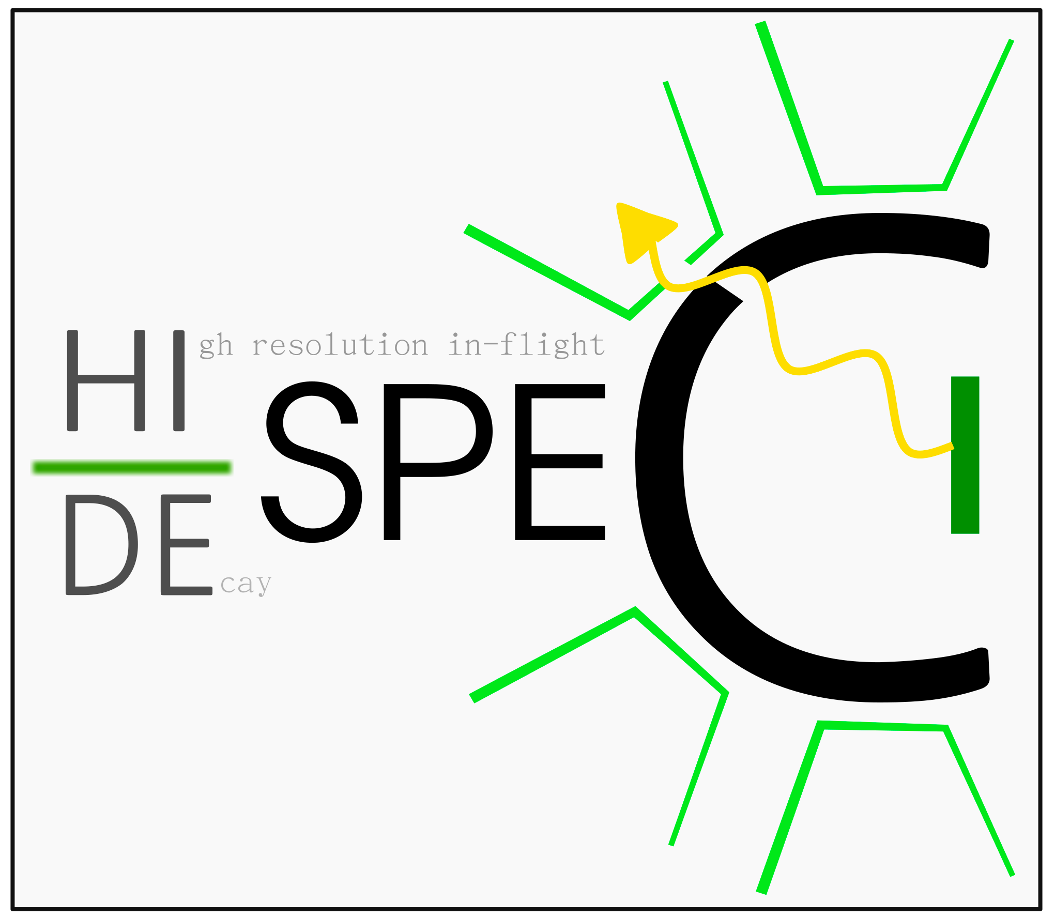
DESPEC Phase-0 Physics Programme
126
Strategic decisions:
-use unique secondary beams from SIS/FRS
-focus on heavy isotopes
-exploit rare earth beams
-employ newly available set-ups
82
50
Structure of nuclei along the N=126 line
Nuclear structure beyond ²⁰⁸Pb
Evolution of collectivity near ²⁰⁸Pb
Shell structure around ¹⁰⁰Sn
Development of nuclear collectivity
M1, E1, E2, E3 strengths
82
50

Slide 14
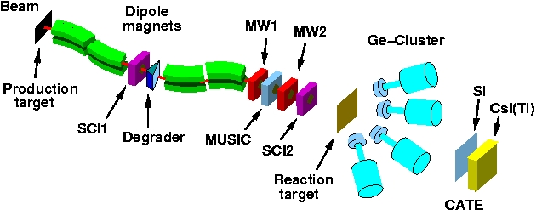
DESPEC: Decay Spectroscopy
production
selection
spectroscopy
identification
implantation
γ detectors
Active
Implanter

Slide 15
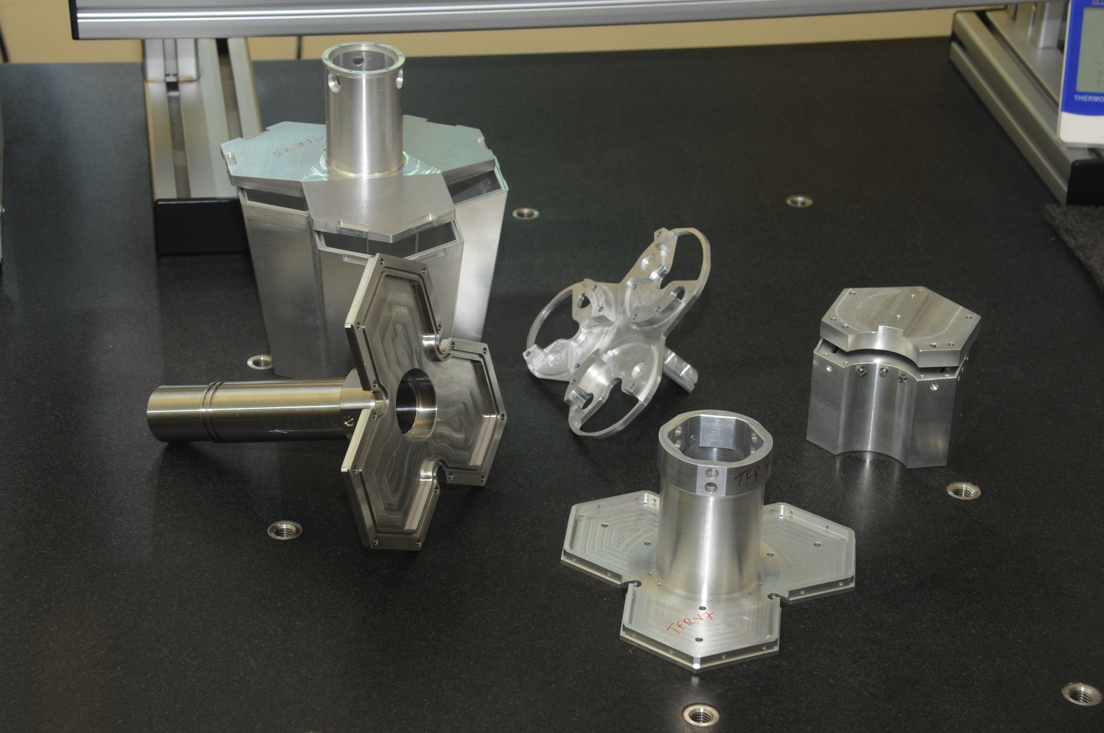
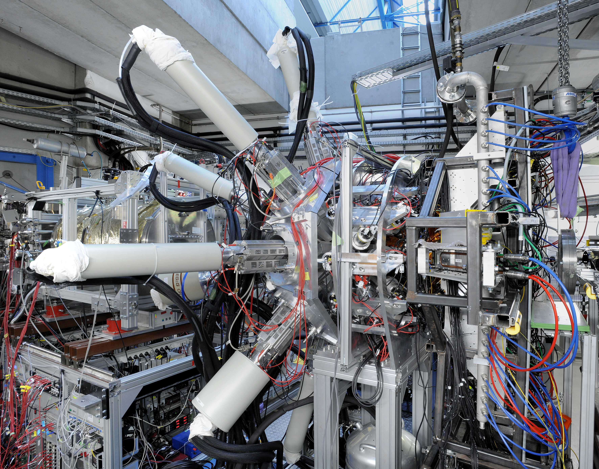
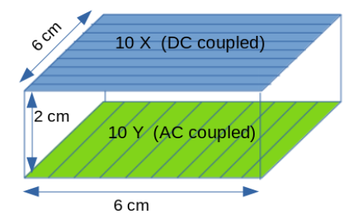
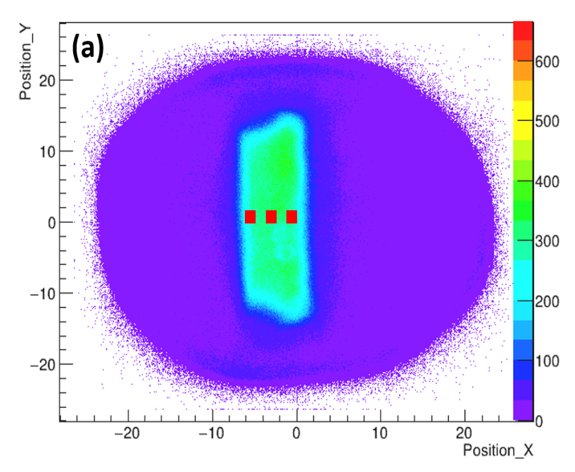
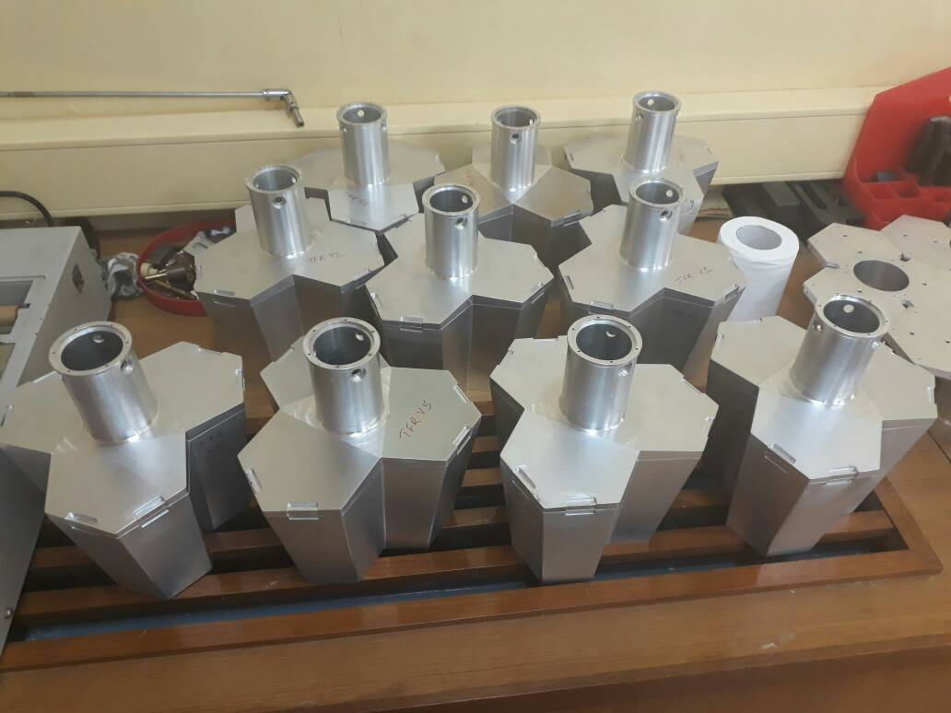
DESPEC: DEGAS γ spectroscopy array
A prototype of DEGAS mechanics made in India has been approved
DEGAS mechanics fabricated in India are used in the Experiment at FAIR
An Implant HPGe Double Sided Strip Detector was used in an experiment at GSI/FAIR
Geant4 Simulation for DEGAS
Several Ph.D students are being trained in R&D related to DEGAS
Active contribution in experiments of DESPEC Collaboration
major contribution
TIFR, Univ. Delhi

Slide 16
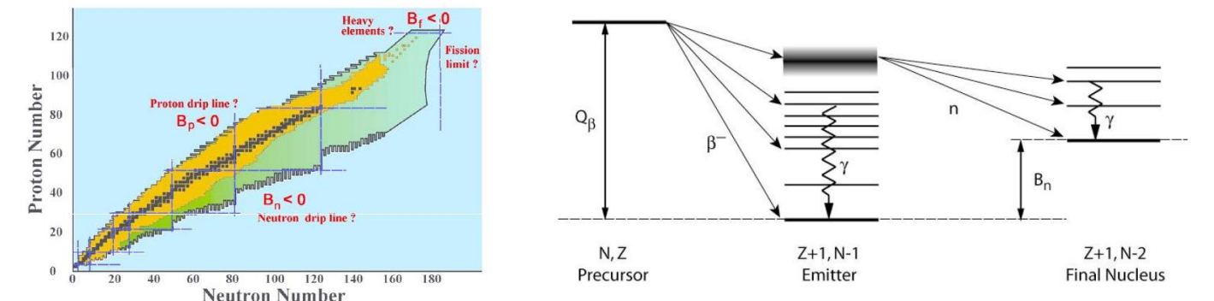
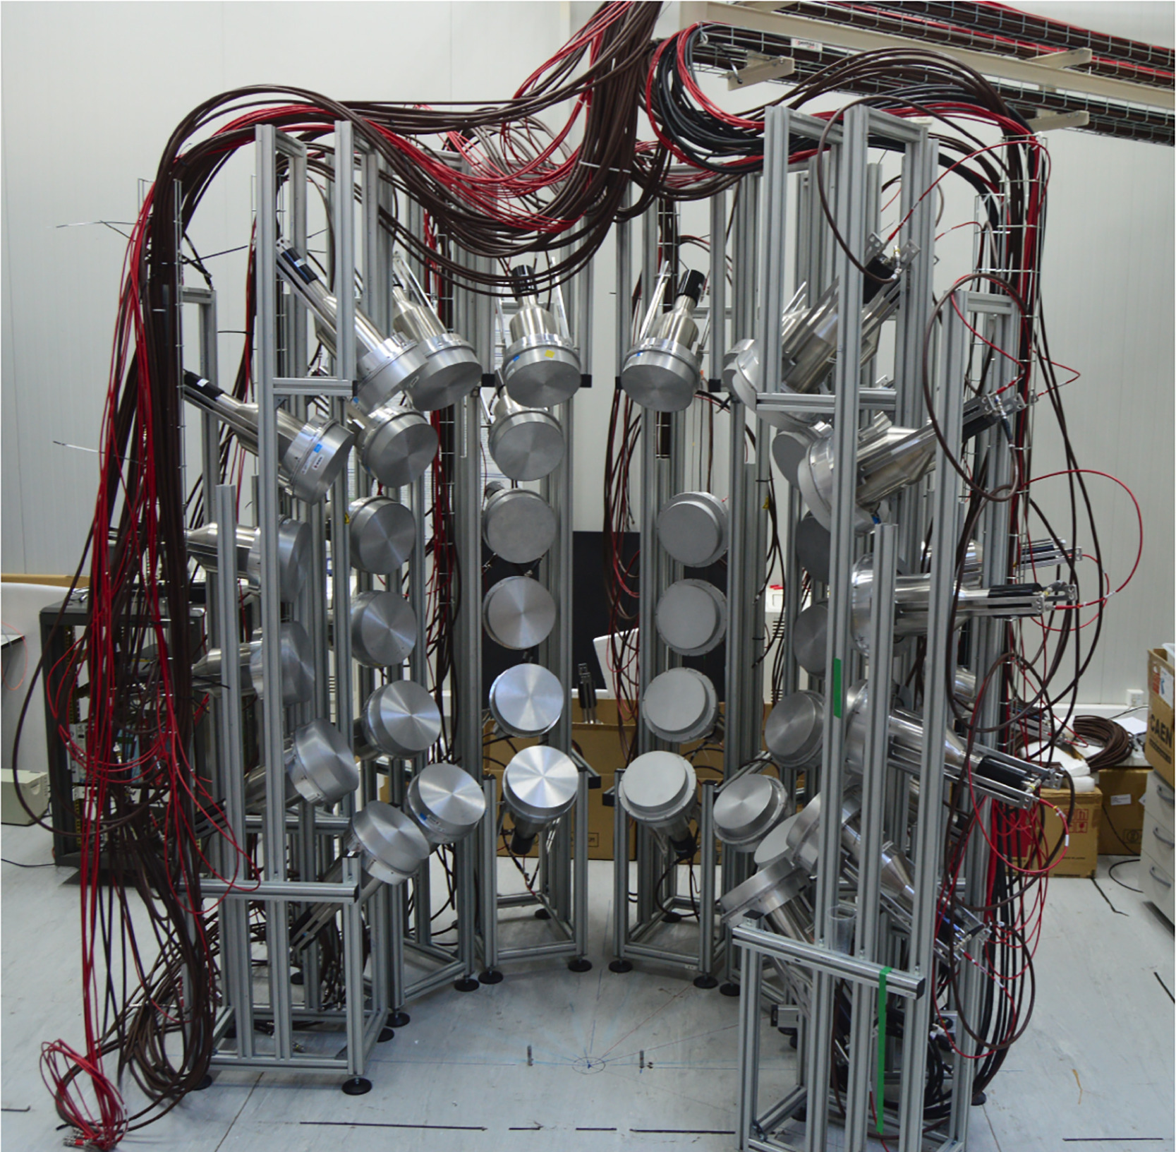
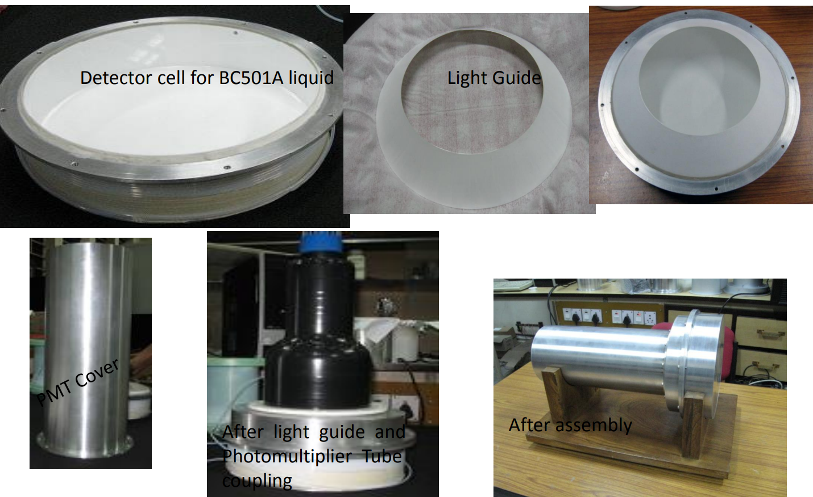
DESPEC: MONSTER neutron ToF array
major contribution
VECC

Slide 17
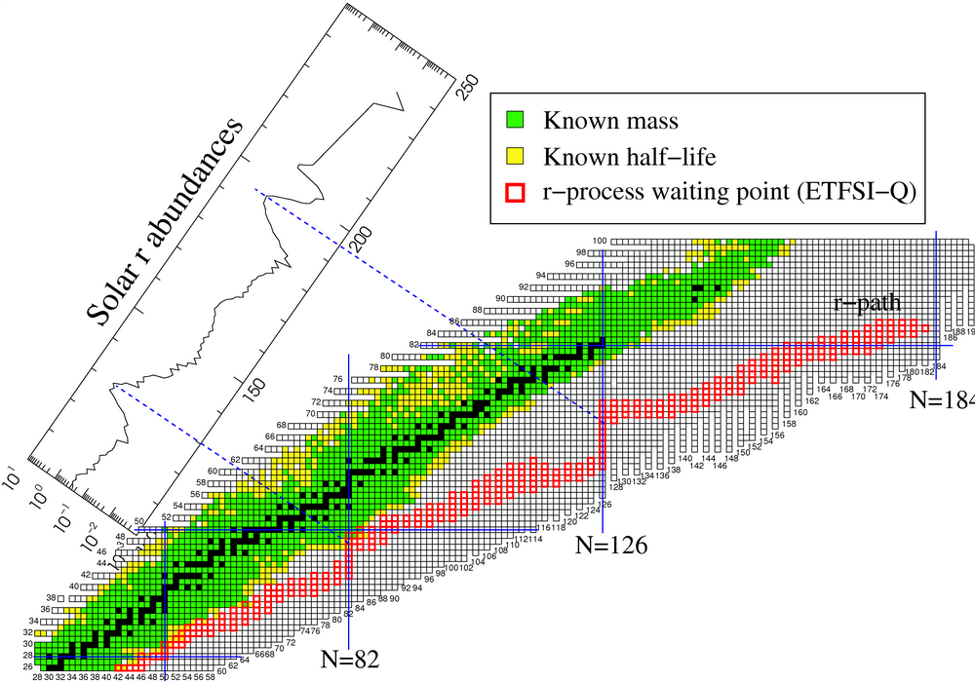
N=126 nuclei and the r-process
Needed:
Masses
Half-lifes
Excited states
Decay properties

Slide 18
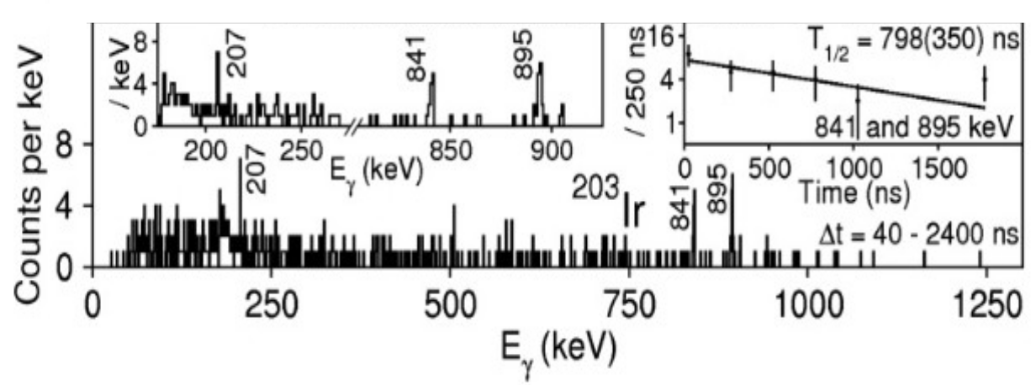
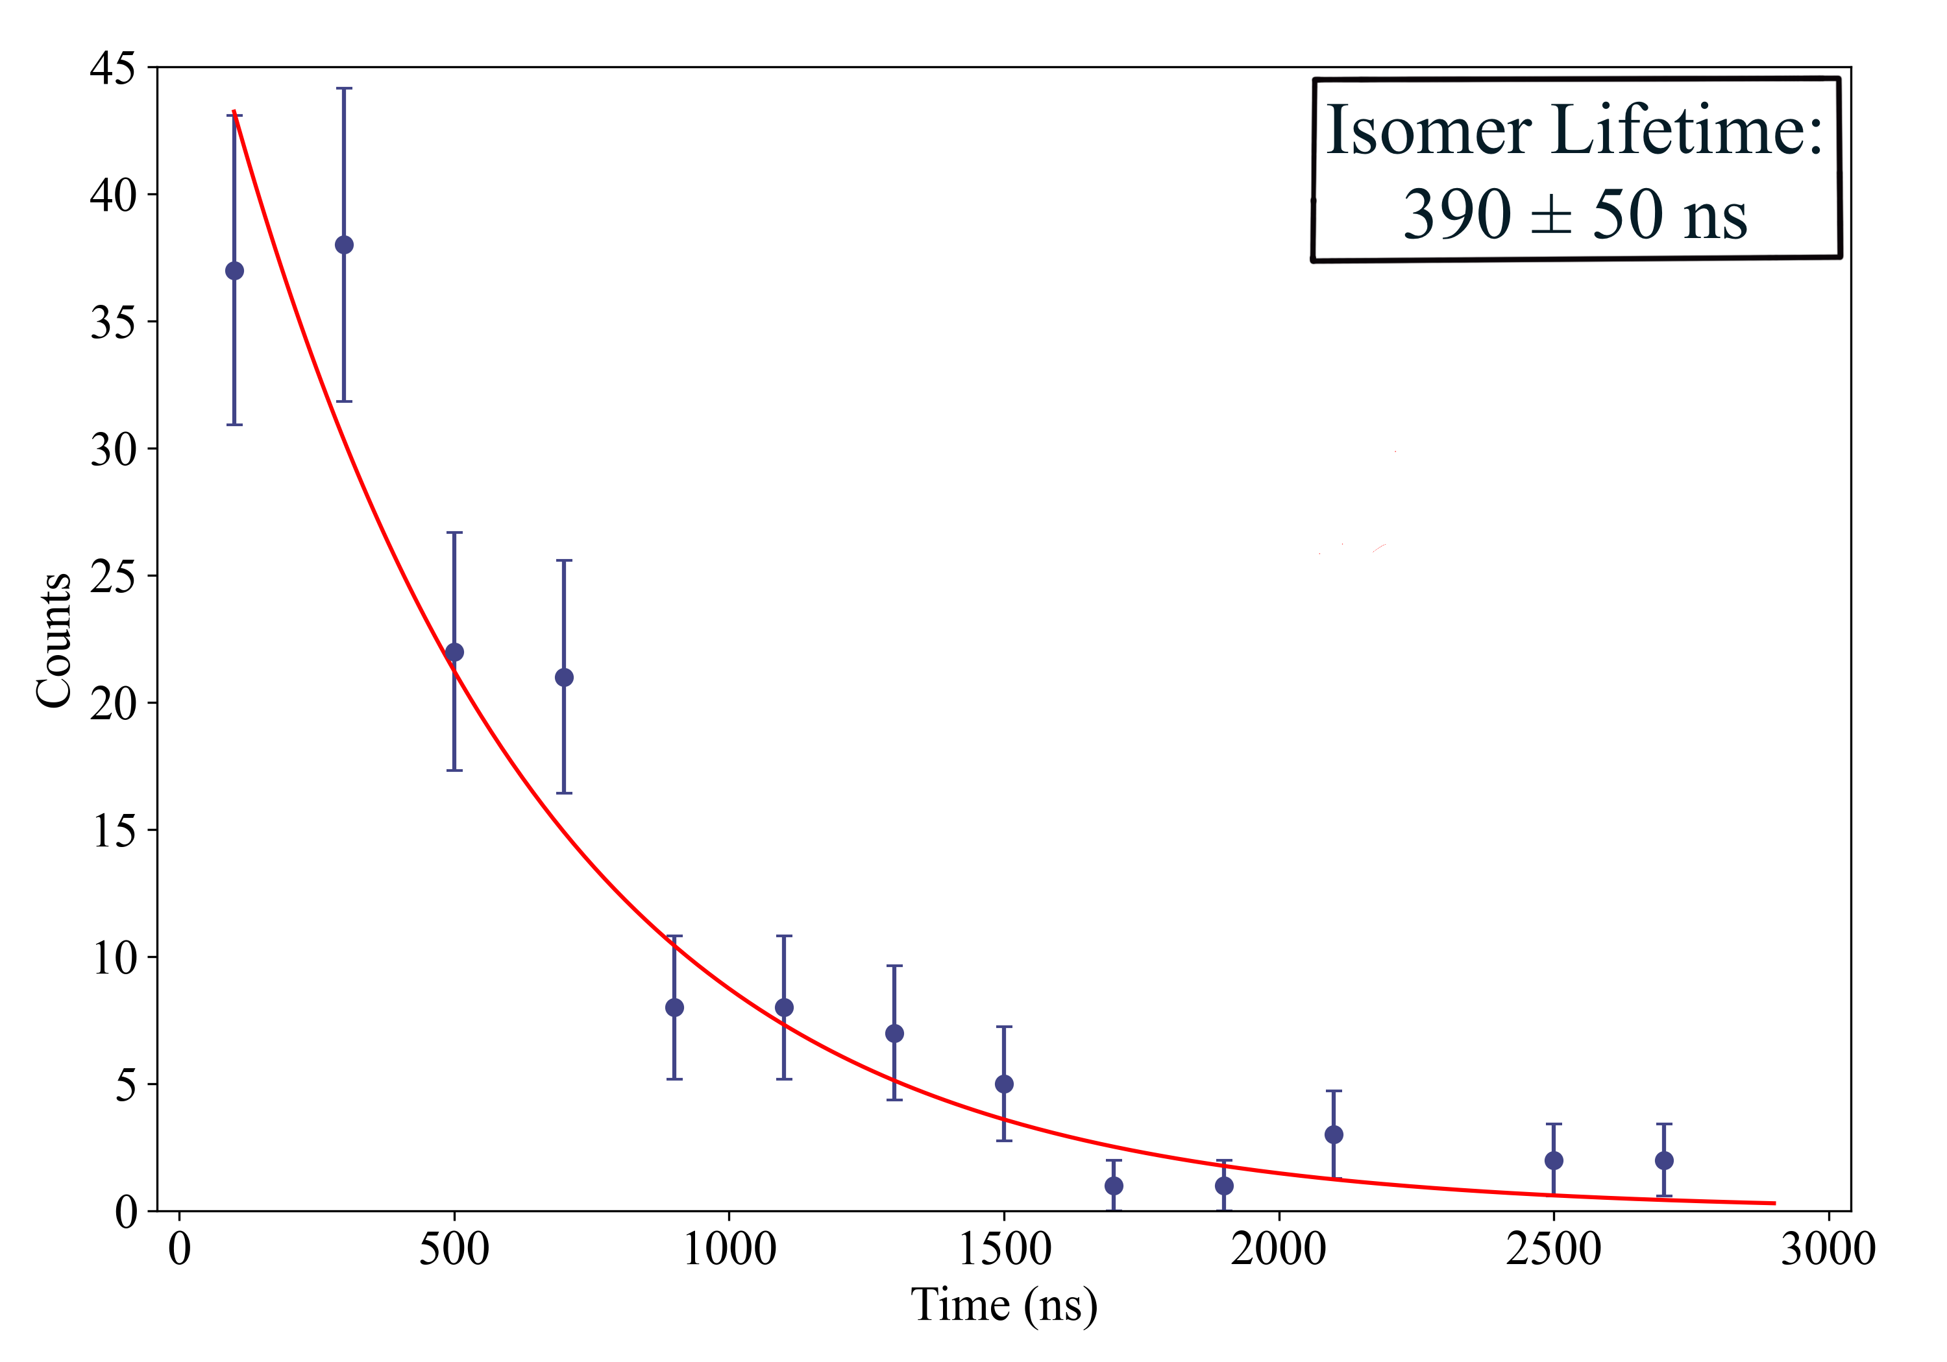
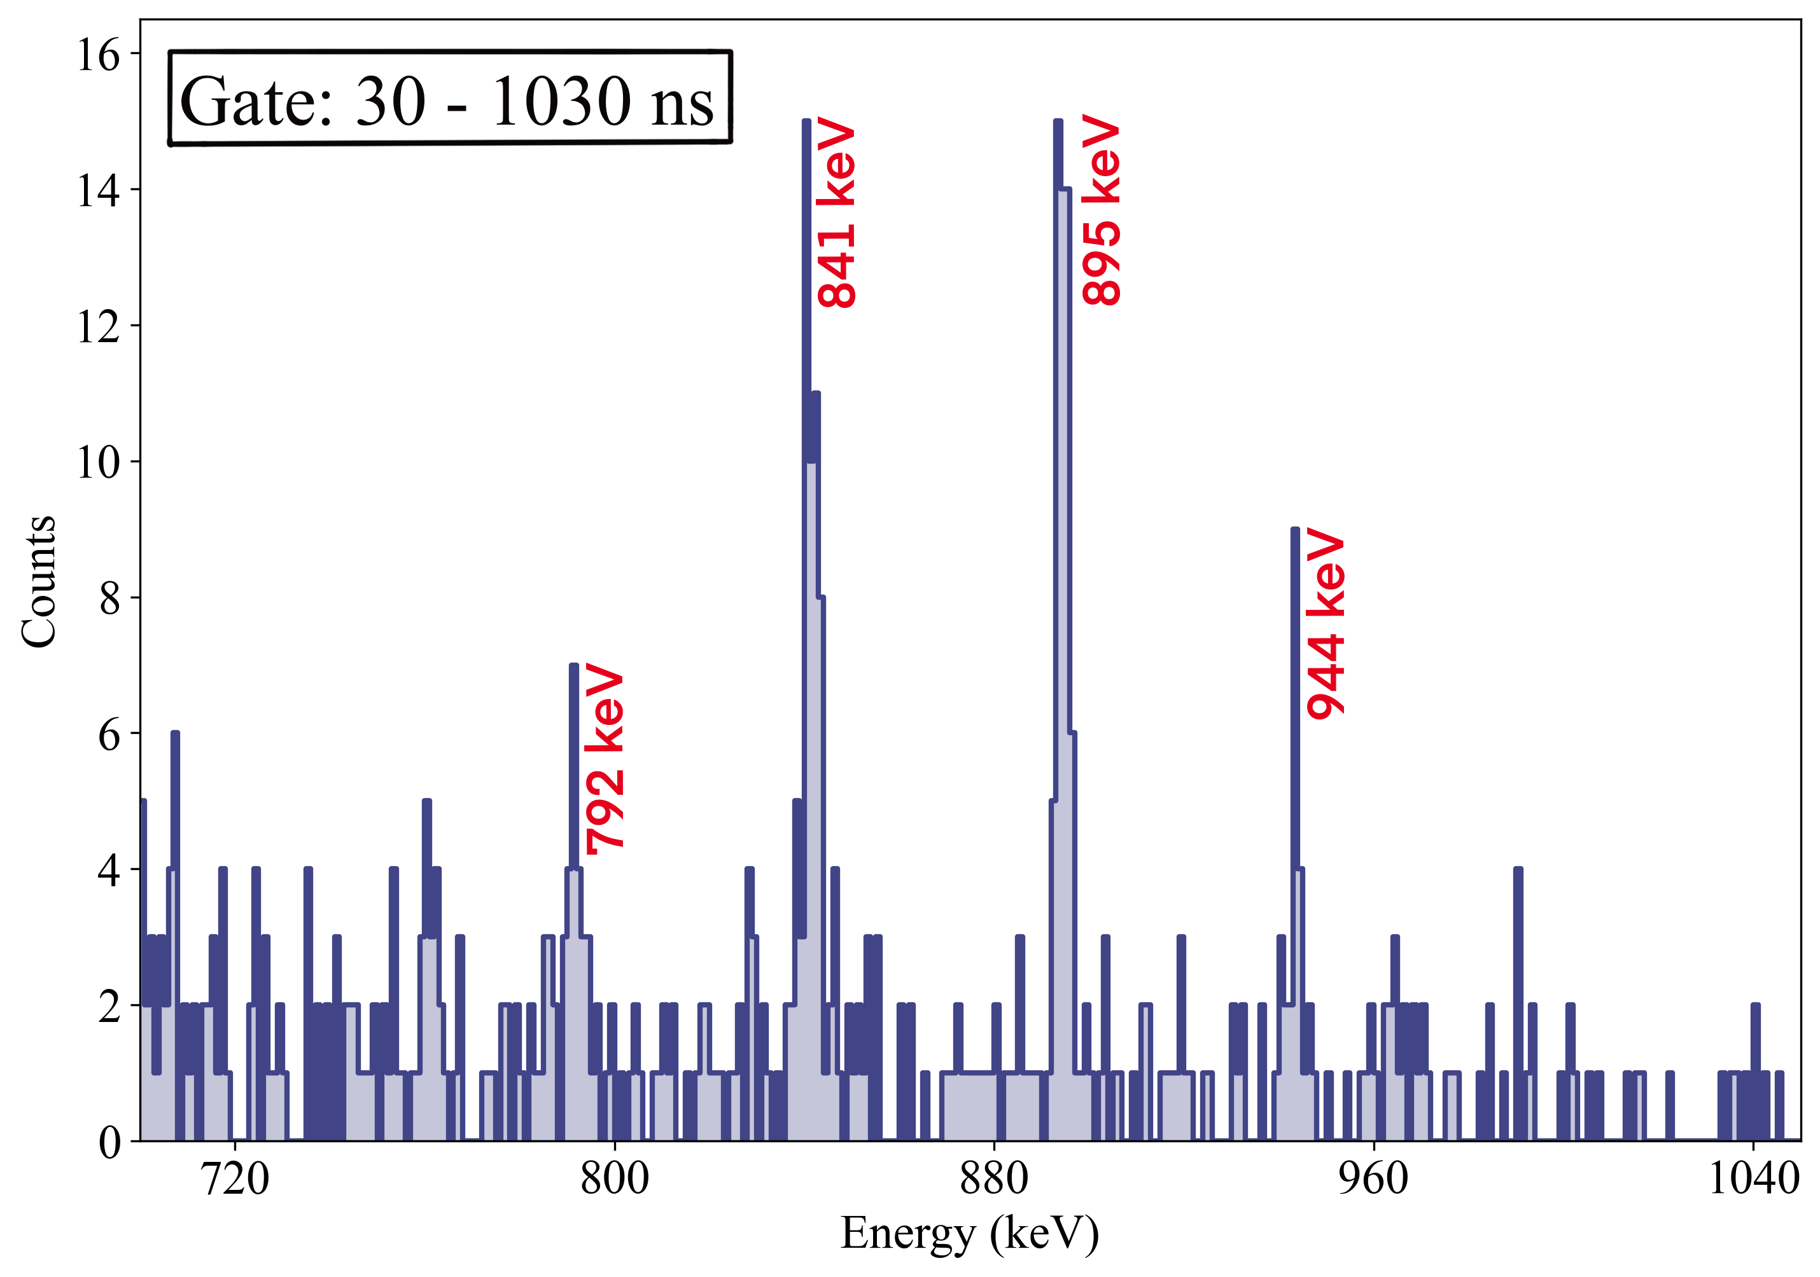
DESPEC Experiment in 2022: ²⁰³ Ir isomeric decay
old
S. Steer (2010):
798±350 ns
This experiment: 390±50 ns
Gee Bartram, University of Surrey, to be published

Slide 19
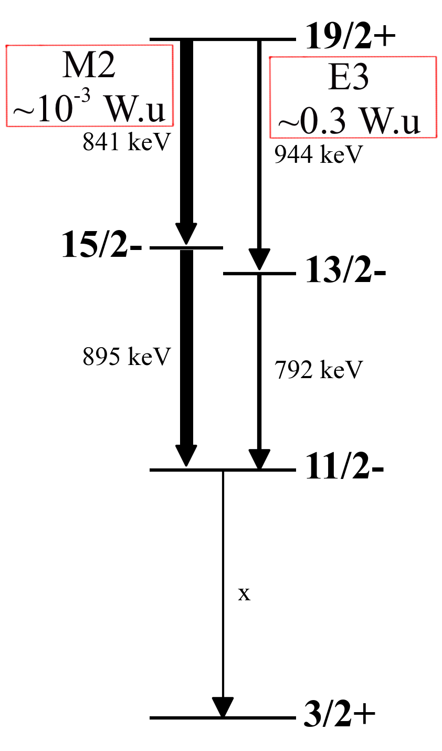
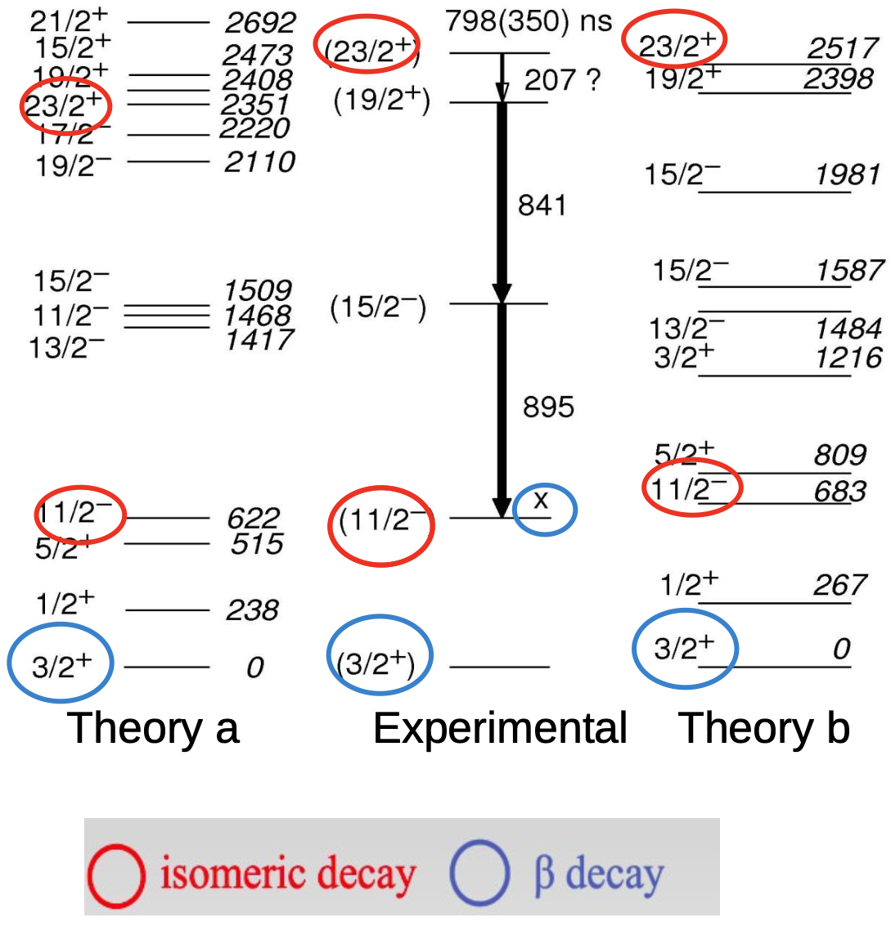
DESPEC Experiment in 2022: ²⁰³ Ir isomeric decay
old
S. Steer (2010):
Updated:
Gee Bartram, University of Surrey, to be published

Slide 20

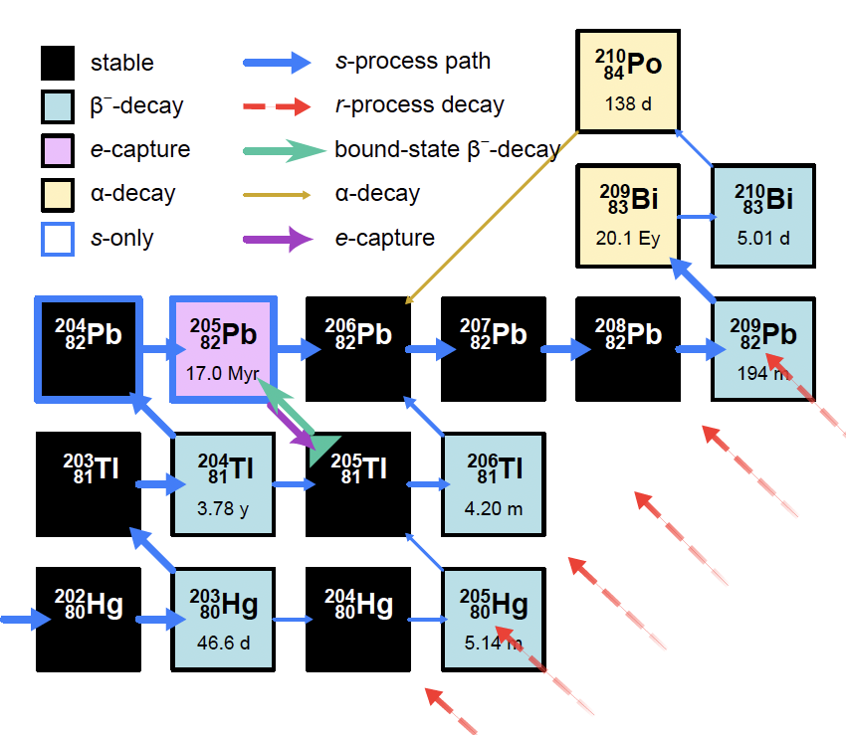
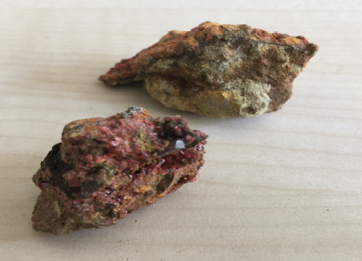
Bound-State Beta Decay of ²⁰⁵Tl
²⁰⁵Tl: Stable in neutral atoms
Radioactive in bare ions
Cosmochronometer of the s-process
Neutrino energy threshold 53 keV!
LOREX project: new solar neutrino detector

Slide 21
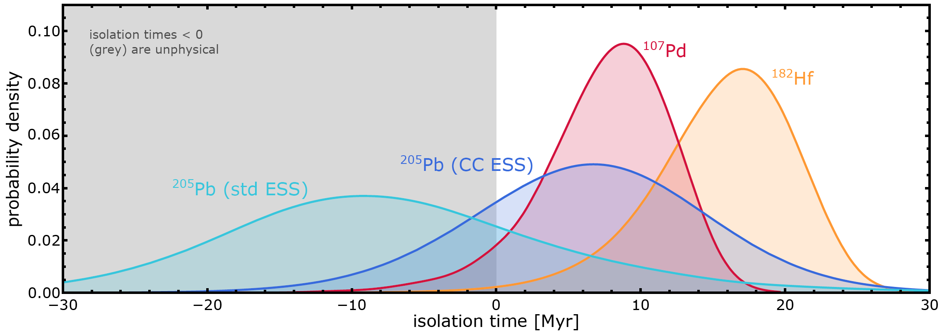
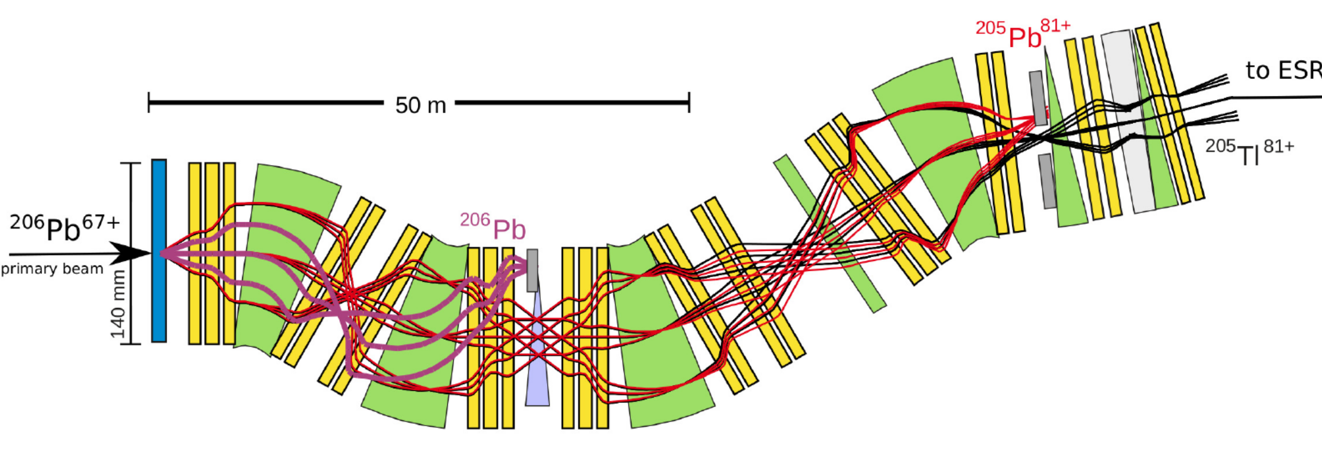

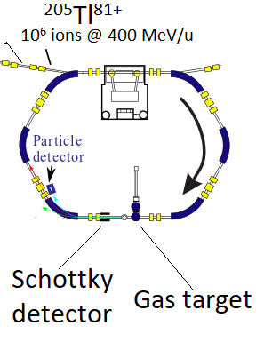
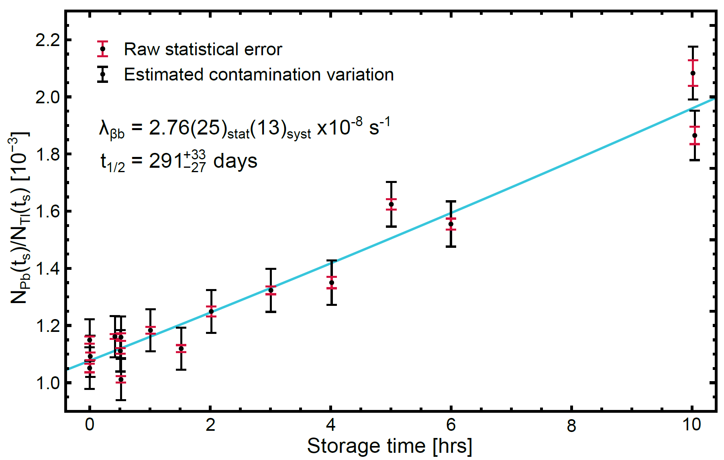




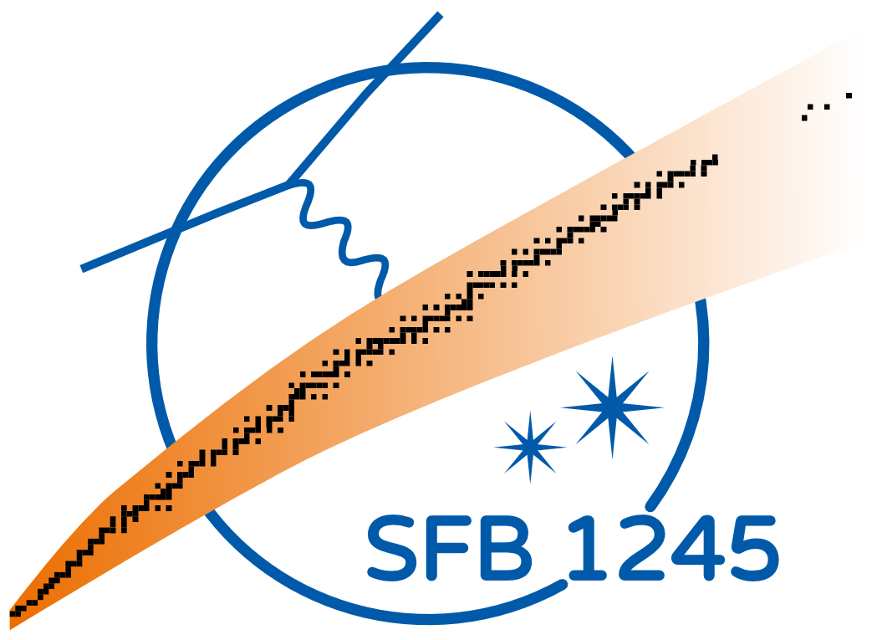
Bound state beta decay of ²⁰⁵Tl⁸¹⁺
Accepted in
Combined with meteoritic data, new ²⁰⁵Pb and ²⁰⁵Tl decay rates in plasmas, and astrophysical simulations, the isolation time of the solar matter from the last synthesis of ²⁰⁵Pb is for the first time positive!
G. Leckenby et al., Nature 635, 321 (2024)
Combined with new neutrino capture rates, the new ²⁰⁵Tl decay constant sets precise constraints on the production of ²⁰⁵Pb by solar pp neutrinos, and thus for the LOREX project aiming at measuring ²⁰⁵Pb in lorandite minerals
T_{1/2}^{the} =122 days
T_{1/2}^{exp}=291 days
R. S. Sidhu et al., Phys. Rev. Lett. 133, 232701 (2024)
ESR:
Storage times of up to 10 hours
Notes:
205Tl is stable as atom but decays if all bound electrons are removed
The decay rate is significantly different from theoretical predictions
205Tl-205Pb pair has the lowest Q-value for capturing solar neutrinos. 205Tl has therefore been a candidate for solar pp neutrino detector. LOREX is the project to determine the number of 205Pb atoms created by solar neutrinos in 3.2 My old lorandite mineral
Decay of 205Pb and back-decay of 205Tl determine the termination of slow neutron capture process in AGB stars. With new 205Tl rate, the production of 205Pb can be constrained. The origin of the solar system can be determined as well.

Slide 22

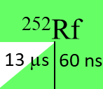

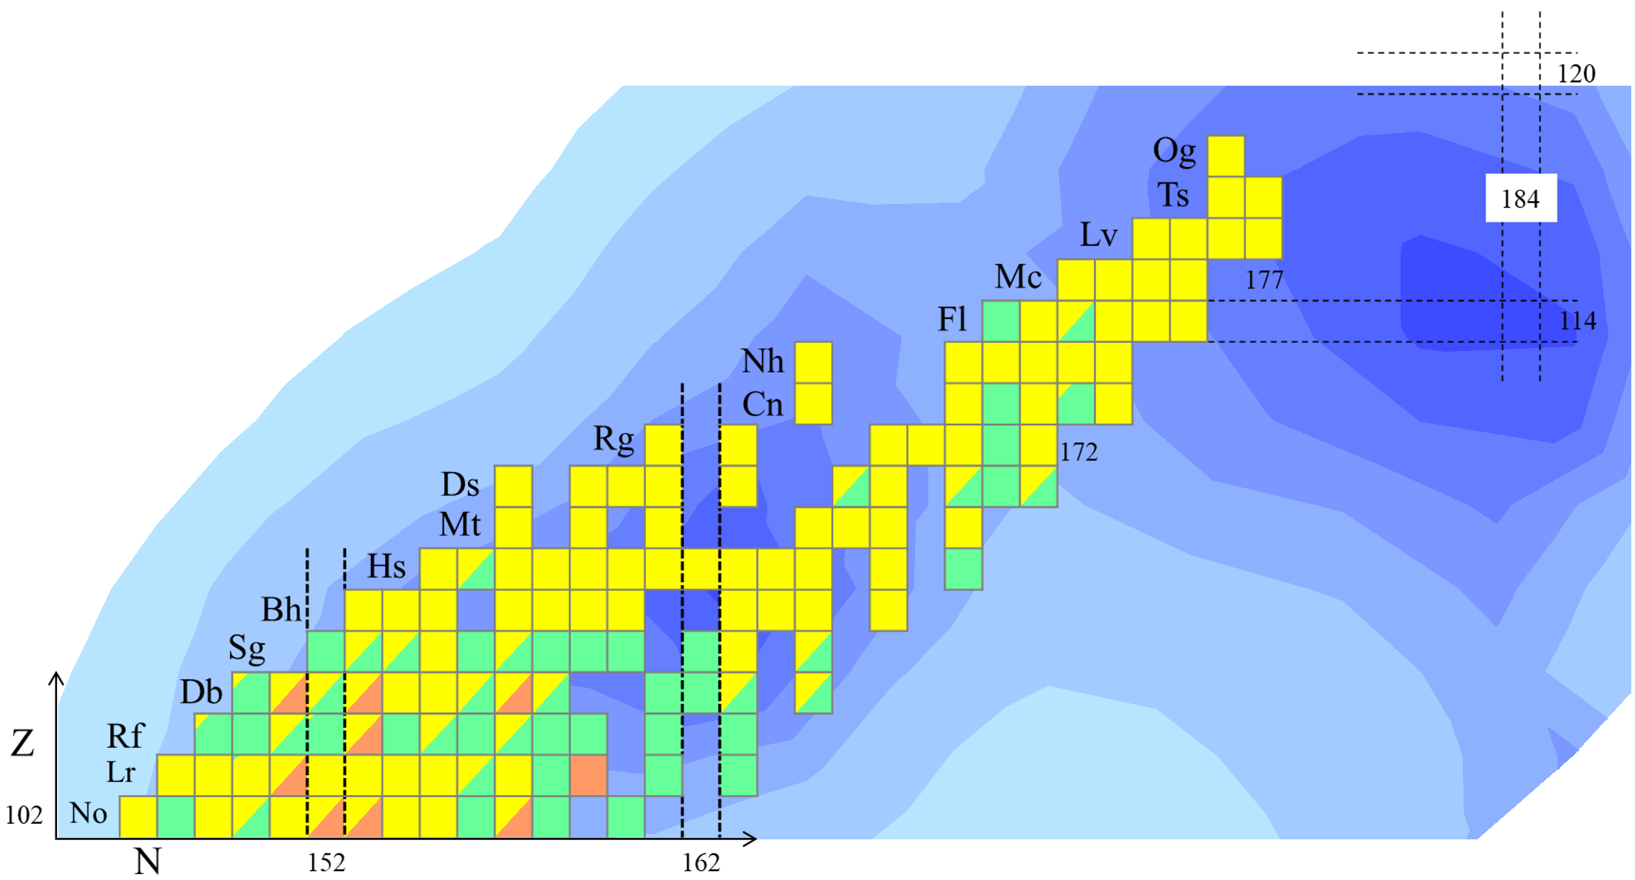

252
104
Discovery of 60-ns Rf:
Marking the shoreline of the Island of Stability
  J. Khuyagbaatar, P. Mosat et al., Phys. Rev. Lett. 134, 022501 (2025)
  Editors’ Suggestion / Featured in Physics
Prediction: “Clouds of stability” of superheavy nuclei
K-isomeric state (Rf-252m): 50 µs
Ground state (Rf-252): 100 ns
J. Khuyagbaatar, Eur. Phys. J. A 58, 243 (2022).
  Shoreline towards the Sea of Fission Instability is reached in the new ²⁵²Rf
  Detection only possible thanks to longer-lived high-K state
Experiment: ⁵⁰Ti+²⁰⁴Pb @TASCA
K-isomeric state (Rf-252m): 13 µs
Ground state (Rf-252): 60 ns
+4
-3
+90
-30
Sea of fission
instability
250 ns

Slide 23
Conclusions
Experiments running at FRS
Creation of the chemical elements
²⁰⁵Tl bound-state beta decay
SHE; hadron therapy
shape evolution at N~126; N=126 nuclei
Eearly Science (with SuperFRS)
increased transmission; better detection systems
from end of 2027
First Science (with SIS100)
increased primary beam intensity
from end of 2028

Slide 25
Part of the Segrè chart, highlighting the isotopes first identified since 2010.
G.G. Kiss, Zs. P., Eur. Phys. J. A 60, 175 (2024)

Slide 26
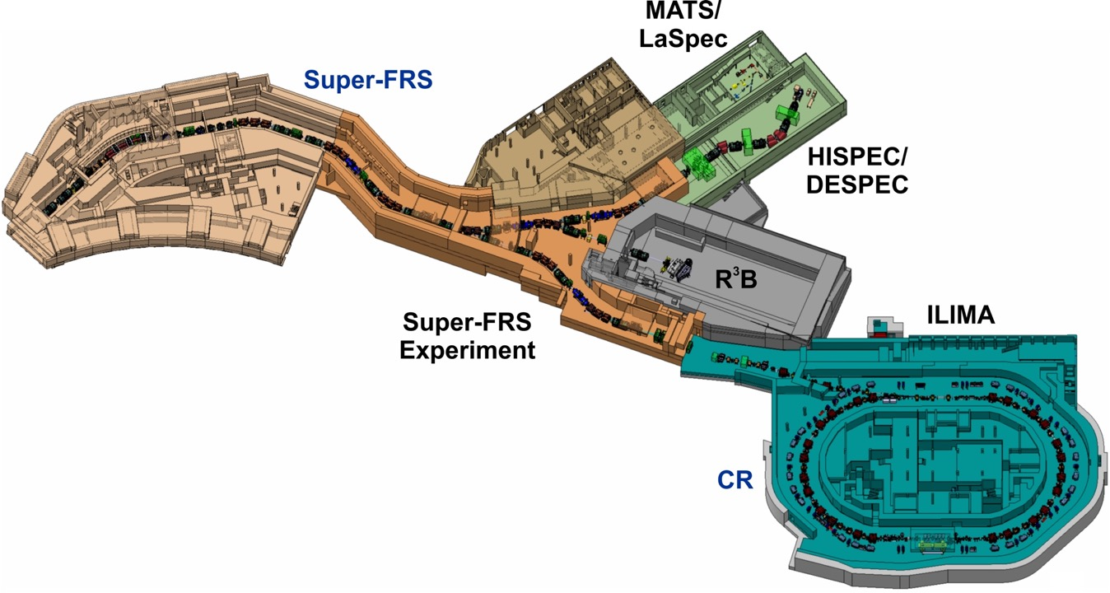
FUTURE: Experiment locations at Super-FRS:
ES and FS
Early Science
(with SuperFRS)
end of 2027 ->
First Science
(+ SIS100)
End of 2028 ->
FHF1
FHF2
FMF2
FHF1: Compact setups (DESPEC and SuperFRS-EC)
FHF2: R3B in HEC

Slide 27
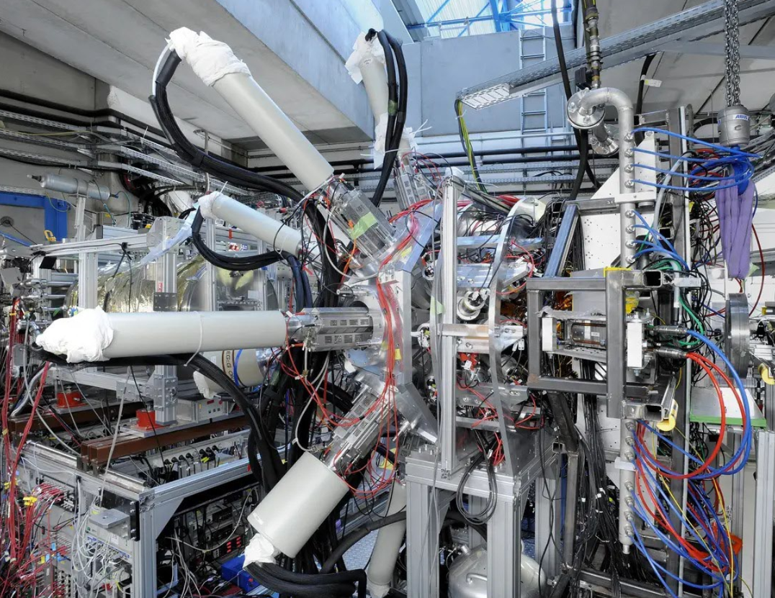
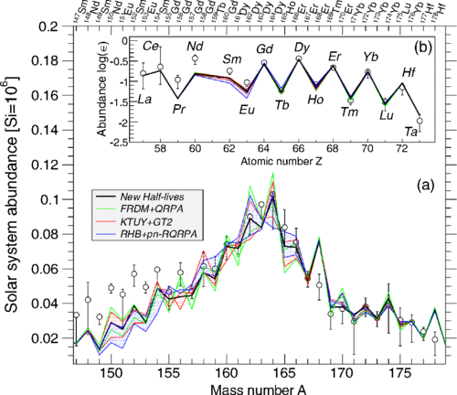
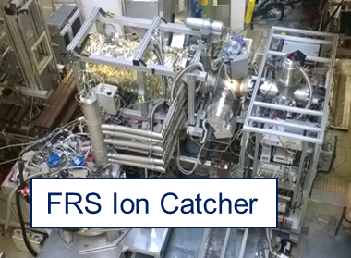
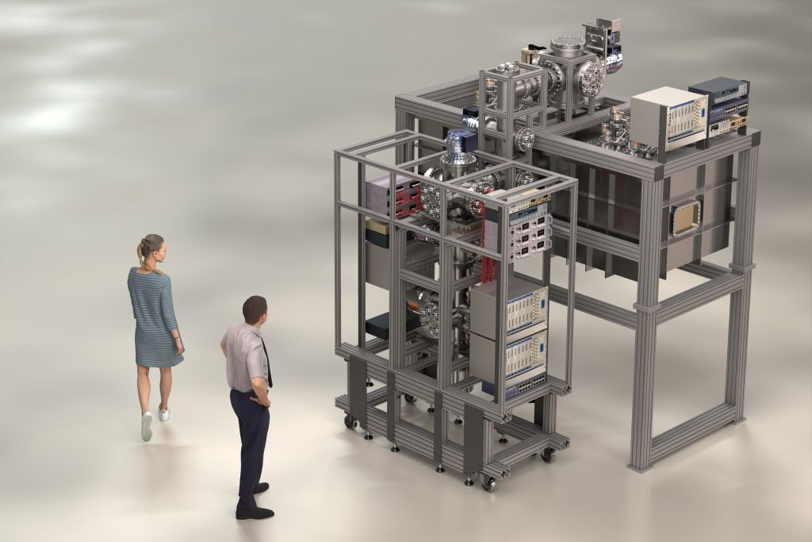
Physics in the SuperFRS tunnel
Production of exotic neutron-rich isotopes
Measurement of their beta-decay lifetimes
Measurement of their masses
Astro impact, based on theory
Decay setup
SuperFRS Ion Catcher
Notes:
New ion catcher is being built, commissioning at FRS is not planned; off-line commissioning planned for mid 2027

Slide 28
FAIR/GSI strategic operation scenario:
ES, FS, towards FS+
beam time
Acc. Operation total / days
134
44
140
Pre-paration works
EH
140+30
renovation
EH
140
renovation
EH
140
200
240
240
beam time
Physics beam time/ days
107
0
100
100+30
50
70
min. 120*
180
180
engineering-runs
Project phases (ES, FS, FS+)
FAIR Installation of Accelerator Components
FAIR Hardware Commissioning
FCC OP ready
UNILAC CS ready
DR
FAIR Beam Commissioning
PCP reached
Facility availability
now
included
early science (ES) →
SIS18 → SFRS → NUSTAR
still
missing
first science (FS) →
SIS100 → SFRS → NUSTAR
first science + (FS+) →
SIS100 –> CBM
UNILAC → EH, SIS18 → TH, EX, FRS, ESR → HITRAP, Cryring
2022
2023
2024
2025
2026
2027
2028
2029
2030
FAIR Phase 0
Early Science
Early Science & First Science+

Slide 29
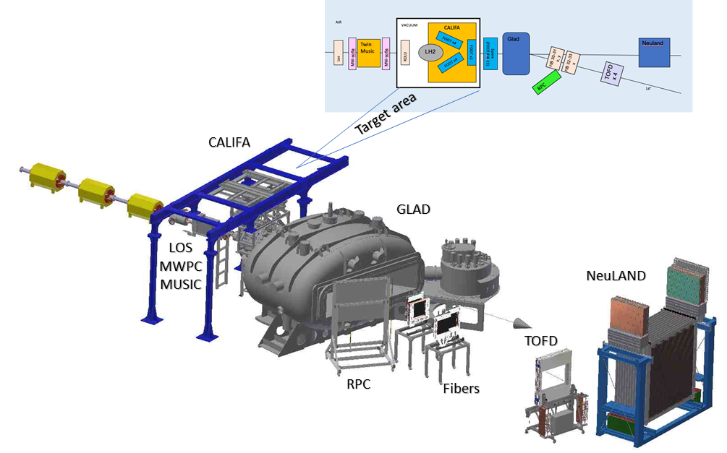
First experiment
R³B setup in the high-energy cave
Focusing on:
- neutron skin measurements
- fission
It needs commissioning in the high-energy cave.
(EDAQ coupling)
Notes:
Needs commissioning (many things can be done before in Cave C):
-new tracker recoil detector; -new proton arm spectrometer; -new vacuum system for TOF wall; -new fibre tracker; Major improvement: longer TOF=> higher mass; also better angular resolution
Supper FRS: main gain in medium-heavy Ca-Sn

Slide 30
Major improvements
Super-FRS transmission
Maximum gain for light to medium-heavy nuclei
Cleaner beams
R3B
longer TOF => identification to high mass
better angular resolution
Unique
no other place with high energy fragmentation beam

Slide 31


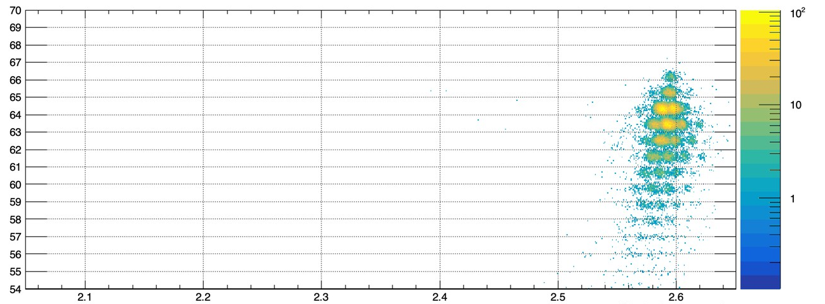
Newly-developed Er beam (unique for GSI/FAIR)
Very preliminary
Online analysis (data of first night)
¹⁷⁰Er
¹⁷⁰Er + Be reaction at 1.08 GeV/u
Stabilitätslinie:
166-Er: A/Z=166/68=2,44
130-Xe: A/Z=130/54=2,41
Element number Z
Valley of stability
Mass-to-charge ratio A/Q
◇ Wide range of cross section data serve as important basis for developments of future FRS/SFRS and
NUSTAR experiments with the newly developed Er beam, uniquely available at GSI/FAIR
◇ Similar for ¹⁰⁰Mo, ²³⁸U et al.
Y.Tanaka, E.Haettner, S.Singh, et al.

Slide 32
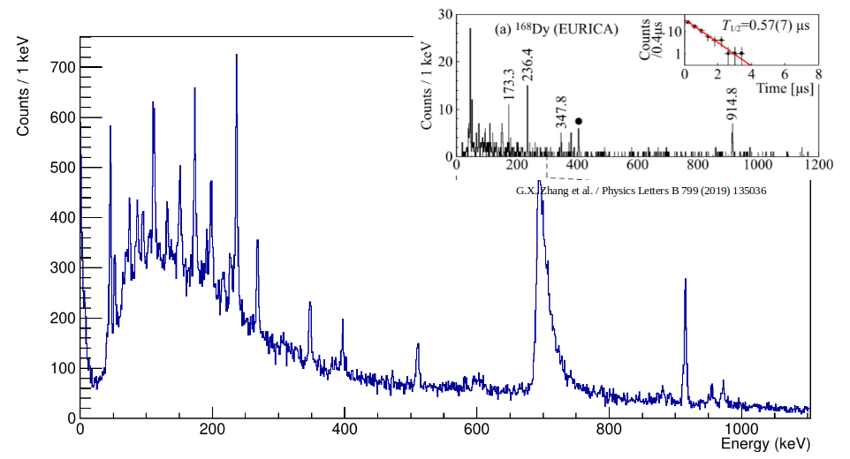
New beams: ¹⁷⁰Er, ¹⁸⁶W, ¹⁶⁰Gd
~22 shifts of data collection in April 2024
Reduced transition probabilities B(E2;2⁺→ 0⁺) are derived from nuclear lifetimes
B(E2;2⁺→ 0⁺) values access fundamental information regarding wavefunctions of initial and final states
EURICA at RIKEN with ²³⁸U
new beams
➔ new opportunities
¹⁶⁸Dy
¹⁸⁰Er beam
Subset of online data, DEGAS HPGe spectrum
H.M.Albers, T.Grahn, C.M.Petrache, V.Werner, et al.

Slide 33
Structure of neutron-rich, rare-earth nuclei far from stability
Main Experimental Goals:
  2⁺ (and 4⁺) lifetimes in even-even neutron-rich Dy, Gd and Sm isotopes
  New data on isomeric decays, search for new isomers
~22 shifts of data collection in April 2024
Reduced transition probabilities B(E2;2⁺→ 0⁺) are derived from nuclear lifetimes
B(E2;2⁺→ 0⁺) values access fundamental information regarding wavefunctions of initial and final states
EURICA at RIKEN with ²³⁸U
¹⁶⁸Dy
Subset of online data, DEGAS HPGe spectrum
¹⁷⁰Er: new beams ➔ new opportunities!
H.M.Albers, T.Grahn, C.M.Petrache, V.Werner, et al.

