Slide 1
Daily updates Thursday 10 July
It is not raining

Slide 2
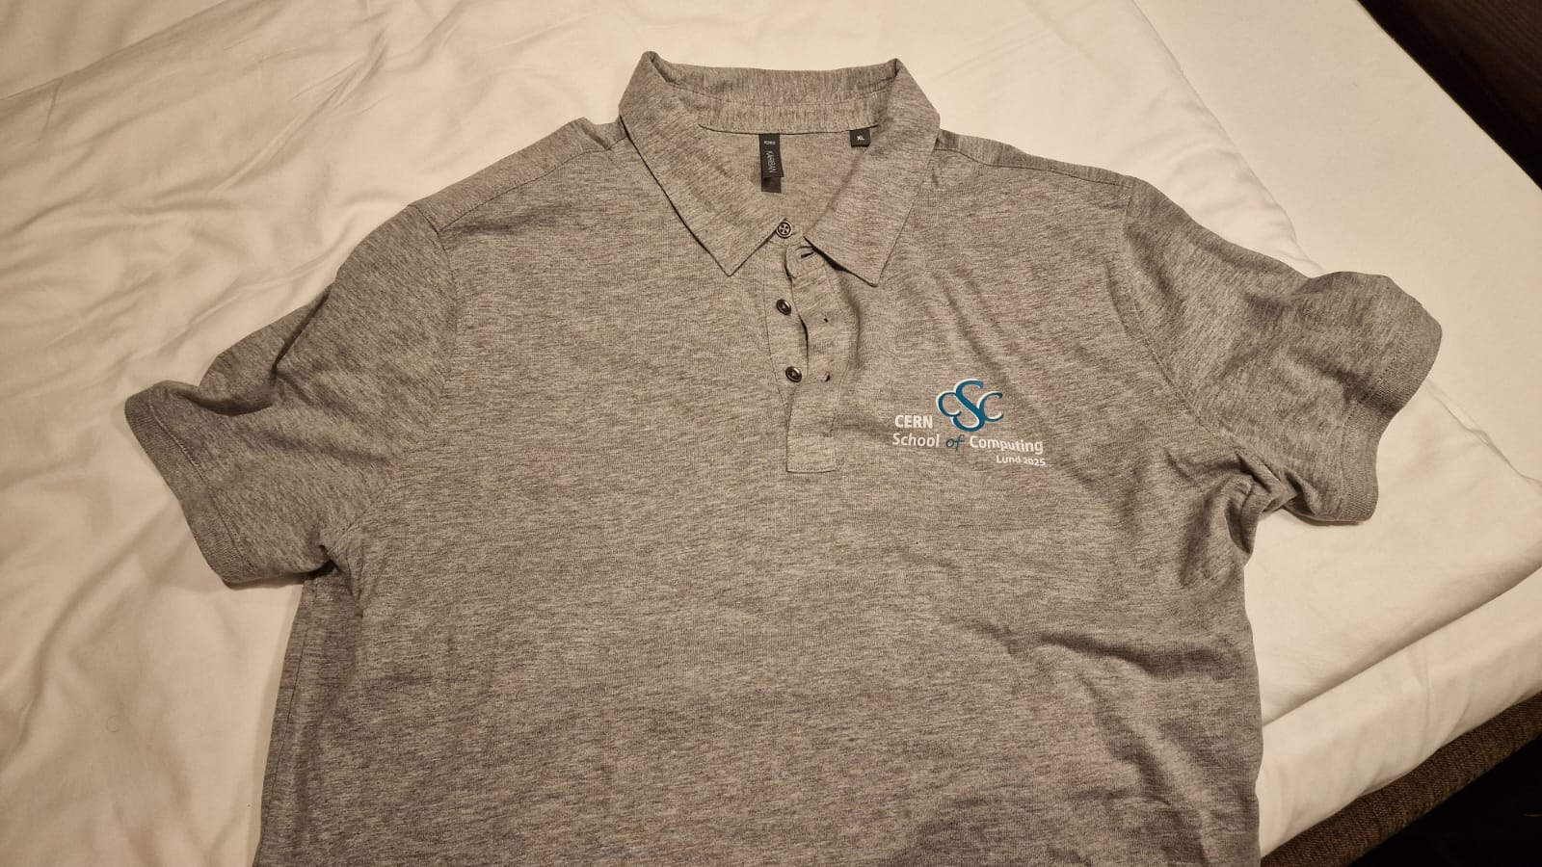
Photo today at 11!
Wear me!

Slide 3
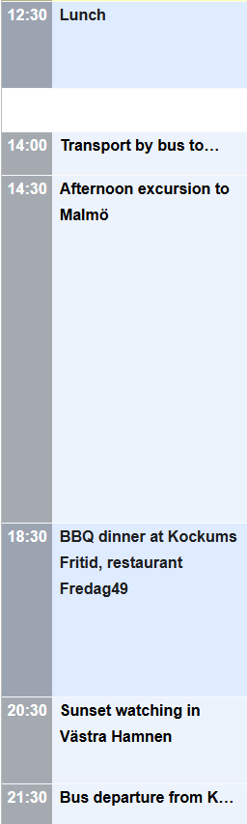
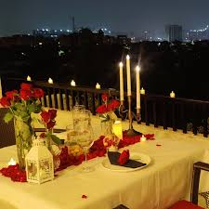
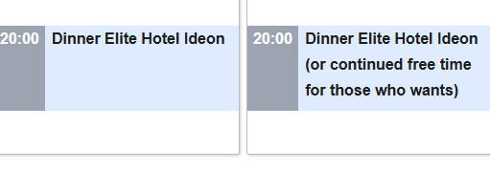
Please note…
Today
Today, lunch at 12.30!
Friday and Saturday, dinner at 20.00!
Friday and Saturday

Slide 4
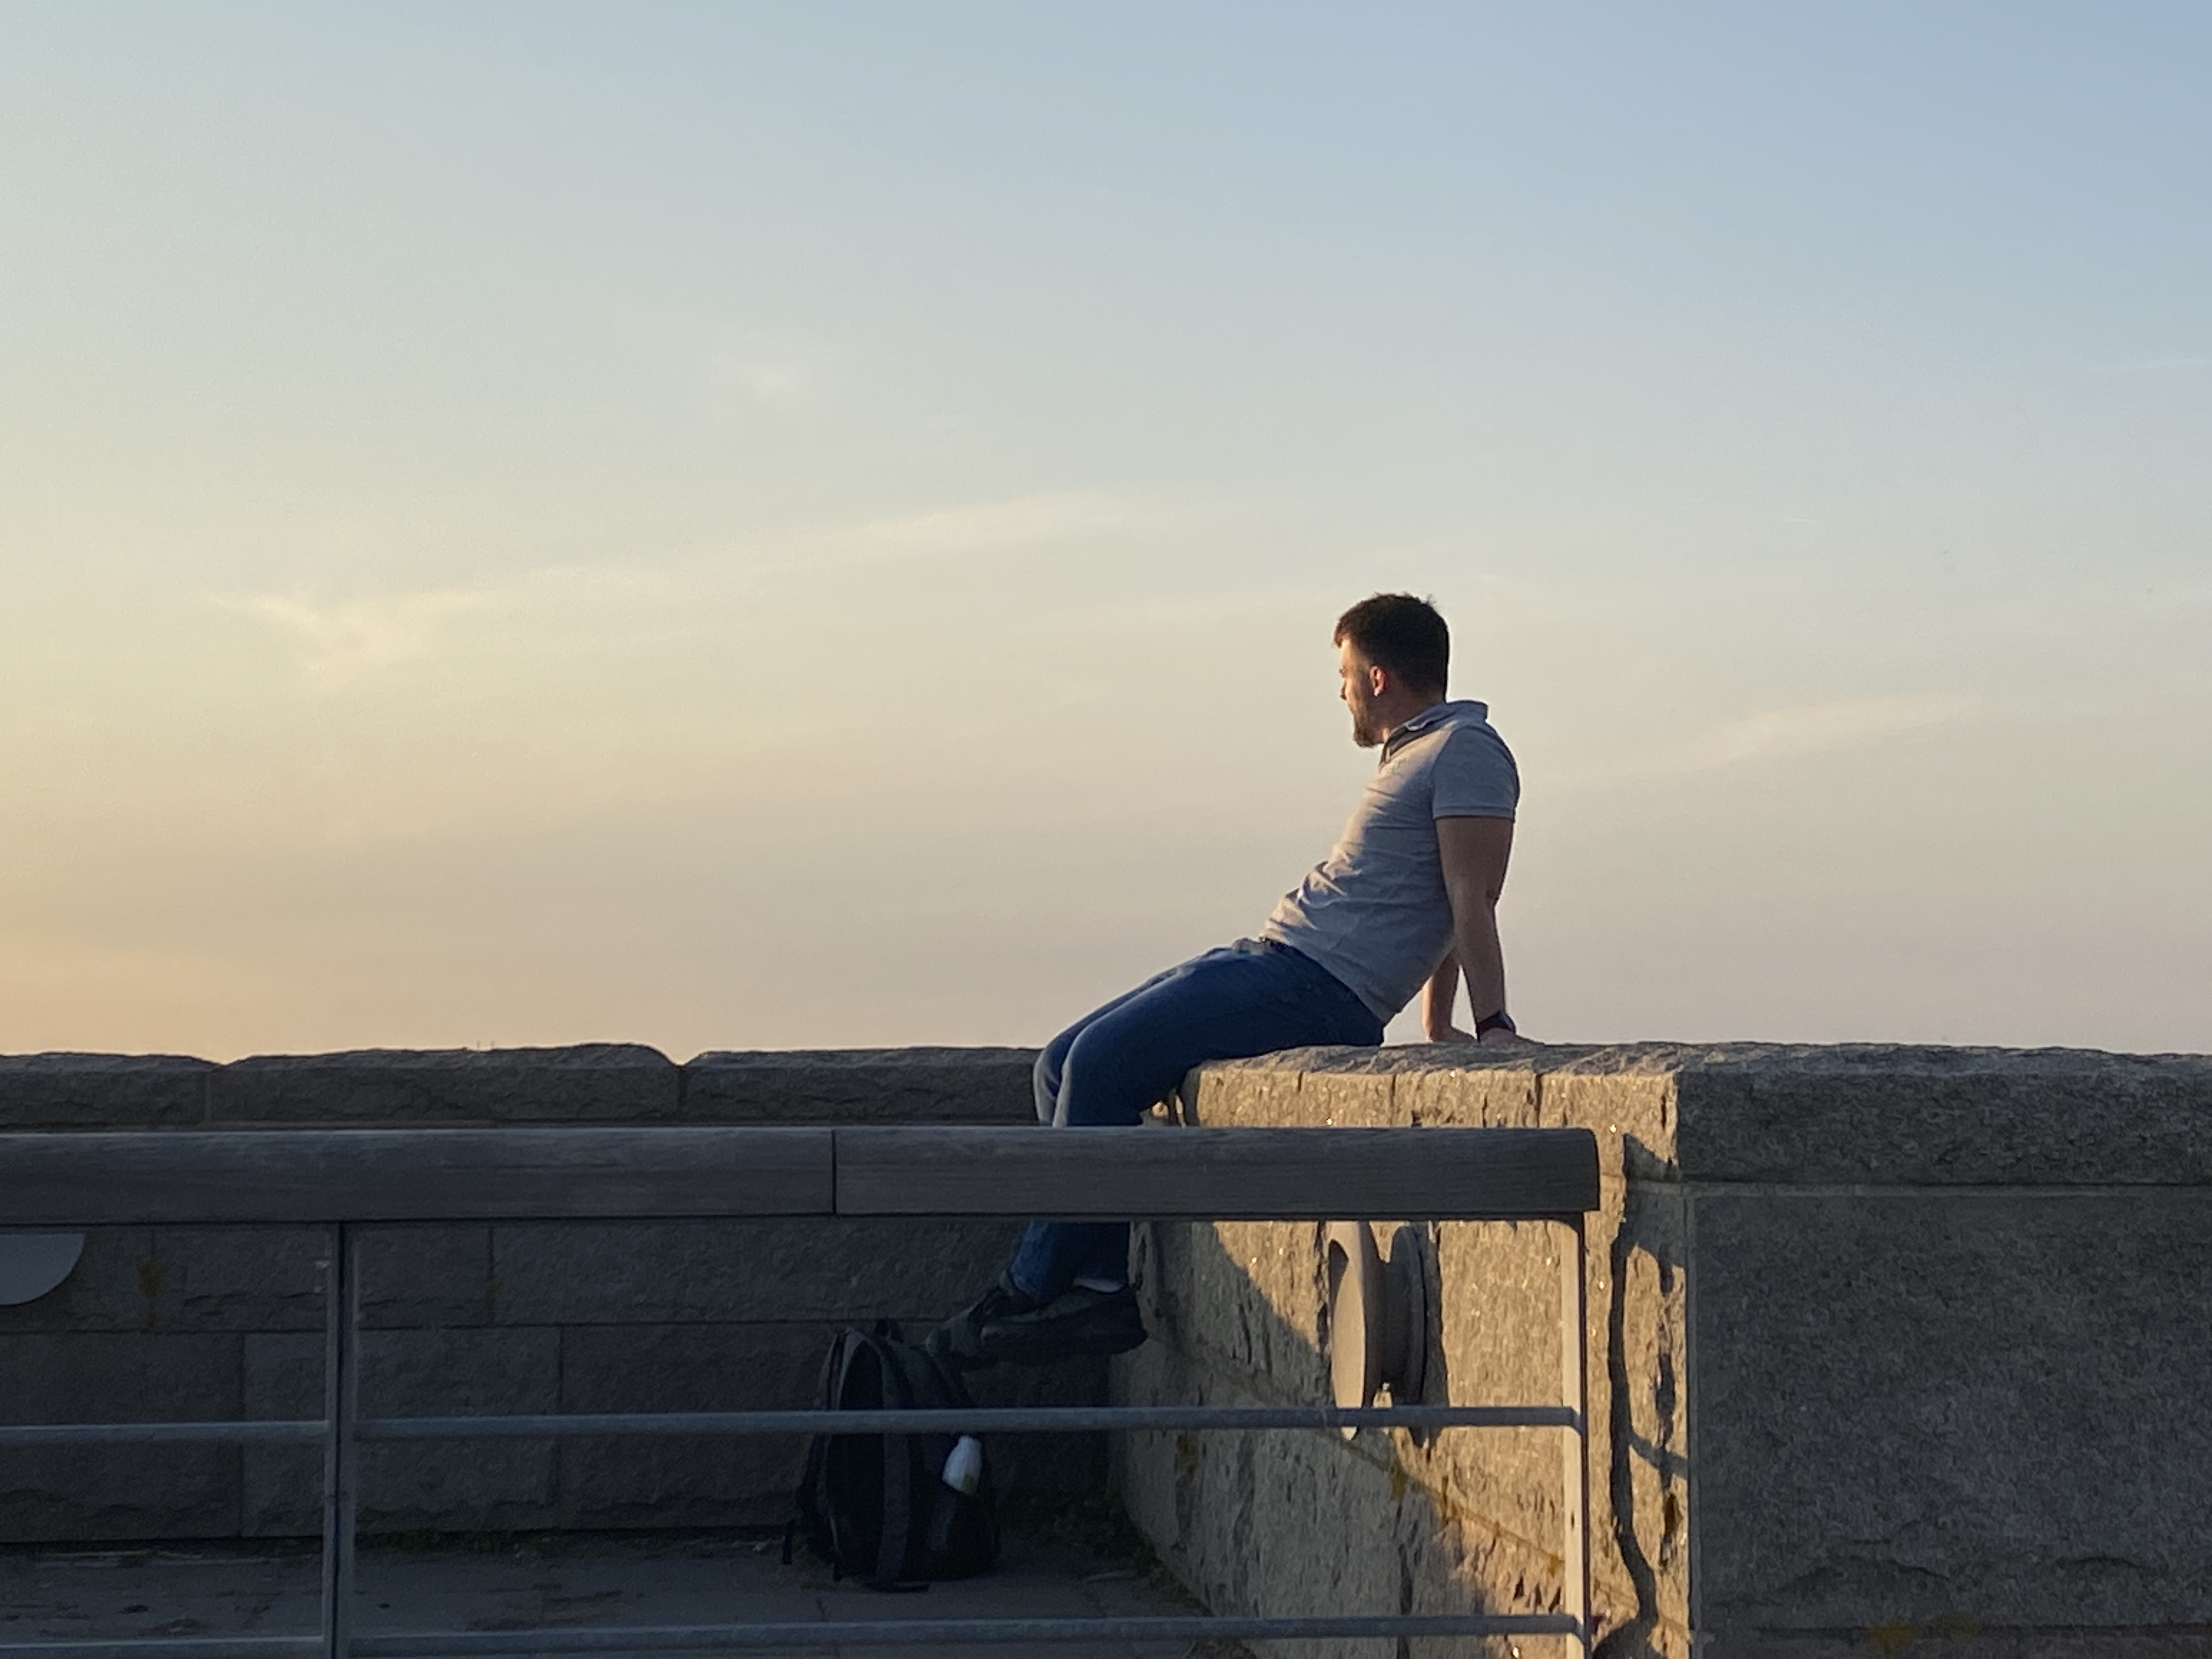
Activities Malmö
Volleyball overload? ;-)
Combinations of activities possible, of course!
Meet up for dinner: 18.30 at Kockum Fritid restaurant Fredag 49
Have a nice time!

Slide 5
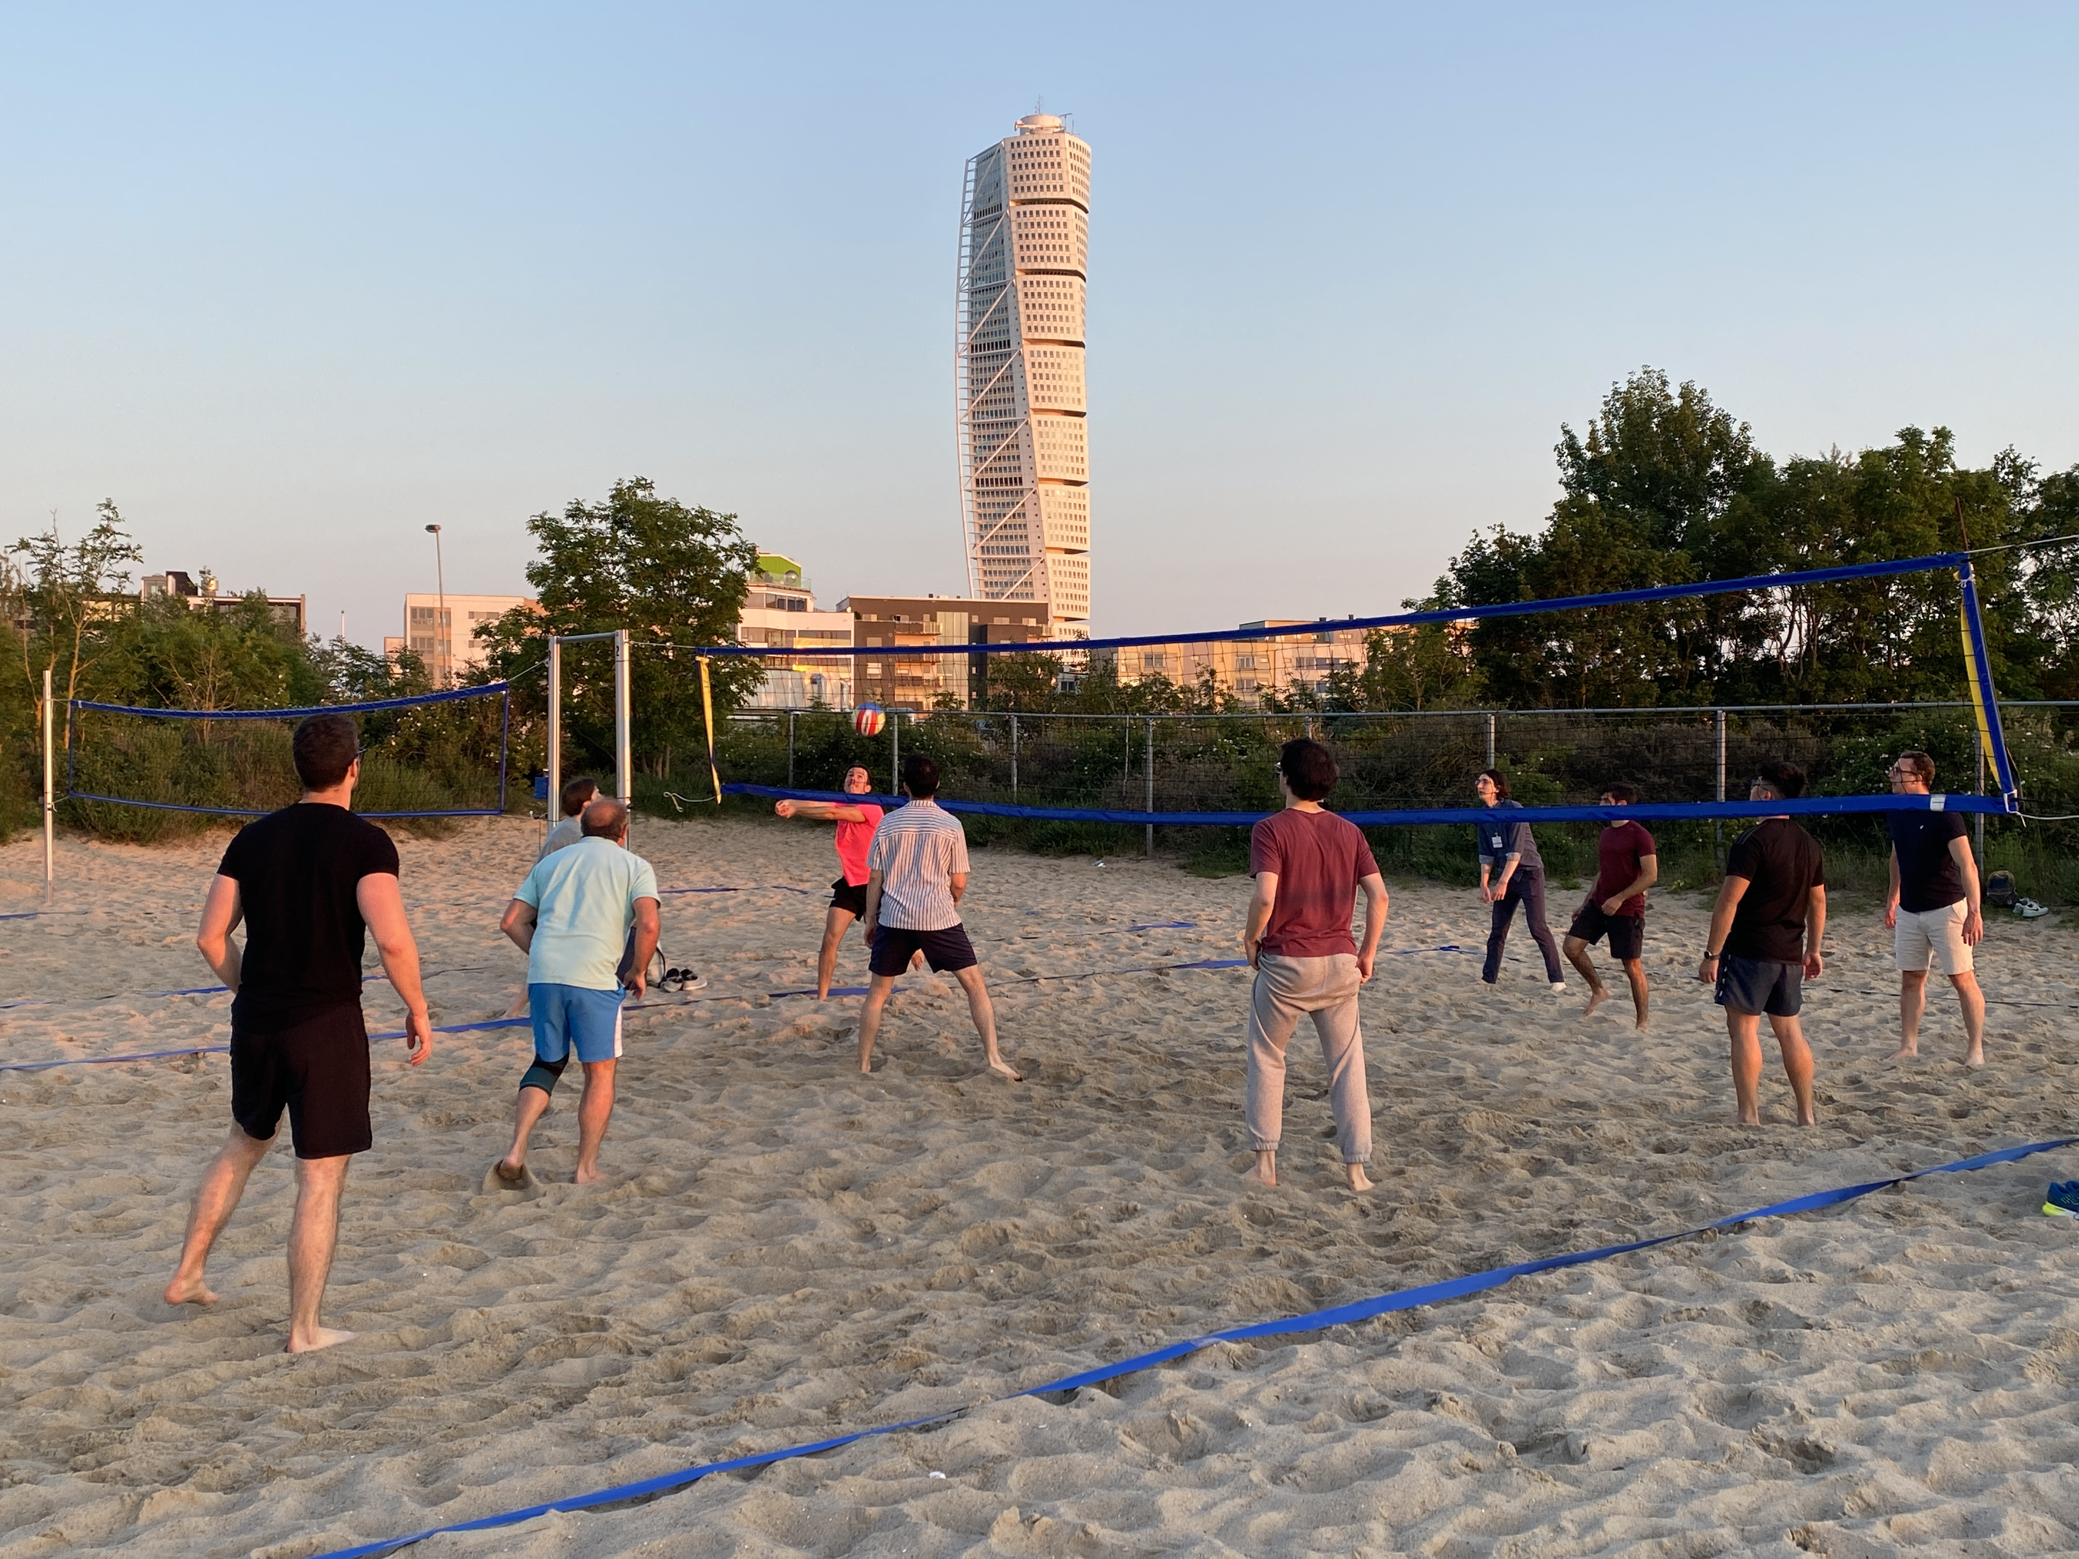
Malmö Excursion
Departure from Hotel at 14h sharp
Prepare things you want to bring before
Bring towel/bathing suit if you plan to swim/do sauna!
No common coffee break organized in the afternoon, bring water or take a “fika” somehwhere on your own.
Dinner in Malmö at 18.30 at Fredag49, inside Kockum Fritid!
BBQ, vegetarian options available of course.
Bus going back to Lund at 22.00 from Kockum Fritid
If you wish to stay for longer, you can take the train back to Lund.

Slide 6
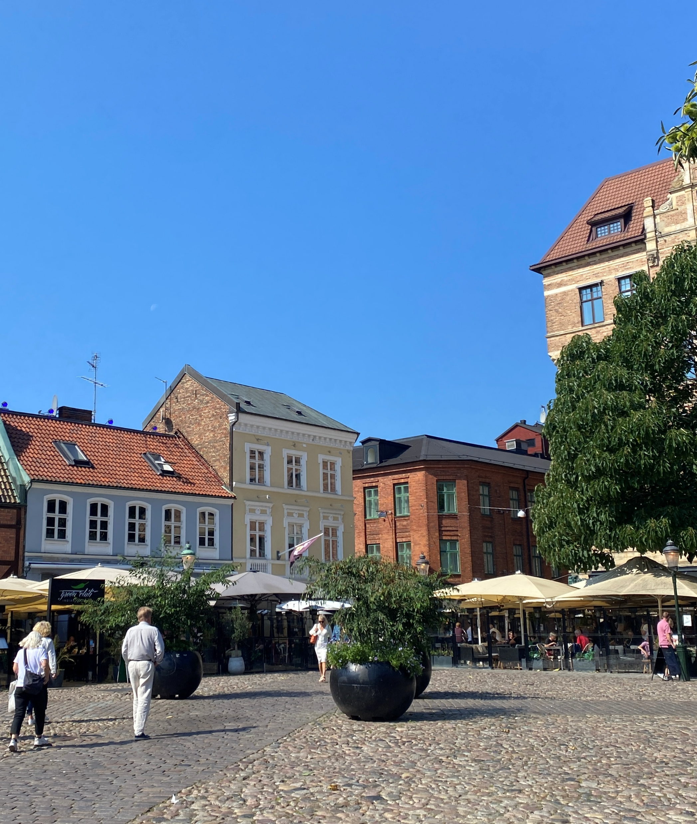
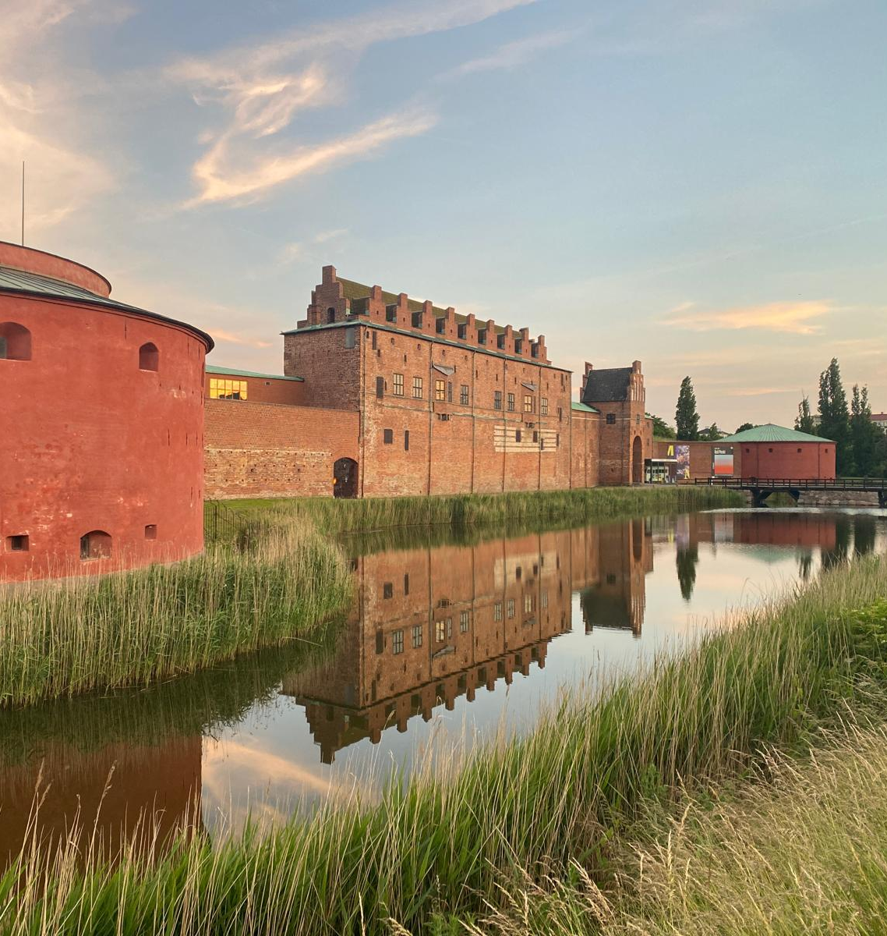
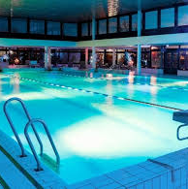
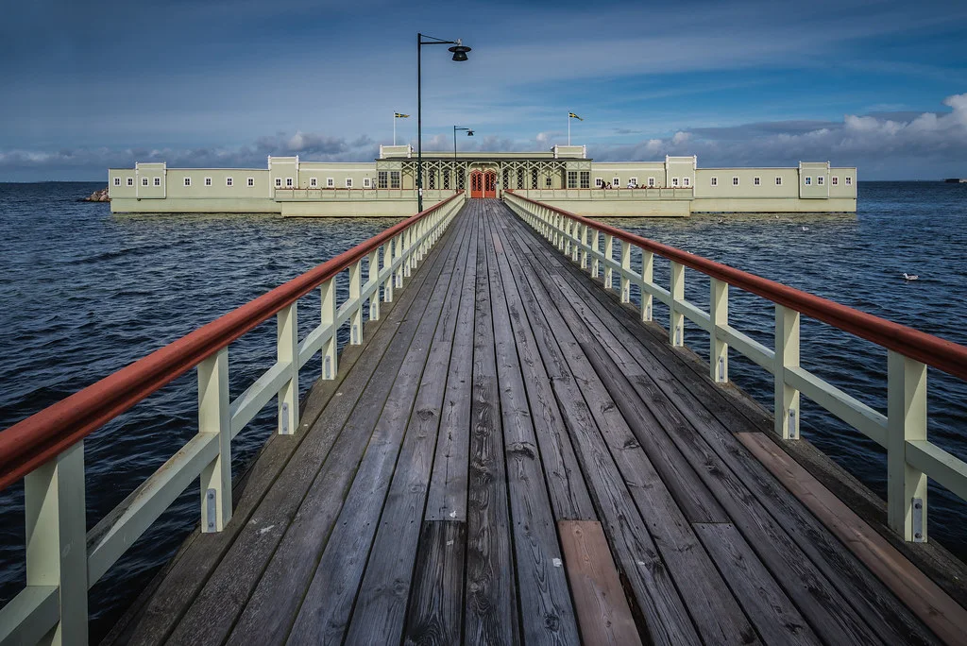
What to do in Malmö
Sauna and swim at “Kallbadhuset” (90 SEK)
If you do not wish to do sauna, you can just grab a drink at the nice café
Swimming at Kockum Fritid (90 SEK)
Hang out on the Ribersborg beach, bring a book and relax.
Walk in the city center, shopping. The Södergatan street is a good place, just after “Stortorget”
Visit the Malmö Museum (50 SEK for students)
Museum is closing at 17h in the summer!
Follow Kristina
Visit to the cosy café in Slottsträdgården,behind the museum.
Volleyball on the beach, follow Alberto (likely after sauna)
Rent a bike, bike to the bridge (from Central station)
Share your location in the Whatsapp group if you find interesting spots

Slide 7
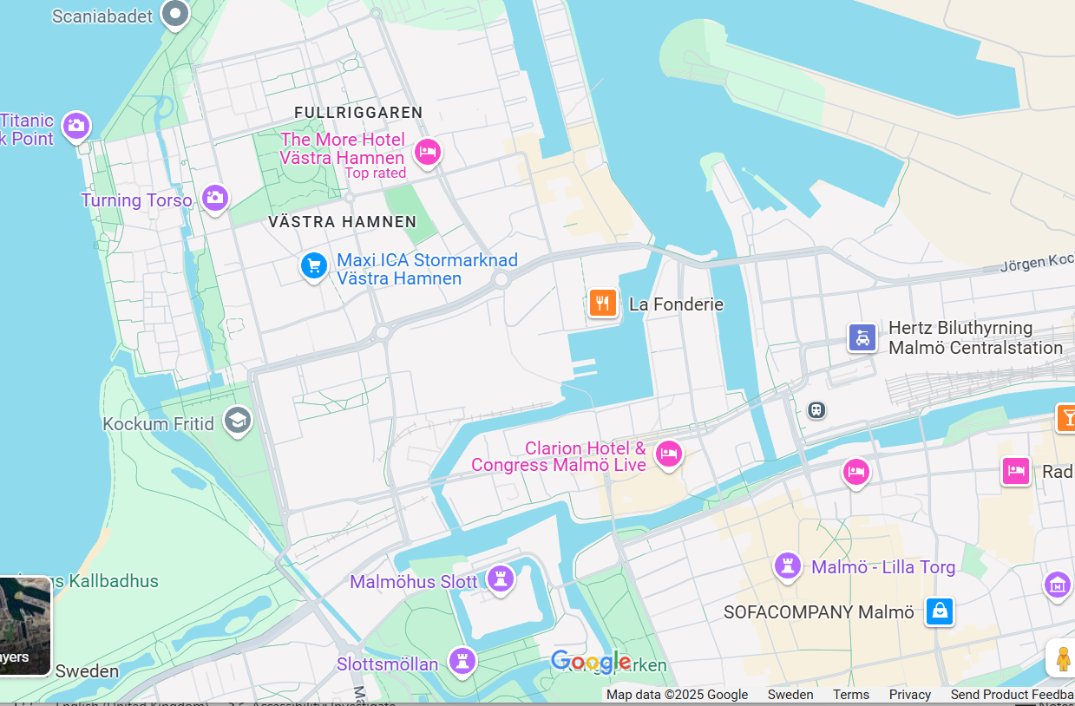
Volleyball
Sun set spot
Bus arrival and departure site
Dinner place inside Kockum Fritid, restaurant Fredag49
Shopping area
Sauna, nice café
Museums
Nice café

Slide 8
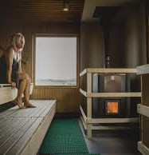
Sauna rules…
Always take a shower before the sauna, and wipe off excess water before entering the sauna
The sauna is a place of piece and calm, talk quietly
No bathing suits are allowed inside the sauna
You can wrap a towel around you, in any case you should always sit on a towel
Exit and enter the sauna swiftly to avoid letting too much of the heat out
You make make multiple “tours”(sauna, swim, sauna, swim, repeat)
Leave valuables at the hotel, there are lockers, but you need a padlock.. (can be bought at the sauna)

Slide 9
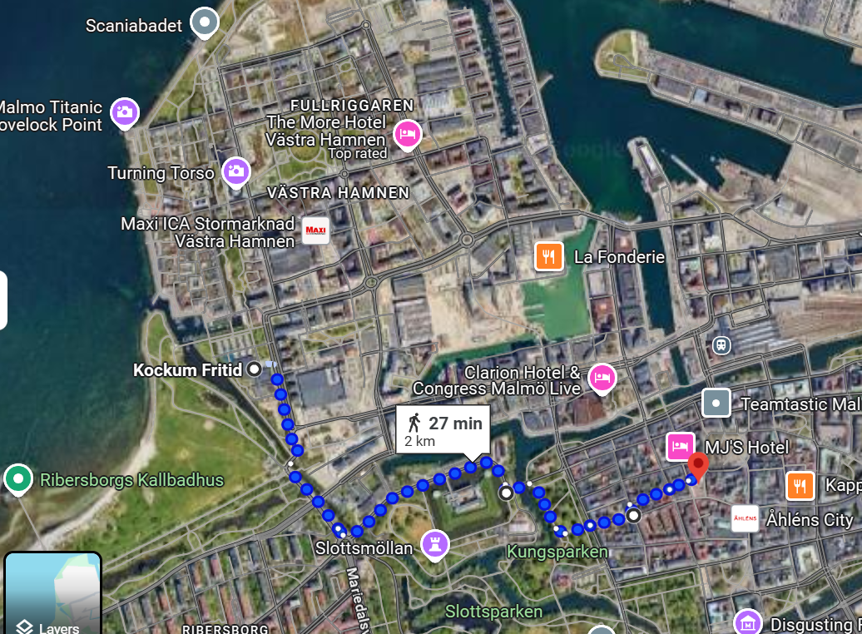
Shopping and walking: Ca 30 min walk from city center to Kockum Fritid, through the parks and by the Castle

Slide 10
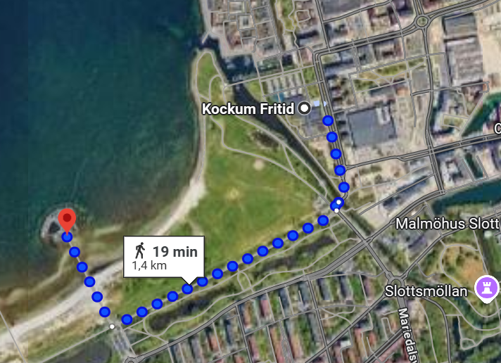
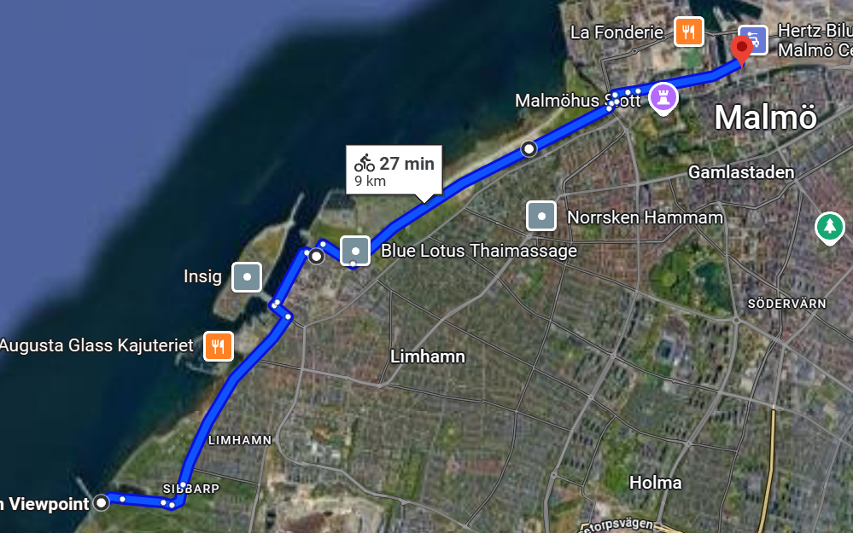
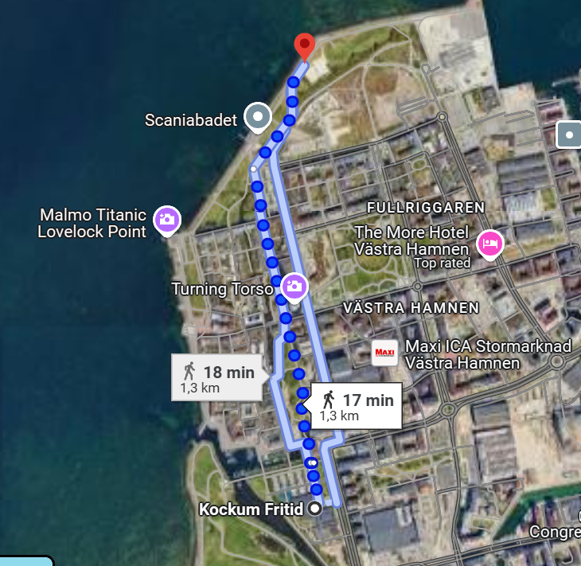
Walking or biking distances
Kallbadhuset to Kockum Fritid (short cut if you walk along the sea!)
Bike tour to Örsund bridge from train station
Volleyball place to Kockum Fritid

Slide 11
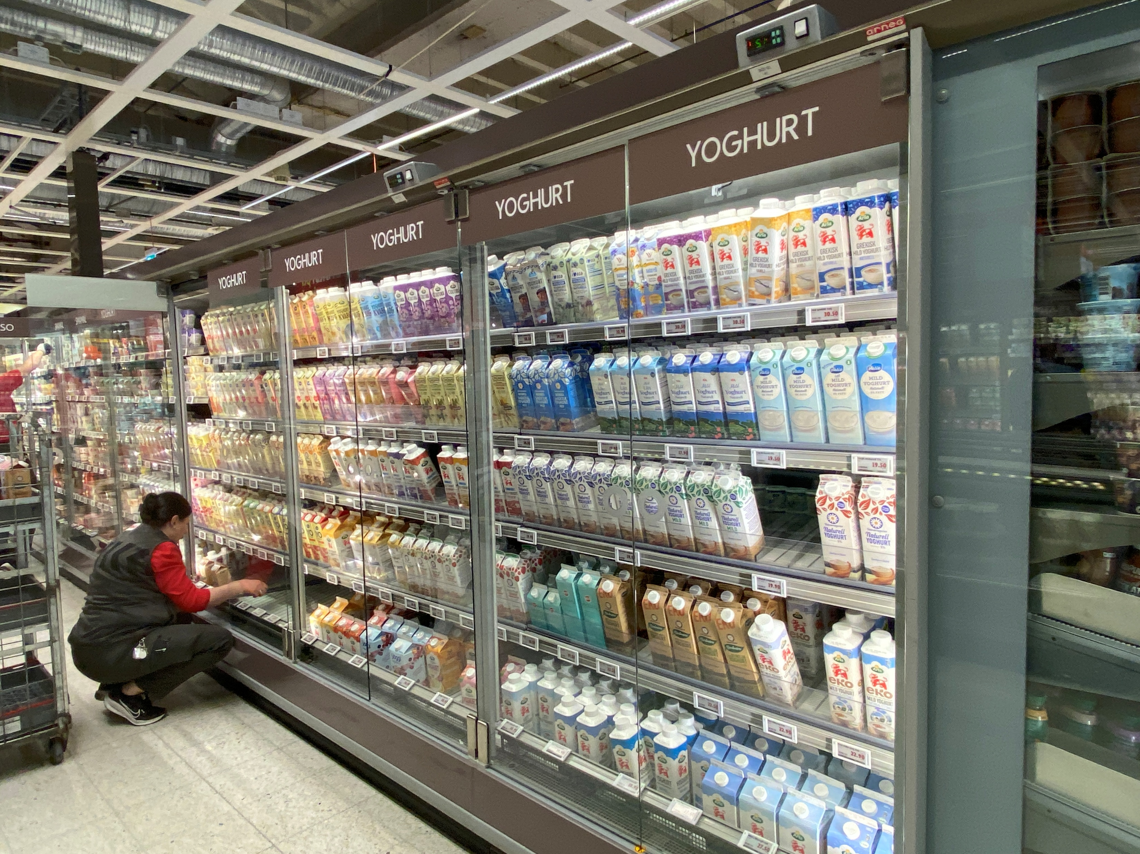
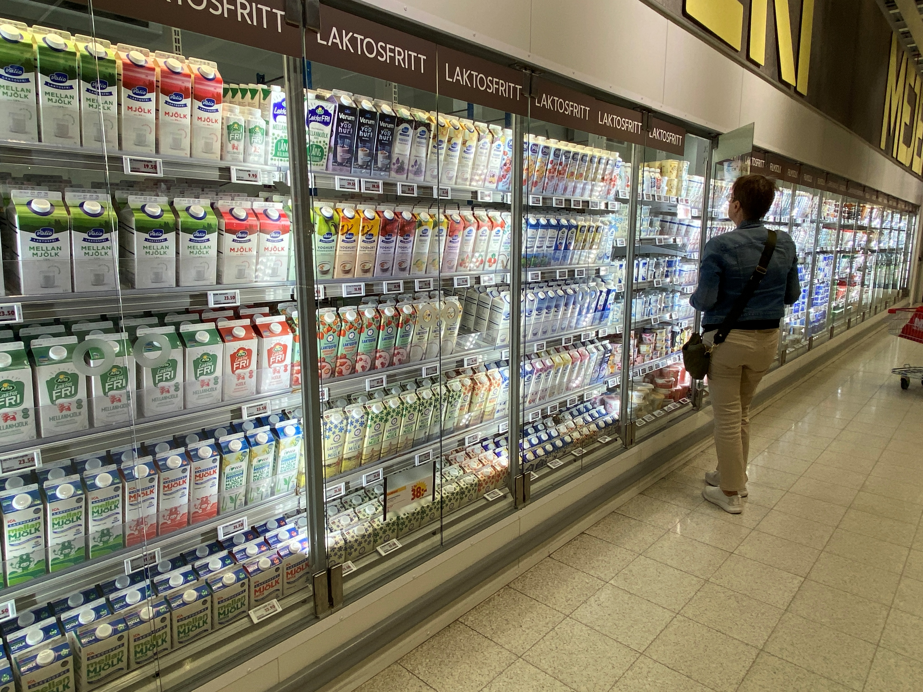
Swedish grej of the day
320 000 dairy cows and 12 000 dairy goats produces around 2.8 billion kilograms of milk per year!

Slide 12
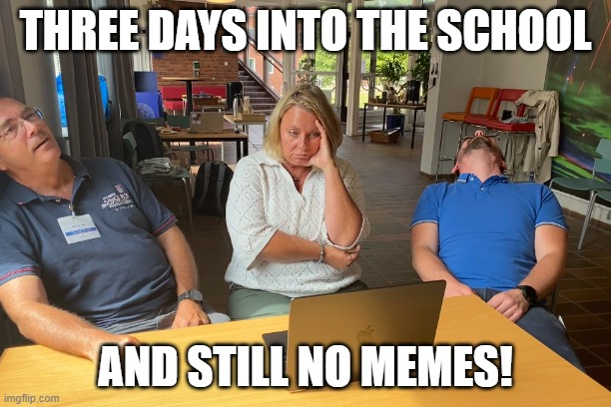
Meme competition

Slide 13
There may be prices at the end of the school for the best meme

Slide 14
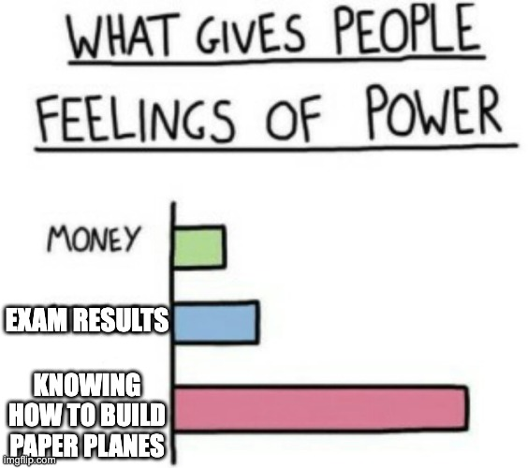
Meme competition

Slide 15
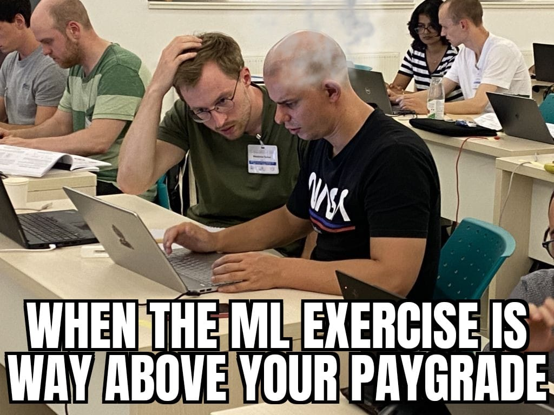
Meme competition

Slide 16
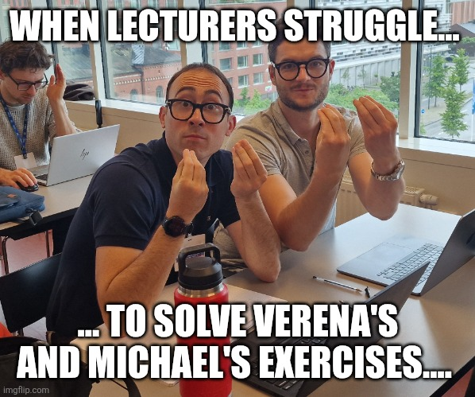
Meme competition

Slide 17
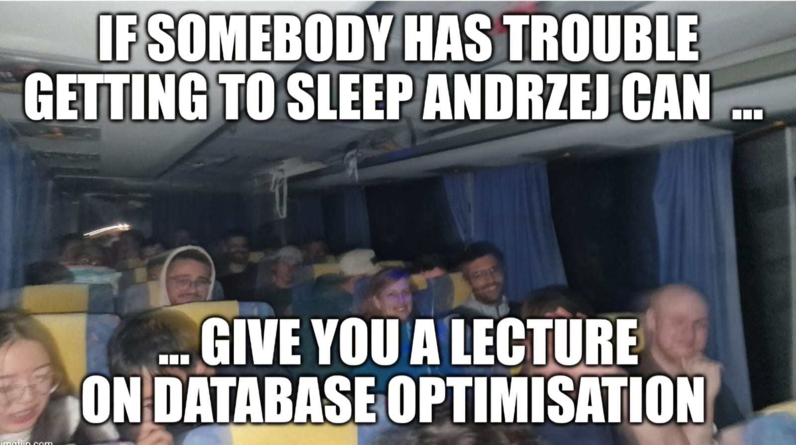
Meme competition

Slide 18
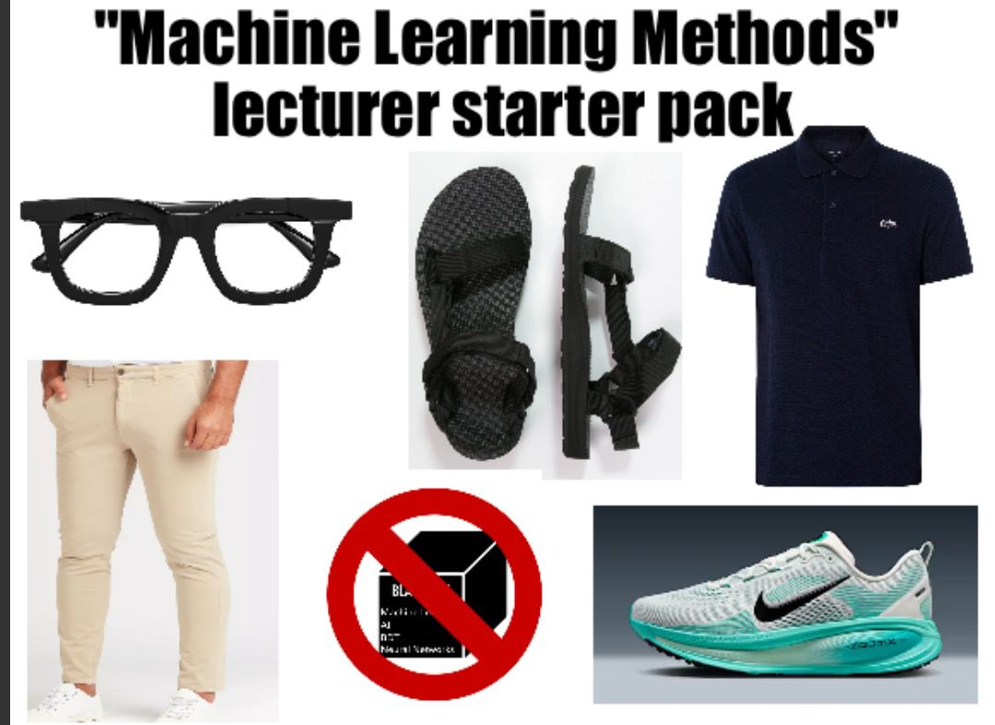
Meme competition

Slide 19
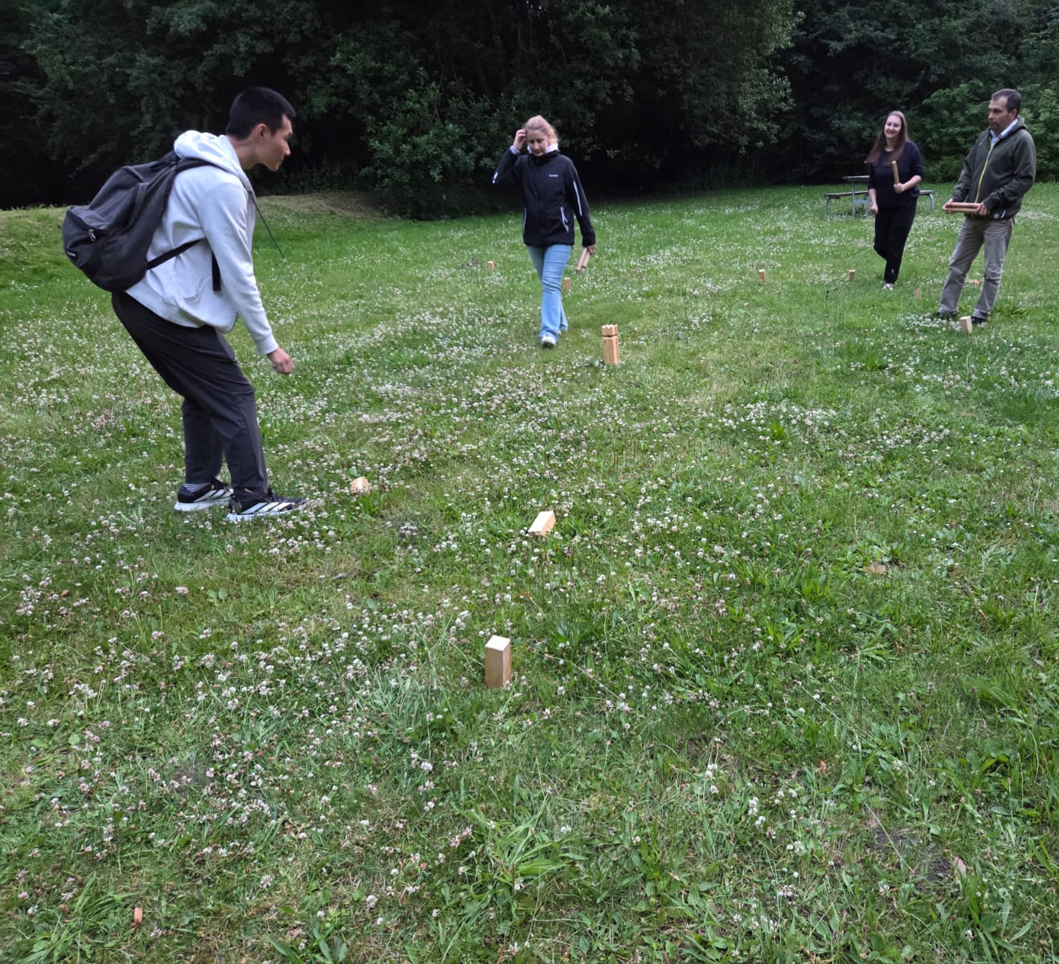
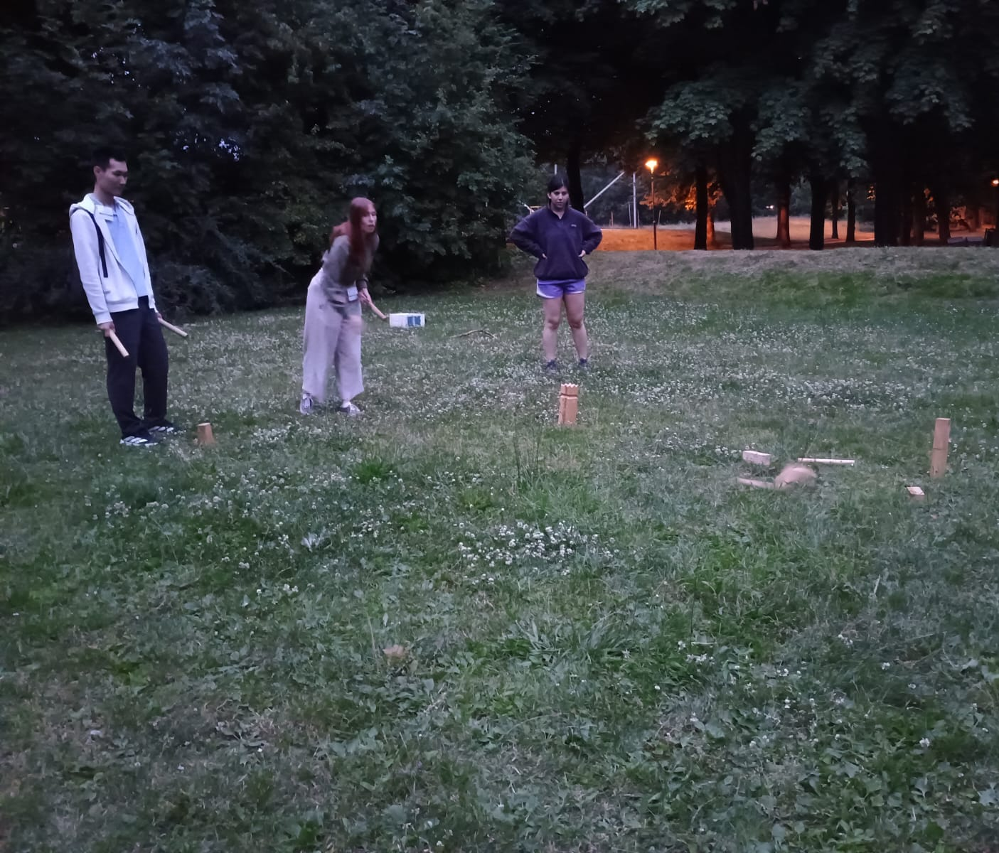
And now…. Photo and a short introduction to kubb!

Slide 20
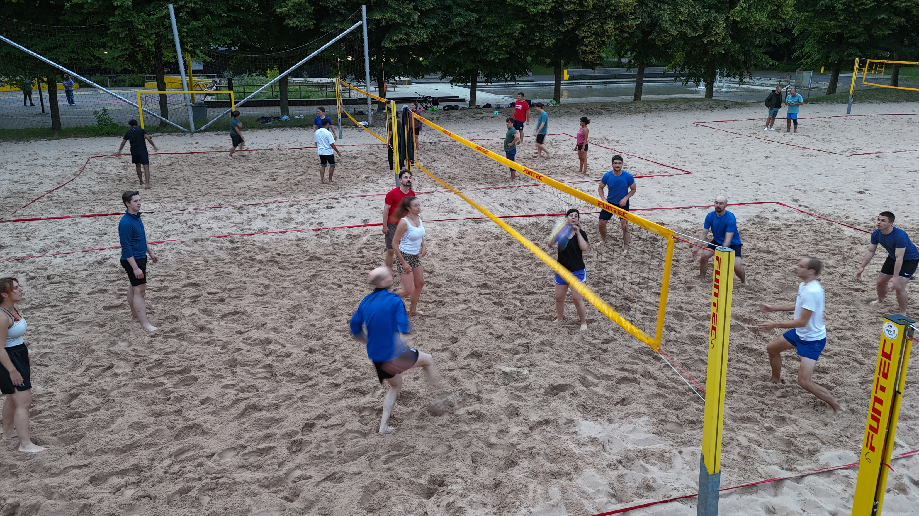
Basketball teams
Can you see the balls ?

Slide 21
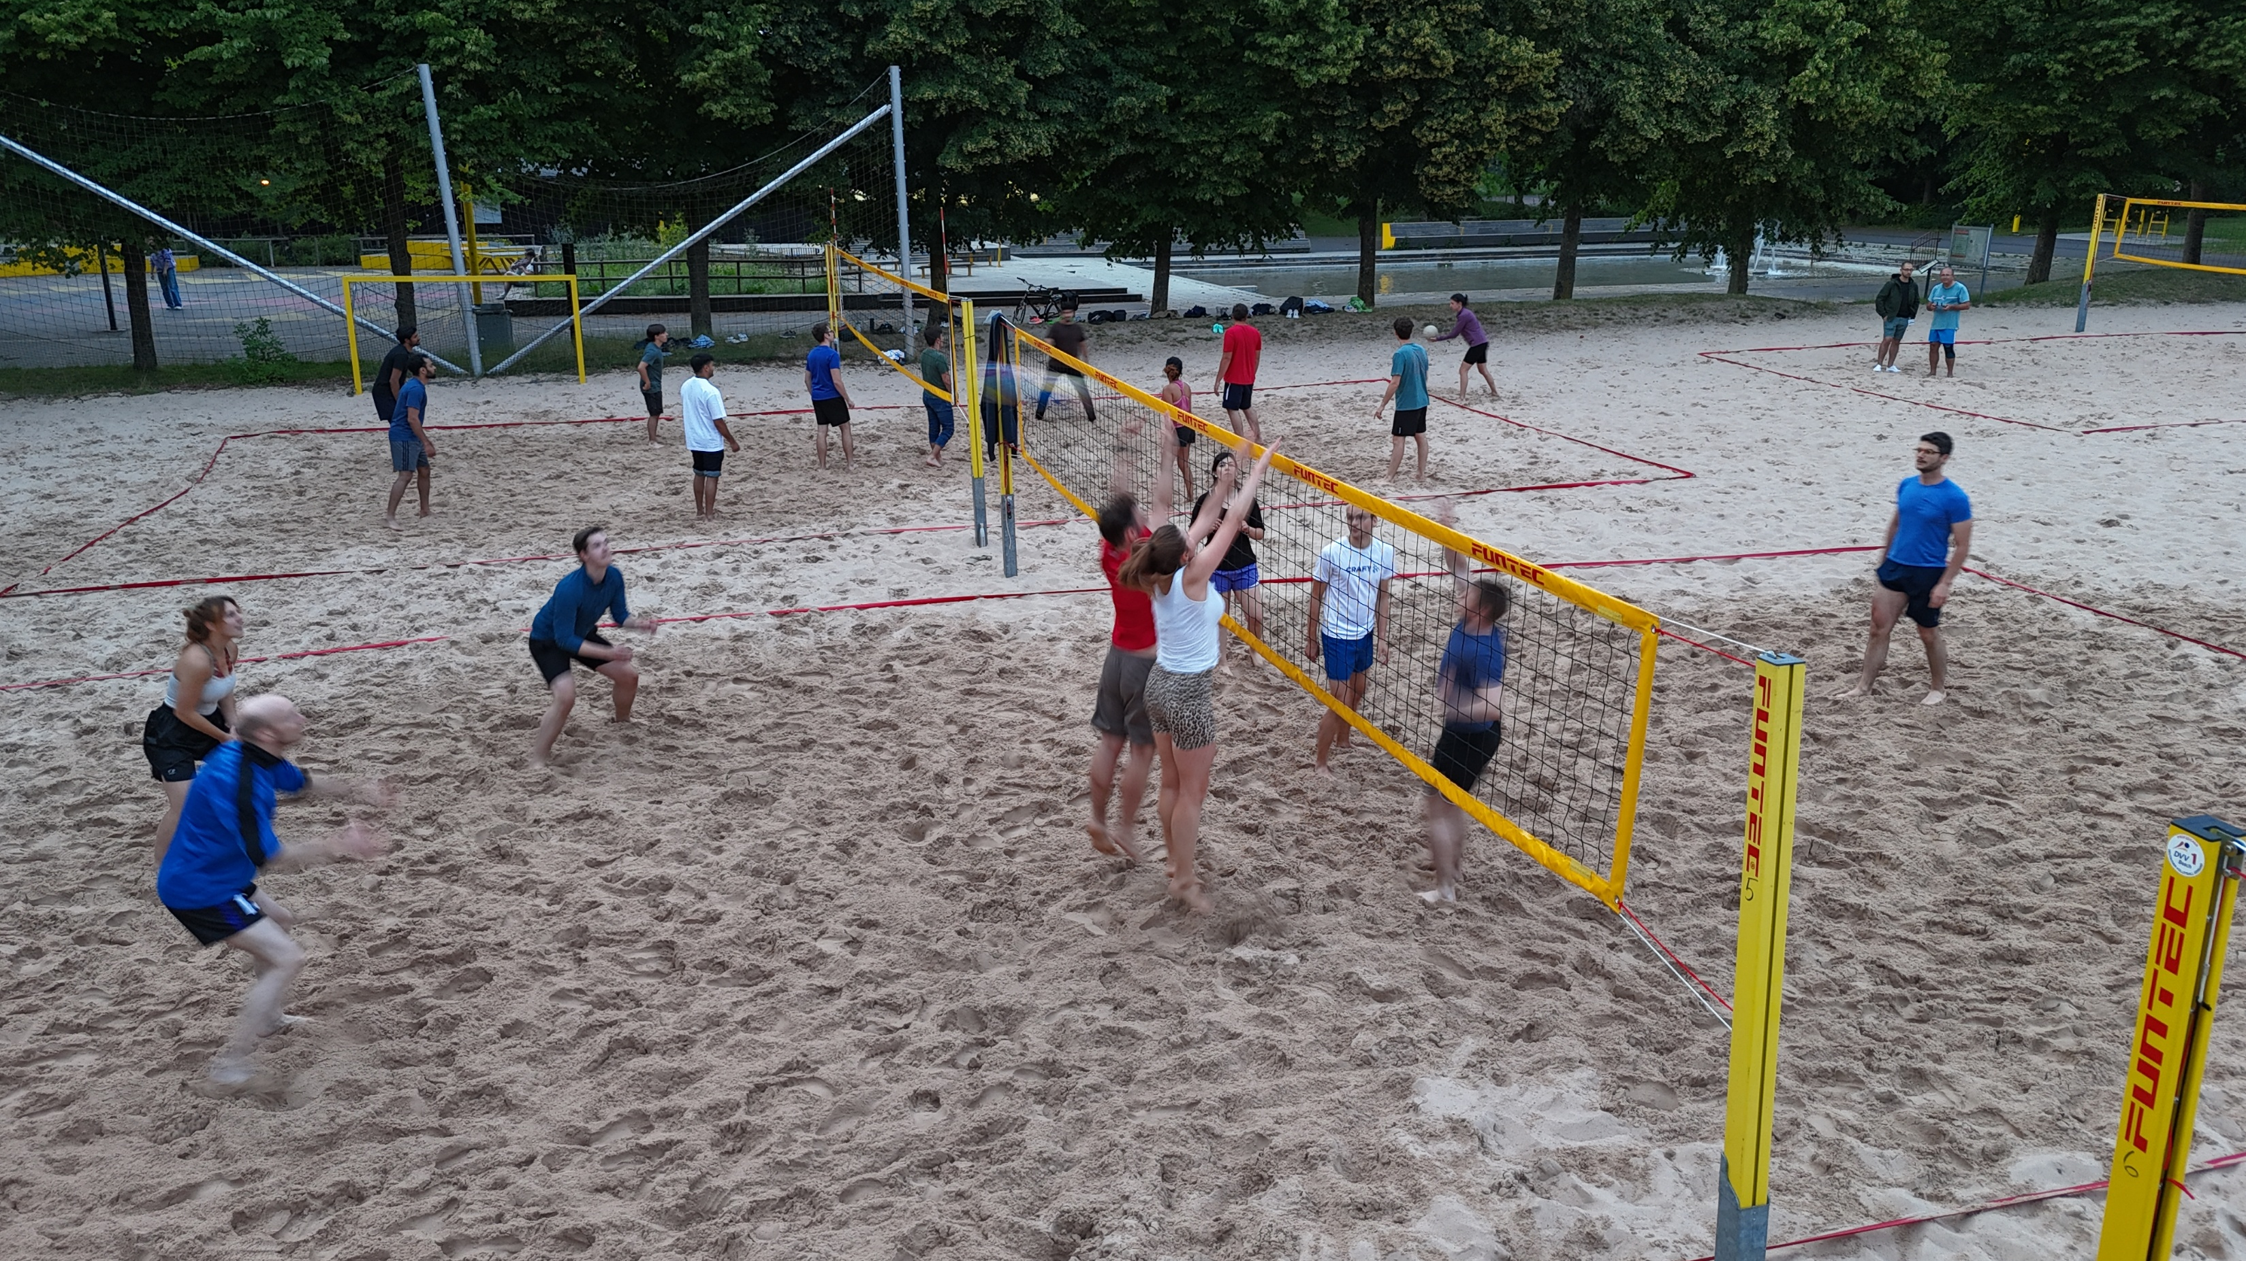

Slide 22
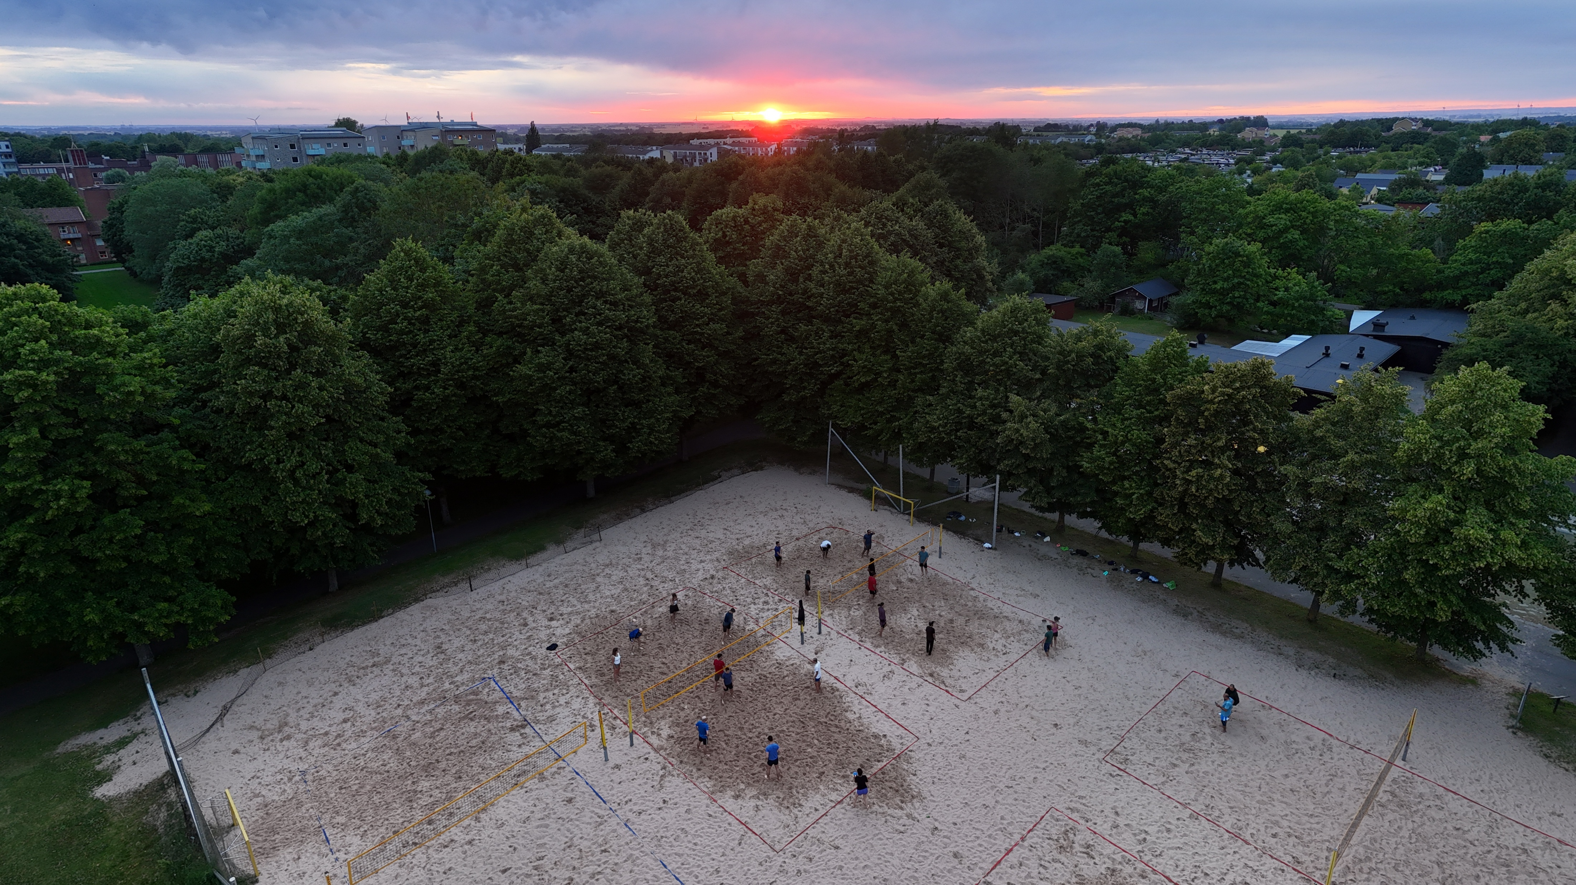

Slide 23
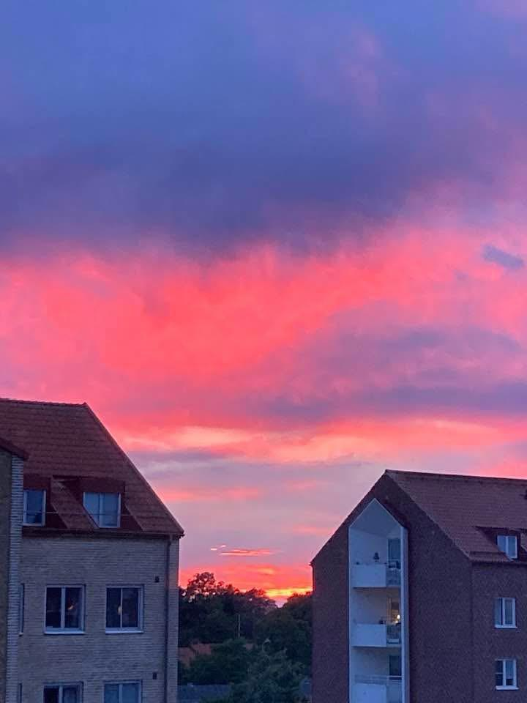

Slide 24
CSC 2025 Kubb Tournament
We are looking for players to form at least 8 Kubb teams for a Kubb Tournament. Add your name if interested. A team usually consists of 3-4 players.
10th July is the sign up day. The Tournament will be run on three game days during the sport/evening slots.
Preliminary Tournament schedule:
Friday 11 July (sport slot): Game DAY 0: rules introduction, team ranking , try-out games
Saturday 12 July: GAME DAY 1, quarterfinals
Monday 14th July: GAME DAY 2, semifinals
Tuesday 15th July: GAME DAY 3: Final & placement matches

Slide 25
Photo now !
Wear me!

