Slide 1


RCS Optics Update
mmWG Meeting, 06/03/2025
L. Soubirou, A. Chance

Slide 2
Recap and overview
Last update : Milestone n°5 (11/2024). Unrealistic QP gradient and very big apertures (>100mm for RCS 1&2 of Greenfield)
Work on different cell types :
  Normal FODO
  Hybrid FODO
  Combined function magnets (for normal RCS only)
Focus on feasibility (QP gradients, magnet lengths) and optimization towards minimization of the magnet apertures
  Beam size dominated by dispersion => focus on minimizing D_{x} .
Study for Greenfield and CERN-siting

Slide 3
Types of cell
DIPOLES
DIPOLES
« Normal » FODO
QP NC Foc
QP NC Defoc
Interconnexion length
L_{cell}
QP SC
Foc
QP SC
Defoc
DIPOLES
DIPOLES
« Hybrid » FODO
QP NC Foc
QP NC Defoc
DIPOLES
k_{f}
DIPOLES
-k_{d}
Combined Functions
Insertion
Insertion
L_{sss}

Slide 4
Normal and Hybrid FODO cell
« Normal » FODO (normal conducting QP):
  Old approach: minimizing total length of QP.
    Unrealistic gradient + aperture too large
  New optimization approach: QP occupy the maximum total length possible and we see « the best we can do » at minimizing D_{x} -> highlight limitation of normal FODO cells.
« Hybrid » FODO (normal and superconducting QP) :
  Same approach: NC QP + SC QP at maximum occupancy

Slide 5
Constraints for Normal and Hybrid FODO cell
Element lengths:
  Length of dipoles: L_{dip, SC/NC} > 2m, .
  Length of NC and SC quadrupoles: L_{quad, SC/NC} > 0.75m.
Gradient:
  Field on NC quadrupole pole: B_{pole, QP NC} < 1T.
  SC quadrupole gradient: G_{QP, SC} < 400 T/m.
Assumption for aperture:
  Aperture margin (diameter): Δx = 20mm.

Slide 6
Combined Functions magnet cell
Configuration only studied for normal RCS.
Goal : minimizing D_{x}.
Parameter to be optimized :
  Bending field B_{bend, inj} and B_{bend, ext}
  Phase advances µ_{x} and µ_{y} (or equivalently quadrupole strength k_{f} and k_{d} in dipoles)
Constraints :
  B_{pole} = B_{bend} + G*r < 1.8 T
  µ_{x}, µ_{y} < 120°
  Assumes the gradient follows the reference trajectory when computing the apertures

Slide 7
Normal RCS
Greenfield RCS1 and CERN RCS 1, 2

Slide 8
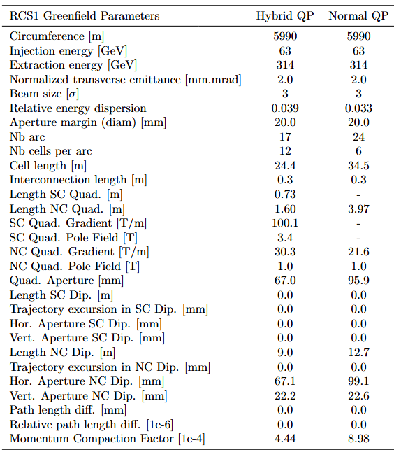
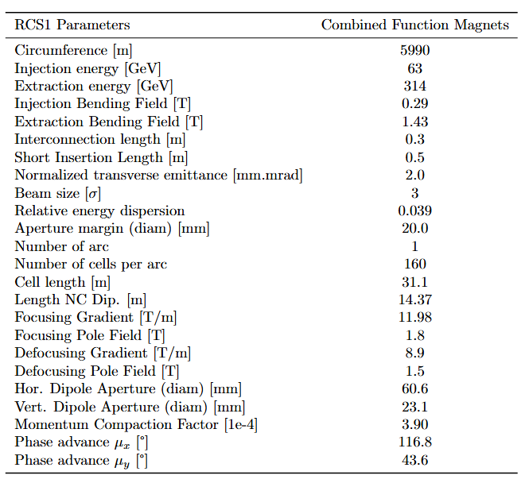
Greenfield RCS1
Limiting factor
FODO

Slide 9
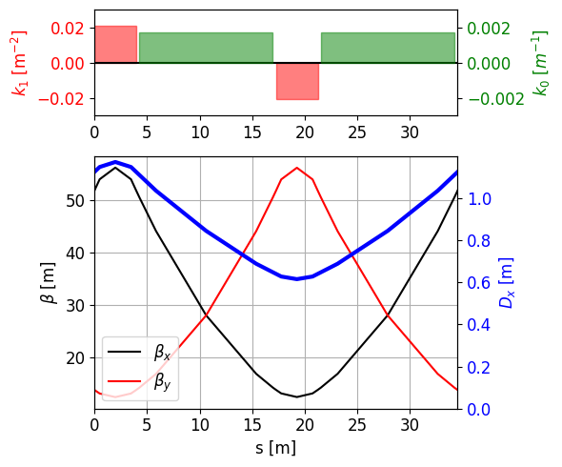
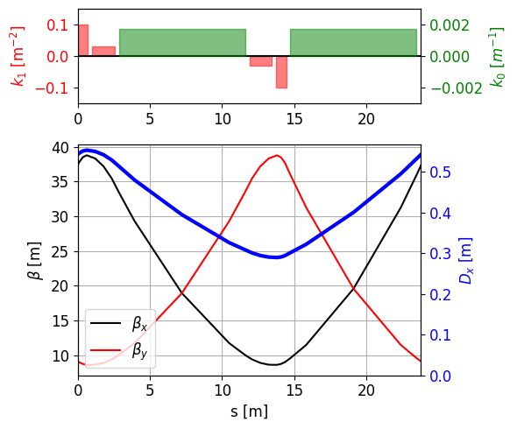
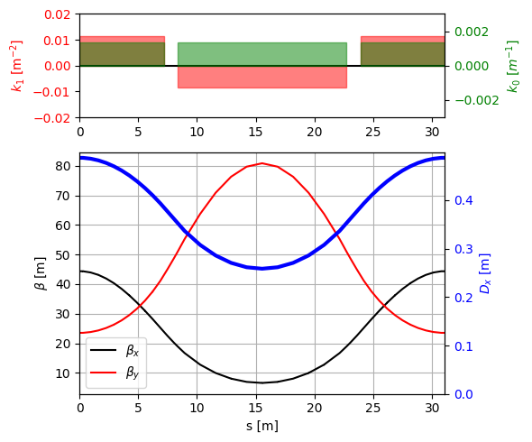
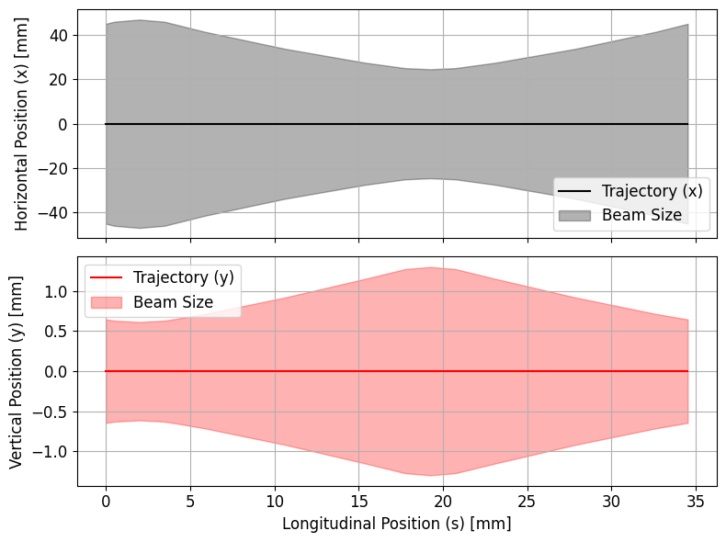
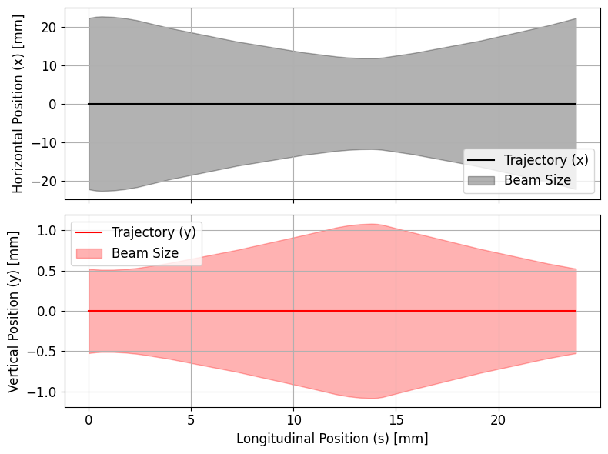
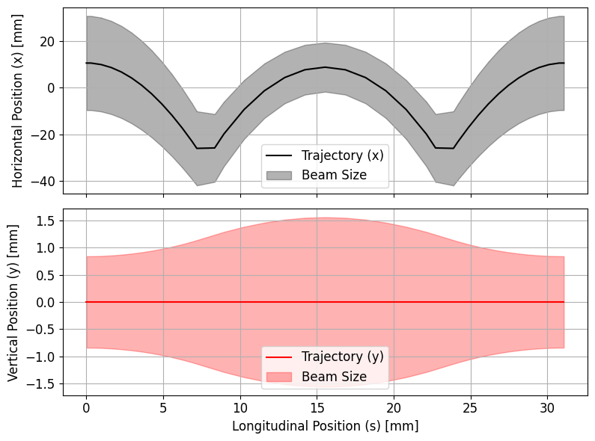
« Normal » FODO
« Hybrid » FODO
Combined Functions
Effect of sagitta !

Slide 10
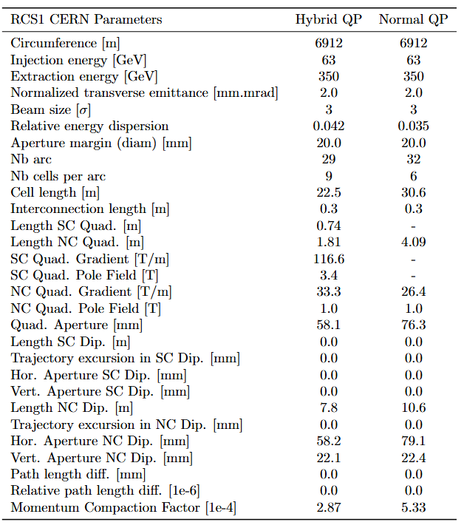
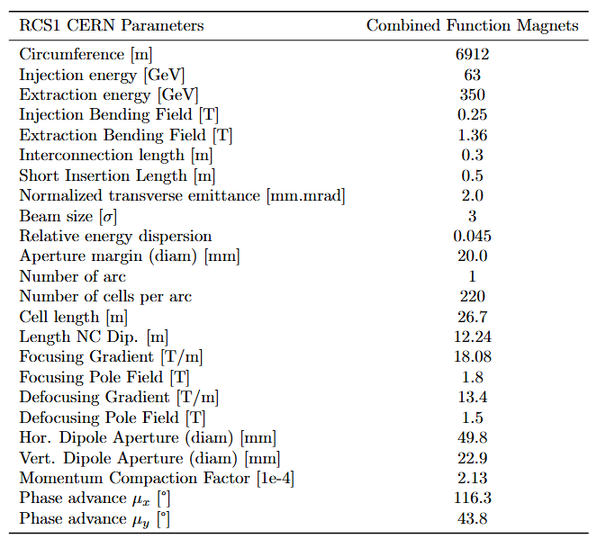
CERN RCS 1
Limiting factor
FODO

Slide 11
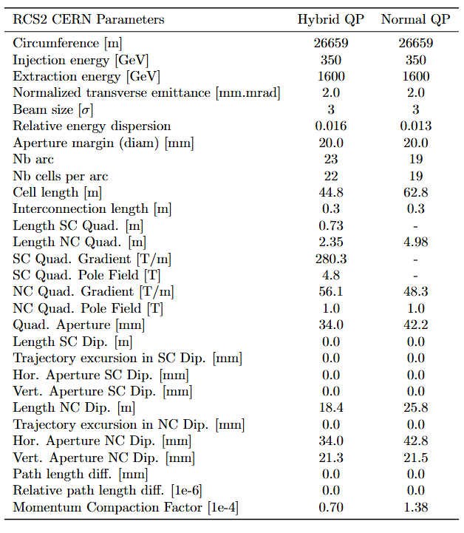
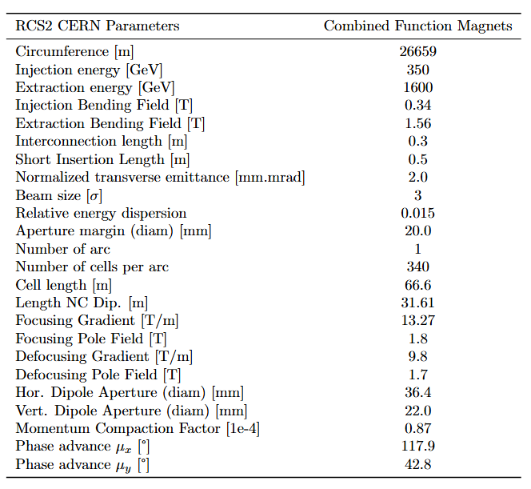
CERN RCS 2
Limiting factor
FODO

Slide 12
Hybrid RCS: FODO Cells
Greenfield RCS 2,3,4 and CERN RCS 3

Slide 13
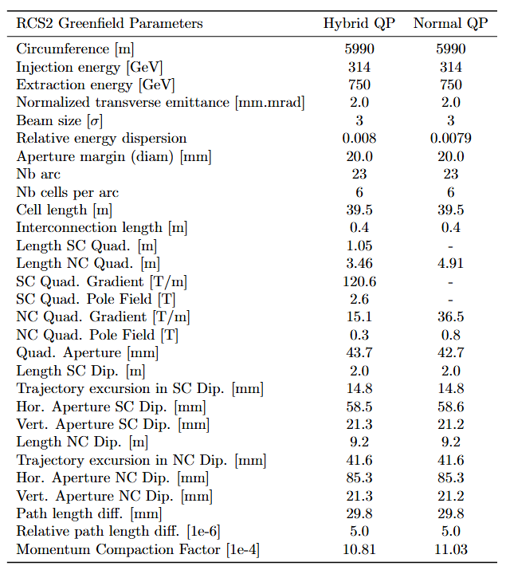
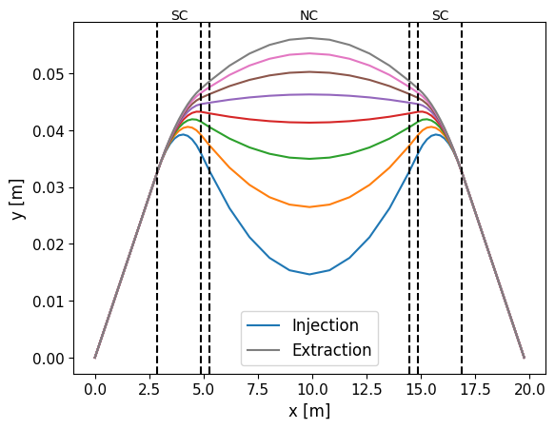
Greenfield RCS 2
No difference between Normal and Hybrid FODO.
Limitations: L_{dip,SC} = 2 m.
  Restricts maximum n_{c}: 41.6mm of trajectory excursion out of 85.3mm total aperture.
Trajectory in a half-cell of RCS2

Slide 14
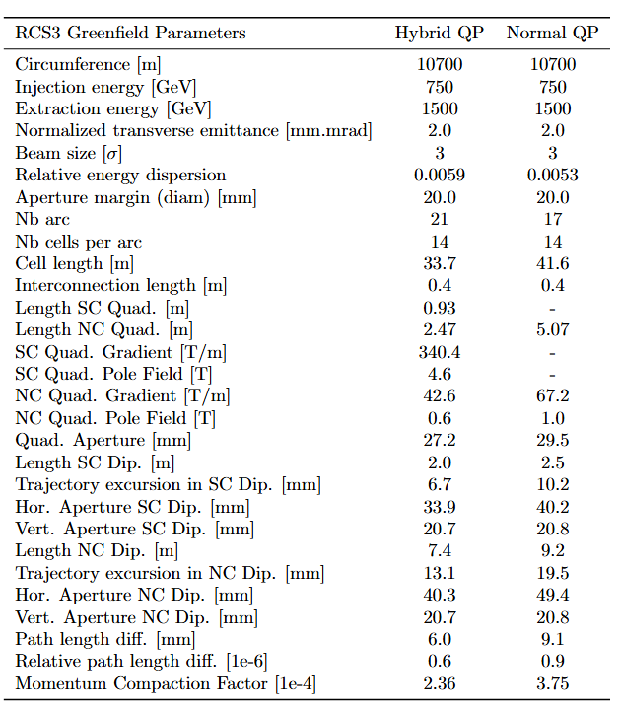
Greenfield RCS 3
No such constraint on RCS3 (larger energy and bigger machine): rather small trajectory excursion.
Limitations:
  Hybrid : L_{dip,SC}
  Normal : B_{QP, NC}
Global parameters for RCS 2/3 do not look optimized for apertures.

Slide 15
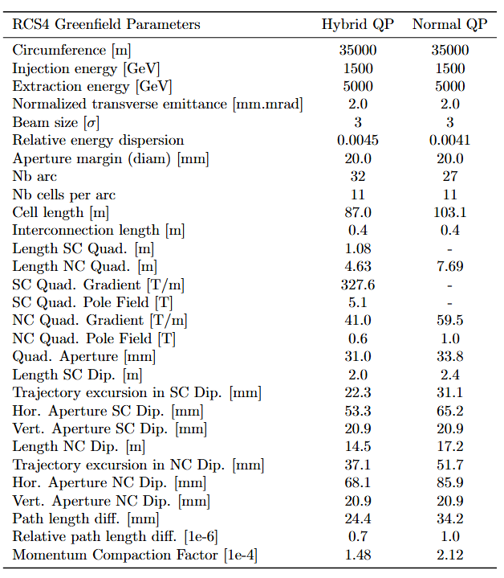
Greenfield RCS 4
Same case as RCS 2
Limitations:
  Hybrid : L_{dip,SC} .
    Restricts maximum n_{c}: 37mm of trajectory excursion out of total 68mm aperture.
  Normal : B_{QP, NC} .

Slide 16
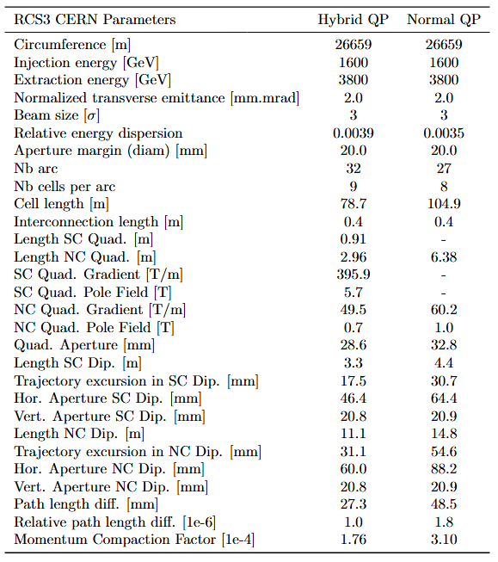
CERN RCS 3
Limitations:
  Hybrid: B_{QP, SC}
  Normal : B_{QP, NC}

Slide 17
Summary on horizontal apertures: Greenfield
Greenfield | [mm] | Normal FODO | Hybrid FODO | Combined Functions
RCS 1 | Apert. NC Dipole | 99.1 | 67.1 | 60.6
 | Apert. SC Dipole | / | / | /
 | Apert. Quad | 99.1 | 67.1 | -
RCS 2 | Apert. NC Dipole | 85.3 | 85.3 | -
 | Apert. SC Dipole | 58.6 | 58.5 | -
 | Apert. Quad | 43.7 | 43.7 | -
RCS 3 | Apert. NC Dipole | 49.4 | 40.3 | -
 | Apert. SC Dipole | 40.2 | 33.9 | -
 | Apert. Quad | 29.5 | 27.2 | -
RCS 4 | Apert. NC Dipole | 85.9 | 68.1 | -
 | Apert. SC Dipole | 65.2 | 53.3 | -
 | Apert. Quad | 33.8 | 31.0 | -
RCS 1 : Combined functions and Hybrid FODO much better than Normal FODO (the sagitta is not taken into account for any type of cells)
RCS 2 : No improvement made with Hybrid FODO (limiting RCS)
RCS 3 and 4 : Better performance with Hybrid FODO

Slide 18
Summary on horizontal apertures: CERN-siting
CERN | [mm] | Normal FODO | Hybrid FODO | Combined Functions
RCS 1 | Apert. NC Dipole | 79.1 | 58.2 | 49.8
 | Apert. SC Dipole | / | / | /
 | Apert. Quad | 79.1 | 58.2 | -
RCS 2 | Apert. NC Dipole | 42.8 | 34.0 | 36.4
 | Apert. SC Dipole | / | / | /
 | Apert. Quad | 42.8 | 34.0 | -
RCS 3 | Apert. NC Dipole | 88.2 | 60.0 | -
 | Apert. SC Dipole | 64.4 | 46.4 | -
 | Apert. Quad | 32.8 | 28.6 | -
RCS 1 : Combined functions and Hybrid FODO much better than Normal FODO
RCS 2 : Equivalent apertures for Hybrid and combined functions, averall small apertures for all type of cells.
RCS 3 : Better performance with Hybrid FODO.

Slide 19
Conclusion on limitations
Normal FODO: limitations on B_{pole, QP NC} = 1T
Hybrid FODO:
  For normal RCS or “low energy machines” (Greenfield RCS1 and CERN RCS1, 2) : limitations on L_{QP, SC} = 0.75m .
  For hybrid RCS or “high energy machines” (Greenfield RCS2, 3, 4 and CERN RCS3): limitations on L_{dip, SC} = 2m .
Combined Functions: limitations on B_{pole} = 1.8T.

Slide 20
Discussion
Open Questions
List of constraints
Do the constraints look realistic ?
  Magnet lengths, interconnections, pole field…
Would it be possible to bend NC and SC magnets ?
Combined functions:
  Possible to get different circuits for dipole and quadrupole component ? (for more flexibility)
No sextupoles included yet in cell design.
  Possible to include sextupole component in pulsed magnets directly ?
  Do you have an estimation of the sextupole component induced by eddy currents ?
Magnet lengths:
  L_{dip, SC/NC} > 2m
  L_{quad, SC/NC} > 0.75m
Interconnections:
  Normal RCS: L_{dd} = 0.3m
  Hybrid RCS: L_{dd} = 0.4m
Field and gradients :
  B_{pole, QP NC} < 1T
  G_{QP, SC} < 400 T/m
Combined functions:
  B_{pole} = B_{bend} + G*r < 1.8 T

